Slide 1
RADIOLOGY ANATOMY OF THE PITUITARY GLAND
Practical(1)
RADIOLOGY

Slide 2
NORMAL PITUITARY GLAND
The gland is composed of two parts:
  Anterior lobe (adeno hypophysis)
  Posterior lobe (neuro hypophysis)
Normal size:
  Weight: 0.5g
  Height: 4-16 mm
  Anterior posterior: 5-16 mm

Slide 3
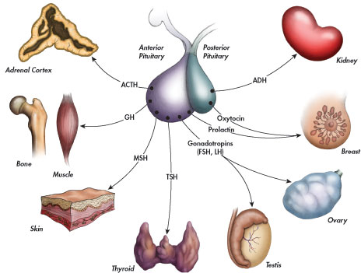

Slide 4
INDICATIONS FOR IMAGING THE PITUITARY GLAND
Hormonal dysfunction
  Cushing syndrome
  Growth abnormalities e.g. Growth hormone deficiency, acromegaly
Visual abnormalities
headache

Slide 5
What is best modality to image the pituitary gland ?
    X ray
    CT scan
    MRI
    US
    Nuclear medicine

Slide 6
What is best modality to image the pituitary gland ?
    X ray
    CT scan
    MRI
    US
    Nuclear medicine

Slide 7
X RAY

Slide 8
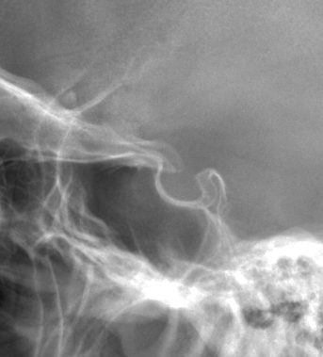


Slide 9
1
2
3
4
5
6

Slide 10
1
2
1-Optic sulcus
2- Anterior clinoid process
3-Floor of sella turcia (Pituitary fossa)
4- Posterior clinoid process
5- Dorsum sella
6- Sphenoid sinus
3
4
5
6

Slide 11
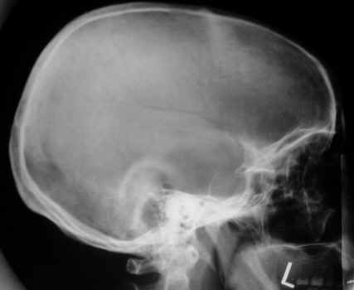

Slide 12
MRI

Slide 13
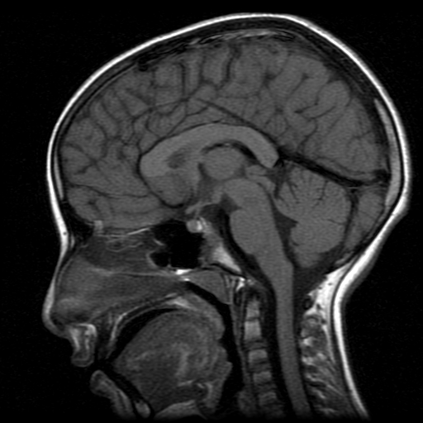
4
3
5
2
6
1

Slide 14
4
3
1- pituitary gland
2- sphenoid sinus
3- optic chiasm
4- hypothalamus
5- pituitary stalk
6- claivus
5
2
6
1

Slide 15
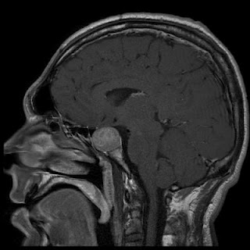
NORMAL
PITUITARY ADENOMA

Slide 16
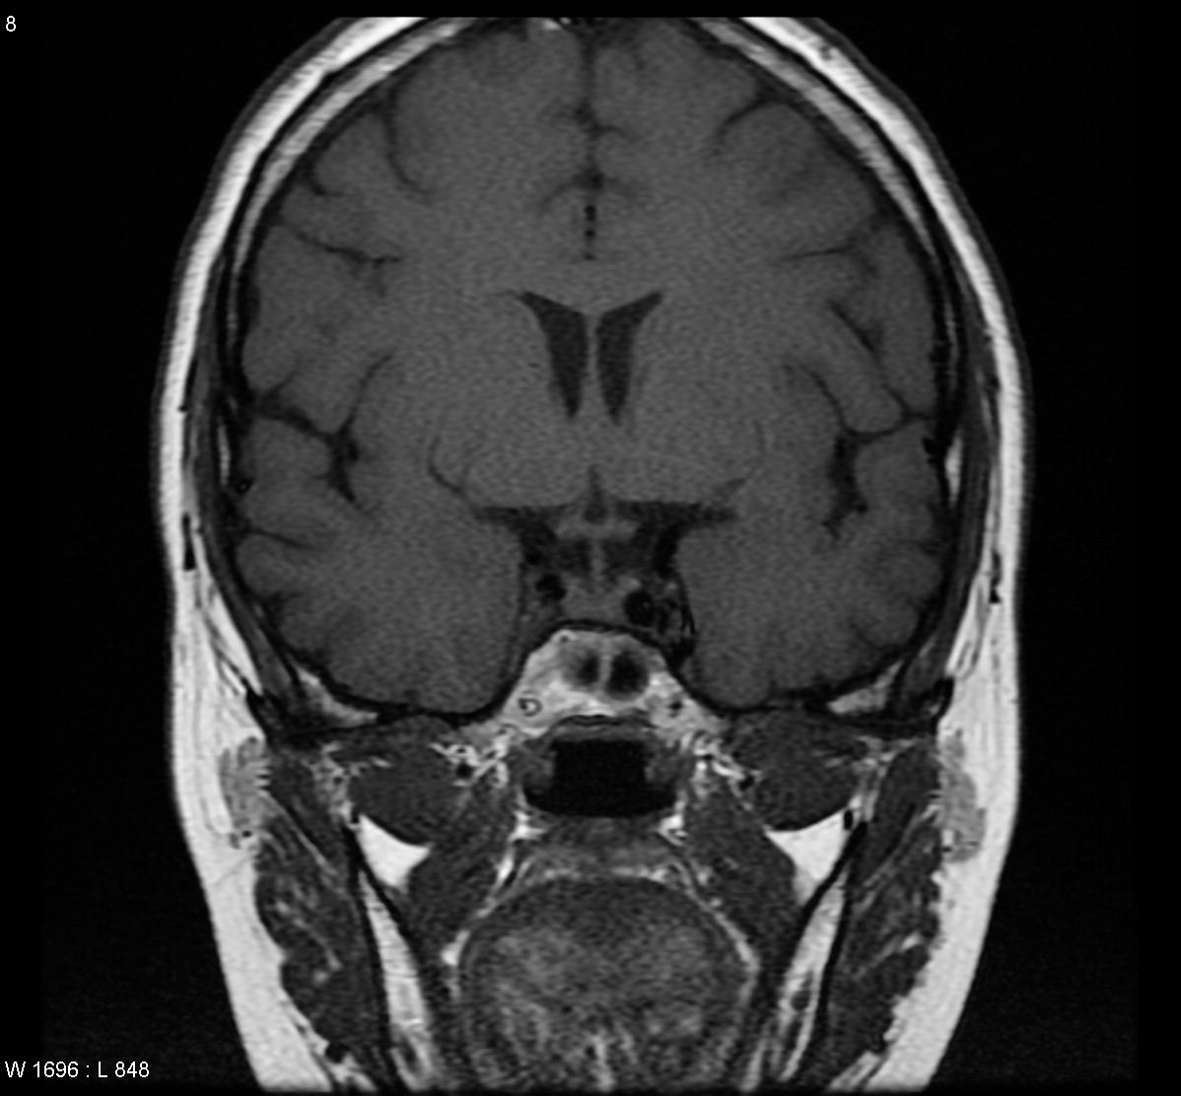
2
3
1
4
5
6

Slide 17
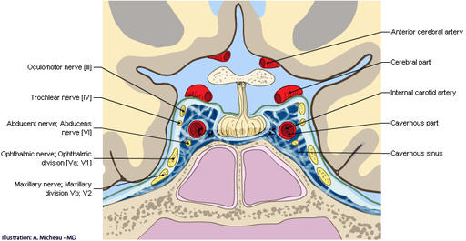
2
3
1
4
5
6

Slide 18
Optic chiasm
Pituitary stalk
Pituitary gland
Carotid artery
Cavernous sinus
Sphenoid sinus

Slide 19
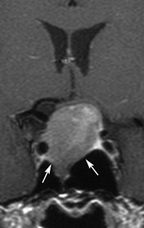
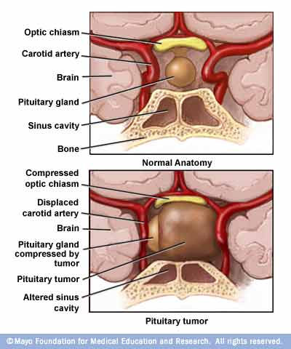

Slide 20
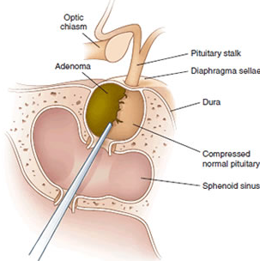
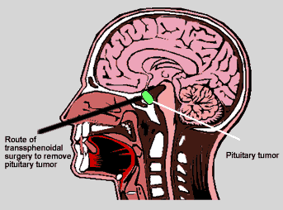

Slide 21
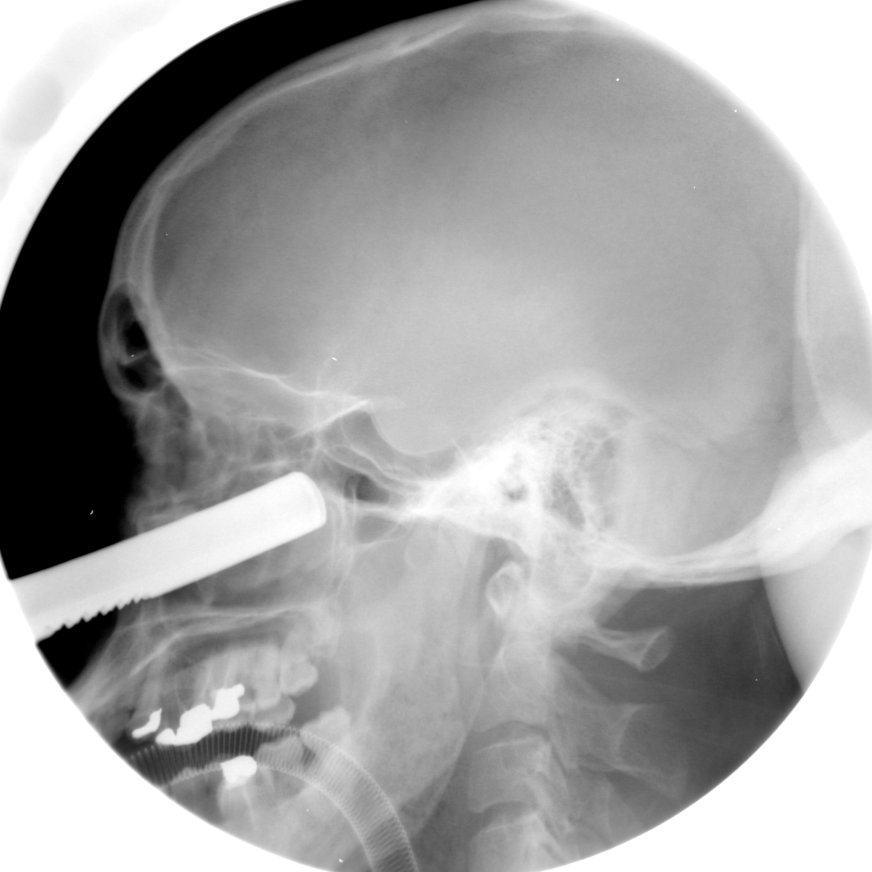
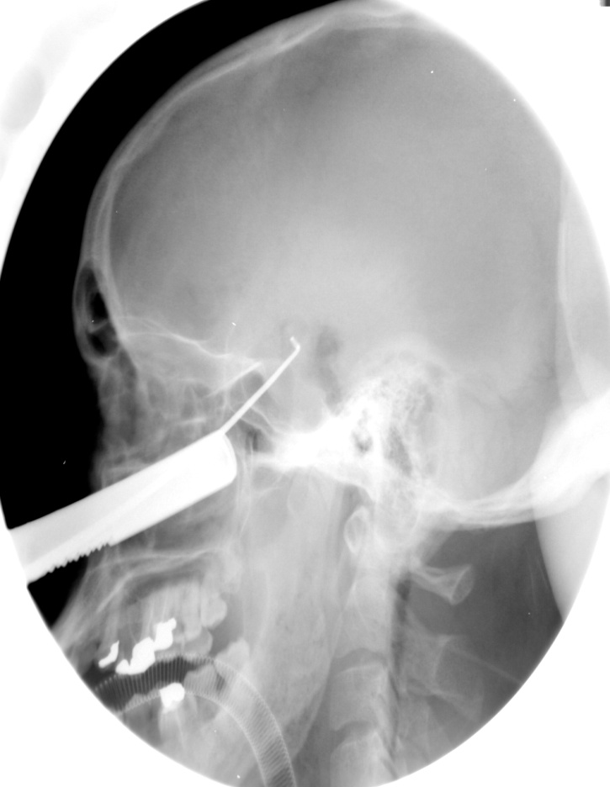
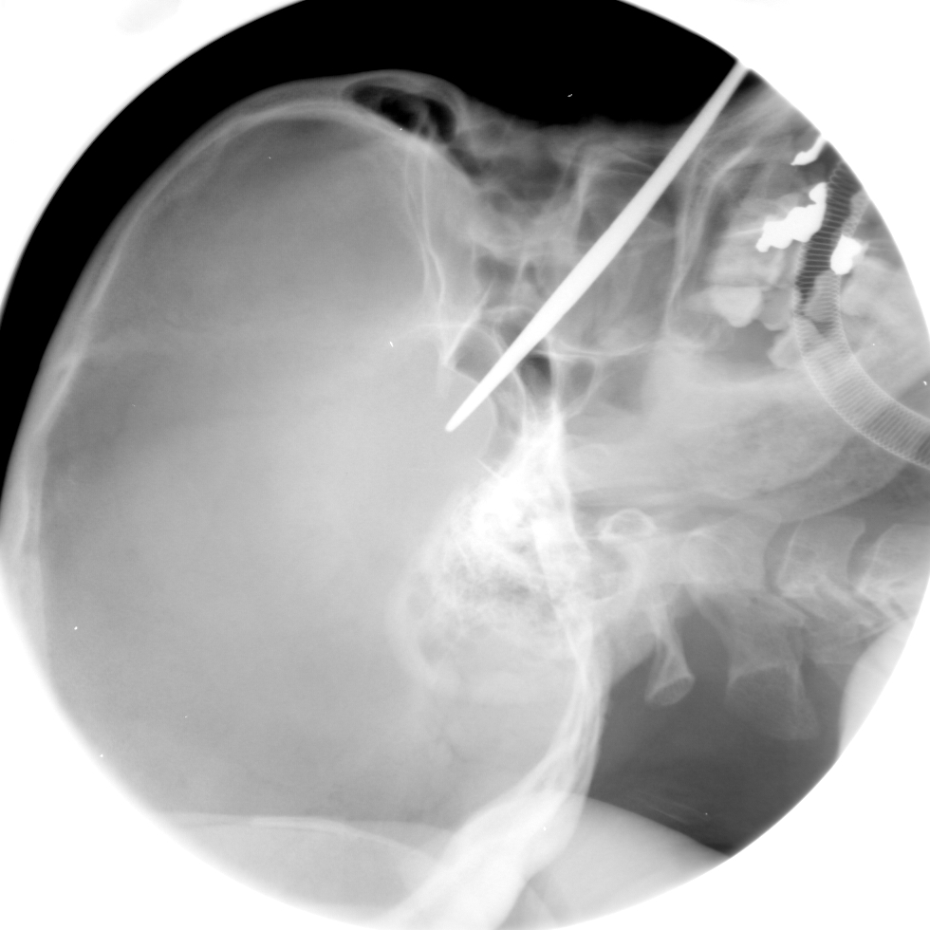

Slide 22
THE END

