Slide 1
BREASTFEEDING
BY: RUBANA BAABBAD
CONSULTANT NEONATOLOGIST

Slide 2
contents
Introduction
Breastfeeding definitions
Breast milk contents
Advantages of breastfeeding
Preparation of the prospective mother
Establishing and maintaining the milk supply
Technique of breastfeeding
Expression of breastmilk
Contraindications

Slide 3
قال الحق تبارك وتعالى: (وَالْوَالِدَاتُ يُرْضِعْنَ أَوْلَادَهُنَّ حَوْلَيْنِ كَامِلَيْنِ لِمَنْ أَرَادَ أَنْ يُتِمَّ الرَّضَاعَةَ) [البقرة :233 ].

Slide 4
introduction
Breastfeeding is the normal feeding for infants during the first months of life which can ‘t be replicated .
It contains over 200 known component.
Breast milk bring both nutritive& non nutritive signals to the neonate .

Slide 5
human milk: a “life-saving” drug
human milk: the best food for term and preterm infants
human milk: the main component of premature infant care.

Slide 6
In recent decades, there has been a significant reduction in infant mortality, which is currently estimated at 4.5 million children in the first year of life with 3 million (that is to say 45%) occurring in the first 28 days
The principal cause of death is no longer infections but prematurity. Many of these deaths are preventable, and of all known approaches, feeding babies exclusively with human milk in the first hours, days, and months of life has the greatest potential impact on child survival and development

Slide 7
HUMAN MILK UNIQUE COMPOSITION
Exclusive human milk feeding for the first 6 mon. of life, with continued breastfeeding for 2 years of life is the normative standard for infant feeding because of Its unique nutritive composition and non nutritive bioactive factors that promote survival and healthy development.

Slide 8
CONT.
Human milk composition is dynamic, and varies within a feeding, diurnally, over lactation, and between mothers and populations.
Influences on compositional differences include maternal and environmental factors and the expression and management of milk (e.g. Storage and pasteurization)

Slide 9
Nutritional component of human milk
Macronutrients :varies within mothers and across lactation but is remarkably conserved across populations despite variations in maternal nutritional status.
differs between preterm and term milk, with preterm milk tending to be higher in protein and fat .
It contain fat ,carbohydrate, proteins
minerals

Slide 10
Micronutrients
many micronutrients vary in human milk depending on maternal diet and body stores .
including vitamins A, B1, B2, B6, B12, D, and iodine.
. Regardless of maternal diet, Vitamin K is extremely low in human milk and thus, the American Academy of Pediatrics recommends an injection of this vitamin to avoid hemorrhagic disease of the newborn
. Vitamin D also occurs in low quantity in human milk, particularly with low maternal exposure to sunshine.

Slide 11
Bioactive factor
living cells (macrophages and stem cells)
anti-infectious
anti-inflammatory agents
growth factors
Prebiotics
Probiotics
vitamins,hormons, enzymes complements,
lysozymes , immunoglobulins
cytokines
mucins

Slide 12
Breast milk under microscopy

Slide 13
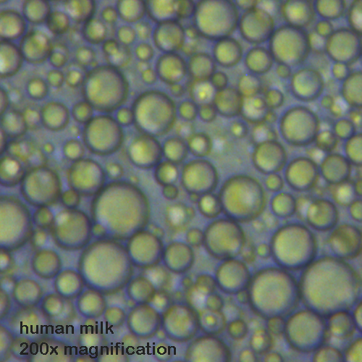
Comparison of microscopic picture

Slide 14
Colostrum vs. breast milk

Slide 15
colostrum
Colostrum The often yellow and sometimes clear fluid that is released by a new mother’s breasts before her breast milk comes in.
This fluid has often been referred to as “liquid gold” and it resembles blood more than it does milk as it contains protective white blood cells capable of attacking harmful bacteria. and it also acts to “seal” the inside of the baby’s intestines thus preventing the invasion of bacteria. Colostrum is an ideal first food for baby as it is high in protein and low in sugar and fat, thus making it easy to digest.

Slide 16
colostrum
Is the first fluid produced after delivery up to 3-5 days and some times longer in premature delivery and with maternal obesity.
The colostrum
----primary functions is immunological and trophic

Slide 17
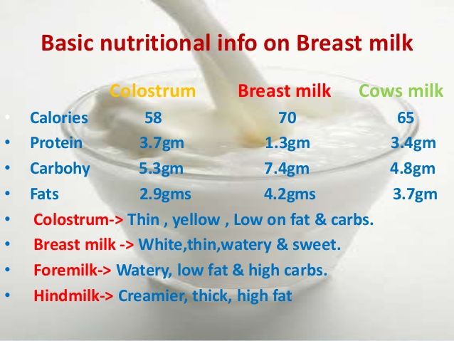

Slide 18
Colostrum in comparison to transitional and mature milk
Higher in
Lower in
Rich in immunological components(s. IgA, lactoferrin,leukocytes, developmental factors such as epidermal growth factors.
Na
Cl
Mg
Low volume
lactose
Potassium
calcium

Slide 19
BIOACTIVE COMPONENTS AND THEIR SOURCES
defined as elements that “affect biological processes or substrates and hence have an impact on body function or condition and ultimately health”.
Bioactive components in human milk come from a variety of sources;
produced and secreted by the mammary epithelium,
produced by cells carried within the milk,
drawn from maternal serum and carried across the mammary epithelium by receptor-mediated transport.

Slide 20
Sources of mother milk immune factors

Slide 21
BIOACTIVE FACTORS
recognition of potent, bioactive human milk factors indicates the importance of preserving their biologic activity, to the extent possible, through the process of milk collection, storage, and pasteurization.

Slide 22
IMMUNOLOGICAL FACTORS
Transfer of living protection and programming: Cells of human milk
Human milk contains a variety of cells, including macrophages, T cells, stem cells, and lymphocytes.
Communication between cells: Cytokines and chemokines
Cytokines are multi-functional peptides that act in autocrine/paracrine fashion.
Chemokines are a special class of chemotactic cytokines that induce movement of other cells.

Slide 23
Cont.
Finally, recognition of the unique mechanisms by which human milk protects and enhances development provides models for new preventive and therapeutic approaches in medicine.
Many of these factors act synergistically, such that consumption of human milk is superior to supplementation with individual factors or their combinations.

Slide 24
Breastfeeding Definitions
Exclusive breastfeeding (Breast milk (including milk expressed or from a wet nurse)
Predominant breast milk :Breast milk (including milk expressed or from a wet nurse) as the predominant source of nourishment
Complementary feeding; Breast milk (including milk expressed or from a wet nurse) and solid or semi-solid foods
May include anything else: any food or liquid including non-human milk and formula

Slide 25
Cont.
Breastfeeding: Breast milk (including milk expressed or from a wet nurse) and solid or semi-solid foods ,may include anything else: any food or liquid including non-human milk and formula
Bottle-feeding: Any liquid (including breast milk) or semi-solid food from a bottle with nipple/teat may include anything else: any food or liquid including non-human milk and formula

Slide 26
WHO recommendation
Breastfeeding is the normal way of providing young infants with the nutrients they need for healthy growth and development. Virtually all mothers can breastfeed, provided they have accurate information, and the support of their family, the health care system and society at large.
Exclusive breastfeeding is recommended up to 6 months of age, with continued breastfeeding along with appropriate complementary foods up to two years of age or beyond.

Slide 27
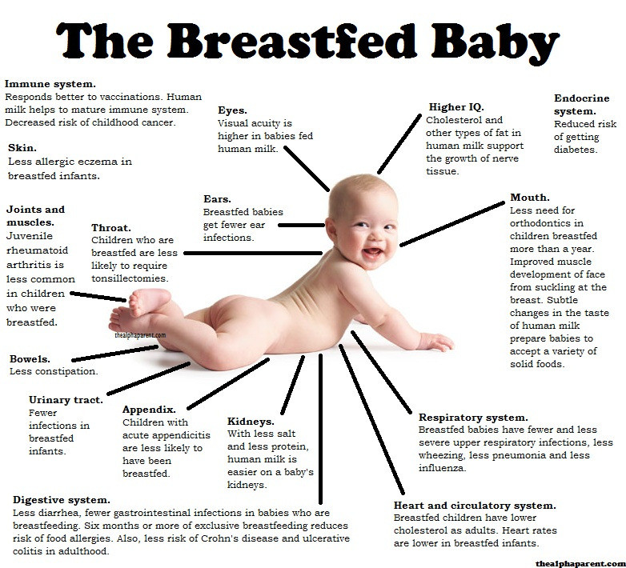

Slide 28
Benefits of breastfeeding for mothers
Helps the uterus to regress to its size before pregnancy.
Losing accumulated fat during pregnancy.
Empowerment
Decrease risk of osteoporosis
Improve blood sugar control for diabetics
Decrease the incidence of high cholesterol ,diabetes ,breast, cervical,ovarian,uterine cancers, less chance for gallstone formation and rheumatoid arthritis
Bonding ,decrease post partum depression

Slide 29
Advantages of breastfeeding
Superior health outcomes in breastfed infant
Protection during breastfeeding | Protection after weaning in early childhood | Protection later in childhood
Gastrointestinal and respiratory infections | Gastrointestinal and respiratory infections | Obesity
Urinary infections | Wheezing | Types I and II diabetes
Sepsis and meningitis | Celiac disease | Leukemia/lymphomas
Atopic dermatitis | Growth faltering | Crohn disease
Food allergies | Cognition | Cognition
Wheezing | Visual acuity | Strong, secured personality
Necrotizing enterocolitis
Celiac disease
Growth faltering
Visual acuity

Slide 30
Preparation of the prospective mother
Most women are physically capable of breastfeeding, provided the receive sufficient encouragement and are protected from discouraging experiences and comments while the secretion of breast milk is becoming established.
Physical Factors: leading to a good breastfeeding include: good health, having enough rest, freedom of worry, treatment of any disease, and adequate nutrition.
Retracted & inverted nipples.

Slide 31
Nipple problems
.
Flat nipples Flat nipples don't stand out much from the surrounding area (called the areola) and don't protrude when stimulated. That sometimes can make it difficult for your baby to latch on and breastfeed.
shouldn't pose a problem unless your baby isn’t latching on well or your breasts are overly full or engorged.

Slide 32
Cont.
Inverted nipples retract or pull inward when stimulated. They may look flat, or their appearance may range from slightly dimpled and indented to very clearly indented in the center.
briefly use a breast pump to draw out the nipple before nursing and pull back on the breast tissue while your baby is latching on to help the nipple protrude

Slide 33
management
Stimulating your nipple. Unless it retracts completely, grasp the nipple and roll it between your thumb and index finger for 30 seconds, then touch it with a moist, cold cloth immediately before offering it to your baby. A disposable nursing pad that is dampened and put in the freezer makes a great ice pack to help the nipple evert immediately before nursing.

Slide 34
Pulling back on the areola before you latch the baby on. Support your breast with your thumb on top and your other fingers underneath, and pull back on the breast toward the chest wall. This will help the nipple protrude. : Draw The Nipple Out Before Feeding ,You can try manually expressing milk for a short while before feeding or you might the nipple use a breast pump to get to stand out. A couple of companies sell a syringe-like device especially for everting the nipple before feeding.
Using a nipple shield. This is a thin, flexible silicone nipple with holes in the end that fits over your nipple during feedings.

Slide 35
Cont.
Use a breast pump to gently draw out the nipple and to make it easier for your baby to latch on. Most nipples will extend out with only a minute or two of pumping. Once you see the nipple lengthen, remove the pump, and quickly place your baby on your breast.
Keep your breasts from getting engorged. It is harder to draw out a flat or inverted nipple when your breast is overly full. To keep your breasts from becoming engorged, be sure to breastfeed at least 8 times in each 24-hour period.

Slide 36
latching.
Pay particular attention to your baby’s position and latch. Your baby’s mouth should be opened wide and filled with breast tissue. When your baby is positioned well, your nipple will be at the back of your baby’s mouth, near the junction of the hard and soft palate.

Slide 37
Establishing and maintaining the milk supply
The most satisfactory stimulus to the secretion of human milk is regular and complete emptying of the breast; milk production is reduced when the secreted milk is not drained.
The breastfeeding should begin as soon after delivery as the condition of the mother and the baby permits, preferably within the first hour.

Slide 38
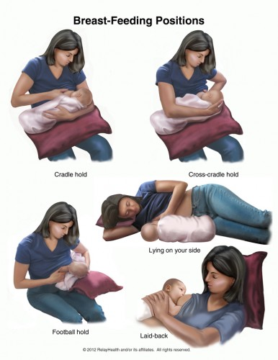
Breastfeeding position

Slide 39
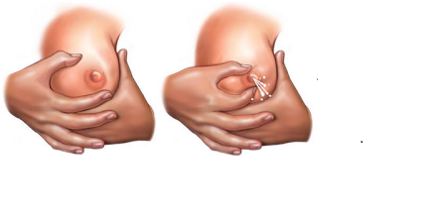
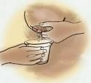
Manual expression of breast milk

Slide 40
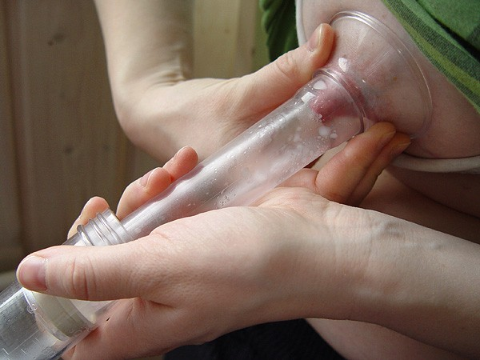
Expression of breastmilk

Slide 41
Contraindications
It is important to look at the entities that put the mother or infant at significant risk and are not remedial.
Infectious Diseases:
Life – threatening illnesses in the mother:
Medications:

Slide 42
Correct latching

