Slide 1
Reproductive System, Ovarian Cysts and Tumors
Amany Fathaddin, MD

Slide 2
Lecture outlines
Lecture: Ovarian cysts and ovarian tumors.
At the end of this lecture, the students should have a working knowledge of:
The pathology of the major types of ovarian cysts (follicular and luteal).
The classification and pathology of common ovarian tumors including surface epithelial, germ cell, stromal and metastatic neoplasms.

Slide 3
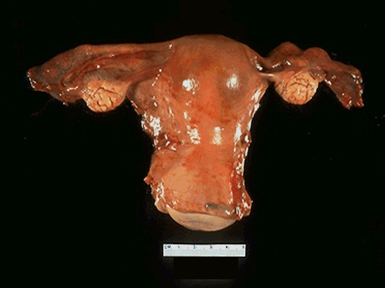
Ovarian Cysts and Tumors
Non neoplastic cysts are common but they are not serious problems.
Inflammation of ovaries is rare. It is ususally associated with salpingitis of fallopian tubes (salpingo-oophoritis)
Frequently, the ovaries are affected by endometriosis.
The most important medical problems in ovaries are the neoplasms
Death from ovarian cancers is more common than that of cervix and uterus together because ovarian tumors grow silently and are usually diagnosed late, which make them so dangerous.

Slide 4
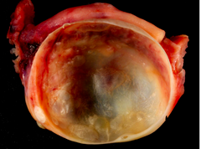
Non-Neoplastic Cysts of ovary
Non Neoplastic Cyst are more common than the neoplastic ones. They usually cause no problems. Rarely a non neoplastic cyst can rupture and cause acute pain and intrabdominal hemorrhage. Common
non-neoplastic cysts are as follows:
Follicullar cyst
Corpus luteum cyst
Theca lutein cyst
Chocolate cyst /Endometriotic cyst
http://o.quizlet.com

Slide 5
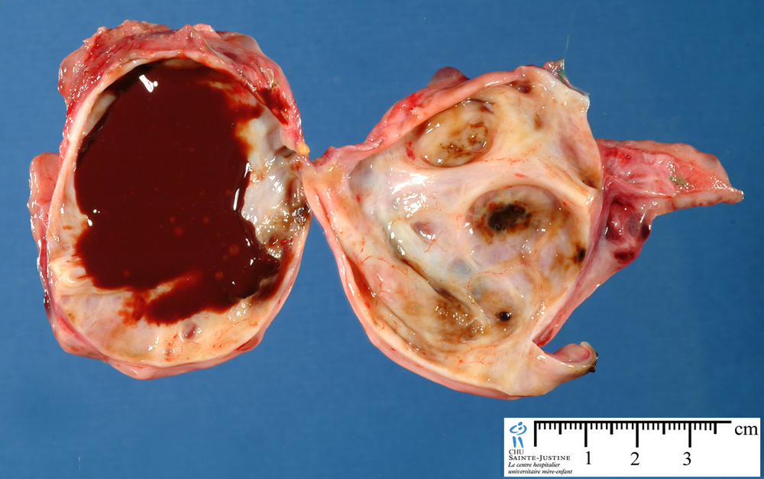
Non-Neoplastic Cysts of ovary
Follicullar cyst
Arise from the ovarian follicles and are due to distension of un-ruptured Graafian follicle.
Corpus luteum cyst
Results from hemorrhage into a persistent mature corpus luteum.
Theca lutein cyst/ hyperreactio luteinalis
Are thin walled cysts lined by luteinized theca cells. They are associated with high levels of circulating gonadotropins (e.g. pregnancy, hydatidiform mole, etc).
Chocolate cyst /Endometriotic cyst
The ovary is the most frequent site of endometriosis. And chocolate cyst is a blood filled cyst of the ovary. It is due to endometriosis in the ovary with hemorrhage.
Endometriotic cyst
http://www.humpath.com/IMG/jpg_ovarian_endometriotic_cyst_07_2a.jpg

Slide 6
Polycystic ovarian syndrome
Polycystic ovarian syndrome (formerly called Stein-Leventhal syndrome) is a complex endocrine disorder characterized by hyperandrogenism, menstrual abnormalities, polycystic ovaries, chronic anovulation, and decreased fertility.
It usually comes to attention after menarche in teenage girls or young adults who present with oligomenorrhea, hirsutism, infertility, and sometimes with obesity.
The ovaries are usually twice the normal size, graywhite with a smooth outer cortex, and studded with subcortical cysts 0.5 to 1.5 cm in diameter.
Histologic examination shows a thickened, fibrotic ovarian capsule overlying innumerable cystic follicles lined by granulosa cells with a hyperplastic luteinized theca interna. There is a conspicuous absence of corpora lutea in the ovary

Slide 7
Ovarian Tumors
One of the leading cause of cancer death in women
Ovarian cancers grow silently and go undetected in the early stage when it is still curable. Most of the patients already have metastasis at the time of diagnosis.
The WHO Histological Classification for ovarian tumors divides ovarian neoplasms into primary and metastatic (secondary).

Slide 8
Ovarian Tumors classification
A. PRIMARY TUMORS: There are three main primary types of ovarian tumors based on the origin of the tumor cell. They are:
Surface epithelial ovarian tumors (65%): derived from the cells on the surface of the ovary. This is the most common form of primary ovarian cancer and occurs in adults.
Germ cell tumors (15%): derived from the from the ovarian follicles. This occurs mainly in children, teens and young women. They are less common as compared to epithelial ovarian tumors.
Sex cord stromal tumors (10%): derived from the ovarian stroma. Uncommon and this class of tumors often produces steroid hormones.
These 3 main types are further divided into many subtypes (see later).
B. METASTATIC/ SECONDARY TUMORS (5%): Cancers from other organs can also spread to the ovaries

Slide 9
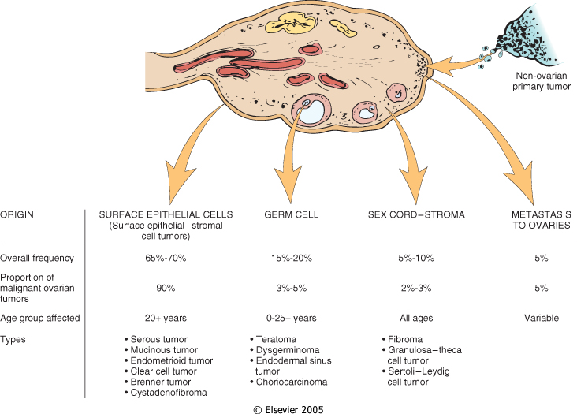

Various ovarian neoplasms and their frequency and age distribution.
Downloaded from: Robbins & Cotran Pathologic Basis of Disease

Slide 10
Simplified classification of primary ovarian tumors
SURFACE EPITHELIAL TUMORS
Serous tumors:
Benign (cystadenoma)
Borderline tumors (serous borderline tumor)
Malignant (serous adenocarcinoma)
Mucinous tumors:
Benign (cystadenoma)
Borderline tumors (mucinous borderline tumor)
Malignant (mucinous adenocarcinoma)
Endometrioid tumors:
Benign (cystadenoma)
Borderline tumors (endometrioid borderline tumor)
Malignant (endometrioid adenocarcinoma)
Clear cell tumors:
Benign
Borderline tumors
Malignant (clear cell adenocarcinoma)
Transitional cell tumors:
Brenner tumor
Brenner tumor of borderline malignancy
Malignant Brenner tumor
Transitional cell carcinoma (non-Brenner type)
Others
SEX CORD STROMAL TUMORS
Almost always Benign
Fibromas/ Fibrothecomas /Thecomas
With Malignant Potential
Granulosa cell tumors
Sertoli-Leydig cell tumors
Others
GERM CELL TUMORS
Teratoma:
  Immature (malignant)
  Mature (benign)
    Solid
    Cystic (dermoid cyst)
  Monodermal (e.g., struma ovarii, carcinoid)
Dysgerminoma
Yolk sac tumor (endodermal sinus tumor)
Choriocarcinoma
Embryonal carcinoma
Mixed germ cell tumors
NOTE: all ovarian GCTs are considered as malignant except mature teratoma

Slide 11
Surface Epithelial Ovarian Tumors

Slide 12
Surface Epithelial Ovarian Tumors
Neoplasms of surface epithelium account for majority of all primary ovarian tumors.
Are 65 – 70 % of overall tumors
They account for 90 % of malignant tumors in the ovary
Age 20+

Slide 13
The majority of ovarian tumors arise from the fallopian tube or epithelial cysts in the cortex of the ovary . S
tudies have shown that many of the tumors thought to arise from the coelomic epithelium that covers the surface of the ovary are now thought to arise from the fimbriated end of the fallopian tube .
The epithelium lining the cortical cysts may be derived from displaced ovarian surface epithelium or the lining of fallopian tube. These can become metaplastic or undergo neoplastic transformation to give rise to a number of different epithelial tumors.

Slide 14
Important risk factors for ovarian cancer include:
nulliparity, family history, and germline mutations in certain tumor suppressor genes.
* Of interest, prolonged use of oral contraceptives reduces the risk.
*Around 5% to 10% of ovarian cancers are familial, and most of these are associated with mutations in the BRCA1 or BRCA2 tumor suppressor genes. mutations in BRCA1 and BRCA2 also are associated with hereditary breast cancer.
* The average lifetime risk for ovarian cancer is approximately 30% in BRCA1 carriers; the risk in BRCA2 carriers is somewhat lower.

Slide 15
Surface Epithelial Ovarian Tumors
The subtypes of the surface epithelial tumors are:
  Serous Tumors
  Mucinous Tumors
  Endometrioid Tumors
  Clear cell Tumors
  Transitional/Brenner cell Tumors
  Others
All surface epithelial tumors are further divided into:
  Benign: They do not spread and invade other tissues.
  Malignant: are carcinomas and have potential to metastasize beyond the ovary.
  Borderline/ intermediate/ tumors of low malignant potential: this is a gray zone. They are ‘semi-malignant’. These appear to be low grade cancers with limited invasive potential. They have better prognosis than malignant. These tumors may seed or implant into the peritoneum.

Slide 16
Simplified classification of primary ovarian tumors
SURFACE EPITHELIAL TUMORS
Serous tumors:
  Benign (cystadenoma) /(cystadenofibroma)
  Borderline tumors (serous borderline tumor)
  Malignant (serous adenocarcinoma)
Mucinous tumors, endocervical-like and intestinal type:
  Benign (cystadenoma)
  Borderline tumors (mucinous borderline tumor)
  Malignant (mucinous adenocarcinoma
Endometrioid tumors:
  Benign (cystadenoma)
  Borderline tumors (endometrioid borderline tumor)
  Malignant (endometrioid adenocarcinoma)
Clear cell tumors:
  Benign
  Borderline tumors
  Malignant (clear cell adenocarcinoma)
Transitional cell tumors:
  Brenner tumor
  Brenner tumor of borderline malignancy
  Malignant Brenner tumor
  Transitional cell carcinoma (non-Brenner type)
Others

Slide 17
Serous tumors
Serous tumors are the most common of the ovarian epithelial tumors overall, and also make up the greatest fraction of malignant ovarian tumors.
About 60% are benign, 15% are borderline, and 25% are malignant.
Benign lesions are usually encountered in patients between 30 and 40 years of age, and malignant serous tumors are more commonly seen between 45 and 65 years of age.
There are two types of serous carcinomas, low-grade and high-grade. The former arise from benign or borderline lesions and progress slowly in a stepwise manner to become invasive carcinoma. These low-grade tumors are associated with mutations in genes encoding signaling proteins, such as KRAS, a member of the RAS gene family.
The high-grade serous tumors develop rapidly. many of these high-grade lesions arise in the fimbriated end of the fallopian tube via serous tubal intraepithelial carcinoma, rather than ovarian coelomic epithelium.
TP53 mutations in high-grade serous cancers, being present in over 95% of cases.
Other frequently mutated genes include the tumor suppressors NF1 and RB, as well as BRCA1 and BRCA2 in familial ovarian cancers.

Slide 18
Serous tumor, morphology
Gross:
Most serous tumors are large, spherical to ovoid, cystic structures up to 30 to 40 cm in diameter.
About 25% of the benign tumors are bilateral.
In the benign tumors, the serosal covering is smooth and glistening. By contrast, the surface of adenocarcinomas often has nodular irregularities representing areas in which the tumor has invaded the serosa.
On cut section, small cystic tumors may have a single cavity, but larger ones frequently are divided by multiple septa into multiloculated masses. The cystic spaces usually are filled with a clear serous fluid. Protruding into the cystic cavities are papillary projections, which are more prominent in malignant tumors

Slide 19
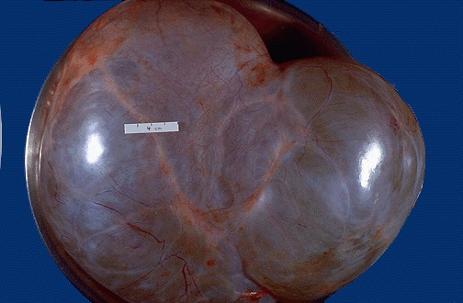
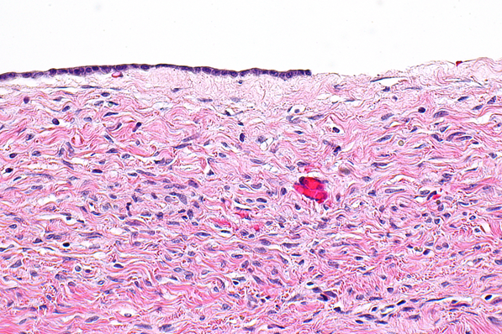
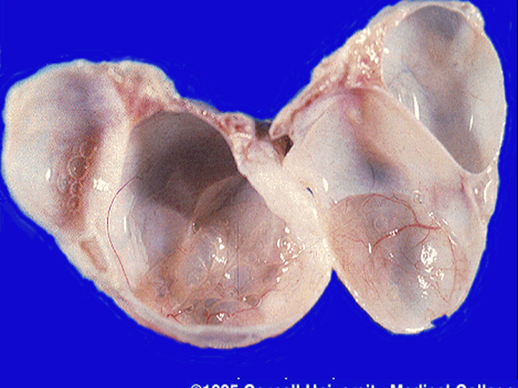
Serous cystadenoma
single layer of columnar epithelial cells that line the cyst or cysts. The cells often are ciliated. Psammoma bodies (concentrically laminated calcified concretions) are commo
commons.wikimedia.org

Slide 20
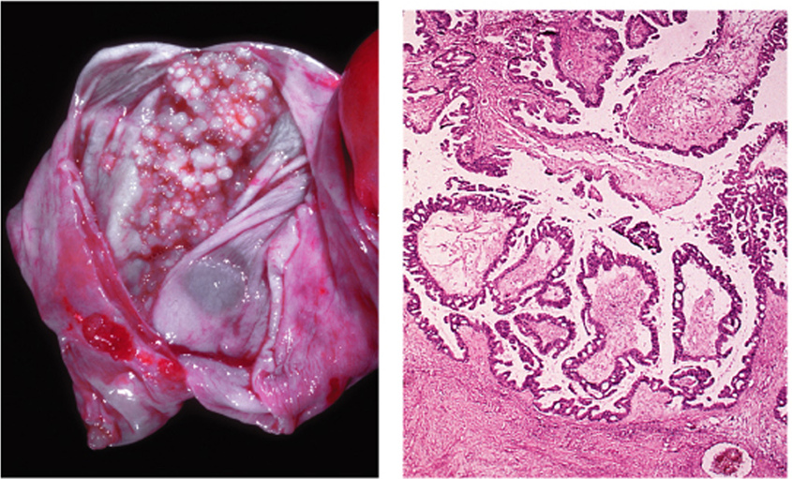
Borderline serous tumor
borderline tumors, which exhibit cytologic atypia and typically no stromal invasion
"Ovarian Cancer - A Clinical and Translational Update", book edited by Iván Díaz-Padilla, ISBN 978-953-51-1030-9, Published: February 27, 2013 under CC BY 3.0 license. © The Author(s). Borderline Epithelial Tumors of the Ovary By Gennaro Cormio, Vera Loizzi, Maddalena Falagario, Doriana Scardigno, Donatella Latorre and Luigi E. Selvaggi DOI:http://dx.doi.org/10.5772/54828

Slide 21
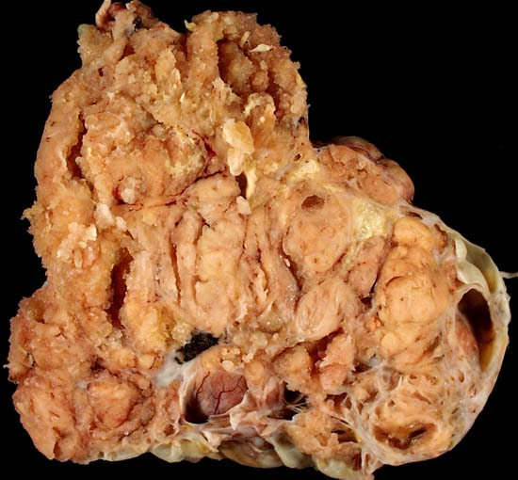
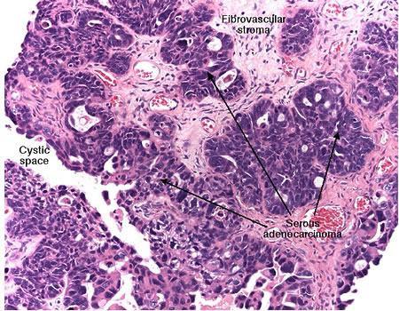
Serous cystadenocarcinoma, ovary
In high-grade carcinoma the cells are markedly atypical, the papillary formations are usually complex and multilayered, and by definition nests or sheets of malignant cells invade the ovarian stroma.
Ed Uthman, MD. http://web2.airmail.net/uthman/specimens/images/ovary_serous_ca.html
imgbuddy.com http://missinglink.ucsf.edu/lm/IDS_107_ovary_uterus_kidney/assets/Slide340OACAhp_small.jpg

Slide 22
Serous tumors prognosis
In general, malignant serous tumors spread throughout the peritoneal cavity and to regional lymph nodes, including periaortic lymph nodes; distant lymphatic and hematogenous metastases are infrequent.
The prognosis for patients with high-grade serous carcinoma is poor, even after surgery and chemotherapy, and depends heavily on the stage of the disease at diagnosis..

Slide 23
Mucinous Tumors
Mucinous tumors form about 25% of all ovarian neoplasms. The tumor cells are mucin-producing cells (which are either endocervical type or intestinal type cells).
Less likely to be malignant
80% are benign
10% are borderline
10% malignant
Bilaterality is uncommon.
Mucinous tumors can be very large.
They are typically cystic and multilocular and filled with thick sticky, viscous mucoid fluid.

Slide 24
Mucin-producing epithelial cells line the cyst
Malignant tumors are characterized by solid areas of growth, piling up (stratification) of lining cells, cytologic atypia, and stromal invasion.
Compared with serous tumors, mucinous tumors are much less likely to be bilateral. This feature is sometimes useful in differentiating mucinous tumors of the ovary from metastatic mucinous adenocarcinoma from a gastrointestinal tract primary (the so-called “Krukenberg tumor”), which more often produces bilateral ovarian masses.

Slide 25
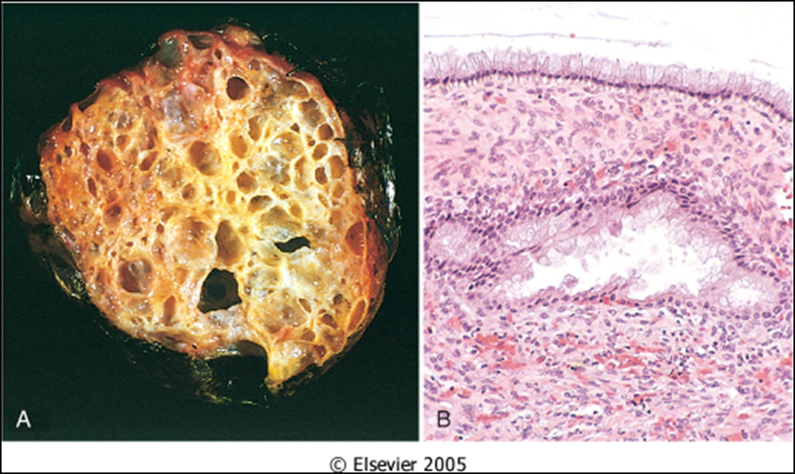
Mucinous cystadenoma with multicystic cut section and glistening mucoid material; in it. B. the cyst is lined by columnar epithelium (mucin producing)

Slide 26
Other surface epithelial tumors
ENDOMETRIOID TUMORS
TRANSITIONAL CELL/ BRENNER TUMOR
They have tubular gland that resemble the endometrium so the name endometrioid (endometrium-like) .
Endometrioid tumors form 10 to 20% of all ovarian tumors.
Most of the endometrioid tumors are malignant (carcinomas).
Some endometrioid tumors are accompanied by an endometrial carcinoma in the uterus and / or endometriosis in the ovaries
Tumor cell are transitional cell type
Most are benign

Slide 27
Germ Cell Tumors

Slide 28
Classification of Ovarian Germ Cell Tumors (GCT)
GERM CELL TUMORS
Teratoma:
  Immature
  Mature (benign)
    Solid
    Cystic (dermoid cyst)
    Monodermal (e.g., struma ovarii, carcinoid)
Dysgerminoma
Yolk sac tumor (endodermal sinus tumor)
Choriocarcinoma
Embryonal carcinoma
Mixed germ cell tumors: mixture of germ cell tumors occurring together in one tumor mass
NOTE: all ovarian GCTs are considered malignant except mature teratoma.

Slide 29
Germ Cell Tumors:
Teratoma
Teratomas constitute 15% to 20% of ovarian tumors.
A distressing feature of these germ cell tumors is their predilection to arise in the first 2 decades of life; to make matters worse, the younger the person, the greater the likelihood of malignancy.
More than 90% of these germ cell neoplasms, however, are benign mature cystic teratomas; the immature, malignant variant is rare.
Mature cystic teratoma
  Is the most common ovarian germ cell tumor and the most common type of ovarian teratoma
  It is a benign neoplasm that typically occurs during reproductive years composed of mature elements of the ectoderm, endoderm and mesoderm
  It is a cystic tumor, filled with sebaceous material and hair and occasionally teeth.
  Histology: skin, hair, sebaceous glands, and mature neural tissue predominate; cartilage, bone, respiratory and intestinal epithelium are common.
  Complications include torsion, rupture, infection etc.

Slide 30
Benign (mature) cystic teratomas
are marked by the presence of mature tissues derived from all three germ cell layers: ectoderm, endoderm, and mesoderm.
Usually these tumors contain cysts lined by epidermis with adnexal appendages—hence the common designation dermoid cysts.
Most are discovered in young women as ovarian masses or are found incidentally on abdominal radiographs or scans because they contain foci of calcification produced by toothlike structures contained within the tumor.
About 90% are unilateral
On cut section, they often are filled with sebaceous secretion and matted hair that, when removed, reveal a hair-bearing epidermal lining .
Sometimes there is a nodular projection from which teeth protrude. Occasionally, foci of bone and cartilage, nests of bronchial or gastrointestinal epithelium, or other tissues are present.
For unknown reasons, these neoplasms sometimes produce infertility and are prone to undergo torsion (in 10%–15% of cases), which constitutes an acute surgical emergency.
Malignant transformation, usually to a squamous cell carcinoma, is seen in about 1% of cases.

Slide 31
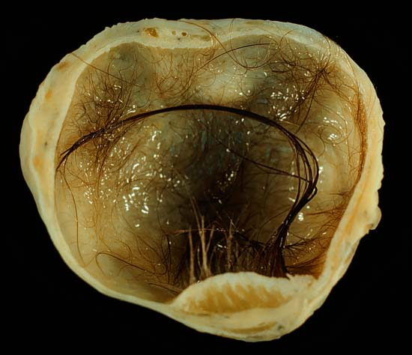
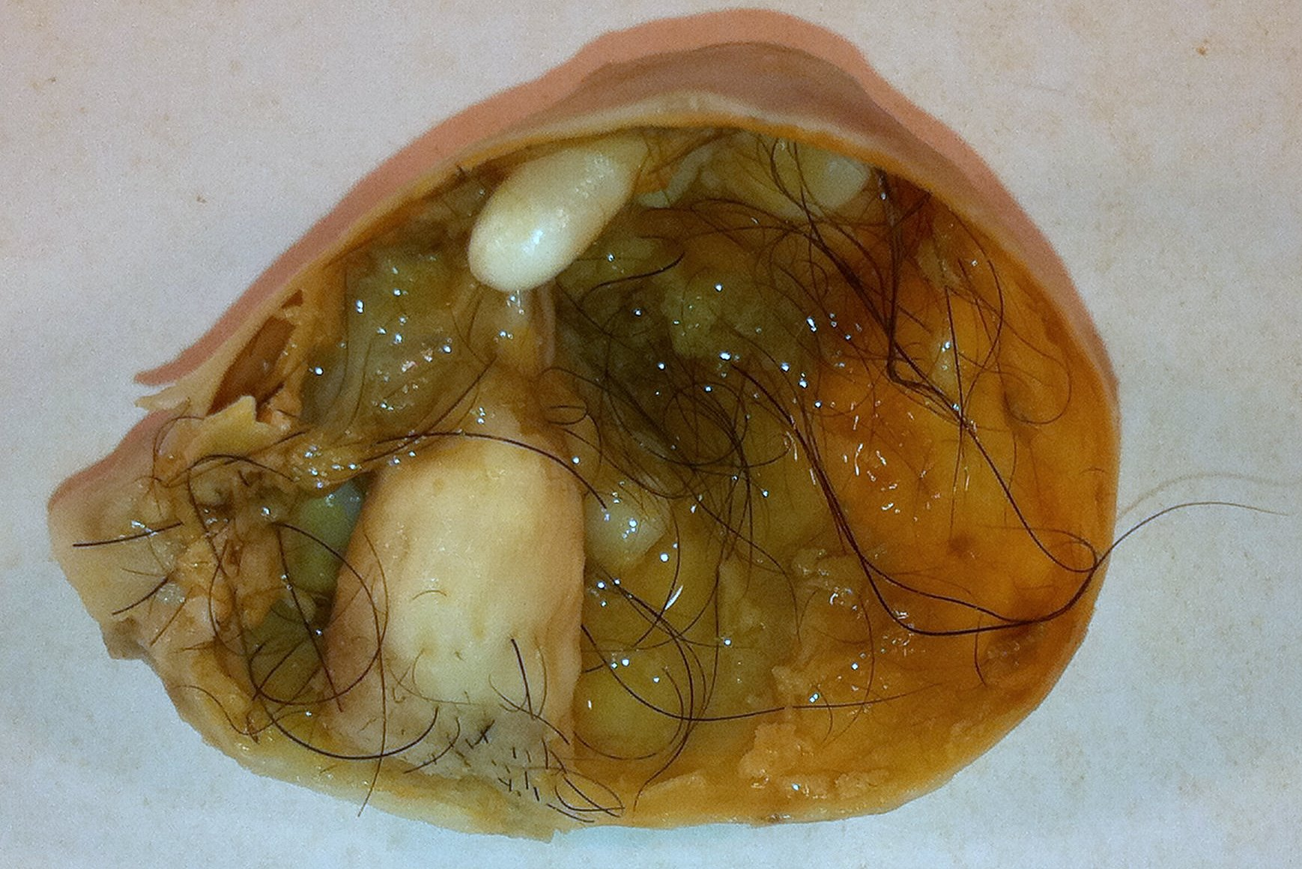
"Mature cystic teratoma of ovary" by Photograph by Ed Uthman, MD. - http://web2.airmail.net/uthman/specimens/index.html. Licensed under Public Domain via Wikimedia Commons - http://commons.wikimedia.org/wiki/File:Mature_cystic_teratoma_of_ovary.jpg#/media/File:Mature_cystic_teratoma_of_ovary.jpg
http://commons.wikimedia.org/wiki/File:Mature_Cystic_Teratoma_of_the_Ovary_%285560431170%29.jpg

Slide 32
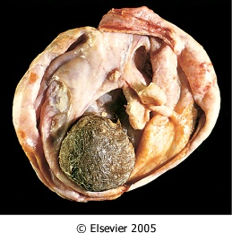
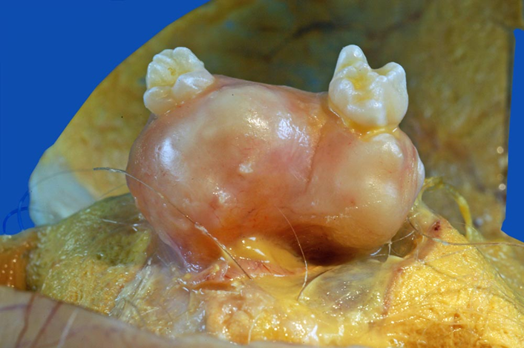

Opened mature cystic teratoma (dermoid cyst) of the ovary. Hair ball is present.
Robbins & Cotran Pathologic Basis of Disease

Slide 33
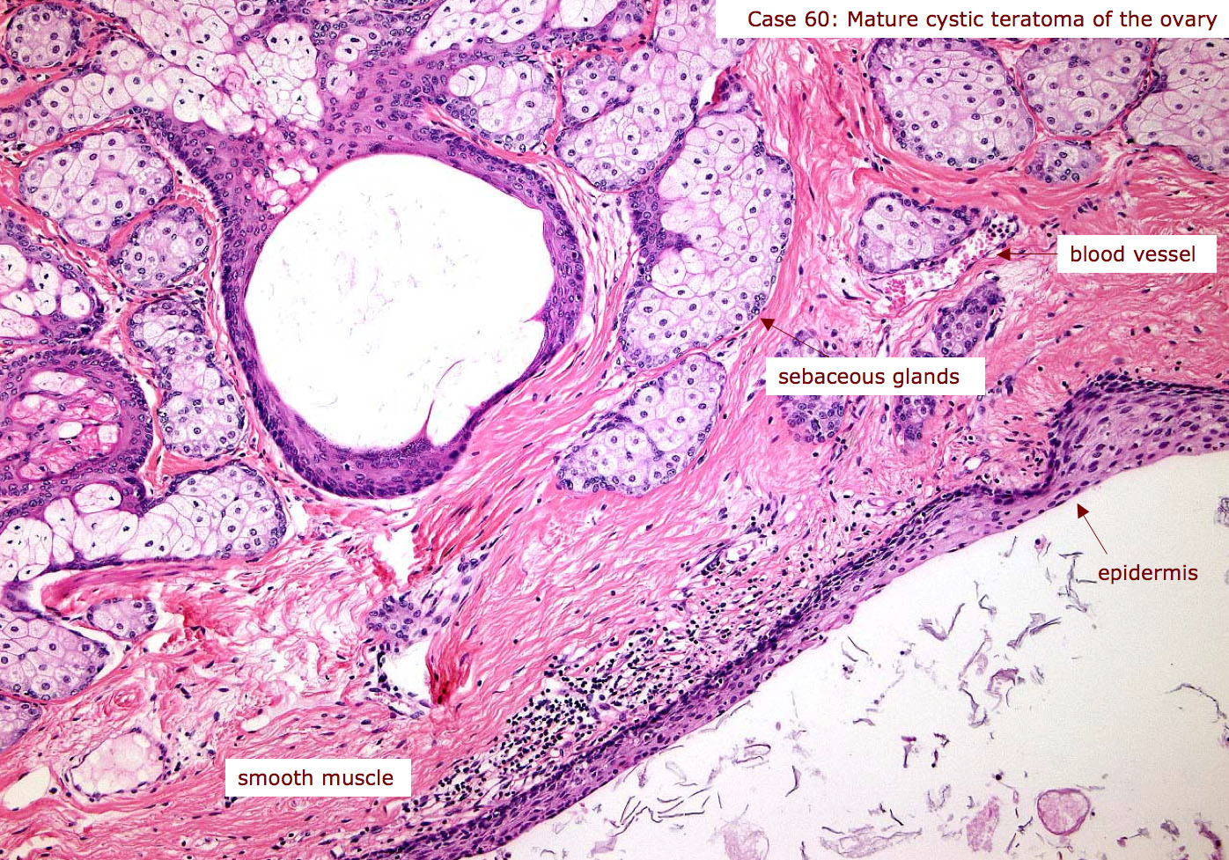
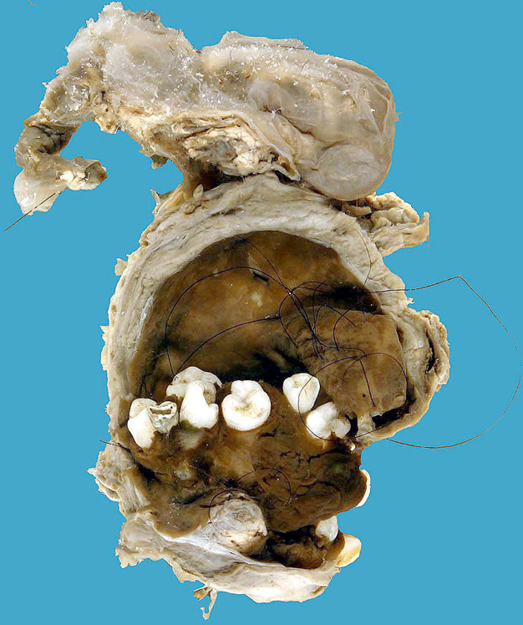
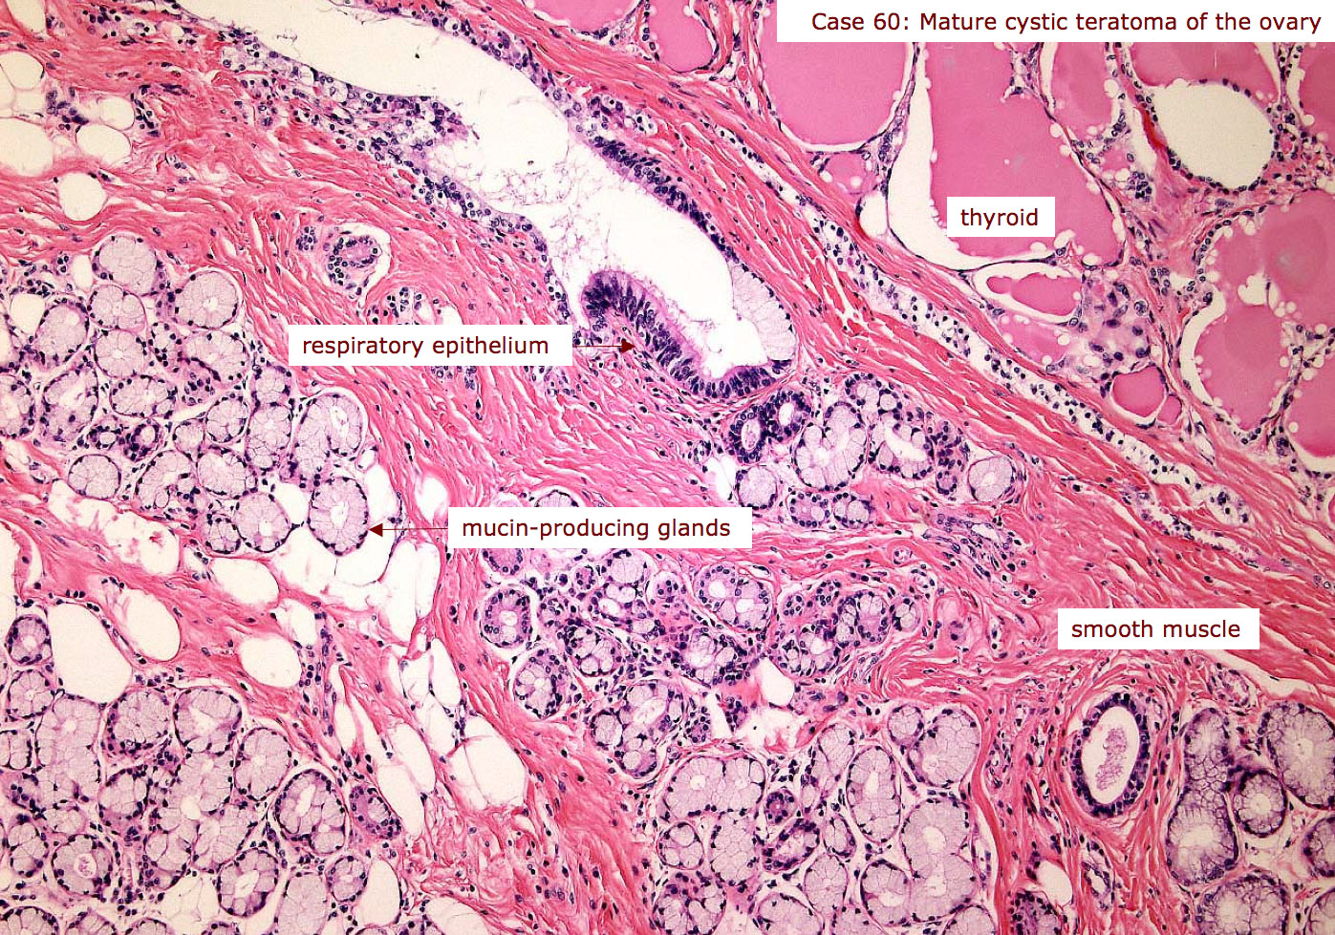
https://secure.health.utas.edu.au/intranet/cds/pathprac/Files/Cases/Female/Case60/Case60.htm

Slide 34
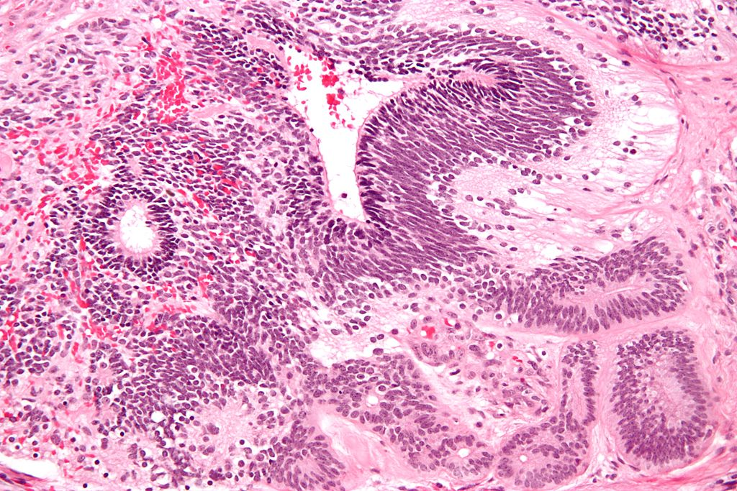
Germ Cell Tumors:
Teratoma
Immature teratoma
Are found early in life, the mean age at clinical detection being 18 years.
They typically are bulky and appear solid on cut section, and they often contain areas of necrosis; uncommonly, cystic foci are present that contain sebaceous secretion, hair, and other features similar to those of mature teratomas.
On microscopic examination, the distinguishing feature is the presence of immature elements or minimally differentiated cartilage, bone, muscle, nerve, or other tissues.
As with other tumors, the prognosis depends on grade and stage
"Immature teratoma high mag" by Nephron - Own work. Licensed under CC BY-SA 3.0 via Wikimedia Commons - http://commons.wikimedia.org/wiki/File:Immature_teratoma_high_mag.jpg#/media/File:Immature_teratoma_high_mag.jpg

Slide 35
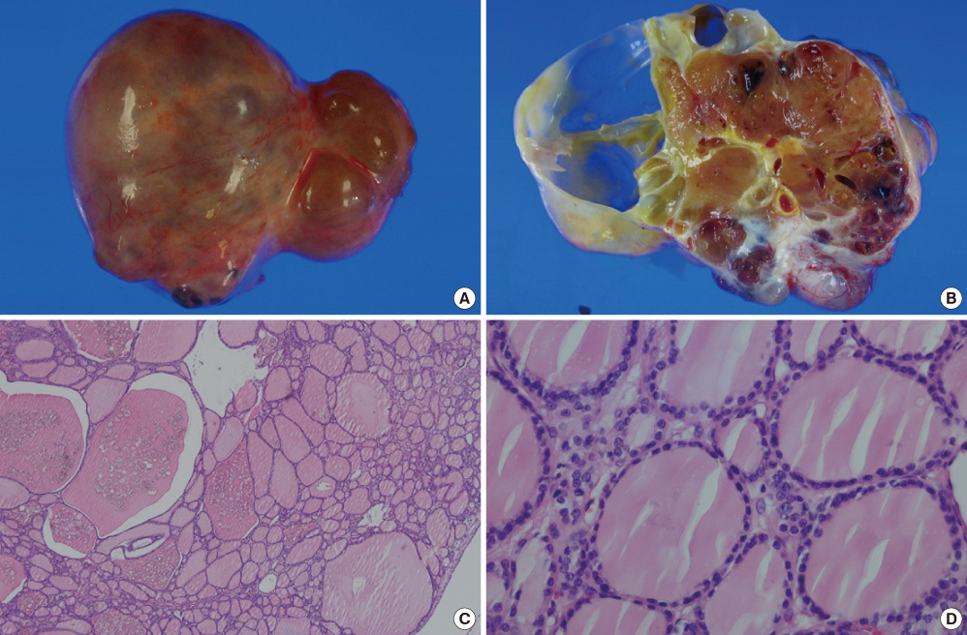
Germ Cell Tumors:
Teratoma
Specialized teratoma
  A rare subtype of teratoma is composed entirely of specialized tissue. The most common example is struma ovarii. which is composed entirely of mature thyroid tissue that may actually produce hyperthyroidism. These tumors appear as small, solid, unilateral brown ovarian masses.
  Other specialized teratomas include ovarian carcinoid, which in rare instances produces carcinoid syndrome.
A Case of Bilateral Struma Ovarii Combined with Subclinical Hyperthyroidism
Endocrinol Metab. 2012 Mar;27(1):72-76. Korean. http://dx.doi.org/10.3803/EnM.2012.27.1.72

Slide 37
Summary
Tumors may arise from epithelium, sex cord–stromal cells, or germ cells.
Epithelial tumors are the most common malignant ovarian tumors and are more common in women older than 40 years of age.
The major types of epithelial tumors are serous, mucinous, and endometrioid. Each has a benign, malignant, and borderline (low malignant potential) counterpart.
Sex cord–stromal tumors may display differentiation toward granulosa, Sertoli, Leydig, or ovarian stromal cell type. Depending on differentiation, they may produce estrogens or androgens.
Germ cell tumors (mostly cystic teratomas) are the most common ovarian tumor in young women; a majority are benign.
Germ cell tumors may differentiate toward oogonia (dysgerminoma), primitive embryonal tissue (embryonal), yolk sac (endodermal sinus tumor), placental tissue (choriocarcinoma), or multiple fetal tissues (teratoma).

Slide 38
Reference
Robbins basic pathology 10th edition

