Slide 1
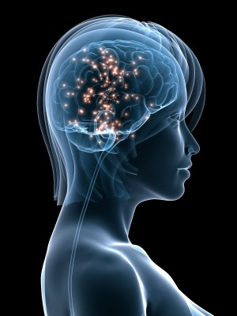
HORMONE REPLACEMENT THERAPY
Dr. Asma Alonazi
(Slides are adopted and modified from Dr. Ishfaq Bukhari)

Slide 2
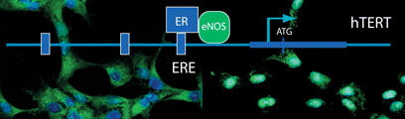
ILOs
By the end of this lecture, you will be able to:
Recognize menopausal symptoms & consequences
Classify drugs used to alleviate such symptoms that are used as Hormonal Replacement Therapy [HRT]
Expand on the mechanism of action, indications, preparations, side effects & contraindications of such agents.

Slide 3
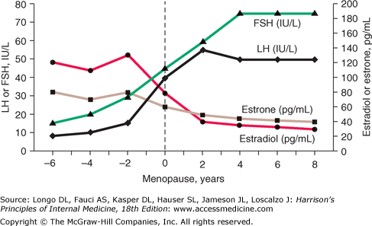
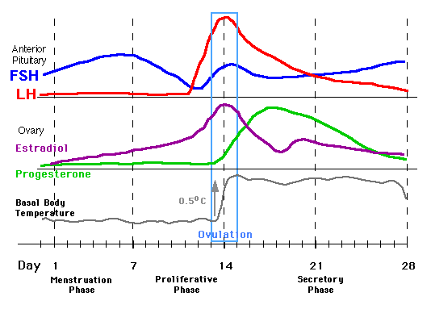
HRT
Is a system of medical treatment that is designed to artificially boost female hormones, in hope to alleviate symptoms caused by  in their circulating levels.
1/3 ^{rd} of total female population
?
PERI & POSTMENOPAUSE
MENOPAUSE
Natural, Pathological, Induced
A complex physiological change that occurs at the time when the last period ends generally as women age and loss fertility (age late 40s)
Estrogen & Progesterone
◉ Androgens
 FSH & LH
Insulin Resistance
'menos’ (month)
'pausis’ (cessation)
Normal menstruation

Slide 4
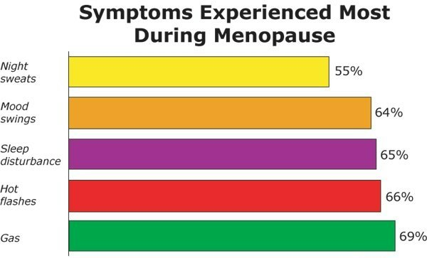
HRT
SYMPTOMS & CONSEQUENCES of MENOPAUSE
Immediate
Intermediate
Long Term
Hot Flushes / Night Sweats (vasomotor symptoms)
Insomnia, Anxiety, Irritability
Mood Disturbances
Reduction In Sexuality & Libido
Poor Concentration / Memory Loss
20% no symptoms, 60% some symptoms, 20% severe symptoms
Osteoporosis
CVS Risks; LDL/HDL ratio, CHD, stroke,..
CNS deficits; Alzheimer's, dementia
Dyspareunia & vaginal dryness
Urethral syndrome (dysuria, urgency & frequency)
Incontinence, difficulty in voiding
Increased bruising
Generalized aches and pains

Slide 5
Menopausal Symptoms
Estrogen
Replace the Estrogen
◉
Alleviate
Estrogen Some undesirable side effects

add Progestins; but not if there is hysterectomy
Selective ER-Modulators [SERMs]
Phytoestrogens
Androgens  responsible for sexual arousal  given only if there is loss of libido & orgasm
HRT
Given for short term; never exceed 5 years to control meno-pausal symptoms without allowing ample time for malignant transition that might be induced by estrogen
Long-term administration was only indicated in osteoporosis & CVS protection but now better drugs are available
No more preferred

Slide 6
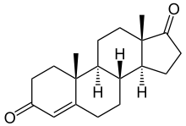
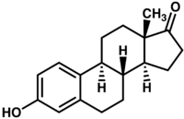
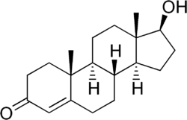
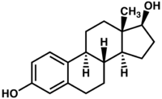
1. ESTROGEN
In NATURE
Aromatase
Ovaries & adrenals pre-menopausal
Adrenals in menopause
Androstenedione
Estrone
Dehydrogenase
Aromatase
Ovaries in pre-menopause
Testosterone
Estradiol
As Therapy
Estradiol; Oral bioavailability is low due to its rapid oxidation in the liver so used only in transdermal patch, intradermal implant, ….
Conjugated estrogens  mixture of Na salts of sulfate esters of estrone & equilin.
Esterified estrogens

Slide 7
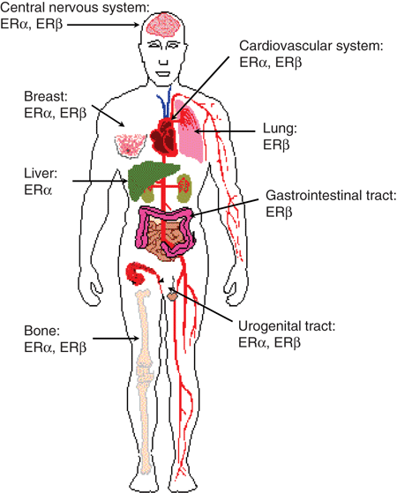
?
What does estrogen do
It binds to its receptors
Distribution of ER
Types of Estrogen Receptors [ER]
ER α 
> mediates female hormonal functions
Endometrium, breast, ovaries, hypothalamus,…
ER β 
> mediates other hormonal functions
brain, bone, heart, lungs, kidney, bladder, intestinal mucosa, endothelial cells,….

Slide 8
Estrogens bind to ER (α or β) that exist either;
Cytoplasmic; mediates its genomic actions  hrs – dys time scale development, neuro- endocrines, metabolism
Membranous; GPER2nd messenger   Ca or cAMP or  MAP Kinase
> mediates its non-genomic actions sec – min. time scale on NO, neuro- transmitters, endometrium, …..
Genomic effects
GPER; G protein ER
MAP Kinase; mitogen activated protein kinase that activate transcription factors to promote mitogenesis

Slide 9
INDICATIONS
A. In Menopause
Not given unless presence of symptoms; alone only after hysterectomy or with progestin as HRT
(never exceed 5 yrs administration)
Improves hot flushes & night sweats
Controls sleep disturbance & mood swings by acting on NE, DA & 5HT at reticular formation
Improves urethral & urinary symptoms by  epithelial thickness & vascularity, collagen content at urethra & NE transmission that contract sphincters & relax detrusal muscles.
Improves vaginal dryness by  epithelial thickness & vascularity, collagen content (topical and systemic estrogens prep are effective)
Increases bone density by  osteoclastic activity.
Progestins act synergestic by blocking cortico- steroid induced bone resorption. (Decrease incidence of hip fracture)

Slide 10
Protects CVS; enhance vasodilatation via  NO production, &  HDL & LDL thus  atherosclerosis & ischemic insults (HRT started at the beginning of menopause will prevent CVS problems) HRT increases CVs problems (long term)
Improves insulin resistance & glycaemic control in diabetics.
Improves cognitive function via  expression of ER in brain & by  amyloid deposition thus preventing Alzehimer ‘s.
Delays parkinsonism by acting on DA system in midbrain.
B. Other Uses
Contraception
Primary ovarian failure
Amenorrhea & Hirsutism caused by excess androgens

Slide 11
Administration
Oral:
Conjugated equine
Estradiol valerate
Estrial succinate
Transdermal (estradiol):
Patches 24 hour twice weekly.
Subcutaneous implant (estradiol)  6 monthly.
Vaginal cream as such or as rings pessaries
ADRs
Irregular vaginal bleeding (patients discontinue HRT).
Nausea.
Vaginal discharge.
Fluid retention. Weight gain.
Breast tenderness (patients discontinue HRT)..
Spotting or darkening of skin (on face)

Slide 12
ESTROGEN
Contraindications
Absolute;
Undiagnosed vaginal bleeding
Severe liver disease
Thromboembolic manifestations
Cancer; endometrial, breast (hormone sensitive), ovarian.
Interactions
See contraception
NB. If given with
SERMs additive side effects for both drugs
Aromatase inhibitors  efficacy
Corticosteroids  side effects

Slide 13
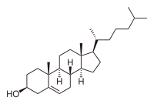
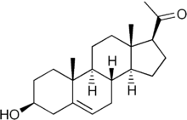
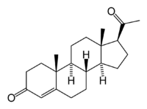
Estrogen and progestin combinations (pills or tablets)
2. PROGESTINs
In NATURE
Produced by; Adrenal glands, Gonads, Brain, Placenta
Synthesis;
Induced by LH
Cholesterol
Pregnenolone
Progesterone
As Therapy
Progesterone is destructed in GIT, so can be given only parentally
Progestins are synthetic progestogens that have progestinic effects similar to progesterone but are not degraded by GIT.
Progestin preparations; as in contraceptive pills
Binds to its receptors
What does progesterone do?
Two types of progesterone receptors [PR] PR-A & PR-B
They could exist cytoplasmic mediating genomic long term effects or membranous mediating non-genomic rapid effects

Slide 14
Estrogen and progestin combinations (pills or tablets)
INDICATIONS
A. In Menopause
As HRT, usually given in combination with estrogen Some use it alone in risk of cancer but does not  all menopausal symptoms
Protects against possibility of estrogen induced endometrial cancer
Estrogen  cell growth. If unopposed endometrial cell lining can show (atypical hyperplasia)
Progesterone beneficially matures endometrial cell lining ( become differentiated) &  apoptosis of atypical cells by activation of p53.
Progesterone (natural) protects against breast cancer development by anti-inflammatory & apoptotic mechanisms, but this effect is not as clear with synthetic progestins. Mamography recommended every 6ms.
Counteract osteoporosis, directly +ve osteoblasts

Slide 15
Estrogen and progestin combinations (pills or tablets)
B. Other Uses
Contraception (Estradiol + Progestins) 2. Dysmenorrhea
Menpauasal symptoms (Estradiol + Progestins given together)
Administration
Oral; Micronized progesterone or progestins see contraception
IU; as Levonorgestrel or Progestasert
Vaginal - natural progesterone gel / pessary.
Transdermal - sequential / continuous patch.
ADRs
Mood changes, as anxiety, irritability
Headache, dizziness or drowsiness
Nausea, vomiting, abdominal pain or bloating (distention).

Slide 16
Benefits and Risks of HRT
Definite benefits
Symptoms of menopause (vasomotor, genitourinary)
Osteoporosis (Definite increase in bone mineral density; probable decrease in risk of fractures)
Definite risks
Endometrial cancer (estrogen only)
Venous thromboembolism (long term)
Breast cancer (long term 5 yrs)
Uncertain benefits
Cognitive functions
Note: the risk of CVS broblems and breast cancer with HRT is more than their benefits)

Slide 17
Estrogen and progestin combinations (pills or tablets)
3. SERMs
Tamoxifen, Raloxifene (oral and non-hormonal)
Raloxifen Antagonist in breast and uterus and agonist in bone.
Tamoxifen Antagonist in breast and partial agonist in bone and endometrium.
An ideal SERM for use as HRT should be agonistic in brain, bone, CV system (not necessarily the liver), vagina & urinary system but antagonistic in breast & uterus
 | Brain | Uterus | Vagina | Breast | Bone | CVS
Estradiol | ++ | ++ | ++ | ++ | ++ | ++
Ideal SERM | ++ | — | ++ | — | ++ | ++
Tamoxifen | — | + | — | — | + | +
Raloxifene | — | — | — | — | ++ | +
+ = agonist
- = antagonist
Not Ideal
Tamoxifen risk of venous thrombosis & tends to precipitate vaginal atrophy & hot flushes.
Raloxifene  has no effect on hot flushes or (very effective preventing vertebral bone fracture and CVs problems less compared to Estrogen) for osteoprosis use of bisphosphonate is bettere than SERMs

Slide 18
Estrogen and progestin combinations (pills or tablets)
5. PHYTOESTROGENS
Supplements from plants; containing isoflavones (soya beans, flaxseeds) or lignans (whole grains). Avoid in esterogen dependent breast cancer
They mimic action of estrogen on ER-b alleviate symptoms related to hot flushes, mood swings, cognitive functions & possess CVS protective actions. (data limited on their efficacy).
Estrogen and progestin combinations (pills or tablets)
6. ANDROGENS
Testosterone is responsible for sexual arousal in females. It is given as the sole therapy to menopausal women in whom their menopausal symptoms are focused on lack of sexual arousal. It is given as adjuvant to combined estrogen & progestin if all other menopausal symptom exist.
N.B. Tibolone, can be effective in some women  has some androgen agonistic properties. (androgens use is not approved by FDA in women)

Slide 19
The Women’s Health Initiative (WHI) and HRT
Menopausal Hormone Therapy
For decades, hormone therapy widely used in menopausal symptoms.
Estrogen has been used alone in menopausal women who have had their uterus removed.
Progestin, the synthetic form of an estrogen-related hormone called progesterone, is combined with estrogen in menopausal women who still have their uterus.
The Women’s Health Initiative (WHI), a 15-year research program launched in 1991, addressed the most common causes of death, disability, and poor quality of life in postmenopausal women.
The research program examined the effectiveness of hormone replacement therapy in women. In 2002, findings from two WHI clinical trials examined:
The use of estrogen plus progestin in women with a uterus
The use of estrogen only in women without a uterus.
In both studies, women were randomly assigned to receive either the hormone medication or placebo.
In both studies, when compared with placebo, the hormone medication (whether estrogen plus progestin or estrogen only) resulted in an increased risk of stroke and blood clots. In addition, the estrogen plus progestin medication resulted in an increased risk of heart attack and breast cancer.
These concerns are one reason that many women are turning to mind and body practices and natural products to help with menopausal symptoms.

Slide 20
Non-hormonal agents used in management of menopausal symptoms
Fuoxetins (SSRI)
Clonidine (centrally acting antihypertensive)
Gabapentin (anti-convulsant)
Physical activity: exercise, smoking cessation and relaxation of mind will improve symptoms of menopuase (e.g hot flushes) and fall preventing strategies prevents chances of fracture.

Slide 21
THANK YOU

