Slide 1
Oral and Other Contraceptives

Slide 2
Objectives
Perceive the different contraceptive utilities available
Classify them according to their site and mechanism of action
Justify the existing hormonal contraceptives present
Compare between the types of oral contraceptives pills with respect to mechanism of action, formulations, indications, adverse effects, contraindications and possible interactions
Hint on characteristics & efficacies of other hormonal modalities

Slide 3
Introduction
IN CONCEPTION there is fusion of the sperm & ovum to produce a new organism.
IN CONTRACEPTION  we are preventing this fusion to occur

Slide 4
Contraception achieved by interfering with:
Normal process of ovulation
Implantation
Preventing sperm from fertilizing the ovum
IUD (copper T)
hormonal therapy
Killing the sperm
Interruption by a barrier
Oral Contraceptive (OC) pills
Contraceptive Patches
Vaginal rings
Injectable
IUD (with hormone)
Spermicidals
Jells
Foams
Condoms
Cervical caps Diaphragms
Thin films

Slide 5
HYPOTHALAMUS
1)GnRH
ANTERIOR PITUITARY
2)FSH
LH
OVARY
3)ESTROGENS (β-ESTRADIOL)
AND
PROGESTERONE

Slide 6
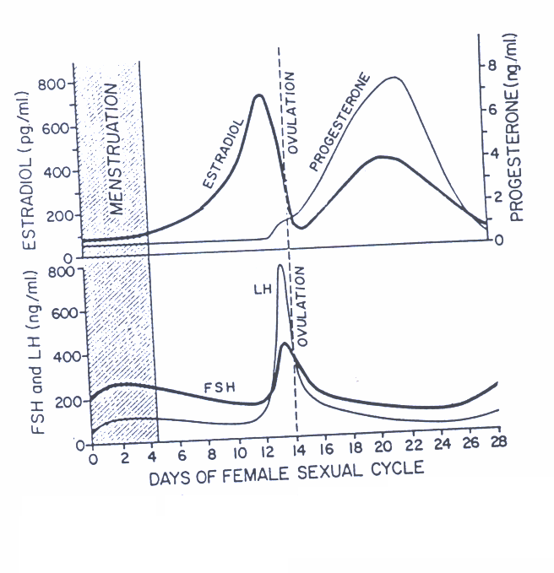
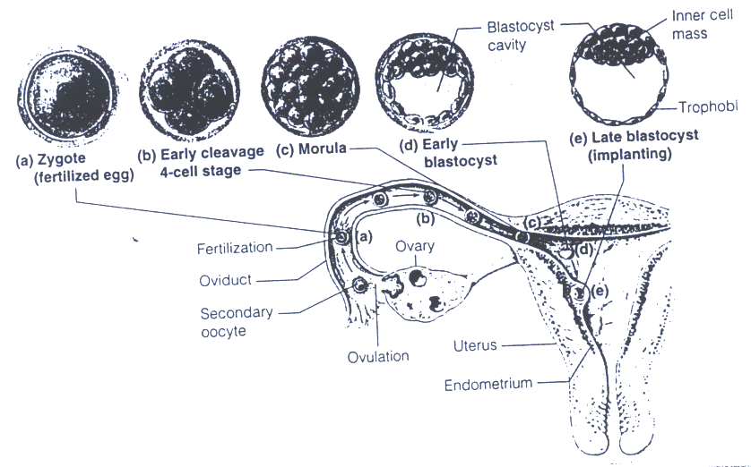
Plasma concentrations of the gonadotropins & ovarian hormones during the normal female sexual cycle

Slide 7
Types ORAL CONTRACEPTIVE (OC) Pills According to composition & intent of use
COMBINED Pills (COC)
MINI Pills (POP)
MORNING-AFTER Pills
Contain estrogen & progestin (100% effective)
Contain only a progestin (97%effective)
Contain both hormones or
Each one alone (high dose) or Mifepristone (Antiprogestin) + Misoprostol (Pg)
ESTROGENS
Ethinyl estradiol or mestranol [a “prodrug” converted to ethinyl estradiol]
Currently concentration used now is very low to minimize estrogen hazards
PROGESTINS
Norethindrone, Levonorgestrel (Norgestrel), and Medroxyprogesterone acetate
Has systemic androgenic effect; acne, hirsutism, weight gain.
Currently
Norgestimate, Desogestrel, and Drospirenone
Has no systemic androgenic effect
Notes:
Progestin is a synthetic form of progesterone
Currently are progestin medications to avoid progestin side effects
Progestin is testosterone-based derivative so it may have testosterone like effect, so it cause hirsutism and acne
Weight gain due to water retention and increase appetite

Slide 8
Combined Oral Contraceptives (COC):
Mechanism of Action:
Inhibit ovulation by SUPPRESSING THE RELEASE OF GONADOTROPHINS (FSH & LH)  no action on the ovary  ovulation is prevented.
Inhibit implantation by causing abnormal contraction of the fallopian tubes & uterine musculature  ovum will be expelled rather than implanted.
Increase viscosity of the cervical mucus making it so viscous  no sperm pass
abnormal transport time through the fallopian tubes.

Slide 9
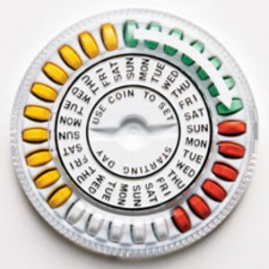
Combined Oral Contraceptives (COC):
Method of administration of monthly pills:
Pills are better taken same time of day
For 21 days; starting on day 5 / ending at day 26.
This is followed by a 7 day pill free period
To improve compliance; a formulation of 28 pills
The first 21 pills are medicated
Followed by the last 7 pills (dummy pills).

Slide 10
Combined Oral Contraceptives (COC):
Seasonal Pills
Are known as Continuous / Extended cycle  Cover 91 days schedule
Taken continuously for 84 days, break for 7 days
Has very low doses of both estrogens and progestins
Benefit: It lessens menstrual periods to 4 times a year (1 period every 3 months)  useful in those who have pain from endometriosis and can prevent migraines during period.
Disadvantages: Higher incidence of breakthrough bleeding during early use.

Slide 11
Combined Oral Contraceptives (COC):
Monthly Pills
Currently, their formulation is improved to mimic the natural on going changes in hormonal profile.
Accordingly we have now the phase formulations
Monophasic (a fixed amount of estrogen & progestin)
Biphasic (2 doses)(a fixed amount of estrogen, while amount of progestin increases stepwise in the second half of the cycle)
Triphasic (3 doses)(amount of estrogen; fixed or variable & amount of progestin increases stepwise in 3 phases).

Slide 12
 | Estrogen (mg) |  | Progestin (mg)
Monophasic combination tablets
Loestrin 21 1/20 | Ethinyl estradiol | 0.02 | Norethindrone acetate | 1.0
Desogen, Apri, Ortho-Cept | Ethinyl estradiol | 0.03 | Desogestrel | 0.15
Brevicon, Modicon, Necon 0.5/35 | Ethinyl estradiol | 0.035 | Norethindrone | 0.5
Demulen 1/35 | Ethinyl estradiol | 0.035 | Ethynodiol diacetate | 1.0
Nelova 1/35 E, Ortho-Novum 1/35 | Ethinyl estradiol | 0.035 | Norethindrone | 1.0
Ovcon 35 | Ethinyl estradiol | 0.035 | Norethindrone | 0.4
Demulen 1/50 | Ethinyl estradlol | 0.05 | Ethynodiol dlacetate | 1.0
Ovcon 50 | Ethinyl estradlol | 0.05 | Norethindrone | 1.0
Ovral-28 | Ethinyl estradiol | 0.05 | _{D,L}-Norgestrel | 0.5
Norinyl 1/50, Ortho-Novum 1/50 | Mestranol | 0.05 | Norethindrone | 1.0
Biphasic combination tablets
Jenest-28, Ortho-Novum 10/11, Necon 10/11, Nelova 10/11
Days 1—10 | Ethinyl estradiol | 0.035 | Norethindrone | 0.5
Days 11—21 | Ethinyl estradlol | 0.035 | Norethlndrone | 1.0

Slide 13
 | Estrogen (mg) |  | Progestin (mg)
Triphaslc combination tablets
Triphasil, Tri-Levlen, Trivora
Days 1—6 | Ethinyl estradlol | 0.03 | _{L}-Norgestrel | 0.05
Days 7—11 | Ethinyl estradiol | 0.04 | _{L}-Norgestrel | 0.075
Days 12—21 | Ethinyl estradiol | 0.03 | _{L}-Norgestrel | 0.125
Ortho-Novum 7/7/7, Necon 7/7/7
Days 1—7 | Ethiriyl estradiol | 0.035 | Norethindrone | 0.5
Days 8—14 | Ethinyl estradiol | 0.035 | Norethindrone | 0.75
Days 15—21 | Ethinyl estradiol | 0.035 | Norethindrone | 1.0
Ortho-TrI-Cyclen
Days 1—7 | Ethinyl estradiol | 0.035 | Norgestimate | 0.18
Days 8—14 | Ethinyl estradiol | 0.035 | Norgestlmate | 0.215
Days 15—21 | Ethinyl estradiol | 0.035 | Norgestimate | 0.25

Slide 14
Combined Oral Contraceptives (COC): (Adverse Drug Reactions)
A. Estrogen Related
B. Progestin Related
Nausea and breast tenderness
Headache
Skin Pigmentation
Impair glucose tolerance (hyperglycemia)
 incidence of breast, vaginal & cervical cancer??
Cardiovascular - major concern a. Thromboembolism b. Hypertension
 frequency of gall bladder disease
Nausea, vomiting & headache
Slightly higher failure rate
Fatigue
Depression of mood
Menstrual irregularities
Weight gain
Hirsutism
Masculinization (Norethindrone)
Ectopic pregnancy.

Slide 15
Combined Oral Contraceptives (COC): (Contraindications of estrogen containing pills)
Thrombophlebitis / thromboembolic disorders
CHF or other causes of edema
Vaginal bleeding of undiagnosed etiology
Known or suspected pregnancy
Known or suspected breast cancer, or estrogen-dependent neoplasms
Impaired hepatic functions
Dyslipidemia, diabetes, hypertension, migraine…..
Lactating mothers – use progestin - only pills (mini pills)
N.B. Obese Females, Smokers, Females > 35 years
better given progestin only pills
Notes:
Estrogen cause autoimmune hepatitis and damage liver

Slide 16
Combined Oral Contraceptives (COC): (Interactions)
Medications that cause contraceptive failure: ( i.e. impairing absorption & CYT P450 Inducers)
Antibiotics that interfere with normal GI flora → ↓absorption and ↓ enterohepatic recycling → ↓ its bioavailability.
Microsomal Enzyme Inducers → ↑ catabolism of OC. (Phenytoin , Phenobarbitone, Rifampin)
Medications that ↑ COC toxicity: (i.e. CYT P450 inhibitors)
Microsomal Enzyme Inhibitors; ↓ metabolism of OC → ↑ toxicity. (Acetaminophen, Erythromycin, SSRIs.)
Medications of altered clearance (↓) by COC: ↑ toxicity
WARFARIN, Cyclosporine, Theophylline.

Slide 17
Types ORAL CONTRACEPTIVE (OC) Pills According to composition & intent of use
COMBINED Pills (COC)
MINI Pills (POP)
MORNING-AFTER Pills
Contain only a progestin (97%effective)
Contains only a progestin  as norethindrone or desogestrel….
Mechanism of Action:
The main effect is  increase cervical mucus, so no sperm penetration & therefore, no fertilization.

Slide 18
Mini Pills
Indications:
Are alternative when oestrogen is contraindicated (e.g.: during breast feeding, hypertension, cancer, smokers over the age of 35).
Contraceptives containing only a progestin
Should be taken every day, the same time, all year round
I.M injection e.g. medroxy progesterone acetate 150 mg every 3 months..

Slide 19
Morning-after pills
Indications:
When desirability for avoiding pregnancy is obvious:
Unsuccessful withdrawal before ejaculation
Torn, leaking condom
Missed pills
Exposure to teratogen e.g. Live vaccine
Rape

Slide 20
Morning-after pills
Post Coital Contraception
Emergency Contraception
Composition | Method of Administration | Timing of 1st dose After Intercourse | Reported Efficacy
Ethinyl estadiol + Levonorgestrel | 2 tablets twice with 12 hrs in between | 0- 72hrs | 75%
High-dose only Ethinyl estadiol | Twice daily for 5 days | 0- 72hrs | 75 - 85%
High dose only levonorgestrel | Twice daily for 5 days | 0- 72hrs | 70 – 75%
Mifepristone (Antiprogestin) ± Misoprostol (Pg) | A single dose | 0- 120 hrs | 85 - 100%

Slide 21
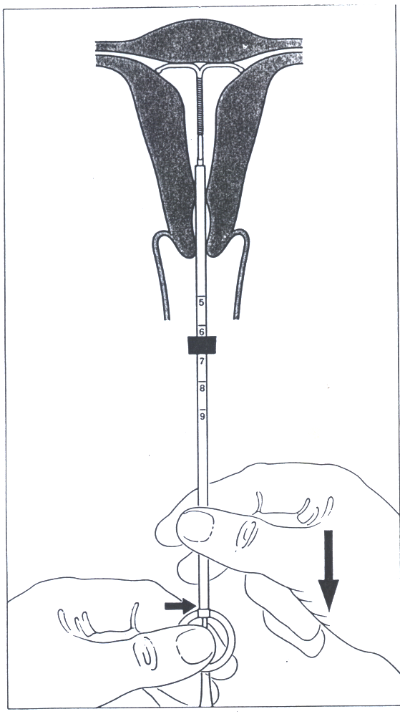
Intrauterine Device
(IUD)

Slide 22
Contraceptive Diaphragm

Slide 23
Vaginal ring

Slide 24
Questions ???

