Slide 1

Teratogens and drugs of abuse in pregnancy
Prof. Hanan Hagar Dr. Ishfaq Bukhari Pharmacology Unit College of Medicine

Slide 2
Los
The students should be able to know:
Factors affecting drug placental transfer
Harmful effects of drugs during different stages of development
FDA classifications of drugs.
Teratogenic drugs
Adverse effects of drugs
Drugs of abuse

Slide 3
Medications in pregnancy
Majority of pregnant women are exposed to medications during pregnancy.
Unless absolutely necessary, drugs should not be used during pregnancy because many can harm the fetus.
Fetal effects of most of the therapeutic agents are unknown for about one-half of medications.
About 2 to 3 % of all birth defects result from the use of drugs.

Slide 4
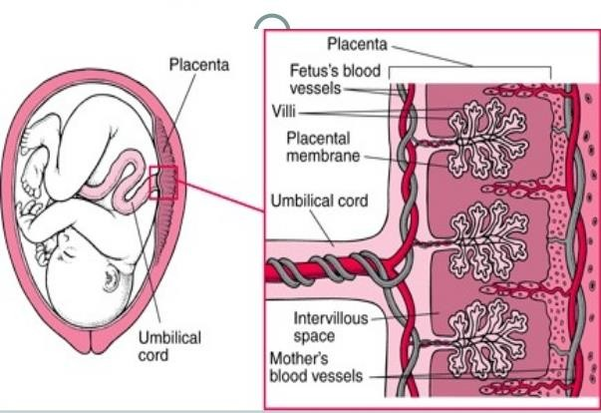
How drugs can cross placenta?

Slide 5
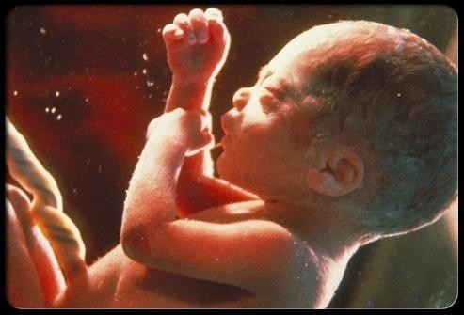
How drugs can cross placenta?
Most drugs can cross placenta through the placental membrane (semi-permeable).
Thus drugs in the mother's blood can cross this membrane into fetal blood vessels in the villi and pass through the umbilical cord to the fetus.

Slide 6
Factors controlling placental drug transfer
Physiochemical properties of the drug
  Lipid solubility or diffusion.
  Molecular size.
  Protein binding.
The stage of placental and fetal development at the time of exposure to the drug.
Duration of exposure to the drug.

Slide 7
I. Physiochemical properties of the drug
Lipid solubility of the drug:
Lipophilic drugs
diffuse readily across the placenta and enter fetal circulation. e.g. Thiopental→ crosses placenta & causes sedation, apnea in newborn infants.
Ionized drugs
cross the placenta very slowly → very low conc. in the fetus e.g. Succinylcholine & pancuronium

Slide 8
Molecular size of the drug
MW affects the rate of transfer:
250 - 500 cross placenta easily.
500 - 1000 cross placenta with more difficulty.
↑ 1000 can not cross placenta e.g. Heparin

Slide 9
Protein binding
Protein binding in maternal circulation hinders passage of drugs
e.g propythiouracil and chloramphenicol

Slide 10
The stage of mammalian fetal development
Harmful action of drugs depend upon stage of fetal development at time of drug exposure.
Mammalian fetal development passes through three phases:
  Blastocyst formation (1 up to 16 days).
  Organogenesis (17-60 days).
  Histogenesis & maturation of function (8 weeks onwards).

Slide 11
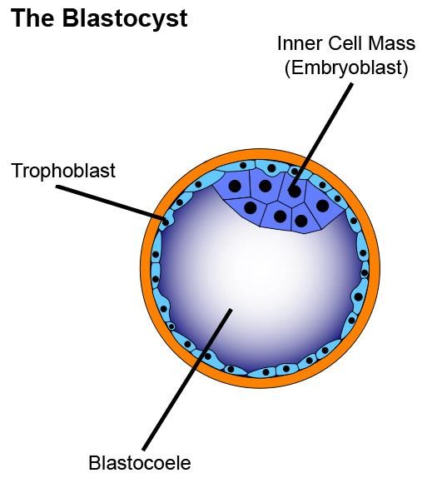
Blastocyst formation (First 2 weeks)
Occurs from (1-16 days) in the first trimester.
Period of dividing zygote and implantation
Pre-differentiated period (conceptus).
Drugs have an all-or-n
Exposure to harmful d period→ Prenatal death
othing effect.
rugs during this & abortion.

Slide 12
Organogenesis: (2-8 weeks)
is the process by which cells specialize and organize to form the tissues and organs of an organism.
Occurs in (17- 60 days) in the first trimester.
The most sensitive period of pregnancy.
Exposure to harmful drugs → major birth defect in body parts or major congenital malformation.

Slide 13
Histogenesis and functional maturation (8 weeks onwards)
Growth and fetal development occur during this stage.
Fetus depends upon nutrients & hormonal supply.
Exposure to drugs can cause “Function problems” rather than “gross malformation”

Slide 14
Histogenesis and functional maturation
Exposure to drugs during 2nd and 3rd will not induce major malformation but drugs can produce minor morphologic abnormalities, growth retardation and functional defects.

Slide 15
II. The stages of mammalian fetal development First trimester (week 1- week 12)
Blastocyst formation (all or none). Organogenesis: major congenital malformations (teratogenesis).
Second & Third trimesters: (week 13-week 28) affect growth & fetal development
Near Term: (week 29-week 40)
adverse effects on neonates or labor after delivery

Slide 16
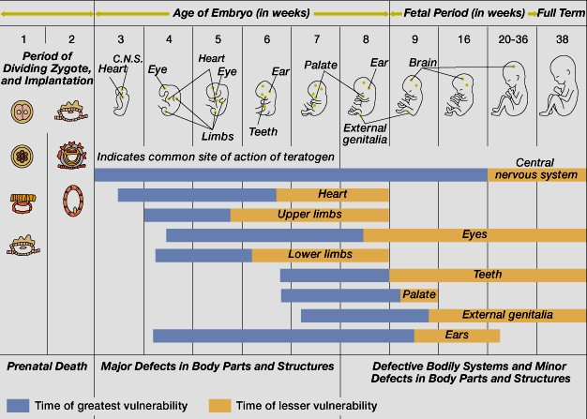
Critical Periods of Human Development

Slide 17
Teratogenesis
Occurrence of congenital defects of the fetus.
What are teratogens?
are substances that may cause permanent birth defects via a toxic effect on an embryo or fetus.
Examples medication, street drug, chemicals, diseases, environmental agents.
This could be severe during critical periods of development e.g. (organogenesis).

Slide 18
FDA Classification System
Category A
Adequate and well-controlled human studies have failed to demonstrate a risk to fetus
Drugs can be used
Category B
No risk in animal studies
No adequate and well-controlled human studies
Drugs can be used in pregnancy

Slide 19
FDA Classification System
Category C
Adverse effects on the fetus in animals only
No adequate and well-controlled studies in humans.
Drug may be used in serious situation despite its potential risk.

Slide 20
FDA Classification System
Category D
Positive evidence of human fetal risk based on adverse reaction data from studies in humans, investigational or marketing experience.
May be used in serious diseases or life threatening situations.

Slide 21
FDA Classification System
Category X
Proven fetal abnormalities in animal and human studies
the risks involved in the use of the drug in pregnant women clearly outweigh potential benefits.
Drugs are teratogens and contraindicated in pregnant women or planning to conceive.

Slide 22
FDA Classification System
Category | Characteristics | Examples
A | Controlled human studies show no risk | Folic acid Thyroxine
B | Animal studies ok No human data | Paracetamol Erythromycin
C | Animal studies are not ok No human data Risk can not be ruled out | morphine
D | Positive evidence of risk Benefits outweigh risks | Antiepileptics
X | Contraindicated in pregnancy | Thalidomide

Slide 23
Proven teratogens
The following drugs are contraindicated during pregnancy (category X):
Thalidomide (sedative/ hypnotics ).
Retinoids
Lithium
Alcohols
Cytotoxic drugs
  Folate antagonists (methotrexate).
  Alkylating agents (cyclophosphamide).
Anticonvulsant drugs (valproic acid).

Slide 24
Proven teratogens
Anticoagulants (warfarin).
Antibiotics (tetracyclines, quinolones)
ACEIs
Ionizing radiation (diagnostic X-ray or radiation therapy).
Radioactive iodine (I¹³¹).
Corticosteroids.
Hormones

Slide 25
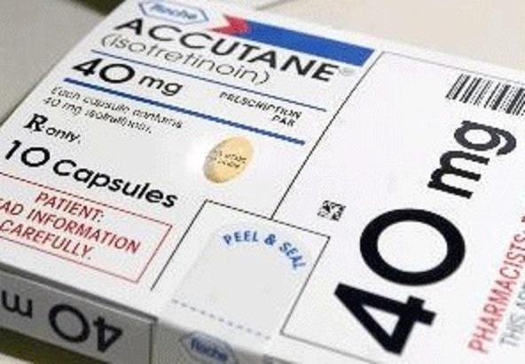
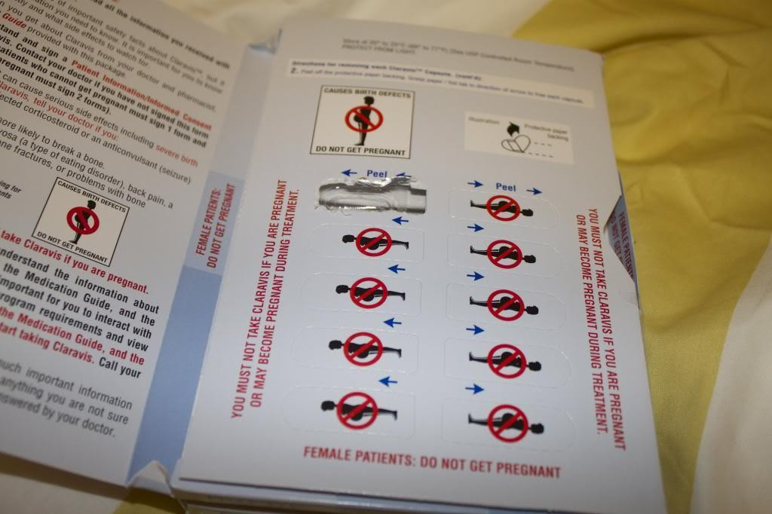
Proven teratogens
Retinoids e.g.
  vitamin A ( should be limited to 700 μg/day)
  isotretinoin (used in treatment of acne)

Slide 26
Teratogenesis of drugs
Thalidomide | Phocomelia shortened or absent long bones of the limbs
Alcohol | Fetal Alcohol Syndrome (FAS) Microcephaly Craniofacial abnormalities Intrauterine growth retardation CVS abnormalities CNS abnormalities (attention deficits, intellectual disability, mental retardation)

Slide 27
Teratogenesis of drugs
Phenytoin | Fetal Hydantoin Syndrome Nail & Digital hypoplasia Oral Clefts (cleft lip and palate) Cardiac Anomalies
Valproic acid | Neural tube defect (spina bifida) Antiepileptic drug Impairs folate absorption
Tetracyclines | Altered growth of teeth and bones Permanent teeth staining Enamel hypoplasia
Warfarin | Hypoplasia of nasal bridge CNS malformation

Slide 28
Corticosteroids | Cleft lip and Palate
Hormones Estrogens Androgens Diethylstilbestrol | Serious genital malformation Testicular atrophy in male fetus Fetal masculinization in female fetus Vaginal carcinoma of female offspring

Slide 29
Lithium | Ebstein's anomaly Cardiovascular anomalies mainly valvular heart defect involving tricuspid valve
ACE inhibitors Captopril Enalapril | Renal damage Fetal & neonatal anurnia Fetal hypotension Hypo- perfusion Growth retardation ACE inhibitors disrupt the fetal renin- angiotensin system, which is essential for normal renal development

Slide 30



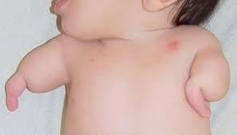
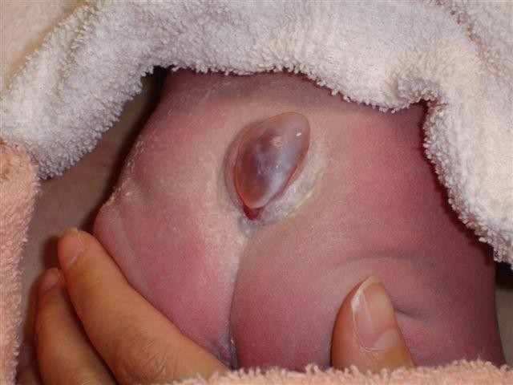
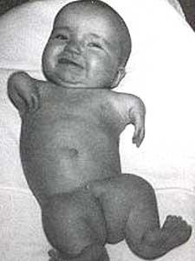


Spina bifida
Phocomelia
Thalidomide
Valproic acid

Slide 31
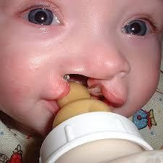

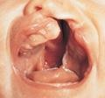

Cleft lip and palate
Fetal hydantoin syndrome

Slide 32
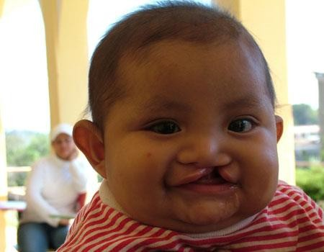
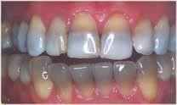
Cleft lip
Teeth staining
Corticosteroids and
phenytoin
Tetracycline

Slide 33
Adverse effects of drugs
During second and third trimesters
Some drugs can produce adverse effects on the fetus more likely than major malformations due to their pharmacological actions.
Affect growth & fetal development

Slide 34
Adverse effects of drugs
Tetracyclines | Impaired teeth & bone development, yellow-brown discoloration of teeth
Aminoglycosides | Streptomycin, kanamycin Ototoxicity = 8th Cranial nerve damage
Cloramphenicol | Gray baby syndrome
Corticosteroids | Adrenal atrophy – growth retardation
Propranolol | Bradycardia, neonatal hypoglycemia, placental insufficiency, reduced uterine blood flow, fetal distress
Antithyroid drugs | Iodide, methimazole, carbimazole, propylthiouracil, risk of neonatal hypothyroidism and goiter

Slide 35
Adverse effects of drugs
NSAIDs | e.g. Aspirin-indomethacin Prostaglandin synthesis inhibitors Constriction of ductus arteriosus (close prematurely), pulmonary hypertension in newborns Increase in gestation time, prolong labor, Neonatal bleeding Risk of postpartum hemorrhage
Benzodiazepines as Diazepam | Chronic use → neonatal dependence and withdrawal symptoms
ACEIs | Renal damage
warfarin | Risk of bleeding

Slide 36
Adverse effects of drugs prior to labor or near term
CNS depressants | e.g. diazepam, morphine Interference with suckling Respiratory depression Reduced blood flow, fetal distress
Sulfonamides | can displace bilirubin from albumin (neonatal hyperbilirubinemia, Jaundice)

Slide 37
Hypertension in pregnancy
Contraindicated
- •
ACE inhibitors
Angiotensin II receptor blockers
Thiazide diuretics
Propranolol
Calcium channel blockers in mild hypertension
Probably safe α- methyl dopa Labetalol
Emergency Hydralazine Labetalol

Slide 38
Coagulation disorders in pregnancy
Contraindicated
warfarin is contraindicated in all trimesters Cross placenta
1st trimester : teratogenicity 2nd, 3rd : risk of bleeding
Probably safe Heparin
Polar, does not cross placenta
The antidote, protamine sulphate is available

Slide 39
Antithyroid drugs in pregnancy
Are used in thyrotoxicosis or Grave’s disease
Propylthiouracil
Methylthiouracil (Methimazole)
Carbimazol
Radioactive Iodine (I¹³¹)
All can cross placenta
All have risk of congenital goiter and hypothyroidism The lowest dose of antithyroid drugs should be used.
Propylthiouracil is preferable over others.

Slide 40
Antibiotics in pregnancy
Contraindicated :
Tetracyclines: Teeth and bones deformity
Quinolones as ciprofloxacin: arthropathy (bone and cartilage damage)
Aminoglycosides: ototoxicity
Sulfonamides: neonatal jaundice-kernicterus
Chloramphenicol: Gray baby syndrome
Probably safe
Penicillins: (ampicillin, amoxicillin)
Cephalosporins
Macrolides (erythromycin and azithromycin) as alternative in penicillin-sensitive individuals BUT erythromycin estolate should be avoided (risk of hepatic injury to mother).

Slide 41
Drugs of choice in pregnancy
Antihypertensive | α-methyl dopa Labetalol (α - β Blocker) Hydralazine (emergency only)
Antibiotics | penicillin, cephalosporins, erythromycin
Antidiabetics | Insulin, avoids oral antidiabetics
Anticoagulants | Heparin
Analgesics | Acetaminophen
Antithyroid drugs | Propylthiouracil (protein-bound)
Anticonvulsants | All antiepileptics have potential to cause malformations avoid valproic acid (highly teratogenic) Folic acid supplementation prevents neural tube defects in women receiving AEDs

Slide 42
Drugs of Abuse in Pregnancy

Slide 43
Drug abuse
Drug abuse:
Habitual use of drugs not for therapeutic purposes but for alteration of one's mood or state of consciousness.

Slide 44
Drug abuse
The most commonly abused drugs are alcohol; barbiturates; benzodiazepines, opium alkaloids
amphetamines; cocaine; nicotine; marijuana.
Drug abuse may lead to organ damage, dependence, addiction, and disturbance of behavior.

Slide 45
Alcohols
The use of alcohol is contraindicated during all trimesters of pregnancy

Slide 46
Fetal Alcohol Syndrome (FAS)
Caused by chronic maternal alcohol
abuse during early weeks of first trimester of pregnancy.
Characters
  Microcephaly
  Low weight birth
  Craniofacial abnormalities
  CVS abnormalities
  CNS abnormalities (attention deficits, intellectual disability, mental retardation)

Slide 47

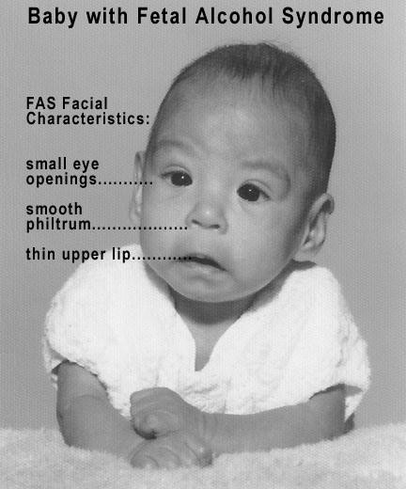
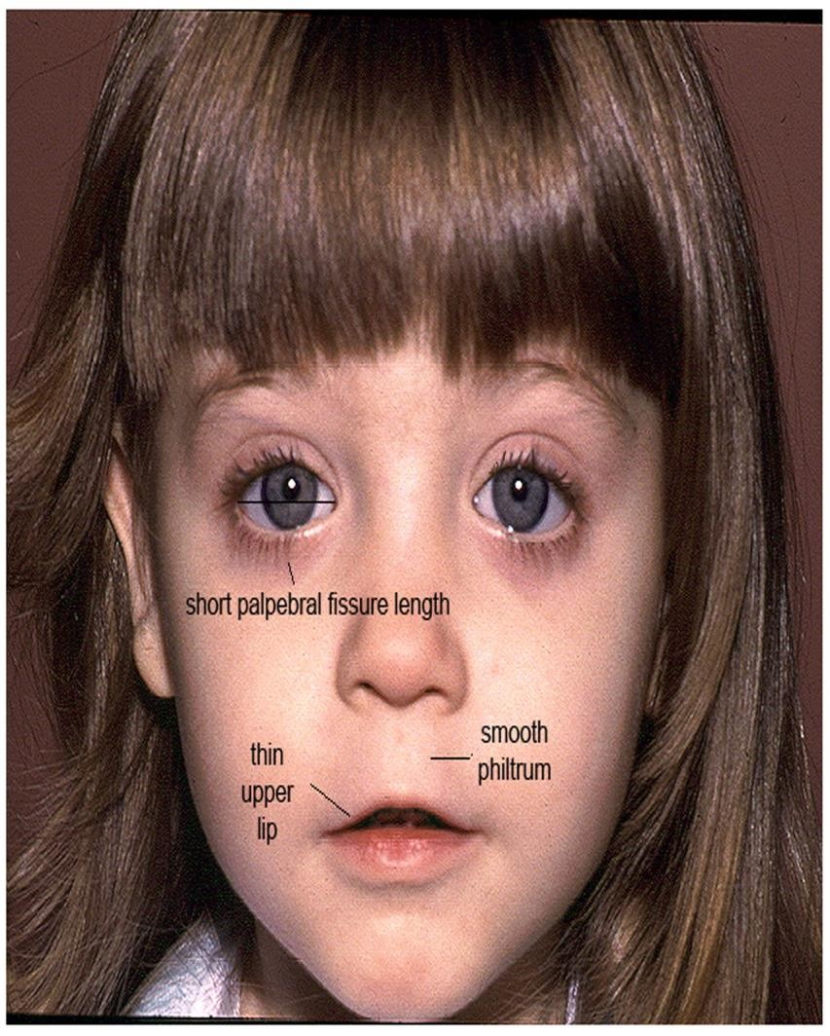
Fetal Alcohol Syndrome ( FAS )

Slide 48
Cocaine
Cocaine has low molecular weight, easily passes into fetus through placenta.
Inhibits re-uptake of sympathomimetics (epinephrine, NE, dopamine), causing vasoconstriction, rapid heart rate, hypertension (Vascular disruption).
It decreases blood flow to uterus and fetal oxygenation (Hypoxia).
It increases uterine contractility

Slide 49
Cocaine
Microcephaly
Prematurity
Intrauterine growth retardation.
Placental abruption (separation of placenta from uterus wall before delivery)
Growth retardation
Mental retardation

Slide 50
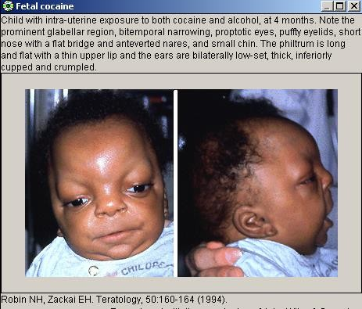

Slide 51
Tobacco
Tobacco contains nicotine and carbon monoxide that may harm fetus. No evidence it causes birth defects but Tobacco can increase risk of:
Reduced blood flow to placenta
Fetal hypoxia
Retarded fetal growth
Low birth weight
Spontaneous abortion
Prematurity (Preterm labor)
Perinatal mortality

Slide 52
Conclusions
The use of drugs during pregnancy should be avoided unless absolutely necessary.
Most drugs cross the placenta to some extent.
Birth defects are of great concern.
Drugs can harm the embryo or foetus depending upon the stage of foetal development.
The most critical period of pregnancy is organogenesis (2– 8 weeks).
Alcohol, nicotine and other addicting drugs should be avoided.

Slide 53






Thank you
Questions ?

