Slide 1
Tocolytics and Oxytocin
Lecture
By
Dr. Aliah Alshanwani
aalshanawani@ksu.edu.sa
Notes:
1

Slide 2
Objectives
At the end of the lectures, students should be able to know and understand the:
Drugs used to induce & augment labor
Drugs used to control post partum hemorrhage
Drugs used to induce pathological abortion
Drugs used to arrest premature labor
The mechanism of action and adverse effects of each drug.

Slide 3
DRUGS PRODUCING UTERINE CONTRACTIONS (Oxytocic Drugs )
OXYTOCIN
Syntocinon
ERGOT ALKALOIDS
Ergometrine (Ergonovine)
Methyl ergometrine (methyl ergonovine)
PROSTAGLANDINS
PGE2
PGF2α
PGE1 (misoprostol).

Slide 5
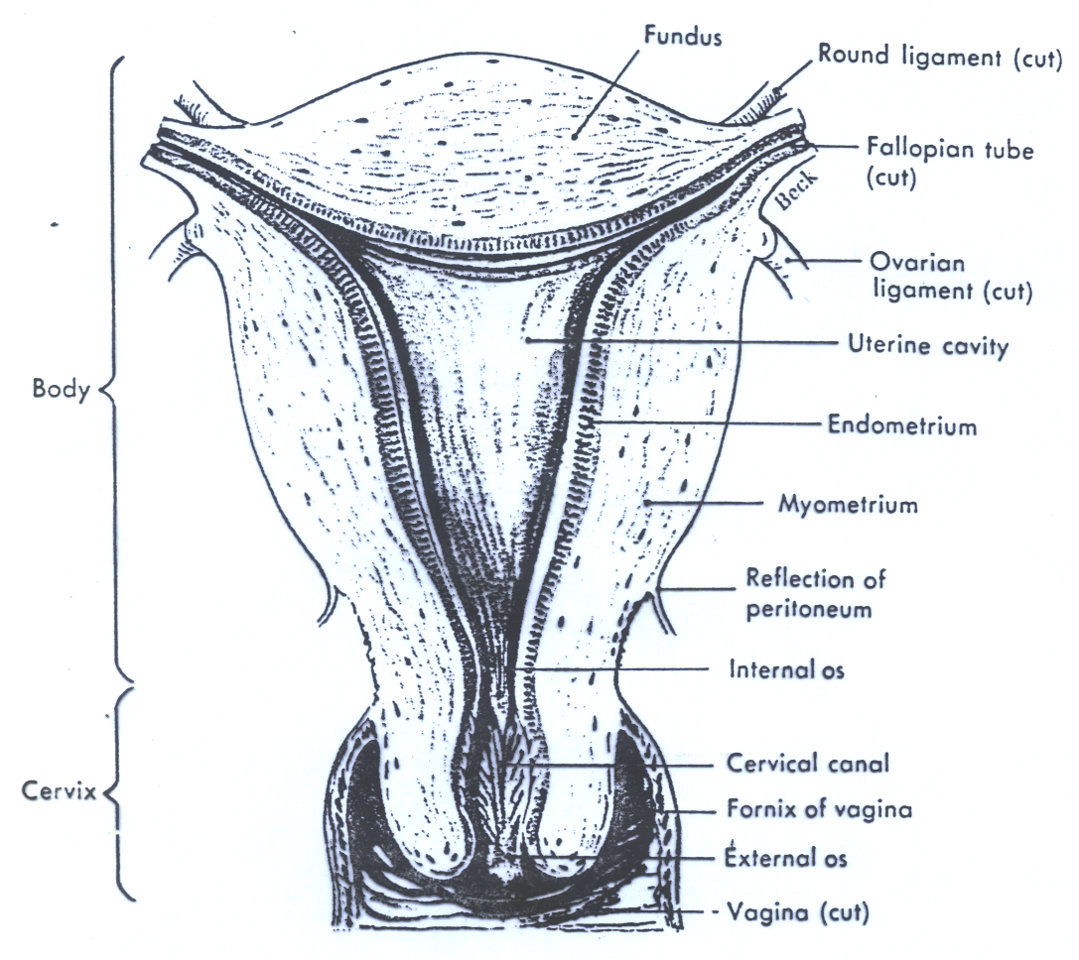

Slide 6
Role of oxytocin
Uterus
Stimulates both the frequency and force of uterine contractility particularly of the fundus segment of the uterus.
These contractions resemble the normal physiological contractions of uterus (contractions followed by relaxation).

Slide 7
Role of oxytocin (cont.)
Immature uterus is resistant to oxytocin
Contract uterine smooth muscle only at term
Sensitivity increases to 8 folds in last 9 weeks and 30 times in early labor
Clinically oxytocin is given only when uterine cervix is soft and dilated.

Slide 8
Role of oxytocin
Myo-epithelial cells
Oxytocin contracts myoepithelial cells surrounding mammary alveoli in the breast & leads to milk ejection.

Slide 9
Pharmacokinetics of oxytocin
Absorption, Metabolism and Excretion
Not effective orally (destroyed in GIT)
Administered i.v. (augment labor)
Also as nasal spray (impaired milk ejection)
Not bound to plasma proteins
Eliminated by liver & kidneys
Half life = 5 minutes.

Slide 10
Mechanism of action
Oxytocin acts through G protein-coupled receptors & the phosphoinositide-calcium 2nd-messenger system to contract uterine smooth muscle
The interaction of endogenous or administered oxytocin with myometrial cell membrane receptor promotes :
the influx of Ca⁺⁺ from extra cellular fluid & from S.R. into the cell, this increase in cytoplasmic Ca⁺⁺ , stimulates uterine contraction.
S.R. Sarcoplasmic Reticulum

Slide 12
Therapeutic Uses of Oxytocin
Synthetic preparations of oxytocin; e.g. syntocinon are preferred.
Induction & augmentation of labor* (slow I.V infusion)
Mild preeclampsia near term
Uterine inertia
Incomplete abortion
Post maturity
Maternal diabetes
Notes:
Preeclampsia: is a pregnancy characterized by high blood pressure and signs of damage to other organs
Uterine inertia: failure of uterine to contract and expel fetus cause feline dystocia (عسر ولادة)
No evidence that OXT can help in diabetes insipidus however it decreased in type 1 DM and highly obese

Slide 13
Therapeutic Uses of Oxytocin
Post partum uterine hemorrhage (I.V drip)
(ergometrine is often used ??)
Impaired milk ejection
One puff in each nostril 2-3 min before nursing.
Notes:
Because ergometrine has direct effect on blood vessels as vasoconstrictor since it is an partial agonist to alpha adrenergic receptors in blood vessels

Slide 14
Oxytocin Side Effects
Maternal death due to hypertension
Uterine rupture
Fetal death (ischemia)
Water intoxication if oxytocin is given with relatively large volumes of electrolyte-free aqueous iv fluid.
Notes:
Oxytocin cause severe hypotension and tachycardia due to decrease peripheral vascular resistance
Water intoxication due to anti-diuretics hormone-like effect of oxytocin which leads to decease free water clearance

Slide 15
Oxytocin Contraindications
Hypersensitivity
Prematurity
Abnormal fetal position
Evidence of fetal distress
Cephalopelvic disproportion
Incompletely dilated cervix.
Notes:
Fetal distress: fetus not feeling well and not receiving enough oxygen
CPD: when fetus head is too large and not fit into mother pelvis

Slide 16
Oxytocin Precautions
Multiple pregnancy
Previous c- section
Hypertension.

Slide 17
Ergot Alkaloids
Natural
Ergometrine (Ergonovine)
Is a fungus that grow on rye & contains pharmacologically active substances.
Synthetic
Methyl ergometrine (Methylergonovine)
Notes:
Ergot poisoning>>> abortion

Slide 18
Effects on the Uterus
Ergot alkaloids induce TETANIC CONTRACTION of uterus without relaxation in between (not like normal physiological contractions)
It causes contractions of uterus as a whole i.e. fundus and cervix (tend to compress rather than to expel the fetus)
Difference between oxytocin & ergots??

Slide 19
Ergot alkaloids (pharmacokinetics)
Absorption, fate and excretion
Can be given orally & absorbed from GIT (tablets)
Usually given I.M
Extensively metabolized in liver
90% of metabolites are excreted in bile.

Slide 20
Clinical uses
Post partum hemorrhage (3rd stage of labor)**
When to give it?
Preparations:
Syntometrine (ergometrine 0.5 mg + oxytocin 5.0 I.U) , I.M.
Notes:
Immediately after delivery of the baby

Slide 21
Ergot alkaloids Side effects
Nausea, vomiting, diarrhea
Hypertension
Vasoconstriction of peripheral blood vessels (toes & fingers)
Gangrene.

Slide 22
Ergot Contraindications:
Induction of labor
1st and 2nd stage of labor
vascular disease
Severe hepatic and renal impairment
Severe hypertension

Slide 23
PROSTAGLANDINS
PGE2 – Dinoprostone
Vaginal suppository/gel
Extra- amniotic solution
PGF2α- Dinoprost, Carboprost
Intra-amniotic injection
Misoprostol (synthetic PGE1).
Notes:
Extra-amniotic route of administration: space between fetus membrane and endometrium

Slide 24
Prostaglandins therapeutic uses
Induction of abortion in early & late pregnancy (pathological)**
Induction of labor (fetal death in utero)
Postpartum hemorrhage.
Notes:
Chromosomal or genetic correlations

Slide 25
Difference between PGs and Oxytocin:
PGs promote coordinated contraction of uterine smooth muscle not only at term (as with oxytocin), but throughout pregnancy
PGs soften/relax the cervix; whereas oxytocin does not
PGs have longer duration of action than oxytocin.

Slide 26
Prostaglandins side effects
Nausea , vomiting
Abdominal pain
Diarrhea
Bronchospasm (PGF2α)
Flushing (PGE2).

Slide 27
Prostaglandins
Contraindications:
Mechanical obstruction of delivery
Fetal distress
Predisposition to uterine rupture
Precautions:
Asthma
Multiple pregnancy
Glaucoma
Uterine rupture

Slide 28
Difference between Oxytocin and Prostaglandins
Prostaglandins | Oxytocin | Character
Contraction through out pregnancy | Only at term | Contraction
soften the cervix | Does not soften the cervix | Cervix

Slide 29
Difference (cont’d)
Prostaglandins | Oxytocin | Character
Longer | Shorter | Duration of action
Induce abortion in 2nd trimester of pregnancy Used as vaginal suppository for induction of labor. | Induce and augment labor & post partum hemorrhage | Uses

Slide 30
Difference b/w Oxytocin and Ergometrine
Ergometrine | Oxytocin | Character
Tetanic contraction ; doesn't resemble normal physiological contractions | Resembles normal physiological contractions | Contractions
Only in postpartum hemorrhage | To induce & augment labor Post partum hemorrhage | Uses
Moderate onset Long duration of action | Rapid onset Shorter duration of action | Onset and Duration

Slide 31
UTERINE RELAXANTS

Slide 32
DRUGS PRODUCING UTERINE RELAXATION (Tocolytic Drugs )
Action and Uses:
Relax the uterus and arrest threatened abortion or delay premature labor.
β-Adrenoceptor agonists**
Ritodrine, i.v. drip
Selective β₂ receptor agonist used specifically as a uterine relaxant.

Slide 33
β- adrenoceptor agonists
Mechanism of action
Bind to β-adrenoceptors , activate enzyme Adenylate cyclase, increase in the level of cAMP reducing intracellular calcium level.

Slide 34
β- adrenoceptor agonists Side Effects
Tremor
Nausea , vomiting
Flushing
Sweating
Tachycardia (high dose)
Hypotension
Hyperglycemia
Hypokalemia.

Slide 35
CALCIUM CHANNEL BLOCKERS
Nifedipine
Causes relaxation of myometrium
Markedly inhibits the amplitude of spontaneous and oxytocin-induced contractions.

Slide 36
CALCIUM CHANNEL BLOCKERS Side effects
Headache, dizziness
Hypotension
Flushing
Constipation
Ankle edema
Coughing
Wheezing
Tachycardia.

Slide 37
Atosiban
New tocolytic agent
Compete with oxytocin at its receptors on the uterus.
Given by IV infusion for 48 hrs

Slide 38
Thank u

