Slide 1
LECTURE 4 PHYSIOLOGY OF UTERINE CYCLE
Dr. Laila Al Dokhi
Associate Professor
Department of Physiology

Slide 2
Objectives
By the end of this lecture, you should be able to:
Describe the normal menstrual cycle
Discuss the structural changes that occur in the endometrium during the menstrual cycle
Describe phases of the menstrual cycle
Describe the hormonal control of the menstrual cycle
Describe the major disorders of the menstrual cycle
Describe the physiology of menopause
Keywords: proliferative phase, secretory phase, amenorrhea, menorrhagia, menopause

Slide 3
Monthly endometrial cycle and menstruation:
Associated with monthly cyclical production of estrogens & progesterone by the ovaries the endometrial lining of the uterus pass through the following stages.
1- Proliferative phase (estrogen phase) of the endometrial cycle, occurring before ovulation:
At the beginning of each cycle, most of the endometrium has been desquamated by menstruation.
After menstruation only thin layer of the endometrial stroma remains & the deeper portions of the glands &crypts of the endometrium
Under the influence of estrogens, secreted in large quantities by the ovaries, the stromal cells & epithelial cells proliferate rapidly.
The endometrial surface re-epitheliazed within 4-7 days after the beginning of menstruation.
Before ovulation the endometrium thickness increase, due to increase numbers of stromal cells &progressive growth of the glands & new blood vessels.
At the time of ovulation, the endometrium is 3-5 mm thick. The endometrial glands in cervical region secrete a thin, stringy mucus which help to guide sperm in the proper direction from the vagina into the uterus.

Slide 4
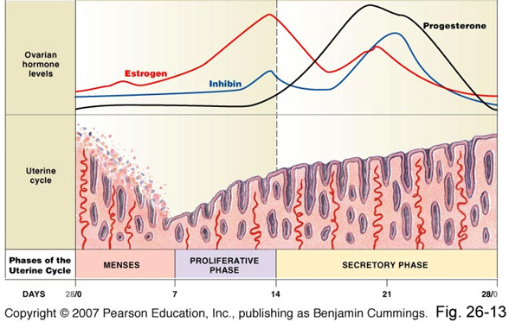
Phases of uterine cycle

Slide 5
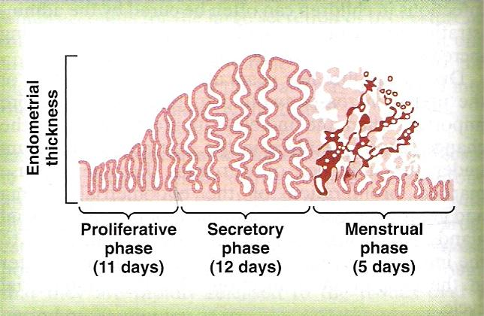

Slide 6
2- Secretory phase (progestational phase) of the endometrial cycle, occurring after ovulation:
After ovulation, estrogen & progesterone are secreted in the later part of the monthly cycle by the corpus luteum.
Estrogen cause slight proliferation in the endometrium Progesterone causes marked swelling & secretory development of the endometrium.
The glands increase in tortuosity, excess secretory substances accumulate in the glands.
Stromal cells cytoplasm increases
Lipid &glycogen deposits increases in the stromal cells
Blood supply to the endometrium increases and become more tortuous.
1 week after ovulation, endometrium thickness is 5-6 mm.
The secretory changes prepare the endometrium (stored nutrients) for implantation of the fertilized ovum .
Uterine secretions called “uterine milk” provide nutrition for the diving ovum.
The trophobastic cells on the surface of the implanted ovum begin to digest the endometrium & absorb endometrial stored substances.

Slide 7
Menstruation:
If the ovum is not fertilized, about 2 days before the end of the monthly cycle, the corpus luteum involutes & estrogens & progesterone decrease to low levels.
Due to decrease estrogen & progesterone there is decrease stimulation of the endometrium, followed by involution of the endometrium to about 65% of its previous thickness.
During the 24 hrs preceding the menstruation, there is vasospasm of the tortuous blood vessels due to release of vasoconstrictor (prostaglandins).
There is
1) Vasospasm
2) Decrease nutrients to the endometrium
3)Loss of hormonal stimulation,
All initiate necrosis in the endometrial blood vessels.
Gradual necrosis of the outer layer of the endometrium leads to separation from the uterus at the site of the hemorrhages
Within 48 hrs, all the superficial layers of the endometrium desquamated in the uterine cavity.
- The mass of desquamated tissue & blood plus the contractile effects of prostaglandins initiate contractions which expel the uterine contents.

Slide 8
In normal menstruation, about 40 ml of blood + 35 ml of serous fluid are lost.
The menstrual blood is normally non-clotting due to the presence of fibrinolysin.
Within 4 to 7 days after menstruation, the loss of blood ceases & the endometrium become re-epithelialized.
Leukorrhea during menstruation:
During menstruation, leukocytes are released with the necrotic material & blood so the uterus is highly resistant to infection (protective mechanism).

Slide 9
Feedback oscillation of the hypothalamic-pituitary-ovarian system:
Postovulatory secretion of the ovarian hormones, and depression of the pituitary gonadotropins:
During the postovulatory phase (between ovulation & beginning of menstruation) the corpus luteum secrete large quantities of both progesterone &estrogen & inhibin which all together cause negative feedback effect on AP & hypothalamus to inhibit both FSH & LH secretion.
(lowest level 3-4 days before the onset of menstruation)

Slide 10
Definition of menopause:
The period during which the cycle ceases & the female sex hormones diminish to almost none.
It occurs at the age of 40 to 50 years
When estrogens production falls below the critical value, estrogens no longer inhibit the production of gonadotropins (FSH & LH).
The reproductive cycle becomes irregular,
Ovulation fails to occur &the cycle ceases.
With advanced age the ovaries become unresponsive to gonadotropins (decline in the number of primodial follicles), and their function declines so that reproductive cycles disappear (menopause). The ovaries no longer secrete estrogen and progesterone.
The uterus and vagina atrophy.
Due to removal of the negative feedback effect there is increased secretion of FSH and LH.

Slide 11
Physiological changes due to loss of estrogens
“hot flushes” characterized by extreme flushing of the skin.
Psychic sensations and dyspnea.
Irritability.
Fatigue.
Anxiety.
Occasionally various psychotic states.
decreased strength and calcification of bones throughout the body.

Slide 12
Abnormalities of menstrual cycle
Amenorrhea: Is absence of menstrual period either
Primary amenorrhea in which menstrual bleeding has never occurred.
Secondary amenorrhea cessation of cycles in a woman with previously normal periods, causes:
Pregnancy (is the most common cause)
Emotional stimuli and changes in the environment.
Hypothalamic diseases (↓ GnRH pulses)
Pituitary disorders
Primary ovarian disorders and various systemic disease.
Menorrhagia: Refer to abnormally profuse flow during regular periods.
Hypomenorrhea: Refer to scanty flow.
Dysmenorrheal: Painful menstruation (cramps due to accumulation of prostaglandins in the uterus
can be treated with inhibitors of prostaglandin synthesis).

