Slide 1
Physiology of pregnancy
Dr. Hana Alzamil

Slide 2
Objectives
Describe Fertilization & implantation of the blastocyst into the endometrium.
Recognize the development and normal physiology of the placenta
Describe the physiological functions of placental hormones during pregnancy
Explain the physiological responses of mother’s body to pregnancy

Slide 3
Revision ( large group activity )
How many sperms in the ejaculated semen?
In which stage the ova is after ovulation?
What is the % of ovulated ova that can reach fallopian tube?
Can the ova that is released from the right ovary reaches the left fallopian tube?

Slide 4
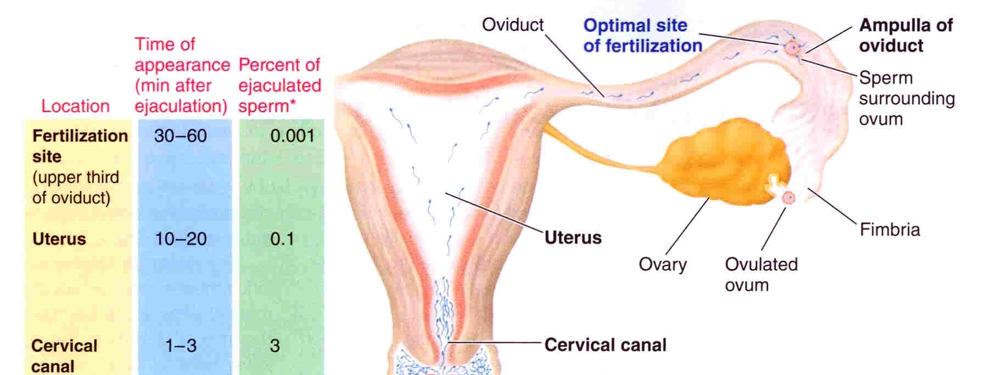
Fertilization

Slide 5
Small group activity
What are the factors that help the ovulated ova to reach the fallopian tube ?
Is there any obstacles?
What are the factors that help the sperm to travel in the female genital tract ?
Is there any obstacles?

Slide 6
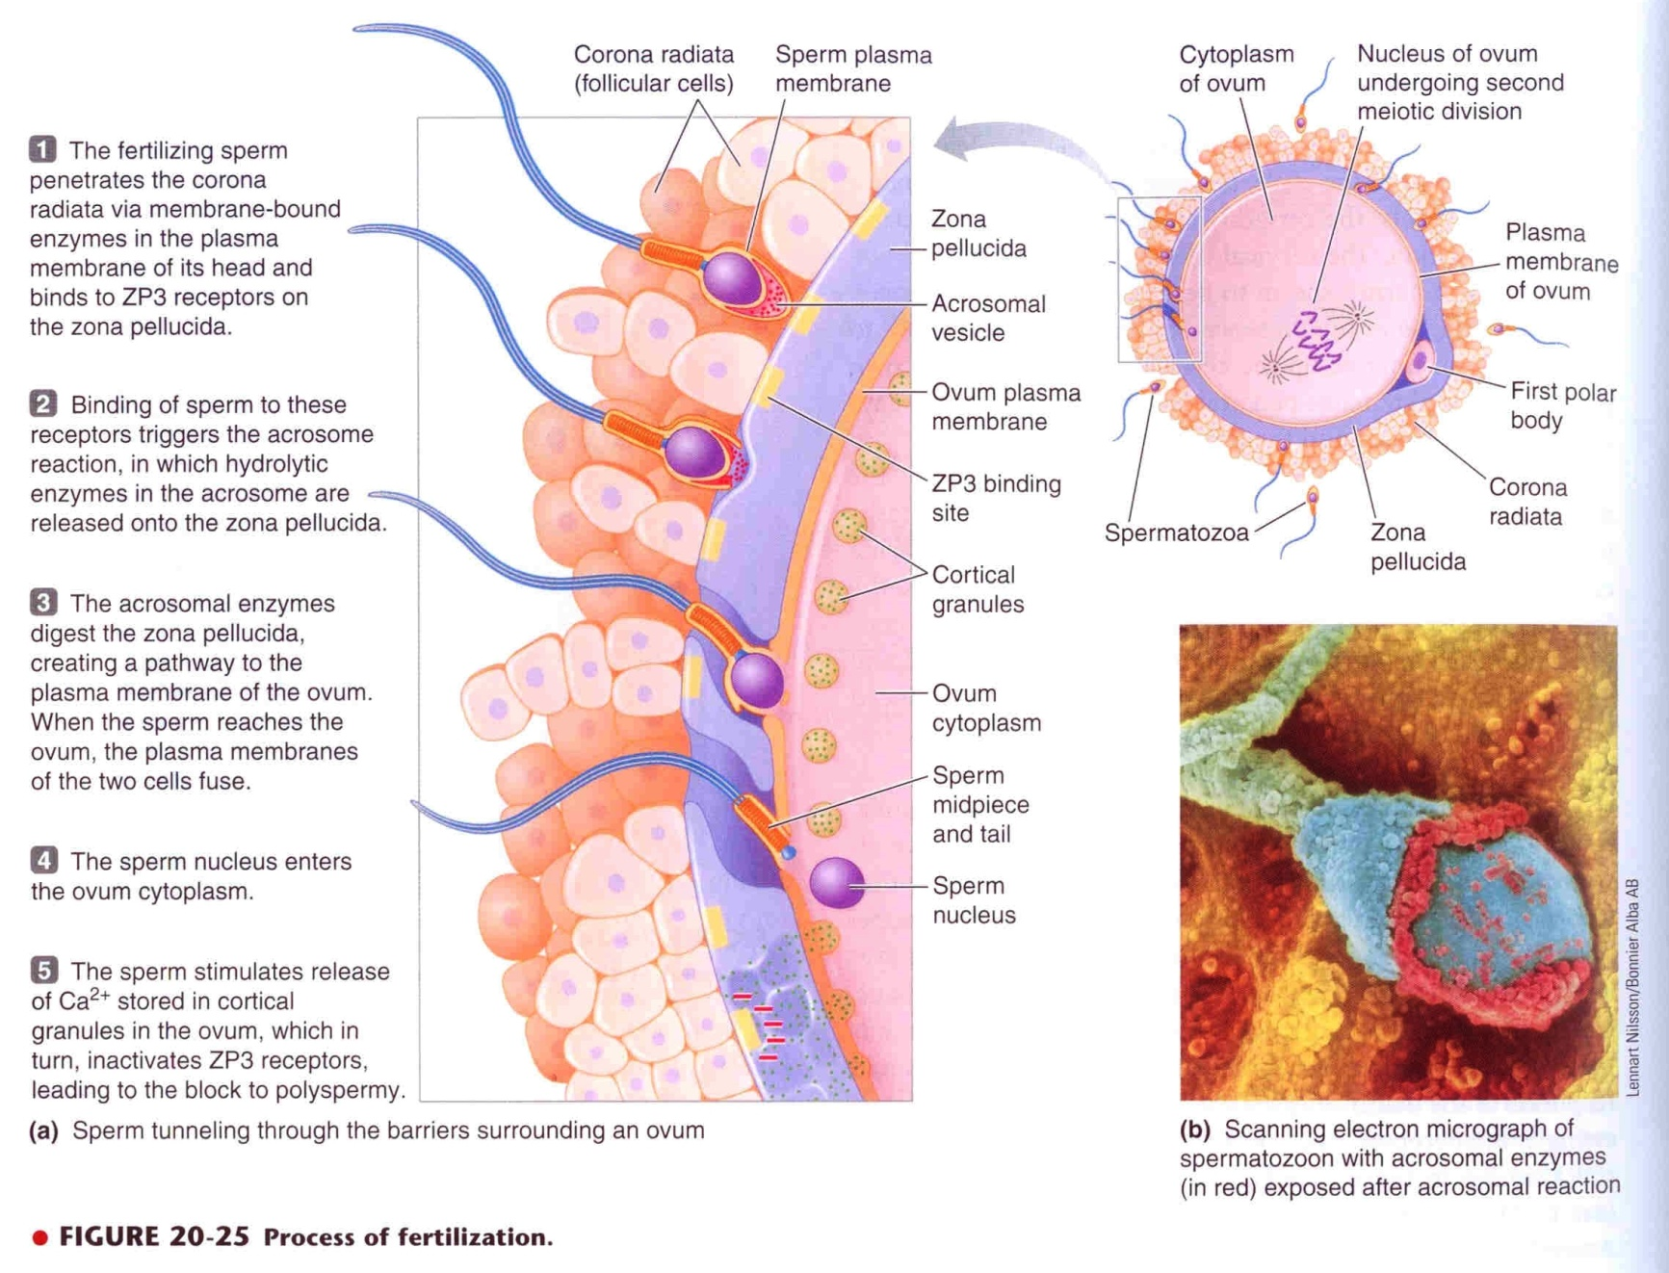
Fertilization

Slide 7
Fertilization

Slide 8
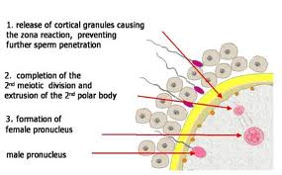
Fertilization

Slide 9
Fertilization
After ejaculation sperms reach ampulla of fallopian tube within 30-60 min (ut cont)
Sperm penetrate corona radiata and zona pellucida (hyaluronidase & proteolytic enzymes)
Oocyte divides to form mature ovum (female pronucleus 23 unpaired chr) + 2nd polar body
Head of sperm swells (male pronucleus 23 unpaired chr)
Fertilized ovum (zygote) contain 23 paired chr

Slide 10
Zygote

Slide 11
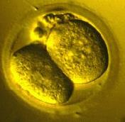
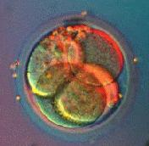
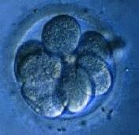
Cleavage
Following fertilization the zygote undergoes several mitotic divisions inside the zona pellucida (overall size does not change).
1st cleavage yields a 2 celled embryo,
each cell is called a blastomere and is totipotent
Divisions continue rapidly until the 32 cell stage

Slide 12
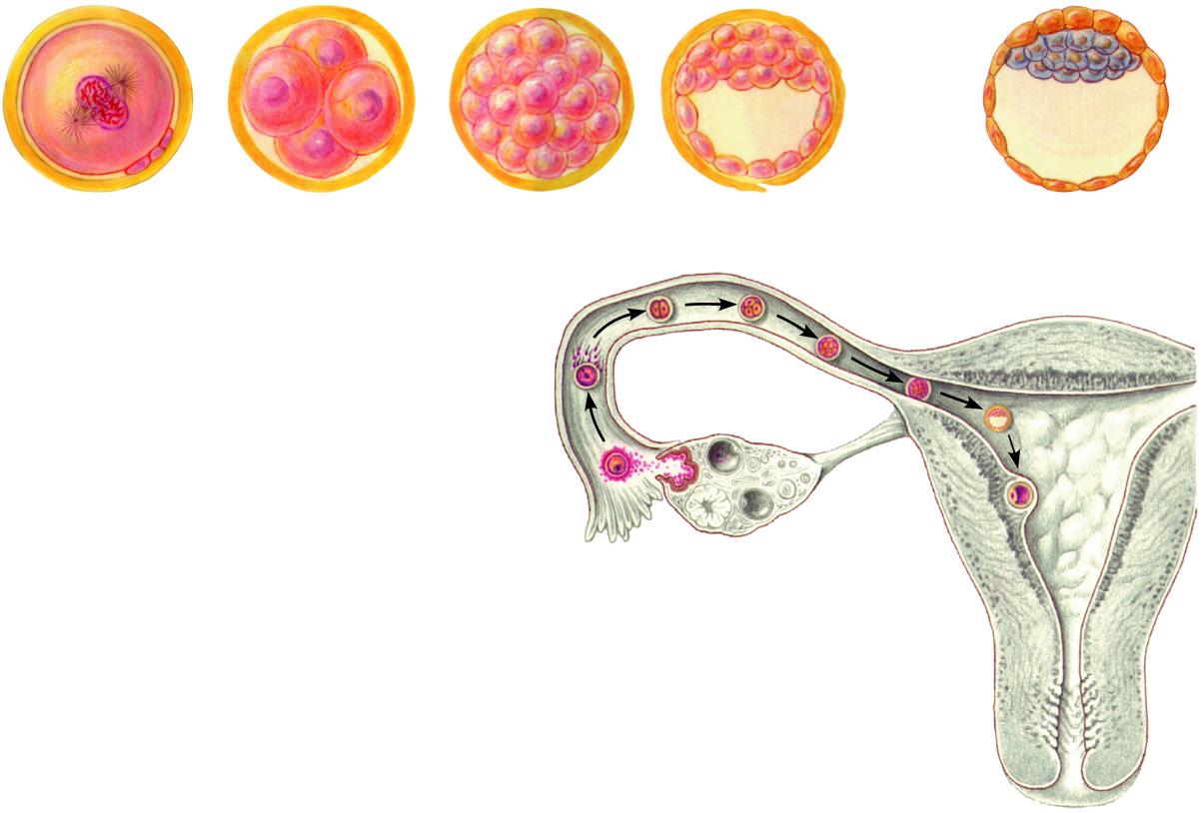
Cleavage
Blastocyst cavity
Inner cell mass
Trophoblast
(a)
Zygote (fertilized egg)
(b)
Early cleavage 4-cell stage
(c)
Morula
(d)
Early blastocyst
(e)
Late blastocyst (implanting)
(b)
(c)
Fertilization
(a)
Ovary
(d)
Uterine tube
Secondary oocyte
(e)
Ovulation
Uterus
Endometrium

Slide 13
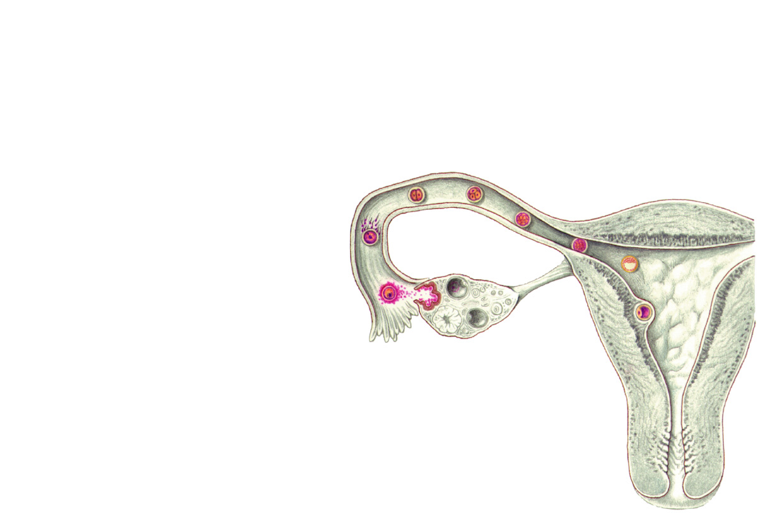
Cleavage
Ovary
Uterine tube
Secondary oocyte
Ovulation
Uterus
Endometrium
Figure 16.15, step 1

Slide 14
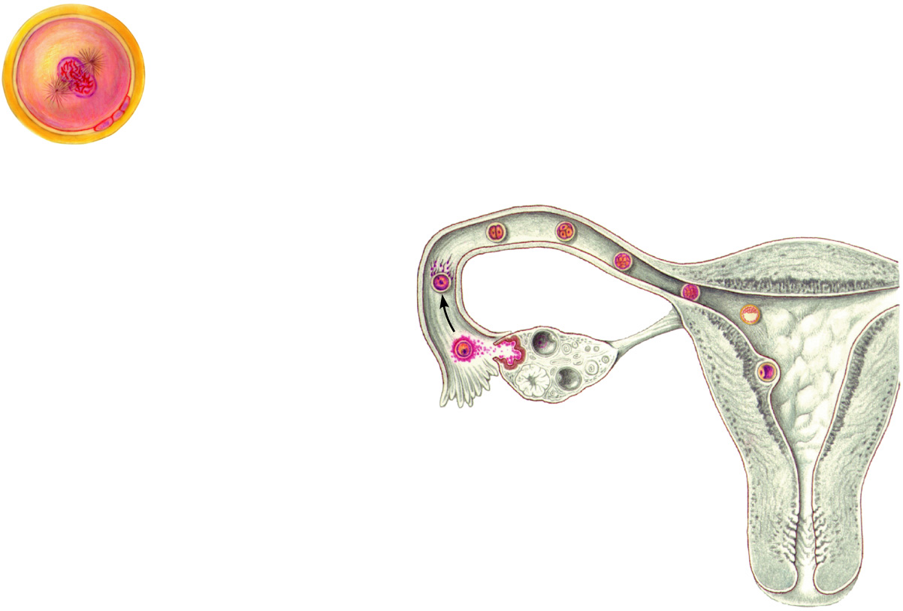
Cleavage
(a)
Zygote (fertilized egg)
Fertilization
(a)
Ovary
Uterine tube
Secondary oocyte
Ovulation
Uterus
Endometrium
Figure 16.15, step 2

Slide 15
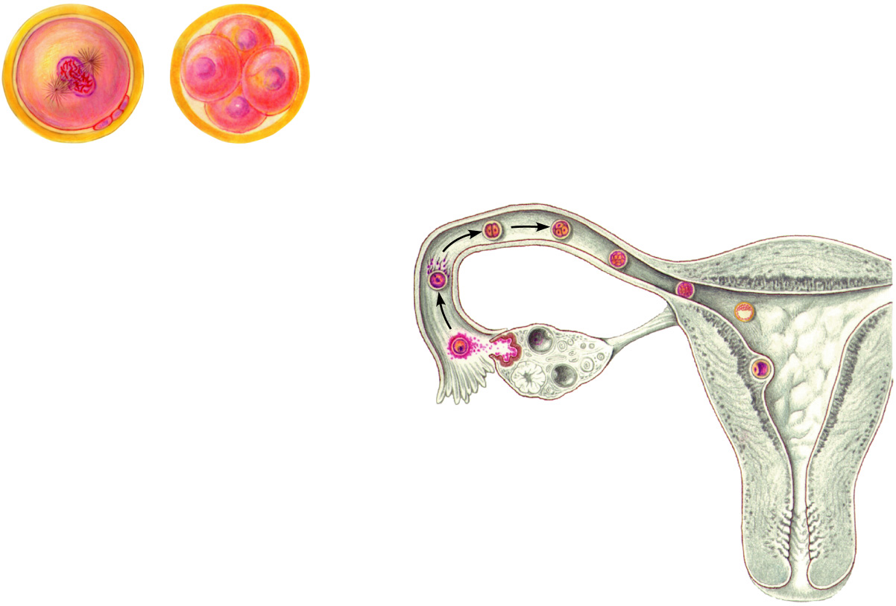
Cleavage
(a)
Zygote (fertilized egg)
(b)
Early cleavage 4-cell stage
(b)
Fertilization
(a)
Ovary
Uterine tube
Secondary oocyte
Ovulation
Uterus
Endometrium
Figure 16.15, step 3

Slide 16
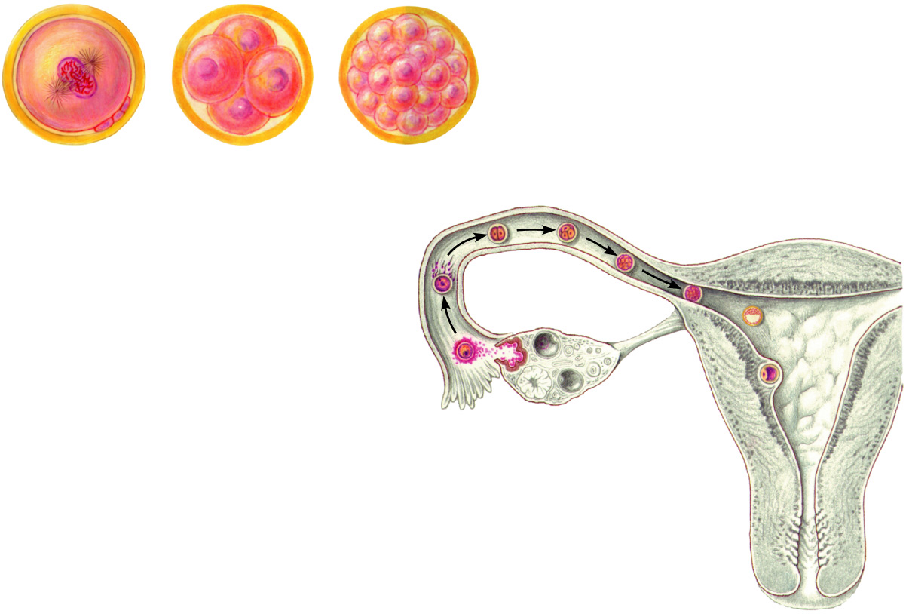
Cleavage
(a)
Zygote (fertilized egg)
(b)
Early cleavage 4-cell stage
(c)
Morula
(b)
(c)
Fertilization
(a)
Ovary
Uterine tube
Secondary oocyte
Ovulation
Uterus
Endometrium
Figure 16.15, step 4

Slide 17
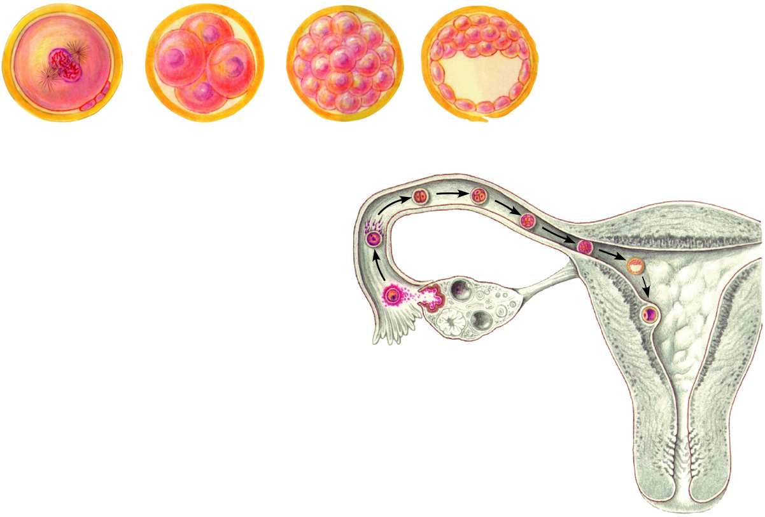
Cleavage
Blastocyst cavity
(a)
Zygote (fertilized egg)
(b)
Early cleavage 4-cell stage
(c)
Morula
(d)
Early blastocyst
(b)
(c)
Fertilization
(a)
Ovary
(d)
Uterine tube
Secondary oocyte
Ovulation
Uterus
Endometrium
Figure 16.15, step 5

Slide 18
Cleavage
Blastocyst cavity
Inner cell mass
Trophoblast
(a)
Zygote (fertilized egg)
(b)
Early cleavage 4-cell stage
(c)
Morula
(d)
Early blastocyst
(e)
Late blastocyst (implanting)
(b)
(c)
Fertilization
(a)
Ovary
(d)
Uterine tube
Secondary oocyte
(e)
Ovulation
Uterus
Endometrium

Slide 19
How does the ova survive in the fallopian tube?

Slide 20
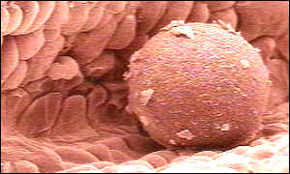
Traveling
Zygote begins to divide as it travels through oviduct
Nutrition of blastocyst (secretory cells in fallopian tube)
Effect of Progesterone on (SM) of isthmus
rugged
isthmus

Slide 21
Transport of fertilized ovum
After fertilization 3-5 days till zygote reach uterine cavity
Transport: fluid current + action of cilia + weak contractions of the fallopian tube (estrogen, PGs)
Isthmus (last 2cm) relaxes under effect of progesterone
Delayed transport allows cell division
Blastocyst (100 cells) enters the uterus

Slide 22
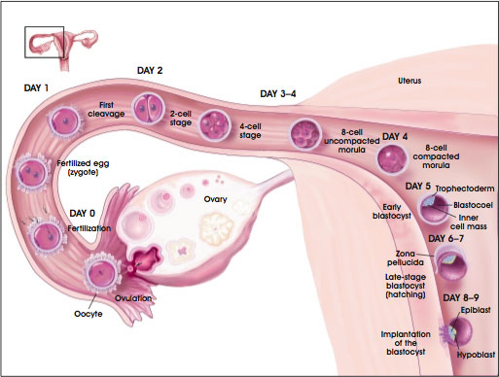
Transport of fertilized ovum

Slide 23
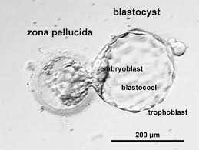
Hatching

Slide 24
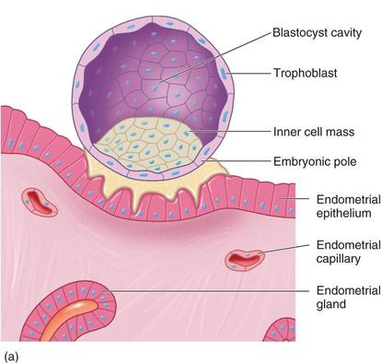
Blastocyst differentiation

Slide 25
Implantation
Digestion of endometrium
Decidual cells (glycogen, proteins, lipids & minerals)
(‏ والله أنبتكم من الأرض نباتا‏)
يسمي علماء الأجنة عملية إنغراس النطفة الأمشاج المنقسمة والتي تعرف باسم الأرومة
المتكيسة في جدار الرحم باسم عملية الاستنبات أو الاستزراع

Slide 26
Placenta
Trophoblastic cords from blastocyst
Blood capillaries grow in the cords
21 days after fertilization blood start to be pumped by fetal heart into the capillaries
Maternal blood sinuses develop around the trophoblastic cords
More and more trophoblast projections develop (placental villi)

Slide 27
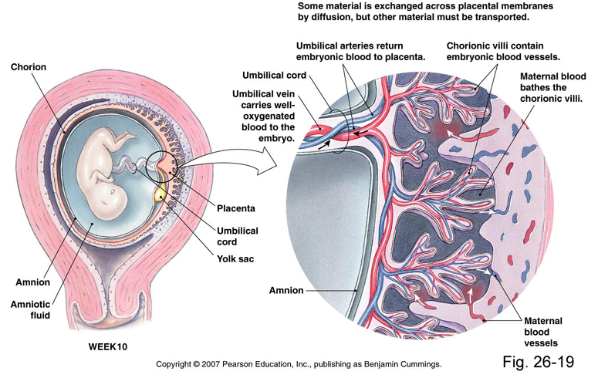
Placenta

Slide 28
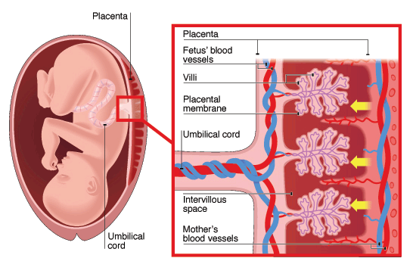

Slide 29
Function of the placenta
Major function:
Respiration
Nutrition
Excretion
Endocrine
Protection

Slide 30
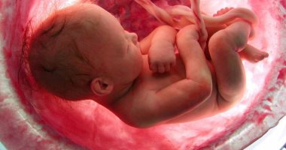
يَخْلُقُكُمْ فِي بُطُونِ أُمَّهَاتِكُمْ خَلْقًا مِنْ بَعْدِ خَلْقٍ فِي ظُلُمَاتٍ ثَلاثٍ

Slide 31
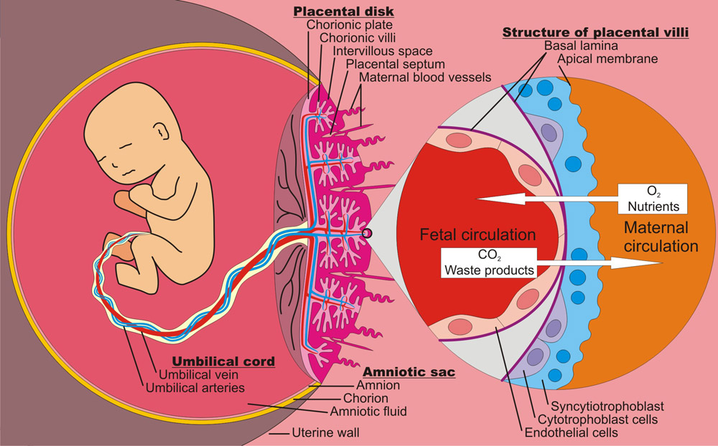
Respiration

Slide 32
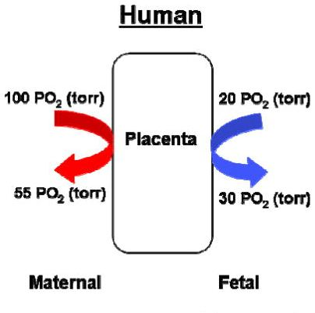
Respiration
PCO₂ 2-3 mm Hg higher in fetal than maternal blood
Dissolved O₂ in mother’s blood passes to fetal blood by simple diffusion
PO₂ 50 mm Hg (M) - 30 mm Hg (F) =20 mmHg
At low PO₂HbF carry 20-50% more O₂ than HbA (HbF has a higher oxygen carrying capacity than HbA)
HbF conc 50% higher than HbA in mother

Slide 33
Respiration
Double Bohr effect
Low pH in mother’s blood (acidic)
High pH in fetal blood (alkaline)
Important shifts of the dissociation curves take place in the placenta:
The maternal blood gains CO₂, the pH falls and the curve shifts to the right releasing additional oxygen.
On the fetal side of the placenta CO₂ is lost, the pH rises and the curve shifts to the left allowing additional oxygen uptake.

Slide 34
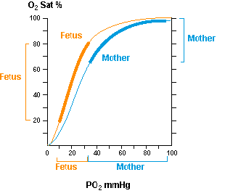
Oxygen dissociation curve

Slide 35
Important factors facilitate delivery of oxygen to the fetal tissues
High maternal intervillous blood flow (almost double the fetal placental flow)
High fetal haemoglobin (16 - 17 g/dl)
High fetal cardiac output
The fetal metabolic acidosis which shifts the curve to the right and thus aids delivery of oxygen to the tissues.

Slide 36
Respiration

Slide 37
Nutrition
Fetus uses mainly glucose for nutrition so the trophoblast cells in placental villi transport glucose by carrier molecules; GLUT (facilitated diffusion)
Fatty acids diffuses due to high solubility in cell membrane (more slowly than glucose)
The placenta actively transports all amino acids, with fetal concentrations exceeding maternal levels.
K+, Na+ and Cl- diffuses from maternal to fetal blood

Slide 38
Excretion
Excretory products of the fetus diffuse through placental membrane to maternal blood to be excreted with waste products of the mother
Urea, uric acid and creatinine
Higher conc. Of excretory products in fetal blood insures continuous diffusion of these substances to the maternal blood

Slide 39
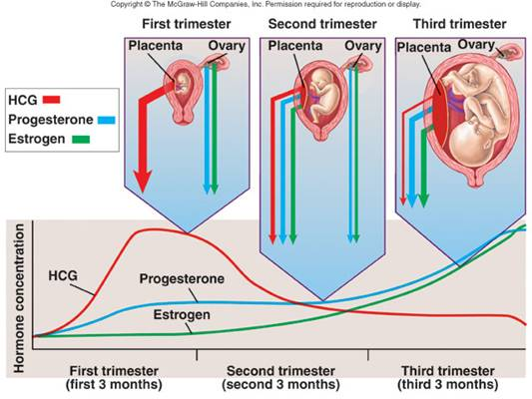
Endocrine

Slide 40
Endocrine
Human Chorionic Gonadotropin (hCG)
Glycoprotein
Most important function is to maintain corpus luteum (↑estrogen & progesterone) till 13-17 weeks of gestation
Exerts interstitial (Leyding) cell-stimulating effect on testes of the male fetus (growth of male sex organs)

Slide 41
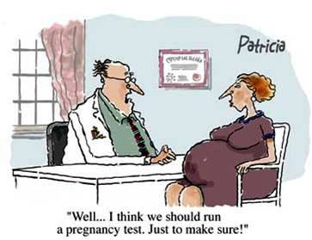
hCG level (pregnancy test)

Slide 42
Endocrine
Estrogen
Steroid hormone
Secreted by syncytial trophoblast cells
Towards end of pregnancy reaches 30×
Derived from weak androgen (DHEA) released from maternal & fetal adrenals
Functions in the mother
Enlargement of uterus, breast ducts & external genitalia
Relaxation of pelvic ligaments in preparation to labor
Activation of the uterus (gap junctions)

Slide 43
Endocrine
Progsterone
Steroid hormone
Secreted by syncytial trophoblast cells
Towards end of pregnancy reaches 10×
Derived from cholesterol
Functions in the mother
Development of the breast lobules.
Provides nutrition to developing embryo
Development of decidual cells
Inhibit the contractility of the uterus

Slide 44
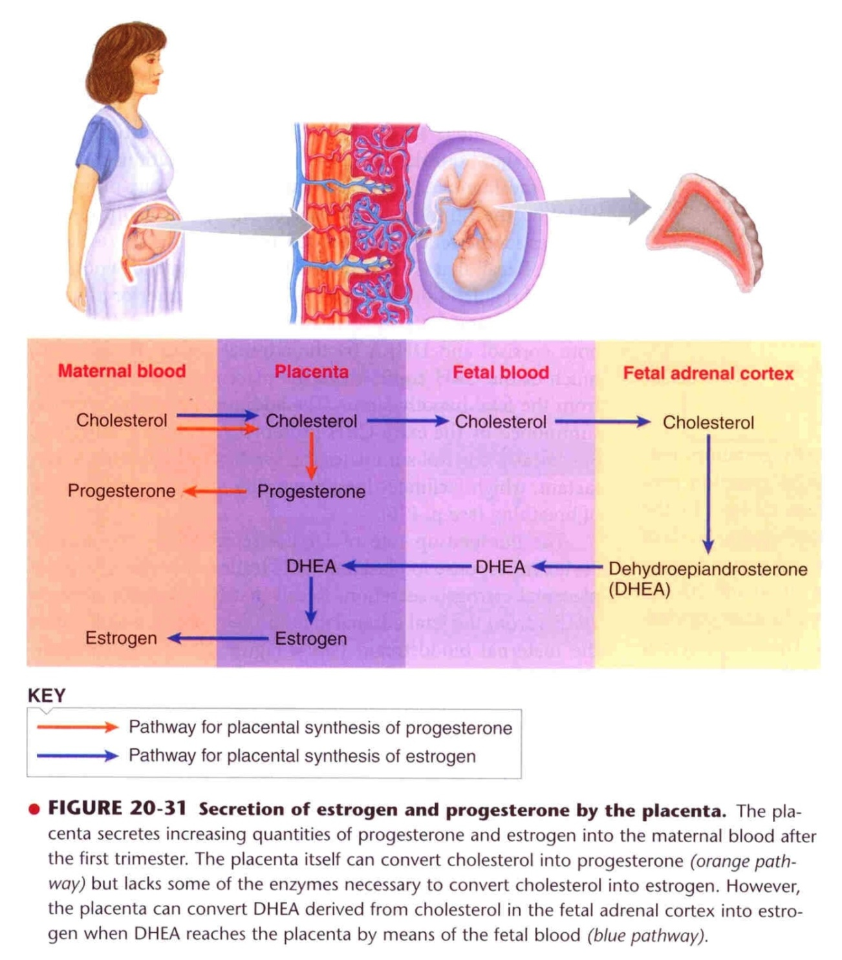

Slide 45
Endocrine
Human Chorionic Somatomamotropin
Protein hormone
Secreted by placenta around 5th gestational week
Functions in the mother
Breast development (hPL)
Weak growth hormone‘s action
Inhibit insulin sensitivity =↓ glucose utilization
Promote release of fatty acids

Slide 46
Endocrine
Relaxin
Polypeptide
Secreted by corpus luteum and placenta
Functions in the mother
Relaxation of symphysis pubic ligament (weak)
Softens the cervix at delivery

Slide 48
Physiological adaptation to pregnancy

Slide 49
Changes in maternal endocrine system
Anterior pituitary gland enlargement (50%)
Release of ACTH, TSH and PL increase
FSH and LH almost totally suppressed
Adrenal gland
Increase glucocorticoids secretion (mobilize aa)
Increase aldosterone (retain fluid)
Thyroid gland enlargement (50%)
Increase thyroxine production (hCG)
Parathyroid gland enlargement
Increase PTH secretion (maintain normal Ca⁺²)

Slide 50
Changes in different organs
Increase in uterine size (50 gm to 1100 gm)
The breasts double in size
The vagina enlarges
Development of edema and acne
Masculine or acromegalic features
Weight gain 10-12 kg (last 2 trimesters)
Increase appetite
Removal of food by fetus
Hormonal effect

Slide 51
Changes in metabolism
Increase basal metabolic rate (15%)
Increase in daily requirements for
Iron
Phosphates
Calcium
Vitamins
Vitamin D (Ca⁺² absorption)

Slide 52
Changes in circulatory system
Increase in COP (30-40%) by 27 weeks
Increase in blood flow through the placenta.
Increase in maternal blood volume (30%) due to
Increase aldosterone and estrogen (↑ ECF )
Increase activity of the bone marrow
(↑ RBCs 40%)

Slide 53
Changes in respiration
Increase in O₂ consumption (20%)
Increase BMR
Increase in body size
Growing uterus presses upwards (restriction)
Increase in respiratory rate (RR)
Increase in minute ventilation (TV× RR) 50%
Progesterone ↑ sensitivity of respiratory center (RC) to CO₂ leading to ↑ RR

