Slide 1
feMale Reproductive System - Practical
Dr. Maria A. Arafah
Associate Professor – Department of Pathology

Slide 2
Objectives
At the end of the practical classes, the medical students should be able to:
Know the normal structures of the female genital systems.
Acquire the knowledge about the gross appearances and histopathological features of the following diseases in the female genital system.

Slide 3
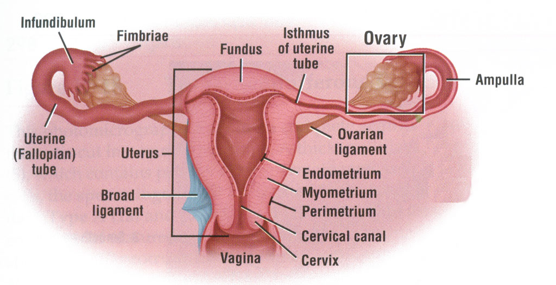
Female Reproductive System - Diagram

Slide 4
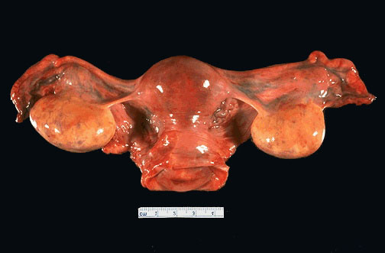
Female Reproductive System - Gross
Uterus with Cervix, Ovaries and Fallopian Tubes

Slide 5
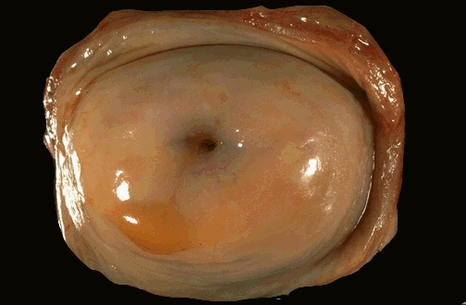
Normal Uterine Cervix - Gross
Normal cervix with a smooth, glistening mucosal surface. There is a small rim of vaginal cuff from this hysterectomy specimen. The cervical os is small and round, typical for a nulliparous woman. The os will have a fish-mouth shape after one or more pregnancies

Slide 6
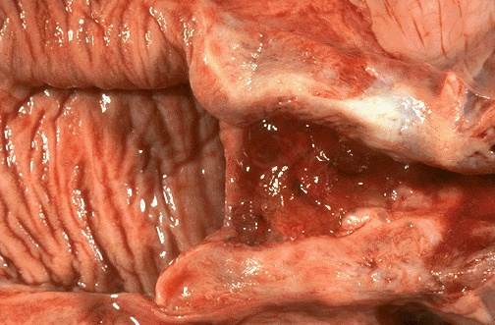
Normal Vagina & Cervix - Gross Cut section
The normal adult vaginal mucosa with a wrinkled appearance that is seen in women of reproductive years appears at the left. The cervix has been opened to reveal an endocervical canal leading to the lower uterine segment at the right. It has an erythematous appearance extending to the cervical os consistent with chronic inflammation.

Slide 7
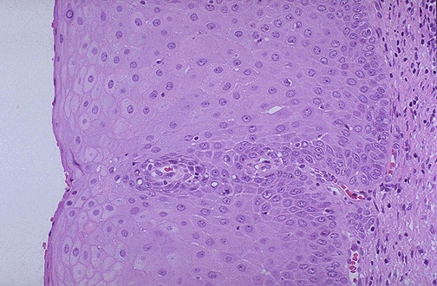
Normal Cervical Mucosa - HPF
This is normal ectocervical non-keratinizing squamous epithelium. The squamous cells show maturation from the basal layer to the surface

Slide 8
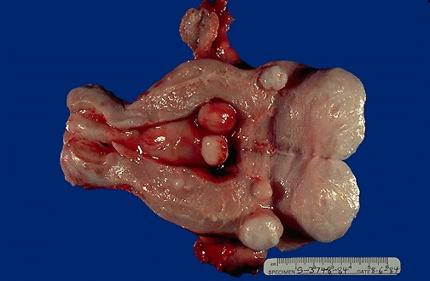
Multiple Uterine Leiomyomata - Gross
Smooth muscle tumors of the uterus are often multiple.
They are seen here as submucosal, intramural, and subserosal leiomyomata.

Slide 9
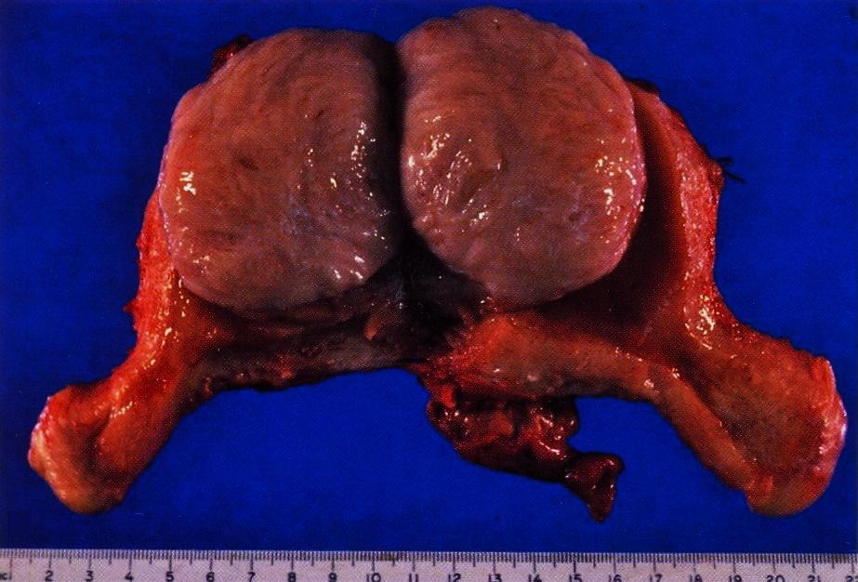
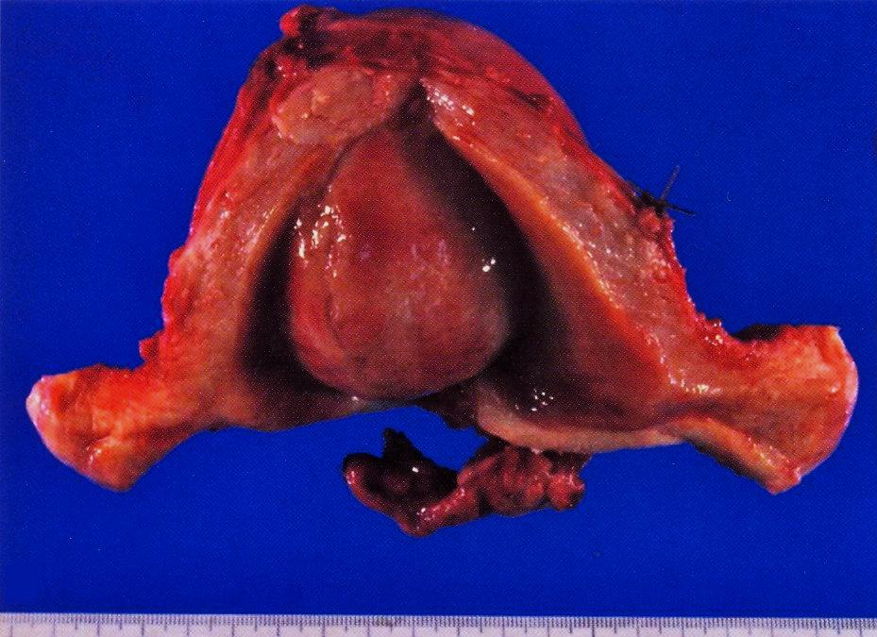
Multiple Uterine Leiomyomata - Gross
A well demarcated tumour mass in the muscle coat of
uterus without a definite capsule.

Slide 10
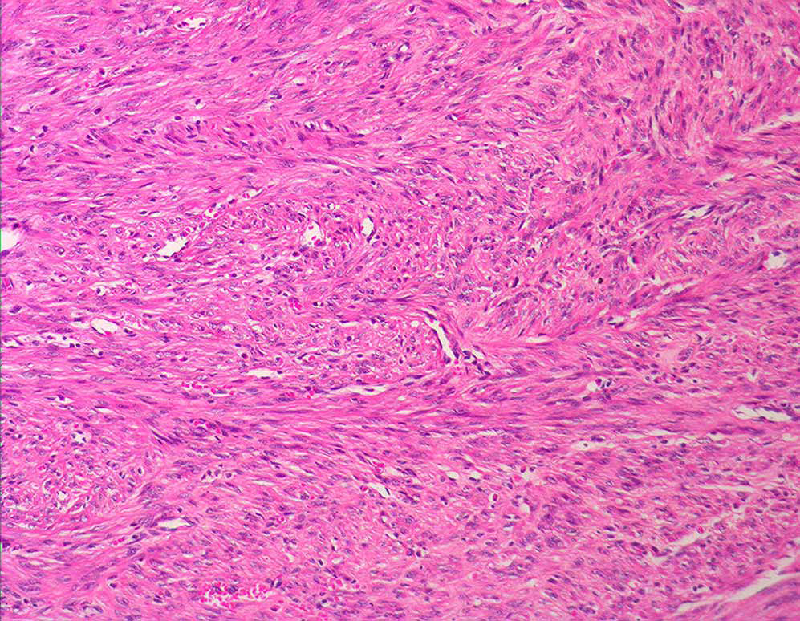
Uterine Leiomyoma – LPF
The tumour consists of interlacing bundles of smooth muscle and fibrous tissue. The muscle cells are spindle shaped with elongated nuclei and eosinophilic cytoplasm.

Slide 11
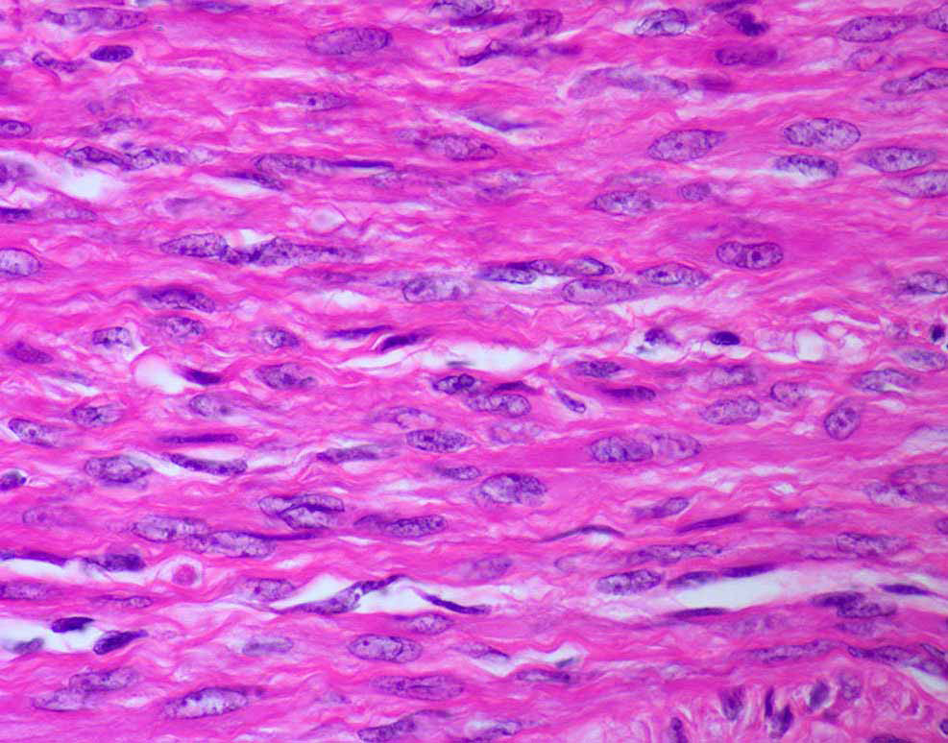
Uterine Leiomyoma – HPF
The muscle cells are spindle shaped with elongated
nuclei and eosinophilic cytoplasm

Slide 12
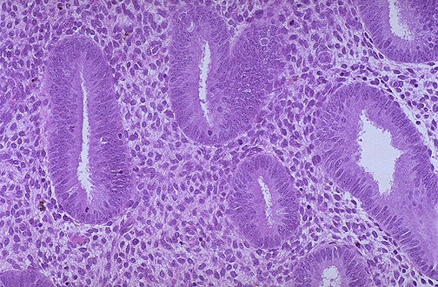
Normal Proliferative Endometrium
A normal proliferative endometrium in the menstrual cycle. The proliferative phase is the variable part of the cycle. In this phase, tubular glands with columnar cells and surrounding dense stroma are proliferating to build up the endometrium following the shedding of the previous cycle.

Slide 13
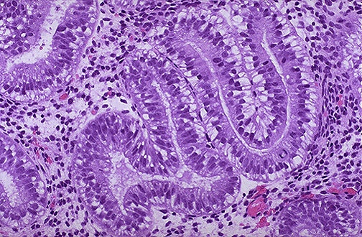
Early Secretory Endometrium
The appearance with prominent subnuclear vacuoles in cells forming the glands is consistent with post-ovulatory day 2 of the luteal phase. The histologic changes following ovulation are quite constant over the 14 days to menstruation and can be utilized to date the endometrium.

Slide 14
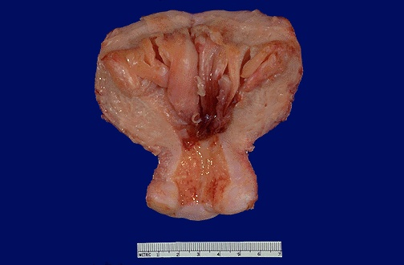
Endometrial Hyperplasia - Gross
Thick and hyperplastic endometrium.
Areas of hemorrhage.
The endometrial cavity is opened to reveal fronds of hyperplastic endometrium. Endometrial hyperplasia and carcinoma usually results with conditions of prolonged estrogen excess and can lead to metrorrhagia (uterine bleeding at irregular intervals), menorrhagia (excessive bleeding with menstrual periods), or menometrorrhagia.

Slide 15
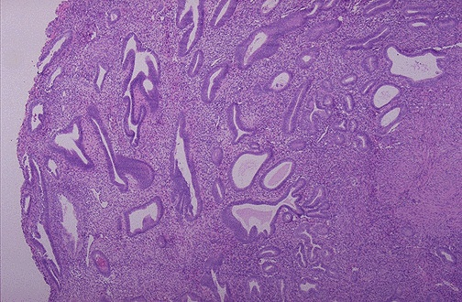
Endometrial Hyperplasia without atypia (Simple and cystic endometrial hyperplasia) - LPF
Cystic and elongated glands.
Increased glands to stromal ratio.
Irregular glands lined by columnar cells.
The amount of endometrium is abnormally increased and not cycling as it should. The glands are enlarged and irregular with columnar cells. Hyperplasia can cause bleeding.

Slide 16
Endometrial Hyperplasia
Endometrial hyperplasia is placed in two categories based on the presence of cytologic atypia: hyperplasia without atypia and hyperplasia with atypia.
Hyperplasia without cellular atypia carries a low risk (between 1% and 3%) for progression to endometrial carcinoma, whereas hyperplasia with atypia, also called endometrial intraepithelial neoplasia (EIN), is associated with a much higher risk (20%–50%).

Slide 17
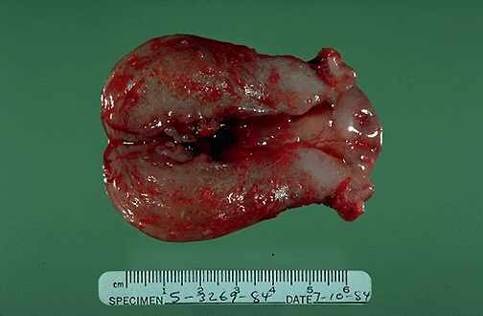
Endometrial Adenocarcinoma - Gross
This uterus is not enlarged, but there is an irregular mass in the upper fundus that proved to be endometrial adenocarcinoma on biopsy. Such carcinomas are more likely to occur in postmenopausal women. Thus, any postmenopausal bleeding should make you suspect that this lesion may be present.

Slide 18
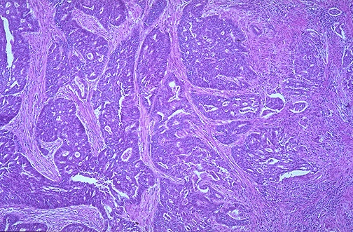
Endometrial Adenocarcinoma - LPF
This is an endometrial adenocarcinoma which can be seen invading into the smooth muscle bundles of the myometrial wall of the uterus. This neoplasm has a higher stage than a neoplasm that is just confined to the endometrium

Slide 19
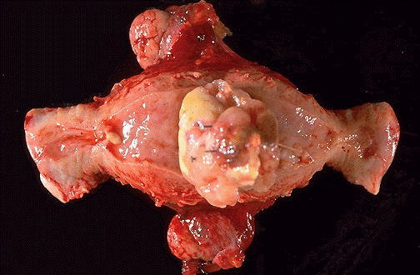
Endometrial Leiomyosarcoma - Gross
A large pale irregular mass protruding from myometrium.

Slide 20
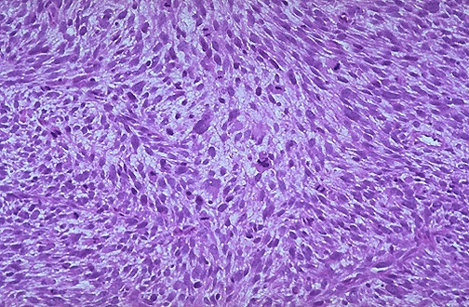
Endometrial Leiomyosarcoma - LPF
It is much more cellular and the cells have much more pleomorphism and hyperchromatism than a benign leiomyoma. An irregular mitosis is seen in the center

Slide 21
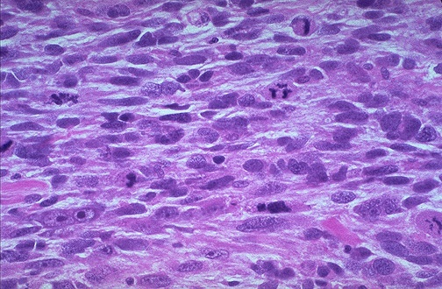
Endometrial Leiomyosarcoma - HPF
Spindle cells with nuclear and cellular pleomorphism and mitoses.

Slide 22
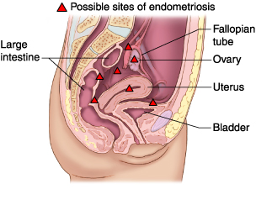
Endometriosis sites - Diagram
Pouch of Douglas: a pouch-like space between the rectum and uterus and it is also called rectouterine pouch.
Endometriosis, a chronic noncancerous disorder of the female reproductive system, develops when the endometrium grows outside the uterus. Common sites for endometriosis include ovaries, fallopian tubes, external genitalia (vulva), ligaments supporting the uterus, intestine, bladder, cervix, and vagina.

Slide 23
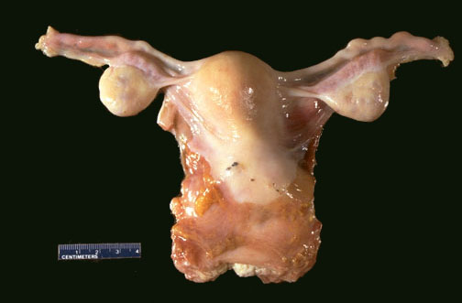
Endometriosis - Gross
Grossly, in areas of endometriosis the blood is darker and gives the small foci of endometriosis the gross appearance of "powder burns". Small foci are seen here just under the serosa of the posterior uterus in the pouch of Douglas.

Slide 24
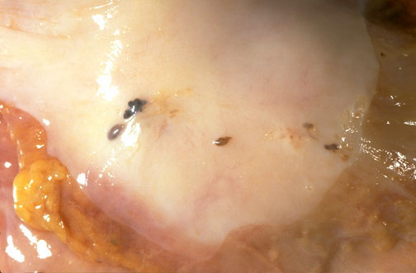
Endometriosis - Gross
Hemorrhagic spots on the peritoneal surface of the pouch of Douglas.
Upon closer view, these five small areas of endometriosis have a reddish-brown to bluish appearance. Typical locations for endometriosis include: ovaries, uterine ligaments, rectovaginal septum, pelvic peritoneum, and laparotomy scars

Slide 25
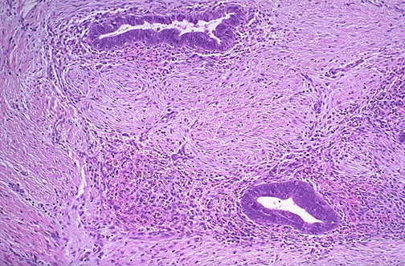
Endometriosis - HPF Microscopy
Endometrial glands along with stroma with fibrosis.

Slide 26
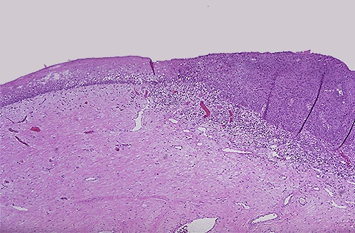
Normal and Dysplastic Cervical Squamous Epithelium
Dysplasia
Normal
The normal cervical squamous epithelium at the left transforms to dysplastic changes on the right with underlying chronic inflammation. The diagnosis is: CIN/SIL.

Slide 27
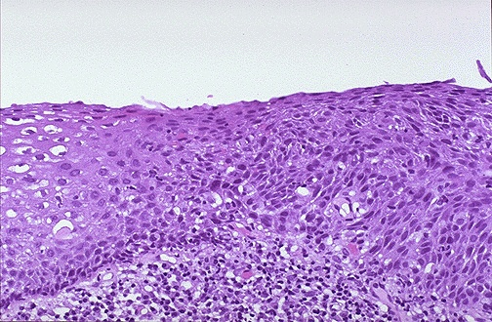
Endocervical Squamous Dysplasia
Lt
Rt
Note the disordered cells with loss of polarity, dysplastic cells/nuclei and the large and dark nuclei. Chronic inflammatory cells are also present.

Slide 28
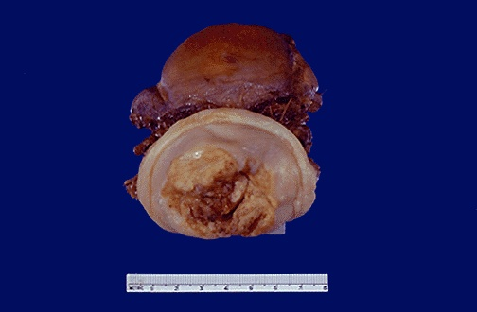
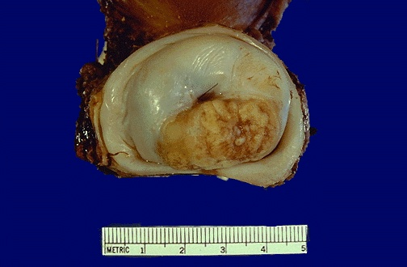
Cervical Squamous Cell Carcinoma
This is the gross appearance of a cervical squamous cell carcinoma that is still limited to the cervix (stage I). The tumor is a fungating red to tan to yellow mass.

Slide 29
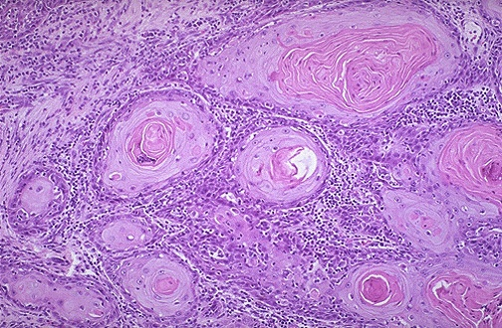
Cervical Squamous Cell Carcinoma - HPF
*
At high magnification, nests of neoplastic squamous cells are separated by a chronically inflamed stroma. This cancer is well- differentiated, as evidenced by the keratin pearls (*) within nests of tumor cells. However, most cervical squamous carcinomas are non-keratinizing.

Slide 30
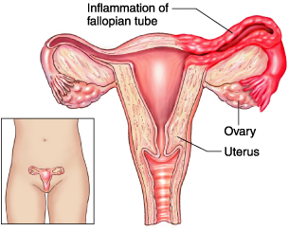
Normal vs Inflamed Fallopian Tube

Slide 31
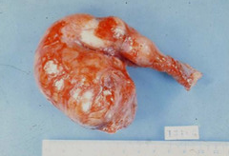
Acute Salpingitis - Gross
Acute salpingitis: Excised congested swollen fallopian tube with hemorrhagic patches

Slide 32
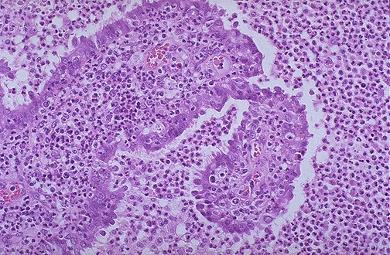
Acute Salpingitis - Microscopic
A remnant of tubal epithelium is seen here surrounded and infiltrated by numerous neutrophils. This is acute salpingitis. Neisseria gonorrheae was cultured.

Slide 33
End of session
Thank You

