Slide 1
Male Reproductive System - Practical
Dr. Maria A. Arafah
Associate Professor – Department of Pathology

Slide 2
Objectives
At the end of the practical classes, the medical students should be able to:
Know the normal structure of the male genital system.
Acquire the knowledge about the gross appearances and histopathological features of the diseases in the male genital system.

Slide 3
Contents
Testicular Atrophy.
Seminoma of the testis.
Embryonal carcinoma and teratoma of testis.
Prostatic Hyperplasia.
Adenocarcinoma of the prostate.

Slide 4
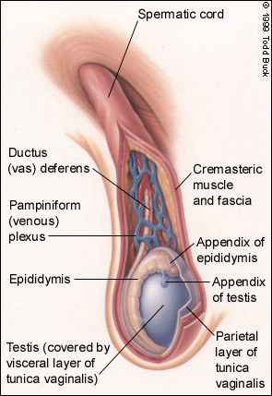
Diagram of Normal Testis

Slide 5
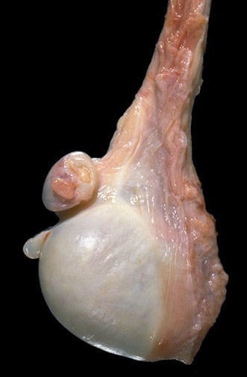
Anatomy of Normal Testis - Gross
Here is a normal testis and adjacent structures. Identify the body of the testis, epididymis, and spermatic cord. Note the presence of two vestigial structures, the appendix testis and the appendix epididymis.

Slide 6
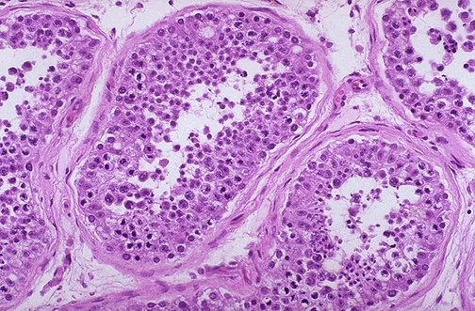
Histology of Normal Testis - LPF
The seminiferous tubules have numerous germ cells. Sertoli cells are inconspicuous. Small dark oblong spermatozoa are seen in the center of the tubules.

Slide 7
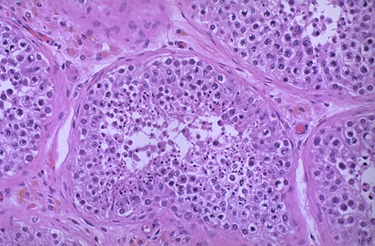
Histology of Normal Testis - LPF
Pink Leyding cells are seen here in the interstitium. Note the pale golden brown pigment as well. There is active spermatogenesis.

Slide 8
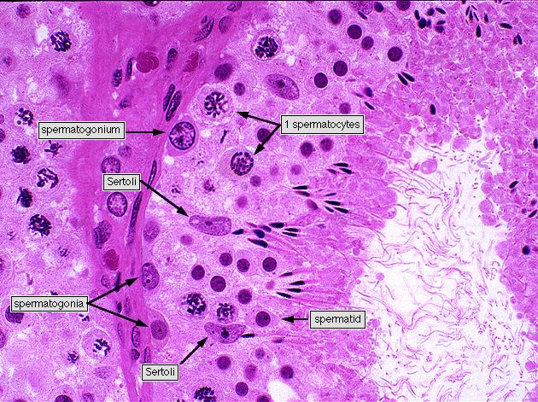
Histology of Normal Testis - HPF

Slide 9
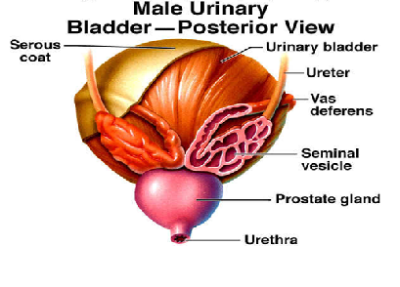
Diagram of Prostate and Seminal Vesicle

Slide 10
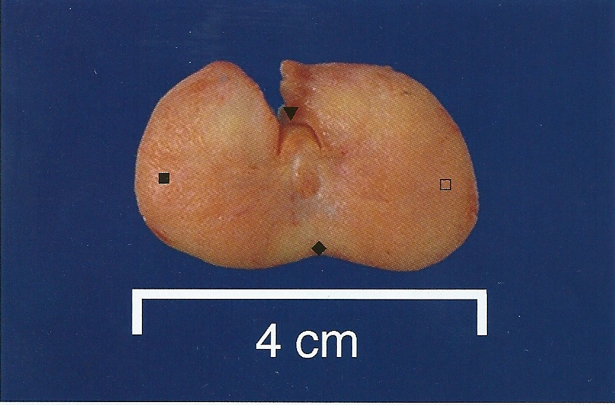
Normal Prostate - Gross
A normal prostate gland is about 3 to 4 cm in diameter.
This is an axial transverse section of a normal prostate. There is a central urethra (▼), at the depth of the cut made to open this prostate anteriorly at autopsy, with the left lateral lobe (), the right lateral lobe () , and the posterior lobe (). The consistency is uniform without nodularity.

Slide 11
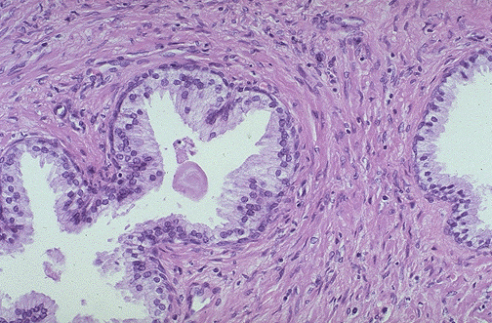
Normal Prostate Histology - LPF
A small pink concretion (typical of the corpora amylacea seen in benign prostatic glands) appears in the gland just to the left of center. Note the well-differentiated glands with tall columnar epithelial lining cells. These cells do not have prominent nucleoli.

Slide 12
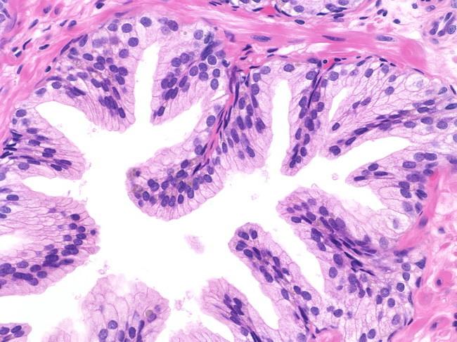
Normal Prostate Histology - HPF
In this benign gland, the luminal contour shows tufts and papillary infoldings. The tall secretory epithelial cells have pale clear cytoplasm and uniform round or oval nuclei. Prominent nucleoli are not seen. Many basal cells can be identified.

Slide 13
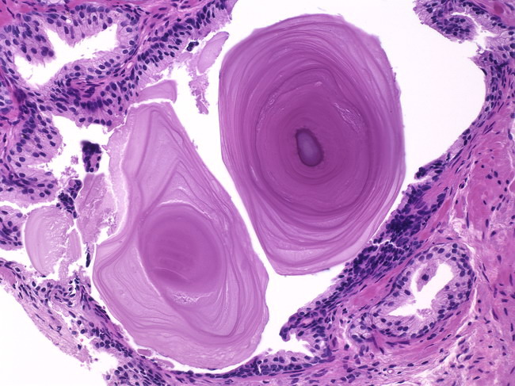
Corpora Amylacea in Prostate - HPF
Corpora amylacea are inspissated secretions that may have a lamellated appearance. Usually they are pink or purple in appearance. Sometimes they may be golden-brown

Slide 14
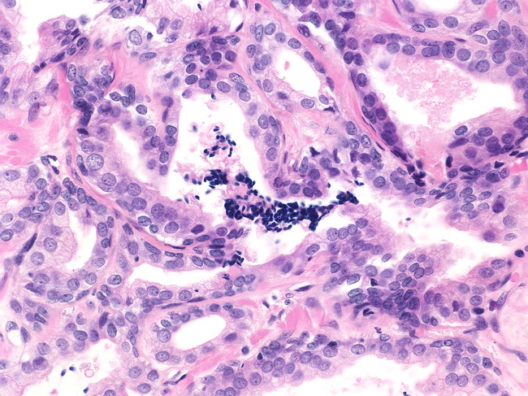
Sperms in Normal Prostate Biopsy – HPF
Spermatozoa are seen in approximately 1% of prostate needle biopsies (unpublished personal observation).

Slide 15
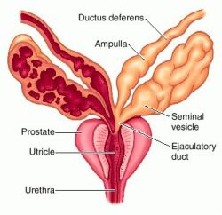
Diagram of Seminal Vesicle

Slide 16
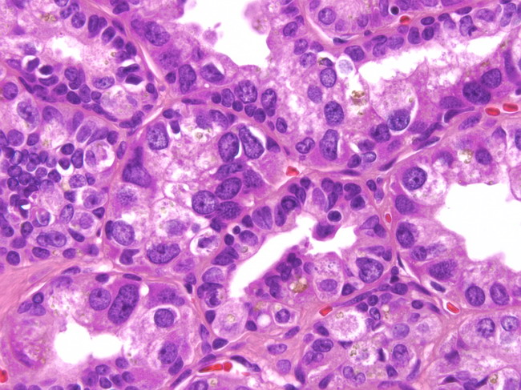
Normal Seminal Vesicle – HPF
Highly atypical cells are a normal finding in seminal vesicles of about 80% of older men. The nuclei are large, irregular, hyperchromatic & show prominent nucleoli. The atypia is degenerative and not observed in the seminal vesicles of young men.

Slide 17
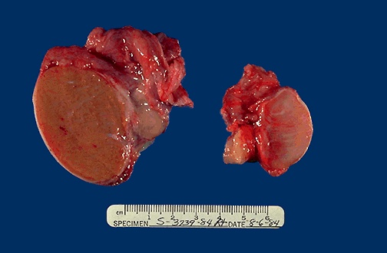
Normal vs Atrophied Testis - Gross
On the left is a normal testis. On the right is a testis that has undergone atrophy. Bilateral atrophy may occur with a variety of conditions including chronic alcoholism, hypopituitarism, atherosclerosis, chemotherapy or radiation, and severe prolonged illnesses.

Slide 18
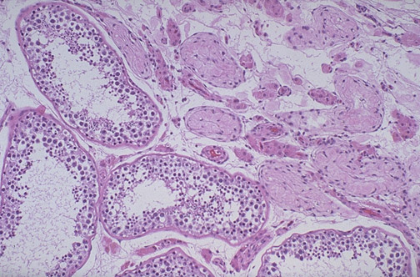
Normal vs Atrophied Testis - Microscopic
Lt
Rt
There is focal atrophy of the tubules seen here to the upper right. The most common reason for this is probably a childhood infection with mumps virus, which produces patchy orchitis.

Slide 19
Seminoma of the Testis - Gross
Here is a large seminoma. Part of a normal testis appears to the left of the mass. It is a pale and lobulated testicular mass with bulging and potato like cut surface with an attached congested spermatic cord. The most important risk factor is cryptorchidism (undescended testicle).

Slide 20
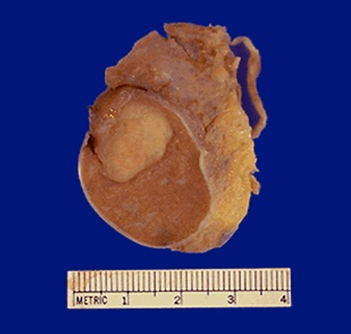
Seminoma of the Testis - Gross
Seminoma.
Germ cell neoplasms are the most common types of testicular neoplasm. They are most common in the 15 to 34 age group. They often have several histologic components: seminoma, embryonal carcinoma, teratoma & choriocarcinoma.

Slide 21
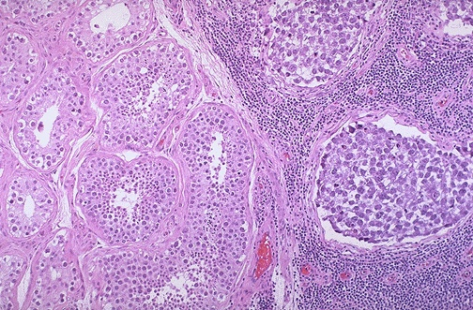
Seminoma vs Normal Testis - LPF
Lt
Rt
Normal testis appears at the left, and a seminoma is present at the right. Note the difference in size and staining quality of the neoplastic nests of cells compared to normal germ cells.
Note the lymphoid stroma between the nests of seminoma.

Slide 22
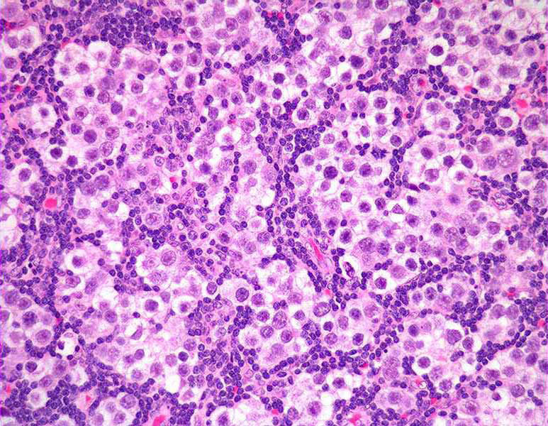
Seminoma of the Testis - HPF
Seminoma: a malignant tumour consisting of sheets of uniform malignant germ cells showing large vesicular nuclei and prominent nucleoli.

Slide 23
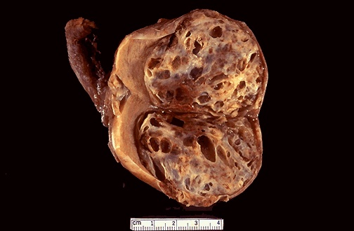
Embryonal Carcinoma & Teratoma - Gross
Here is an embryonal carcinoma mixed with teratoma in which islands of bluish white cartilage from the teratoma component are more prominent. A rim of normal brown testis appears at the left.

Slide 24
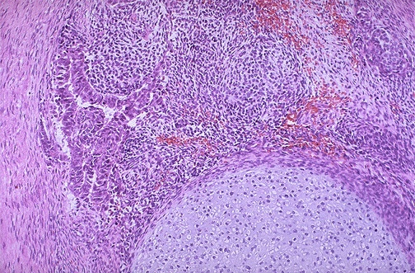
Embryonal Carcinoma & Teratoma - HPF
At the bottom is a focus of cartilage. Above this is a primitive mesenchymal stroma and to the left a focus of primitive cells most characteristic for embryonal carcinoma. This is embryonal carcinoma mixed with teratoma.

Slide 25
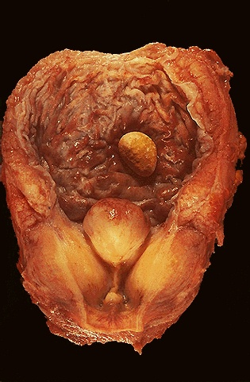
Prostatic Hyperplasia - Gross
Enlarged lateral and median lobes obstructing the prostatic urethra and leading to bladder hypertrophy, as evidenced by the prominent trabeculation of the bladder mucosa. Obstruction with stasis also lead to the formation of a yellow-brown calculus (stone).

Slide 26
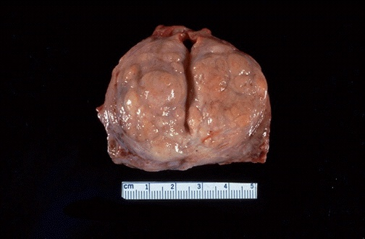
Prostatic Hyperplasia - Gross
Here is another example of benign prostatic hyperplasia. Nodules appear mainly in the lateral lobes. Such an enlarged prostate can obstruct urinary outflow from the bladder and lead to obstructive uropathy

Slide 27
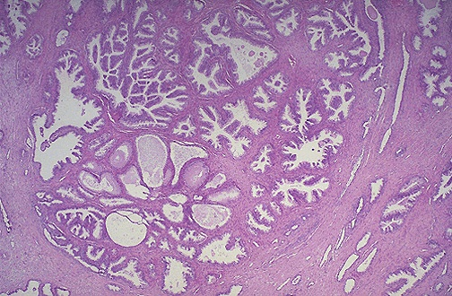
Prostatic Hyperplasia - LPF
Microscopically, benign prostatic hyperplasia can involve both glands and stroma, though the former is usually more prominent. Here a large hyperplastic nodule of glands is seen.

Slide 28
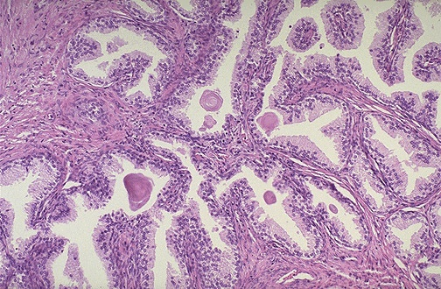
Prostatic Hyperplasia - HPF
The enlarged prostate has glandular hyperplasia. The glands are well-differentiated and still have some intervening stroma. The small laminated pink concretions within the glandular lumina are known as corpora amylacea.

Slide 29
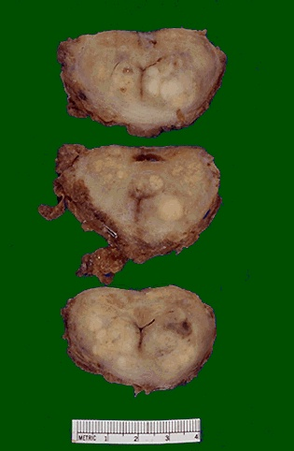
Adenocarcinoma of the Prostate - Gross
These sections through a prostate removed via radical prostatectomy reveal irregular yellowish nodules, mostly in the posterior portion (seen here superiorly). This proved to be a prostatic adenocarcinoma.

Slide 30
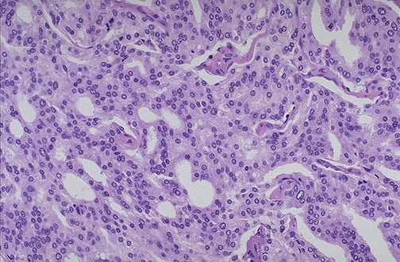
Adenocarcinoma of the Prostate - MPF
At high magnification, the neoplastic glands of prostatic adenocarcinoma are still recognizable as glands, but there is no intervening stroma and the nuclei are hyperchromatic.

Slide 31
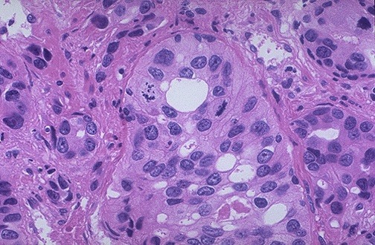
Adenocarcinoma of the Prostate - HPF
At high magnification, this poorly differentiated prostatic adenocarcinoma demonstrates cells with nucleoli and mitotic figures.

Slide 32
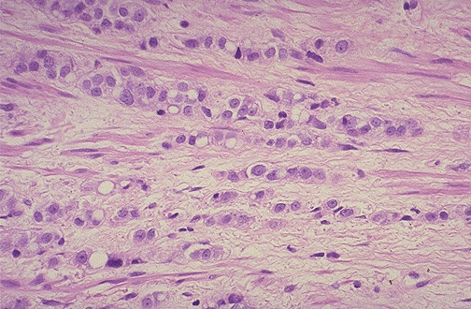
Adenocarcinoma of the Prostate - HPF
This adenocarcinoma of the prostate is so poorly differentiated that no glandular structure is recognizable, only cells infiltrating in rows are seen.

Slide 33
End of Session
Thank You

