Slide 1
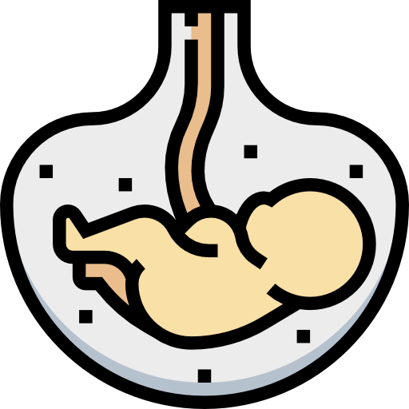
Reproduction Block
Pharmacology team 439
Summary of the LAST Block in the Basic Years!
Table of Contents
Lecture | Slide | Lecture | Slide
L3- inducing ovulation | 2 | L8- Drugs and Lactation | 8
L6- Tocolytics and oxytocin | 3 | L9-HRT | 9
L7- Gonorrhea and syphilis | 6
438’s revision file
Click here

Slide 2
Lecture(3): Drugs Inducing Ovulation
Drugs | MOA | Uses | ADRs
Antiestrogens (Selective estrogen receptor modulators, SERMs)
Clomiphene P.K.: Each dose can be repeated not more than 3 cycles | Compete with estrogen on the hypothalamus and anterior pituitary gland: decrease the -ve feedback of estrogen on hypothalamus → increase GnRH → increase production of FSH & LH → ovulation (They’re estrogen antagonists) | -Female infertility due to anovulation or oligoovulation, not due to ovarian or pituitary failure (Normogonadotrophic) -The success rate for ovulation is 80% & pregnancy is 40% -Treatment of PCOS PCOS is the most common cause of infertility and insulin resistance may play a role→use Metformin, Clomiphene | clomiphene is associated with: -Hyperstimulation of the ovaries and high incidence of multiple birth -Hot Flushes & breast tenderness -nausea and vomiting -Visual disturbances (reversible) -↑nervous tension & depression -Skin rashes -Fatigue -Weight gain -Hair loss (reversible)
Tamoxifen |  | -Tamoxifen is alternative to clomiphene in women with PCOS and resistant cases -Used in palliative treatment of estrogen receptor- positive breast cancer | -
GnRH Agonists
Leuprolin & Goserelin (pulsatile administration) | Analogous with agonist activity Note: Pulsatile administration → stimulates gonadotropin release. Continuous administration → suppresses gonadotropin release. | -Induction of ovulation in patients with hypothalamic amenorrhea (GnRH deficient ) -continuous administration when suppression is desirable e.g. precocious puberty and advanced breast cancer prostatic cancer | -GIT disturbances: abdominal pain,nausea. -Headache -long term use → hypoestrogenism ( hot flashes , ↓ libido, osteoporosis, rarely ovarian hyperstimulation )
Gonadotrophins
Menotropin | Human Menopausal Gonadotrophin (hMG ) → contains LH & FSH | -Stimulation & induction of ovulation in infertility secondary to gonadotropin deficiency (pituitary insufficiency) P.k. hMG is given from 2nd-3rd day for 10 days followed by hCG on (10th - 12th day) for ovum retrieval | ● FSH containing preparations: -Fever -Ovarian Hyperstimulation -multiple pregnancy ● LH containing preparation: -Headache -edema
Pregnyl | Human Chorionic Gonadotrophin (hCG) extracted from urine of pregnant women → contains mainly LH
D2 receptors agonist
Bromocriptine | -D2 receptors agonists binds to dopamine receptors in the anterior pituitary gland & Inhibit prolactin secretion | - Female infertility secondary to hyperprolactinemia | -GIT disturbances: nausea, vomiting, constipation -Headache dizziness & orthostatic hypotension -Dry mouth & nasal congestion -Insomnia
Note: focus on the MOA

Slide 3
Lecture(6): Tocolytics and Oxytocin
Drugs | MOA | Uses | ADRs | C.I
Drugs Producing Uterine Contractions
Oxytocin
Syntocinon & pitocin (Synthetic) Given slow IV infusion - To induce & augment labor Given as nasal spray - in cases of impaired milk ejection Note: it contracts uterine smooth muscle only at term. | The interaction of Oxytocin with myometrial cell membrane receptor promotes the influx of Ca2+ from ECF and from sarco endoplasmic reticulum into the cell, this increase in cytoplasmic calcium → stimulates uterine contraction Action: stimulates frequency & force of uterine contractility particularly fundus segment (contractions are followed by relaxation) | Clinically oxytocin is given only when uterine cervix is soft and dilated. 1st line in labor induction It is used for: -Induction & augmentation of labor in: ○ Mild preeclampsia near term ○ Uterine inertia ○ Incomplete abortion ○ Post maturity ○ Maternal diabetes -Postpartum uterine hemorrhage -Impaired milk ejection (due to its contraction effect on myoepithelial cells) | -Maternal death due to hypertension. -Uterine rupture. -Fetal death. - Water intoxication: if oxytocin is given with relatively large volumes of electrolyte-free aqueous fluid intravenously. | -Hypersensitivity -Evidence of fetal distress. -Prematurity of the uterus. -cephalopelvic disproportion -Abnormal fetal position. -Incompletely dilated cervix Caution: - Multiple pregnancy - Previous C-section - Hypertension
Ergot Alkaloids
Natural: E.g. Ergometrine (Ergonovine) | -induce Tetanic contraction of uterus without relaxation in between. - It causes contraction of uterus as whole i.e. fundus and cervix (tend to compress rather than to expel the fetus) | Postpartum hemorrhage (third stage of labor): - When to give ? 1- After birth 2- third stage of labor Note: given when pt is allergic to oxytocin First line in postpartum | -Vasoconstriction of peripheral blood vessels (toes & finger) - Gangrene - Severe hypertension - Nausea, vomiting, diarrhea | - Induction of labor (first and second stage of labor) - Vascular diseases - Severe hepatic and renal impairment - Severe hypertension
Synthetics: E.g. Methyl ergometrine (Methyl- ergonovine)
Syntometrine | ergometrine + oxytocin | Postpartum hemorrhage
Prostaglandins
Synthetic PGE1: - Misoprostol | Dinoprostone: Extra-amniotic injection Dinoprost: intra-amniotic injection | -Induction of abortion (viable pregnancy) - Induction of labor when fetal death in utero occur (non-viable pregnancy) 1st line in fetal death in utero - Postpartum hemorrhage Note: can soften the cervix, unlike oxytocin and is only indicated when cervix is dilated and ready | - | - Mechanical obstruction of delivery - Fetal distress - Predisposition to uterine rupture Caution: - Asthma - Multiple pregnancy -Glaucoma -Uterine rupture
PGE2: - Dinoprostone |  |  | Flushing
PGF2α: - Dinoprost - Carboprost |  |  | Bronchospasm

Slide 4
Lecture(6): Tocolytics and Oxytocin
Male’s doc: These differences are IMP
 | Oxytocin | Ergometrine
Type of contraction | Resemble normal physiological contraction | Tetanic contraction,does not resemble normal physiological contraction
Uses | To induce & augment labor Postpartum hemorrhage | Only in postpartum hemorrhage as a combination with oxytocin
Onset & Duration | Rapid onset Shorter duration of action | Moderate onset Long duration of action
 | Oxytocin | Prostaglandins
 | Contraction only at term | Contraction throughout pregnancy not only at term
Cervix | Does not soften the cervix | Soften the cervix
 | Cervical smooth muscle play almost no role in softening the cervix, therefore oxytocin (its action is mainly on myometrium) plays almost no role in softening. It is PGs that cause uterine softening, this happens because they degrade the collagen within the cervix and increase the synthesis of glycosaminoglycans (make the cervix more flexible), so that the head of the fetus can easily dilate the cervix helped by the intrauterine pressure from uterine contractions.
Uses | To induce & augment labor & postpartum hemorrhage | Induce abortion in second trimester of pregnancy Used as vaginal suppository for induction of labor (to augment oxytocin’s effects)
Duration of action | Shorter 5 min | Longer

Slide 5
Lecture(6): Tocolytics and Oxytocin
Drugs | MOA | Uses | ADRs
Uterine Relaxants (tocolytic)
β2-Adrenoceptor agonists
Ritodrine | -Selective β2 receptor agonist used specifically as a uterine relaxant. - Bind to β-adrenoceptors → activate enzyme Adenylate cyclase → increase in the level of cAMP → reducing intracellular calcium level. | - Arrest threatened abortion - Delay premature labor - Severe Dysmenorrhea | - Hyperglycemia -Hypokalemia -Tremor -Nausea, vomiting -Flushing -Sweating -Tachycardia(high dose) -Hypotension
Calcium Channel Blockers
Nifedipine | - Markedly inhibits the amplitude of spontaneous and oxytocin-induced contractions | - Arrest threatened abortion - Delay premature labor - Severe Dysmenorrhea | -Ankle edema -Flushing -Constipation -Headache, dizziness -Hypotension -Coughing -Wheezing -Tachycardia
Oxytocin Antagonists
Atosiban | - Compete with oxytocin at its receptors on the uterus. | - Arrest threatened abortion - Delay premature labor - Severe Dysmenorrhea | -

Slide 6
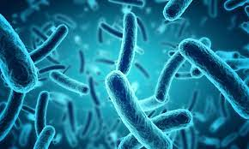
Lecture(7): Treatment of Gonorrhea and Syphilis
1- Treatment of Syphilis
the MOA of each drug is important
Drugs | MOA | Uses | ADRs
β-Lactam Antibiotics:
Natural Penicillins
Benzylpenicillin (penicillin G) | -Inhibits bacterial cell wall synthesis through inhibition of transpeptidase enzyme required for crosslinks. -Bactericidal. | First choice | -Hypersensitivity. -Convulsions with high doses or in renal failure. -Super infections.
Procaine penicillin G
Benzathine penicillin G
2) 3rd generation cephalosporins
Ceftriaxone | -Inhibits bacterial cell wall synthesis. -Bactericidal. | When patient is allergic to penicillin | -Hypersensitivity reactions -Thrombophlebitis -Superinfection -Diarrhea
Tetracycline:
Doxycycline | -Inhibit bacterial protein synthesis by reversibly binding to 30S bacterial ribosomal subunits. -Bacteriostatic. | When patient is allergic to penicillin | -Nausea, vomiting ,diarrhea & epigastric pain. -Brown discoloration of teeth in children. -Deformity or growth inhibition of bones in children. -Hepatic toxicity in prolonged therapy with high dose. -Vertigo. -Superinfections. -Phototoxicity C.I: - Pregnancy* - Breastfeeding - Children below 10 yrs
Macrolides:
Azithromycin (unlike clarithromycin It as no effect on CYP450) | -inhibits bacterial protein synthesis by binding to bacterial 50S ribosomal subunits. -Bacteriostatic | When patient is allergic to penicillin | -GIT upset: Nausea, vomiting, abdominal pain and diarrhea. -Allergic reactions: urticaria and mild skin rashes.
*the safe antibiotics for treating a pregnant woman with syphilis:
Penicillins
Ceftriaxone
Macrolides

Slide 7
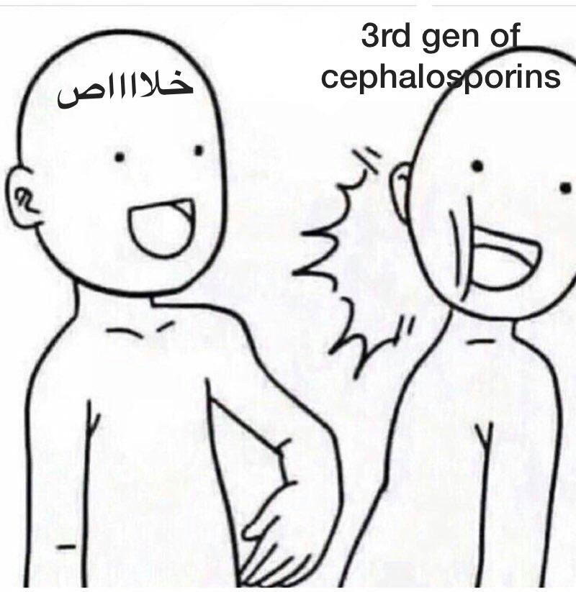
Lecture(7): Treatment of Gonorrhea and Syphilis
2- Treatment of Gonorrhea
Drugs | MOA | Uses | ADRs
Uncomplicated
3rd generation cephalosporins E.g Ceftriaxone Cefixime | -Inhibits bacterial cell wall synthesis. -Bactericidal. | 1st line treatment for uncomplicated gonorrheal infections | -Hypersensitivity reactions -Thrombophlebitis -Superinfection -Diarrhea
Fluoroquinolones E.g Ciprofloxacin | -Inhibit DNA synthesis by inhibiting DNA gyrase enzyme (required for DNA supercoiling ) -Bactericidal | 2nd choice of treatment | -Nausea ,vomiting & diarrhoea. -Headache & dizziness. -May damage growing cartilage & cause arthropathy. -Phototoxicity C.I: - Pregnancy - Nursing mothers - Children < 18
Spectinomycin | -Inhibits protein synthesis by binding to 30S ribosomal subunits | Alternative treatment in patient cannot be treated with cephalosporins or quinolones | -Pain at the site of injection. -Fever and Nausea. -Nephrotoxicity
Complicated
Erythromycin | -0.5% ointment for treatment & prevention of corneal & conjunctival infections. | Put into conjunctival sac immediately after birth (no later than 1 hour after delivery) | -
Silver nitrate 1% solution | -It has germicidal effects due to precipitation of bacterial proteins by liberated silver ions. |  | -
مفيش راحة غير الراحة الأبدية

Slide 8
Lecture(8): Drugs and Lactation
Choosing of a Drug depends upon
Factors related to the Drug
Factors related to the Mother
Factors related to the Neonate
(IMP to differentiate)
1. Large MW
breast alveolar cells is most permeable to drugs during the 1st week postpartum
2. Low lipid solubility
3. Weak acidic drugs (appearance of alkaline drug in milk)
4. Ionized (polar) drugs
5. High protein binding capacity
6. Short half life
7. Large Vd ( poor bioavailability)
Large Vd → less conc. Of drug in the blood, more in the tissue (↓risk)
1. Topical preparations (they carry less risk than systemically administered drugs)
2. Mother should take the medication just after nursing and 2-4 hrs before the next feeding (to allow time for drug to be cleared from the mother’s blood)
3. Breastfeeding is C.I in:
- HIV , Active/ untreated TB, herpes on breast, she use illegal drugs, chronic disease medications
4. Dose
5. Maternal drug conc.
Age & body weight & health status
Special precautions are required in: Premature infants,Low birth weight, Infants with G6PD deficiency, Infants with impaired ability to metabolize\excrete drugs.E.g Hyperbilirubinemia
Health status:
- Oxidizing drugs as (sulfonamides, trimethoprim, primaquine: antimalarial)
can cause:
-Methemoglobinemia (Methemoglobin: is an oxidized form of hemoglobin that has a decreased affinity for oxygen)→hypoxia In infants under 6 months.
-Hyperbilirubinemia (infants with inherited G6PD deficiency are susceptible to oxidizing drugs that can cause hemolysis of RBCs→↑ ­ bilirubin) → kernicterus in premature infant & who has G6PD deficiency
Infants < 6 months if given an oxidant:
Normal infant will develop metHb
G6PD-deficiency infant will develop metHb and hyperbilirubinemia
Drugs During Lactation:
Totally C.I
Suppress Lactation
Increase Lactation
1. Anticancer drugs
(e.g. Doxorubicin, cyclophosphamide, methotrexate)
2. Radioactive iodine & Potassium iodide
3. CNS acting drugs (e.g amphetamine)
4. Lithium
5. Chloramphenicol
6. Atenolol
7. Tobacco,heroin, cocaine, Alcohol
(They reduced prolactin)
1. Levodopa(dopamine precursor)
2. Bromocriptine(dopamine agonist).
3. Estrogen,combined oral contraceptives that contain high-dose of estrogen and a progestin.
4. Androgen
5. Thiazide diuretics
(DA antagonists: they stimulate prolactin secretion galactorrhea)
1. Metoclopramide & Domperidone (antiemetic)
2. Haloperidol (antipsychotic)
3. Methyldopa (antihypertensive)
4. Theophylline ( in asthma)
Use | Avoid | Use | Avoid
Antibiotics |  | Anticonvulsant
1. Penicillins (Amoxicillin & Ampicillin) 2. Cephalosporins 3. Macrolides (Erythromycin & Clarithromycin) | 1. Quinolones (arthropathies) 2. Chloramphenicol (Gray baby syndrome) 3. Tetracycline (teeth discoloration) 4. Sulfonamides (co-trimoxazole) (hyperbilirubinemia-neonatal jaundice, Should be avoided in premature infants or infants with G6PD deficiency) | 1. Carbamazepine (Drug of choice) 2. Phenytoin | 1. Lamotrigine 2. Valproic acid (Infants must be monitored for CNS depression)
Hypnotics |  | Antithyroid
Single use of low dose of Benzodiazepines (Diazepam, lorazepam) | 1. Chronic use of Benzodiazepines 2. Barbiturates (phenobarbitone) | Propylthiouracil | 1.Carbimazole 2.Methimazole 3.Potassium iodide 4. Radioactive iodine
Antidiabetics |  | Analgesic
1. Insulin 2. Oral antidiabetics | 1. Metformin (avoid due to lactic acidosis) | 1. Paracetamol 2. Ibuprofen | 1. Aspirin(Theoretical risk of Reye’s syndrome)
Antidepressant |  | Anticoagulants
SSRI (Paroxetine is preferred) | - | 1. Heparin (better) 2. Warfarin (monitor PT) | -
Oral contraceptives |  | Antiasthmatic
Progestin only pill | Estrogen containing pill | Inhaled Prednisone | -
Drugs of choice among Antibiotics: Cephalosporins & Penicillins
Drugs of choice among Anticonvulsant: Carbamazepine and Phenytoin
Drugs of choice among Antithyroid: Propylthiouracil is preferred over others and should be used rather than Carbimazole or Methimazole
Drugs of choice among Antidiabetics: Insulin and Oral antidiabetic
Drugs of choice among Analgesic: Paracetamol (Acetaminophen)
Drugs of choice among Anticoagulants: Both Warfarin and Heparin
Drugs of choice among Oral contraceptive: Progestin only pills or mini-pills

Slide 9
Lecture(9): Hormonal Replacement Therapy
Drugs | MOA | Uses | ADRs | C.I
Hormonal therapy
Estrogen: - Estradiol (used transdermally & as subcutaneous implants) (major endogenous estrogen) - Conjugated estrogens (equine) -Esterified estrogen - Hysterectomy: estrogen - In presence of uterus: estrogen + progestin (All estrogens mentioned are natural forms) | It binds to estrogen receptors (ER): 1- ER α : mediates female hormonal functions. Found in (Endometrium, breast, ovaries, hypothalamus). 2- ER β: mediates other hormonal functions. Found in (brain, bone, heart, lungs, kidney, bladder, intestinal mucosa, endothelial cells). (These natural estrogen prep have less risk of adverse CVS effects associated with synthetic estrogen used in oral contraceptive e.g ethinylestradiol) | -In menopause: 1- Alone only after hysterectomy 2- In presence of uterus (premenopause), combined with progestin to avoid cancer (never exceed 5 years administration) -Other uses: 1- Contraception. 2- Primary ovarian failure. 3- Amenorrhea & Hirsutism caused by excess androgens. | - Irregular vaginal bleeding - Breast tenderness (patients should discontinue the therapy) - Vaginal discharge. - Fluid retention, Weight gain. - Spotting or darkening of skin (on face). | - Undiagnosed vaginal bleeding. - Severe liver disease. -Thromboembolic manifestations - Endometrial, breast (hormone sensitive), ovarian cancers
Progestin: - Old preparation: Norethindrone, Levonorgestrel & Medroxy- progesterone acetate - New preparation: Norgestimate, Desogestrel & Drospirenone | Binds to progesterone receptors (PR): PR-α & PR-β Same as Estrogen | -In menopause: 1- Usually given in combination with estrogen 2- Used alone in risk of cancer but does not ↓ all menopausal symptoms as estrogen . -Other uses: - Contraception - Dysmenorrhea | - Mood changes e.g. anxiety, irritability - Headache, dizziness or drowsiness - Nausea, vomiting, abdominal pain or bloating. | -
Actions
Improves vaginal dryness
Increases bone density: ↓ osteoclastic activity (↓ resorption)
Protects CVS : vasodilatation via ↑ nitric oxide production & ↑ HDL & ↓ LDL thus ↓ (HRT started at the beginning of menopause will prevent CVS problems) however HRT increases cardiovascular problems in long term
Improves hot flushes & night sweats.
Controls sleep disturbance & mood swings: norepinephrine, dopamine & serotonin
Improves urethral & urinary symptoms:↑ epithelial thickness, vascularity & collagen content at urethra & norepinephrine transmission that contract sphincters & relax detrusor muscles of the urinary bladder.
Improves insulin resistance & glycemic control in diabetics.
Improves cognitive function :↑ expression of estrogen receptor in brain & by ↓ amyloid deposition thus preventing Alzheimer's.
Delays parkinsonism by acting on dopamine system in midbrain.
Advantages of Estrogen and Progestins when used in menopausal women
Estrogen | Progestins
Improves vaginal dryness Increases bone density (↓osteoclastic activity) Protects CVS (only in short term therapy) Improves hot flushes & night sweats Controls sleep disturbance & mood swings Improves urethral & urinary symptoms Improves insulin resistance Improves cognitive function Delays parkinsonism | Protects against possibility of estrogen induced endometrial cancer Progesterone (natural) protects against breast cancer development Counteract osteoporosis (↑osteoblastic activity)
Benefits and Risks of HRT
Definite benefits: Alleviates symptoms of menopause (vasomotor, genitourinary). Improve osteoporosis (Definite increase in bone mineral density → decrease risk of fractures) Uncertain benefits: Improve cognitive functions. | Definite risks: Endometrial cancer (estrogen only). Venous thromboembolism (long term) (most important complication) Breast cancer (Long term 5 years) The risk of CVS problems and breast cancer with HRT is more than their benefits

Slide 10
Lecture(9): Hormonal Replacement Therapy
Drugs | MOA | Uses \ Effects
Selective Estrogen Receptor Modulators
Raloxifene For patients with cvs problem (e.g. MI), and bone problems (e.g. osteoporosis, low density) | -Antagonist in the breast and uterus (used in case of history of endometrial or breast cancer) -Agonist in bone (used in the case of reduced bone density) | Effects: - Very effective preventing vertebral bone fracture. - Has no effect on hot flushes. - Cardiovascular problems are less in compared to Estrogen.
Tamoxifen (More toxic) | -Antagonist in the breast. No Effect on uterus -Partial agonist in bone and endometrium. | Effects: - Increase the risk of venous thrombosis. - Tends to precipitate vaginal atrophy & hot flushes.
Selectivity
Other Types of HRT
Phytoestrogens (Avoid in Estrogen dependent cancer) Supplements from plants containing isoflavones (soya beans, flaxseeds) or lignans (whole grains). | - They mimic the action of estrogen on estrogen receptor-β | - Alleviate symptoms related to hot flushes, mood swings, cognitive functions & possess CVS protective actions.
 | -They block actions mediated by estrogen receptor-α | - lower risks of developing endometrial & breast cancer.
- Androgen - Tibolone | - Testosterone is responsible for sexual arousal in females -Tibolone is a synthetic steroid drug with estrogenic, progestogenic and weak androgenic actions | - Testosterone is given alone to menopausal women in whom their menopausal symptoms are focused on lack of sexual arousal - It is given as adjuvant to combined estrogen & progestin if all other menopausal symptom exist. Important: 1)loss of libido only = testosterone 2 )loss of libido with menopausal symptom = estrogen & progestin & testosterone
 | Brain | Uterus | Vagina | Breast | Bone | CVS
Estradiol | ++ | ++ | ++ | ++ | ++ | ++
Ideal SERM | ++ | - | ++ | - | ++ | ++
Tamoxifen | - | + | - | - | + | +
Raloxifene | - | - | - | - | ++ | +
Non-hormonal Agents
Fluoxetine | - SSRI | - Reduces vasomotor symptoms.
Clonidine | - Centrally acting antihypertensive, α2 agonist | - Helps with vasomotor symptoms.
Gabapentin | - Anticonvulsant | - Reduces severity and frequency of hot flushes.
Physical activity | - Exercise, smoking cessation and relaxation of mind will improve symptoms of menopause (e.g.hot flushes) and fall prevention strategies prevents chances of fracture.

Slide 11
Thank you for all the love and support you gave the team in those two years!
This amazing work was originally done by (Team438):
Team Leaders:
May Babaeer (رحمها الله) Zyad Aldosari
Team Members:
Sara AlFarraj Nujud AlAbdullatif
Deana Awartani Reema AlSerhani
Haifa Alessa Dena AlTwaijri
Rahaf AlShabri
Edited by (Team439):
Team Leaders:
Banan AlQady | Ghada AlOthman | Nawaf Alshahrani
Team Members:
Raghad Albarrak Hamad Almousa
Sarah Alaidarous Sarah Alobaid

