Slide 1

Interprofessional Education & Collaboration:
Concept and Competencies
Prof. Mohamed Al Naami, FRCSC, FACS, M Ed
Department of Surgery, College of Medicine
Dr. Ghada Bawazeer, MSc., PharmD, BCPS
Clinical Pharmacy Department – College of pharmacy
King Saud University
Acknowledgement to Dr. Hanaa Alzamil for sharing the slides
Oct 1st, 2018

Slide 2
Objectives
Define interprofessional education and interprofessional collaborative practice
Describe the core competencies of interprofessional education
Appreciate the importance of interprofessional collaboration impact on quality and safety of patient care.
Understand the importance of communication for effective collaboration
Understand the roles, responsibilities, and abilities of different professions
Reflect on an interprofessional exposure with students from another healthcare college
Identify the opportunities for using IPE/C to improve interprofessional collaboration.
By the end of these 2 sessions, students should be able to:

Slide 3

What do you think IPE is about?
Notes:
Spend 2-3 min engaging students in answering the question

Slide 4
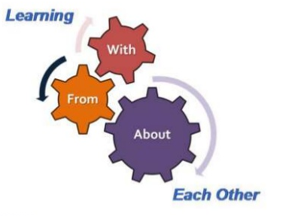
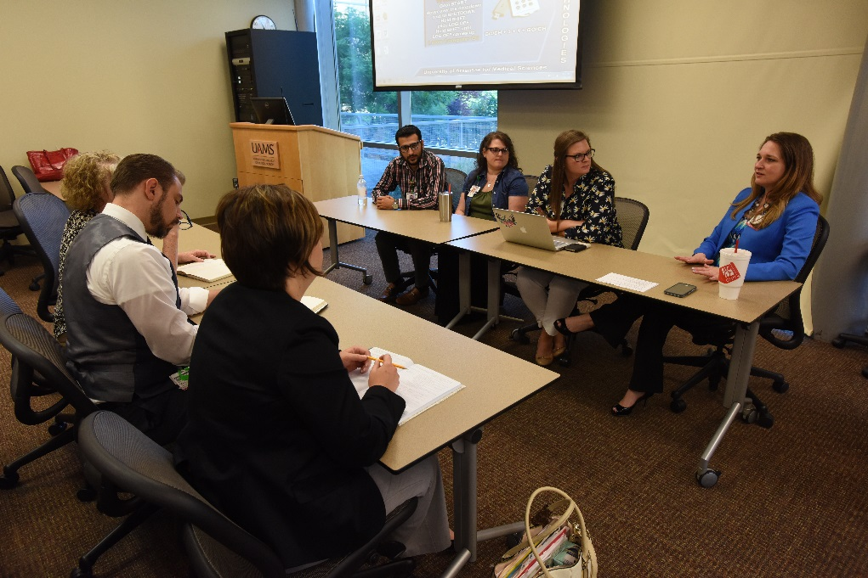

Definition of Interprofessional Education (IPE)
Learners from two or more professions learn about, from, and with each other to enable effective collaboration
(WHO 2010)

Slide 5

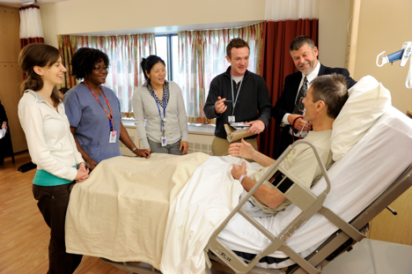
Definition of Interprofessional Collaboration (IPC)
  When multiple health workers
  from different professional backgrounds
  work together with patients, families, [careers], and communities
  to deliver the highest quality of care.

Slide 6



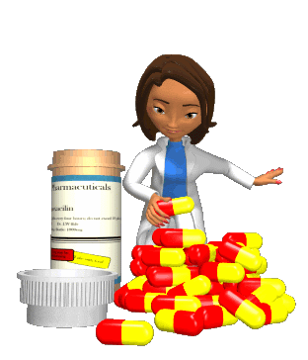

What does this slide tell us? And who is missing?
Excuse me, but Nurses actually work directly with Patients…
We are the Doctors. We Lead!
Without me, you both wouldn’t know a benzodiazapine from a barbiturate.
When you get to the mouth, call us.

Slide 7

“It is no longer enough for health workers to be professional. In the current global climate, health workers also need to be interprofessional.”
~ WHO, 2010

Slide 8
IPE/IPC is NOT a new fashion
1972
1987
2003
Education for the health team (IOM)
Crossing the quality chasm: A new health system for the 21st century (IOM)
Health professionals education: A bridge to quality (IOM)
UK Centre for the Advancement of Interprofessional Education (CAPIE)
2001
2005
2009
2010
Canadian International Health Group
Interprofessional education collaboration (IPEC)
Framework for action on IPE/IPC (WHO)
Notes:
This slide is not for memorization just to let you appreciate the efforts on IPE/IPC was going on for quite sometime

Slide 9

IPE/C competencies
Integrated enactment of knowledge, skills, and values/attitudes
that define working together across the professions, with other healthcare workers, patients, families, and communities as appropriate
to improve health outcomes in specific care contexts.
Notes:
So what are we talking about here?
Studying side by side same knowledge and skills…? Wait for students response.
Each profession domain of knowledge and set of professional skills and duties are protected.
what IPE and IPC competencies all about is to define working across professionals should be integrated with each others and with patients/families for the purpose of improving patient care

Slide 10

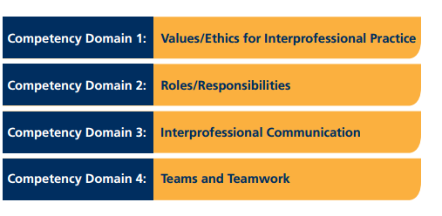
Interprofessional Education Competencies Domains
Notes:
So what are IPE competencies
Education takes our students through these same domains…

Slide 11

Competency Domain: Values/Ethics for Interprofessional Practice
  Work with individuals of other professions to maintain a climate of mutual respect and shared values
IPEC. Core Competencies for Interprofessional Collaborative Practice. May 2011

Slide 12
Specific Values and Ethics Competencies
Place the interests of patients and populations at the center of interprofessional health care delivery.
Respect the dignity and privacy of patients while maintaining confidentiality in the delivery of team-based care.
Embrace the cultural diversity and individual differences that characterize patients, populations, and the health care team.
Respect the unique cultures, values, roles/responsibilities, and expertise of other health professions.
Work in cooperation with those who receive care, those who provide care, and others who contribute to or support the delivery of prevention and health services.
Develop a trusting relationship with patients, families, and other team members .
Demonstrate high standards of ethical conduct and quality of care in one’s contributions to team-based care.
Manage ethical dilemmas specific to interprofessional patient/ population centered care situations.
Act with honesty and integrity in relationships with patients, families, and other team members.
Maintain competence in one’s own profession appropriate to scope of practice.
Notes:
This the specific competencies of the core competency in the domain values and ethics
It was part of your reading assignment.
I will only high
Place the Interests of Patients and Populations at the Center of Interprofessional Healthcare Delivery
There are clearly competing interests that can move the patient from the center of the healthcare team's efforts. These include placing financial incentives above the goal of most appropriate care, disorganization of the responsibilities of the team, and interpersonal factors, to name a few.
Patient-centered care provides a bright guiding star to guide the development and implementation of IPC. Always thinking about the patient first can help one avoid the barriers and pitfalls described earlier.
Moreover, this competency focuses not just on individual patients but also on populations. IPC should address the larger goals of the triple aim for healthcare: improved outcomes, a better care experience, and a reduction in health costs. The application of patient-centered care across millions of patients improves the well-being of our society as a whole.
Respect the Dignity and Privacy of Patients While Maintaining Confidentiality in the Delivery of Team-Based Care
IPC is not without potential risks. One of the primary risks is the breach of patient confidentiality. IPC depends on technology to improve communication and efficiency. The careless application of this technology can lead directly to negative consequences.
An example: A 15-year-old young woman is seeking family planning services, which can be provided without parental consent in your state. She is very fearful of her parents finding out about her prescription for oral contraceptive pills. When she calls in for a refill for her prescription, 2 members of the healthcare team promptly respond with messages at her house, not her cellphone, that her prescription is ready.
The potential implications of these actions on this patient extend beyond losing her choice to prevent pregnancy. Although IPC depends on sharing information, care must be taken to do so responsibly.
Embrace the Cultural Diversity and Individual Differences That Characterize Patients, Populations, and the Healthcare Team
There is a tremendous opportunity to improve healthcare by embracing diversity. This begins with the members of the healthcare team itself. Patients often prefer to be cared for by professionals whose background and values reflect their own, yet healthcare teams often do not look like or share common experiences with the communities in which they serve. It is a large issue, but the pipeline to careers in healthcare needs to be galvanized to create a more diverse and dynamic workforce.
Being patient-centered means respecting each patient as a culture of 1. In a multicultural society that is constantly evolving, we cannot practice in stereotypes. However, we can and should recognize common beliefs and behaviors that represent opportunities to improve not only satisfaction with care but also critical outcomes such as severe illness and mortality.
Respect the Unique Cultures, Values, Roles/Responsibilities, and Expertise of Other Health Professions
Embracing diversity extends beyond the patient to the different members of the healthcare team itself. Each member brings her or his own background, in terms of clinical skills and training, but each teammate also has something to contribute in terms of cultural awareness and experience. These skills and knowledge should be enumerated during the assignment of clinical roles and responsibilities to augment what has been standard medical care with a cultural responsiveness that can boost outcomes.
Work in Cooperation With Those Who Receive Care, Those Who Provide Care, and Others Who Contribute to or Support the Delivery of Prevention and Health Services
Listening and responding to patients in a proactive manner should be obvious. But listening to the patient's caregivers and loved ones can be just as important. They can provide critical insights into patients' thoughts and behaviors that would otherwise never be recorded. They are also often instrumental in translating instructions for care and improving adherence. It is difficult to achieve good levels of patient satisfaction when the healthcare team does not respond to families and caregivers. And this dissatisfaction leads to poor adherence and worse health outcomes.
Develop a Trusting Relationship With Patients, Families, and Other Team Members
Clinical practice always seems to be very busy. It is important to communicate the framework for the healthcare team early in the patient's care plan so that the patient is appropriately oriented and can begin to participate as thecentral player on the team. Information should focus on who is on the team, where they are located, and their expected role. This can be delivered to the patient in an efficient format, and different methods (ie, written and verbal; video and print) may be preferred to reinforce the message.
Demonstrate High Standards of Ethical Conduct and Quality of Care in One's Contributions to Team-Based Care
Of course, maintaining a high ethical standard is key to any successful practice. Although a diverse healthcare team is a superior model for providing comprehensive care, the assignment of providers should be driven by the needs of the patient, and not financial decisions.
In addition, the medical literature has clearly documented biases, both large and small, that hurt patient care and cost lives. The planning group for the healthcare team should understand this risk in their local practice and build in tools to provide more equitable care to all.
Manage Ethical Dilemmas Specific to Interprofessional Patient-/Population-Centered Care Situations
Ethical dilemmas are common across all practice sites, and not all practitioners have access to a trained medical ethicist. However, IPC can address difficult ethical issues with the involvement of smart, caring providers from different backgrounds, which is a strong start to resolving these dilemmas fairly and constructively. Managing ethical issues should be built into the mandate for IPC teams and be part of how they function on a regular basis.
Act With Honesty and Integrity in Relationships With Patients, Families, and Other Team Members
Healthcare team members should intrinsically understand the importance of acting honestly with patients and their caregivers. Traditionally, relationships between different team members have not always been so respectful. The IPC team should strongly discourage disrespectful communication or actions between team members and confront the inevitable breaches in this standard directly and constructively. Maintaining an atmosphere of cooperation and respect can certainly be difficult, but doing so makes the national practice environment stronger, bit by bit.
Maintain Competence in One's Own Profession Appropriate to Scope of Practice
Although teamwork is emphasized as part of IPC, each team member is ultimately responsible for her or his own competence in treating patients. The team-based nature of IPC can actually improve individuals' performance through transparency in outcomes and providing tools and training to improve practice patterns.
IPC is not a uniform solution to improve healthcare. Each practice site will perform IPC differently. However, regardless of location or resources, the age of IPC is here. We as a healthcare community need to embrace IPC and initiate its best practices for the sake of our patients and fellow healthcare professionalslight some important aspects

Slide 13
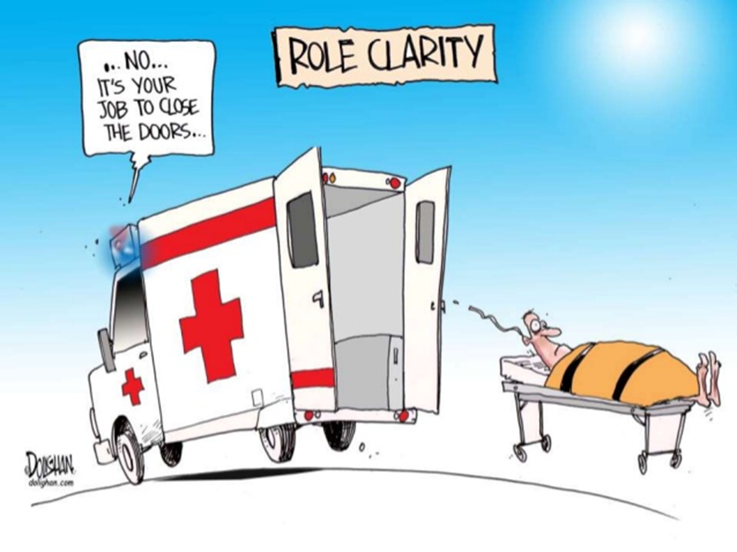
Competency Domain: Roles/Responsibilities
  Use the knowledge of one’s own role and those of other professions to appropriately assess and address the health care needs of the patients and populations served
IPEC. Core Competencies for Interprofessional Collaborative Practice. May 2011

Slide 14
Specific Roles and Responsibilities Competencies
Communicate one’s roles and responsibilities clearly to patients, families, and other professionals.
Engage diverse healthcare professionals who complement one’s own professional expertise, as well as associated resources, to develop strategies to meet specific patient care needs.
Explain the roles and responsibilities of other care providers and how the team works together to provide care.
Use the full scope of knowledge, skills, and abilities of available health professionals and healthcare workers to provide care that is safe, timely, efficient, effective, and equitable.
Communicate with team members to clarify each member’s responsibility in executing components of a treatment plan or public health intervention.
Forge interdependent relationships with other professions to improve care and advance learning.
Engage in continuous professional and interprofessional development to enhance team performance.
Use unique and complementary abilities of all members of the team to optimize patient care.
Recognize one’s limitations in skills, knowledge, and abilities.
Notes:
Communicate One's Roles and Responsibilities Clearly to Patients, Families, and Other Professionals
Successful IPC does not just happen out of thin air. It requires a thoughtful assessment of the goals of collaboration and an evaluation of local resources that can provide the capital to achieve these goals.
A core domain of planning for IPC includes the definition of roles. Each team member should clearly understand what is required of her/him, as well as what she/he may be asked to do in a critical situation. The team roles should be shared so that all teammates understand what is expected of one another, and redundancy of responsibilities is allowed for key procedures that may require backup.
The busy routine of a clinic or hospital setting is not the place to learn these roles. Guidelines regarding responsibilities should be drafted, vetted with the key stakeholders, and then applied through training outside the clinical setting. The practice setting is then used to apply, evaluate, and improve collaborative practices.
Finally, IPC can only gain limited success if it fails to include patients, families, and other professionals. They should also understand the roles of different team members, with a simple illustration of the team structure available to all.
Recognize One's Limitations in Skills, Knowledge, and Abilities
Arrogance and hubris can be deadly in the healthcare setting. Developing successful IPC is not only about every team member doing his or her job well but is also about setting limits when a member of the healthcare team is out of his or her scope of care. Practicing beyond this limit as part of the collaborative protocol is unacceptable.
Engage Diverse Healthcare Professionals Who Complement One's Own Professional Expertise, as Well as Associated Resources, to Develop Strategies to Meet Specific Patient Care Needs
I will never be an expert at talk therapy for patients with mood disorders. At the same time, a licensed clinical social worker may not grasp all the potential adverse events associated with different antidepressants. And the pharmacist may not recognize the symptoms of depression and key diagnostic criteria.
Clearly, it is only when all these providers are combined in a thoughtful manner that promotes teamwork and communication that we develop best practices in patient care. Moreover, it should lead to higher rates of job satisfaction for the team members themselves, as they all understand their respective roles and can focus on the things that they do well.
Explain the Roles and Responsibilities of Other Care Providers and How the Team Works Together to Provide Care
The paradigm of team-based care remains novel for many patients and their families. Many do not even understand what certain team members are trained for and how they may improve a patient's care. Therefore, there should be a record of who is on the care team and a brief summary of their role, and this should be available to patients. Team members should also have a verbal script to explain their roles to patients.
Use the Full Scope of Knowledge, Skills, and Abilities of Available Health Professionals and Healthcare Workers to Provide Care That Is Safe, Timely, Efficient, Effective, and Equitable
This competency includes both "timely" and "efficient." IPC should not and cannot result in 2-hour meetings for every single patient. The effective healthcare team should be supported by communication tools and technology that allow them to do their jobs and create evidence-based and safe care plans in a highly efficient way. The goal is not to increase the amount of time the patient spends in the hospital or clinic but to maximize the utility of that time.
Communicate With Team Members to Clarify Each Member's Responsibility in Executing Components of a Treatment Plan or Public Health Intervention
Respecting each provider's skills, as well as his or her limitations, is critical to successful IPC, and there has to be honest communication at the outset of an IPC project to establish providers' roles and responsibilities.
Forge Interdependent Relationships With Other Professions to Improve Care and Advance Learning
IPC has been practiced for years, but its value and potential liabilities are not widely understood. The best practice for IPC needs to evolve and be disseminated so that all practices and all patients may benefit.
Engage in Continuous Professional and Interprofessional Development to Enhance Team Performance
Although the current competencies emphasize the establishment of a baseline level of responsibility for different members of the healthcare team, IPC is only successful if there is a process for continuous quality improvement. This improvement should always focus on improving patients' well-being, but it should also include the ambitions of team members. The planning group should listen to staff members who feel they are doing too much or too little and provide opportunities to expand patient care skills to reduce gaps and advance the careers of team members.
Use Unique and Complementary Abilities of all Members of the Team to Optimize Patient Care
The flight crews of Pan Am 1736 and KLM 4805 had expertise in the flight operations of jumbo aircraft and the things that could go wrong with these massive machines. The ground crew had extensive experience in local conditions and the limitations of their smaller airport. Yet none of these team members could work effectively to produce the most critical outcome in travel: safety.
The same situation is repeated in healthcare on a daily basis. The traditional culture of healthcare does not value the contributions of a diverse team, and that does harm to the patients, providers, and healthcare system. The competencies presented here can serve as a framework to establish IPC, but the real work and value are derived from applying these principles to resources at a local level and changing the cultural milieu. It is not an easy process, but it is one that is absolutely essential to ensure the best care for our patients.

Slide 15


What do you know about the scope of practice of your own profession and other health profession?
From the video assignment what do you think about the roles/responsibilities of each member?

Slide 16
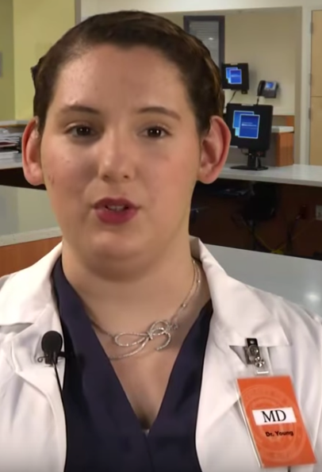
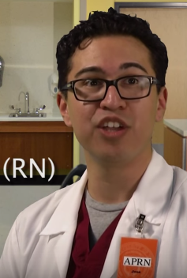
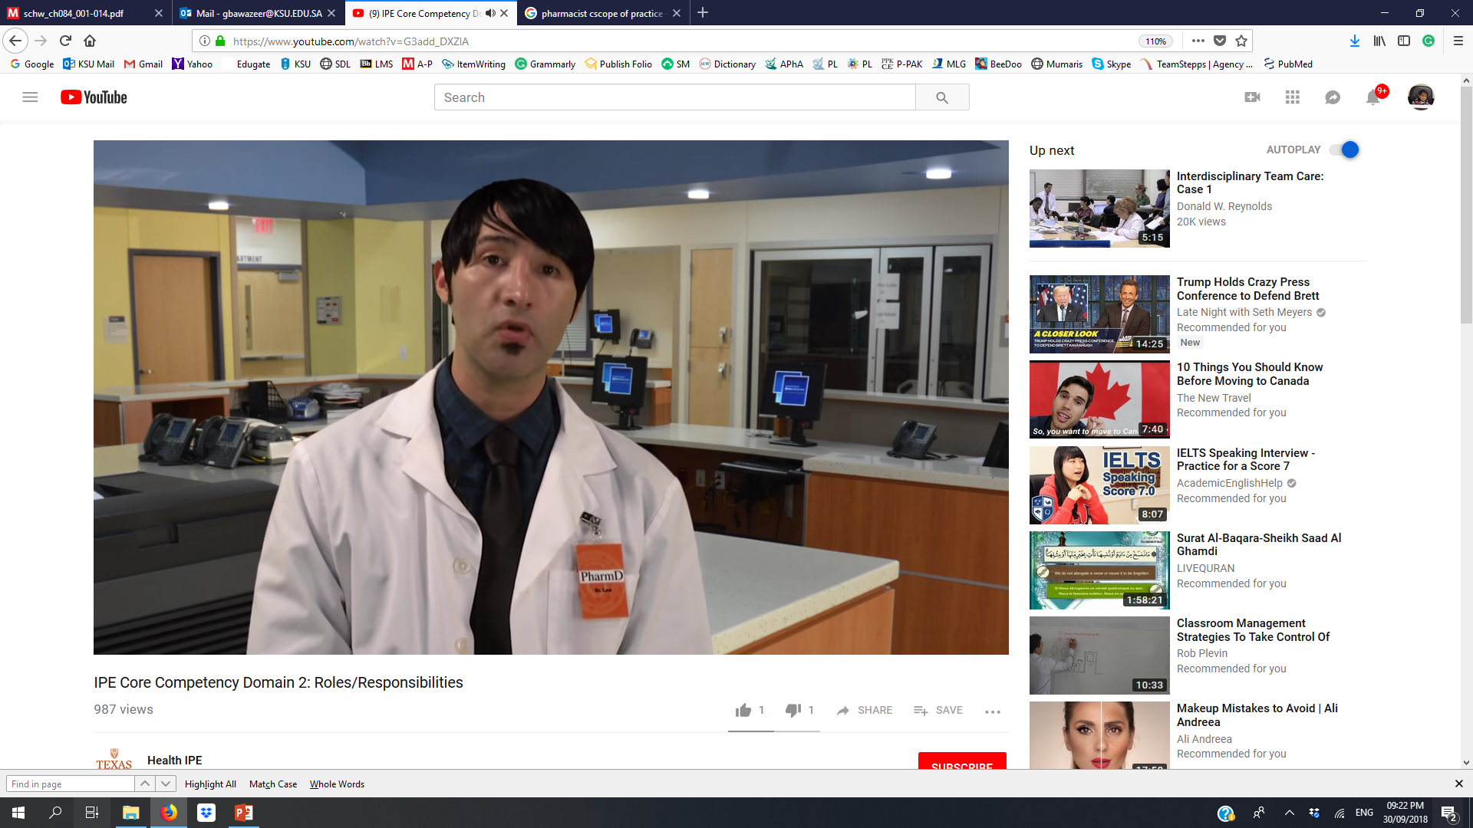
What was the Roles & Responsibilities of the professionals in the assigned video?
Physician | Registered Nurse | Clinical pharmacist
Perform history & physical to determine differential Dx | Ongoing assessment of patient health status | Medication expert to assure Safe and effective use of medication
Make diagnosis >>> Treats and manage a variety of conditions | Manage care to meet patients needs | Assess patient for medication related issues
Collaborative with health care team (e.g. referral) | Collaborate with healthcare team | Collaborate with healthcare team
Provide education | Provide education | Provide education
Advocate for patient and family | Advocate for patients and families | Advocate for patient and families

Slide 17

Competency Domain: Interprofessional Communication
  Communicate with patients, families, communities, and other health professionals in a responsive and responsible manner
IPEC. Core Competencies for Interprofessional Collaborative Practice. May 2011

Slide 18
Specific Interprofessional Communication Competencies
Choose effective communication tools and techniques, including information systems and communication technologies, to facilitate discussions and interactions that enhance team function.
Organize and communicate information with patients, families, and healthcare team members in a form that is understandable, avoiding discipline-specific terminology when possible.
Express one’s knowledge and opinions to team members involved in patient care with confidence, clarity, and respect, working to ensure common understanding of information and treatment and care decisions.
Listen actively, and encourage ideas and opinions of other team members.
Give timely, sensitive, instructive feedback to others about their performance on the team, responding respectfully as a team member to feedback from others.
Use respectful language appropriate for a given difficult situation, crucial conversation, or interprofessional conflict.
Recognize how one’s own uniqueness, including experience level, expertise, culture, power, and hierarchy within the healthcare team, contributes to effective communication, conflict resolution, and positive interprofessional working relationships.
Communicate consistently the importance of teamwork in patient-centered and community focused care.

Slide 19
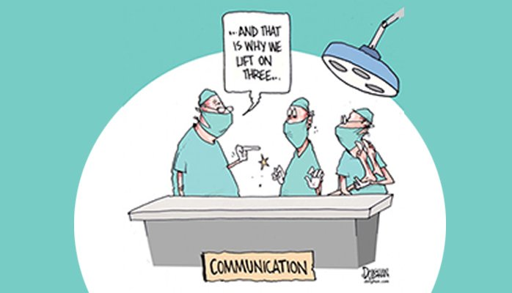
Importance of Interprofessional communication
In 2006, the Joint Commission on Accreditation of Health Care Organization reported that: 70% of medical errors were caused by
lack of communication between team members.

Slide 20

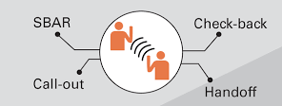
Best Practices in Interprofessional Communication
The lifeline of care team
Process by which information is exchanged between individuals, departments, or organizations
Should be:
    Complete
    Clear
    Brief
    Timely
Notes:
Complete
Communicate all relevant information
Clear
Convey information that is plainly understood
Brief
Communicate the information in a concise manner
Timely
Offer and request information in an appropriate timeframe
Verify authenticity
Validate or acknowledge information

Slide 21

Interprofessional Communication
Information Exchange Strategies
  Situation – Background – Assessment – Recommendation (SBAR)
    to effectively communicate information to one another
  Call-Out:
    to communicate important or critical information. Ex. During emergency, codes, etc
Situation
Background
Assessment
Recommendation
What is going on with the patient?
What is the clinical background or context?
What do I think the problem is?
What would I recommend?

Slide 22
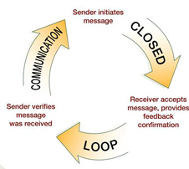

Interprofessional Communication
Information Exchange Strategies
  Check-Back
    to ensure that message is received
  Handoffs
    to transfer information during transitions in care across the continuum
      Includes an opportunity to ask questions, clarify, and confirm

Slide 23
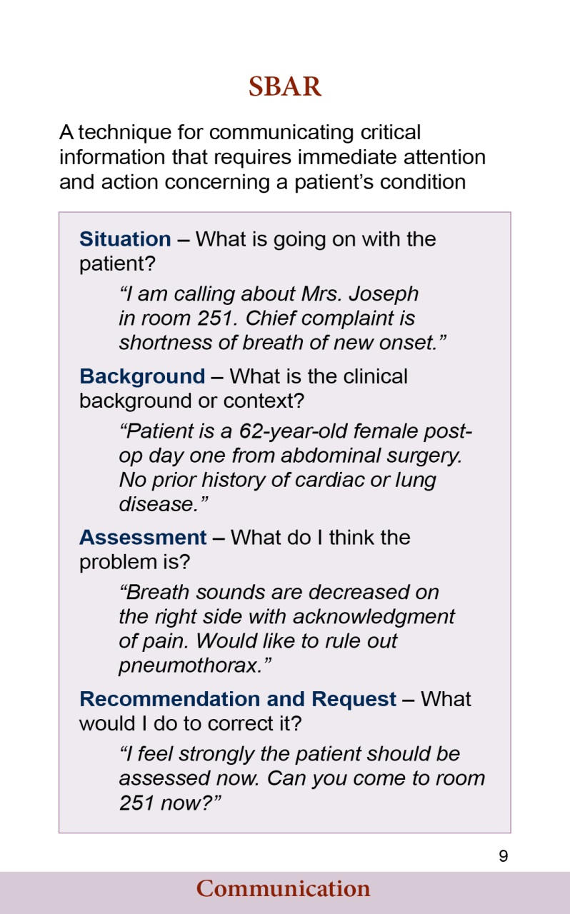
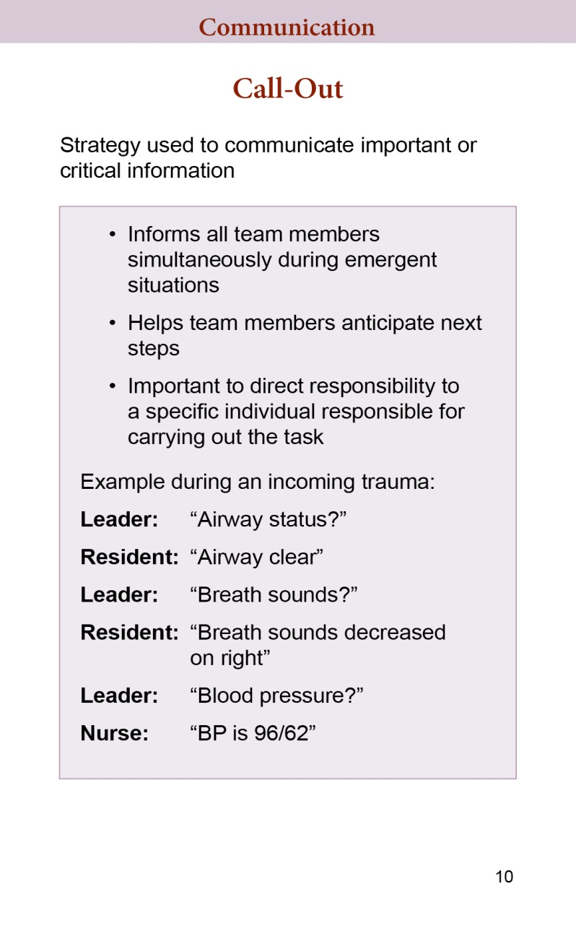
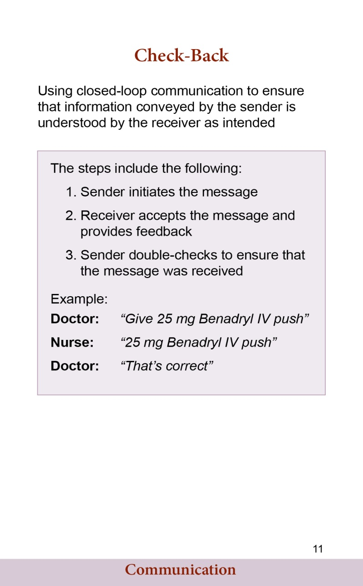
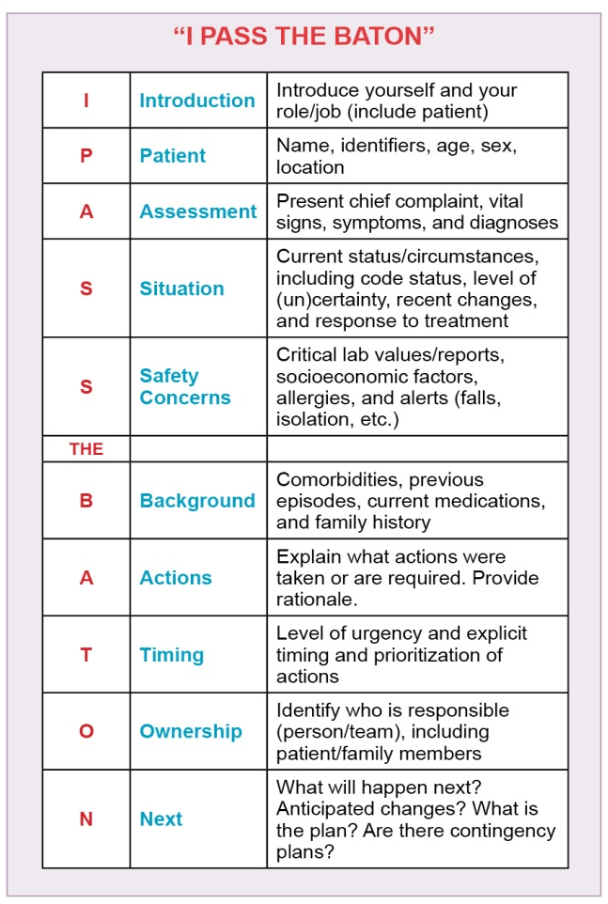
Interprofessional Communication: Examples

Slide 24
Interprofessional Communication
Challenges/Barriers
    Language barrier
    Distractions
    Physical proximity
    Personalities
    Workload
    Varying communication styles
    Conflict
    Lack of information verification
    Shift change

Slide 25

Specific Teams and Teamwork Competencies
Describe the process of team development and the roles and practices of effective teams.
Develop consensus on the ethical principles to guide all aspects of patient care and team work.
Engage other health professionals in shared patient-centered problem-solving.
Integrate the knowledge and experience of other professions, appropriate to the specific care situation to inform care decisions, while respecting patient and community values and priorities/ preferences for care.
Apply leadership practices that support collaborative practice and team effectiveness.
Engage self and others to constructively manage disagreements about values, roles, goals, and actions that arise among healthcare professionals and with patients and families.
Share accountability with other professions, patients, and communities for outcomes relevant to prevention and health care.
Reflect on individual and team performance for individual, as well as team, performance improvement.
Use process improvement strategies to increase the effectiveness of interprofessional teamwork and team-based care.
Use available evidence to inform effective teamwork & team-based practices.
Perform effectively on teams and in different team roles in various settings

Slide 26
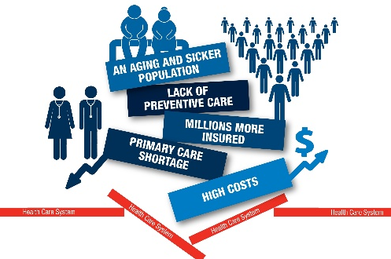

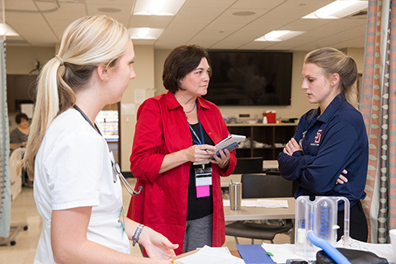

Do you think IPE/IPC is needed or important?
Overcome fragmentation and cost.
The burden exceeds the capacity of any one profession.
Increase access to care. Improves quality and safety of care
Enhance job satisfaction and ease stress and create a more flexible workforce
Remedy failures in trust, respect and communication between professions
Notes:
To modify negative attitudes and perceptions
To remedy failures in trust and communication between professions
To reinforce collaborative competence
To secure collaboration
to implement policies , to improve services and to effect change
To cope with problems that exceed the capacity of any one profession
To enhance job satisfaction and ease stress
To create a more flexible workforce
To counter reductionism and fragmentation as professions proliferate in response to technological advance
To integrate specialist and holistic care

Slide 27
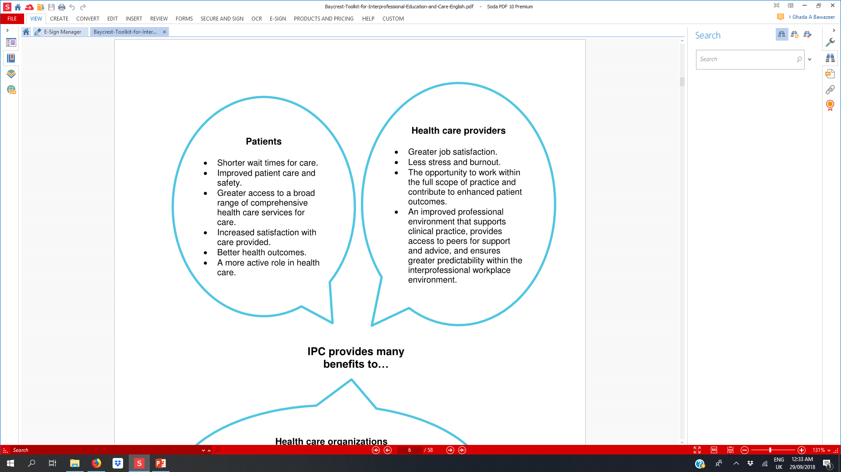

Benefits of IPE/IPC: Patients, HC providers, Health care organizations
Health care organizations
Greater efficiency and capacity — ability to provide
care for more people, enhancing patient satisfaction.
Decreased staff turnover with enhanced staff morale.
Improved recruitment and retention.
Increased patient safety and fewer treatment errors.
Enhanced opportunities to develop ongoing quality improvement and accountability measures in health care delivery.
Notes:
It Empowers Team Members
It Closes Communication Gaps
It Enables Comprehensive Patient Care
It Minimizes Readmission Rates
It Promotes a Team Mentality
It Promotes Patient-Centered Care
Increased efficiency
Improve employee morale, increases inter-staff support
Fosters creativity, ideas
Reduced competition & conflict, better conflict resolution
Better clinical outcomes, cost-effectiveness, safety
Facilitated collaborative projects

Slide 28
“Collaboration and teamwork can BEST be achieved if it starts early.”
Robert Wood Johnson Foundation, 2011

Slide 29
UW SOP IPE Curriculum Framework
Opportunities for incorporating IPE/C
Patient Care Outcomes
Population Health Outcomes
Practice
Teamwork
Clinical
Placements/Experiences
Practice
Integration
Simulations
Communication
Project-Based Learning
Immersion
Case Exercises
Immersion
Roles
Active Learning
Shadowing
Exposure
Exposure
Values
Service Learning
Student Growth
Danielson J, Willgerodt M. UW Health Sciences. 2015
Notes:
This slide shows how should IPE be implemented in curricula to achieve the desired outcomes and enhance success
The first describes the Methods to deliver IPE
Then during these activities competencies are addressed gradually and increase the exposure to immersion and to practice level (usually during internship and then beyond that)
You can see also that competency such are ethics are good subject for initial exposure ..etc

Slide 30
Example of IPE Activities
Experiential training programs
  Clinical Sessions during internship
  Interprofessional clinical rounds
  Interprofessional ambulatory clinics:
    Students team up and assigned a real patient from outpatient clinic
  Case presentations
  Case studies
  Journal clubs
  Ethic cases
Community-based related activities
  Service learning:
    Students teams up and identify a community partner (nursing home, Rehab center, etc) and conduct a community project
  Health campaigns
  Screening programs
  Free- or Mobile clinic (e.g. in Hajj)
  Extracurricular activities

Slide 31
Where to go from here?
Students assigned to IPE activity should form groups of 5-10 students and pair up with students from pharmacy college (already arranged with the course instructor)
You may include students from other colleges as well.
Select one of the activities listed in document sent to you earlier. You can suggest other activity as son as you included students from other colleges, target one of the core competencies, and inform course instructor, submit your submission afterward
During session 2 (Oct 15th) each team will present (5-7 min) about their experience in fornt of the whole class.

Slide 32
Activities listed
 | Suggested activity | Max No. of groups* | Person to contact for arrangement **
1 | Conduct a medication reconciliation in ER | 3 | Dr. Ghada & Dr. Nora
2 | Conduct a medication reconciliation upon discharge | 3 | Dr. Ghada & Dr. Nora
3 | Conduct a patient interview – hospitalized patient | 3 | Dr. Ghada & Dr. Nora
4 | Conduct a patient interview – ambulatory patient | 3 | Dr. Ghada & Dr. Nora
5 | Discuss a patient case | 3 | All instructors
6 | Discuss a recent article. Example: Aspirin for primary prevention | 3 | All instructors
7 | Discuss a medication error case | 1 | Dr. Ghada & Dr. Alnaami
8 | Use the material from TeamSTEPPS 2.0 curriculum. Access through: https://www.ahrq.gov/teamstepps/instructor/index.html to discuss health professional teams structures to understand roles and responsibilities | 2 | Dr. Ghada
9 | Conduct a medication counseling session on a simulated patient (arrange through course instructor) | 3 | All instructors
10 | Observe a medication counseling session on an actual patient | 1 | Dr. Ghada & Dr. Nora
11 | Attend a diabetes educator session | 1 | Dr. Ghada
12 | Shadow a healthcare professional for 2 hours and reflect on their roles and responsibilities | 3 | All instructors
13 | Discuss a scenario about professional conflict and come up with conflict resolution strategies | 2 | All instructors
14 | Develop an education brochure for a target population about a specific health issue | 2 | All instructors
15 | Complete a self-learning module. Example Polypharmacy and deprescribing: https://www.bruyere.org/patientsafetymodules/Deprescribing/story.html | 2 | Dr. Ghada
16 | Reflect on the act of interprofessional collaborative practice at the tumor board every Thursday morning at 11-12 am (please contact our fellow Dr. Husam0541229996 for guiding them to the meeting room) | Max 1 group | Dr. Alnaami
17 | Attend obesity clinic at Prince Sultan Humanitarian City (Binban-Qasim Road) on Monday and Tuesday 9-12 am (arrange through instructors) | 1 (Monday) 1 (Tuesday) | Dr. Alnaami
18 | Dr. Alnaami General Surgery and Obesity clinic at KKUH every Monday 2-4 pm (outpatient clinics building, first floor, surgery clinic) | 1 | Dr. Alnaami
19 | Dr. Ghada Bawazeer diabetes clinic (outpatient clinics building, ground floor, primary care clinics-females) every Tuesday 8-12 | 1 | Dr. Ghada
20 | Attend Heme-Onco grand round on Monday 12:30 (onco) the heme (1:30) | 2 | Dr. Nora
21 | Attend a healthcare team round on Thursday at 9 a.m.: East building, floor 4 Ward 41 (onco building). Need to arrange through | 1 | Dr. Nora
22 | Any other activities suggested by groups can be accommodated

Slide 33
Additional Activities can arranged
Pair with pharmacy students, each profession reads up on their own Code of Ethics. Assess their ethical code in regards to its “interprofessional readiness.”
Pair with pharmacy students, have each profession discuss their scope of practice
  Both activities need arrangement with practitioners from each profession to facilitate the session

Slide 34
Lecture Resources & Readings
Required Reading:
  Competencies for interprofessional collaborative practice: 2016 update
    https://nebula.wsimg.com/2f68a39520b03336b41038c370497473?AccessKeyId=DC06780E69ED19E2B3A5&disposition=0&alloworigin=1
Required Videos:
  interprofessional core competencies: https://www.youtube.com/watch?v=0LRZEp-ECVQ
Optional Videos (HIGHLY RECOMMENDED)
  Competency 1: Value and ethics (Scenario)
    https://www.youtube.com/watch?v=L7--0Igd0bQ
  Competency 2: roles and responsibilities (Scenario)
    https://www.youtube.com/watch?v=G3add_DXZlA
  Competency 3: communication (Scenario)
    https://www.youtube.com/watch?v=p75Qkn-953A
  Competency 4: Teams and teamwork (Scenario)
    https://www.youtube.com/watch?v=IRIkJKppR_8

Slide 35
Local context for IPE/IPC
Education System Mechanisms
Health System mechanisms
Educator mechanisms (i.e. academic staff training, champions, Institutional support, managerial commitment, learning outcomes)
curricular mechanisms (i.e. logistics and scheduling, programm content, compulsory attendance, shared objectives, adult learning principles, contextual learning, assessment
institutional support mechanisms (i.e. governance models, structured protocols, shared operating resources, personnel policies, supportive management practices)
working culture mechanisms (i.e. communications strategies, conflict resolution policies, shared decision-making processes);
environmental mechanisms (i.e. built environment, facilities, space design).

