Slide 1
The Concept of Communication Skills in Medicine
Dr. Fahad Alrashed
King Saud University
https://www.skillpro.com/webinar/communicating-to-reduce-misunderstanding-and-conflict-7

Slide 2
At the end of today’s session students should be able to;
Define communication, its theory and types.
Describe the importance of communication in medicine.
Demonstrate effective communication in day to day practice.
Overcome barriers to effective communication.
Apply the principles of communication and collaboration skills in PBL sessions.

Slide 3
Communication Skills
There is substantial evidence indicating that communication skills are crucial in the development of satisfactory health care provider-patient relationships. [1-4]
In the 21st century, teaching and assessment of communication skills in medical schools are well recognized. [5]
Effective communication is considered to be one of the most important skills of a physician [6].

Slide 4
Communication Skills
SaudiMEDS
ACGME
ABMS
AAMC
GMC
WFME
GMC
COMMUNICATION
(An essential competency)
Saudi MEDS: Saudi MEDs Framework, ACGME: Accreditation Council for Graduate Medical Education , ABMS: American Board of Medical Specialties, AAMC: Association of American Medical Colleges, GMC::General Medical Council, WFME: World Federation for Medical Education (7-11)

Slide 5
Communication Skills
What is Communication?
The act by which information is shared.
It is the process by which we relate and interact with other people.
It includes listening & understanding with passion & respect as well as expressing views, ideas and passing information to others in a clear manner.

Slide 6
Communication Skills

Slide 7
Communication Skills
Communication theory:
Communication is a learned skill based on 3 pillars
Accuracy
Efficiency
Supportiveness
Effectiveness of communication
All of the above combine to contribute to the effectiveness of good communication

Slide 8
Types of communication
Communication Skills
Verbal
(most common)
Verbal communication is the sharing of information between individuals by using speech.
Non-verbal
Non-verbal communication is the communication done by sending and receiving wordless clues.
Written
Written communication is the process of communication in which messages or information is exchanged or communicated within sender and receiver through written form.
Visualization
Visual communication is a transmission of information and ideas using symbols and imagery.

Slide 9
Communication Skills
Verbal | Non-verbal
Speaking to the person Look straight in the eye make eye contact Show respect | Facial expressions Tone of voice Movement Appearance Eye contact Gestures Posture Silence Touch
Clear message Relevant Use understandable language Support by illustrations if needed
Good listener Allow others to understand the message and reply Listen carefully Make a dialogue ant not one way instruction

Slide 10
Communication Skills
Clarify your thoughts and the purpose
Identify the key points, facts and themes
Decide on a logical order
Use short paragraphs and sentences
Compose a strong introduction and ending
http://www.learndirect.com/store/business-workplace/communication-skills http://www.englishgrammar.org/effective-business-writing

Slide 11
Communication Skills
Why visual communication is important ?
Complements verbal communication. For making verbal communication more effective and meaningful, it is always helpful to use visual tools and techniques e.g. a graph or picture. Short films and television advertisements are perfect examples of this combination.
Helps in maintaining interest and retaining information. The larger the audience, the lesser the opportunity to interact one-on-one. The use of visual aids is what can save the day by helping you grab the attention of everyone amongst the audience, ensure that they remain engaged, and make them retain the delivered information.

Slide 12
Communication Skills
Effective Communication
Specifically, effective communication skills have been shown to improve providers’ interviewing skills, facilitate information-gathering, and decrease malpractice claims. [12]
Interviewing skill
information-gathering
Malpractice claims

Slide 13
Communication Skills
Communication: Why?
Effective communication is the basis of mutual understanding & trust.
Poor communication causes a lot of misunderstanding & hinders work & productivity.

Slide 14
Communication Skills
Communication: Why? Cont.
Good Communication is needed to:
Develop relationships
Increase our knowledge
Make our feelings and thoughts known
Find out about people
Find out information

Slide 15
Communication Skills
Communication & MEDICINE
Historically the emphasis was on the biomedical model in medical training which places more value on technical proficiency than on communication skills.
Recently learning communication skills & evidence-based practice become the corner stones of modern medicine.

Slide 16
Communication Skills
Communication in medicine
Increases patient satisfaction and health outcomes (Barlett, Grayson et al., 1984).
Reduces the risk of complaint and litigation (Beckmam 1994).
Higher levels of job satisfaction (Kramer et al., Suchman et al., 1993).

Slide 17
Communication Skills
What is required from Doctors?
Towards patients | Towards colleagues
Listen to patients and respond to their concerns and preferences. Give patients information in way they can understand. Taking patient’s views into consideration when assessing their condition. Respond to patients questions, keep them informed & share information . You must make sure, wherever practical, that arrangements are made to meet patient’s language and communication needs. You must be considerate to relatives, carers and partners in providing information and support. | Communicate effectively with colleagues within and outside the team. Make sure your colleagues understand your role and responsibilities in the team and who is responsible for each aspect of patient care. You must treat your colleagues fairly and with respect.

Slide 18
Communication Skills
Why do the doctors need to practice good communication??
Doctors need to learn essentials of good communication more than other professionals because patients are humans with sensitive needs.
Doctors cannot practice medicine without effective communication skills.
Poor communication causes a lot of medico-legal and ethical problems.

Slide 19
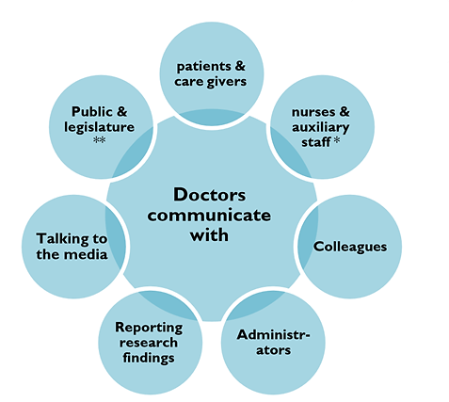
Communication Skills
Communication: With whom?

Slide 20
Communication Skills
Where to apply our Communication skills?
The medical interview is the usual communication encounter between the doctor and the patient.
It can be classified according to the purpose of the interview into 4 types:
History taking
Consultations
Obtaining informed consent
Breaking bad news

Slide 21
Communication Skills
Effective communication, the heart of the art of medicine
Ensures good working relationship.
Increases patients satisfaction.
Increases patients understanding of illness & management.
Improves patients compliance with treatment.
Reduce medico-legal problems.
Reduce uncertainty.

Slide 22
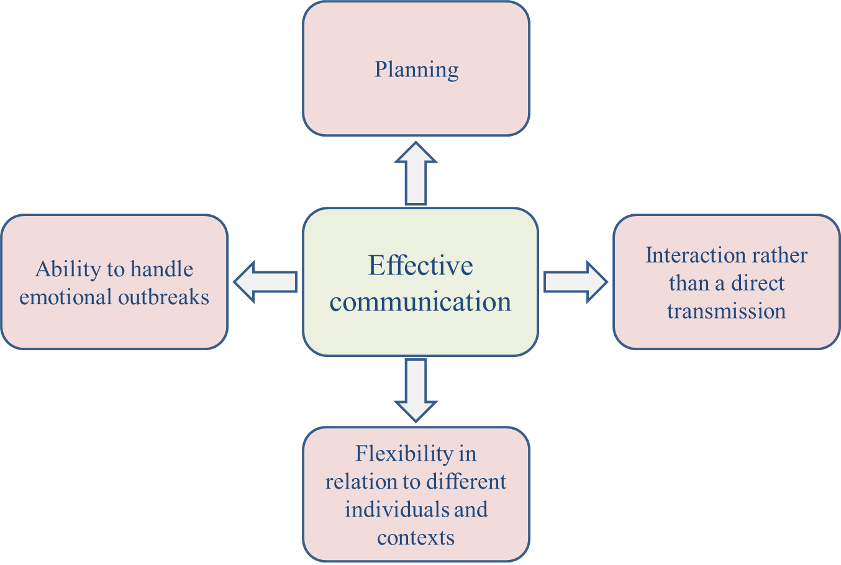
Communication Skills
Principles of effective communication

Slide 23
Communication Skills
Communication & Medical care
Mutual trust & respect.
Exchange information.
Ask your seniors.

Slide 24
Communication Skills
Communication with peers
Good communication should be established between the patient , the family and the treating multidisciplinary team.
Patient & family should be encouraged to participate and verbalize in the ward round discussion about:
Offered medical care & treatment
Rehabilitation
Follow- up/re-admission plans
Doubts & worries
Proper information to patient and family regarding services available and how they can utilize them.

Slide 25
Communication Skills
Communication skills: Some techniques
PRACTICE- fluent dialogue with patient.
USE- silence effectively, allowing patient enough time to express thoughts or feelings.
ENCOURAGE- patients with your supportive words.
UTILIZE - non-verbal communication.
Listening vs Hearing
Hearing | Listening
A passive activity; no effort | Attention
 | Active involvement
 | Full understanding
 | Takes time and effort

Slide 26
Communication Skills
Barriers to effective communication
Personal attitudes
Ignorance
Human failings (tiredness, stress)
Cultural & language barriers
Poor time management
Strenuous working environment
Physical/environmental/biological barriers

Slide 27
Communication Skills
Conclusion
Effective communication is the key to success in professional career.
Good communication is essential for proper doctor-patient relationship and help avoids problems of misunderstanding.

Slide 28
Communication Skills
Further reading
Effective Interact Interaction with Patients.
Faulkner, A (2001), 2nd Ed. Churchill Livingstone, London.
Clinical Communication in Medicine.
Editors(s): Dr Jo Brown, Dr Lorraine M. Noble, Dr Alexia Papageorgiou, Dr Jane Kidd.
Print ISBN:9781118728246 |Online ISBN:9781118728130 |DOI:10.1002/9781118728130
The Complete Guide to Communication Skills in Clinical Practice (pdf).
Walter F. Baile, M.D
https://www.mdanderson.org/documents/education-training/icare/pocketguide-texttabscombined-oct2014final.pdf

Slide 29
Communication Skills
References
1. Hochman O, Itzhak B, Mankuta D, Vinker S. The relation between good communication skills on the part of the physician and patient satisfaction in a military setting. Mil Med 2008;173(9):878–81.PubMedGoogle Scholar.
2. Leite R, Makuch M, Petta C, Morais S. Women’s satisfaction with physicians’ communication skills during an infertility consultation. Patient Educ Counsel 2005;59(1):38–45.CrossRefPubMedGoogle Scholar.
3. Greco M, Spike N, Powell R, Brownlea A. Assessing communication skills of GP registrars: a comparison of patient and GP examiner ratings. Med Educ 2002;36(4):366–76.CrossRefPubMedGoogle Scholar.
4. Jackson JL, Chamberlin J. Predictors of patient satisfaction. Soc Sci Med 2001;52(4):609–18.CrossRefPubMedGoogle Scholar.
Hausberg MC, Hergert A, Kröger C, Bullinger M, Rose M, Andreas S (2012) Enhancing medical students' communication skills: Development and evaluation of an undergraduate training program. BMC Medical Education 12: [PMC free article] [PubMed].
6. Baig LA, Violato C, Crutcher RA (2009) Assessing clinical communication skills in physicians: Are the skills context specific or generalizable. BMC Medical Education 9: [PMC free article] [PubMed].
7. Accreditation Council for Graduate Medical Education (ACGME) (2007) Common program requirements. Available: https://www.acgme.org/acgmeweb/Portals/0/PFAssets/ProgramRequirements/CPRs_07012015.pdf Accessed 15 Oct 2015.
8. American Board of Medical Specialties (ABMS) (2014) Standards for the ABMS Program for Maintenance of Certification (MOC). Available: http://www.abms.org/media/1109/standards-for-the-abms-program-for-moc-final.pdf Accessed 15 Oct 2015.
Association of American Medical Colleges (AAMC) (1998) Report I. Learning objectives for medical student education. Guidelines for medical schools. Available: https://members.aamc.org/eweb/upload/Learning%20Objectives%20for%20Medical%20Student%20Educ%20Report%20I.pdf Accessed 16 Oct 2015.
General Medical Council (GMC) (2009) Tomorrow’s doctors. Outcomes and standards for undergraduate medical education. Available: http://www.gmc-uk.org/Tomorrow_s_Doctors_1214.pdf_48905759.pdf Accessed 15 Oct 2015.
11. World Federation for Medical Education (WFME) (2015) Basic medical education. WFME global standards for quality improvement. The 2015 revision. Available: http://wfme.org/standards/bme/78-new-version-2012-quality-improvement-in-basic-medical-education-english/file Accessed 15 Oct 2015.
12.. Smith RC, Lyles JS, Mettler J, et al. The effectiveness of intensive training for residents in interviewing. Ann Intern Med 1998;128(2):118–26.PubMedGoogle Scholar.

