Slide 1

Volunteering works and the role of medical professionals in serving the community
221 Professionalism course
KSU 2020
Prof. Sulaiman Alshammari
Professor & Consultant -Family and Community Medicine

Slide 2
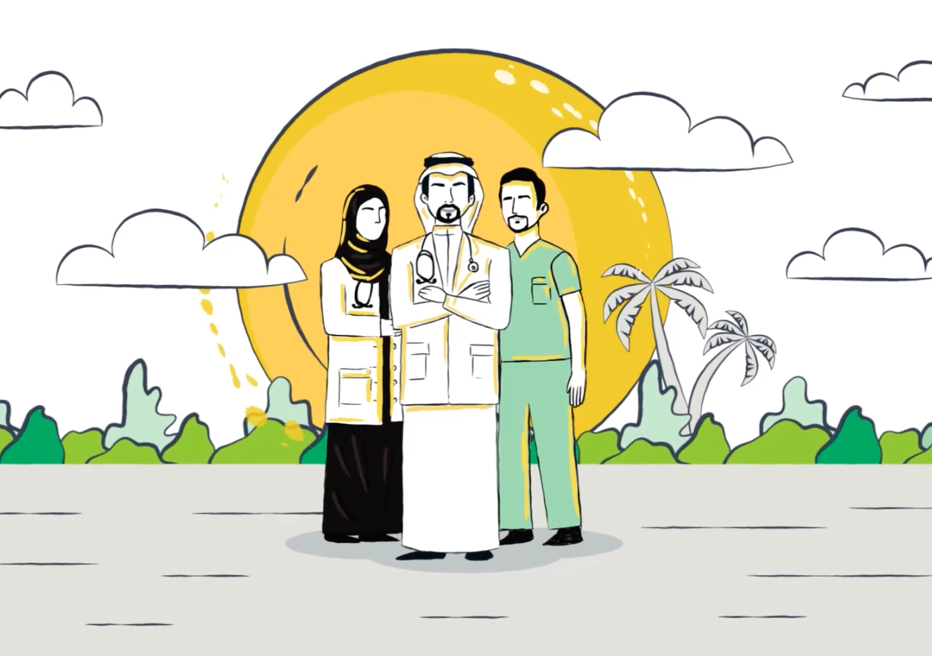
Objectives
Describe the spectrum of volunteering works.
Discover the aims of volunteering works
Describe the steps of preparation of volunteers.
Identify the expectations of volunteers.
Demonstrate how to act along the social, public and community responsibilities as a professional.
Recognize opportunities in the volunteering.
Apply the ethics of volunteering.
Practice as a volunteer.

Slide 3
How can we help those in needs?

Slide 4
Volunteering is promoted as a way of enhancing students’ career prospects, at the same time as getting involved in community activities
Students are increasingly exalted to build up their CV profiles in the pursuit of enhancing employability
Clare Holdsworth (2010) Why Volunteer? Understanding Motivations For Student Volunteering, British Journal of Educational Studies, 58:4, 421-437

Slide 5
Volunteering work
University
College
Student organization
Individual student

Slide 6
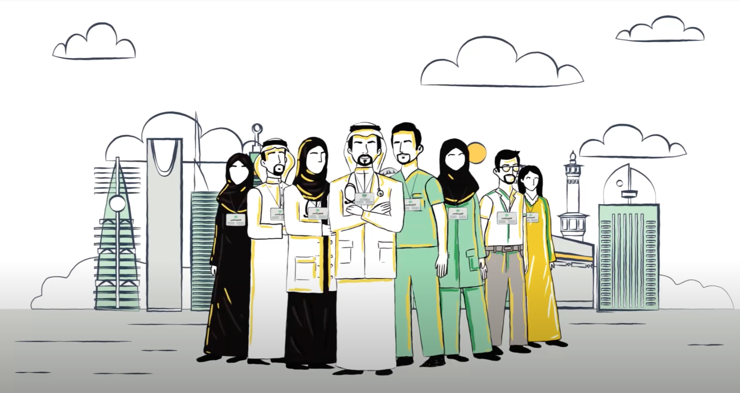
Volunteering work
What is volunteering
Who is the volunteer
Why do you want to be a volunteer (benefits)
What difficulties stop you becoming a volunteer.
How to be a volunteer
How to start an awareness campaign
Report writing and presentation of volunteering work.

Slide 7
What is volunteering?
Volunteering is defined as “any activity which involves spending unpaid,time, doing something which aims to benefit someone (individuals or groups) other than or in addition to close relatives, or to benefit the environment.”

Slide 8
Volunteering as an education activity
In some universities and colleges, volunteer activities are part of the curriculum. These activities are often organized like other curricular programs; students are given a set number of hours’ work to complete, followed by assessments.
Khasanzyanova A. How volunteering helps students to develop soft skills. Int Rev Educ (2017) 63:363–379

Slide 9
Volunteer motivation
Expectancy Motivation Theory
this theory suggests that behavior is caused by a belief
that it will result in a desired reward or goal.
Three factors affect behavior:
The need for achievement, which is defined as the capacity for taking pride in accomplishment
The need for affiliation, defined as the concern for one’s relationships with others
The need for power, or wanting to have an influence or impact on others.
Janet C. Winniford, D. Stanley Carpenter & Clint Grider (1997) Motivations of College Student Volunteers: A Review, NASPA Journal, 34:2, 134-146, DOI:10.2202/1949-6605.1015

Slide 10
Volunteer motivation
B. Altruistic Motivation
altruism is an aspect of human motivation that is present to the degree that the individual derives intrinsic satisfaction or psychic rewards for attempting to optimize the intrinsic satisfaction of one or more other persons without the conscious expectation of participating in an exchange relationship.
Janet C. Winniford, D. Stanley Carpenter & Clint Grider (1997) Motivations of College Student Volunteers: A Review, NASPA Journal, 34:2, 134-146, DOI:10.2202/1949-6605.1015

Slide 11
Factors favor volunteering
Internal
External
Self esteem
Generosity
Social responsibility
Personal satisfaction
Social status
Family traditions
Identification with organization/college
Personal obligation
Professional image
Recognition from society
Organizational/college image
Organizational/college reputation
Holidays
Natural disasters
Being invited
C.Vs differentiation
Identification with other volunteers (friend/family)

Slide 12
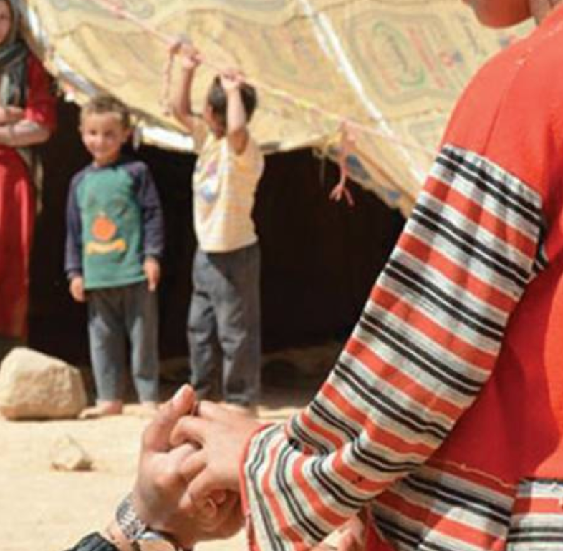
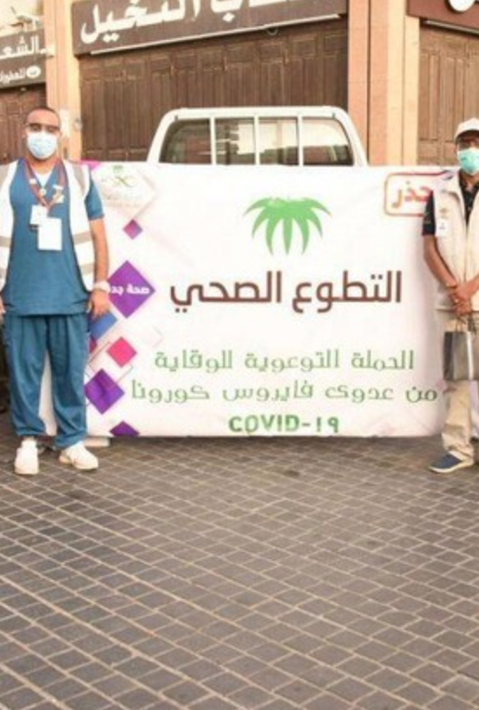
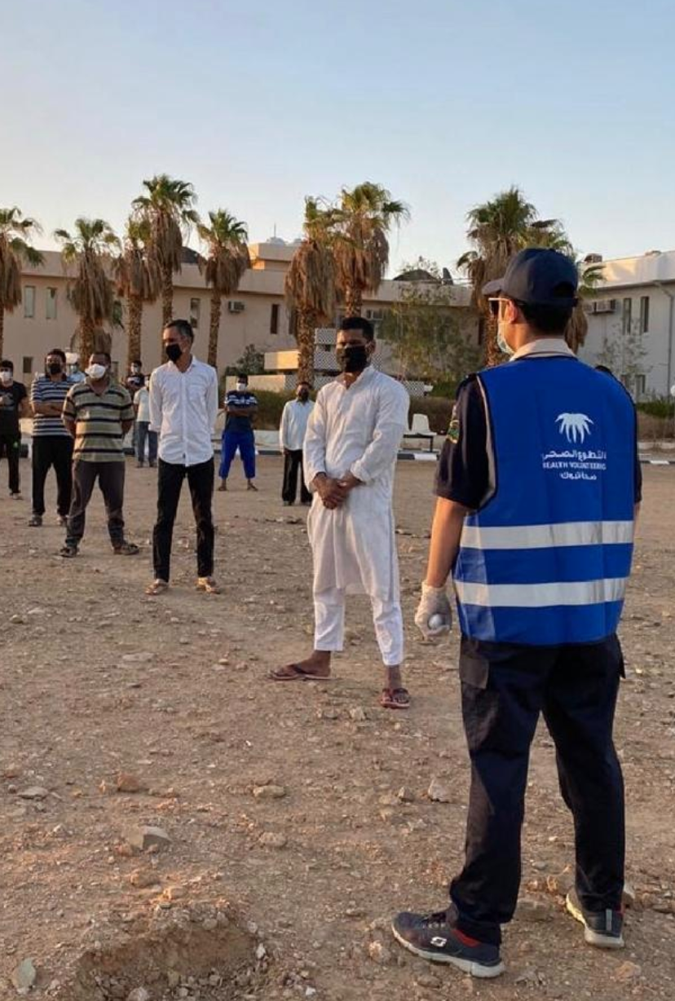
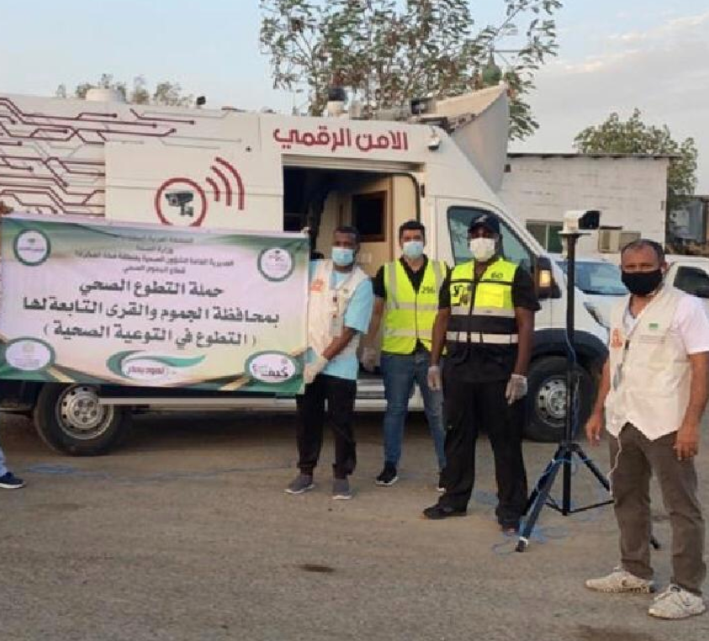
Notes:
عمل مركز التطوع الصحي في وزارة الصحة السعودية، على إطلاق مبادرة "الممارس الصحي مستعد"، التي تهدف إلى استقطاب المتطوعين الصحيين وتأهيلهم ليكونوا على استعداد، في حال الحاجة إليهم.
وبلغ عدد المسجلين في المبادرة، أكثر من 78 ألف متطوع ومتطوعة، حسب ما ذكرت وكالة "واس".
وتأتي هذه المبادرة في ظل الأزمة التي يشهدها العالم بسبب وباء "كوفيد-19"، الذي يتطلب جهدا كبيرا في مجال الاهتمام الصحي والتوعوي.
كما شارك مركز التطوع الصحي في مبادرة "مجتمع واعي" التي تهدف إلى تفعيل التطوع الميداني، بالتعاون مع الإدارة العامة للتطوع بوزارة الموارد البشرية والتنمية الاجتماعية ومجلس الجمعيات الأهلية، وبتنفيذ من الجمعيات الصحية المتخصصة، مثل "جمعية التطوع الصحية أثر".
وقال مدير عام مركز التطوع الصحي في وزارة الصحة السعودية، سفر بتار، إن العمل التطوعي هو "أحد أهم مبادرات وزارة الصحة تجاه مثل هذه الأحداث، التي تتطلب إدارة الأزمات بعناية".

Slide 13
عدد المتطوعين اثناء جائحة كرونا حتى ابريل ٢٠٢٠

Slide 14


Slide 15
Principles of Volunteering
Is mutually beneficial (to individual and organisation)
Is independently chosen and freely given
Is enabling and flexible wherever possible
Has a community or social benefit
Offered to not-for-profit activities

Slide 16


Ethics of volunteering
Respect
Responsibility
Compassion and generosity
Justice and fairness
Trustworthiness

Slide 17

Who is the volunteer?
is someone who does work without being paid for it, because they want to do it.
is someone who offers to do a particular task or job without being forced to do it.

Slide 18
Why do you want to be a volunteer (benefits)?
There are numerous reasons you should consider making volunteering a part of your every day life
Volunteers live longer and are healthier. during later life, volunteering is even more beneficial for one's health than exercising and eating well.
Volunteering establishes strong relationships. study reported that prevalence of loneliness is at an all time high, with about one in three adults age 45 or older categorized as lonely. Dedicating your time as a volunteer helps you make new friends, expand your network, and boost your social skills.
Volunteering is good for your career. Volunteering has long been viewed as a way to create new “weak tie” connections that lead to career opportunities

Slide 19
Why do you want to be a volunteer (benefits)?
4- Volunteering is good for society.
5. Volunteering gives you a sense of purpose. Although it is not well-understood why volunteering provides such a profound health benefit, a key factor is assumed to be that volunteering serves to express and facilitate opportunities to carry out one’s sense of purpose.
  Volunteering helps counteract the effects of stress, anger, and anxiety.
  Volunteering combats depression.
  Volunteering increases self-confidence.
  Volunteering helps you stay physically healthy.

Slide 20
What difficulties/obstacles stop you becoming a volunteer?
Conceptual model on reasons not to volunteer, based on three-fold classification of Bradyet al. (1995).

Slide 21
What difficulties/obstacles stop you becoming a volunteer?
Preconceptions and attitudes within your organization/ college
Inadequate community communication
Limited experience
History of being ignored
Resistant leaders
Sense of powerlessness
Lack of time
Lack of transportation
Lack of child care
Overcommitted leaders or citizens
Too many involved
Poor organization of existing action groups
History of unproductive meetings

Slide 22

How to be a volunteer?
z

Slide 23

https://www.lifeclubksu.com/

Slide 24
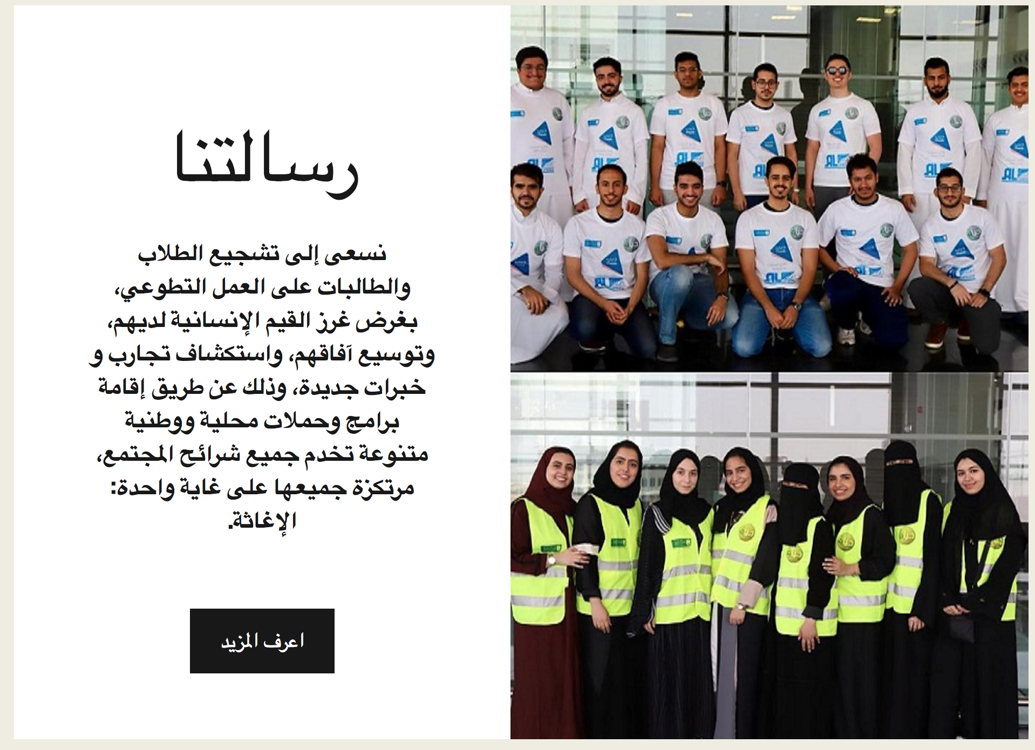

Slide 25
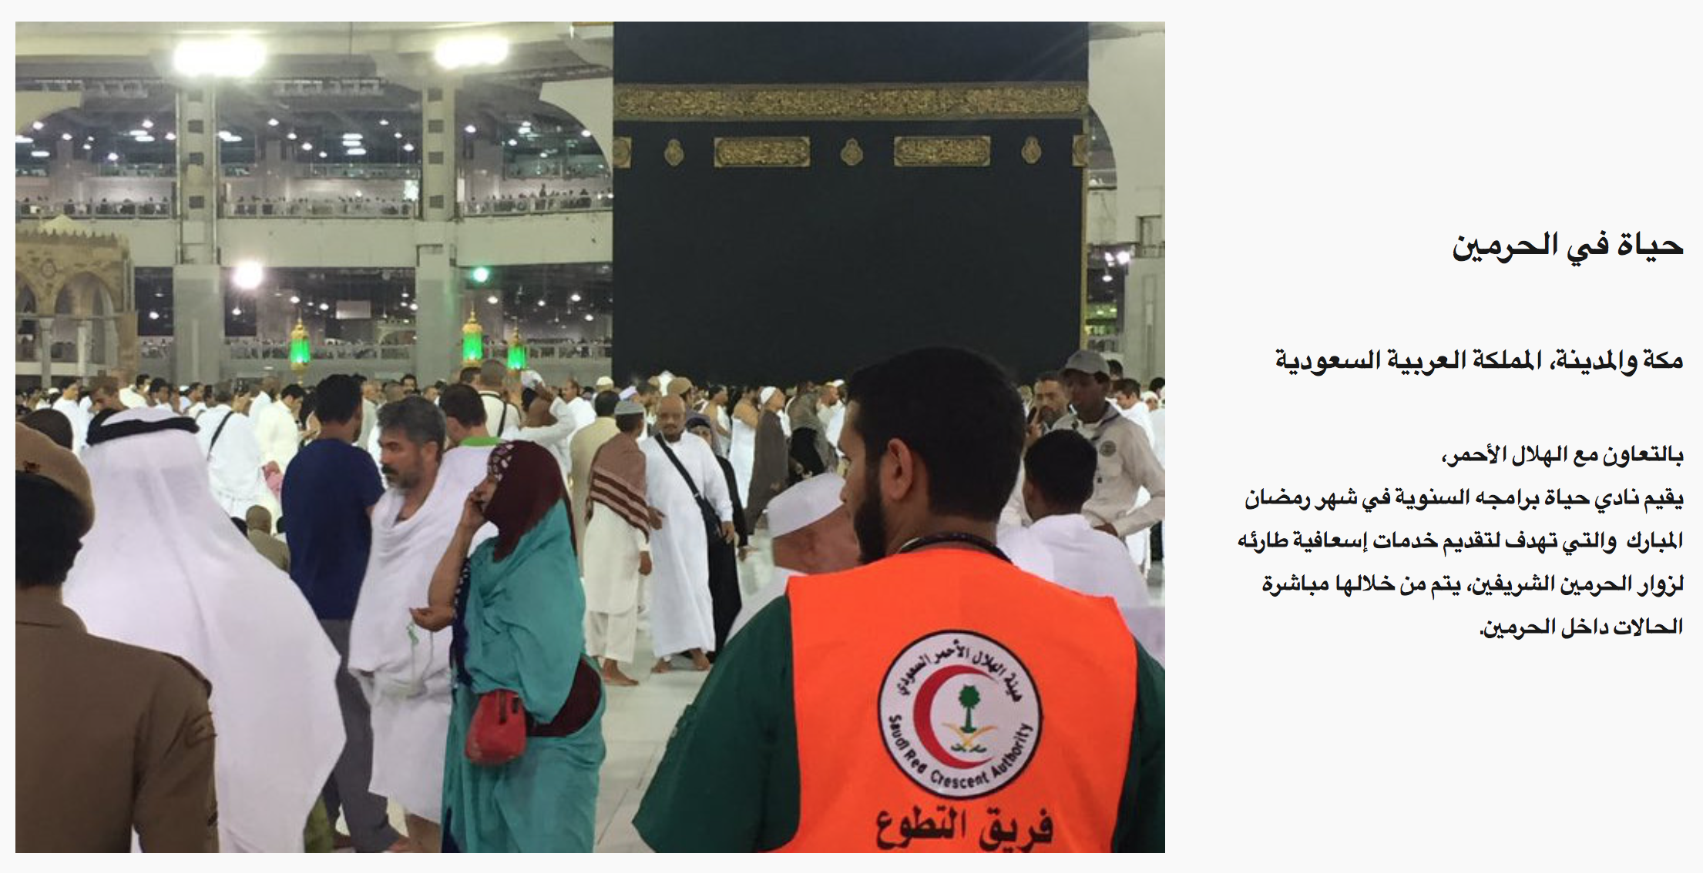

Slide 26
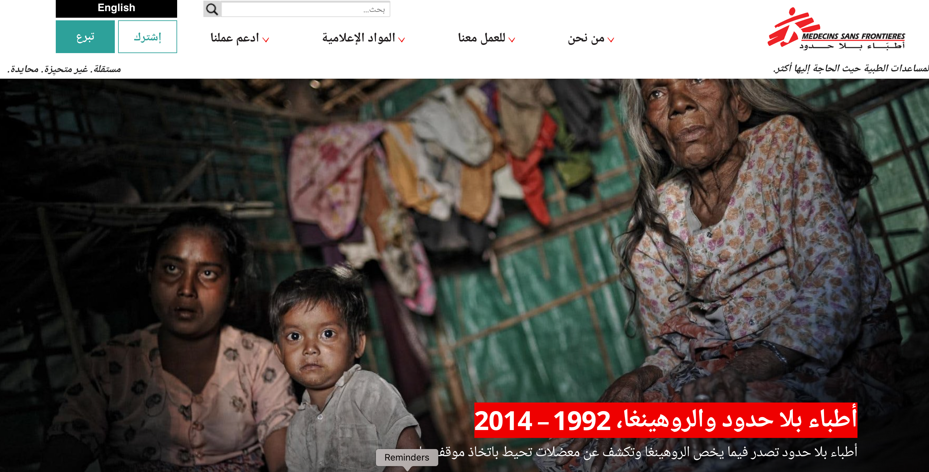
https://www.msf-me.org/ar

Slide 28

https://srcavolunteer.srca.org.sa/#!/home

Slide 29
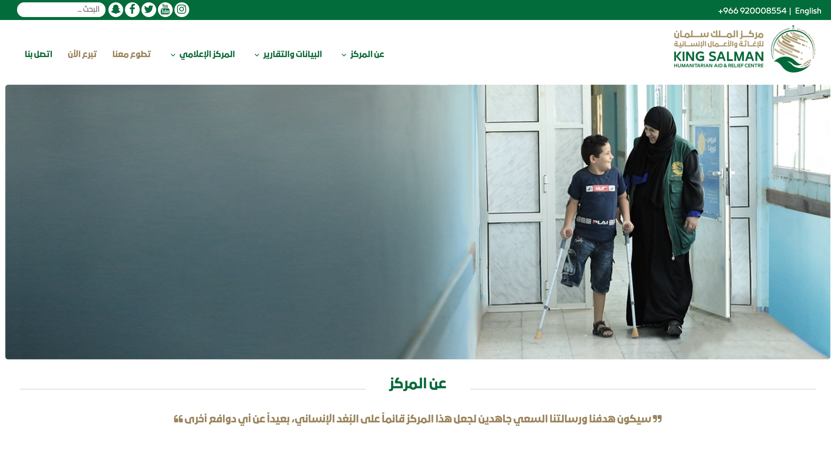
https://www.ksrelief.org/

Slide 30

http://www.kfshrc.edu.sa/ar/home/giving/volunteer

Slide 31

https://athar.org.sa/

Slide 32

https://volunteer.srca.org.sa/#!/home

Slide 33
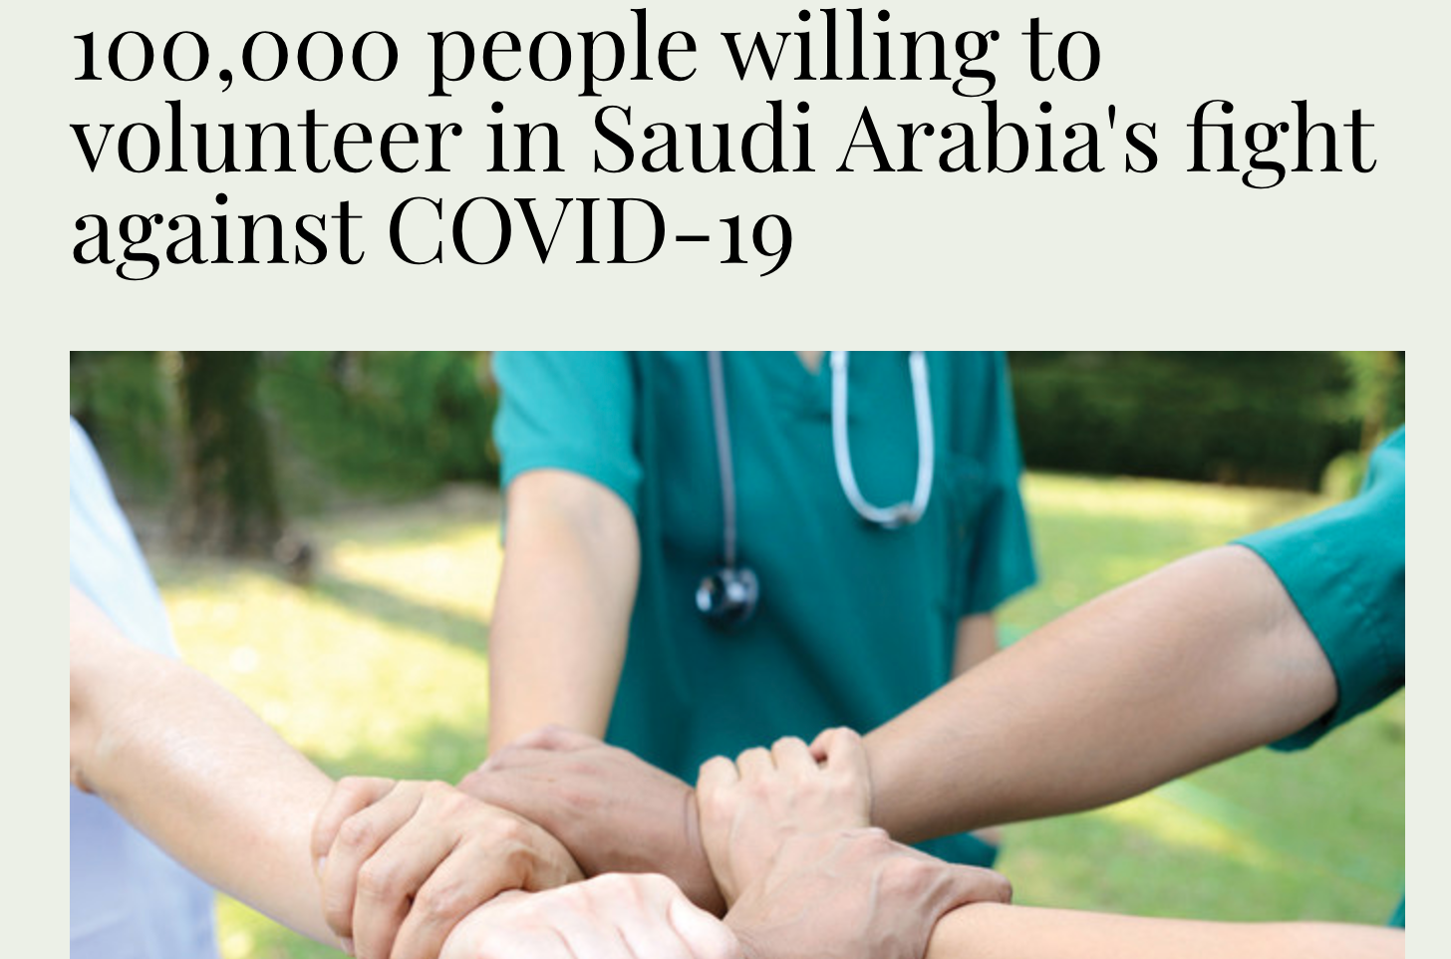

Slide 34
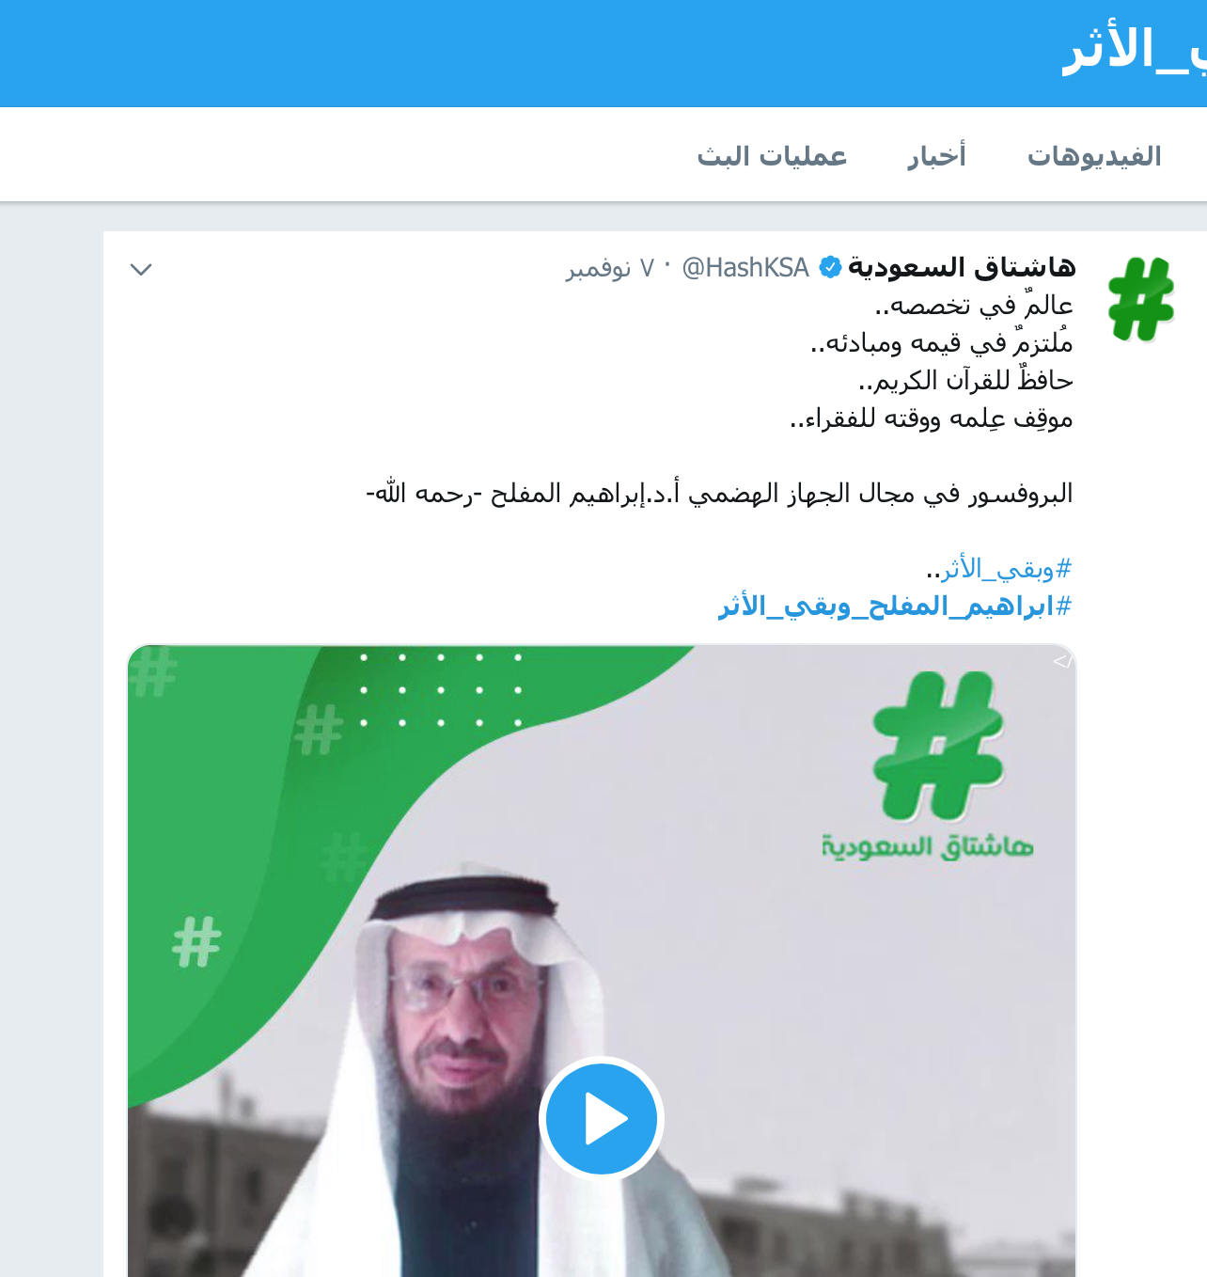

Slide 35
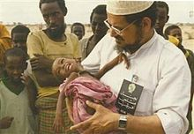

Slide 36

Tips for getting started
First, ask yourself if there is something specific you want to do.
For example, do I want…
…to make it better around where I live
…to meet people who are different from me
…to try something new
…to do something with my spare time
…to see a different way of life and new places
…to have a go at the type of work I might want to do as a full-time job
…to do more with my interests and hobbies
…to do something I’m good at
The best way to volunteer is to match your personality and interests.
Having answers to these questions will help you narrow down your search.
Source: World Volunteer Web

Slide 37
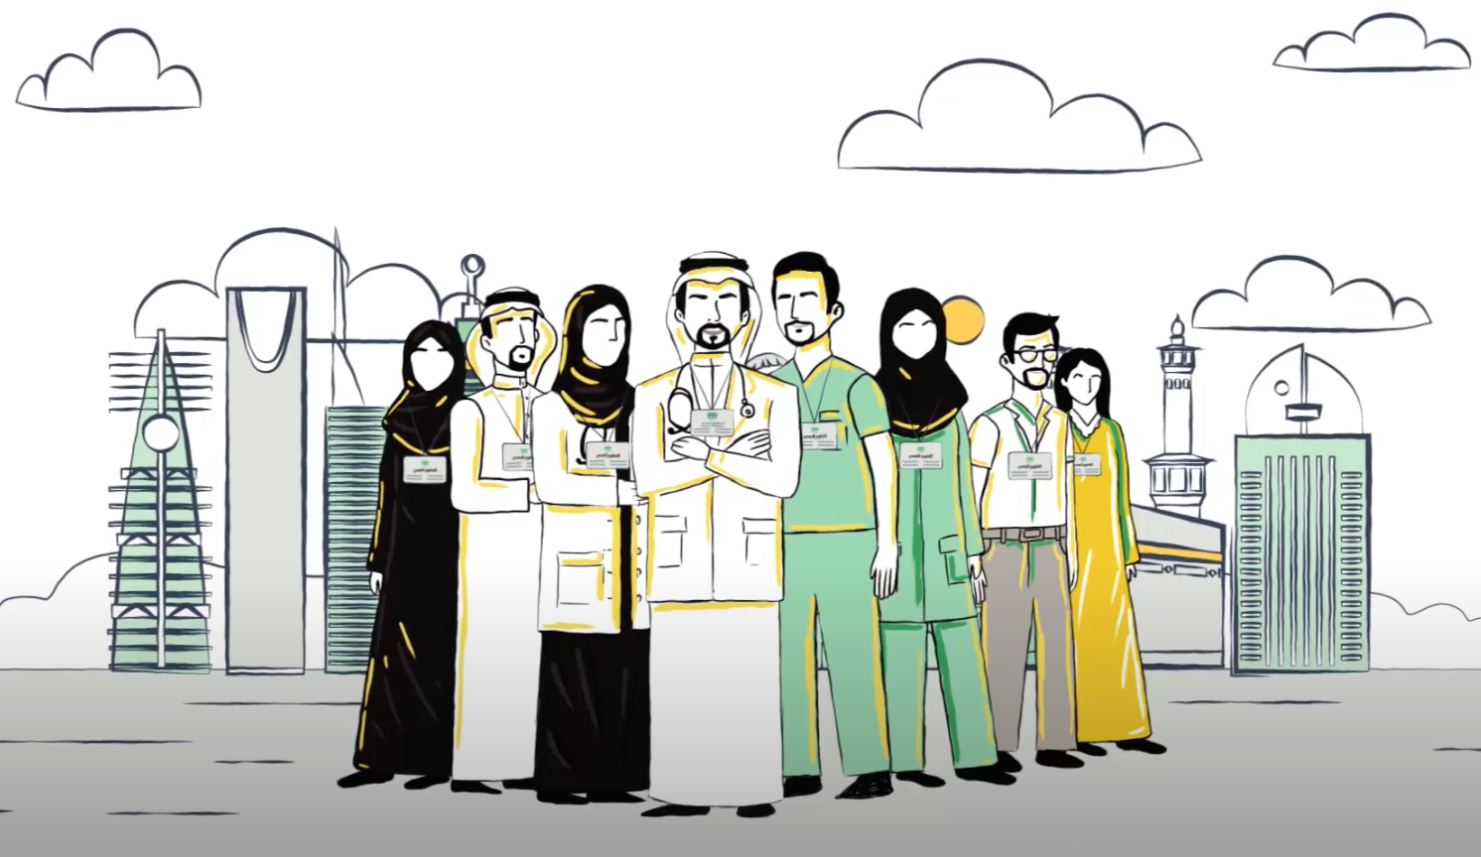
How to find the right volunteer opportunity
Ask yourself the following:
Would you like to work with adults, children, or remotely from home?
Do you prefer to work alone or as part of a team?
Are you better behind the scenes or do you prefer to take a more visible role?
How much time are you willing to commit?
What skills can you bring to a volunteer job?
What causes are important to you?

Slide 38

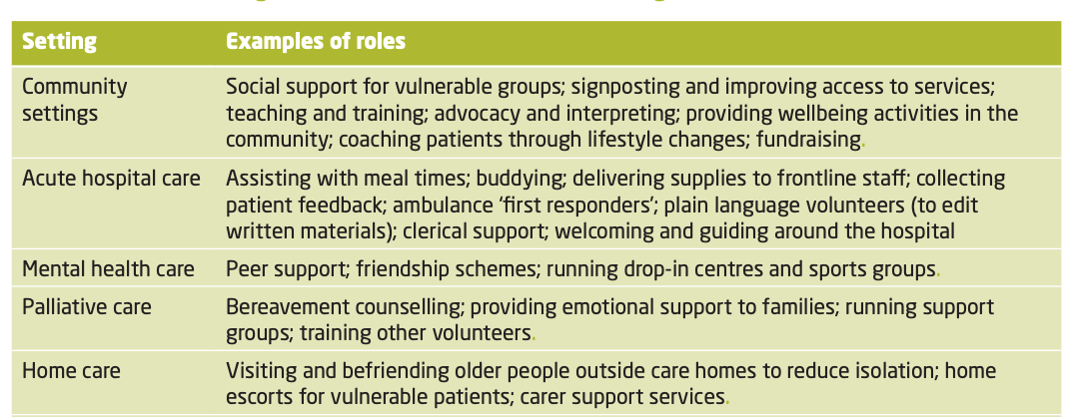
Volunteering in health and social care
settings and roles

Slide 39

Examples of volunteering project
How to start an awareness campaign
z

Slide 40
The Precede-Proceed Model
The model involves nine phases is based on the premise that a thorough assessment (Precede) should be made before planning a health promotion intervention, and evaluation (Proceed) is built in to the process to enable measurement of the effectiveness of interventions.
Priority targets for intervention are established through each phase of the assessment process (phases 1–5) on the basis of causal importance in the chain of health determinants, their prevalence and their changeability.

Slide 41
The Precede-Proceed Model
The results of this assessment process guide the development of the intervention (phase 6)
The evaluation (phases 7–9) then tracks the impact of the intervention on factors identified as important targets in the assessment process.

Slide 42
Application of the Precede-Proceed Model to The Compass Strategy.

Slide 43
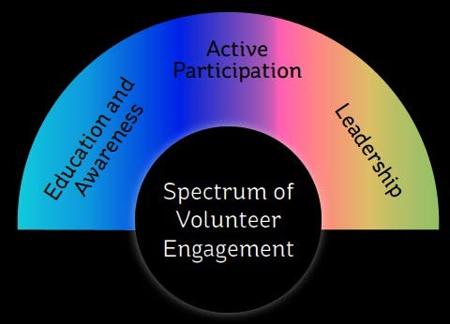

Slide 44
منصة العمل التطوعي
فَمَن تَطَوَّعَ خَيْرًا فَهُوَ خَيْرٌ لَّهُ سورة البقرة (184)
حاضنة سعودية للعمل التطوعي توفر بيئة آمنة
تخدم وتنظم العلاقة بين الجهات الموفرة للفرص التطوعية والمتطوعين في المملكة.
https://youtu.be/1BT4DBNKSzA

Slide 45

Assignment
Report writing and presentation of health volunteering project proposal
z

Slide 46
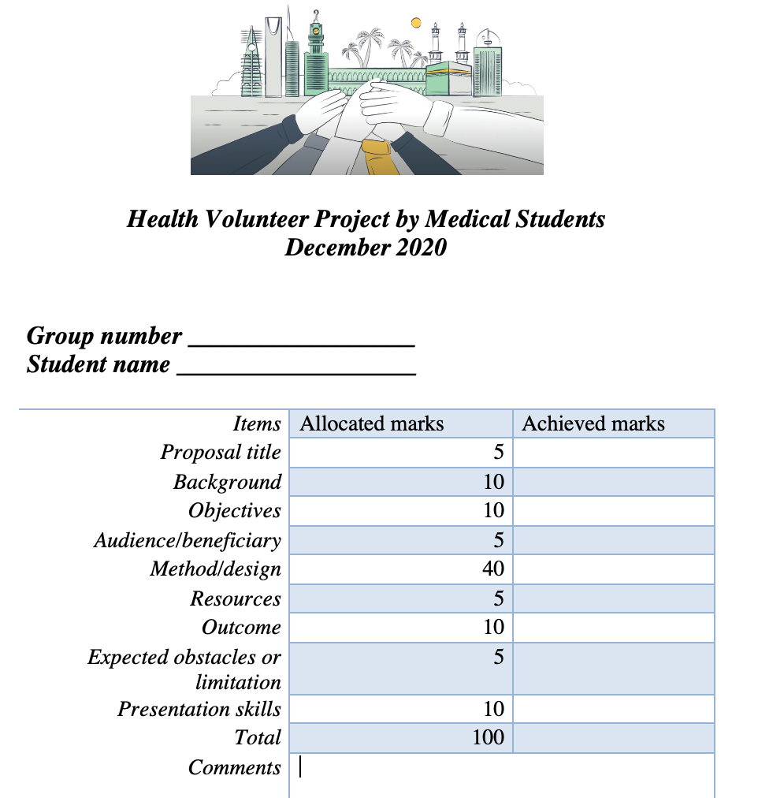
Report writing and presentation of health volunteering project proposal
PLEASE Use the provided template to write the details of your proposed volunteer project. The maximum number of pages is six pages.
PLEASE Attach the details of the student name and task of each participant in your group.
PLEASE attach a sketch of your proposed project workflow.
Instructions for PowerPoint Presentation: maximum of ten slides, minimum font size 16, the time allowed to present your project is 7 minutes.

Slide 47
PROPOSAL FOR VOLUNTEERING WORKS
STUDENTS NAMES:
Proposal title:
Is the title clear and concise? Innovative? Novel?
Background:
Elaborate literature review on the reasons why this project is important, what is the strategic importance of this.
OBJECTIVES:
What is your addressing with this project. What is the projects, what does it aspire to achieve.
AUDIENCE/BENEFICIARY:
Who are the target population, how there were defined and why,
METHOD/DESIGN/Project plan:
How the team plans to deliver this project? Is there a timeline that is realistic? What consideration were taken into account?
RESOURCES:
Does the proposal include an estimation of resources needed, financial, logistical, and human power? Are they realistic and balanced?
Is there an efficient use of resources?
OUTCOME measurement/ statistics and data acquisition:
What data and statistics the team would want to capture? How does this help? How (if possible) the outcome and impact of the proposal can be measured?
SUPERVISOR:
Where you able to recruit a supervisor? What got them interested?

Slide 48
وحدة التطوع والعلاقات المجتمعية
التشكيل
الوصف الوظيفي
الخطة الزمنية
مؤشرات الاداء

Slide 49
مسؤولية الوحدة
1) ... إقتراح البرامج والمبادرات والمشاريع ذات الصلة بالهدف الثامن.
2) ... إنشاء بنية تحتية للجان لإنتاج المحتوى والمشاركة والمشاركة في البرامج المذكورة وما إلى ذلك.
3) الموضوعات التي يجب تغطيتها ، نوع الوسائل ، المواصفات الفنية (طول النص ، مدة المقابلة ، النطاق العام).
4) ... التنسيق عن كثب مع اللجان في الاقسام
5) ... المساعدة والتوجيه للجان لتسجيل فرقها على منصات التطوع الوطنية.

Slide 50
المتوقع من اللجان في الاقسام
1) ... الحفاظ على اتصال ممتاز وفي الوقت المناسب مع الوحدة عبر وسائل اتصال رسمية وفعالة.
2) ... تقديم التغذية الراجعة للوحدة عندما يُطلب منها ذلك فيما يتعلق بسير العمل والبنى التحتية والبرامج.
3) ... المشاركة بشكل احترافي مع "الوحدة" في المهام المعينة ، وضمان تسليم المنتجات المطلوبة في الوقت المناسب.
4) ... المشاركة المهنية مع الوحدة فيما يتعلق ببرامج التوعية الصحية من حيث التوظيف والتعيين.
5) ... التسجيل النشط وفي الوقت المناسب لفريق المتطوعين في الإدارات على منصات التطوع الوطنية.

Slide 51
References
Janet C. Winniford, D. Stanley Carpenter & Clint Grider (1997) Motivations of College Student Volunteers: A Review, NASPA Journal, 34:2, 134-146, DOI: 10.2202/1949-6605.1015
Khasanzyanova A. How volunteering helps students to develop soft skills. Int Rev Educ (2017) 63:363–379
Clare Holdsworth (2010) Why Volunteer? Understanding Motivations For Student Volunteering, British Journal of Educational Studies, 58:4, 421-437, DOI: 10.1080/00071005.2010.527666
Matti Ullah Butt , Yu Hou , Kamran Ahmed Soomro & Daniela Acquadro Maran (2017) The ABCE Model of Volunteer Motivation, Journal of Social Service Research, 43:5, 593-608, DOI: 10.1080/01488376.2017.1355867
GÓMEZ, P. & FERNÁNDEZ, J.L. (2017): “Brakes and barriers of Corporate Volunteering”,
CIRIEC-España, Revista de Economía Pública, Social y Cooperativa, 90, 253-290.
Wright A. Development and evaluation of a youth mental health community awareness campaign – The Compass Strategy. BMC Public Health 2006, 6:215 doi:10.1186/1471-2458-6-215. http://www.biomedcentral.com/1471-2458/6/215

