Slide 1
Human Factors & Patient Safety

Slide 2
Objectives
After completing this lecture you should:
Define and describe the Human Factors and its relation to patient safety
Recognize the importance of applying human factors in healthcare
Summarize the impact of Human Factors on people’s health and patient safety
Differentiate between the different types of Medical Errors
Describe several specific Actions to reduce medical errors as related to Humans Factors

Slide 3
What are Human Factors
Human factors refer to environmental, organizational and job factors, and human and individual characteristics which influence behavior at work in a way which can affect health and safety.

Slide 4
What are Human Factors?
Human factors can be defined as anything that affects an individual’s performance.

Slide 5
What are Human Factors
A simple way to view human factors is to think about three aspects:
1
The job
2
The individual
3
The organization

Slide 6
1
The job
Including :
Nature of the task
Workload
Working environment
This includes matching the job to the physical and the mental strengths and limitations of people.

Slide 7
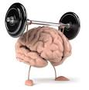
2
The individual
Including:
Competency
Skills (changeable)
Personality, attitude(fixed)
Risk perception
Sleep deprivation
Individual characteristics influence behavior in complex ways.

Slide 8
3
The organization
Including:
The culture of the workplace, resources Communications
Leadership and so on.

Slide 9
The Benefits of Applying Human Factors in Healthcare
Awareness of human factors can help you to:
To prevent Medical Errors.
Understand why healthcare staff make errors.
Identify ‘systems factors’ threaten patient safety.
To prevent occupational accidents and ill health.

Slide 10
Medical errors
Failure of a planned action to be completed as intended or the use of a wrong plan to achieve an aim

Slide 11
Medical Errors
Expired medication dispensed
Un planned hysterectomy
Wrong Sponge counting
Self extubation
Wrong patient ID , went to wrong procedure
Wrong medication delivered
Wrong dose administered

Slide 12
Sources of Error

Slide 13
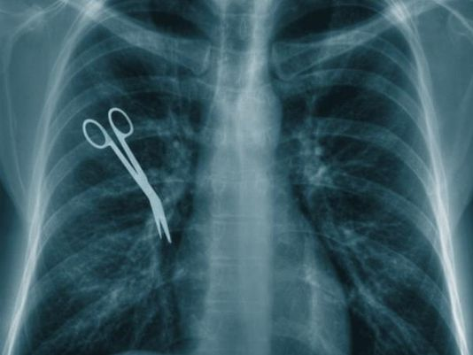
The Most Common Medical Errors
Wrong site surgery (13.4%)
Patient suicide (11.9%)
Operative and post operative complication (10.8% )
Delay in treatment (8.6 %)
Medication error (8.1 %)
Patient fall (6.4 %)

Slide 14
Burden of the Medical Errors
How many of you know or had come cross any Medical Error?

Slide 16
Causes of Medical Errors ?
Healthcare Complexity
System and Process Design
Environmental factors
Infrastructure failure.
Human Factors and Ergonomics

Slide 17
How Does the Team Communicate?
Causes of Medical Errors
1- Healthcare Complexity
Complicated technologies
Drugs interaction.
Intensive care
Prolonged hospital stay.
Multidisciplinary approach
Healthcare Complexity

Slide 18
2- System and Process Design
Inadequate communication,
Unclear lines of authority
System and Process Design

Slide 19
Cont:
Environmental factors
3- Environmental factors.
Over crowded services
Unsafe care provision areas
Areas poorly designed for safe monitoring
4- Infrastructure failure.
Lack of documentation process
Lack of continuous improvement process
Infrastructure failure.

Slide 20
Cont:
Human Factors and Ergonomics
5- Human Factors and Ergonomics
Hungry
Angry/ Emotions
Late/ lazy
Tired/fatigue/sleep less
lack of skilled workers.
Lack of training.

Slide 21
Actions to Reduce Medical Errors as Related to Humans Factors
Organizational Management and Human Factors
Making your care and work safer (individual level )

Slide 22
Making your care and work safer (individual level ) | Organizational Management and Human Factors
Stress Focus first on the tasks that are high risk or where it is particularly important In emergency situations : use algorithms and protocols Quickly allocate a clear leader Consider if there is a way of running a simulation with your team | Developing a positive safety culture Just culture Reporting culture (e-OVR Reporting system) Learning culture(Morbidity and mortality review process)
Complex calculations Find out if there is a pre-calculated list available in your area Before you start the task, think about ways of managing or avoiding distractions. For example, ask a colleague to take your bleep for a minute Look at the dose strengths of ampoules in your drug cupboard Double check with your colleague | Human factors training in healthcare
 | Develop Clinical Practice Guidelines , protocols , algorithms.. etc

Slide 23
Making your care and work safer (individual level ) | Organizational Management and Human Factors
Storage Look at the products you use and have stored. E.g Look-alike packaging
Physical demands Physical tiredness :get enough sleeping before your duty Demands exceeding capability : Most people at some time overestimate their abilities or underestimate their limitations.
Teamwork Briefing and debriefing can help teams develop a shared mental model of a planned procedure or a patient’s clinical status SBAR (Situation, Background, Assessment, Recommendation)
+ Poor lighting: Look at the lighting in the areas where you need to +perform detailed or complex tasks

Slide 24
Watch the video
https://www.youtube.com/watch?v=aGZz3w5Hy8Y

Slide 26
A child with a known penicillin allergy was prescribed and administered an intravenous dose of an antibiotic of the penicillin class2
A child was due to have a pacemaker fitted. On pre-admission an allergy to penicillin was recorded. This was noted on both the nursing admission assessment form and the anesthetic record chart. Prior to operation, the allergy was discussed with the specialist pediatric cardiology registrar, the consultant pediatric anesthetist, anesthetic specialist registrar and the cardiology consultant. However, following the procedure the patient’s plan included intravenous and oral penicillin.

Slide 27
How did this happen?
There was no up-to-date protocol on what other antibiotics should be used if a pediatric cardiac patient has a penicillin allergy
There was no clear record of the allergy in the medical
No system was in place to prevent penicillin prescription when a known allergy was recorded.
A number of appropriate checks were not followed prior to administration of the antibiotics.
During independent checks, neither nurse checked allergy status, and both were under pressure to complete tasks.
The patient’s allergy band was on the same side as their identity band, both of which were covered with a bandage for an intravenous drip.

Slide 28
Do you think the outcome could be quite different if human factors had been taken into account?
How we can prevent such error by applying human factors in healthcare?

Slide 29
OVR(Occurrence Variance Reporting) or IR(Incident Reporting)
Occurrence :An Occurrence is defined as any event or circumstance that deviates from established standards of care & safety.
OVR :an internal form/system used to document the details of the occurrence/event and the investigation of an occurrence and the corrective actions taken.

Slide 30
OVR Sample :
http://medicinequality.ksu.edu.sa/ContentData/QualityPolicies/en_2044-37-689042734-OVR%20Annual%20Report%202012.pdf

