Slide 1
Understanding & Managing Clinical Risk

Slide 2
Learning objective
By end of this lecture you will be able to
  Understand how you can learn from errors.
  Identify situational and personal factors that are associated with the increased risk of error.
  Participate in analyses of adverse event and practice strategies to reduce errors.
  Know how to apply risk-management principles in the workplace.
  Know how to report risks or hazards in the workplace.

Slide 3
Introduction
Risk management is routine in most industries and has traditionally been associated with limiting litigation costs.
Usually associated with patients taking legal action against a health professional or hospital.
To avoid problems, hospitals and health organizations use a variety of methods to manage risks.
Hospitals are potentially dangerous places for patients as well as medical workers.
It’s important to keep in mind that while there are a lot of potential hazards in hospitals, creating and maintaining safe systems of care could be.

Slide 4
Clinical Risk Management
Hazard
Risk
Risk Management

Slide 5
Clinical Risk Management
Hazard: is any activity, situation or, substance that potential to cause harm, including ill health, injury, loss of product and/or damage to plant and property.
  Blood borne Pathogens
  Hazardous Chemicals
  Stress
Risk: is the probability that harm (illness or injury) will actually occur.
Risk Management: Organizational effort to identify, assess, control and evaluate the risk to reduce harm to patient, visitors and staff and protect the organization from financial loss.

Slide 6
Purpose of Risk Management
Improve organizational and client safety.
Identify and minimize the risks and liability losses.
Protect the organization resources.
Support regulatory, accreditation compliance.
Creating and maintaining safe systems of care, designed to reduce adverse events and improve human performance.

Slide 7
Process Used to Manage Clinical Risks
The following simple four process is commonly used to manage clinical risks:
Identify the risk
Assess the frequency and severity of the risk
Assess the costs saved by reducing the risk or the costs of not managing the risk
Reduce or eliminate the risk

Slide 8
Identify the risk
Use the following data as a sources for identification:
  Adverse event reports.
  Mortality and morbidities reports.
  Patient complaints reports.
  Assess the frequency and severity of the risk

Slide 9
Assess the frequency and severity of the risk
SAC (Severity Assessment Code) Score:
It is a matrix scoring system/ numerical scores are given to the severity and likelihood of risks and these scores are multiplied to get a rating for the risk.
SAC is a numerical score that rates incidents affecting a patient or security incidents. The score is based on the consequence of that incident and also the likelihood of its recurrence.
The SAC Matrix assists in calculating the score. The score guides the level of incident investigation or review that is undertaken.

Slide 10
SAC steps
The SAC score is applied to all incidents whether they are of a corporate or a clinical nature. The SAC matrix is the method by which the SAC score is derived. The steps are:
• Using Step 1: determine the actual consequence of the incident (Serious, Major, Moderate, Minor and Minimal);
• Using Step 2: determine the likelihood of recurrence of this incident (Frequent, Likely, Possible, Unlikely, rare) ;
• Using Step 3: allocate a SAC score to the incident;
• Using Step 4: determine the appropriate action to be taken.

Slide 11
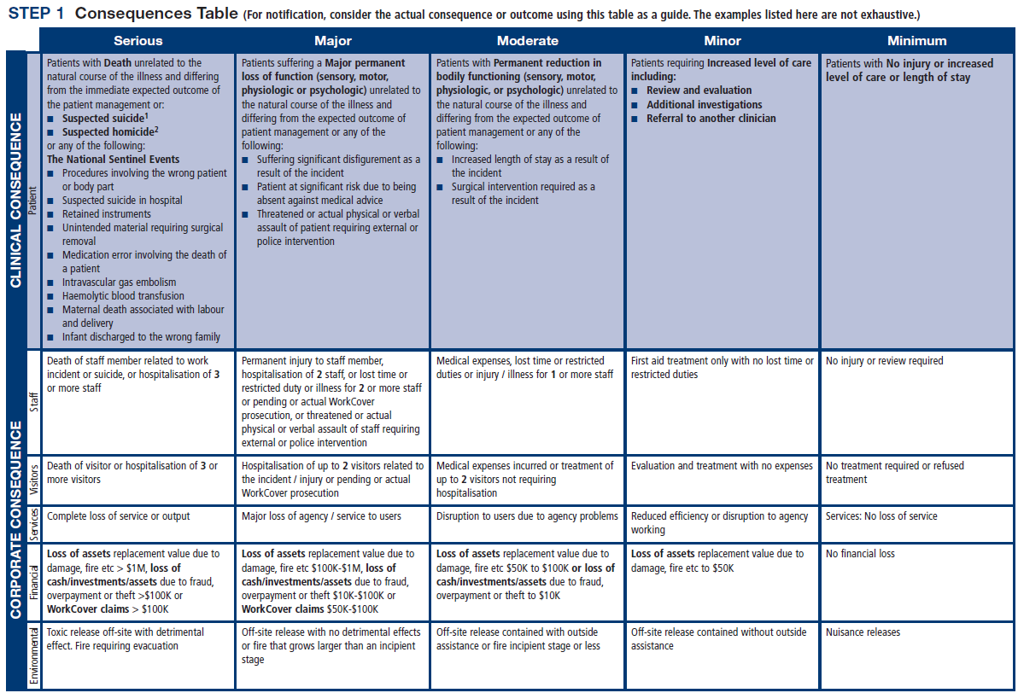

Slide 14
Reduce or eliminate the risk

Slide 15
SAC Score example Case 1
Whilst providing routine care nursing staff where showering a patient in the shower room on the ward. The patient was seated in a chair being washed when he slid off the chair and hit his face, hip and shoulder. The doctor examined the patient and x-rays were ordered. No fractures were noted. The patient returned to the ward where neurological checks were initiated according to policy and reported as normal.
Actual consequence based on scenario: Minor
Based on the experience of the evaluator, the likelihood is: Likely
SAC score: 3

Slide 16
SAC score example Case 2
A patient in the ICU developed cardiac arrhythmias but the monitor failed to trigger the alarm. The arrhythmia was observed by two nurses. As the patient was determined to be NFR (Not For Resuscitation), he was not resuscitated.
Actual consequence based on scenario: Minimum
Based on the experience of the evaluator, the likelihood is: Unlikely
SAC score: 4

Slide 17
Activities Commonly Used to Manage Clinical Risk
Incident monitoring
Sentinel events
Patient complaint
Fitness-to-practice requirements

Slide 18
Activities Commonly Used to Manage Clinical Risk
Incident monitoring:
  An incident: as an event or circumstance that could have or did lead to unintended and/or unnecessary harm to a person and/or a complaint, loss or damage.
  Incident monitoring: refers to mechanisms for identifying, processing, analyzing and reporting incidents with a view to preventing their reoccurrence
  The key to an effective reporting system is for staff to routinely report incidents and near misses.

Slide 20
Activities Commonly Used to Manage Clinical Risk
Sentinel events:
  Is usually unexpected and involving a patient death or serious physical or psychological injury to a patient
    e.g. surgery on the wrong patient or body site, incompatible blood transfusion.
  Many health-care facilities have mandated the reporting of these types of events because of the significant risks associated with their repetition

Slide 21
Activities Commonly Used to Manage Clinical Risk
The role of complaints in improving care
  A complaint : is defined as an expression of dissatisfaction by a patient, family member with the provided health care.
  Complaints often highlight problems that need addressing, such as poor communication or suboptimal decision making.
  Communication problems are common causes of complaints, as are problems with treatment and diagnosis.

Slide 22
Benefits of Complaints
Assist the maintenance of high standards;
Reduce the frequency of litigation;
Help maintain trust in the profession;
Encourage self-assessment;
Protect the public.

Slide 23
Activities Commonly Used to Manage Clinical Risk
Fitness-to-practice requirements
  Accountability
  Competency of healthcare professionals.
  Are they practicing beyond their level of experience and skill? Are they unwell, suffering from stress or illness
Credentialing
Registration (licensure)
Accreditation

Slide 24
Credentialing
The process of assessing and conferring approval on a person’s suitability to provide specific consumer/patient care and treatment services, within defined limits, based on an individual’s license, education, training, experience, and competence.

Slide 25
Registration (licensure)
Registration of health-care practitioners with a government authority, to protect the health and safety of the public through mechanisms designed to ensure that health practitioners are fit to practice.
E.g. Saudi Commission for Health Specialties
Proper registration/licensure is an important part of the credentialing and accreditation processes.

Slide 26
Accreditation
Is a formal process to ensure delivery of safe, high-quality health care based on standards and processes devised and developed by health-care professionals for health-care services.
National Accreditation Program: CBAHI
International Accreditation Program: Joint commission (US), Accreditation Canada(Canada)

Slide 27
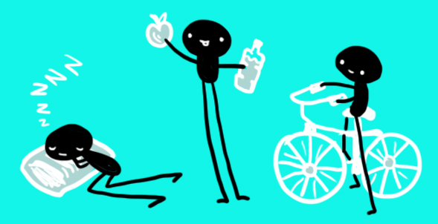
Personal Strategies for Managing Risk and Reduce Errors
Care for one’s self (eat well, sleep well and look after yourself);
Know your environment;
Know your task(s);
Prepare and plan (what if...);
Build checks into your routine;
Practice the good documentation:
A referral or request for consultation : it is important to only include relevant and necessary information:
Keep accurate and complete health-care records
Provide sufficient information
Note any information relevant to the patient’s diagnosis or treatment and outcomes;
Document the date and time

Slide 28

Personal Strategies for Managing Risk and Reduce Errors
Report any risks or hazards/incidents in your workplace
Participate in meetings to discuss risk management and patient safety
Respond appropriately to patients and families after an adverse event
Respond appropriately to complaints
Ask if you do not know. Request that a more experienced person

Slide 29
Summary
Health-care professionals are responsible for the treatment, care and clinical outcomes of their patients.
Personal accountability is important, as any person in the chain might expose a patient to risk.
One way for professionals to help prevent adverse events is to identify areas prone to errors.
The proactive intervention of a systems approach for minimizing the opportunities for errors can prevent adverse events.
Individuals can also work to maintain a safe clinical working environment by looking after their own health and responding appropriately to concerns from patients and colleagues.

Slide 30


