Slide 1
Understanding & Managing Clinical Risk
Patients Safety Course
College of Medicine
King Saud University

Slide 2
General Instruction to all students
We will start at 11:15 AM to 12:15pm, we will go in breakout rooms to discuss the case for 15 minutes in 10 groups. Each group about 8-10 students. They will discuss the six questions on the first slide among themselves. At 11:30 all groups will come back and we will discuss the answers of the items of these six questions.
Be active all over the remaining 45 minutes
I will be asking questions by names. Please, open your microphone and answer,
Any extra participation/ Question could be made in chat-box, or raising hand
No excuse that your microphone is not working, fix it before if any problem.
At the end ten minutes for the take-home messages at the end (What we have learned today), should be shared by you

Slide 3
Discussion Questions
1. What is our understanding about following 12 terms?
(1) Hazards (2) Risk (3) Error (4) Incidence (5)Litigation
(6) Accountability (7) Registration (8) Credential (9)Accreditation (10) Adverse events (11) Sentinel event (12) Complaint
2. How we can learn from errors
3. What are the factors that are associated with the increased risk of error.
4. How we can analyses an adverse event to reduce errors?
5. What are the risk-management principles
6. How to report risks / hazards in the workplace

Slide 4
Learning objectives
By the end of this lecture you will be able to
Recall terminologies: Hazards, Risk, litigation, incidence, accreditation,
Recognize how we can learn from errors.
Identify situational and personal factors that are associated with the increased risk of error.
Participate in analyses of adverse event and practice strategies to reduce errors.
Recognize how to apply risk-management principles in the workplace.
Identify how to report risks / hazards in the workplace.

Slide 5
Introduction
Hospitals are potentially dangerous places for patients as well as medical workers
It’s important to keep in mind that while there are a lot of potential hazards in hospitals
To avoid problems, hospitals and health organizations use a variety of methods to manage risk
Risk management is routine in most industries and has traditionally been associated with limiting litigation costs
Usually associated with patients taking legal action against a health professional or hospital

Slide 6
Clinical risk management
Hazard: is any activity, situation or, substance that potential to cause harm, including ill health, injury, loss of product and/or damage to plant and property.
Blood borne Pathogens
Hazardous Chemicals
Stress
Risk: is the probability that harm (illness or injury) will actually occur.
Risk Management: Organizational effort to identify, assess, control and evaluate the risk to reduce harm to patient, visitors and staff and protect the organization from financial loss

Slide 7
Purpose of Risk Management
Improve organizational and client safety
Identify and minimize the risks and liability losses
Protect the organization resources
Support regulatory, accreditation compliance
Creating and maintaining safe systems of care, designed to reduce adverse events and improve human performance

Slide 8
Process Used to Manage Clinical Risks
The following simple four-step process is commonly used to manage clinical risks:
1. Identify the risk;
2. Assess the frequency and severity of the risk;
3. Reduce or eliminate the risk;
4. Assess the costs saved by reducing the risk or the costs of not managing the risk.

Slide 9
Process Used to Manage Clinical Risks
Identify the risk:
Use the following data as a sources for risk identification:
Adverse event reports.
Mortality and morbidities reports.
Patient complaints reports.

Slide 10
Process Used to Manage Clinical Risks
2. Assess the frequency and severity of the risk:
SAC (Severity Assessment Code) Score:
It is a matrix scoring system based on
Severity,
Consequences for whom?
likelihood of risks
These scores are multiplied to get a rating for the risk

Slide 11
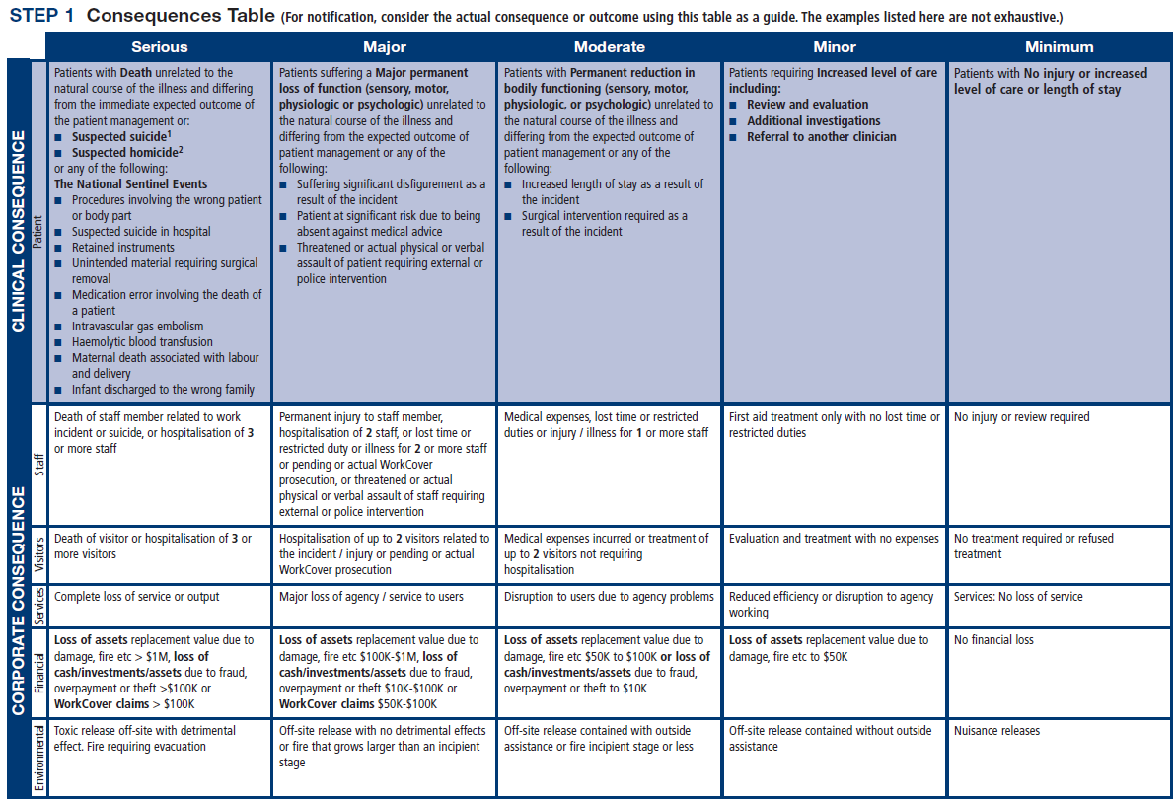

Slide 14
Process Used to Manage Clinical Risks
3. Reduce or eliminate the risk:

Slide 15
Activities Commonly Used to Manage Clinical Risk
Incident monitoring:
An incident: as an event or circumstance that could have or did lead to unintended and/or unnecessary harm to a person and/or a complaint, loss or damage.
Incident monitoring: refers to mechanisms for identifying, processing, analyzing and reporting incidents with a view to preventing their reoccurrence
The key to an effective reporting system is for staff to routinely report incidents and near misses.

Slide 17
Activities Commonly Used to Manage Clinical Risk
Sentinel events:
Is usually unexpected and involving a patient death or serious physical or psychological injury to a patient
e.g. surgery on the wrong patient or body site, incompatible blood transfusion.
Many health-care facilities have mandated the reporting of these types of events because of the significant risks associated with their repetition

Slide 18
Activities Commonly Used to Manage Clinical Risk
The role of complaints in improving care
A complaint : is defined as an expression of dissatisfaction by a patient, family member with the provided health care.
Complaints often highlight problems that need addressing, such as poor communication or suboptimal decision making.
Communication problems are common causes of complaints, as are problems with treatment and diagnosis.

Slide 19
Benefits of complaints
Assist the maintenance of high standards;
Reduce the frequency of litigation;
Help maintain trust in the profession;
Encourage self-assessment;
Protect the public.

Slide 20
Activities Commonly Used to Manage Clinical Risk
Fitness-to-practice requirements
Accountability
Competency of healthcare professionals.
Are they practicing beyond their level of experience and skill? Are they unwell, suffering from stress or illness
Credentialing
Registration (licensure)
Accreditation

Slide 21
Credentialing
The process of assessing and conferring approval on a person’s suitability to provide specific consumer/patient care and treatment services, within defined limits, based on an individual’s license, education, training, experience, and competence.

Slide 22
Accreditation
Is a formal process to ensure delivery of safe, high-quality health care based on standards and processes devised and developed by health-care professionals for health-care services.
Accreditation Bodies:
National Accreditation Program: CBAHI
International Accreditation Program: Joint commission (US), Accreditation Canada(Canada)

Slide 23
Registration (licensure)
Registration of health-care practitioners with a government authority, to protect the health and safety of the public through mechanisms designed to ensure that health practitioners are fit to practice.
e.g. Saudi Commission for Health Specialties
Proper registration/licensure is an important part of the credentialing and accreditation processes

Slide 24
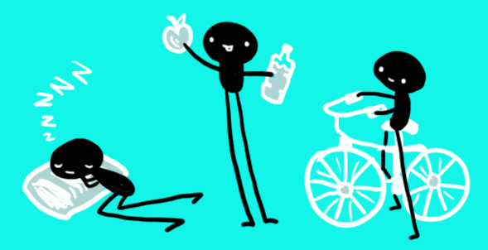
Personal Strategies for Managing Risk and Reduce Errors
Care for one’s self (eat well, sleep well and look after yourself);
Know your environment;
Know your task(s);
Prepare and plan (what if...);
Build checks into your routine;
Practice the good documentation:
A referral or request for consultation : it is important to only include relevant and necessary information:
Keep accurate and complete health-care records
Provide sufficient information
Note any information relevant to the patient’s diagnosis or treatment and outcomes;
Document the date and time

Slide 25
Personal Strategies for Managing Risk and Reduce Errors
Report any risks or hazards/incidents in your workplace
Participate in meetings to discuss risk management and patient safety
Respond appropriately to patients and families after an adverse event
Respond appropriately to complaints
Ask if you do not know. Request that a more experienced person

Slide 26
Summary
Medical error is a complex issue, but error itself is an inevitable part of being human.
These tips are known to limit the potential errors caused by humans
Avoid reliance on memory
Simplify process
Standardize common processes and procedures
Routinely use checklists
Decrease reliance on vigilance
Learning from error can occur at both an individual level and an organizational level through incident reporting and analysis.
Root cause analysis (RCA) is a highly structured systemic approach to incident analysis that is generally reserved for the most serious patient harm episodes

Slide 27
Summary
Health-care professionals are responsible for the treatment, care and clinical outcomes of their patients.
Personal accountability is important, as any person in the chain might expose a patient to risk.
One way for professionals to help prevent adverse events is to identify areas prone to errors.
The proactive intervention of a systems approach for minimizing the opportunities for errors can prevent adverse events.
Individuals can also work to maintain a safe clinical working environment by looking after their own health and responding appropriately to concerns from patients and colleagues.

Slide 28
Thank You !
Questions??

