Slide 1
Engaging with Patients and Carers
Ruaim Muaygil, MD, MBE, HEC-C, PhD
Assistant Professor and Consultant of Health Care Ethics

Slide 2
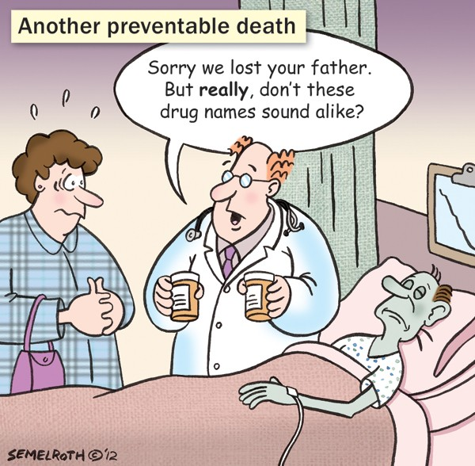
Objectives
Understand the ways in which patients and carers can be partners in health care:
Preventing harm.
Learning and healing from an adverse event.
Understand basic communication techniques.
Learn elements of informed consent .
Recognize the basics of open disclosure after an adverse event.

Slide 3
Engaging with patients and carers is important
Every patient has the right to receive information about the care they are receiving.
Through informed consent, patients-in collaboration with health-care providers- make decisions about interventions.

Slide 4
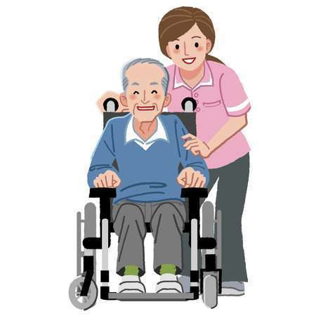
Promoting patients’ Involvement in Their Own Care
Patients who play active roles in the management of chronic health conditions enjoy better outcomes.
Patients and their families can be made aware of opportunities to engage in adverse event prevention by:
Awareness raising about the risks of preventable harm.
Encouragement to speak up to providers about safety concerns.

Slide 5
Ways to Engage Patients
Actively encourage patients and carers to share information.
Show empathy, honesty and respect for patients and carers.
Communicate effectively.
Obtain informed consent.
Show respect for cultural and religious differences.
Understand the basic steps in an open disclosure process.

Slide 6
Benefits of Patient and Carer Engagement
Patient stories are inspiring:
Patient stories about adverse events are powerful message.
Health care provides must engage with these stories and incorporate new understanding in their practice.
Patients’ experiences play a role in:
Diagnosis.
Treatment decisions
Care provider decisions.
Proper treatment administration.
Identifying adverse events.

Slide 7
Aiding Good Communication
Communication techniques and helpful questions.
Element of informed consent.
SPIKES communication tool.
SEGUE framework.
Cultural competence.
Open disclosure after an adverse event.

Slide 8
Communication Techniques Helpful Statements
How can we ask patients to describe their feelings?
I imagine this is difficult news.
You appear to be angry. Can you tell me what you are feeling?
Does this news frighten you?
Tell me more about what you are feeling about what I have just said.
I’ll try and help you.
Is there anyone you would like me to call?

Slide 9
Gaining Informed Consent
Consent is more than a signature on a form, it is a process not an event.
Elements of informed consent:
Elements which inform the patient:
Disclosure of information by the health-care practitioner.
Understanding or comprehension of the information by the patient.
Elements that enable the patient to make a decision:
Free and voluntary choice by the patient.
Comprehension. Ethical terminology: “Decision making capacity.”

Slide 10
What information do patients need?
The diagnosis, including degree of uncertainty.
Risks of the treatment.
Benefits of the treatment.
Information on recovery time.
Name, position, qualifications, and experience of health workers who are providing the care and treatment.
Availability and costs of any service required after discharge from hospital.

Slide 11
SPIKES A Communication Tool
Used to guide in communicating bad news in “end-of-life” situations, but may also be used more generally.
Setting:
Privacy, significant others, sit down, listen.
Perception:
Ask patients what they think is going on.
Invitation:
Ask patients how much they want to now about their diagnosis and treatment.
Knowledge:
Help patients anticipate disturbing news.
Empathy:
Listen for and identify the emotions, identify the source, acknowledge emotion, be quiet.
Strategy and Summary:
Summarize key information, encourage questions, assess understanding, share plan.

Slide 12
Aiding Good Communication SEGUE Framework
Set the stage.
Elicit information.
Give information.
Understand the patient perspective
End the encounter.

Slide 13
Aiding Good Communication Cultural Competence
Cultural competence: knowledge, skills and attitudes necessary to provide care in a way that respects and honors cultural values:
Be aware and accept cultural differences.
Be aware of one’s own cultural values.
Recognize that cultural beliefs impact how patients perceive their health, treatment options, and health practitioners.

Slide 14
Open Disclosure of Adverse Events Do patients want disclosure of adverse events?
Studies have shown that a majority of patients want:
An explanation of what happened.
An admission of responsibility.
An apology.
The assurance of prevention of similar events to others in the future.
Punishment and compensation.
Common barriers to disclosing adverse events:
Want to avoid confrontation.
Causing more distress to patients
Loss of reputation, job, insurance.
Fear legal action.

Slide 15
Open Disclosure After an Adverse Event
Distinguished from bad outcomes that are expected from the disease or injury.
Key Principles of Open Disclosure:
Open timely communication.
Acknowledgement of the incident.
Expression of regret/apology.
Recognition of reasonable expectations.
Support and confidentiality for staff.

Slide 16
The Harvard Framework for Disclosure
Preparing:
Review facts, identify and involve participants, choose appropriate setting.
Initiating conversation:
Determine patient and family readiness, level of medical understanding.
Presenting the facts:
Simple description, speak slowly, explain current outcome, describe next steps.
Sincerely acknowledge the patient's and family’s suffering.
Active listening:
Allow ample time for questions, do not monopolize the conversation.
Acknowledging what you have heard.
Responding to any questions.
Concluding the conversation:
Summarize, repeat key questions raised, establish the follow-up.
Documentation:
Describe the event, describe the discussion.

Slide 17
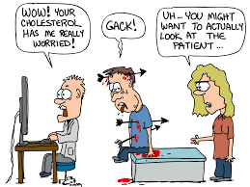
What do you think?
Are these checklists and tools helpful or do they dehumanize the clinical encounter?
Is this a “scientification” of the moral aspect of medicine?

