Slide 1
Antiamoebic Drugs Dr.Saeed Ahmed Sheikh Department Of Pharmacology King Saud University

Slide 2
Antiamoebic Drugs
Protozoal infections are common among people in underdeveloped tropical and subtropical countries, where sanitary conditions, hygienic practices, and control of the vectors of transmission are inadequate. However, with increased world travel, protozoal diseases, such as

Slide 3
Antiamoebic Drugs
amebiasis, giardiasis, trichomoniasis malaria, leishmaniasis, trypanosomiasis, are no longer confined to specific geographic locales.
Protozoa are eukaryotes, the unicellular protozoal cells have metabolic processes closer to those of the human host than to prokaryotic bacterial pathogens.

Slide 4
Antiamoebic Drugs
Protozoal diseases are thus less easily treated than bacterial infections, and many of the antiprotozoal drugs cause serious toxic effects in the host, particularly on cells showing high metabolic activity, such as neuronal, renal tubular, intestinal, and bone marrow stem cells.

Slide 5
Antiamoebic Drugs
Most antiprotozoal agents have not proved to be safe for pregnant women.
Antiamoebic drugs are as under:
1. Metronidazole
2. Tinidazole
3. Diloxanide furoate
4. Iodoquinol
5. Emetine and dehydroemetine
6. Chloroquine., 7. Paromomycin

Slide 6
Antiamoebic Drugs
Amoebiasis: (It is also called amoebic dysentery) is an infection of the intestinal tract caused by Entamoeba histolytica.
The disease can be acute or chronic, with patients showing varying degrees of illness, from no symptoms to mild diarrhoea to fulminating dysentery.

Slide 7
Antiamoebic Drugs
The diagnosis is established by isolating E. histolytica from fresh faeces.
Life cycle of E.histolytica:
Entamoeba histolytica exists in two forms: cysts that can survive outside the body, and labile but invasive trophozoites that do not persist outside the body.

Slide 8
Antiamoebic Drugs
Cysts, ingested through feces contaminated food or water, pass into the lumen of the intestine, where the trophozoites are liberated. The trophozoites multiply, and they either invade and ulcerate the mucosa of the large intestine or simply feed on intestinal bacteria.

Slide 9
Antiamoebic Drugs
(one strategy for treating luminal amebiasis is to add antibiotics, such as tetracyclines to the treatment regimen, resulting in a reduction in intestinal flora – the amoeba’s major food source).
The trophozoites within the intestine are slowly carried toward the rectum, where they return to the cyst form and are excreted in feces.

Slide 10
Antiamoebic Drugs
Large numbers of trophozoites within the colon wall can also lead to systemic invasion.
Classification of Antiamoebic Drugs:
1. systemic: Tinidazole, Chloroquine, dehydroemetine, emetine. They are effective against amebas in the intestinal wall and liver.

Slide 11
Antiamoebic Drugs
Luminal: Diloxanide furoate, iodoquinol, paromomycin. They act on the parasites in the lumen of the bowel.
Mixed: (luminal and systemic) Metronidazole

Slide 12
Antiamoebic Drugs
Amebiasis is infection with Entamoeba histolytica. This organism can cause;
1. Asymtomatic intestinal infection
2. Mild to moderate colitis
3.Severe intestinal infection (dysentery)
4.Amoeboma
5. Liver abscess
6. Other intestinal infections

Slide 13
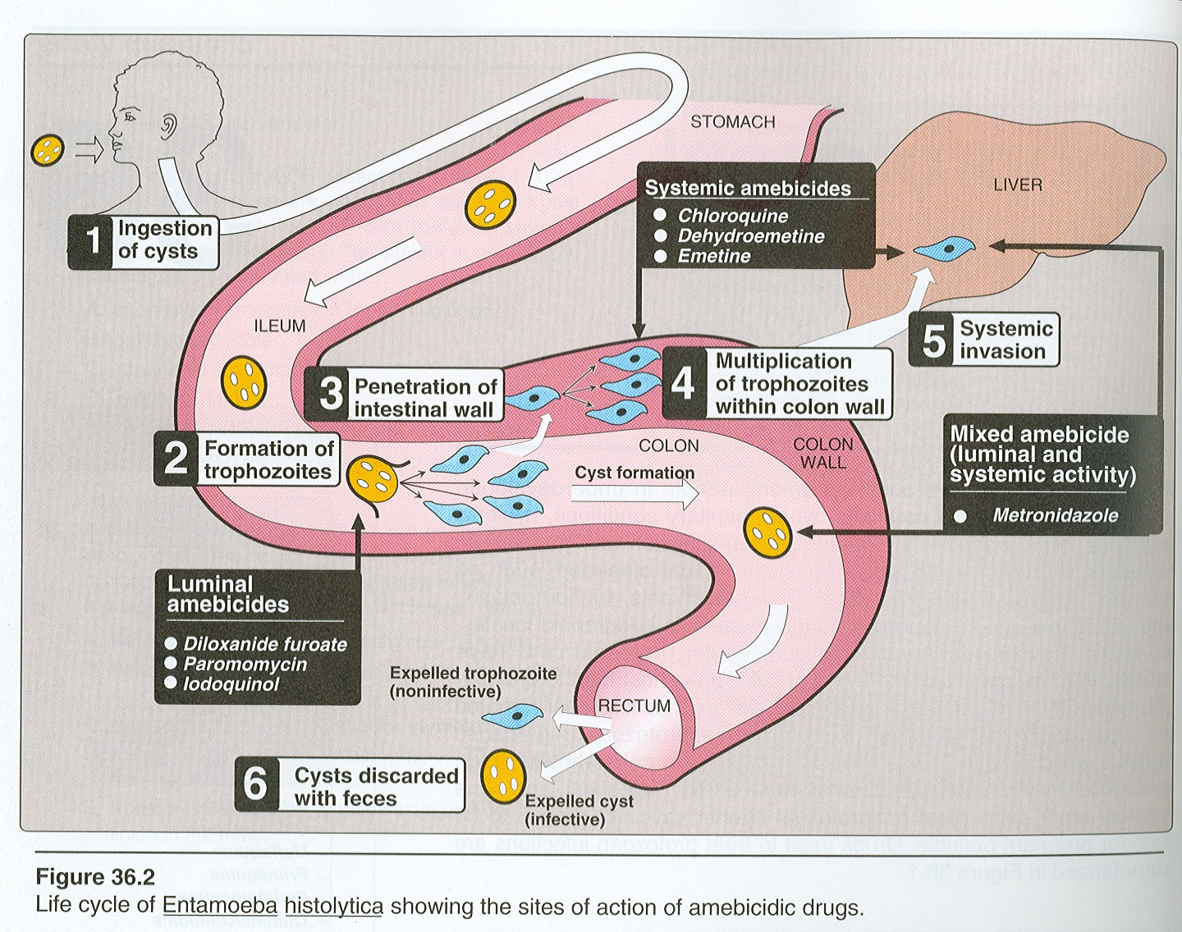

Slide 14
Antiamoebic Drugs
Metronidazole:
A nitroimidazole, is the drug of choice in the treatment of extra luminal amoebiasis.
It kills trophozoites but not cysts of E.histolytica and effectively eradicates intestinal and extra intestinal tissue infections.

Slide 15
Antiamoebic Drugs
Pharmacokinetics:
Route of administration: oral, and I.V.
Oral metronidazole readily absorbed and permeate all tissues by simple diffusion.
Intracellular concentration rapidly approach extra cellular levels.
Peak plasma concentration reached in 1- 3 hours.

Slide 16
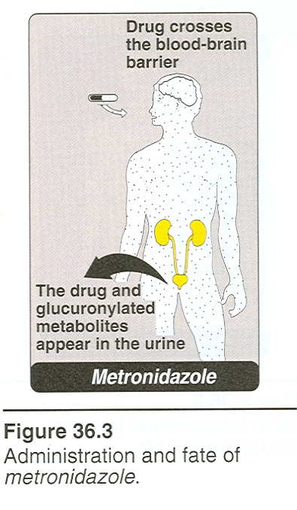
Antiamoebic Drugs

Slide 17
Antiamoebic Drugs
Protein binding is low (10-20%)
The half life of unchanged drug is 7.5 hours for metronidazole
Metronidazole and its metabolites are excreted mainly in the urine.

Slide 18
Antiamoebic Drugs
Mechanism of Action:
The nitro group of metronidazole is chemically reduced in anaerobic bacteria and sensitive protozoans.
Reactive reduction products appear to be responsible for antimicrobial activity

Slide 19
Antiamoebic Drugs
Clinical Uses:
1.Amoebiasis: Metronidazole is the drug of choice in the treatment of all tissue infections with E.histolytica.
It is not reliably effective against luminal parasites and so must be used with a luminal amebicide to ensure eradication of the infection.
Dose:750mgTDS or 500mg I.V QID1odays

Slide 20
Antiamoebic Drugs
2. Giardiasis:
Metronidazole is the treatment of choice for giardiasis.
The dosage for giardiasis is much lower and the drug thus better tolerated than that for amebiasis.
3. Trichomoniasis: Metronidazole is the treatment of choice. 2G,single dose is effective.

Slide 21
Antiamoebic Drugs
4. Anaerobic Bacterial infections:
Metronidazole also useful in infections caused by anaerobic bacteria for e.g. bacteroids fragilis, fusobacterium, clostridium perfringens.
5. Dracunculosis: infection caused by guinea worm.

Slide 22
Antiamoebic Drugs
Adverse effects:
Nausea, dry mouth, metallic taste in the mouth and headache occurs commonly.
Infrequent adverse effects include:
Vomiting, Diarrhoea, insomnia, weakness, dizziness, thrush, dysuria, dark urine , paraesthesias, neutropenia, pancreatitis, ataxia, encephalopathy, seizures are rare

Slide 23
Antiamoebic Drugs
I.V. infusion rarely caused seizures or peripheral neuropathy.
_{CAUTION:}
THE DRUG SHOULD BE USED WITH CAUTION IN PATIENTS WITH CNS DISEASE. IT SHOULD BE AVOIDED IN PREGNANT WOMEN DUE TO RISK OF TERATOGENICITY(NOT PROVED IN HUMANS, PROVED IN BACTRERIA, MICE)

Slide 24
Antiamoebic Drugs
DRUG INTERACTION:
Metronidazole has a disulfiram like effect, so that nausea and vomiting can occur if alcohol ingested during therapy.
It potentiate the anticoagulant effect of coumarin type of anticoagulants.
Phenytoin & phenobarbitone may increase
elimination of the drug, cimetidine decrease plasma clearance

Slide 25
Tinidazole
Tinidazole, a related nitroimidazole, having similar activity and a better toxicity profile than metronidazole, and it offers simpler dosing regimens.
Pharmacokinetics:
Tinidazole readily absorbed and permeate all tissues by simpler diffusion.

Slide 26
Tinidazole
Intracellular concentration rapidly approach extra cellular levels.
Peak plasma level reached in 1- 3 hours.
Protein binding is low(10- 20%)
The half life of Tinidazole is 12- 14 hours
Mechanism of Action: It has similar to metronidazole.

Slide 27
Tinidazole
Clinical uses:
1. Amebiasis: Tinidazole is also a drug of choice in the treatment of all tissue infections with E. histolytica.
It must be used with luminal amebicide because it is not effective against luminal parasites.
Dose: 2 G daily for 3 days

Slide 28
Tinidazole
2. Giardiasis: Tinidazole is at least equally effective like metronidazole
3. Trichomoniasis: It may be effective against some of these resistant organisms
Adverse effects: toxicity profile is better than metronidazole.

Slide 29
Diloxanide furoate
Diloxanide furoate is a dichloroacetamide derivative.
It is an effective luminal amebicide but is not active against tissue trophozoites.
Dose: 500mg three times/day for 10 days
Pharmacokinetics:
After oral administration, in the gut, diloxanide furoate is split into diloxanide and furoic acid; about 90% of the drug is

Slide 30
Diloxanide furoate
Rapidly absorbed ad then conjugated to form glucuronide, which is promptly excreted in the urine.
The unabsorbed diloxanide is the active antiamoebic substance.
Mechanism of Action: unknown

Slide 31
Diloxanide furoate
Clinical uses:
It is considered the drug of choice for asymptomatic luminal infections
It is used with a tissue amebicide, usually metronidazole to treat serious intestinal and extra intestinal infections.
Adverse effects: flatulence is common, nausea, abdominal cramps and rashes

Slide 32
Iodoquinol
Iodoquinol (diiodohydroxyquin) is a halogenated hydroxyquinoline.
Dose: 650mg TDS for 21days
Pharmacokinetics:
It is poorly understood
90% of the drug is retained in the intestine and excreted in feces. The remainder enters the circulation, and is excreted in the urine as glucuronides.

Slide 33
Iodoquinol
mechanism of action:
The mechanism of action of iodoquinol against trophozoites is unknown.
It is effective against organisms in the bowel lumen but not against trophozoites in the intestinal wall or extra intestinal tissues
Adverse effects: Diarrhoea, anorexia, nausea, vomiting, abdominal pain,

Slide 34
Iodoquinol
Headache, rash, pruritus
Neurotoxicity with prolonged use with high dosage.
Cautions:
1. iodoquinol should be taken with meals to limit GI toxicity
2. it should be used with caution in patients with optic neuropathy, renal or thyroid disease, or non amebic hepatic dis.

Slide 35
Iodoquinol
3. The drug may increase protein-bound serum iodine, leading to a decrease in measured ¹³¹I uptake that persist for months.
4. It should be discontinued if it produces persistent diarrhea or signs of iodine toxicity( dermatitis, urticaria pruritus, fever)
C.I: It is contraindicated in patients with intolerance to iodine.

Slide 36
Emetine and Dehydroemetine
Emetine, an alkaloid derived from ipecac and dehydroemetine, a synthetic analog, are effective against tissue trophozoites of E. histolytica, but because of major toxicity concerns they have been almost completely replaced by metronidazole.
Route of administration:
Subcutaneous (preferred) or I.M, never I.V

Slide 37
Emetine and Dehydroemetine
CLINICAL USES:
Their use is limited to unusual circumstances. in which severe amebiasis warrants effective therapy and metronidazole can not be used.
Dehydroemetine is preferred because of its some what better toxicity profile. It should be used for the minimum period usually 3- 5 days.

Slide 38
Emetine and Dehydroemetine
Adverse effects:
diarrhea is common
Nausea, vomiting, muscle weakness
Cardiac arrhythmias, heart failure, hypotension (serious toxicity)
Caution: the drug should not be used in patients with cardiac or renal disease, in young children, or in pregnancy.

Slide 39
Paromomycin
Paromomycin is an aminoglycoside antibiotic.
It is not significantly absorbed from the GIT.
The small amount absorbed, is slowly excreted unchanged, mainly by glomerular filtration.
Dose: 10mg/kg TDS for 7 days

Slide 40
Paromomycin
Clinical uses:
It is used only as a luminal amebicide, has no effect against extra intestinal amebic infections.
Paromomycin is an effective luminal amebicide that appears to have similar efficacy and less toxicity than other agents.

Slide 41
Paromomycin
In a recent study, it was superior to diloxanide furoate in clearing asymptomatic infections.
Parenteral paromomycin is under investigation in treatment of visceral leishmaniasis.
Adverse effects:
abdominal distress, diarrhea.
It should be avoided in patients with significant renal disease and cautiously used with G I ulceration

Slide 42
Tetracyclines
Tetracyclines are broad – spectrum bacteriostatic that inhibit protein synthesis in susceptible microorganisms.
They are active against many gram- positive and gram- negative bacteria including anaerobes, rickettsiae, chlamydiae, mycoplasma, and against some protozoa e.g., amebas.

Slide 43
Tetracyclines
Mechanism of action:
Tetracyclines enter microorganisms in part by passive diffusion and in part by an energy dependent process of active transport. Susceptible cells concentrate the drug intracellularly. Once inside the cell, tetracyclines bind reversibly to the 30S subunit of the bacterial ribosimes, blocking the binding of aminoacyl- tRNA to the acceptor site on the mRNA- ribosome complex. This prevents addition of aminoacid to the growing peptide .
.

Slide 44
Tetracyclines
Dose: 250mg 3 times daily for 10 days
Adverse effects:
1. G I adverse effects: nausea, vomiting,diarrhea
2. bony structure and teeth
3. liver toxicity
4. kidney toxicity
5.photosensitization
6.vestibular reactions

Slide 45
Erythromycin
Erythromycin 500mg, 4 times daily for 10 days.
Erythromycin inhibits protein synthesis occurs via binding to the 50S ribosomal RNA, which blocks the aminoacyl translocation reaction and formation of initiation complexes.

Slide 46
Chloroquine
It is used in combination with metronidazole and diloxanide furoate to treat and prevent amoebic liver abscesses.
It eliminates trophozoites in liver abscesses, but it is not useful in treating luminal amebiasis

Slide 47
Chloroquine
MECHANISM OF ACTION:
Chloroquine probably acts by concentrating in parasitic food vacuoles, preventing the polymerization of the hemoglobin breakdown product, heme into hemozoin, and thus eliciting parasite toxicity due to buildup of free heme.

Slide 48
Chloroquine
Adverse effects:
pruritus is common,
nausea, vomiting, abdominal pain, anorexia.
Headache, blurring of vision uncommon.
Hemolysis in G6-PD deficient patients, impaired hearing, agranulocytosis alopecia, hypotension.

