Slide 1

Sedatives
Hypnotics
Anxiolytics

Slide 2
What is a sedative?

Slide 3
What is a hypnotic?

Slide 4
What is sedative- hypnotic?

Slide 5
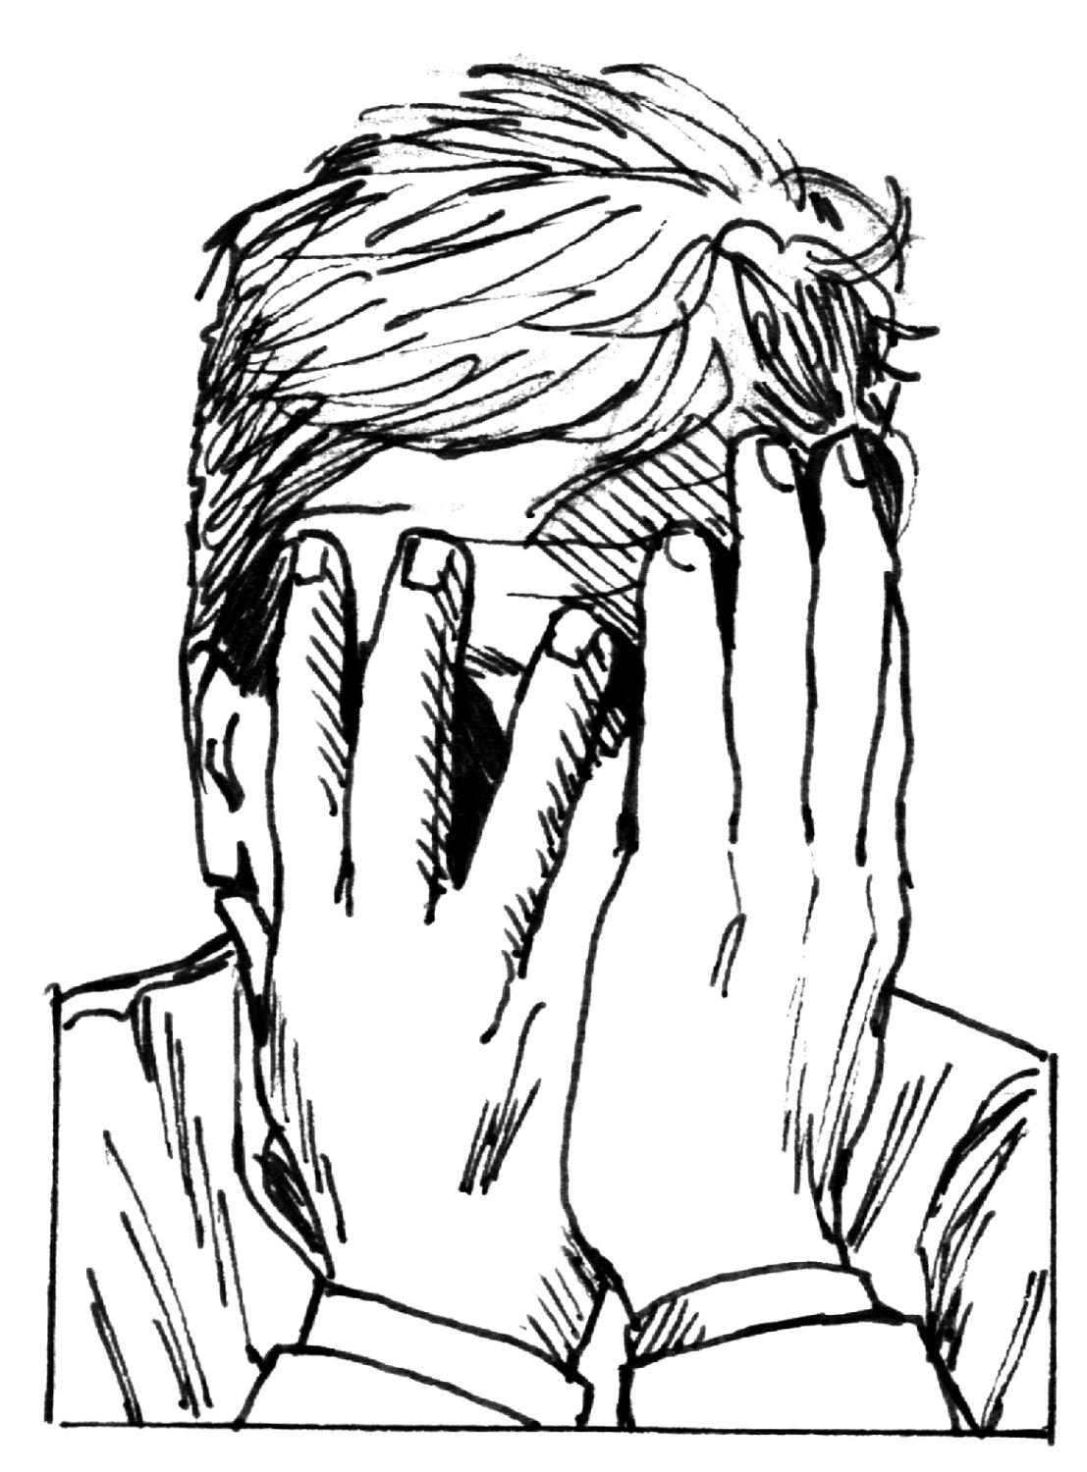

What is an anxiolytic agent?

Slide 6

Anxiety:prevalence
Anxiety disorders affect approximately 1 in 4 people worldwide at some point in their lives.
Anxiety affects twice as many women as men

Slide 7
Insomnia: prevalence
World Health Organization (WHO) → 27% for insomnia.
More frequently in women than in men
Older people have poorer quality of sleep

Slide 8
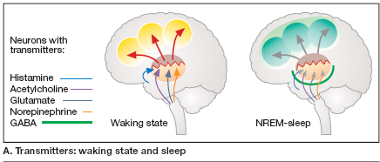
Notes:
There is evidence that histaminergic, cholinergic, glutamatergic, and adrenergic neurons are more active during waking than during the
NREM sleep stage.
During sleep, input from the brain stem decreases,
giving rise to diminished thalamocortical activity and disinhibition of the GABA neurons (A).

Slide 9
Notes:
As the margin between excitatory and inhibitory activity decreases with age, there is an increasing tendency towards
shortened daytime sleep periods and more frequent interruption of nocturnal
sleep

Slide 10
Anxiolytic drugs are among the most frequently prescribed substances, used regularly by upwards of 10% of the population in most developed countries.

Slide 11


Anxiety Disorders
Generalized anxiety disorder.

Slide 12


Panic disorder.

Slide 13

Phobia.
Post-traumatic stress disorder.

Slide 14
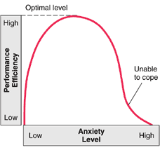
How Anxiety Affects Performance
How Anxiety Affects Performance
How Anxiety Affects Performance
How Anxiety Affects Performance
Notes:
The effects of anxiety on performance can be shown on a curve. As the level of anxiety increases, performance efficiency increases proportionately, but only up to a point. As anxiety increases further, performance efficiency decreases. Before the peak of the curve, anxiety is considered adaptive, because it helps people prepare for a crisis and improve their functioning. Beyond the peak of the curve, anxiety is considered maladaptive, because it produces distress and impairs their functioning.

Slide 15
Sedatives , Hypnotics & Anxiolytics
Classification:-
1- Benzodiazepines
2- 5-HT_{1A} agonists
3- Barbiturates
4-β-Adrenoceptor blockers, used to treat some forms of anxiety with sweating & tremors.

Slide 16
5-Zolpidem , zaleplon and eszopiclone.
6-Melatonin receptors agonists e.g. rameleteon.
7-Miscellaneous ,
chloral hydrate,
paraldehyde
mebrobamate,
methaqualone,
sedative antihistamines.
Notes:
which is not needed immediately, i.e., one for a non-life-threatening disorder.

Slide 18
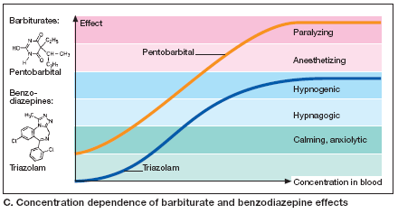
Notes:
Hypnagogic:-Denoting a transitional state, related to the hypnoidal, preceding sleep;
Hypnogenic:-Relating to the production of hypnotic sleep;

Slide 19
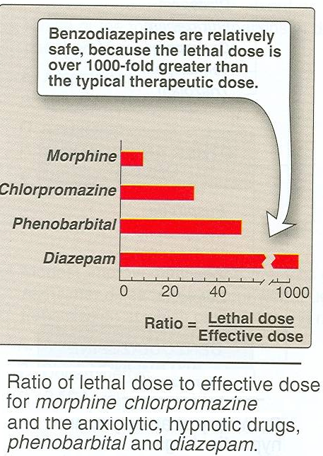

Slide 20
1- Benzodiazepines:-
pharmacologic effects:-

Slide 21
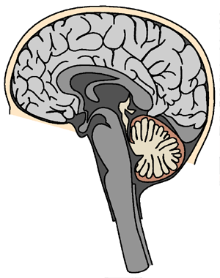
Benzodiazepines
limbic system
thalamus
hypothalamus
benzo receptors in brain ; felt to be same receptor as that of GABA; if not same then located next to; benzo’s depressant action on CNS related to ability to inhibit brain stimulation

Slide 22
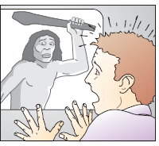
1- Reduction of anxiety & aggression:-
active against all types of anxiety,
alprazolam antidepressant,
triazolam shortest duration of action

Slide 23

Reduction of aggression
have “taming effect”,

Slide 24
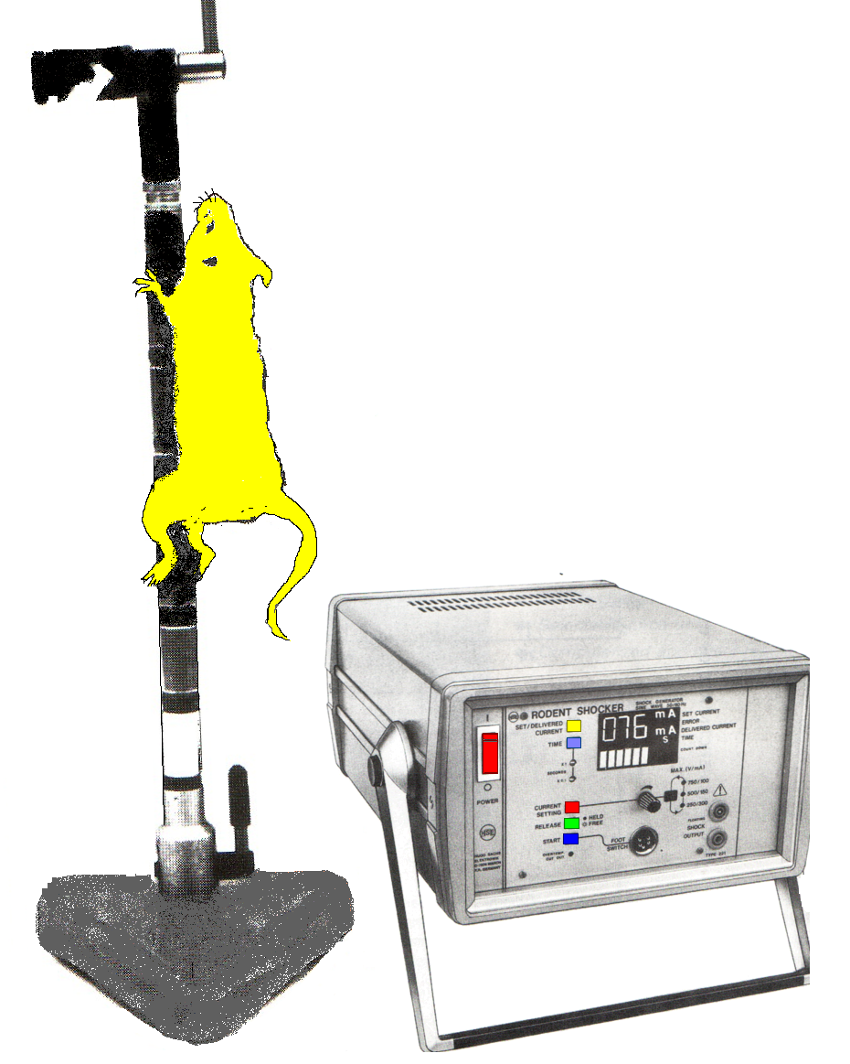
2-sedation
Exert calming effects.
Disinhibit punishment-suppressed behavior.

Slide 25
3-induction of sleep:-
Effects of benzodiazepines on patterns of normal sleep:-
1-↓time taken to get to sleep,
2-↑total duration of sleep.

Slide 27
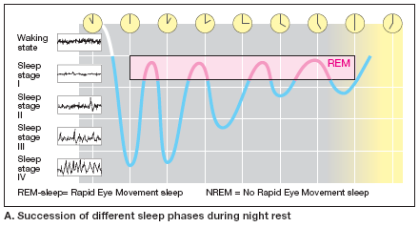

Slide 28
3-induction of sleep:-
3-The duration of stage 2 NREM sleep is increased.
4-The duration of REM sleep is decreased; and
5-The duration of stage 4 NREM slow-wave sleep is decreased.
REM sleep → dreaming ,
SW sleep →↓metabolic rate & adrenal steroids lowest , GH highest

Slide 29
Benzodiazepines affect REM sleep to a lesser extent.
Interruption of REM sleep →irritability & anxiety, made up for by a rebound ↑in REM sleep
i.e. REM sleep has a function,
Lesser reduction by benzodiazepines is an advantage.

Slide 30
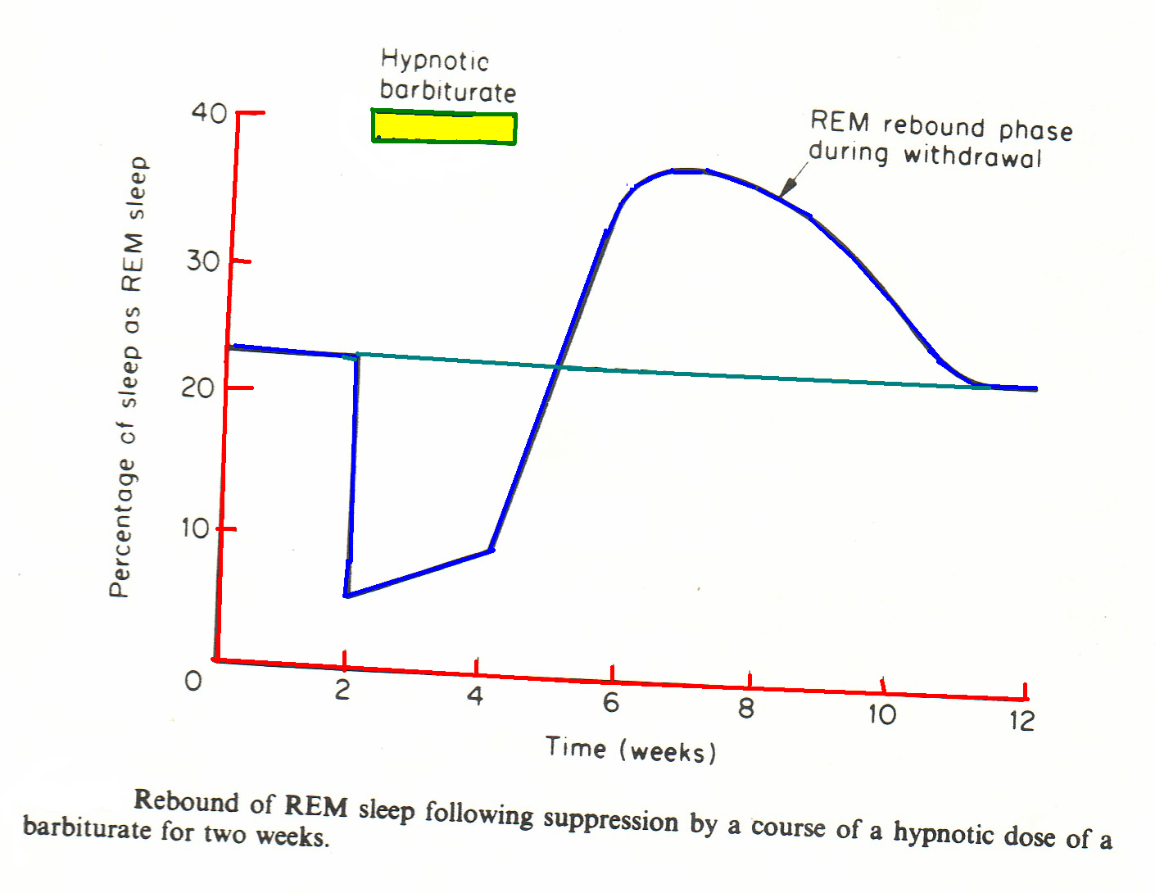

Slide 31
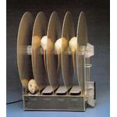
4- Reduction of muscle tone & coordination:-
↑Muscle ton is a common feature of anxiety , may contribute to aches, pains & headache.
Rota-rod
Notes:
Internuncial transmission:-Communicating or transmitting impressions between different parts of the body; said of the nervous system.

Slide 32
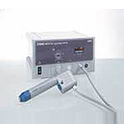
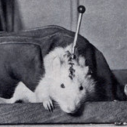
5- Anticonvulsant effect:-
More effective against chemically –induced convulsions caused by leptazol & bicuculline,
Less effective against electrical- induced convulsions.
Electro-shock

Slide 33
No effect on strychnine –induced convulsions.
Some selectivity → e.g. clonazepam, nitrazepam, lorazepam, and diazepam.

Slide 34
6-Anterograde amnesia:-
Benzodiazepines obliterate memory of events experienced under their influence.

Slide 35
Mechanism:-
α1-subunit→ sedation, amnesia and possibly antiseizure effects.
α2 -subunit → anxiolytic and muscle relaxing action.
α5-subunit→ memory impairment.

Slide 36
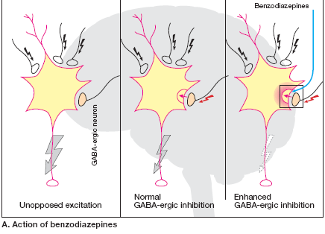

Slide 37
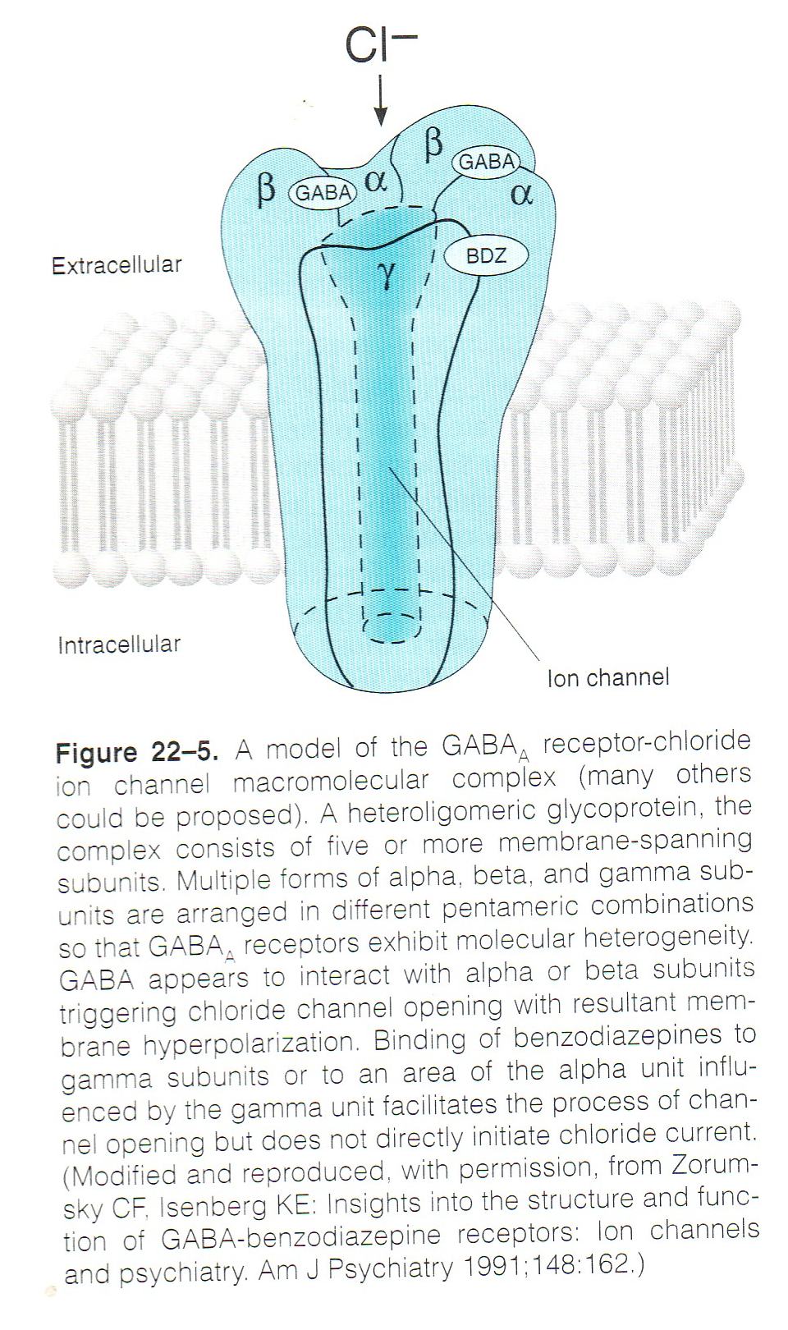

Slide 38
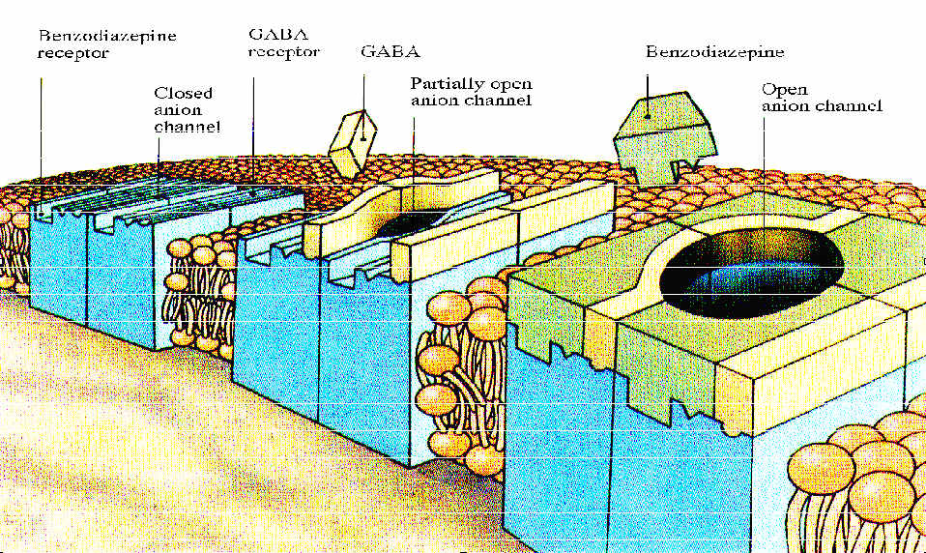

Slide 39
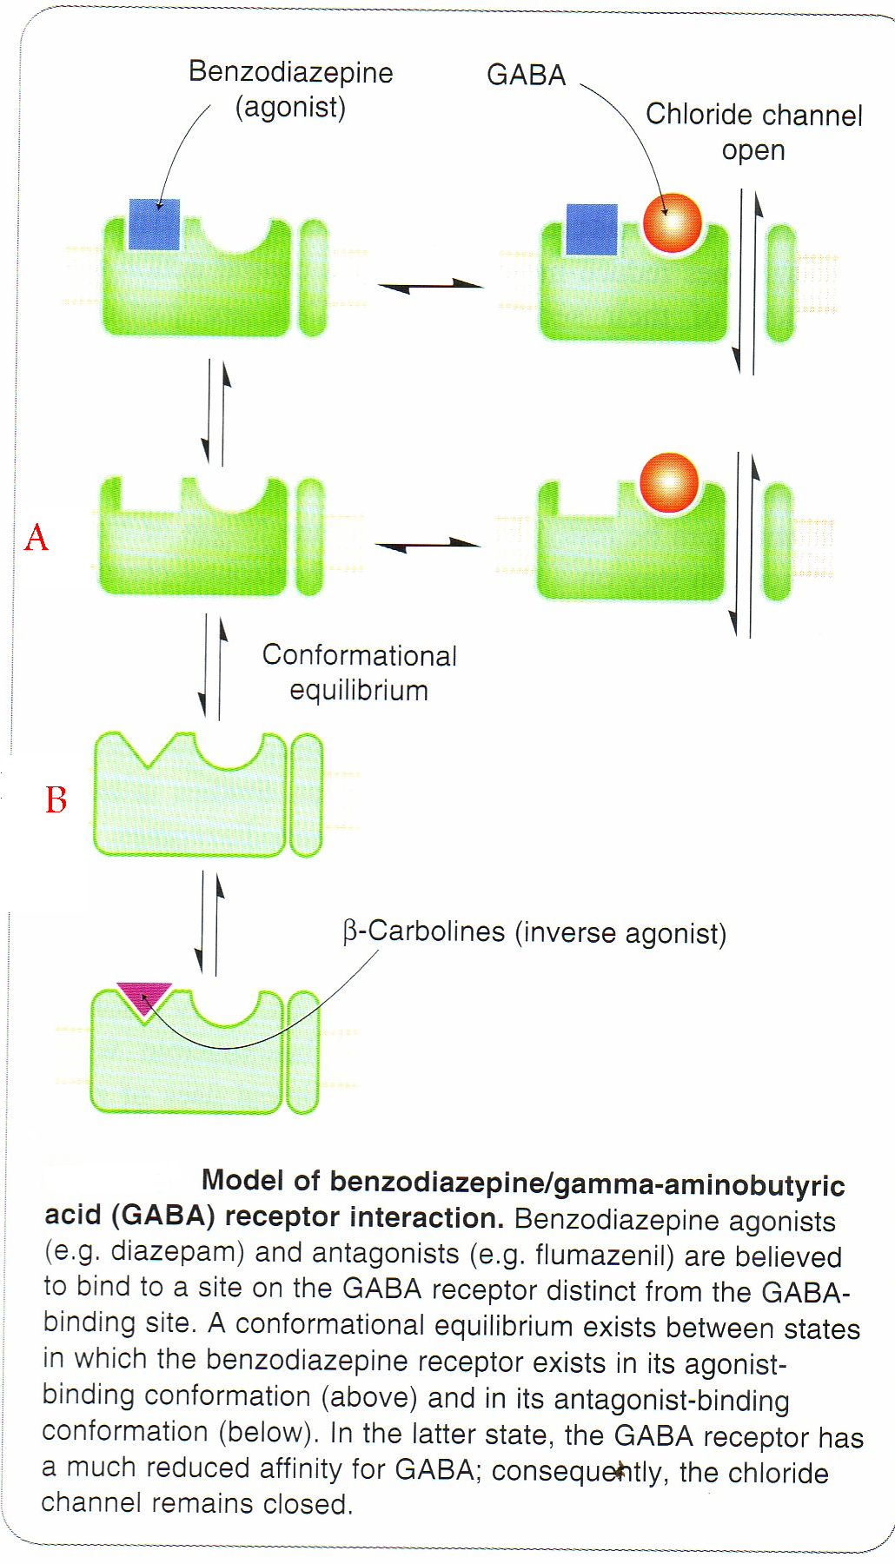

Slide 40
Pharmacokinetics:-
The rate of oral absorption varies depending on lipophilicity.
Absorption of triazolam is extremely rapid.
Chlorazepate is a pro-drug converted to active metabolite (nordiazepam) by acid hydrolysis in the stomach.
peak plasma concentration 1 hr ,

Slide 41
Benzodiazepines bind strongly to plasma proteins ,
accumulates in body fats,
high VD[1l/kg],
normally given by mouth , IV [IM slower absorption]
Metabolized by oxidation, hydroxylation (by cytochrome P450 especially CYP3A4) & glucouronyl conjugation

Slide 42
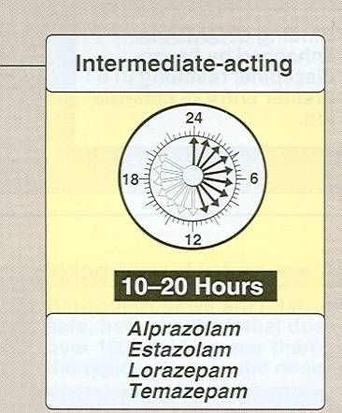
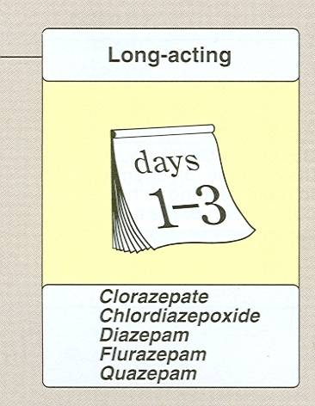
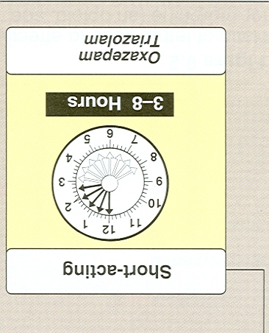
Can be classified according to the duration of action into short, medium & long- acting

Slide 43
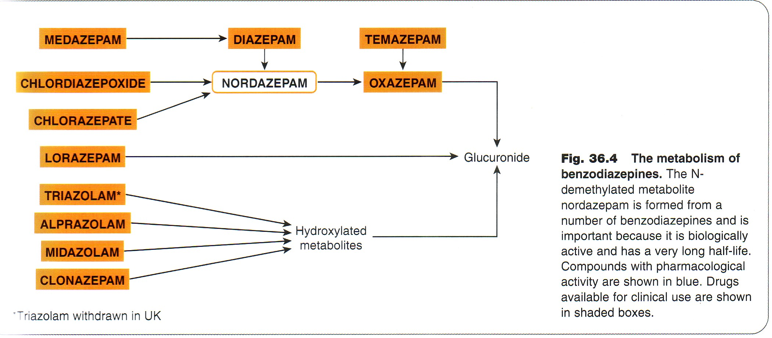

Slide 44
Individual Benzodiazepines

Slide 45
Triazolam and Midazolam
Half-life of parent compound (2-4h)
Active metabolite: Hydroxylated derivative
Main uses:-
Hypnotic ,Midazolam used as intravenous anaesthetic .

Slide 46
Lorazepam, Oxazepam , Temazepam
Half-life of parent compound (8-10h)
Active metabolite: No
Main uses:-
Anxiolytic, hypnotic

Slide 47
Diazepam and Chlorodizepoxide
Half-life of parent compound (20-40h)
Anxiolytic, muscle relaxant ,Diazepam used intravenously as anticonvulsant.

Slide 48
Clonazepam
Half-life of parent compound (50)
Main uses:-
Anticonvulsant, anxiolytic (especially mania)

Slide 49
Alprazolam
Half-life of parent compound (6-12h)
Main uses:-
Anxiolytic, antidepressant

Slide 50
Clinical uses:-
1- Hypnotic[insomnia]
2-Anxiolytic{severe anxiety}
3- Preoperative sedation
4-for alcohol withdrawal.

Slide 51
5- anticonvulsant :- diazepam IV in status epilepticus
6- muscle relaxant in chronic muscle spasm & spasticity.
8-initial management of mania.
9-control of drug- induced hyperexcitability states [e.g. phencyclidine intoxication]

Slide 52
Unwanted effects:-
1-Toxic effects resulting from acute over dosage:- ,
over dose →prolonged sleep.
In presence of other CNS depressants →severe life – threatening respiratory depression.

Slide 53
2- Side effects during therapeutic use:-
drowsiness,
confusion,
amnesia,
↓motor coordination
↓psychomotor performance

Slide 54
3-Tolerance & dependence:-
Stopping benzodiazepines after weeks →↑symptoms of anxiety , tremor , insomnia ,dizziness.

Slide 55
Cause physical dependence.
The withdrawal symptoms are more pronounce with the short acting benzodiazepines e.g. triazolam (t½=4h).

Slide 56
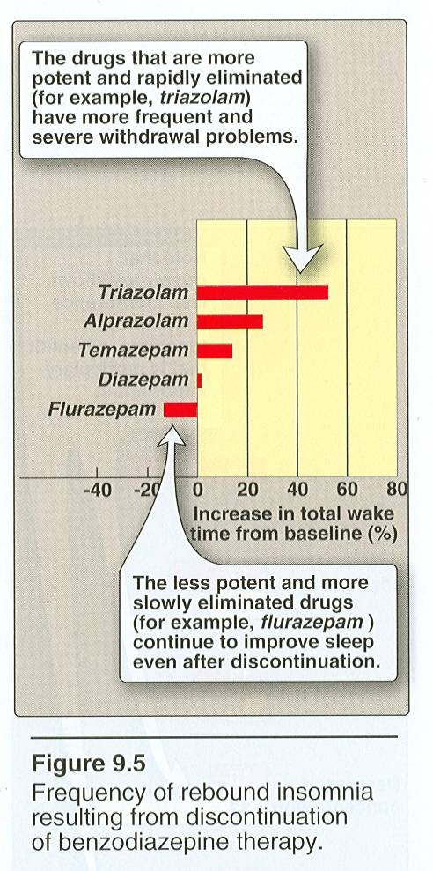

Slide 57
Benzodiazepine antagonist [flumazenil],
1-Used in treatment of benzodiazepine overdose,
2-to reverse sedative action of benzodiazepine used during anaesthesia,
3-to treat drowsiness & coma associated with alcohol intoxication & severe liver disease [hepatic encephalopathy]
t½=0.7-1.3h.

Slide 58
May precipitated abstinence syndrome.
Benzodiazepines with tricyclic antidepressants, seizures and cardiac arrhythmias.
ADR:-agitation, confusion, dizziness, and nausea.

Slide 59
Drug Interactions: Benzodiazepines
Additive pharmacodynamic effects (e.g., alcohol)
Inhibit BZD metabolism (e.g., nefazodone via P450 3A 3/4 inhibits metabolism of triazolam)
Diazepam may increase levels of digoxin and phenytoin
Notes:
BZD withdrawal when other drugs that increase seizure risk are also taken

Slide 60

Quiz?
Which of the following statements about benzodiazepines is INCORRECT:
A. Diazepam undergoes hepatic N dealkylation to nordiazepam, and metabolism continues to oxazepam
B. Oxazepam is an appropriate hypnotic drug when daytime anxiety is present, since it is converted to active metabolites
C. The mechanism of action of benzodiazepines is related to an allosteric action at postjunctional GABAA receptors
D. Diazepam has anticonvulsant and central muscle relaxant activity
E. Benzodiazepines suppress REM sleep

Slide 61

Quiz?
Which of the following is described as a competetive benzodiazepine receptor antagonist?:-
A) chlorodiazepoxide
B) lorazepam
C) alprazolam
D) flumazenil
E) triazolam

Slide 62
Quiz?
Which one of the following is most likely to result from treatment with moderate doses of diazepam?
(A) Alleviation of the symptoms of major depressive disorder
(B) Agitation and possible hyperreflexia with abrupt discontinuance after chronic use
(C) Increased porphyrin synthesis
(D) Improved performance on tests of psychomotor function
(E) Retrograde amnesia

Slide 63
2- 5- HT- agonists[Azapirones]:-
Buspirone ,has high affinity for 5HT1A receptors .
Anxiolytic effect gradually evolves over 1-3weeks.
Ipsapirone & gepirone are more selective.

Slide 64
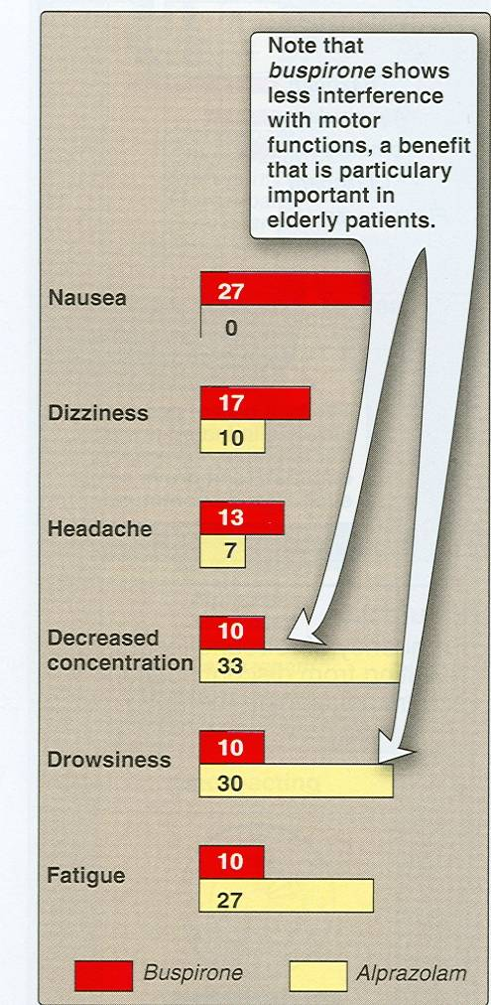
Buspirone relieves anxiety ,no marked sedative effects.
No rebound anxiety or withdrawal signs.

Slide 65
used in generalized anxiety states but is not very effective in panic disorders.
Buspirone is rapidly absorbed orally , undergoes extensive first-pass metabolism via hydroxylation and dealkylation reactions to form several active metabolites.
t½=2-4h,
not affect driving skills
not potentiate CNS depressant effects of other sedative hypnotic drugs.

Slide 66
Side effects:-
Nausea , dizziness,
headache, restlessness,
tachycardia, palpitations,
nervousness, gastrointestinal distress,
and paresthesias.
Blood pressure may be elevated in patients receiving MAO inhibitors.

Slide 67
Quiz?
Which of the following statements about buspirone is correct:
A. It binds to dopamine and 5HT receptors in the central nervous system
B. It has marked sedative activity
C. It is chemically related to benzodiazepines
D. It causes marked central nervous system depression when combined with alcohol
E. It possesses muscle relaxant activity

Slide 68
3-Barbiturates:-have depressant effect similar to general anaesthetics ,
Cause death from respiratory & CVS depression
Able to enhance the action of GABA.

Slide 69
Barbiturates
barb’s site of action
2. cerebral cortex
inh. nerve
impulses
to
1. brain stem
*potentiate GABA = inhibitory AA (neurotransmitter)

Slide 70
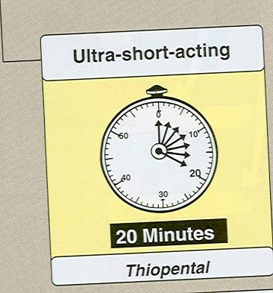
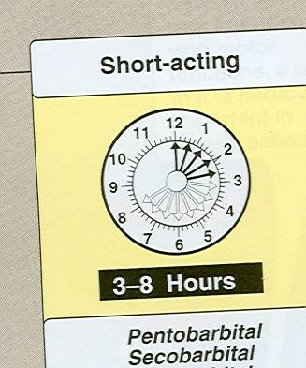
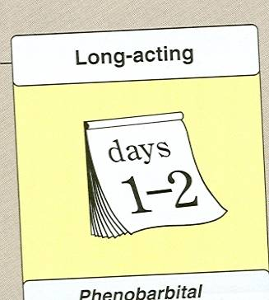
Classified into ultra short-acting, short –acting and long –acting according to their duration of action

Slide 71

Ultra Short- acting:-
thiopental and methohexital are very lipid-soluble.
Have short duration of action→ rapid tissue redistribution.

Slide 72
Short –acting:-pentobarbitone 6-12hr used as sleeping pills & anxiolytic {less safe}
Long –acting :-phenobarbital and metharbital (converted to phenobarbital in the body) are effective in the treatment of generalized tonic-clonic seizures.

Slide 73
Pharmacokinetics
Barbituratesare absorbed rapidly into the blood following their oral administration.
Crosses placental barrier and appear in nursing mother milk.
Phenobarbital is excreted unchanged in the urine (20–30%), and its elimination rate can be increased significantly by alkalinization of the urine.
Metabolized by oxidation followed by glucouronyl conjugation.

Slide 74
ADRs:-
Induce high degree of tolerance & dependence.
Induce synthesis of hepatic cytochrome P450 & conjugating enzymes→↑rate of metabolic degradation
Aggravation of porphyria.
More likely to causes cardiovascular & respiratory depression.

Slide 75
Barbiturates
Drug Interactions
Additive effects:-
ETOH, antihistamine, benzodiazepines, narcotics, & tranquilizers
Inhibit metabolism:-
MAOI →prolong barbiturates effects
Increased metabolism:-
anticoagulants →decreased AC response

Slide 76
Contra-indications :-
Severe pulmonary insufficiency
Hepatic failure
Attacks of porphyria

Slide 77
Quiz?
Barbituates produce:
A. Respiratory depression in high doses
B. Physical and psychological dependence with prolonged use
C. Hangover effects when used as hypnotics
D. Suppression of REM sleep resulting in rebound REM sleep on withdrawal
E. All of the above

Slide 78

Quiz?
Which one of the following statements concerning the barbiturates is accurate?
(A) Symptoms of the abstinence syndrome are more severe during withdrawal from phenobarbital than from secobarbital
(B) Compared with barbiturates, the benzodiazepines exhibit a steeper dose-response relationship
(C) Barbiturates may increase the half-lives of drugs metabolized by the liver
(D) An increase in urinary pH will accelerate the elimination of phenobarbital
(E) Respiratory depression caused by barbiturate overdosage can be reversed by flumazenil

Slide 79
Zolpidem
Has hypnotic action.
It binds selectively to the BZ1.
Its actions are antagonized by flumazenil.
It has minimal muscle relaxing and anticonvulsant effects.

Slide 80
Amnestic effects have been reported with use of doses greater than recommended.
It has a rapid onset of action, and its duration of hypnotic action is close to that of triazolam.
minor effects on sleep patterns at the recommended hypnotic dose but can suppress REM sleep at higher doses.
It may cause rebound insomnia on abrupt discontinuance of higher doses.

Slide 81
It may cause respiratory depression if large doses are ingested with other CNS depressants, including ethanol.
Lower risk of development of tolerance and dependence.
Rapidly metabolized to inactive metabolites by oxidation and hydroxylation in the liver, t½=1.5-3.5h.
Clearance decreased in elderly patients ,in liver disease and by cimetidine.
and increased by rifampin.

Slide 82
Zaleplon
Zaleplon binds selectively to the BZ1 receptor subtype.
Rapidly absorbed from the GIT ,t½=1h.
Metabolized into inactive metabolites by hepatic aldehyde oxidase & CYP3A4.
t½=1h
Dosage should be reduced in the elderly and patients with hepatic impairment.
Cimetidine ↑ peak plasma levels.

Slide 83
Produces rapid onset & short duration sleep.
Less risk of amnesia & withdrawal symptoms.
Zaleplon potentiates the CNS depressant effects of ethanol and other sedative-hypnotics.

Slide 84
Clinical Pharmacology

Slide 85
Treatment of Anxiety States
1-Secondary anxiety:-
2-Situational anxiety
The short-term use of sedative-hypnotics may be appropriate.

Slide 86
Generalized anxiety state:-amenable to drug therapy, usually in conjunction with psychotherapy.
Alprazolam is particularly effective in the treatment of panic disorders and agoraphobia.

Slide 87
Advantages of the benzodiazepines
(1) a relatively high therapeutic index plus availability of flumazenil for treatment of overdose;
(2) a low risk of drug interactions based on liver enzyme induction;
(3) slow elimination rates, which may favor persistence of useful CNS effects.

Slide 88
Disadvantages of the benzodiazepines
risk of psychologic dependence,
the formation of active metabolites,
amnestic effects,
cost
exert additive central nervous system depression
impairment of performance of any task requiring mental alertness and motor coordination.

Slide 89
Buspirone is a more selective drug
Limitations:-
1-Slow onset of its anxiolytic actions—
2-limited efficacy in panic attacks and phobia.
In the treatment of generalized anxiety disorders and certain phobias, newer paroxetine and venlafaxine are considered to be drugs of first choice.
However, these agents have minimal effectiveness in acute anxiety states.

Slide 90
Beta-blocking drugs (eg, propranolol) may be used as antianxiety agents in situations such as performance anxiety.
Notes:
a state of an intense anxiety that happens prior and/or during a performance. This fear may occur when giving an in-class or a conference presentation, performing a piece of music, going for a job interview or any situation in which a particular activity brings the presenter to the attention of the audience.

Slide 91
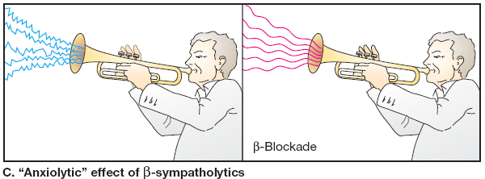

Slide 95
Quiz?
This hypnotic drug facilitates the inhibitory actions of GABA, but it lacks anticonvulsant or muscle relaxing properties and has minimal effect on sleep architecture.
(A) Buspirone
(B) Diazepam
(C) Flurazepam
(D) Phenobarbital
(E) Zaleplon

Slide 96


Case
The wife of a 24-year-old computer programmer considers him to be of a "nervous
disposition." He is easily startled, worries about inconsequential matters, and sometimes complains of stomach cramps. At night he grinds his teeth in his sleep. There is no current history of drug abuse.
Notes:
<procedure, surgery> General term for abdominal surgery

Slide 97
Q1?
Assuming that the symptoms experienced by this young man are not related to a medical condition, the most appropriate drug treatment would be the judicious use of
(A) Buspirone
(B) Midazolam
(C) Phenobarbital
(D) Diazepam
(E) Zolpidem

Slide 98
Q2?
Regarding the characteristic properties of the drug prescribed for this young man, the physician should inform the patient to anticipate
(A) Additive CNS depression with alcoholic beverages
(B) A significant effect on memory
(C) That the drug will take a week or so to begin working
(D) A need to gradually increase drug dosage because of tolerance
(E) That if he stops taking the drug abruptly he will experience withdrawal signs

