Slide 1
OPIOID ANALGESICS
Dr.Abdul latif Mahesar
Department of Pharmacology
King Saud University

Slide 2
PAIN
Pain is defined as an unpleasant sensory and emotional experience with actual or potential tissue damage.
It is a common every day experience that performs essential defensive function.
uncontrolled pain can severely diminish quality of life.
pain can be acute or chronic

Slide 3
Pain transmission and processing
Noxious stimuli
Activation of nociceptors
Transmission of information through dorsal horn of s.cord
(release of stimulatory transmitter peptides like sub.P ,gultamete ,NO)
Onward transmission to higher brain centers
Processing in the higher brain center
Release of inhibitory trasnsmitters
(endogenous peptides like enkephalins ,endorphins ,dynorphins)

Slide 4
Painful stimulus

Slide 5
Impulse transmission

Slide 6
action potential passes through Ad and C-type sensory fibers

Slide 7
Action potential arrives at junction of peripheral and spinal cord neurons

Slide 8
Fibers at Dorsal Horn level

Slide 9
Release of neurotransmitters(e.g glutamate, sbustance P)

Slide 10
Continuation of the transmission of impulses to the brain

Slide 11
Information of the pain being processed in higher centers in brain(thalamus, cortex)

Slide 12
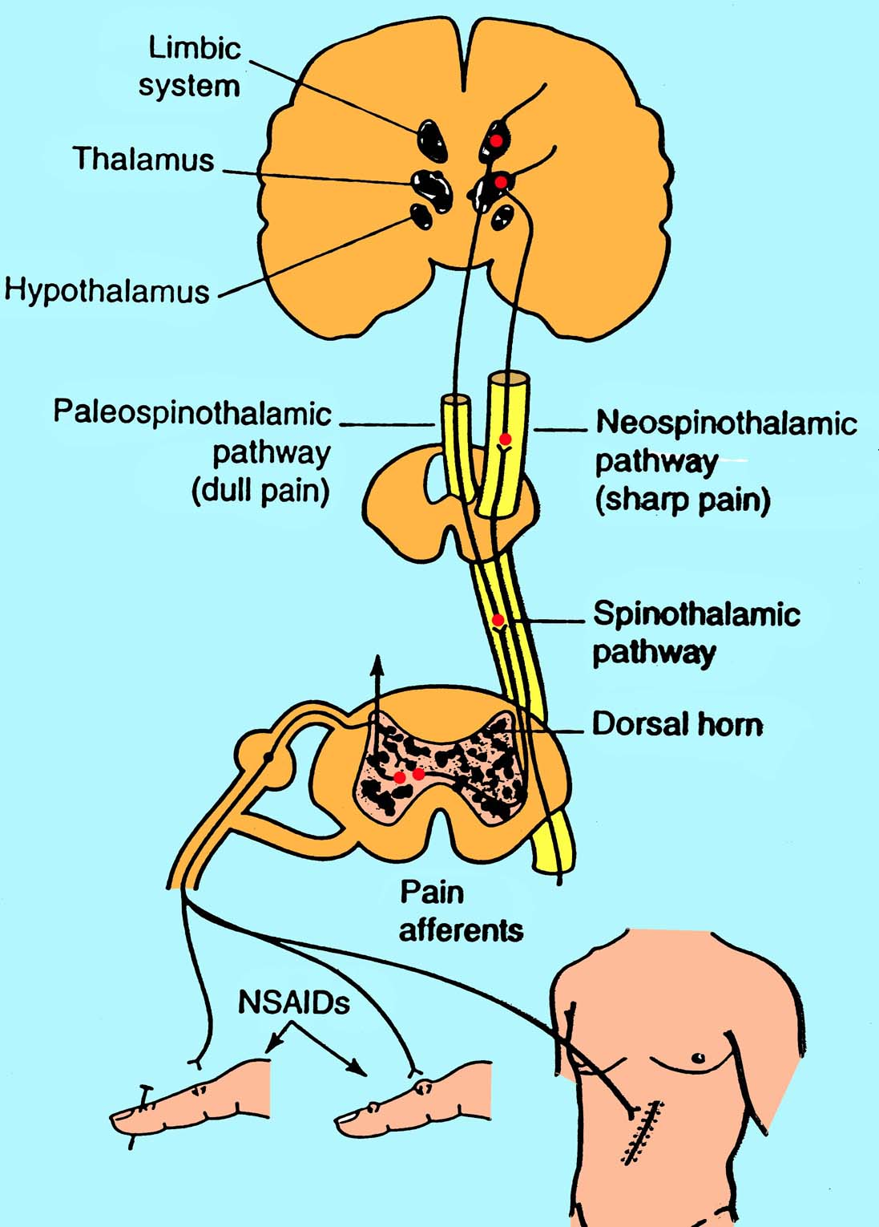

Slide 15
Mechanism of analgesia
Endogenous Opioid neurotransmitters:
Endorphins
Dynorphins
Enkephalins
These endogenous chemicals in the spinal cord and brain constitute pain inhibiting system.
Analgesia: it is a state in which a painful stimuli are moderated (modulated) , although perceived but felt no more painful.

Slide 16
Opioid Receptor types
mu (for morphine) µ
delta (δ )
kappa (ҝ)
These belongs to family of G-protein coupled receptors, new receptor subtypes have also been cloned.

Slide 17
Functions related to Opioid receptors

Slide 18
Most of the clinically used opioids are relatively selective for the µ (mu) receptors.

Slide 19
Mechanism of action
On binding to receptors at presynaptic nerve fiber they cause decrease in Ca⁺⁺ influx which results to ↓ in release of excitatory neurotransmitters like glutamate .
Post synaptically activation of receptors ↑K⁺ efflux. This leads to ↓ the response of post synaptic neuron to excitatory neurotransmitter.(i.e. hyperpolarization)

Slide 20
Mechanism at Opioid receptors

Slide 21
CLASSIFICATION OF OPIOIDS
Strong agonists
Moderate / low agonists
Mixed agonists antagonists
Antagonists
Others

Slide 22
Strong agonists
Morphine
Mepridine (Pethdine)
Methadone
Heroin (acetyl morphine)
Fentanyl
Alfentanyl

Slide 23
B) Moderate Agonists
Codeine , oxycodone
Propoxyphene
C) Mixed: Agonist/Antagonist
Pentazosine
Buprenorphine (partial agonist at µ receptors)
D) Pure Antagonist:
Nalaxone
Naltraxone
Nalmefene

Slide 24
MORPHINE (strong agonist)
It is strong agonist binds to mu, kappa, and delta receptors.
It is obtained naturally from the extract of poppy
( called opium)
ACTIONS:
Analgesia: Relief of pain without loss of consciousness by raising pain threshold at spinal cord level and by altering the brain perception for pain.

Slide 25
Morphine cont’d
Euphoria: powerful sense of contentment and of well being by stimulation of ventral tegmentum.
Respiration: Respiratory depression by reducing sensitivity of respiratory center neurons to CO2.
This effect is dose dependant and large doses may lead to respiratory cessation and death.( most common cause of death in acute Opioid over dose)
Cough reflex: It posses antitussive effect but codeine is clinically superior and has more powerful antitussive effect. Receptors involved seems to be different.
Miosis: pin point pupil due to stimulation of mu and kappa receptors at Edinger westphal neuclus of occulomoter nerve. This is diagnostic sign of morphine poisoning. There is little tolerance to this effect.

Slide 26
Morphine causes enhanced parasympathetic
stimulation
of eye results into miosis

Slide 27
Morphine cont’d
Emesis: vomiting due to stimulation of CTZ in area postrema, but sensations produced are not unpleasant.
GIT: It relives diarrhea and dysentery by ↓ motility .It also ↑the tone of intestinal smooth muscle and anal sphincters. overall it causes constipation with little tolerance
It also causes contraction of gall bladder and constriction of billiary sphincter which ↑ biliary pressure.
CVS: No major effect on B.P or H.R. except with large doses when hypotension or bradycardia may occur.
Due to respiratory depression and CO2 retention , cerebral vessels dilates and ↑ in CSF pressure.
(it is contraindicated in head injury)

Slide 28
Morphine cont’d
Histamine release: release of histamine from mast cells cause urticaria , sweating ,vasodilatation, it can cause bronchoconstriction, asthmatics should not receive the drug.
Hormonal actions: It inhibits the release of GRH and CRH.also↓in con. of LH, FSH, ACTH, β-endorphins, testosterone and cortisone.
↑ prolactin and growth hormone by diminishing
dopaminergic inhibition.
↑ antidiuretic hormone that leads to urinary retention..

Slide 29
Therapeutic uses Morphine cont’d
Analgesia: In severe pain and when sleep is desired.
e.g. Cancer pain, severe burn, severe visceral pain( except renal or biliar colic)
Diarrhea: As it ↓ GIT motility and ↑tone of anal sphincter
Cough: As it suppress cough reflex ( codeine and
dextromethorphan are superior)
Treatment of acute pulmonary edema : Dramatically relieve dyspnea caused by pulmonary edema and associated with LVF when administered IV possible by vasodilatory effect.
Preanesthetic medication

Slide 30
Morphine cont’d
Pharmacokinetics
Administration:
orally its absorption is slow and erratic and its
Significant 1st pass metabolism occurs in liver.
Parental administration produce reliable response .
In chronic pain slow release tablets and pumps increase the compliance due to self administration
For non medical purpose inhaling powders or smoke from burning crude opium provides rapid action.
.

Slide 31
Distribution:
It is least lipophilic among common opiates
It Rapidly enters all body tissues including
fetus. Should not be used during labor.
Infants born to addicted mothers show
physical dependence and withdrawal
symptoms.
Only small percentage crosses blood brain
barrier.

Slide 32
Fate Morphine cont’d
It is conjugated in liver to glucuronic acid .
Morphine -6 glucuronide a very potent
analgesic ,and 3-glucuronide is much less
active.
Conjugates primarily excreted in urine but
small quantities also excreted in bile.
It has duration of action for 4-6 hours when
administered systemically. when administered
epidurally duration is increased due to decreased volume of distribution.

Slide 33
Elderly are more sensitive to analgesic effect due to ↓ metabolism, ↓ lean body mass and poor renal function.
Neonates should not receive morphine.
Should be given with caution in patients with liver ,renal impairment and bronchial asthma.

Slide 34
Adverse effects: morphine cont’d
Severe respiratory depression, can lead to death in acute
poisoning especially in patients with emphysema and
cor pulmonale.
vomiting , dysphoria ,allergy, vasodilatation, hypotension
↑ intracranial pressure particularly in head injury
Urinary retention in prostate hypertrophy.
Pts with adrenal insufficiency and myxedema may
experience extended and increased effects.

Slide 35
Tolerance and dependence : morphine cont’d
Repeated use develops tolerance to
Respiratory depression
Analgesic effect
Euphoria
sedative effect of morphine
But no tolerance to
Miosis and
Constipation.

Slide 36
Withdrawal effects Morphine cont’d
Physical and psychological dependence occurs very early and withdrawal produces serious autonomic, motor and psychological symptoms such as
severe body ache
insomnia
restlessness ,irritability
diarrhoea
Goose flesh
lacrimation
increased in B.P ,Respiration and Temprature
Opioid addicts are detoxified by methadone and clonidine

Slide 37
CONTRA INDICATIONS morphine cont’d
Head injury
Pregnancy
Bronchial Asthma
liver and renal disease
Renal and biliary colics
Endocrine disease
Infants

Slide 38
MEPRIDINE(Pethidine) (strong agonist)
Is synthetic opioid , it also possess antimuscrinic effect
Is structurally unrelated to morphine
Is used for the treatment of acute pain.
Mechanism of action;
It primarily binds to mu receptors
It also binds to kappa receptors

Slide 39
Actions: Mepridine cont’d
Respiratory depression similar to morphine
No significant CVS action when given orally. On IV administration it cause ↓in PVR, ↑peripheral blood flow and ↑ cardiac rate.
Dilates cerebral vessels like morphine. ↑CSF pressure and contracts smooth muscles ( but less than morphine)
It posses atropine like actions
Does not cause pinpoint pupil rather dilates pupil
Less urinary retention than morphine

Slide 40
Therapeutic uses: Mepridine cont’d
Analgesia for any type of severe pain
now a days it is not recommended for chronic pain and chronic use.
Not useful for treatment of diarrhea or cough.
Commonly employed in obstetrics, due to its shorter duration of action ,and is less depressant on fetal respiration.

Slide 41
Pharmacokinetics:
Well absorbed orally( unlike morphine), and also produce analgesic effect on oral administration , however mostly administered IM.
Has shorter duration of action than morphine 2-4 hrs. It is metabolized in liver by N-methylation to normepridine
Excreted in urine.

Slide 42
Adverse effects: Mepridine cont’d
On repetitive and large doses causes:
Anxiety ,tremors, muscle twitching and rarely convulsions due to accumulation of normepridine
Svere hypotension
It causes pupillary dilatation
Hypotension, dry mouth, blurred vision
If given with neuroleptics provokes severe reactions such as convulsion , hyperthermia.
May Cause dependence , and can be substitute for heroin and morphine dependant person.
Produce partial tolerance to other opiates.

Slide 43
METHADONE (strong agonist)
Is synthetic.
Mechanism of action;
Through mu receptors.
Actions:
Analgesic activity equal to morphine but duration of action is longer
with less euphoria.
well absorbed orally ,fat soluble and readily penetrate into brain.
It has a half life of 24 hrs.
Can be administered rectally, subcutaneously and IV
its miotic and respiratory depressant effects lasts for 24 hrs
It increases billiary pressure and produce constipation like morphine

Slide 44
Therapeutic uses mathadone cont’d
Used for controlled with drawl of dependant abusers from heroin and morphine.
It is administered orally , is substituted for parental opioids and then patient is slowly taken off from methadone.
It causes mild but prolonged with drawl syndrome.
Neuropathic and cancer pain of severe natures.

Slide 45
Pharmacokinetics mathadone cont’d
It is readily absorbed orally
It accumulates in tissues ,and then slowly released.
Biotransformed in liver and excreted in urine as active metabolites.
Adverse effects: Physical dependence like morphine but slow and mild

Slide 46
Fantanyl(synthetic) strong agonist
Chemically related to mepridine
has 100 fold analgesic potency as morphine
Also used in anesthesia ,it is highly lipid soluble and crosses BBB readily.
Has rapid onset and short duration of action (15-30 min)
injected usually I/V or intrathecally.
Epidural fantanyl is used for anlagesia postoperatively and during labor.

Slide 47
Fentanyl cont’d
It can be administered transmucosally and transderml patch in cancer patients.,which may be effective for 72 hours.
It is metabolized to inactive metabolites by P450 3A4 and drugs that inhibit this isoenzyme can potenciate its effect
Eliminated through urine
Adverse effects are similar as mu agonists
Transdermal patch is contraindicated in hypoventilated patients
Unlike mepridine it causes pupillary constriction.

Slide 48
Duration of action and their peak effect when
some opioids administered I/V

Slide 49
SUFENTALNYL,ALFENTANYL, REMIFENTANIL strong agonist
These are related to Fentanyl
Sufentanil is more potent to fentanyl
Other two are less potent and much short acting

Slide 50
Heroin strong agonist
It is synthetic ,produced by the deacetylation of morphine which results to 3 fold increase in potency.
It is highly lipid soluble
Crosses BBB readily
Cause exaggerated euphoria when taken by injection
Converted to morphine in the body and its effects last as half long.
No accepted medical use

Slide 51
MODERATE AGONISTS
CODEINE( Natural)
Less potent analgesic than morphine
Highly effective orally
Good antitussive at dose that does not cause analgesia.
It produces less euphoria
low potential for abuse than morphine
Rarely produces dependance
It is often used in combination with Acetaminophen/Aspirin

Slide 52
Dextrometharphan
Free of analgesic and additive effects.
Less constipating than codeine
Potent antitussive
In nonprescription cough preparations it has replaced codeine

Slide 53
OXYCODONE moderate
It is semisynthetic derivative of morphine
It is orally active
Sometime formulated with aspirin or acetaminophen
It is used to treat moderate to sever pain
It has many properties common with morphine
Metabolized to active metabolites of lower analgesic activity.
Excreted in urine
Abuse of sustained release tablets may lead to death

Slide 54
PROPOXYPHENE moderate /low agonist
It is derivative of methadone
Dextro iomer posses analgesic property and used to relieve mild to moderate pain.
Levo isomer is not analgesic but posses antitussive action.
It is a weaker analgesic than codeine
It is commonly used in combination with aspirin or acetaminophen
Well absorbed orally

Slide 55
Propxyphene cont’d
Peak plasma conc. reaches in one hour
Metabolized in liver
It produces nausea ,anorexia, vomiting
In toxic dose cause resp. depression ,convulsion, hallucination ,confusion, cardio toxicity , and pulmonary edema.

Slide 56
Comparision of maximum efficacy
and addiction/abuse

Slide 57
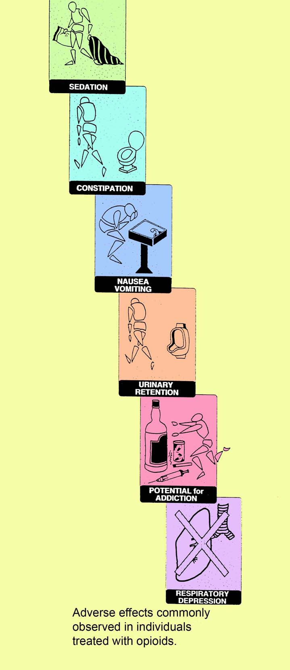

Slide 58
Mixed Agonist –Antagonist and Partial agonist
Drugs that stimulate one receptor and block other are termed as mixed agonist-antagonists.
Their effects depend on previous exposure to Opioid agonists
In individual who have not received opioids , these drugs show agonist activity and are used to relieve pain
In Opioid dependant patients , these drugs may show primarily blocking effects. That is, they produce withdrawal symptoms.

Slide 59
PENTAZOCINE
It has agonist action on kappa receptors, and weak antagonist on mu and delta receptors.
It produces analgesia by activating receptors in spinal cord and used to relieve moderate pain
It is administered orally or parenterally ,has shorter duration of action
It produces less euphoria as compared to morphine
In higher doses causes respiratory depression and ↓ activity at GIT.

Slide 60
Pentazocine cont’d
High doses ↑ B.P and cause hallucination , nightmares , tachycardia ,dizziness.
In patient suffering from angina it ↑es mean arterial pressure ,pulmonary artery pressure and thus ↑es work of heart.
It ↓es renal blood flow.
Despite its antagonist effect it does not antagonizes respiratory depression of morphine but can precipitate a withdrawal syndrome in morphine abusers.
Tolerance and dependence develop on repeated use.
It is contraindicated in epilepsy, co-administration with morphine and cardio vascular diseases

Slide 61
BUPRENORPHINE
It is a partial agonist on mu –receptors, with long duration of action, poor oral bioavailability
Administered S/L or as spray.
It acts like morphine in new patient , but precipitates withdrawal in morphine users.
Its major use is in opiate detoxification, because it has a less sever and short duration of withdrawal symptoms compared to methadone.
It causes little sedation, resp. depression and hypotension even at high doses.

Slide 62
Buprenorphine cont’d
It I administered sublingually Or parenterally
It has long duration of action
It is metabolized in liver and excreted via bile and urine
Adverse effects;
Respiratory depression that cannot be reversed by naloxone ↓ or rarely ↑ B.P ,nausea ,dizziness.

Slide 63
NALBUPHINE AND BUTORPHENOL
Like pentazosine they have little role for treatment of chronic pain.
They are not administered orally
They possess lesser psychomimetic effects than pentazosine
Nalbuphine does not affects heart or any ↑ in B.P in contrast to penta or Butorphenol
They exibit ceiling effect for respiratory depression

Slide 64
TRAMADOL
It is centrally acting analgesic (synthetic)
It binds to mu receptors
It also inhibits (weekly) reuptake of norepinephrine and serotonin in CNS
It is administered orally
It is used to manage moderate to moderately severe pain usually used for treatment of chronic pains
Its respiratory depressive effect is less pronounced than morphine

Slide 65
Naloxone can only partially reverse analgesia produced y tramadol or its active metabolites
It undergoes extensive metabolism
Adverse effects: nausea, vomiting, dry mouth, dizziness, sedation ,
It may cause anaphylaxis ,seizures (esp.patients taking TCA, or SSRI )
Contraindicated in patients with history of epilepsy.

Slide 66
Diphenoxylate
It is similar to mepridine
it is approved for the treatment of diarrhoea
It is available in combination with atrpine
Loperamide:
It is similar to diphenoxylate
It is usually used for controlling chronic diarrhoea.

Slide 67
Opioid drugs and their selectivity for receptor sub types

Slide 68
ANTAGONISTS
In normal individual Opioid antagonists do not produce any effect.
They rapidly reverse the effect of agonists. will normalize respiration, level of consciousness, pupil size an bowel activity.
They precipitate the opiate withdrawal symptoms.
they have a rleatively high affinity for mu receptors but they can also revese the agonists at delta and kappa receptors.

Slide 69
NALOXONE
Used to reverse the respiratory depression and coma due to Opioid over dose
It rapidly displaces all receptor bound Opioid molecule and in this way reverse the effects of opioid overdose.
The effect is very fast ,with in 30 seconds of IV administration, the respiratory depression and coma characters produced by over dose get reversed.
Patient gets revived and alert.

Slide 70
Naloxone cont’d
It has a half life of 60-100 minutes
It is competitive antagonist at mu ,kappa and delta receptors.
It has 10 times more affinity for mu receptors than for kappa.
It readily reverse respiratory depression

Slide 72
NALTREXONE (antagonist)
It is well absorbed orally ,may
Undergoes rapid 1st pass metabolism
It has a half life of 10 hours.
A single dose of drug can block the opioid effect for 48 hours.
Due to long duration of action it is proposed for maintenance for opioid addicts.
It has been observed that naltrexone decreases craving for alcohol in chronic alcoholics

Slide 73
Comparison of main opioids
Heroin
Not used clinically
Mepridine

