Slide 1
General Anesthetics
By
Prof. Abdulqader Alhaider

Slide 2
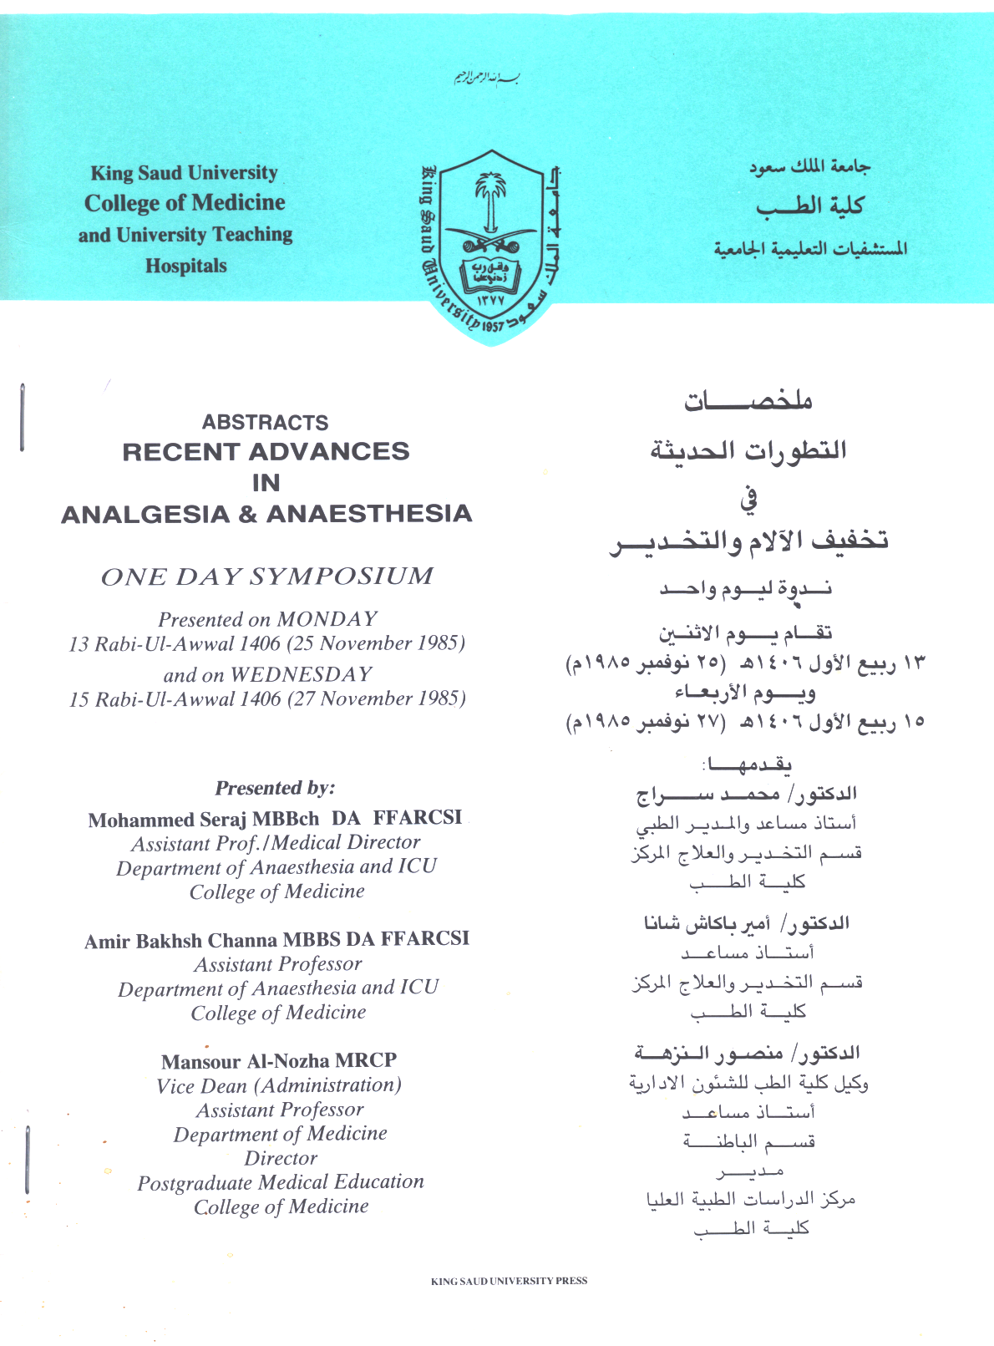

Slide 3
Definition of General Anesthesia
General Anesthetics
Definition of general anesthetics (see Definition)
Goals of Good Anesthesia
Stages of Anesthesia (Stage 1= Stage of Analgesia; Stage 2: Stage of Excitement (should be avoided why?); Stage 3: Stage of surgical Anesthesia (the targeted stage); Stage 4: Stage of modularly depression)
Which of the stages that should be avoided?

Slide 4
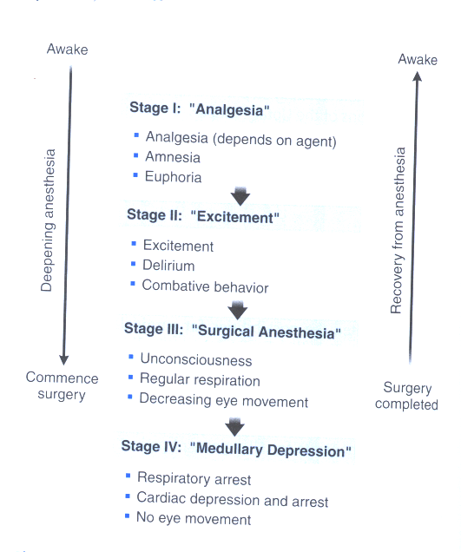

Slide 5
Definitions
Definition | Term
A state of unconsciousness, analgesia, and amnesia with skeletal muscle relaxation and loss of reflexes. | General anesthesia
Anesthesia induced by inhalation of drug | Inhalational anesthesia
The alveolar concentration required to eliminate the response to standardized painful stimulus in 50% of patients | Minimum alveolar concentration (MAC)
A stage of decreased awareness of pain , sometimes with amnesia. | Analgesia
Anesthesia produced by a mixture of drugs, often including both inhaled and intravenous agents.. | Balanced anesthesia

Slide 6
M.O.A.:
No specific receptors, potassium channels are very important for inhaled while GABAA –receptor chloride channel (Cl influx) involved in i.v G.A except ketamine.
(They act by stimulating potassium or chloride channels which leads to the inhibition the firing of neurons in the spinal cord and brain, thus decreasing neurotransmissions). However, the detailed mechanisms are out of the scope of this lecture

Slide 7
General anesthetics
inhaled intravenous
Gas volatile Barbiturates
liquids
Benzodiazepines
Miscellaneous
( Propofol,Etomidate)
Dissoociative
(ketamine)
Opioids
Fentanyl

Slide 8
Classification
Classification
Desflurane
Enflurane
Halothane
Isoflurane
Methoxyflurane
Nitrous oxide (Gas)
Sevoflurane
Which one of them comes in liguid form?
INHALED

Slide 9
Intravenous
Methohexital
Thiamylal Barbiturates
Thiopental
Diazepam
Lorazepam Benzodiazepines
Midaxolam
Etomidate, propofol
Fentanyls Opioids
Morphine
Droperidol +Fentanyl neuroleptic
ketamine

Slide 10
Adjuncts to Anesthetics
Antiemetics
Antihistamines
Benzodiazepines
Skeletal Muscle Relaxants:
Atracurium
Vecuronium
Succinylcholine
Preanesthetic Medication

Slide 11
Classification of G.A.
Inhaled GA
I.V GA
Inhaled General Anesthetics
Remember that a concentration of inhaled general anesthetic in CNS is very important for determining the potency and pharmacological activity.
Inhaled
Intravenous

Slide 12
Factors Affecting General Anesthetics Concentration in CNS
a) Pharmacokinetics ( eg. Partitioning coefficient (lipid Solubility), Anesthetic concentration in inspired air, Pulmonary ventilations etc (see Table)
b) Pharmacodynamics (eg. Minimum Alveolar Concentration (MAC) (see Table 1)
What is the relation between MAC and partitioning co- efficient ?
Suppose that you give a mixture of 40% of N₂O and 1% Sevoflurane, how many MAC in this combination?

Slide 13
Properties of inhaled anesthetics
Comments | metabolism | Minimal Alveoler conc( mac) (%) | Brain:Blood Partion coefficient | Blood : gas partition coeffecient | Anesthetic
Incomplete, rapid onset and recovery | None | >100% | 1.1 | 0.47 | Nitrous Oxide
Low volatility , fast induction, rapid recovery | <0.05% | 6-7 | 1.3 | 0.42 | Desflurane
Rapid onset & recovery, unstable in soda lime | 2-5% (fluoride) | 2.0 | 1.7 | 0.69 | Sevoflurane
Medium rate of onset and recovery | <2% | 1.40 | 2.6 | 1.40 | Isoflurane
Medium rate of onset and recovery | 8% | 1.7 | 1.4 | 1.80 | Enflurane
Nedium rate of onset and recovery | >40% | 0.75 | 2.9 | 2.30 | Halothane
Slow onset and recovery, | >70% (fluoride) | 0.16 | 2.0 | 12 | Methoxyflurane

Slide 14
Pharmacological Effects Of Inhaled Anesthetics
PHARMACOLOGICAL EFFECTS OF
INHALED ANESTHTICS
A. Most inhaled GA Except N2O decrease mean arterial pressure.
However, Desflurane increase BP by stim. Sym. tone in the brain.
Heart rate: Decreased by halothane and enflurane, but increases with Isoflurane & Des, while N₂O and sevoflurane have no effect.
Which one of the inhaled GA is considered as a pro arrythmogenic ?
CVS
Heart rate

Slide 15
B) Effect on Respiratory system
Except N2O, all inhaled GA suppress RS ( rate but tidal volume and minute ventilation leading to Pco2).
However, this is not a big problem. Why ?
Note: Bronchodilation by halothane while desflurane and enflurane produce airway irritation and coughing and have pungent odor. So What?
Diffuse hypoxia with N2O.
C) Effect on CNS : Increase ICP due to
vasodilation. So What ?
Most inhaled GA Except enflurane make burst suppression on EEG. Thus, enflurane may ppt seizure and muscle twitching.

Slide 16
D) Effect on liver: Hepatitis only with halothane ?
E) Effect on kidney : Due to presence of fluoride, renal damage may occur with methoxyflurane and enflurane .
F) Hematological Effect: megaloblastic Anemia only with N2O.
HOW?
G) Skeletal Muscle Relaxation
H) Uterine smooth muscle relaxation
I) Analgesia.

Slide 17
Toxicity:
- Hepatotoxicity with What?
- Nephrotoxicity with……..
- Malignant Hyperthermia with all halogenated GA. (it is an autosomal dominant genetic disorder of skeletal musclethat occurs with susceptible individuals)
Rx: Dantroline
- Desflurane produce centrally mediated sympathetic stim. Leading to HTN and tachycardia.

Slide 18
Comparision b/w NO2 and Halothane
HALOTHANE | NO2
Volatile anesthetic | The only inorganic gas in G.A | Nature
Not flammable Not explosive & not irritant | Not flammable Not explosive | Characteristics
Rapid & smooth, but slower | Rapid & pleasant (2min) | Induction
Slower | Rapid & smooth (1- min) | Recovery
Very strong | Strong | Analgesic
Good effect | Poor as compared to halogenated inhaled G.A | Effect on muscle relaxation
↓HR & BP, depress respiration | No effect | CVS & respiratory system

Slide 19
Comparison cont’d
HALOTHANE | NO2
1. dysrrthmias, due to sensitization of catecholamine receptors. Hepatotoxicity after repeated administration. CVs & respiratory depression | 1.Sever hypoxia if used alone. should not be given alone. 2. Bone marrow depression leucopenia Megaloblastic anaemia, after repeated administration due to inhibition of vit.B12 is required for cell division 3. ↑ the incidence of abortion in pregnant women working in the operating theater Some times nausea and vomiting | Side effects
With history of unexplained jaundice after its use. ↑ICP, family history of malignant hyperthermia | In any patient with clear collection of air in the pleura, pericardial, peritoneal sacs, also, in intestinal obstruction, COPD & emphysema. | Contraindications

Slide 20
Comparison cont’d
HALOTHANE | NO2
1. Can be used for all surgical anesthesia, but usually combined with other anesthetic to ↓ the side effects . 2. Not used in obstetric practice because it will relax the uterine muscle which will delay the labor. | 1.Used in combination with other potent anesthetic agents to maintain surgical anesthesia for two reasons, to lower the dose of the potent agent G.A. to minimize the side effects. 2. Commonly used in dental operation by subanesthetic concentration (25 %) 3. For obstetric practice , during normal or painful labor to relieve pain | Clinical uses
Metabolized in the liver and part of it is excreted in lung. | Un changed through the lung | Elimination

Slide 21
I.V. General Anesthetics
Recently, I.V became the anesthetics of choice. Why ?
Advantages VS Disadvantages
Classification:
A) Analgesic i.v anesthetics (eg. Ketamine; Fentanyls)
B) Non- analgesic i.v anesthetics (eg. Thiopental ; Propofol; Etomidate; Benzodiazepines).

Slide 22
1. Ketamine
History
Good analgesia. How ?
Good for patients with low blood pressure. Why ?
Produces dissociative anesthesia
Bad and limiting side effect as CNS stimulation, thus it is not used in adults.
Used in pediatrics
Increases intracranial pressure.

Slide 23
2. Fentanyl and Sufentanil
They are i.v. of choice for cardiac surgery and for intubations. Why?
They are 100 times more potent than morphine.
Side Effects: Post operative Respiratory depressant (Laryngiospasms) Rx Naloxone.
Note: Remifentanil has very short duration of action thus preferred for ambulatory surgery.
Neurolept- analgesia vs neurolept- anesthesia.

Slide 26
Fentanyl - Actiq (fentanyl on a stick), Duragesic transdermal patches (12, 25, 50, 100 μg/h) Therapeutic index=400, morphine = 70
Alfentanil - Ultra-short acting, 5-10 minutes analgesic duration
Remifentanil - Shortest acting opioid - 1/2 time is 4-6 minutes. Used in MAC anesthesia. TI=30,000
Sufentanil - 5-10x Fentanyl, used for heart surgery.
Carfentanil - (100x Fentanyl) Thought that it was used in the 2002 Moscow theater crisis to subdue Chechen hostage takers. Didn’t turn out so well. 42 terrorists and 130 hostages died. Works well on bears.

Slide 27
B- non- analgesic I.V. GA
Nowadays, these drugs are commonly in use for induction and maintenance together with inhaled GA.
a. Thiopental: An ultrashort acting barbiturate.
Pharmacological features of thiopental
used for induction and maintenance
starts its action in 20 sec ( unconsciousness)
& continue only 10-20 min. why ?
Important effect as a decrease in ICP
Respiratory depressant (desentsitize medulla to hypercapnea).
Good skeletal muscle relaxation.

Slide 28
Hypotensive due to sig. Arterial vasodilation.
Produces porphyria and post-op N/V; N & V.
2. Propofol:
How does it differ from thiopental?.
3. Etomidate : similar to propofol but suppress adrenal gland and may cause involuntary movement. ?
Advantages: less hypotension and resporatory depression as compared to propofol but produce post op N/V (see Table)
4. Benzodiazepines : eg. Diazepam: p.o and i.v); Lorazepam (p.o) and Medazolam (i.v)
Diazepam and lorazepam are given orally as preanesthetic medications while midazolam is used for induction and maintenance.
What is flumazenil?

Slide 29
Chracteristics of intravenous anesthetics
comments | Inductinon and recovery | Drug
Standard induction agent , cardiovascular depression , avoid in porphoryia | Rapid onset and rapid recovery (bolus dose) slow recovery following iv infusion | Thiopental
Cardiovascular stimulation , ↑ cerebral blood flow, emergence reactions impair recovery | Moderately rapid onset and recovery | Ketamine
Used in balanced anesthesia and conscious sedation, marked analgesia | Slow onset and recovery , naloxone reversal available | Fentanyl
used in balanced anesthesia and conscious sedation, cardiovascular stability, marked amnesia. | Slow onset and recovery , flumazenil reversal available | Midazolam
Used in induction and for maintenance , hypotension, useful antiemetic action. | Rapid onset and Rapid recovery | Propofol
Cardiovascular stability ↓steroidogenesis , involuntary muscle movements. | Rapid onset and moderately fast recovery | Etomidate

Slide 30
Clinical Aspects of General Anesthetics:
- Now adays I.V GA became more popular than inhaled ones.
- Nitrous oxide is not used for induction because…….
- Sevoflurane or halothane can be used for induction in pediatrics. Why?
- If patient needs intubation: midazolam or propofol are used for………and fentanyl for……. And atracurium for….

Slide 31
Cardiac Surgery:
Etomidate better propofol for induction why?
Fentanyl
Isoflurane preffered over sevoflurane why?

Slide 32
Therapeutic disadvantages Therapeutic advantages
Good analgesia
Rapid onset/recovery
Safe ,non irritating
Incomplete anesthesia
No muscle relaxation
Must be used with other
Anesthetic for surgical
anesthesia
Inhalation
Anesthetics
Nitrous oxide
Halothane
Enflurane
Isoflurane
Best agent n pediatric
Patients
Bronchial smooth muscle
Relaxation good in
Asthmatic patients
Reduces hepatic and
renal blood flow
Lowers blood pressure
Sensitizes myocardium
to action of catecholamines
Hepatic toxicity
Arrhythmias
Good muscle relaxation
Rapid recovery
Stability of cardiac out put
Does not raise intra cranial
Pressure.
No sensitization of heart
patient

Slide 33
Therapeutic Disadvantages Therapeutic advantages
Intravenous
Anesthetics
Thiopental
Ketamine
Fentanyl
propofol
Rapid onset of action
Potent anesthesia
Poor analgesia
Potent anesthesia
laryngospasm
Good analgesia
Good analgesia
Rapid onset
Lowers intacranial
pressure
Poor analgesia

