Slide 1
Dyslipidemia
(Med-341)
Dr Anwar A Jammah, MD, FRCPC, FACP, CCD, ECNU.
Asst. Professor and Consultant in Medicine & Endocrinology
Department of Medicine, King Saud University

Slide 2
The story of lipids
Chylomicrons transport fats from the intestinal mucosa to the liver
In the liver, the chylomicrons release triglycerides and some cholesterol and become low-density lipoproteins (LDL).
LDL then carries fat and cholesterol to the body’s cells.
High-density lipoproteins (HDL) carry fat and cholesterol back to the liver for excretion.

Slide 3
The story of lipids (cont.)
When oxidized LDL cholesterol gets high, atheroma formation in the walls of arteries occurs, which causes atherosclerosis.
HDL cholesterol is able to go and remove cholesterol from the atheroma.
Atherogenic cholesterol → LDL, VLDL, IDL

Slide 4
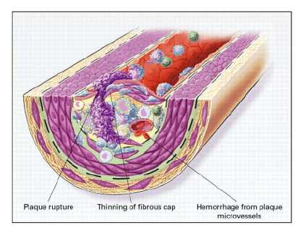
Atherosclerosis

Slide 5
Atherogenic Particles
Apolipoprotein B
MEASUREMENTS:
Non-HDL-C
VLDL
VLDL_{R}
IDL
LDL
Small,
dense
LDL
TG-rich lipoproteins
Notes:
Atherogenic particles
Not only is LDL-C a risk factor for cardiovascular disease, but triglyceride-rich lipoproteins—very low density lipoprotein (VLDL), VLDL remnants, and intermediate-density lipoprotein (IDL)—may also increase the risk of heart disease. The NCEP ATP III uses non-HDL-C principally as a surrogate for these atherogenic particles.

Slide 6
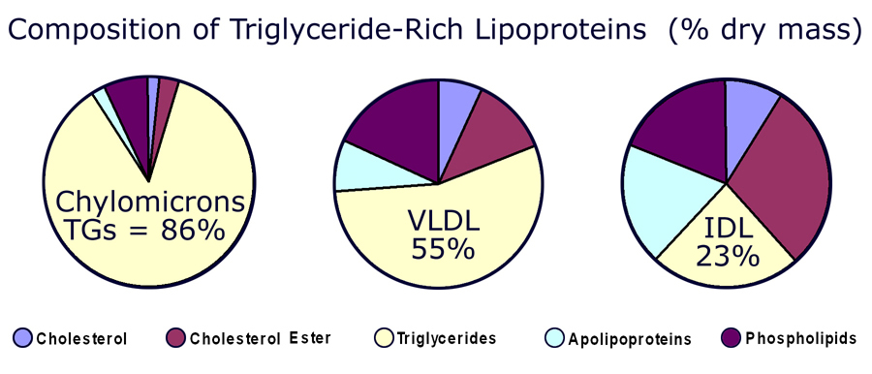

Slide 7
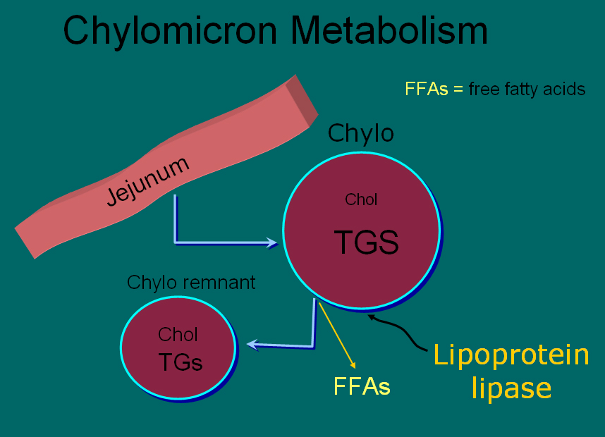

Slide 8
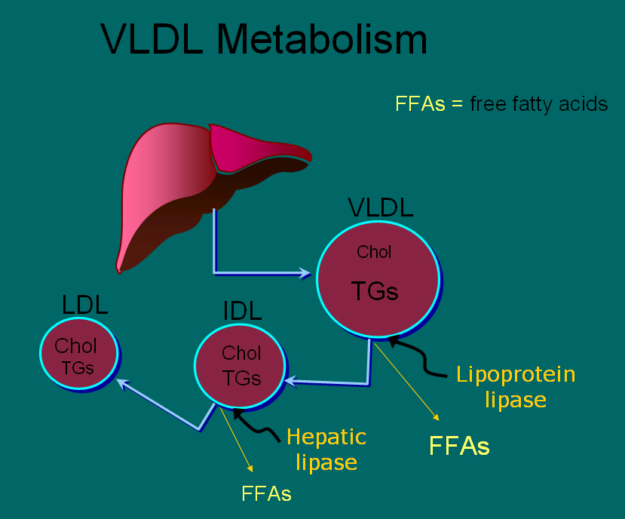

Slide 9
HDL and Reverse Cholesterol Transport
Bile
A-I
A-I
FC
CE
LCAT
CE
FC
FC
CE
FC
SR-BI
Nascent
HDL
ABCA1
Liver
Macrophage
Mature
HDL
Notes:
HDL and reverse cholesterol transport
HDL is believed to protect against atherosclerosis at least in part through the process of reverse cholesterol transport, whereby excess free cholesterol (FC) is removed from cells in peripheral tissues, such as macrophages within the arterial wall, and returned to the liver for excretion in the bile. FC is generated in part by the hydrolysis of intracellular cholesteryl ester (CE) stores. Several key molecules play a role in reverse cholesterol transport, including ATP-binding cassette protein A1 (ABCA1), lecithin:cholesterol acyltransferase (LCAT), and scavenger receptor class-B, type I (SR-BI). Promotion of this pathway could in theory help reduce atherosclerosis.

Slide 10
Plasma lipoproteins
Type | Source | Major lipid | Apoproteins | ELFO | Athero-genicity
Chylomicrons | Gut | Dietary TGs | A-I, B-48, C-I, C-III, E | no mobility | – (pancreatitis)
VLDL | Liver | Endogenous TGs | B-100, E, C-II, C-III, | Pre-β | +
IDL | VLDL remnant | Ch esters, TGs | B-100, C-III, E | Slow pre- β | +
LDL | VLDL, IDL | Ch esters | B-100 | β | +++
HDL | Gut, liver | Ch esters, PLs | A-I, A-II, C-II, C-III, D, E | α | anti- atherogenic
Notes:
Fredrickson Classification of the Hyperlipidemias
Fredrickson phenotypes may be used to classify dyslipidemias on the basis of which lipoproteins are elevated. The Fredrickson classification system is not etiologic, does not distinguish between primary and secondary hyperlipidemias, and does not include HDL.
Reference:
Fredrickson DS, Lees RS. A system for phenotyping hyperlipoproteinemia. Circulation 1965;31:321-327.

Slide 11
Hereditary Causes of Hyperlipidemia
Familial Hypercholesterolemia
    Codominant genetic disorder, coccurs in heterozygous form
    Occurs in 1 in 500 individuals
    Mutation in LDL receptor, resulting in elevated levels of LDL at birth and throughout life
    High risk for atherosclerosis, tendon xanthomas (75% of patients), tuberous xanthomas and xanthelasmas of eyes.
Familial Combined Hyperlipidemia
    Autosomal dominant
    Increased secretions of VLDLs
Dysbetalipoproteinemia
    Affects 1 in 10,000
    Results in apo E2, a binding-defective form of apoE (which usually plays important role in catabolism of chylomicron and VLDL)
    Increased risk for atherosclerosis, peripheral vascular disease
    Tuberous xanthomas, striae palmaris

Slide 12
Fredrickson classification of hyperlipidemias
Phenotype | Lipoprotein(s) elevated | Plasma cholesterol | Plasma TGs | Athero-genicity | Rel. freq. | Treatment
I | Chylomicrons | Norm. to ↑ | ↑↑↑↑ | – pancreatitis | <1% | Diet control
IIa | LDL | ↑↑ | Norm. | +++ | 10% | Bile acid sequestrants, statins, niacin
IIb | LDL and VLDL | ↑↑ | ↑↑ | +++ | 40% | Statins, niacin, fibrates
III | IDL | ↑↑ | ↑↑↑ | +++ | <1% | Fibrates
IV | VLDL | Norm. to ↑ | ↑↑ | + | 45% | Niacin, fibrates
V | VLDL and chylomicrons | ↑ to ↑↑ | ↑↑↑↑ | + pancreatitis | 5% | Niacin, fibrates
Notes:
Fredrickson Classification of the Hyperlipidemias
Fredrickson phenotypes may be used to classify dyslipidemias on the basis of which lipoproteins are elevated. The Fredrickson classification system is not etiologic, does not distinguish between primary and secondary hyperlipidemias, and does not include HDL.
Reference:
Fredrickson DS, Lees RS. A system for phenotyping hyperlipoproteinemia. Circulation 1965;31:321-327.

Slide 13
Primary hypercholesterolemias
Disorder | Genetic defect | Inheritance | Prevalence | Clinical features
Familial hyper-cholesterolemia | LDL receptor | dominant | heteroz.:1/500 5% of MIs <60 yr homoz.: 1/1 million | premature CAD (ages 30–50) TC: 7-13 mM CAD before age 18 TC > 13 mM
Familial defective apo B-100 | apo B-100 | dominant | 1/700 | premature CAD TC: 7-13 mM
Polygenic hypercholesterolemia | multiple defects and mechanisms | variable | common 10% of MIs <60 yr | premature CAD TC: 6.5-9 mM
Familial hyper-alphalipoproteinemia | unknown | variable | rare | less CHD, longer life elevated HDL
Notes:
Fredrickson Classification of the Hyperlipidemias
Fredrickson phenotypes may be used to classify dyslipidemias on the basis of which lipoproteins are elevated. The Fredrickson classification system is not etiologic, does not distinguish between primary and secondary hyperlipidemias, and does not include HDL.
Reference:
Fredrickson DS, Lees RS. A system for phenotyping hyperlipoproteinemia. Circulation 1965;31:321-327.

Slide 14
Primary hypertriglyceridemias
Disorder | Genetic defect | Inheritance | Prevalence | Clinical features
LPL deficiency | endothelial LPL | recessive | rare 1/1 million | hepatosplenomegaly abd. cramps, pancreatitis TG: > 8.5 mM
Apo C-II deficiency | Apo C-II | recessive | rare 1/1 million | abd. cramps, pancreatitis TG: > 8.5 mM
Familial hyper-triglyceridemia | unknown enhanced hepatic TG-production | dominant | 1/100 | abd. cramps, pancreatitis TG: 2.3-6 mM
Notes:
Fredrickson Classification of the Hyperlipidemias
Fredrickson phenotypes may be used to classify dyslipidemias on the basis of which lipoproteins are elevated. The Fredrickson classification system is not etiologic, does not distinguish between primary and secondary hyperlipidemias, and does not include HDL.
Reference:
Fredrickson DS, Lees RS. A system for phenotyping hyperlipoproteinemia. Circulation 1965;31:321-327.

Slide 15
Primary mixed hyperlipidemias
Disorder | Genetic defect | Inheritance | Prevalence | Clinical features
Familial dysbeta-lipoproteinemia | Apo E high VLDL, chylo. | recessive rarely dominant | 1/5000 | premature CAD TC: 6.5 -13 mM TG: 2.8 – 5.6 mM
Familial combined | unknown high Apo B-100 | dominant | 1/50 – 1/100 15% of MIs <60 yr | premature CAD TC: 6.5 -13 mM TG: 2.8 – 8.5 mM
Notes:
Fredrickson Classification of the Hyperlipidemias
Fredrickson phenotypes may be used to classify dyslipidemias on the basis of which lipoproteins are elevated. The Fredrickson classification system is not etiologic, does not distinguish between primary and secondary hyperlipidemias, and does not include HDL.
Reference:
Fredrickson DS, Lees RS. A system for phenotyping hyperlipoproteinemia. Circulation 1965;31:321-327.

Slide 16
Dietary sources of Cholesterol
Type of Fat | Main Source | Effect on Cholesterol levels
Monounsaturated | Olives, olive oil, canola oil, peanut oil, cashews, almonds, peanuts and most other nuts; avocados | Lowers LDL, Raises HDL
Polyunsaturated | Corn, soybean, safflower and cottonseed oil; fish | Lowers LDL, Raises HDL
Saturated | Whole milk, butter, cheese, and ice cream; red meat; chocolate; coconuts, coconut milk, coconut oil , egg yolks, chicken skin | Raises both LDL and HDL
Trans | Most margarines; vegetable shortening; partially hydrogenated vegetable oil; deep-fried chips; many fast foods; most commercial baked goods | Raises LDL

Slide 17
Causes of Hyperlipidemia
Diet
Hypothyroidism
Nephrotic syndrome
Anorexia nervosa
Obstructive liver disease
Obesity
Diabetes mellitus
Pregnancy
Obstructive liver disease
Acute heaptitis
Systemic lupus erythematousus
AIDS (protease inhibitors)

Slide 18
Secondary hyperlipidemias
Disorder | VLDL | LDL | HDL | Mechanism
Diabetes mellitus | ↑ ↑ ↑ | ↑ | ↓ | VLDL production ↑, LPL ↓, altered LDL
Hypothyroidism | ↑ | ↑ ↑ ↑ | ↓ | LDL-rec.↓, LPL ↓
Obesity | ↑ ↑ | ↑ | ↓ | VLDL production ↑
Anorexia | - | ↑ ↑ | - | bile secretion ↓, LDL catab. ↓
Nephrotic sy | ↑ ↑ | ↑ ↑ ↑ | ↓ | Apo B-100 ↑ LPL ↓ LDL-rec. ↓
Uremia, dialysis | ↑ ↑ ↑ | - | ↓ | LPL ↓, HTGL ↓ (inhibitors ↑)
Pregnancy | ↑ ↑ | ↑ ↑ | ↑ | oestrogen ↑ VLDL production ↑, LPL ↓
Biliary obstruction PBC | - | - | ↓ | Lp-X ↑ ↑ no CAD; xanthomas
Alcohol | ↑ ↑ chylomicr. ↑ | - | ↑ | dep. on dose, diet, genetics
Many-many drugs | Please allways see for adverse effects before any drug presciption!!!

Slide 19
Checking lipids
Nonfasting lipid panel
    measures HDL and total cholesterol
Fasting lipid panel
    Measures HDL, total cholesterol and triglycerides
    LDL cholesterol is calculated:
      LDL cholesterol = total cholesterol – (HDL + triglycerides/5)

Slide 20
When to check lipid panel
Two different Recommendations
  Adult Treatment Panel (ATP III) of the National Cholesterol Education Program (NCEP)
      Beginning at age 20: obtain a fasting (9 to 12 hour) serum lipid profile consisting of total cholesterol, LDL, HDL and triglycerides
      Repeat testing every 5 years for acceptable values
  United States Preventative Services Task Force
      Women aged 45 years and older, and men ages 35 years and older undergo screening with a total and HDL cholesterol every 5 years.
      If total cholesterol > 200 or HDL <40, then a fasting panel should be obtained
      Cholesterol screening should begin at 20 years in patients with a history of multiple cardiovascular risk factors, diabetes, or family history of either elevated cholesteral levels or premature cardiovascular disease.

Slide 21
Treatment Targets
LDL: To prevent coronary heart disease outcomes (myocardial infarction and coronary death)
Non LDL( TC/HDL): To prevent coronary heart disease outcomes (myocardial infarction and coronary death)
Triglyceride: To prevent pancreatitis and may be coronary heart disease outcomes (myocardial infarction and coronary death)

Slide 22
LDL and Non-LDL(HDL/TC)
Risk Assessment Tool for Estimating 10-year Risk of Developing Hard CHD (Myocardial Infarction and Coronary Death)
Framingham Heart Study to estimate 10-year risk for coronary heart disease outcomes
http://hp2010.nhlbihin.net/atpiii/CALCULATOR.asp?usertype=prof
  Age
  LDL-C
  T. Chol
  HDL-C
  Blood Pressure
  Diabetes
  Smoking

Slide 23
Adult Treatment Panel III Guidelines for Treatment of Hyperlipidemia
Risk Category | Begin Lifestyle Changes If: | Consider Drug Therapy If: | LDL Goal
High: CAD or CAD equivalents (10-yr risk > 20%) | LDL ≥ 2.58 mM | LDL ≥ 2.58 mM (drug optional if < 2.58 mM) | < 2.58 mM; < 1.8 mM optional
Moderate high: ≥ 2 risk factors with 10-yr risk 10 to 20%* | LDL ≥ 3.36 mM | LDL ≥ 3.36 mM | < 3.36 mM; < 2.58 mM optional
Moderate: ≥ 2 risk factors with 10-yr risk < 10%* | LDL ≥ 3.36 mM | LDL ≥ 4.13 mM | < 3.36 mM; < 2.58 mM optional
Lower: 0–1 risk factor | LDL ≥ 4.13 mM | LDL ≥ 4.91 mM (drug optional if 4.13–4.88 mM) | < 4.13 mM
*For 10-yr risk, see Framingham risk tables

Slide 24
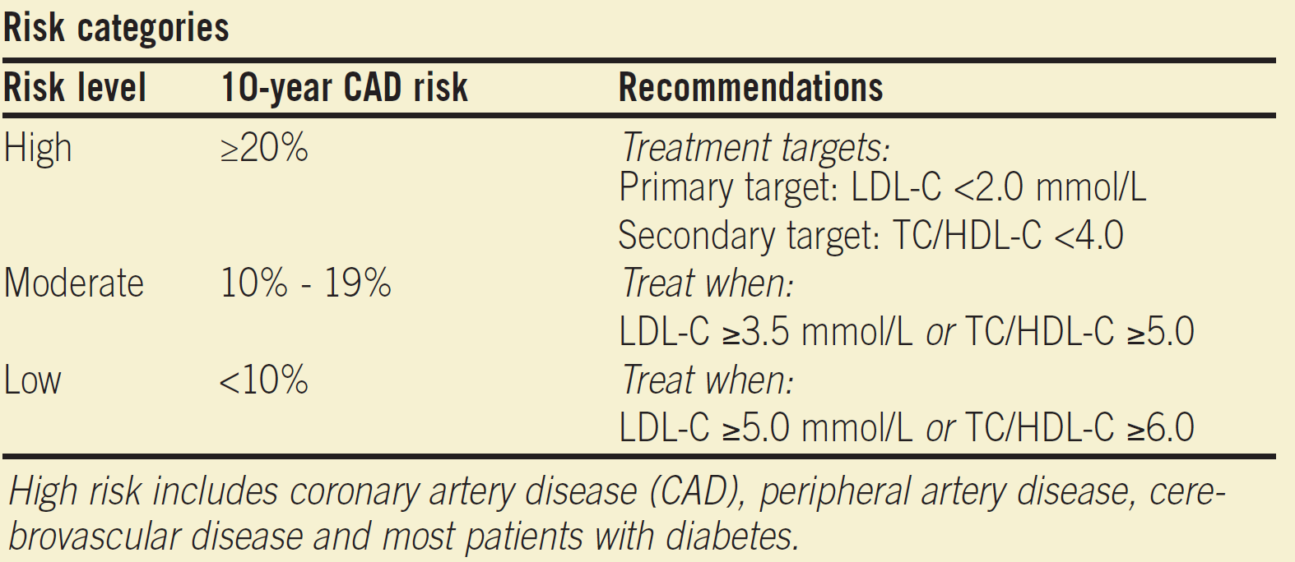
Canadian New Guideline

Slide 25
Treatment of Hyperlipidemia
Lifestyle modification
  Low-cholesterol diet
  Exercise

Slide 26
Medications for Hyperlipidemia
Drug Class | Agents | Effects (% change) | Side Effects
HMG CoA reductase inhibitors | Statins | ↓LDL (18-55),↑ HDL (5-15) ↓ Triglycerides (7-30) | Myopathy, increased liver enzymes
Cholesterol absorption inhibitor | Ezetimibe | ↓ LDL( 14-18), ↑ HDL (1-3) ↓Triglyceride (2) | Headache, GI distress
Nicotinic Acid |  | ↓LDL (15-30), ↑ HDL (15-35) ↓ Triglyceride (20-50) | Flushing, Hyperglycemia, Hyperuricemia, GI distress, hepatotoxicity
Fibric Acids | Gemfibrozil Fenofibrate | ↓LDL (5-20), ↑HDL (10-20) ↓Triglyceride (20-50) | Dyspepsia, gallstones, myopathy
Bile Acid sequestrants | Cholestyramine | ↓ LDL ↑ HDL No change in triglycerides | GI distress, constipation, decreased absorption of other drugs

Slide 27
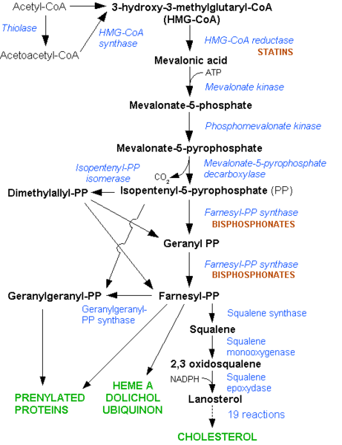

Slide 28
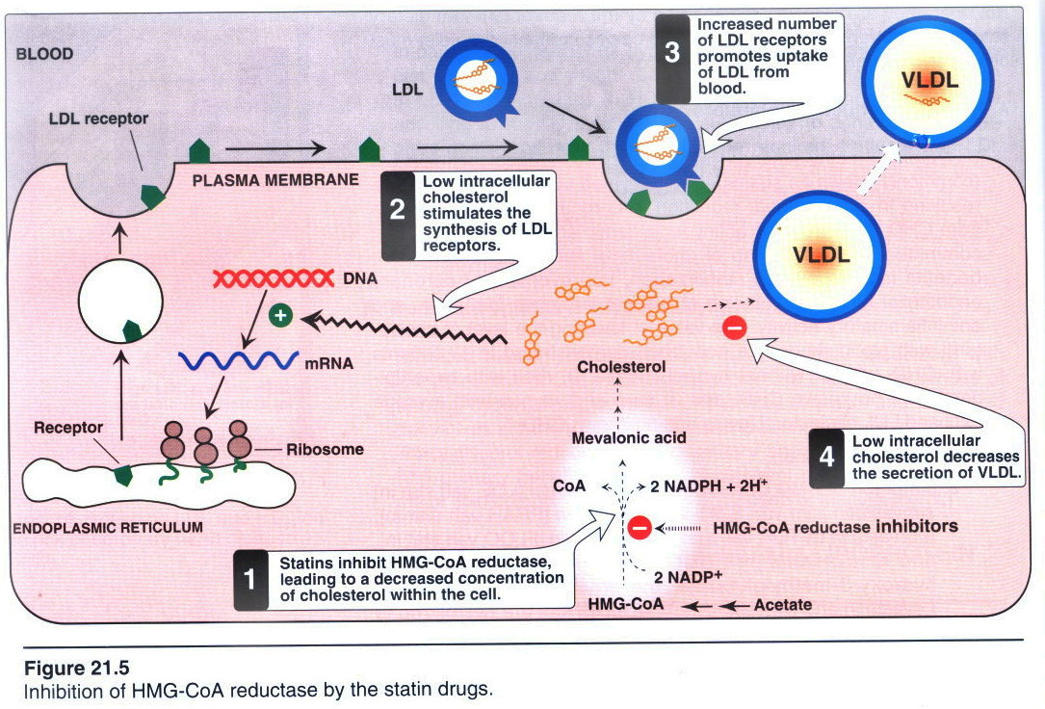

Slide 29
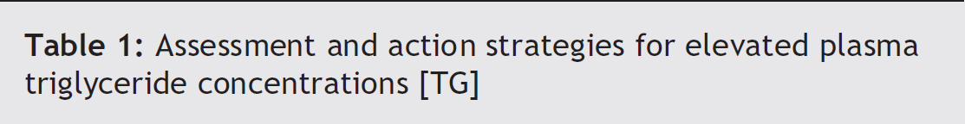
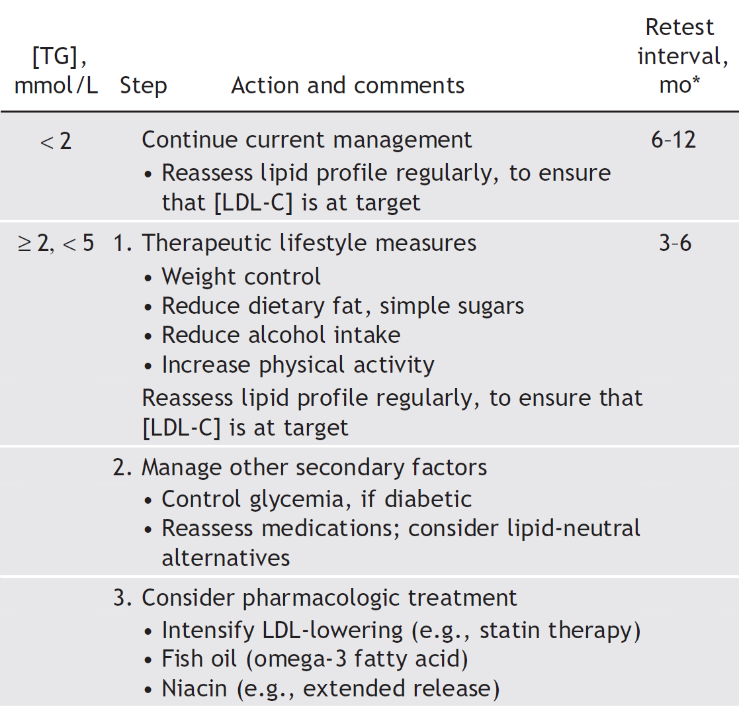

Slide 30
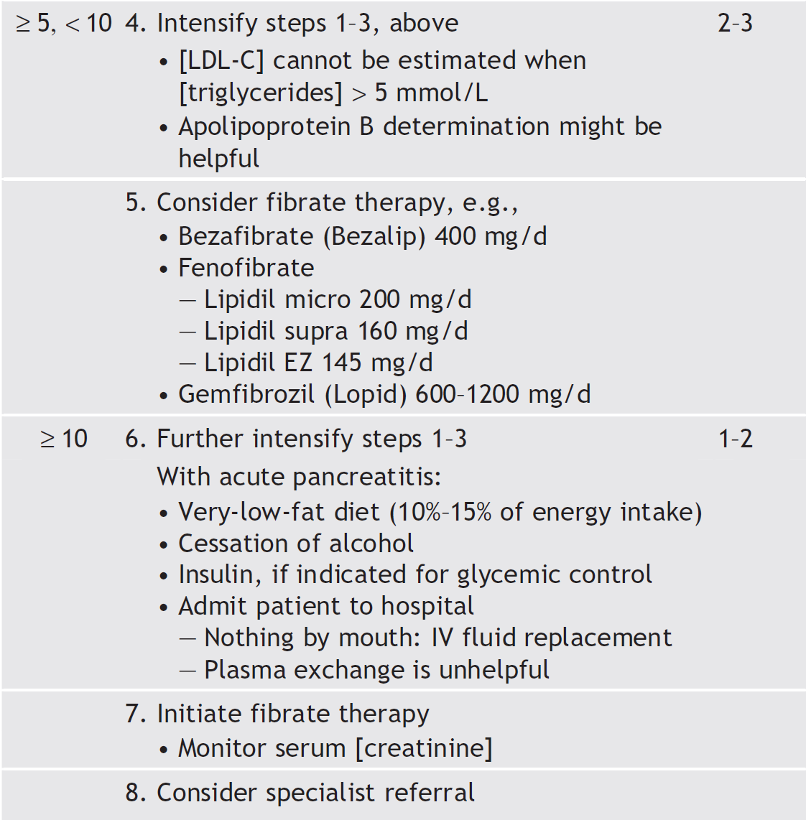
George Yuan, Khalid Z. Al-Shali, Robert A. Hegele
CMAJ • April 10, 2007 • 176(8)

Slide 31
Thank you

