Slide 1
HIV and AIDS for medical students
Dr Mogbil Al hedaithy

Slide 2
HIV and AIDS
Objectives of this lecture
To know HIV structure and modes of transmission
To understand the pathogenesis of the disease
To have an idea about the epidemiology and burden of the disease
To have an idea about the classification of the HIV infection and the natural history
To know when and who to diagnose HIV/AIDS
To have an idea about the principles of treatment and control.

Slide 3
HIV and AIDS
HIV=Human Immunodeficiency Virus
It is an RNA virus belong to the family Retroviredae.
two viruses HIV1 and HIV2.
It causes AIDS in humans .
AIDS=Acquired Immune Deficiency Syndrome.

Slide 4
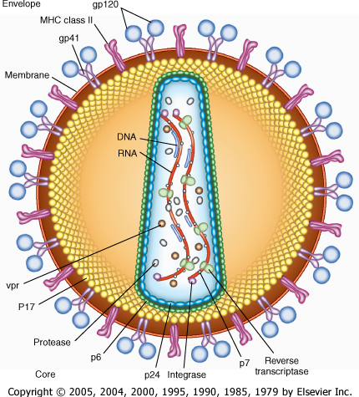
HIV structure

Slide 5
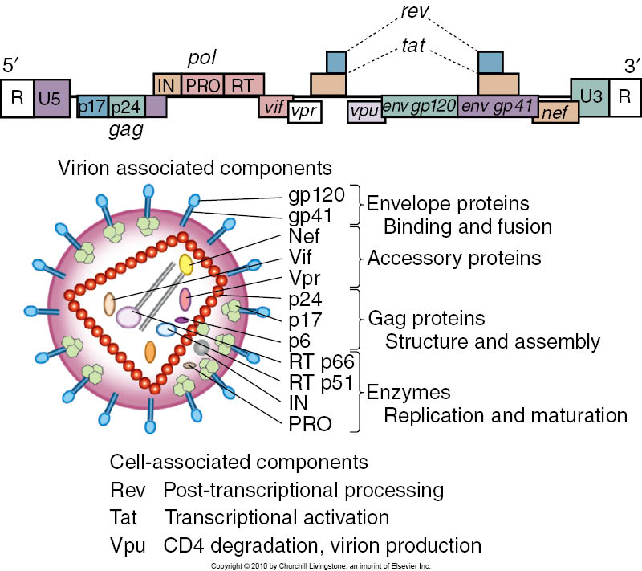

Slide 6
HIV Transmission
Sexual transmission (the commonest)
heterosexual and male homosexual
IVDU
Blood and blood products
Perinatal transmission
Transmission in health care setting

Slide 7
MODES OF TRANSMISSION and FACTORS INCREASING THE RISK OF ACQUISITION OF HIV
Sexual transmission
Sexually transmitted infections (STIs), especially genital ulcers Cervical ectopy Receptive vs insertive anal sex Rectal or vaginal trauma Menstruation Male-male vs heterosexual sex Non-circumcised Increased number of partners
Injection drug use transmission
Sharing equipment Frequency of use Linked commercial sex Lower income Intravenous use Cocaine use Incarceration
Occupational transmission
Deep injury Visible blood on device Previous arterial or venous device siting
Common to all transmission categories
High viral load Lower CD4 cell count AIDS Seroconversion
Vertical transmission
Older gestational age Prolonged rupture of membranes Chorioamnionitis Fetal trauma (e.g. scalp electrodes) Lower birth weight Vaginal vs elective caesarean delivery No peripartum prophylaxis First-born twin
Breastfeeding
Longer duration feeding Lower parity Younger age Mastitis

Slide 8
Regional HIV and AIDS statistics
2008 and 2001
Adults & children living with HIV
Adults & children newly infected with HIV
2008
2001
2008
2001
Sub–Saharan Africa
22.4 million
[20.8 – 24.1 million]
19.7 million
[18.3 – 21.2 million]
1.9 million
[1.6 – 2.2 million]
2.3 million
[2.0 – 2.5 million]
Middle East & North Africa
310 000
[250 000 – 380 000]
200 000
[150 000 – 250 000]
35 000
[24 000 – 46 000]
30 000
[23 000 – 40 000]
South and South–East Asia
3.8 million
[3.4 – 4.3 million]
4.0 million
[3.5 – 4.5 million]
280 000
[240 000 – 320 000
310 000
[270 000 – 350 000]
East Asia
850 000
[700 000 – 1.0 million]
560 000
[480 000 – 650 000]
75 000
[58 000 – 88 000]
99 000
[75 000 – 120 000]
Latin America
2.0 million
[1.8 – 2.2 million]
1.6 million
[1.2 – 1.6 million]
170 000
[150 000 – 200 000]
150 000
[140 000 – 170 000]
Caribbean
240 000
[220 000 – 260 000]
220 000
[200 000 – 240 000]
20 000
[16 000 – 24 000]
21 000
[17 000 – 24 000]
Eastern Europe & Central Asia
1.5 million
[1.4 – 1.7 million]
900 000
[800 000 – 1.1 million]
110 000
[100 000 – 130 000]
280 000
[240 000 – 320 000]
Western & Central Europe
850 000
[710 000 – 970 000]
660 000
[580 000 – 760 000]
30 000
[23 000 – 35 000]
40 000
[31 000 – 47 000]
North America
1.4 million
[1.2 – 1.6 million]
1.2 million
[1.1 – 1.4 million]
55 000
[36 000 – 61 000]
52 000
[42 000 – 60 000]
Oceania
59 000
[51 000 – 68 000]
36 000
[29 000 – 45 000]
3900
[ 2900 – 5100]
5900
[ 4800 – 7300]
TOTAL
33.4 million [31.1 – 35.8 million]
29.0 million [27.0 – 31.0 million]
2.7 million [2.4 – 3.0 million]
3.2 million [2.9 – 3.6 million]

Slide 9
Regional HIV and AIDS statistics
2008 and 2001
(Last of 2 parts)
Adult prevalence (%)
Adult & child deaths due to AIDS
2008
2001
2008
2001
Sub–Saharan Africa
5.2%
[4.9% – 5.4%]
5.8%
[5.5% – 6.0%]
1.4 million
[1.1 – 1.7 million]
1.4 million
[1.2 – 1.7 million]
Middle East & North Africa
0.2%
[<0.2% – 0.3%]
0.2%
[0.1% – 0.2%]
20 000
[15 000 – 25 000]
11 000
[7800 – 14 000]
South and South–East Asia
0.3%
[0.2% – 0.3%]
0.3%
[<0.3% – 0.4%]
270 000
[220 000 – 310 00]
260 000
[210 000 – 320 000]
East Asia
0.1%
[<0.1%]
<0.1%
[<0.1%]
59 000
[46 000 – 71 000]
22 000
[18 000 – 27 000]
Latin America
0.6%
[0.5% – 0.6%]
0.5%
[<0.5% – 0.6%]
77 000
[66 000 – 89 000]
66 000
[56 000 – 77 000]
Caribbean
1.0%
[0.9% – 1.1%]
1.1%
[1.0% – 1.2%]
12 000
[9300 – 14 000]
20 000
[17 000 – 23 000]
Eastern Europe & Central Asia
0.7%
[0.6% – 0.8%]
0.5%
[0.4% – 0.5%]
87 000
[72 000 – 110 000]
26 000
[22 000 – 30 000]
Western & Central Europe
0.3%
[0.2% – 0.3%]
0.2%
[<0.2% – 0.3%]
13 000
[10 000 – 15 000]
7900
[6500 – 9700]
North America
0.6%
[0.5% – 0.7%]
0.6%
[0.5% – 0.7%]
25 000
[20 000 – 31 000]
19 000
[16 000 – 23 000]
Oceania
0.3%
[<0.3% – 0.4%]
0.2%
[<0.2% – 0.3%]
2000
[1100 – 3100]
<1000
[<500 – 1200]
TOTAL
0.8%
[<0.8% – 0.8%]
0.8%
[<0.8% – 0.8%]
2.0 million [1.7 – 2.4 million]
1.9 million [1.6 – 2.2 million]

Slide 10
HIV structure

Slide 11
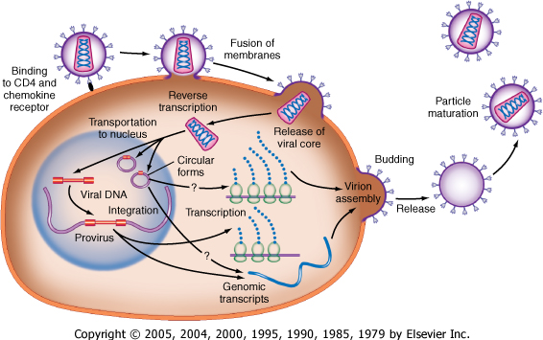
HIV life cycle

Slide 12
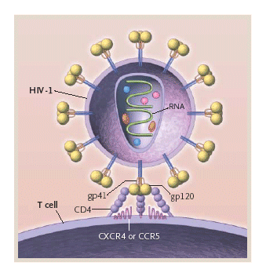
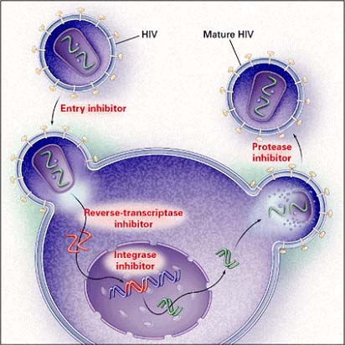

Slide 13
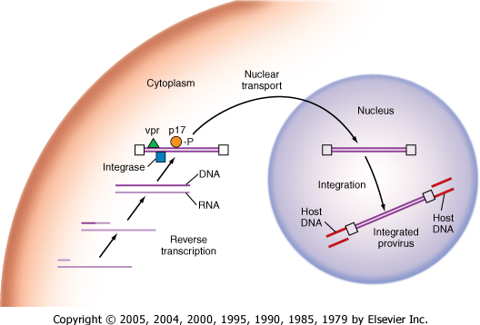
HIV life cycle

Slide 14
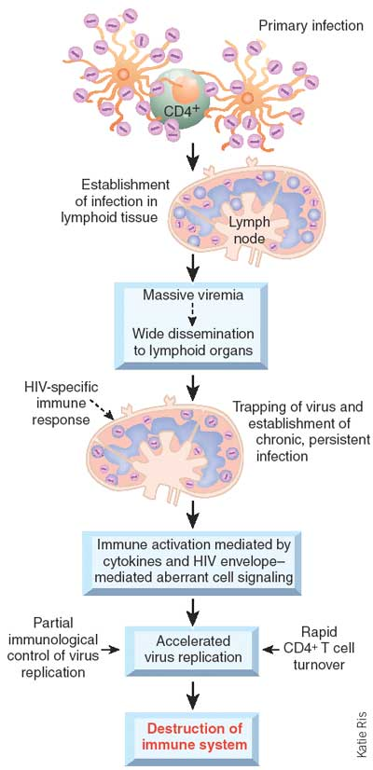
Pathogesis of HIV infection

Slide 15
HIV and AIDS

Slide 16
HIV and AIDS
Diagnosis:
ELISA: is the screening test ,very sensitive test used to screen blood products and patients.
Western blot: confirmatory test
PCR: (polymerase chain reaction) used as confirmatory test and to asses the viral load

Slide 17
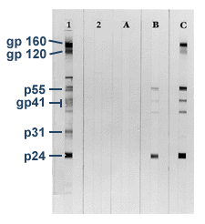
HIV and AIDS
WESREN BLOT

Slide 18
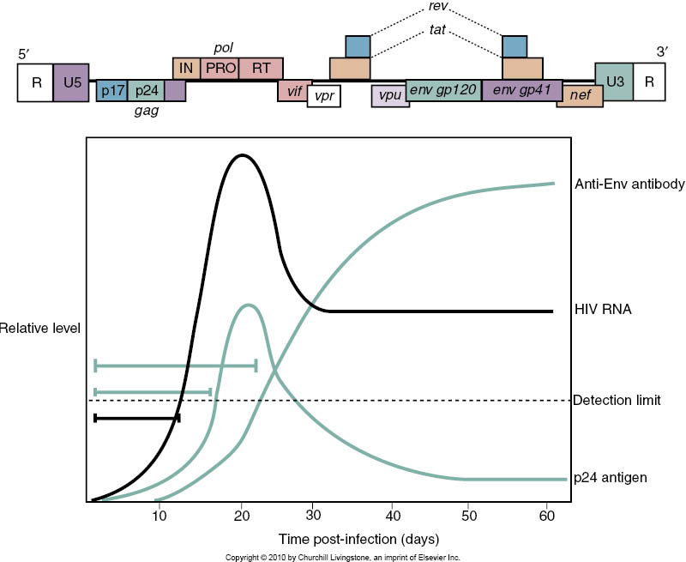
DIAGNOSIS

Slide 19
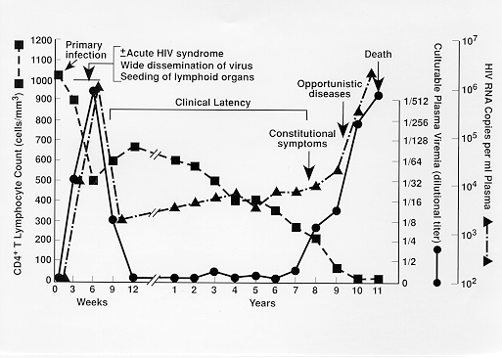
HIV Progression

Slide 20
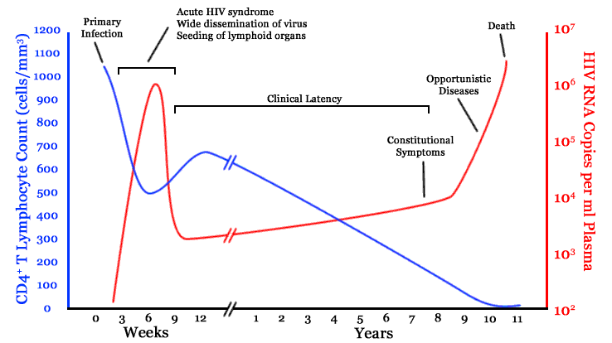
HIV Progression

Slide 21
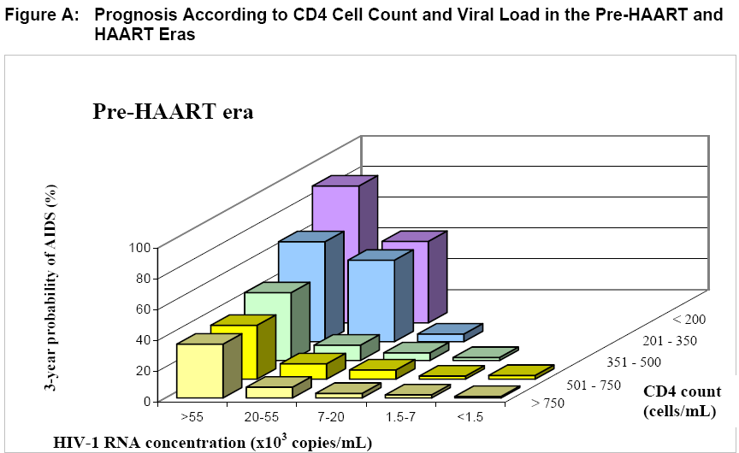
Lancet,2002;360(9327):119-29

Slide 22
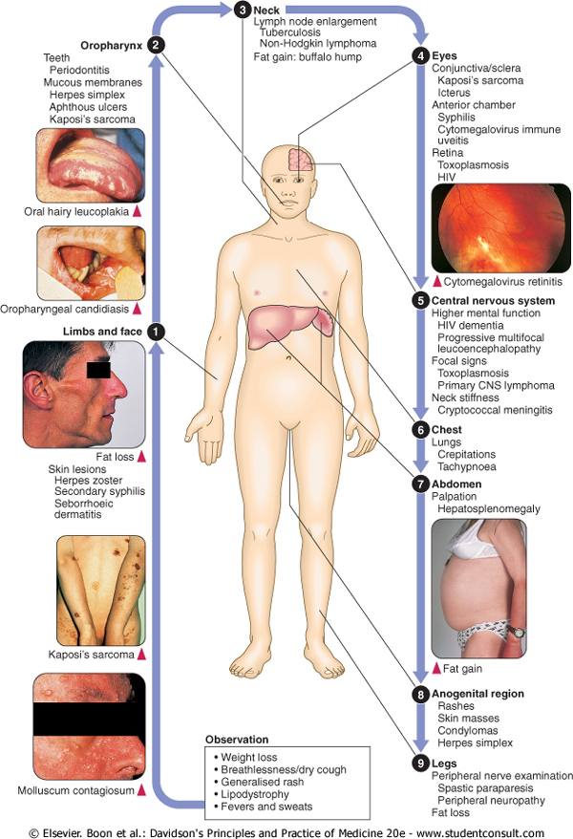

Slide 23
HIV and AIDS
Staging (WHO):
Acute HIV infection
Clinical stage1: asymptomatic infection
Clinical stage2:mild symptoms, lymphadenopathy.
Clinical stage3:moderate symptoms
Clinical stage4:sever symptoms, advanced immune deficiency

Slide 24
HIV and AIDS WHO staging
Primary HIV infection
Asymptomatic
Acute retroviral syndrome
CDC A Clinical stage 1
Asymptomatic
Persistent generalized lymphadenopathy
Clinical stage 2 CDC B
Moderate and unexplained weight loss (<10% of presumed or measured body weight)
Recurrent respiratory tract infections (such as sinusitis, bronchitis, otitis media, pharyngitis)
Herpes zoster
Recurrent oral ulcerations
Papular pruritic eruptions
Angular cheilitis
Seborrhoeic dermatitis
Fungal finger nail infections

Slide 25
HIV and AIDS WHO staging
Clinical stage 3 CDC C
Conditions where a presumptive diagnosis can be made on the basis of clinical signs or simple investigations
Unexplained chronic diarrhoea for longer than one month
Unexplained persistent fever (intermittent or constant for longer than one month)
Severe weight loss (>10% of presumed or measured body weight)
Oral candidiasis
Oral hairy leukoplakia
Pulmonary tuberculosis (TB) diagnosed in last two years
Severe presumed bacterial infections (e.g. pneumonia, empyema, meningitis, bacteraemia, pyomyositis, bone or joint infection)
Acute necrotizing ulcerative stomatitis, gingivitis or periodontitis
Conditions where confirmatory diagnostic testing is necessary
Unexplained anaemia (< 80 g/l), and or neutropenia (<500/µl) and or thrombocytopenia (<50 000/ µl) for more than one month

Slide 26
HIV and AIDS WHO staging
Clinical stage 4 CDC C
Conditions where a presumptive diagnosis can be made on the basis of clinical signs or simple investigations
HIV wasting syndrome
Pneumocystis pneumonia
Recurrent severe or radiological bacterial pneumonia
Chronic herpes simplex infection (orolabial, genital or anorectal of more than one month’s duration)
Oesophageal candidiasis
Extrapulmonary Tuberculosis
Kaposi’s sarcoma
Central nervous system toxoplasmosis
HIV encephalopathy
Conditions where confirmatory diagnostic testing is necessary
Extrapulmonary cryptococcosis including meningitis
Disseminated non-tuberculous mycobacteria infection
Progressive multifocal leukoencephalopathy
Candida of trachea, bronchi or lungs
Cryptosporidiosis
Isosporiasis
Visceral herpes simplex infection
Cytomegalovirus (CMV) infection (retinitis or of an organ other than liver, spleen or lymph nodes)
Any disseminated mycosis (e.g. histoplasmosis, coccidiomycosis, penicilliosis)
Recurrent non-typhoidal salmonella septicaemia
Lymphoma (cerebral or B cell non-Hodgkin)
Invasive cervical carcinoma
Visceral leishmaniasis

Slide 27
Primary HIV infection
Symptomatic in 70-80% of cases.
Usually occurs 2-6 weeks after exposure.
Fever with rash.
Pharyngitis with cervical lymphadenopathy.
Myalgia/arthralgia.
Headache.
Mucosal ulceration.
Rarely, presentation may be neurological (aseptic meningitis, encephalitis, myelitis, polyneuritis).

Slide 28
Acute Retroviral Syndrome: Common Signs and Symptoms
Fever
Lymphadenopathy
Pharyngitis
Rash
Myalgia or arthralgia
Diarrhea
Headache
Nausea and vomiting
Hepatosplenomegaly
Weight loss
Thrush
Neurological symptoms

Slide 29
HIV Mildly SYMPTOMATIC DISEASES CDC Classification category B disease
Oral hairy leucoplakia
Recurrent oropharyngeal candidiasis
Recurrent vaginal candidiasis
Severe pelvic inflammatory disease
Bacillary angiomatosis
Cervical dysplasia
Idiopathic thrombocytopenic purpura
Weight loss*
Chronic diarrhoea*
Herpes zoster
Peripheral neuropathy
Low-grade fever/night sweats*

Slide 30
Acquired immunodeficiency syndrome (AIDS) CDC Classification category C disease
Oesophageal candidiasis
Cryptococcal meningitis
Chronic cryptosporidial diarrhoea
CMV retinitis or colitis
Chronic mucocutaneous herpes simplex
Disseminated Mycobacterium avium intracellulare
Pulmonary or extrapulmonary tuberculosis
Pneumocystis carinii (jirovecii) pneumonia
Progressive multifocal leucoencephalopathy
Recurrent non-typhi Salmonella septicaemia
Cerebral toxoplasmosis
Extrapulmonary coccidioidomycosis.
Invasive cervical cancer.
Extrapulmonary histoplasmosis.
Kaposi's sarcoma.
Non-Hodgkin lymphoma.
Primary cerebral lymphoma
HIV-associated wasting
HIV-associated dementia

Slide 31
HIV and AIDS
Immunological staging:
CD4 positive T lymphocytes level is the main method of assessing the immune status of the HIV positive patient.
1. >500 cells/mm³ normal immunity.
2. 350-500 cells/mm³ mild deficiency.
3. 200-350 cells/mm³ moderate immune deficiency.
4. <200 cells/mm³ sever immune deficiency

Slide 32
Common opportunistic infections in AIDS patients

Slide 33
TOXOPLASMOSIS in AIDS patient

Slide 34
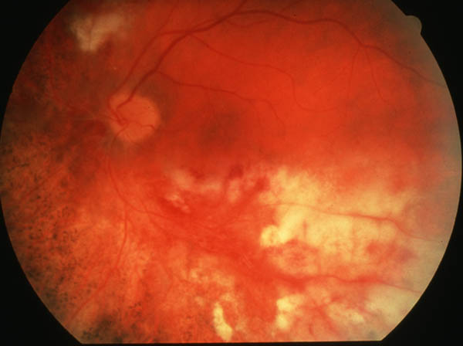
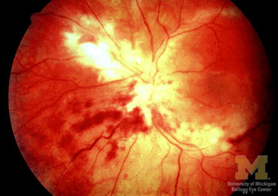
CMV retinitis

Slide 35
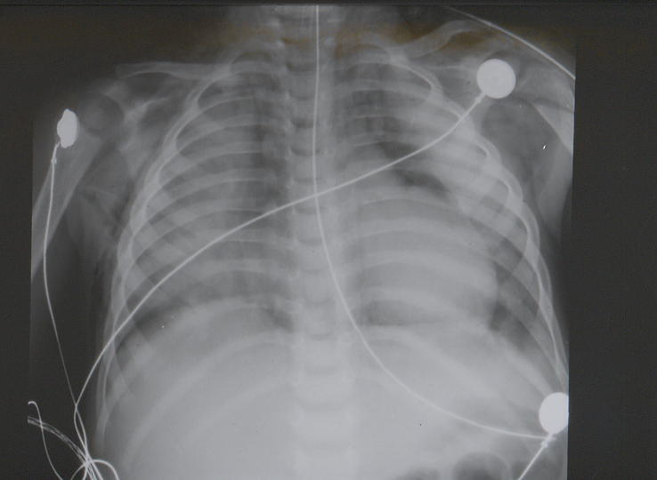
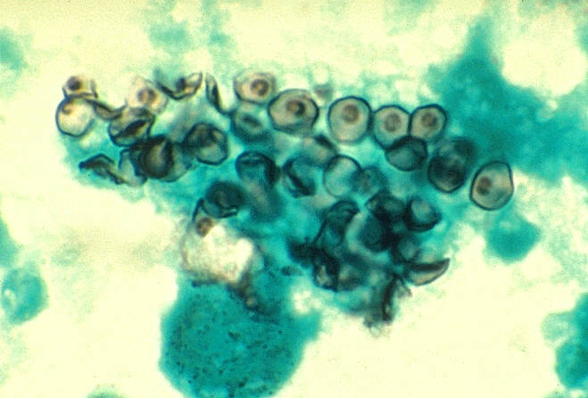
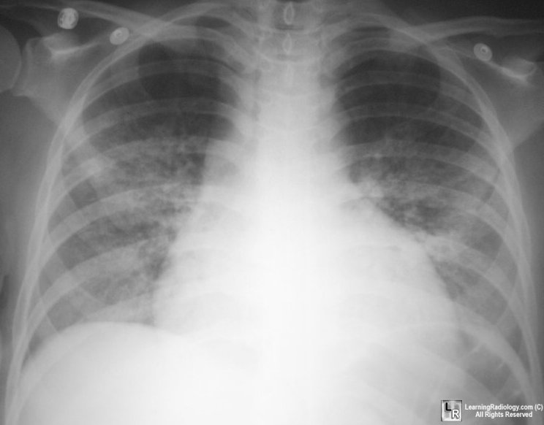
Pneumocystis jiroveci (carinii)
PCP pneumonia

Slide 36
HIV and AIDS
KOPOSI SARCOMA

Slide 37
HIV and AIDS
KOPOSI SARCOMA

Slide 38
HIV and AIDS
CANDIDAISIS

Slide 39
HIV and AIDS
ORAL HAIRY LEUKOPLAKIA

Slide 40
treatment of hiv/aids

Slide 41
Goals of Antiretroviral Therapy (ART)
Eradication of HIV? Not possible with currently available antiretroviral medications.

Slide 42
Goals of Treatment
Improve quality of life
Reduce HIV-related morbidity and mortality
Restore and/or preserve immunologic function
Maximally and durably suppress HIV viral load
Prevent HIV transmission

Slide 43
Goals of Therapy & Tools to Achieve Goals
Improvement of quality of life
Reduction of HIV-related morbidity and mortality
Restoration and/or preservation of immunologic function
Maximal and durable suppression of viral load
Selection of ARV regimen
Preservation of future treatment options
Rational sequencing of therapy
Maximizing adherence
Use of resistance testing in selected clinical settings

Slide 44
Tools to Achieve Treatment Goals
Selection of ARV regimen
Maximizing adherence
Pretreatment resistance testing

Slide 45
HIV life cycle
RTIs
Fusion inhibitors & CCR5 receptor inhibitors
PIs
Integrase inhibitors

Slide 46
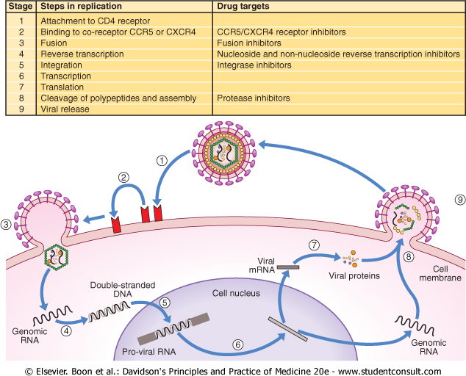

Slide 47
Before Initiating ART
Confirm HIV results
Complete H&P
CBC, chemistry profile
CD4 cell count
Plasma HIV RNA measurement
Consider resistance testing
Assess “readiness” for treatment and adherence

Slide 48
Before Initiating ART: Additional Tests
Gynecologic exam with pap smear
Testing for chlamydia and gonorrhea
Ophthalmology exam (CD4+ T cell count <100 cells/µL)
RPR or VDRL
PPD
Chest X ray
Hepatitis A,B,C serology
Toxoplasma IgG
Fasting glucose and lipids

Slide 49
Use of CD4 Cell Levels to Guide Therapy Decisions
CD4 count
The major indicator of immune function
Most recent CD4 count is best predictor of disease progression
A key factor in decision to start ART or OI prophylaxis
Important in determining response to ART
Adequate response: CD4 increase 50-150 cells/µL per year
CD4 monitoring
Check at baseline (x2) and at least every 3-6 months

Slide 50
Use of HIV RNA Levels to Guide Therapy Decisions
HIV RNA
May influence decision to start ART and help determine frequency of CD4 monitoring
Critical in determining response to ART
Goal of ART: HIV RNA below limit of detection (ie, <40-75 copies/mL, depending on assay)
RNA monitoring
Check at baseline (x2)
Immediately before initiating ART
2-8 weeks after start or change of ART
Every 3-6 months with stable patients
Notes:
Plasma HIV RNA (viral load) should be measured in all patients at baseline and on a regular basis thereafter, especially in patients who are on treatment, because viral load is the most important indicator of response to antiretroviral therapy (AI). Analysis of 18 trials that included more than 5,000 participants with viral load monitoring showed a significant association between a decrease in plasma viremia and improved clinical outcome [9]. Thus, viral load testing serves as a surrogate marker for treatment response [10] and can be useful in predicting clinical progression [11-12]. The minimal change in viral load considered to be statistically significant (2 standard deviations) is a threefold, or a 0.5 log10 copies/mL change. One key goal of therapy is suppression of viral load to below the limits of detection (below 40–75 copies/mL by most commercially available assays). For most individuals who are adherent to their antiretroviral regimens and who do not harbor resistance mutations to the prescribed drugs, viral suppression is generally achieved in 12–24 weeks, even though it may take a longer time in some patients. Recommendations for the frequency of viral load monitoring are summarized below.

Slide 51
When to Start ART
Potent ART may improve and preserve immune function in most patients with virologic suppression, regardless of baseline CD4 count
ART indicated for all with low CD4 count or symptoms
Earlier ART may result in better immunologic responses and better clinical outcomes
Reduction in AIDS- and non-AIDS-associated morbidity and mortality
Reduction in HIV-associated inflammation and associated complications
Reduction in HIV transmission
Recommended ARV combinations are considered to be durable and tolerable

Slide 52
When to Start ART
Exact CD4 count at which to initiate therapy not known, but evidence points to starting at higher counts
Current recommendation: ART for all patients with CD4 <500 cells/µL
For patients with CD4 >500 cells/µL, 50% of the panel recommend ART, 50% consider ART to be optional
Randomized control trial (RTC) data support benefit of ART if CD4 ≤350
No RTC data on benefit of ART at CD4 >350, but observational cohort data
Currently available ARVs are effective and well tolerated

Slide 53
Recommendations for Initiating ART
Clinical Category or CD4 Count | Recommendation
History of AIDS-defining illness CD4 count <350 cells/µL CD4 count 350-500 cells/µL Pregnant women HIV-associated nephropathy (HIVAN) Hepatitis B (HBV) coinfection, when HBV treatment is indicated* | Initiate ART
* Treatment with fully suppressive drugs active against both HIV and HBV is recommended.

Slide 54
Recommendations for Initiating ART (2)
Clinical Category or CD4 Count | Recommendation
CD4 count >500 cells/µL, asymptomatic, without conditions listed above | 50% of the Panel favors starting ART; 50% views ART as optional

Slide 55
Current ARV Medications
NRTI Abacavir (ABC) Didanosine (ddI) Emtricitabine (FTC) Lamivudine (3TC) Stavudine (d4T) Tenofovir (TDF) Zidovudine (AZT, ZDV) NNRTI Delavirdine (DLV) Efavirenz (EFV) Etravirine (ETR) Nevirapine (NVP) | PI Atazanavir (ATV) Darunavir (DRV) Fosamprenavir (FPV) Indinavir (IDV) Lopinavir (LPV) Nelfinavir (NFV) Ritonavir (RTV) Saquinavir (SQV) Tipranavir (TPV) | Integrase Inhibitor (II) Raltegravir (RAL) Fusion Inhibitor Enfuvirtide (ENF, T-20) CCR5 Antagonist Maraviroc (MVC)

Slide 56
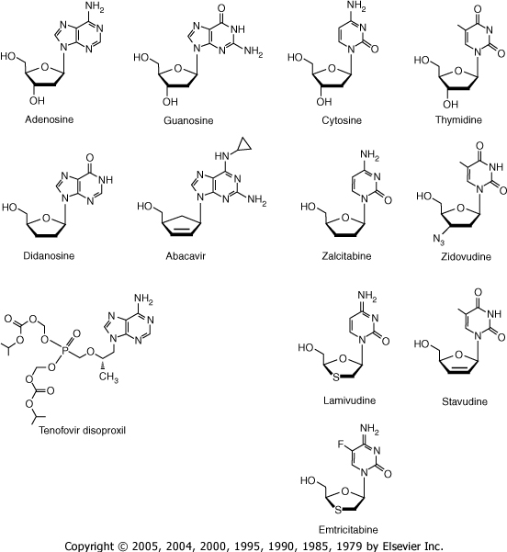
Nucleotides analogue reverse transcriptase inhibitors (NRTIs)

Slide 57
Initial Treatment: Choosing Regimens
3 main categories:
1 NNRTI + 2 NRTIs
1 PI + 2 NRTIs
3 NRTIs
Combination of NNRTI or PI + 2 NRTIs preferred for most patients
Fusion inhibitor, CCR5 antagonist, integrase inhibitor not recommended in initial ART
Few clinical end points to guide choices
Advantages and disadvantages to each type of regimen
Individualize regimen choice
Notes:
Summary of Recommended Regimens
The most extensively studied combination antiretroviral regimens for treatment-naïve patients generally consist of two NRTIs plus either one NNRTI or a PI (with or without ritonavir boosting). A list of Panel-recommended components for initial therapy in treatment-naïve patients can be found in Table 6. Potential advantages and disadvantages of the components recommended as initial therapy for treatment-naïve patients are listed in Table 7 to guide prescribers in choosing the regimen best suited for an individual patient. A list of agents or components not recommended for initial treatment can be found in Table 8. Some agents or components that are not recommended for use because of lack of potency or potential serious safety concerns are listed in Table 9

Slide 58
Treatment for Pregnant Women
To reduce risk of perinatal transmission:
ART recommended for all pregnant women
Suppress HIV viral load ideally to <50 copies/mL, and at least to <1,000 copies/mL

Slide 59
Timing of Perinatal HIV Transmission
Cases documented intrauterine, intrapartum, and postpartum by breastfeeding
In utero 25%–40% of cases
Intrapartum 60%–75% of cases
Addition risk with breastfeeding
14% ↑ risk with established infection
29% ↑ risk with primary infection
Current evidence suggests most transmission occurs during the intrapartum period
Notes:
Using highly sensitive diagnostic tests such as HIV culture or PCR helps to determine when infection occurs in a fetus/infant.
In utero transmission is presumed if a specimen taken in first 48 hours after birth is positive for HIV
Intrapartum transmission is presumed if a specimen taken in the first week of life in a non-breastfed infant is negative, but a later sample is found to be positive.
Mechanisms of Transmission
In Utero
Most likely transplacental, possibly due to placental membrane inflammation, through maternofetal transfusion (placental disruption)
Much of this transmission happens relatively late in gestation; although in some cases, rapid disease progression in infants points to infection earlier in gestation
Early trimester transmission may result in early fetal loss
Intrapartum Transmission
Through maternofetal transfusion of blood during labor
Infant skin or mucous membranes contact with infected blood or other maternal secretions during delivery
Important risk factors:
Increased duration of membrane rupture
Vaginal delivery (woman with VL >1000)
Evidence for intrapartum transmission comes from the reduced transmission rates related to C/S before the onset of labor in women with viral load levels >1000 (The International Perinatal HIV Group, 1999)

Slide 60
Perinatal HIV Transmission
Without antiretroviral (ARV) drugs during pregnancy, mother-to-child transmission (MTCT) has ranged from 16%–25% in North America and Europe
21% transmission rate in the U.S. in 1994 before the standard zidovudine (ZDV) recommendation during pregnancy
With the change in practice, transmission was 11% in 1995
Today, risk of perinatal transmission can be <2% with
effective antiretroviral therapy (ART)
elective cesarean section (C/S) as appropriate
formula feeding
Notes:
In Thailand, transmission rates are up to 24%, in the absence of maternal ARV use; in Africa in breastfeeding populations, the rate of transmission is up to 40%.
The perinatal transmission rate in the United States was 21% in 1994 before ZDV recommendations in pregnancy. In 1995, the transmission rate was 11% after the adoption of the “076” ZDV regimen into practice (Simonds, 1996).
In a longitudinal epidemiologic US study since 1990, (Cooper et al, 2002) transmission was:
20% in women receiving no ARV treatment in pregnancy
10.4% in women on ZDV alone
3.8% in women receiving combination therapy without protease inhibitors
1.2% in women on combination therapy with protease inhibitors

Slide 61
Initial Treatment: Preferred
NNRTI based | EFV/TDF/FTC^{1,2}
PI based | ATV/r + TDF/FTC² DRV/r (QD) + TDF/FTC²
II based | RAL + TDF/FTC²
Pregnant Women | LPV/r (BID)³ + ZDV/3TC
1. EFV should not be used during the first trimester of pregnancy or in women trying to conceive or not using effective and consistent contraception.
2. 3TC can be used in place of FTC and vice versa.

Slide 62
Lancet,2002;360(9327):119-29

Slide 63
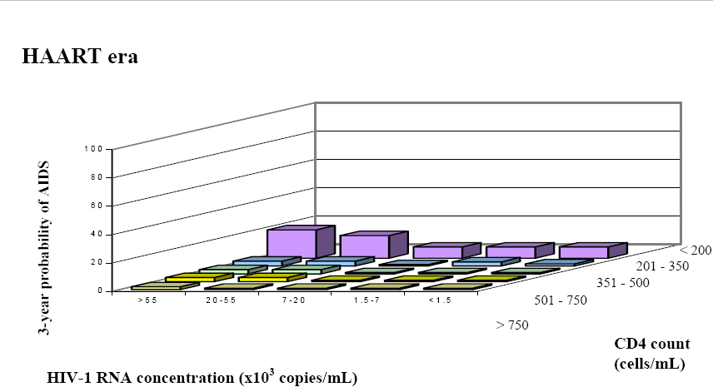
Lancet,2002;360(9327):119-29

Slide 64
HIV and AIDS
Prevention;
Education of the high risk groups about the disease
Voluntary screening and counseling.
Screening of blood and blood products before transfusion
Condom use
Screening and treating pregnant women
Male circumcision

Slide 65
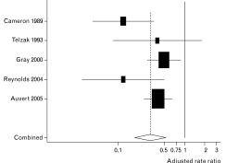
Figure 1 Rate ratios and 95% confidence intervals showing the association of male circumcision and HIV infection in longitudinal studies of heterosexual men
Weiss, Male circumcision ;Current Opinion in Infectious Diseases :2007, 20:66–72

