Slide 1
Acute Injury to the Spine and Brain
Dr.Fahad Al Bader

Slide 4
How to read a spinal x-ray
ABCS
1-Alignment
2-Bone integrity
3-Cartilage spaces (disc spaces, atlanto-axial space)
4-Soft tissues
(prevetebral space 30% C3 100% C7)

Slide 9
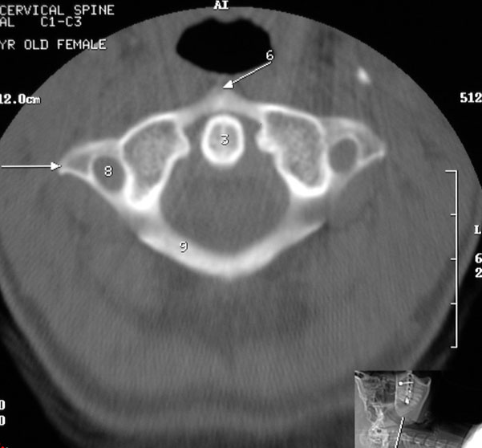

Slide 10
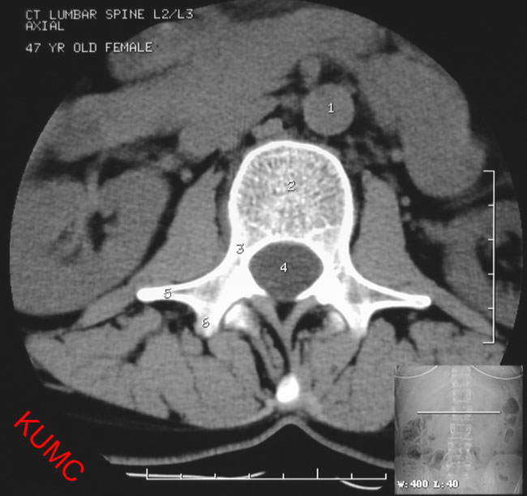

Slide 11
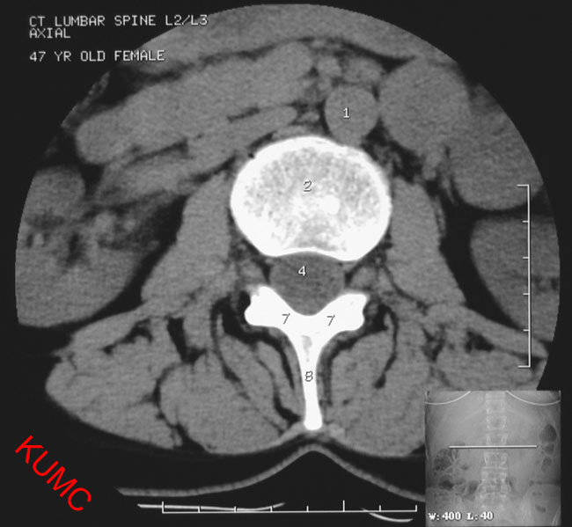

Slide 12
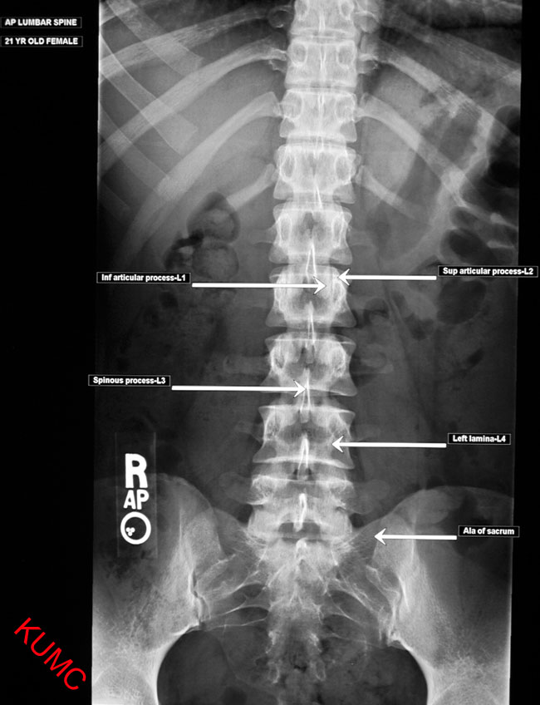

Slide 13
Spinal x-ray abnormalities
When reading a spinal x ray look for:
Alignment and Sulbluxation
Paravertebral swelling
Collapsed vertebra
Spondylolysis
Spondylolisthesis
Retrolisthesis

Slide 14
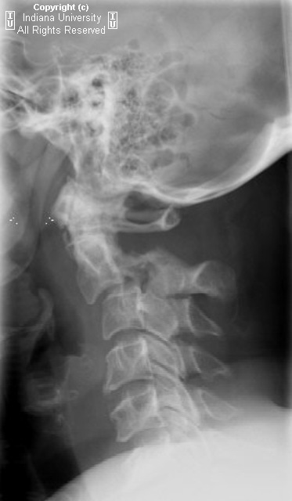
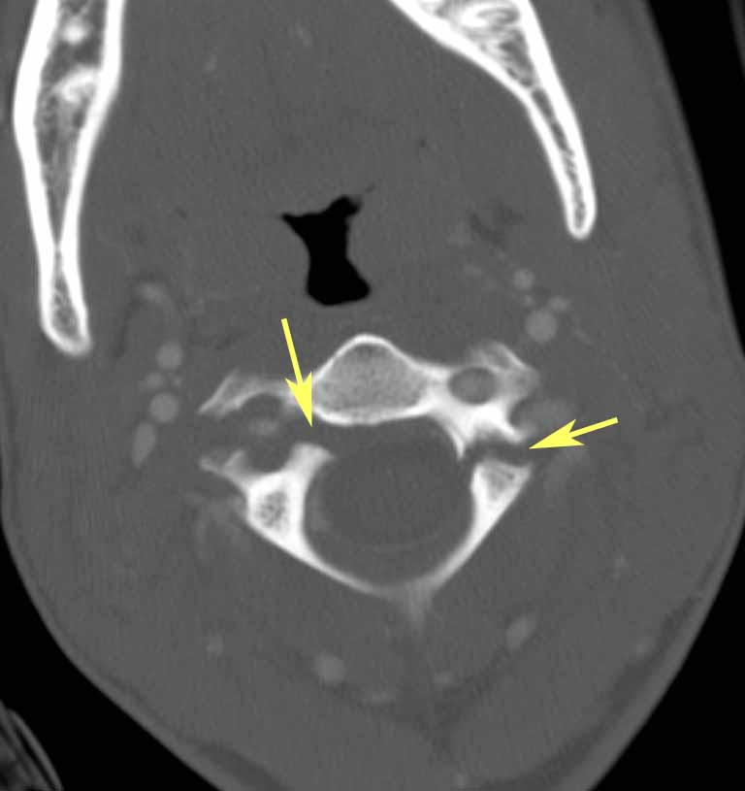

Slide 15
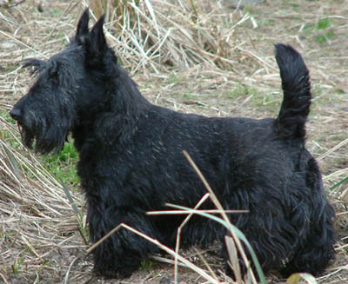
Scottie Dog
Neck : pars interarticularis
eye : pedicle
hindlegs : spinous process
nose : transverse process
ear : superior articular facet
forelegs : inferior articular facet

Slide 16
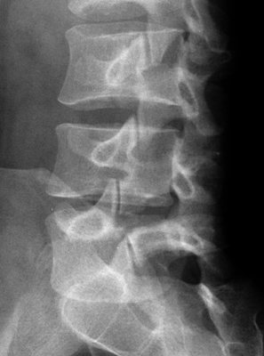
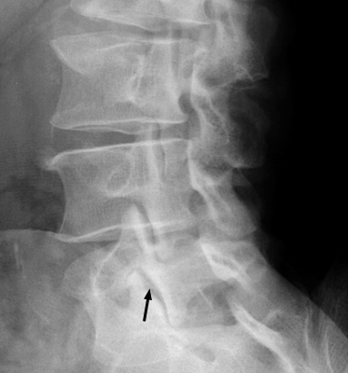
Scottie Dog

Slide 17
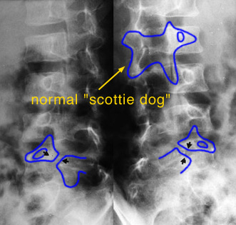
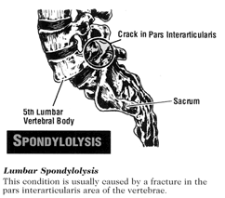

Slide 18
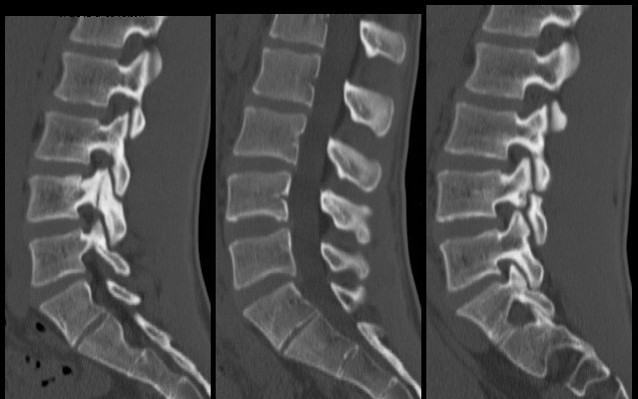

Slide 19
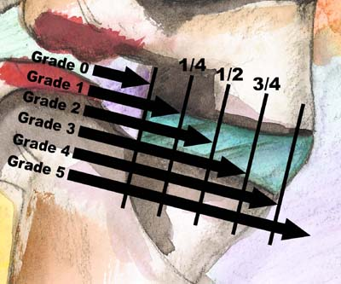

Slide 20
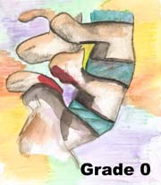
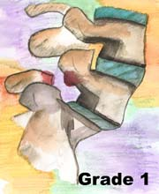
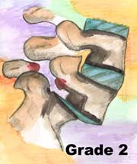
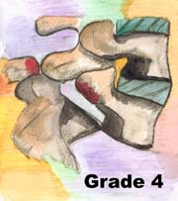
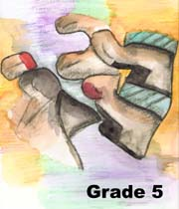

Slide 21
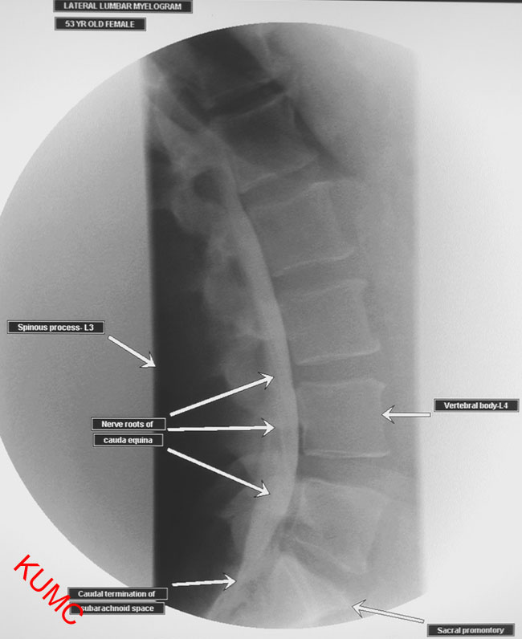

Slide 22
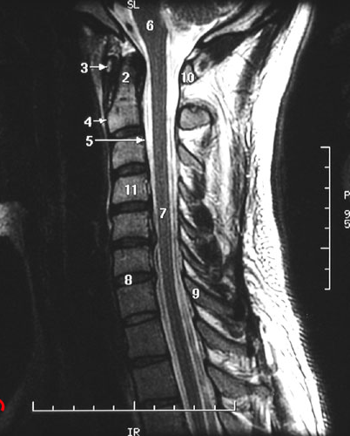

Slide 23
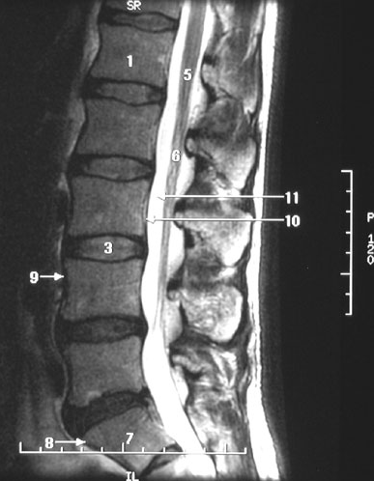

Slide 24
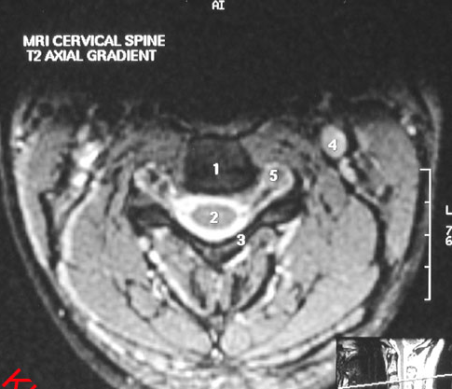

Slide 25
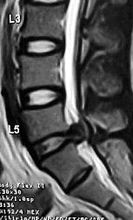
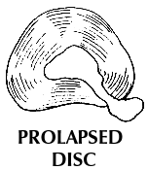
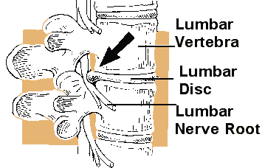

Slide 26
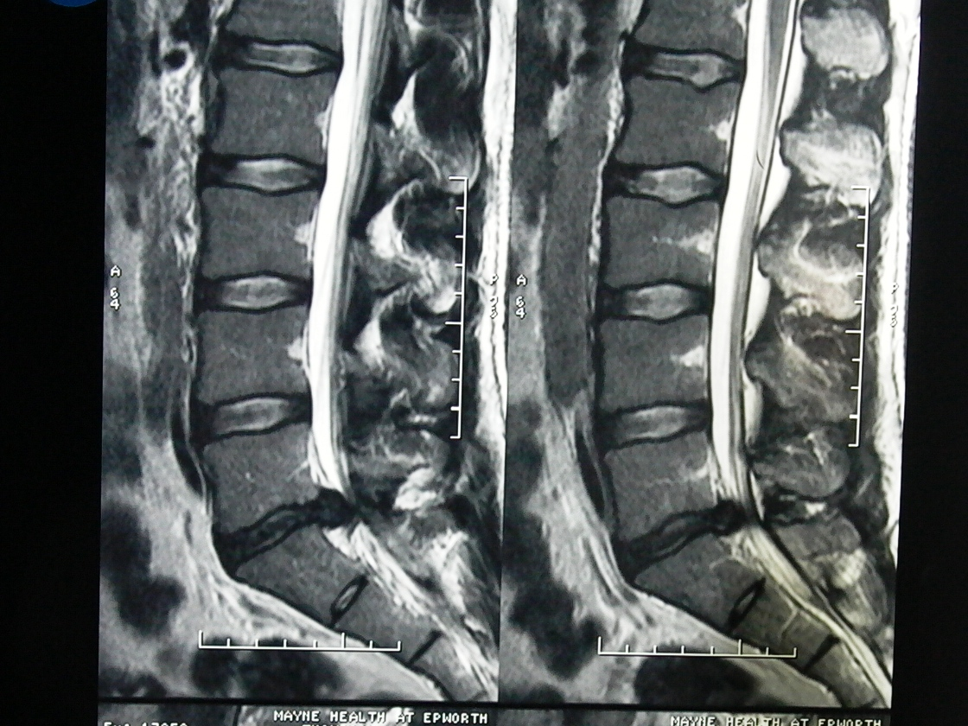

Slide 27
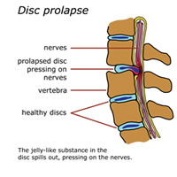

Slide 28
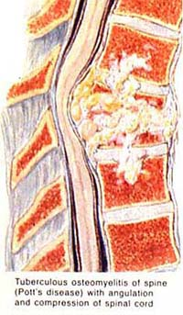
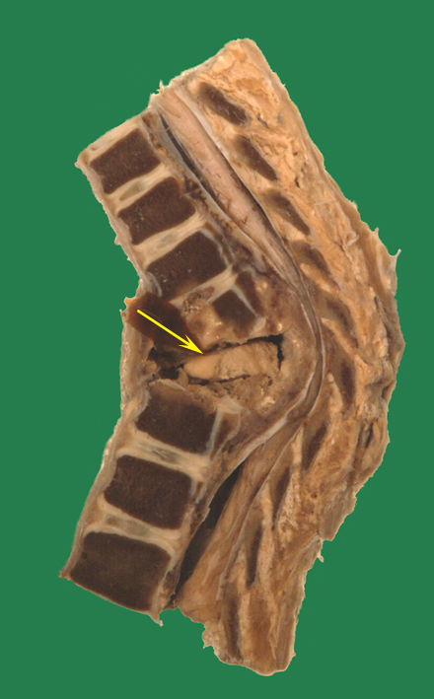
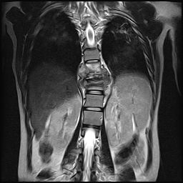

Slide 29
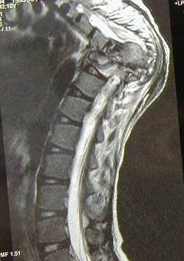
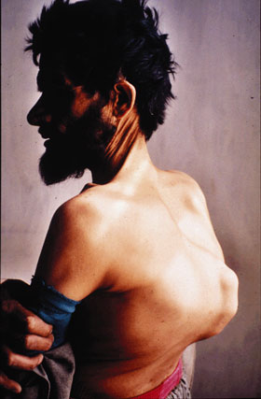

Slide 30
How to read a Brain CT scan
1-Site of the lesion : Intra or extra axial
2- ventricles
3-skull and orbit

Slide 31
Sites of Normal Calcification in the Brain:
1-pineal gland
2-choroid plexus
3-basal ganglia

Slide 32
Hyperdense Lesions
Acute Hematoma
Look for fractures
Is the patient hypertensive?

Slide 34
Epidural VS Subdural Hematoma
Epidural
Subdural
Young Men (20-40's)
– Head Trauma frequent
– Also, dura (periosteum) more adherent in older people
Acute presentation
Skull fracture (90%)
Bi-convex, hyperdense- limited by sutures.
Arterial (meningeal vessels)
Acute to Chronic
Older age group
Concave layer
Fracture +/-
Cross sutures
Venous (bridging veins)

Slide 35
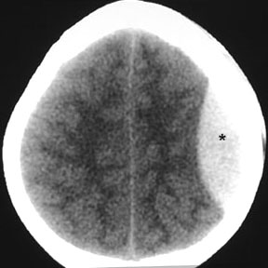

Slide 36
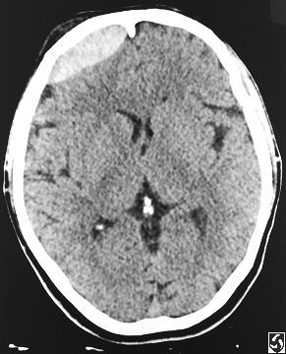
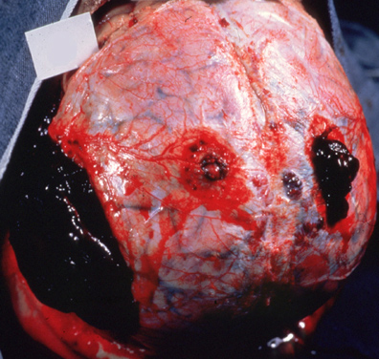

Slide 37
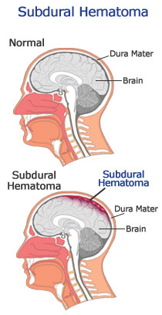

Slide 38
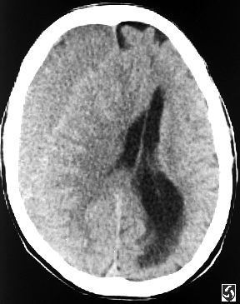
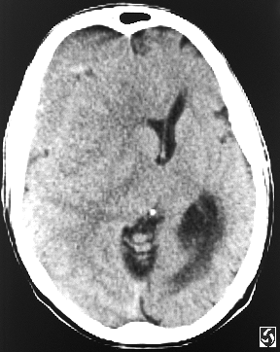

Slide 39
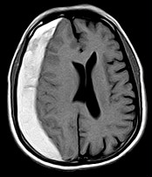
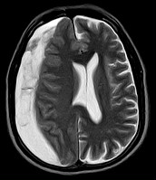
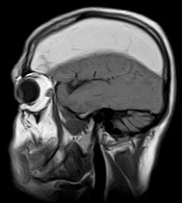

Slide 40
Brain Herniation
Subfalcine : the innermost part of the frontal lobe is scraped under part of the falx cerebri. Cingulate herniation can be caused when one hemisphere swells and pushes the cingulate gyrus by the falx cerebri
Uncal: the innermost part of the temporal lobe, the uncus, can be squeezed so much that it goes by the tentorium and puts pressure on the brainstem, most notably the midbrain

Slide 41
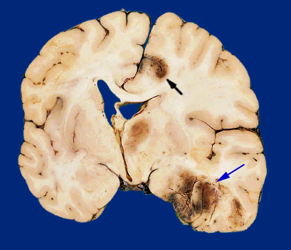
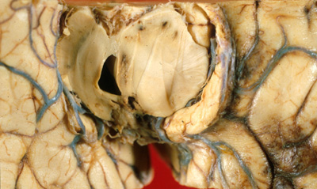

Slide 42
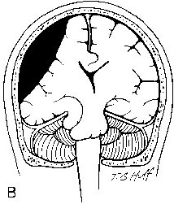

Slide 43
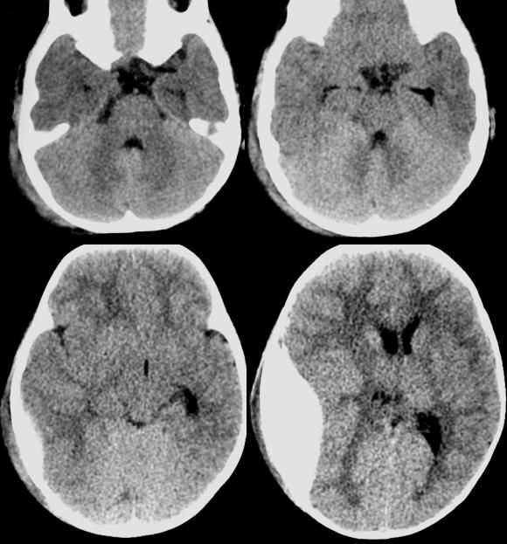

Slide 44
Types of Brain Edema
Vasogenic: Due to a breakdown of tight endothelial junctions which make up the blood-brain barrier (BBB)
- hydrostatic (malignant HTN)
- brain cancer (VEGF➔dexamethasone)
- high altitude
Cytotoxic : - the BBB remains intact
- it is due to the derangement in the celllar metabolism
- inadequate functioning of the Na and K pump
-various intoxications (dinitrophenol, triethyltin, hexachlorophene, isoniazid)
-Reye's syndrome,
-severe hypothermia,
-early ischemia,
-encephalopathy, early stroke or hypoxia, cardiac arrest, pseudotumor cerebri, and cerebral toxins.

