Slide 1
INTRODUCTION TO TRAUMA, MULTIPLE TRAUMA, AND TREATMENT PRIORITIES
DR OMAR EL FAROUK

Slide 2
TRAUMA
Impact of trauma on mortality and morbidity
How to reduce mortality and morbidity related to trauma?
Types of trauma
Management of trauma according to ATLS

Slide 3
INTRODUCTION TO TRAUMA
Trauma is frequent cause of death specially after:
Decreases in infectious diseases
The industrialization of society

Slide 4
MORTALITY
Leading cause of death up to the age of 44 years
The fourth leading cause of death overall (after heart disease, cancer, and stroke).

Slide 5
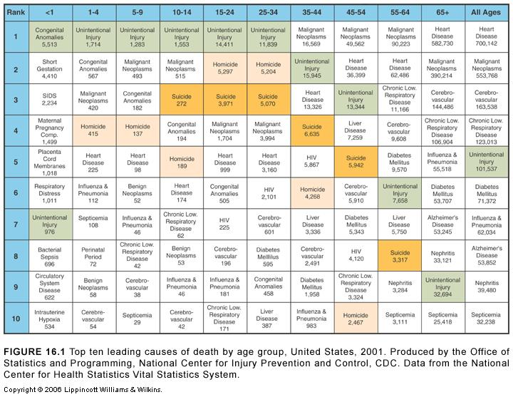

Slide 6
MORTALITY PEAKS AFTER TRAUMA INJURY
Trauma deaths occur at three traditionally recognized times after injury

Slide 7
MORTALITY PEAKS AFTER TRAUMA INJURY
Approximately half of all trauma-related deaths occur within seconds or minutes of injury and are related to lacerations of the:
Aorta
Heart,
Brainstem,
Brain, and
Spinal cord

Slide 8
MORTALITY PEAKS AFTER TRAUMA INJURY
2. The second mortality peak occurs within hours of injury and accounts for approximately 30% of deaths:
Half of which result from hemorrhage and
Half from central nervous system (CNS) injuries.

Slide 9
MORTALITY PEAKS AFTER TRAUMA INJURY
3. The third mortality peak includes deaths that occur from day 1 to 2 after trauma to weeks later. It is due to:
Infection
Multiple organ failure.

Slide 10
MORTALITY PEAKS AFTER TRAUMA INJURY

Slide 11
MORTALITY PEAKS AFTER TRAUMA INJURY
Early deaths can best be reduced with
Injury prevention programs
Legislated protective devices

Slide 12
MORTALITY PEAKS AFTER TRAUMA INJURY
Second mortality peak can be reduced by focusing on the regional planning of trauma system development .

Slide 13
MORTALITY PEAKS AFTER TRAUMA INJURY
Late deaths will be diminished as research generates better understanding of the processes related to:
Inflammation
Sepsis
Coagulopathy
Multiple organ failure
CNS injury.

Slide 14
CLASSIFICATION OF TRAUMA
Blunt
Penetrating

Slide 15
MOTOR VEHICLE COLLISIONS
(a) Head-on or frontal impact
(b) Rear impact
(c) Lateral or side impact
(d) Rotational impact
(e) Rollover.

Slide 16
PREDICTABLE INJURY PATTERNS RESULTING FROM THE UP-AND-OVER COMPONENT OF FRONTAL IMPACT
Anterior chest wall compression against the steering wheel:
Rib fractures
Pulmonary contusion
Flail chest
Myocardial contusion

Slide 17
PREDICTABLE INJURY PATTERNS RESULTING FROM THE UP-AND-OVER COMPONENT OF FRONTAL IMPACT
Blunt abdominal trauma:
1. Intestinal perforation
2. Lacerations of the mesentery
3. Solid organs compression with accompanying hemorrhage

Slide 18
PREDICTABLE INJURY PATTERNS RESULTING FROM THE UP-AND-OVER COMPONENT OF FRONTAL IMPACT
Acute neck flexion, hyperextension, or both, causing a cervical spine injury

Slide 19
FALLS
Falls result in multiple impacts.
Severe falls
more than three times the height of the victim, or from more than 20 feet
That is affected by:
Surface on which the victim lands
Degree of compressibility
(e.g., water versus concrete)

Slide 20
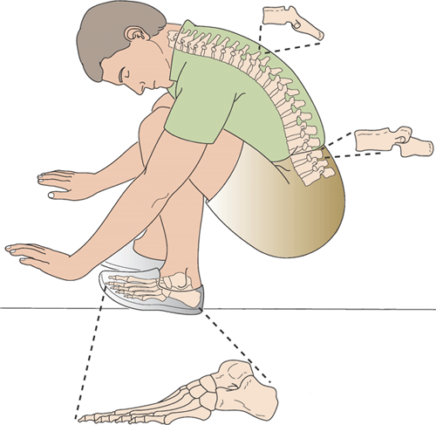
Hyperflexion and axial loading injury after a fall.

Slide 21
GENERAL ANATOMIC CONSIDERATIONS IN BLUNT INJURY
Diagnosed injury | Associated injury
Fracture—temporal, parietal bone | Epidural hematoma
Maxillofacial fracture | Cervical spine fracture
Sternal fracture | Cardiac contusion
First and second rib fracture | Descending thoracic aorta, intraabdominal bleeding
Fractured scapula | Pulmonary contusion
Fractured ribs 8—12, right | Lacerated liver
Fractured ribs 8—12, left | Lacerated spleen
Fractured pelvis | Ruptured bladder, urethral transection

Slide 22
GENERAL ANATOMIC CONSIDERATIONS IN BLUNT INJURY
Diagnosed injury | Associated injury
Fractured humerus | Radial nerve injury
Supracondylar humerus fracture | Brachial artery injury
Distal radius fracture | Median nerve compression
Supracondylar femur fracture | Popliteal artery thrombosis
Anterior dislocation shoulder | Axillary nerve injury
Posterior dislocation of hip | Sciatic nerve injury
Posterior dislocation of knee | Popliteal artery thrombosis

Slide 23
BIOMECHANICS OF PENETRATING INJURIES
Penetrating trauma involves the transfer of energy to a relatively small tissue area.
The velocity of a gunshot wound is exceedingly high compared with any type of blunt trauma.
The kinetic energy of a bullet disrupts and fragments cells and tissues, moving them away from the path of the bullet.

Slide 24
BIOMECHANICS OF PENETRATING INJURIES

Slide 25
BIOMECHANICS OF PENETRATING INJURIES

Slide 26
BIOMECHANICS OF PENETRATING INJURIES

Slide 27
Low-Energy Stab Wounds
Low-energy missiles include knives and other objects that produce damage only by their sharp cutting edges.
Cavitation is minimal and injury can be predicted simply by tracing the pathway of the weapon within the body.
Knowledge of the type of weapon is sometimes helpful.

Slide 28
Low-Energy Stab Wound
The attacker may stab and move the knife or weapon inside the body, which can lead to more injury than that perceived from the cutaneous wound.
Judgment of the potential scope of injury by examination of the entrance wound is not reliable.

Slide 29
OTHER TYPES OF PENETRATING INJURIES
Low- energy Gunshot Wounds:
Defined as those with an initial muzzle velocity of less than 1,200 ft/s.
Medium-velocity projectiles have muzzle velocities between 1,200 and 2,000 ft/s.
- Most handguns and some rifles are low- or medium-energy weapons.

Slide 30
OTHER TYPES OF PENETRATING INJURIES
High-Energy Weapons:
The essential difference between high-energy weapons and the typical civilian gunshot wound is that their projectiles produce a much larger cavity or pressure cone than low- and medium-velocity missiles.
The temporary cavity extends well beyond the actual bullet tract, producing a wider injury.

Slide 31
OTHER TYPES OF PENETRATING INJURIES
Blast Injuries:
Blast injuries caused by close-range shotgun fire constitute
Devastating injuries comprising extensive tissue destruction.
Blast injuries have the highest potential for secondary infection.
These injuries, in general, should be surgically explored, devitalized tissue should be extensively debrided.

Slide 32
PREHOSPITAL CARE
1. Airway Assessment:
Because the most immediately life-threatening problem to the injured patient is loss of airway patency, this is the first priority of the first-response team on arrival at the injury site.
Patients who are awake, alert, and talking obviously have a patent airway.

Slide 33
PREHOSPITAL CARE
Those who are:
Unconscious
Have evidence of respiratory insufficiency require immediate attention.
Endotracheal intubation is the best procedure for airway control for:
1. Shocked patients
2. Abnormal breathing patterns
3. Unable to protect the airway because they are unconscious.

Slide 34
PREHOSPITAL CARE
2. Breathing:
After establishment of a patent and controlled airway, the next priority is to ensure that air exchange is taking place.
Immediately life-threatening injuries that preclude air exchange include
Tension pneumothorax
Massive open chest wounds
Sucking chest wounds
Tracheal disruption.

Slide 35
PREHOSPITAL CARE
Both open chest wounds and sucking chest wounds respond to endotracheal intubation and positive-pressure ventilation.
Tension pneumothorax occasionally requires field decompression:
Needle thoracostomy
Chest tube thoracostomy in the midclavicular line of the second intercostal space.

Slide 36
PREHOSPITAL CARE
3. Circulation:
The most common cause of death during the first hour after injury is hemorrhage.
Direct pressure controls obvious external hemorrhage.
The placement of one or two large-bore intravenous (IV) lines in the upper extremities en route to the trauma center facilitates resuscitation.

Slide 37
PREHOSPITAL CARE
The standard of care in the prehospital setting for hypotensive patients is:
Volume replacement
Rapid transport to a trauma center.

Slide 38
Trauma Team Composition
The trauma team consists of members from different disciplines, each of whom sees the patient from a particular point of view.
the team must have a single “captain of the ship” whose responsibility it is to organize and prioritize treatment efforts.
The team leader integrates and coordinates several tasks simultaneously.

Slide 39
Trauma Team Composition
In most level 1 and 2 trauma centers, the team captain is a general surgeon trained in trauma care.

Slide 40
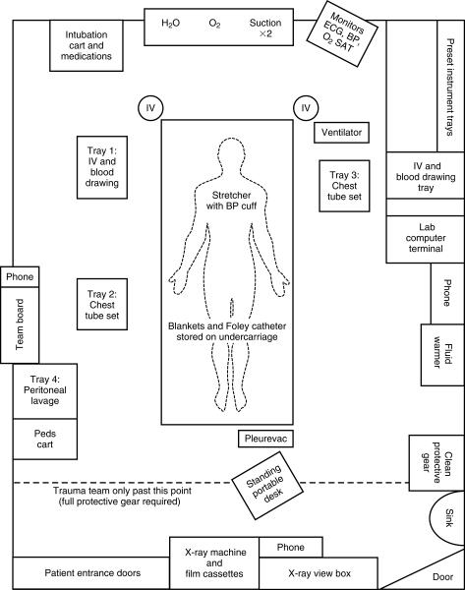

Slide 41
Primary Survey: Initial Assessment
A | Airway (with cervical spine control)
B | Breathing
C | Circulation with hemorrhage control
D | Disability (mental function)
E | Expose (examine every part of the patient)

Slide 42
Primary Survey: Initial Assessment
Airway obstruction often responds to simple maneuvers such as :
Suctioning
Chin lift
Jaw thrust, or
Placement of an oropharyngeal airway.
Protection of the cervical spine with in-line immobilization is imperative during these maneuvers.

Slide 43
Primary Survey: Initial Assessment
Persistence of respiratory insufficiency requires endotracheal intubation.
After an airway is established:
1. auscultate the chest to confirm air exchange
2. obtains a chest radiograph to ensure proper tube position .

Slide 44
Primary Survey: Initial Assessment
Clinical diagnosis of tension pneumothorax requires immediate needle thoracostomy followed by chest tube thoracostomy.
Sucking chest wounds should be sealed with an occlusive dressing secured on three sides to function as a flap valve.

Slide 45
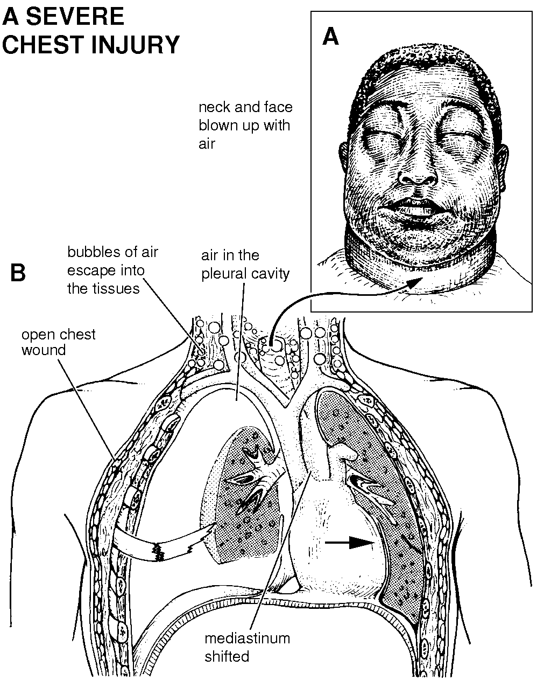

Slide 46
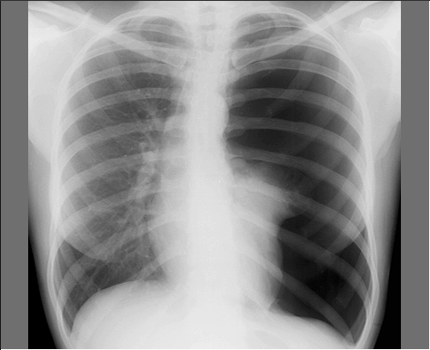

Slide 47
BILATERAL PNEUMOTHORAX

Slide 48
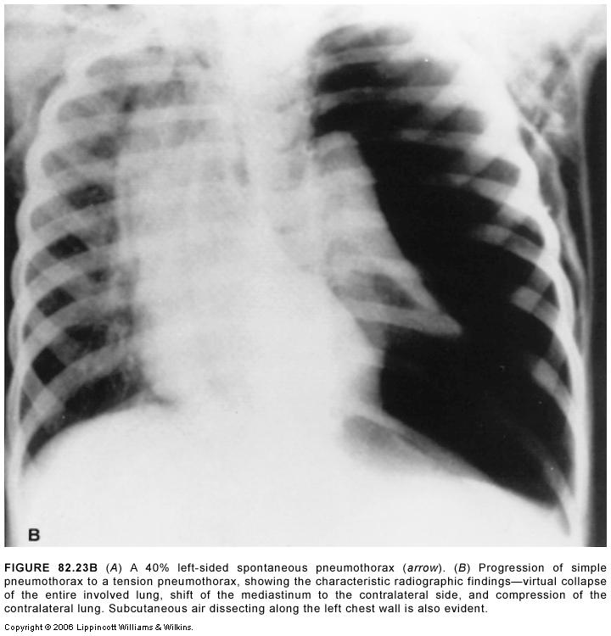

Slide 49
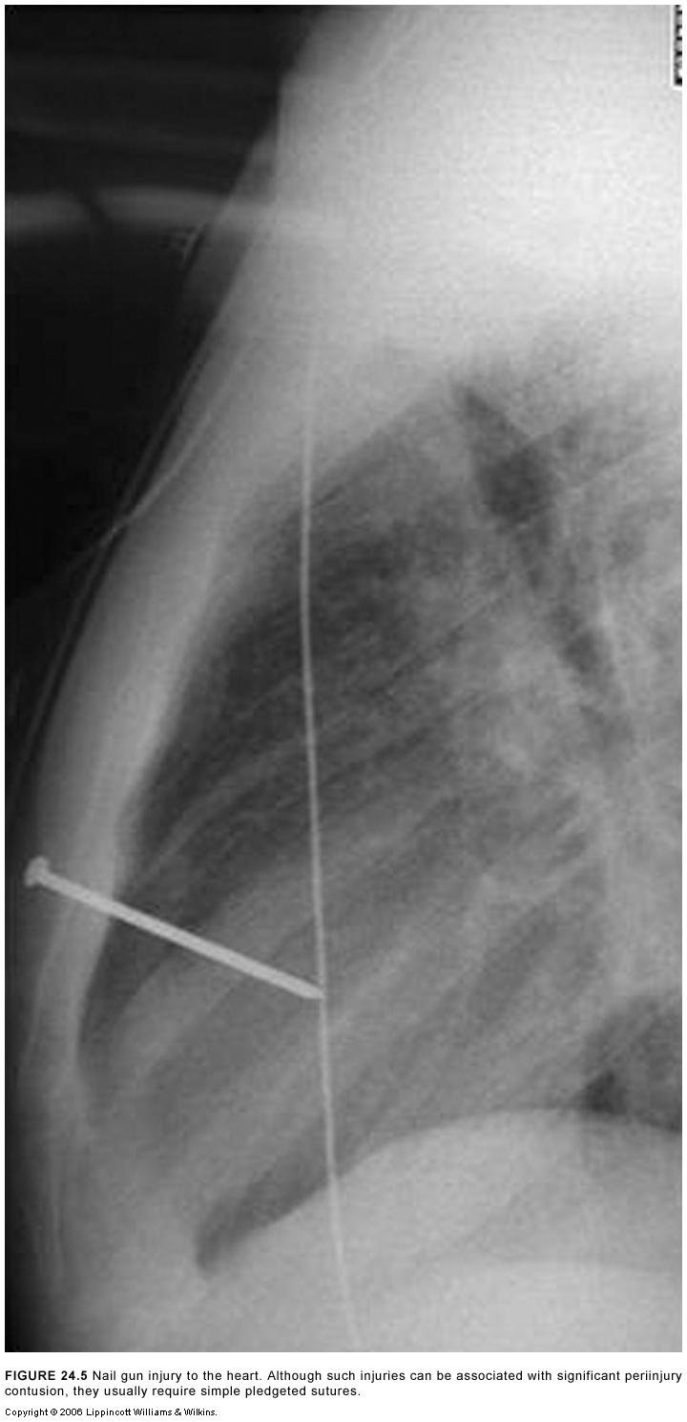

Slide 50
Primary Survey: Initial Assessment
Useful clinical indicators of hemodynamic status:
Blood pressure
Pulse
Skin perfusion
Temperature
Capillary refill
Mental status
Presence of breath sounds, and
Neck vein distention

Slide 51
Primary Survey: Initial Assessment
Is the the patient in hypovolemic shock?
If so, what is the source of hemorrhage?

Slide 52
Primary Survey: Initial Assessment
Circulatory collapse in the injured patient is almost always caused by hypovolemia secondary to hemorrhage.
The mainstay of treatment for hypotension in the injured patient, regardless of cause, is volume resuscitation with crystalloid solution
if hypotension is persistent, packed red blood cells (RBCs).

Slide 53
Primary Survey: Initial Assessment
The final priority in the primary survey is a brief neurologic evaluation to assess the components of the GCS

Slide 54
DIAGNOSTIC GLASGOW COMA SCALE (GCS)
EYE OPENING
VERBAL RESPONSE
MOTOR RESPONSE
GCS SUBTOTAL 3-15

Slide 55
EYE OPENING
Spontaneous | 4
To voice | 3
To pain | 2
None | 1

Slide 56
VERBAL RESPONSE
Oriented | 5
Confused | 4
Inappropriate words | 3
Incomprehensible sounds | 2
None | 1

Slide 57
MOTOR RESPONSE
Obeys commands | 6
Purposeful movement (pain) | 5
Withdraw (pain) | 4
Flexion (pain) | 3
Extension (pain) | 2
None | 1

Slide 58
Secondary Survey
The secondary survey is directed at specific identification of suspected and unsuspected injuries.
It consists of a thorough history and physical examination that includes observation and palpation of the entire body for evidence and characterization of injury.

Slide 59
Secondary Survey
The secondary survey for a patient in hemorrhagic shock unresponsive to initial resuscitative efforts during the primary survey consists only of :
Rapid identification of the bleeding site
Rapid transport to the operating room for definitive control of hemorrhage.

Slide 60
Secondary Survey
History:
ATLS provides a simple mnemonic for the purpose of history assessment, the AMPLE method:
Allergies
Medications
Past illnesses/Pregnancy
Last meal
Events/Environment related to the injury

Slide 61
Secondary Survey
Head and Face :
Palpation of the skull and the head and face for:
Hematomas
Lacerations
Fractures.
Potential ocular injuries are assessed by:
Visual acuity
Pupillary function
Ocular range of motion

Slide 62
Secondary Survey
A funduscopic examination is important to identify ;
Increased intracranial pressure
Vitreal hemorrhage
Retinal detachment.

Slide 63
Secondary Survey
Basilar skull fracture indicated by:
Ecchymosis over the mastoid process
Hemotympanum
Otorrhea
Rhinorrhea
Periorbital ecchymosis

Slide 64
Secondary Survey
2. Neck:
The cervical collar is removed and the neck is examined for:
Tracheal deviation
Subcutaneous emphysema
Hematomas
Lacerations
Distended jugular veins.

Slide 65
Secondary Survey
The posterior cervical spine is palpated to elicit tenderness or other signs of obvious fracture.
Penetrating injuries should not be probed, cannulated, or explored past the platysma because uncontrollable hemorrhage may ensue if a clot is dislodged from a major vascular injury.

Slide 66
Secondary Survey
Radiographic evaluation of the cervical spine should include
Anteroposterior
Lateral
Odontoid views
A CT scan is often used to evaluate suspected bony injuries, and careful flexion and extension films may be necessary to rule out potentially unstable ligamentous injuries of the cervical spine.

Slide 67
Secondary Survey
3. Chest:
The chest wall is inspected for:
Instability
Lacerations
Sucking chest wounds
Abrasions, and contusions.
Auscultation for hemothorax and/ or pneumothorax, and palpation is used to elicit tenderness that may be associated with rib fractures.

Slide 68
Secondary Survey
Tension pneumothorax :
cyanosis
tracheal deviation
distended neck veins
lack of breath sounds
inability to move air.
Tension pneumothorax causing cardiopulmonary collapse is a clinical diagnosis that requires immediate treatment by needle thoracostomy followed by chest tube insertion.

Slide 69
Secondary Survey
Virtually all other life-threatening and potentially life-threatening chest injuries are diagnosed or suspected on chest radiography.
Hemothorax opacification of a hemithorax and is treated by chest tube thoracostomy.
However, thoracotomy is indicated
If the initial blood loss exceeds 1,500 mL or
If the rate of ongoing blood loss shortly following injury exceeds 200 to 300 mL per hour in an adult.

Slide 70
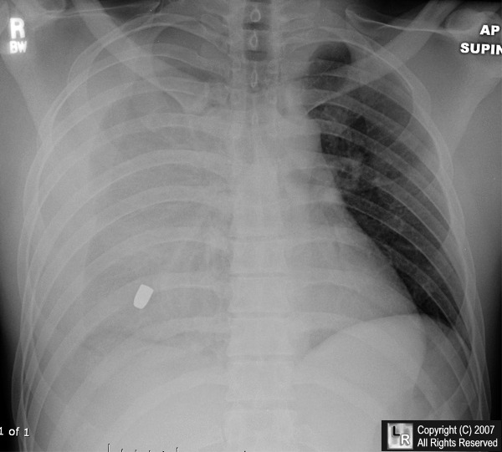

Slide 71
Secondary Survey
Pulmonary contusion is identified by radiographic findings of:
an irregular interstitial pattern or
frank consolidation in the lung parenchyma.
All patients with chest trauma should have an electrocardiographic (ECG) evaluation and continuous monitoring during the first hour in the ED.

Slide 72
Secondary Survey
Patients with ECG changes during the initial hour may have a blunt cardiac injury and should be monitored for at least 24 hours.
Patients with rapid deceleration blunt injuries to the chest may sustain a transection of the thoracic aorta.

Slide 73
Plain chest radiographic study of patient with traumatic aortic rupture. Noted are widening of the superior mediastinum, loss of anteroposterior window, and blurring of the aortic knob

Slide 74
Secondary Survey
The chest radiograph should be evaluated:
Widening of the mediastinum (more than 8 cm on a 40-inch anteroposterior chest radiograph)
Apical capping of the lung with blood
Tracheal displacement
Depression of the left main-stem bronchus loss of the aortic window
Deviation of the nasogastric tube
Loss of the parispinous stripe.

Slide 75
Secondary Survey
Evidence of a ruptured diaphragm on chest radiograph includes the presence of the nasogastric tube or bowel above the normal plane of the diaphragm.

Slide 76
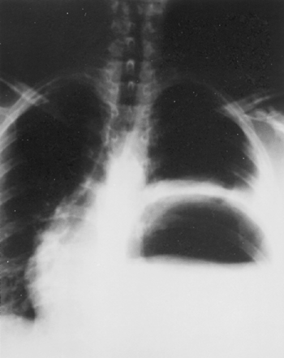

Slide 77
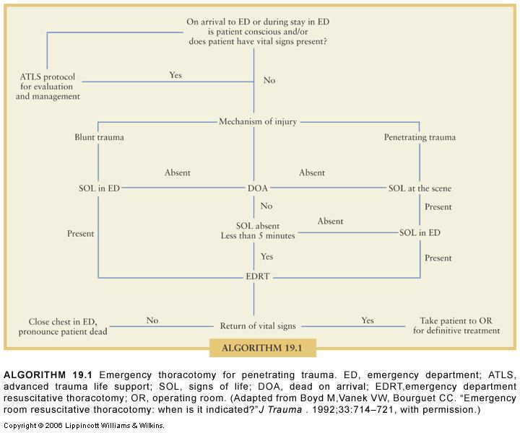

Slide 78
Secondary Survey
4. Abdomen:
The abdominal examination should attempt to determine whether there is a significant injury requiring surgical intervention.
Although physical examination is often accurate and reliable, it can be misleading in 20% to 30% of patients.
This inaccuracy is particularly true in patients who are obtunded from head injury, alcohol, drug use, or shock.

Slide 79
Secondary Survey
If patients are hemodynamically unstable, it is important to determine rapidly whether free intraperitoneal hemorrhage is responsible for the hypotension.
1. Diagnostic peritoneal lavage (DPL) or
2. The focused abdominal sonogram for trauma (FAST) accomplish this goal rapidly and safely.
Both are reported to be extremely reliable in the hemodynamically unstable patient.

Slide 80
The specific indications for DPL or FAST in blunt trauma include the following:
Unconscious patient with question of potential abdominal injury
Patient with a high-energy injury, suspected intraabdominal injury, and equivocal physical findings
Patient with multiple injuries and unexplained shock
Patient with major noncontiguous or thoracoabdominal injuries
Patient with spinal cord injury

Slide 81
The specific indications for DPL or FAST in blunt trauma include the following:
6. Intoxicated patient in whom abdominal injury is suspected
7. Patient who has a suspected intraabdominal injury with equivocal diagnostic findings and who will be undergoing prolonged general anesthesia for another injury, making continued reevaluation impossible

Slide 82
Secondary Survey
DPL is considered positive :
If 10 mL of grossly bloody aspirate is obtained before instillation of lavage fluid
If the siphoned lavage fluid has more than 100,000 red blood cells (RBCs) per milliliter.
Presence of bile
Amylase
Bacteria
Particulate matter
Indicate visceral injury and need for laparotomy.

Slide 83
Secondary Survey
In the hemodynamically stable patient, CT has become routine for the evaluation of the abdomen.

Slide 84
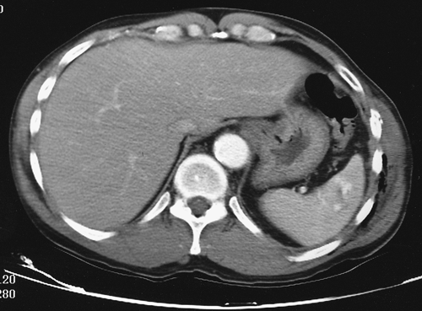

Slide 85
COMPARISON OF DIAGNOSTIC PERITONEAL LAVAGE AND COMPUTED TOMOGRAPHY IN THE DIAGNOSIS OF VISCERAL INJURY AFTER BLUNT ABDOMINAL TRAUMA
 | DPL | CT SCAN
False-negative result | <1% | 5%–20%
False-positive result | 5%–12% | 5%
Time to complete | 5 min | 55 min
Cost | $125 | $900

Slide 86
Diagnosis of blunt abdominal trauma.

Slide 87
Secondary Survey
Patients with penetrating abdominal injuries:
Gunshot wounds to the abdomen are an indication for exploratory laparotomy because 90% to 95% of these patients have intraabdominal injuries.
Tangential subcutaneous wound can be evaluated by laparoscopy or even CT to determine whether peritoneal penetration injury has occurred

Slide 88
Secondary Survey
Stab wounds to the abdomen are often evaluated initially by local exploration of the wound.

Slide 89
Diagnosis of low-velocity penetrating abdominal trauma

Slide 90
Secondary Survey
5. Pelvis :
The bones of the pelvis are palpated gently to elicit tenderness that could indicate fracture.
Evidence of instability of the pelvic ring warrants placement of a sheet around the pelvis to reduce the pelvic volume and minimize venous bleeding in the retroperitoneum.

Slide 91
Secondary Survey
The genitalia should be inspected for scrotal hematoma or blood at the urethral meatus, which indicates probable urethral transection.
A bimanual pelvic examination in women identifies evidence of vaginal laceration, indicating an open pelvic fracture.

Slide 92
Secondary Survey
A rectal examination is performed to identify blood indicative of bowel injury and, occasionally, a mobile, “floating” prostate, which indicates urethral transection.
Evidence of a free-floating prostate, blood at the urethra, or scrotal hematoma should prompt a retrograde urethrogram before placement of a bladder catheter is attempted.

Slide 93
Secondary Survey
If the patient is hemodynamically unstable, the pelvic fracture must be considered a potential source of hemorrhage.

Slide 94
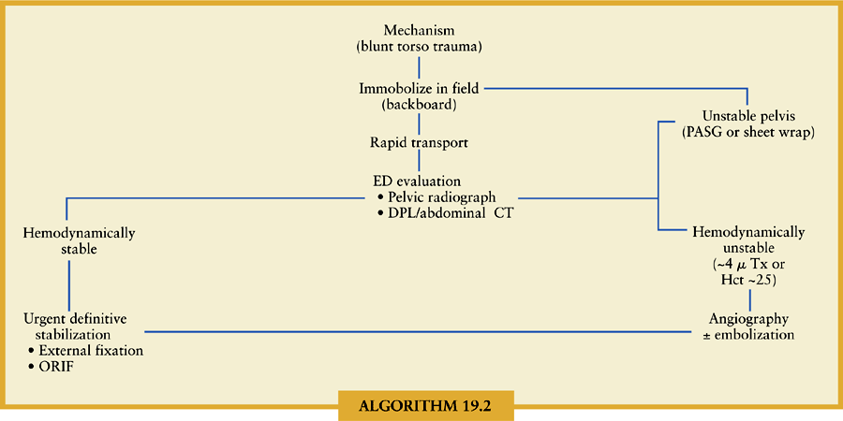
Secondary Survey

Slide 95
Secondary Survey
6. Extremities:
Finally, the extremities are evaluated for open wounds with potential sources of hemorrhage or occult open fractures.
Evaluation of pulses may indicate vascular injury.
Palpation and passive range of motion tests diagnose potential long-bone fractures, dislocations, and ligamentous injuries.

Slide 96
Secondary Survey
Dislocations require prompt reduction, especially if there is any evidence of neurovascular compromise.
Penetrating wounds to the extremities necessitate evaluation for potential vascular injury by palpation of pulses, auscultation for bruits, and recognition of expanding hematomas.

Slide 97
Secondary Survey
Proximity wounds can be evaluated by duplex ultrasound scan or arteriography.

