Slide 1
Epidemiology of Cholera
Ashry Gad Mohamed
Professor of Epidemiology
College of Medicine & KKUH

Slide 2
Greek word for the gutter of a roof, comparing the deluge of water following a rainstorm to that of the anus of an infected person

Slide 3
Acute intestinal infection caused by the bacterium Vibrio cholerae characterized by:
profuse watery diarrhoea with flecks of mucous material (rice water stools), vomiting, abdominal pain
Rapid onset of dehydration causing severe weakness, poor skin turgor, sunken eyes and cheeks

Slide 4
Often muscular cramps, cyanosis, subnormal temperature, tachy-cardia, hypotension; renal failure may follow inadequate treatment
Without treatment a healthy person may become hypotensive within one hour & may die within 2-3 hours.
More commonly: from 1st liquid stool to shock 4-12 hours.

Slide 5
Mechanism
Entrotoxin activates adenylate cyclase enzyme in intestinal wall that is converted into pump that extract water & electrolytes from blood and tissues to intestinal lumen with shedding of mucous and epithelial cells giving rice water severe diarrhea

Slide 6
Infectious agent: Vibrio cholerae
epidemic cholera is caused by two biotypes of Vibrio cholerae :
the classical biotype serogroup O1, and
since 1961 (7th pandemic), the biotype El Tor
Serogroup O1 includes serotypes Inaba, Ogawa and Hikojima
Serogroup O139: in 1992/93, a new Vibrio cholerae O139 strain appeared

Slide 7
Vibrios are one of the most common organisms in surface waters of the world. They occur in both marine & fresh water habitats and in association with aquatic animals.

Slide 8
Most infections are subclinical cases, but excrete the organism in faeces for 7-14 days.
Only 10% of the infected persons develop typical cholera.
90% of episodes are mild or moderate.
Case fatality without treatment = 25-50%.
Case fatality with treatment (ORS) = 1%

Slide 9
During the 19th century, the classical biotype of V. cholerae serogroup O1 caused pandemic cholera, spreading from India to most of the world; currently confined to the Indian subcontinent
Since 1961, the biotype El Tor of V. cholerae serogroup O1 has spread through Asia into Africa, Europe (small epidemics), and South America (since 1991): 7th cholera pandemic
V. cholera serogroup O139 was mainly isolated in Asia and represents currently 15% of isolates

Slide 10
Current epidemic 7th epidemic
Due to V cholerae 01,
V eltor &
V cholerae 0139
Started 1961 in Indonesia.
Bangladesh 1963
India 1964
West Africa 1970
Latin America 1991
Bangladesh 1992 (V cholerae 0139)
South East Asia
South Africa 2000

Slide 11
Magnitude of the problem
2009 221.226 4946 (2.24%)
16% more than 2008 incidence.
4% less than 2008 deaths (5143)
Countries:
98% from Africa
1-Ethiopia 31.509 434 (1.38%)
2-Congo 22.899 237 (1.03)
3-Mozambique 19.679 155 (0.79%)
4-Nigeria 13691 431 (3.15)
5-Sudan 13681 52 (0.38)

Slide 12
Case fatality
45 countries reported cholera 2009.
20 countries CFR > 1%.
9 countries CFR < 1%
15 countries CFR = 0
Outbreaks
55 outbreaks of diarrheal diseases.
47 were due to cholera. (38 Africa + 9 Asia)
10 countries ≥ 2 outbreaks

Slide 13
underestimation
lack of consistency in case definition and vocabularies.
Fear of sanctions (travel-related & trade-related).
It is an indicator of a lack of social development.

Slide 14
Future
New strains
Increased antimicrobial resistance.
Climate change.
Currently no country requires proof of cholera vaccination or prophylaxis as a condition for entry.

Slide 15
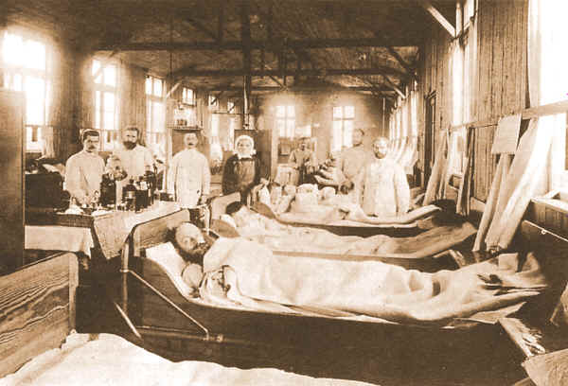

Slide 16
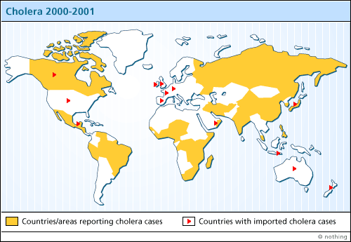

Slide 17
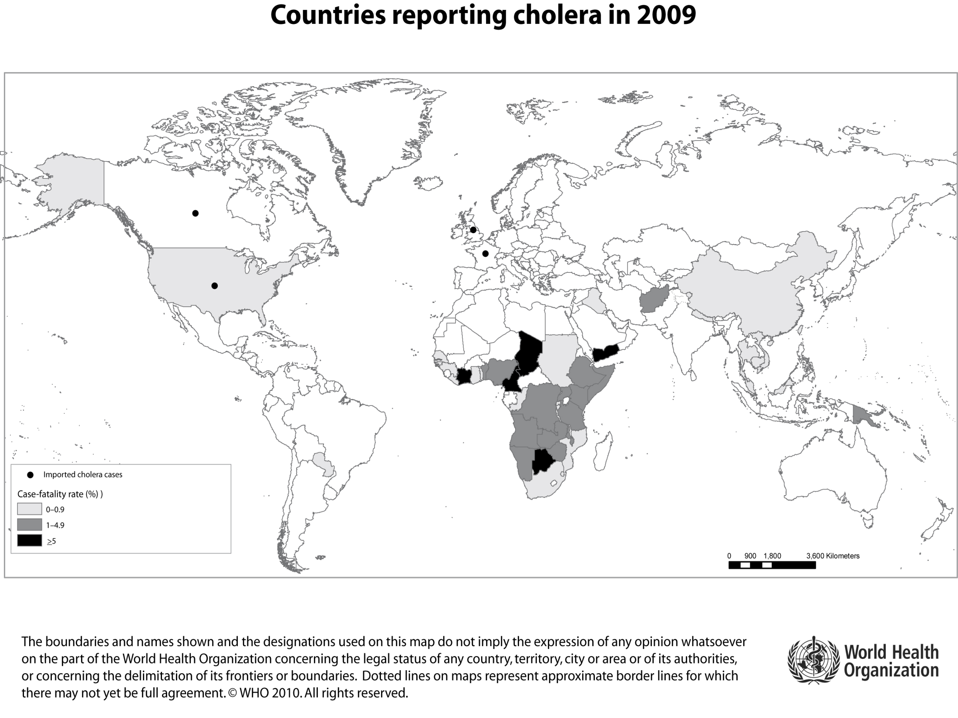

Slide 18
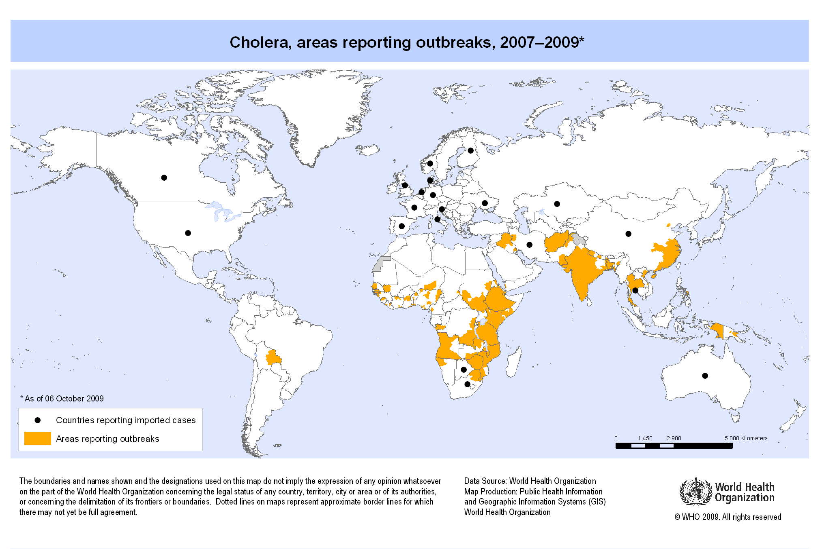

Slide 19
Incubation period: 1-5 days.
Modes of transmission:
1-Contaminated water and food.
2-Rarely direct from person to person.
Reservior
1-Aquatic environment (Brackish water & sea food)
2-Human beings

Slide 20
Communicability
(stool-positive stage):
Usually ends few days after recovery .
Occasionally several months carrier state.
Antibiotics can shorten the period of communicability

Slide 21
Prevention and control
Hygienic disposal of human faeces.
Adequate supply of safe drinking water.
Good food hygiene
Cooking food thoroughly & eating it hot.
prevent contact of cooked food with raw contaminated food, water or ice.
Avoid raw vegetables unless peeled
Boil it, cook it, peel it or forget it.
- Mass chemoprophylaxis has no effect

Slide 22
Vaccination:
The previous parenteral cholera vaccines had little efficacy and are not recommended for use in endemic areas, during outbreaks, or in people traveling to endemic areas.
Oral immunization:
(1) killed bacterial vaccines
(2) live genetically engineered mutants deleted of toxin genes
(3) avirulent vectors genetically engineered to express protective cholera antigens.

Slide 23
Oral live vaccines
Oral cholera vaccine is bivalent whole-cell killed vaccine, 1 with a recombinant B subunit, the other without.
single dose in adults.
It is effective in children and healthy volunteers.
Confer 80% immunity against El Tor cholera.

Slide 24
For a vaccine to be useful in endemic areas, it should do the following:
Produce long-lasting immunity
Be compatible with the Expanded Program on Immunization
Be able to produce immunity rapidly, ideally after one dose, to be useful in epidemics
- Protect against El Tor O1 and O139 Bengal
strains

Slide 25
Because the secondary attack rate of cholera in the household is high, selective antimicrobial prophylaxis of contacts has been attempted. This is not feasible as a routine public health measure.

Slide 26
Food products from cholera infected regions:
Vibrio cholerae 01 survives 5 days in ambient temperature & 10 days at 5-10 degrees.
-It survives freezing & low temperature.
-It is sensitive to acidity & drying.
-It is sensitive to Gamma irradiation & temperature above 70 degrees.

Slide 27
References
1-Cholera, 2009. Weekly Epidemiological Record 2010, 31 (85): 293-308.
2- Cholera vaccines: Who position paper. Weekly Epidemiological Record 2010, 85: 117-128.
3- Global atlas of infectious diseases. http://globalatlas.who.int/globalatlas

Slide 28
Thank You

