Slide 1
بسم الله الرحمن الرحيم

Slide 2
The Patient "Doctor -Relationship
DR. JAWAHER A. AL-NOUH
Consultant psychiatrist-K.K.U.H

Slide 3
CONTENTS:
WHY?
EFFICTIVE P-D-R.
Levels of communication.
The good rapport.
Establishing Rapport.
Transference
Counter transference
Models of interaction between D. and P.

Slide 4
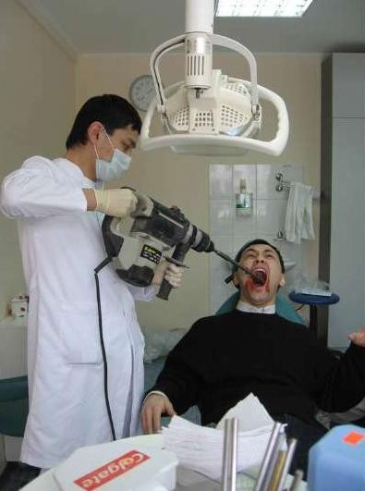
Importance of P-D-R

Slide 5
D.P.R
To diagnose, manage, and treat an ill person, doctors and therapists must learn to listen.
They need the skills of active listening, which means listening both to what they and the patient are saying and to the undercurrents of the unspoken feelings between them

Slide 6
Levels of communication:
1-what the person believes about him self.
2-what he wants others to believe about him.
3-who the person really is.
Learn to monitor:
what actually said(content)
what meant to be said .(process)

Slide 7
An effective relationship is characterized by good rapport
What is rapport?
it is the spontaneous, conscious feeling of harmonious responsiveness that promotes the development of a constructive therapeutic alliance.

Slide 8
Establishing Rapport
1 -putting patients and interviewers at ease;
2 -finding patients' pain and expressing Compassion.
3-evaluating patients' insight and becoming an ally.
4-showing expertise.
5- establishing authority as physicians and therapists
.6- balancing the roles of empathic listener, expert, and
authority.

Slide 9
Empathy
-it is a way of increasing rapport.
It is not a universal human capacity.
It is understanding what other people are feeling .,missing in some personality disorders.
Cannot be created but can it be focused and
Deepened.

Slide 10
Transference :
The pt are transferring feelings toward others in their life onto the physician.
Counter transference:
Emotional reactions to the pt from the doc that often involve the doctor past experience.

Slide 11
Difficult Doctor-Patient R.
The Seductive Patient.
The “Hateful” Patient.,nd opinion,fail to recover
The Patient With a Thousand Symptoms.
The Patient who refused or defeat to help themselfves.
Un cooperative pt.,The Mentally Disturbed Patient.
The Dying Patient.

Slide 12
Models of interaction between doctor and patient
1-the paternalistic model.
2-the informative model.
3-The interpretive model.
4-the deliberative model.

Slide 15
بسم الله الرحمن الرحيم

Slide 16
Erikson's Theory of Psychosocial Development ;
DR. JAWAHER A. AL-NOUH
(F.K.S.U.P)
Consultant psychiatrist-K.K.U.H

Slide 17
Objectives:
1-list all of eriksons stages of development.
2-explain the effect of successful resolution of each stage on an individual.
3-explain the effect of unsuccessful resolution of each stage on an individual.
4-the link between erickson p.t. and care delivery.

Slide 18
What is Psychosocial Development?
Erik Erikson’s theory of psychosocial development is one of the best-known theories of personality in psychology. Much like Sigmund Freud, Erikson believed that personality develops in a series of stages. (8 stages).Unlike Freud’s theory of psychosexual stages, Erikson’s theory describes the impact of social experience across the whole lifespan.
Notes:
L
18

Slide 19
One of the main elements of Erikson’s psychosocial stage theory is the develoment of ego identity.¹ Ego identity is the conscious sense of self that we develop through social interaction.

Slide 20
According to Erikson, our ego identity is constantly changing due to new experience and information we acquire in our daily interactions with others.
In addition to ego identity, Erikson also believed that a sense of competence also motivates behaviors and actions. Each stage in Erikson’s theory is concerned with becoming competent in an area of life.

Slide 21
If the stage is handled well, the person will feel a sense of mastery, which he sometimes referred to as ego strength or ego quality-
(successful resolution_positive)
If the stage is managed poorly, the person will emerge with a sense of inadequacy.(un-successful resolution-negative)
- In each stage specific tasks must be accomplised

Slide 22
Erikson's Psychosocial Stages Summary Chart
stage | Basic Conflict | Important Events | Outcome
Stage-1 -oral-sensory -infancy birth to 18 months) | Trust vs. mistrust | Feeding | Children develop a sense of trust when caregivers provide reliabilty, care, and affection. A lack of this will lead to mistrust.

Slide 23
Children need to develop a sense of personal control over physical skills and a sense of independence. Success leads to feelings of autonomy, failure results in feelings of shame and doubt. | Toilet Training | Autonomy vs. Shame and Doubt | Stage-2 -muscular -anal Early Childhood (2 to 3 years)

Slide 24
Stage-3 -locomotor genital Preschool (3 to 5 years) | Initiative vs. Guilt | Exploration | Children need to begin asserting control and power over the environment. Success in this stage leads to a sense of purpose. Children who try to exert too much power experience disapproval, resulting in a sense of guilt.

Slide 25
Children need to cope with new social and academic demands. Success leads to a sense of competence, while failure results in feelings of inferiority. | School | Industry vs. Inferiority | Stage-4 -latency School Age (6 to 11 years)

Slide 26
Stage-5 Puberty and Adolescence (12 to 18 years) | Identity vs. Role Confusion | social Relationships | Teens needs to develop a sense of self and personal identity. Success leads to an ability to stay true to yourself, while failure leads to role confusion and a weak sense of self.

Slide 27
Stage-6 young Adulthood (19 to 40 years | Intimacy vs. Isolation | Relation -ships | Young adults need to form intimate, loving relationships with other people. Success leads to strong relationships, while failure results in loneliness and isolation.

Slide 28
Adults need to create or nurture things that will outlast them, often by having children or creating a positive change that benefits other people. Success leads to feelings of usefulness and accomplishment, while failure results in shallow involvement in the world. | Work and Parenthood | Generativity vs. Stagnation | Stage-7 Middle Adulthood (40 to 65 years)

Slide 29
Older adults need to look back on life and feel a sense of fulfillment. Success at this stage leads to feelings of wisdom, while failure results in regret, bitterness, and despair. | Reflection on Life | Ego Integrity vs. Despair | Stage-8 Maturity(65 to death)

Slide 30
the link between e.s.p.d.t and care delivery
Caregiver and environmental factors are important factors in the first 7 stages .
Basic task is the trusting relationship which mainly rests with caregivers
(it is not what your mother can do for you that counts, but the way she does it.

