Slide 1
Perception and Behaviour
Perception is an intrapersonal and an interpersonal phenomena.
Perception is described as the interpretation of sensory input ; without sensation it is virtually impossible to perceive.
Perception is directly influenced by past and present experiences of social cultural climate people live in.
The internal process of perception is about certain things happen inside people’s heads when they perceive.
Raw feelings is part of one’s experiences, are taken to mean those feelings which one has about something or someone cannot explain. Eric berene called it “intuition”; for example an individual knows that something is right or wrong but cannot offer any evidence to validate it.

Slide 2
The Perceptual Process Has Numerous Properties:
Structure: How Do We Perceive?
Constancy
Meaningfulness
People are flooded with perceptual stimuli that if they are to process every single one of them their brains would have difficulty coping,
instead they tend to categorise incoming stimuli.

Slide 3
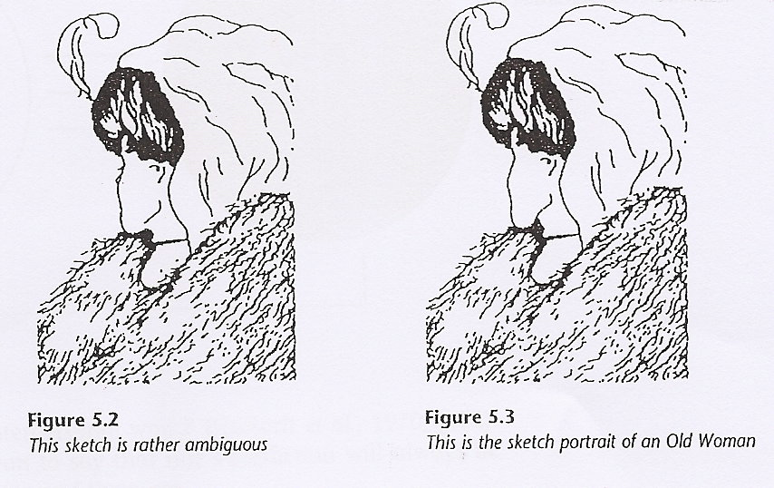
This example helps us to understand why sometimes people may perceive the wrong picture.

Slide 4
A person participates in structuring his experiential world can be described as categorising process. by extracting stimuli from the world and forces them into set of categories.
e.g. one would categorises people by their physical attributes which include their colour, build, height and even accent, and functions, roles.
There is a relationship between the way one categorises people and the way on they interact with them.
for example if I was to categories you as an aggressive person, my behaviour is bound to be influenced by my perception of you and this in turn influence how you behave with me.

Slide 5
Positive and negative reciprocity
Predictability of our interpersonal world
prediction not always right because :
People may perceive the wrong picture.
People may perceive the right picture, but this may be what others want them to see.

Slide 6
People may perceive the wrong picture
People like to think their perception are always accurate, such a thought can be a delusion.
Father see the son in the role of son, physician see the client as client not as individual ..etc.
Why people misperceive? egocentric viewing and viewing through the eyes of another.
Egocentric perspective: people receive the world from their own particular points of view and not able to see it from the point of view of others.
Piaget , stats that a child 2-7 yrs does not process the ability to see thing from the points view of others. (eg. Kid brother)
Residual effect of egocentric with adults such as
Teachers see it from teacher’s point of view
Doctors see it from a medical point of view ( ? Empathic with pt.)

Slide 7
PEOPLE MAY PERCEIVE THE RIGHT PICTURE
People May Perceive The Right Picture, But This May Be What Others Want Them To See.(Seeing It From The Eyes Of Another)
Misperception Occur When The Properties Of A Person Are Mediated To Us Through What Other People Say Or Write About Him Through Newspaper.
This Will Help Us To Understand That Wrong Perception Will Have Serious Implications On Health Care Delivery.
If I Am Labelled As Difficult or non compliant Patient, Then I Will Be Perceived As A Difficult Patient. If I Am Perceived As A Hopeless Case Then I Am Treated As A Hopeless Case.
What We See May Not Be Necessarily Be Correct, Such As Magicians And Politicians. We May Be Led Into Perceiving What Others Want Them To See.

Slide 8
Bandora (1974), Idea Of Observational Learning.
Some people are extremely good at self-monitoring whilst others may not have such well developed monitoring skills.
High On Self-monitoring:
is a person who out of a concern for social appropriateness is particularly sensitive to the expression and self presentation of other in social situations.
they are good “people readers” they have the ability to monitor carefully their own behaviour and to adjust skilfully the self they are presenting when signals from others tell them that they are not having the desired effect.

Slide 9
2 Low On Self- Monitoring:
people’s behaviour suggests congruence with their emotions and feelings.
they are unconcerned about the social cues that surround them they tend to express what they feel rather than tailor their presentation of self to fit the situation.

Slide 10
Snyder (1983), Concept of Self Monitoring:
is a learned behaviour if I am uncertain of how I should react emotionally, then I look to the behaviour of others for guidance. e.g. if others cry I cry as well.
Self monitoring is a major influence of self-regulated behaviour.
High Self-monitoring People:
tend to regulate their behaviour according to the immediate situation. They observe what is going on and behave accordingly. They are concerned about what others do and how they themselves react. They speak in the third person using he, she, they words.
2. Low Self- Monitoring People:
Tend to behave according to their intrapersonal dynamics. They focus on their own behaviour and reaction. They speak in the first person using I, Me My words.

Slide 11
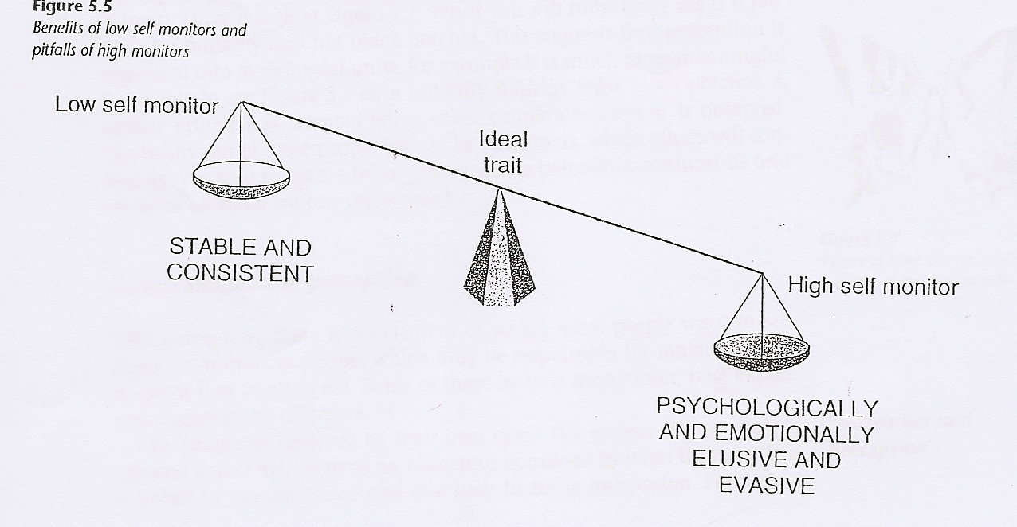

Slide 12
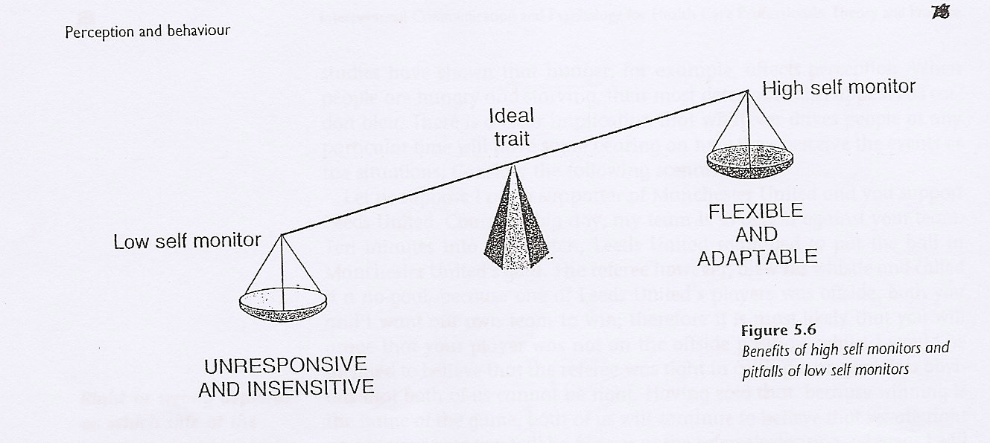

Slide 13
Perceptual Constancy/ stability:
Is an accurate perception of an object even though the sensory patterns they produce are in a state of change ( size, colour, brightness, and location constancy).
e.g. aeroplane , red car , moving trees and houses while driving
The perceptual process gives meaning to our sensory input.
Similar principle is adapted to people behaviours
The behaviour of some people will make sense to us, whilst other will confuse us. We tend to ignore those people whose behaviour confuses us and we focus on those we understand instead

Slide 14
Factors Influencing Perception
In perception, there is an element of seeing what people want to see.
There are numerous factors which are responsible for making people see what they want to see such Motivation, Past Experience, Expectation and Time.
People Can Be Deceived By Their Own Eye eg. When They Are Hungry.
People Are Motivated By What Interest Them. (anger towards referee )
Past Experience Affects Our Version eg. People Regularly See Words Spelled Correctly When In Fact They Are Not.
People‘s Behaviour May Be Dictated By What Aspect They Happen To Be Focusing On At Any One Particular Time.
Expectation Works Like Motivation, People Are More Likely To Pay Attention To Aspects Of Their Environment That They Expect Than Those They Do Not Expect.

Slide 15
Memory Formation & Storage
Memory is the ability to recall thoughts. the neurobiology basis of learning is located in the structures of he brain involved in forming and storing information that is memory.
Memory is divided into
Long Term Memory- Recent Memory- Recent Past Memory-remote Memory-secondary Memory. Smell And Emotion Underlie Long Term Memory.
Short Term Memory- Immediate Memory- Working Memory, Primary Memory, And Buffer Memory. Short Term Memory can be affected by chronic emotional stress, psychological exhaustion, or too much input. The capacity of short term memory is limited 5 to 10 bits of information.

Slide 16
Learning & MEMORY
Learning begins with sense taking in an environmental stimulus that is transformed into a memory trace or memory link. an electrical or chemical impulse, passing through, a neuron when the brain receives information, triggers the formation of connections between synapses.
Long Term Memories have increased time to link with many locations in the cortex and thus are retained longer than term memories. The more connections the better the chance of contacting a neural pathway leading to memory.
Storage Is The Key To A Good Memory.

Slide 17
Learning & MEMORY
Learning and Memory can be affected by stress
the increase production of adrenaline from stress enhances learning if stress is too great learning is inhibited.
Mood affects learning and recalling of material.
The Survived Childhood Memories are associated with the time the child learned to speak between age 3-5 only memories associated with traumatic events or with smell are likely to be remembered. memory trace in the brain is called engram.

Slide 18
Memory is classified into 2 kinds based on how long the memory lasts:
Activated Short Term Memory: Lasts only seconds or hours and is the ability to recall bits of information. e.g. like finding an unfamiliar telephone number. If the number has no special significance is usually forgotten.
2. Long Term Memory: Lasts for days to years. home telephone number is part of long memory if it frequently used. This is called memory consolidation works as reinforcement due to the frequent use.
All information that comes to our conscious attention only about 1 percent goes into long term memory and much of what goes is forgotten. The brain selects a small percentage of our thoughts and lose much of what stored otherwise the brain would be overwhelmed with information. This is why it is easy to remember short list than long ones.

Slide 19
THANK
YOU

