Slide 1
ANEMIAS
Dr. Farjah H. AlGahtani
Consultant Hematologist ,assistant professor
Director of transfusion medicine and blood bank department

Slide 2
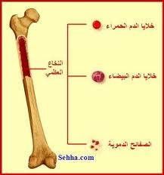
ANEMIA
Single cell line(RBC) problem
Multiple cell line problem
(RBC,WBC,Platelet)
-Bone marrow suppression
-immunologic disorders
-peripheral destruction/sequestration

Slide 3
Anemia
Anemia is generally defined as a hematocrit
<40% (hemoglobin <13.0 g/dL) in men or
<37% (hemoglobin <12.0 g/dL) in women.
(WHO definition)
Red blood cell (RBC) indices, which include the mean corpuscular volume (MCV),
the mean corpuscular hemoglobin (MCH),
the mean corpuscular hemoglobin content (MCHC), and the red-cell distribution width (RDW) index, are further used to define types of anemia.

Slide 4
Anemia
Despite having a set of peculiar symptoms and signs, anemia is not a disease per se, but a syndrome, as it may arise from an extensive list of causes.
It is the chronic syndrome of highest prevalence in clinical medicine.

Slide 5
Anemia Etiology
Based on Hb, red cell indices, retic count and red cell morphology
(1) Inadequate response
A. Hypochromic microcyctic
B. Normochromic Normocytic
C. Macrocytic
(2)Adequate response
R/O blood loss---Includes Hemolytic
disorders

Slide 6
Anemia-symptoms
What are the symptoms of Anemia ?
General malaise, weakness, fatigue, breathlessness on exertion, palpitations, angina.
Desire to eat sand and clay.
Menorrhagia common in women.

Slide 7
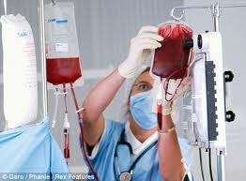
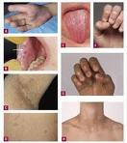
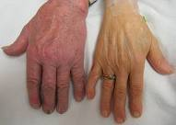

Slide 8
Symptoms of Anemia
The CNS, the heart and the muscle mass are the most affected organs, since they are the ones that most need oxygen for their functions.
The symptoms increase with physical activity, as this consumes oxygen.
-hemoglobin between 9 and 11 g/dL there's irritability, headache .
in the elderly fatigability is observed, and angina may occur.
-Hemoglobin between 6 and 9 g/dL there's tachycardia, dyspnea and fatigue upon the slightest effort.
- hemoglobin below 6 g/dL symptoms are present even in sedentary activities, and
- below 3.5 g/dL heart failure is impending and any activity is unfeasible.

Slide 9
COMPLETE BLOOD COUNT
Hb Conc (g/dl)
Hematocrit (PCV)
MCV (fl)
MCH (pg)
RDW(measure of red cell size variability)
RBC Count (…x10⁹/L )
WbC Count (…x10⁹/L )
Platelet Count (…x10⁹/L)
(Reticulocyte Count) ( % )

Slide 10
Glossary of Useful Blood Count Descriptors
Anisocytosis: red cells of unequal size. Reflected in increased RDW (Red cell Distribution Width.) Dimorphic Blood Film: two populations of red cells - one microcytic and the other normocytic. Seen in treated or transfused iron deficiency, and sideroblastic anemia Howell-Jolly bodies: round nuclear remnants within the red cells. Indicate splenectomy or hyposplenismMacrocytosis: large red cells Erythroblast: any nucleated red cell precursor Hypersegmented neutrophils: a neutrophil with six or more lobes. Usually (but not inevitably) means vitamin B12 or folate deficiency

Slide 11
Glossary of Useful Blood Count Descriptors
Hypochromia: pale red cells. Always accompanied by microcytosis Leukoerythroblastic: the presence of erythroblasts and myelocytes (which are precursors of mature cells) in the blood. Often indicates marrow infiltration eg by secondary cancer or fibrosis
Microangiopathy: indicates mechanical damage to red cells with red cell fragments on the blood filmMicrocytosis: small red cells Poikilocytosis: a traditional term for red cells of unequal shape
Polychromasia: grey coloured red cells on film, indicating presence of increased reticulocytes
Reticulocyte: an erythrocyte newly released from the bone marrow

Slide 12
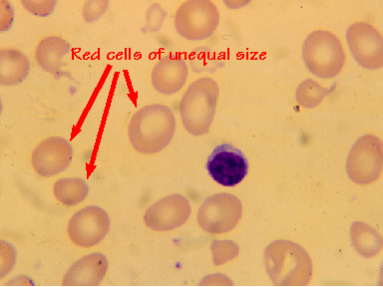
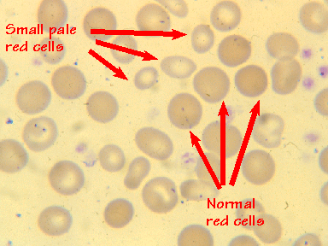
Anisocytosis
Dimorphic Red Blood Cells

Slide 13
How can we diagnose Anemia ?
Blood tests to detect the various components of blood is carried out for proper diagnosis.
Red blood cell count may be normal or decreased.
Peripheral blood smear shows pale small cells.
White blood cell count normal or decreased

Slide 14
Classification of anemia
Anemia can be either acute or chronic.
In acute anemia (sudden loss of blood), the lack of blood volume in the circulatory system is more important than the deficiency of hemoglobin.
In chronic anemia, there's no decrease in blood volume, which is compensated by an increase in plasma volume.

Slide 15
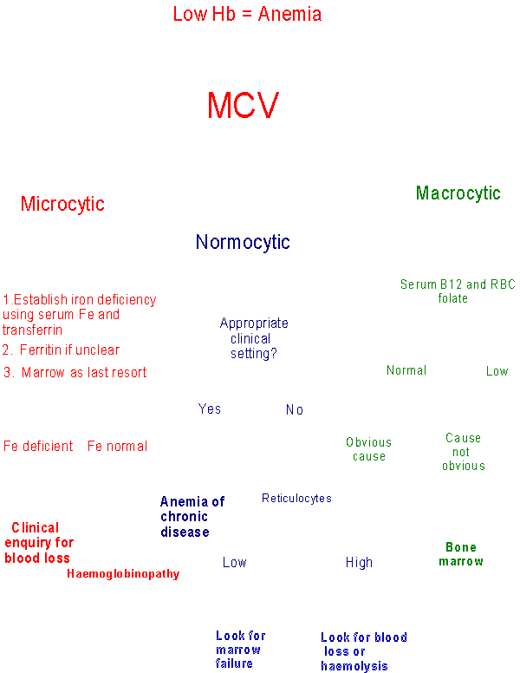

Slide 16
Hypochromic Microcytic Anemia D/D
Microcytic anemias the etiologic possibilities are
Iron deficiency
Thalassemia
Sideroblastic anemia
Anemias of chronic disease.
Severe microcytic anemia (MCV <70 fL) is caused mainly by iron deficiency or thalassemia.

Slide 17
Normochromic Normocytic Anemia D/D
Chronic inflammatory disease— (1)infection (2)collagen vascular disease (3)inflammatory bowel disease
Recent blood loss
Malignancy/Marrow infiltration
Chronic renal failure
Transient erythroblastopenia of chidhood
Marrow aplasia/hypoplasia
HIV infection
Hemophagocytic syndrome

Slide 18
Macrocytic Anemia D/D
Megaloblastic anemias
• Vit.B12 def. - (1) pernicious anemia
(2) malabsorption
• Folate def. - (1) malnutrition (2) malabsorption
(3) chronic hemolysis (4)drugs - phenytoin, sulfa
Hemolysis
Myelodysplastic syndrome
Marrow failure - Aplastic anemia
Chronic liver disease
Hypothyroidism

Slide 19
Macrocytic anemia D/D
Macrocytic anemia may be the result of megaloblastic (folate or vitamin B12 deficiency) or nonmegaloblastic causes. Folate deficiency can in turn be due to either reduced intake or diminished absorption.
Severe macrocytic anemia (MCV >125 fL) is almost always megaloblastic.

Slide 20
The Normocytic Anemias
These may be classified as follows:
underproduction of erythrocytes due to
(1) the anemia of chronic disease
(2) marrow failure
(3) renal failure (decreased erythropoietin)
loss or destruction of erythrocytes due to
(1) hemolysis
(2) acute blood loss
The reticulocyte count is useful in drawing this distinction, being elevated in (b) and reduced in (a).

Slide 21
The Normocytic Anemias
The causes of normocytic anemias include aplastic anemia, bone-marrow replacement, pure red-cell aplasia, anemias of chronic disease, hemolytic anemia, and recent blood loss. A number of anemias have a genetic etiology. Examples of such inherited disorders include hereditary spherocytosis, sickle-cell (SC) anemia, and thalassemia

Slide 22
Hemolytic Disorders
Hemoglobinopathy– Hb SS,SC,S-Bthal
Enzymopathy--G6PD def, PK def
Membranopathy—Hereditary spherocytosis, elliptocytosis
Extrinsic factors—DIC, TTP, HUS,
Immune hemolytic anemia---Autoimmune, Drug induced

Slide 23
Microcytic Anemia
TEST Iron def ThalMin An of ch dis
S.Iron - low normal normal
S.Ferritin - low N/H N/H
Marrow iron - low N/H N/H
Hb A2 or F - N H=Bthal N
N=Athal
RDW - high normal N/H
MCV ÷ RBC - >13 < 13
Sickle/B-thal – Hb S > Hb A
Absence of microcytosis in both parents excludes B-thal or Sickle/B-thal but not A-thal

Slide 24
Iron deficiency anemia (IDA)
It is a condition when supply of iron in the body to bone marrow falls short of that required for the production of red blood cells. It is the commonest cause of anemia throughout the world.

Slide 25
Iron Deficiency Anemia
The incidence of anemia in the general population is about 1.5%.
Iron deficiency related to inadequate replacement of lost iron is the most frequent cause of asymptomatic anemia and has a variety of causes.
Iron deficiency is common among women of childbearing age; 10% to 20% of menstruating women have abnormally low concentrations of hemoglobin (usually <12 g per 100 mL).

Slide 26
Iron Deficiency Anemia
What are the causes of IDA ?
Increased physiological demand for more red blood cells
eg: increased physical activity.
In children, during spurts of growth.
In women during menstruation, pregnancy, parturition
and lactation.
Inadequate dietary intake due to poor economic reasons
or deficient foods.
Decreased absorption due to disorders in the digestive
system.
GI blood loss Peptic ulcer, piles, hiatus hernia, carcinoma of
stomach, carcinoma colon, chronic ingestion of a certain type
of pain relievers, hookworm infestation.

Slide 27
Iron Deficiency Anemia
Between 20% and 60% of pregnant women have hemoglobin levels <11 g per 100 mL.
Anemia was found in 6% of white women and 17% of black women during the first trimester and in 25% of white women and 46% of black women during the third trimester.

Slide 28
Iron Deficiency Anemia
The daily oral iron requirement for men and postmenopausal women is 0.5 and 1 mg
Menstruating and pregnant women have higher requirements: 2 mg and 2.5 mg, respectively.
The replacement of lost iron is complicated by the fact that only 5% to 10% of the 10 to 20 mg of the iron in the average adult diet is absorbed.
Anemia is less likely to occur in women taking birth control pills and more likely to occur in women with intrauterine devices.

Slide 29
Iron Deficiency Anemia
Because men and postmenopausal women rarely develop iron deficiency that is not related to gastrointestinal blood loss (often occult), an evaluation of gastrointestinal tract must be performed when an iron deficiency is detected in these individuals

Slide 30
Iron Deficiency Anemia-Diagnosis
Red blood cell count may be normal or decreased.
Peripheral blood smear shows pale small cells.
Aniso-poikilocytosis
White blood cell count usually normal
Serum iron is reduced
Total iron binding capacity of blood shows an increase.
Low serum ferritin

Slide 31
Iron Deficiency Anemia-Treatment
Correction of iron deficiency - to restore hemoglobin level.
To replenish iron stores.
Oral iron administration is advised. (Side effects of oral iron)
Parenteral iron may be needed occasionally
Treat the underlying cause

Slide 32
Anemia of Chronic Disease
Patients with cancer, infection, or inflammation, commonly have a mild-to-moderate anemia caused by red cell underproduction.
This 'anemia of chronic disease' is very common, and is usually normocytic. Some cases develop abnormalities of iron metabolism, in which case there may be a microcytosis.

Slide 33
Hemolysis
Hemolysis is defined as the premature destruction of red blood cells, from whatever cause.
Recognising the presence of hemolysis
The simplest tests are
Raised reticulocyte count
Raised indirect (unconjugated) bilirubin
Raised serum LDH
Diminished serum haptoglobin concentration. Further more sophisticated testing may be needed in some cases.

Slide 34
Hemolysis
Hemolysis is defined as the premature destruction of red blood cells, from whatever cause.
Recognising the presence of hemolysis
The simplest tests are
Raised reticulocyte count
Raised indirect (unconjugated) bilirubin
Raised serum LDH
Diminished serum haptoglobin concentration. Further more sophisticated testing may be needed in some cases.

Slide 35
Hemolysis
Principal causes
Inherited abnormalities
Membrane (Hereditary Spherocytosis)
Hemoglobin (Sickle Cell Anemia)
Enzymes (Glucose-6-phosphate
dehydrogenase (G6PD) deficiency)

Slide 36
Hemolysis
Acquired causes
Immune
Warm and Cold Autoimmune Hemolytic Anemia
Non-immune
Mechanical Damage from leaky heart valves
Microangiopathic hemolytic anemia (MAHA) like TTP, HUS & DIC

Slide 37
Lead Poisoning
Hypochromic microcytic anemia
Associated iron deficiency
Child has pica and is exposed to lead paint or lead dust
Blood smear shows basophilic stipling and blood lead is elevated.
Removal from exposure,chelation therapy and correction of iron deficiency are important.

Slide 38
THALASSEMIA
Normal Hb is a tetramer of 2 alpha and 2 beta chains
Alpha-thalassemia:decrease or total lack of alpha globin synthesis
Beta-thalassemia:decrease or total lack of beta globin synthesis

Slide 39
THALASSEMIA
Clinical classification-
Silent carrier(AorB):normal CBC
Thal trait(AorB):mild anemia(HM)
HbHdisease(A-thal):moderately severe hemolytic anemia,icterus,splenomegaly
Severe Beta-thal:severe anemia,growth retardation,hepatosplenomegaly,bony def.
Thalassemia major:tranfusion dependent
Thal-intermedia:no regular transfusions

Slide 40
THALASSEMIA-complications
HbH disease:severe hemolytic anemia,spenomegaly,hypersplenism
Thal-major:poorly trasfused-skeletal abnormalities,growth retardation,CHF
Thal-major:well transfused with iron overload-(1)Endocrine disturbances:delayed puberty,growth retardation,diabetes mellitus,hypothyroidism (2)Cardiac:arrhythmias, congestive heart failure (3)Hepatic:cirrhosis,liver failure

Slide 41
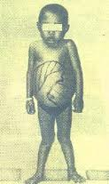
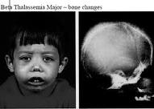

Slide 42
THALASSEMIA-complications
HbH disease:severe hemolytic anemia,spenomegaly,hypersplenism
Thal-major:poorly trasfused-skeletal abnormalities,growth retardation,CHF
Thal-major:well transfused with iron overload-(1)Endocrine disturbances:delayed puberty,growth retardation,diabetes mellitus,hypothyroidism
(2)Cardiac:arrhythmias, congestive heart failure (3)Hepatic:cirrhosis,liver failure

Slide 43
THALASSEMIA-Lab
Thal trait:Hb 9-10 g/dl
HbH disease:Hb 6-7 g/dl
Thal intermedia:Hb 7-8 g/dl
Thal major:Hb less than 5 g/dl
Peripheral smear:hypochromic,microcytic, anisopoikilocytosis,target cells
Hb electrophoresis: (1)Thal trait-HbF 1-5%, HbA2 3.5-8%,rest HbA (2)Thal major- HbF 20-100%,HbA2 2-7%,HbA 0-60%

Slide 44
THALASSEMIA-therapy
Red cell transfusion 3-4 weekly-Hb 9-10
Chelation therapy with desferrioxamine
Splenectomy if transfusion >200ml/kg/yr
Folic acid 5mg daily
Penicillin prophylaxis to all splenectomised
Pneumococcal and Hib vaccine before sply.
Cholecystectomy for gall stones
Bone marrow transplantation is curative
Genetic counselling

Slide 45
SICKLE CELL DISEASE
SA :Sickle cell trait-asymptomatic
SS :Sickle cell anemia
S-Bthal:Sickle cell-beta thal
SC :Hb SC disease
Pathophysiology:Valine replaced by glutamic acid at Beta 6 position. With deoxygenation HbS crystallises&gels

Slide 46
Clinical features
Anemia:chronic,onset at 3-4 mo
Aplastic crisis:parvo virus B12
Sequestation crisis:usuallyspleen
Hemolytic crisis
Dactylitis:Hand foot syndrome(infant)
Painful crisis:muscle,bone,bone marrow,lung, intestines
Cerebrovascular accidents
Acute chest syndrome:infection,infarction,emb
Chronic lung disease:pulmonary fibrosis,restictive lung disease,cor pulmonale

Slide 47
Clinical features
Priapism
Ocular:retinopathy
Gall bladder disease:stones,cholecystitis
Renal:hematuria,conc.deficit,nephropathy
Cardiomyopathy
Skeletal:avascular necrosis of femoral head
Leg ulceration:in older pts
Infections:pneumococcal pneumonia,meningitis, arthritis,Hinf sepsis,salmonella&staph osteomyelitis,mycoplasma pneumonia,viral infe
Growth failure,delayed puberty
Psychologic problems:chronic illness,chronic pain

Slide 48
THERAPY
Anemia is usually chronic&compensated
Blood transfusion only given based on clinical condition,Hb level&retic count
Crisis:Splenic sequestration crisis,aplastic crisis,hyperhemolytic crisis-in all of these PRBC is indicated when anemia is sympto.
Pain crisis:IVF,analgesia with narcotics,NSAIDs
Acute chest syndrome:O2,judicial use of analgesics&fluids,antibiotics,PRBC
Stroke:O2,fluids,exchange transfusion
Hydroxyurea:decrease number&severity of VOC
Bone marrow transplantation

Slide 49
G6PD deficiency
Episodic hemolysis on exposure to oxidants
Severity of hemolysis depends on the enzyme variant
Gene for G6PD is on X chromosome
Jaundice,dark urine(bilirubin,hemoglobin),
Red cells appear blistered
G6PD levels may be normal with hemolysis
Therapy:PRBC,IVF,urine alkalinisation
Prevention:avoid oxidants,fava beans,henna

Slide 50
