Slide 1
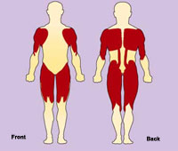
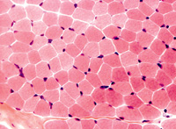
MYOPATHIES
Fawaz Al-Hussain FRCPC, MPH
For medical students 2011

Slide 2
Brief review of anatomy:

Slide 3
Single muscle fiber

Slide 4
Thick filaments: myosin

Slide 5
Thin filaments: actin

Slide 6
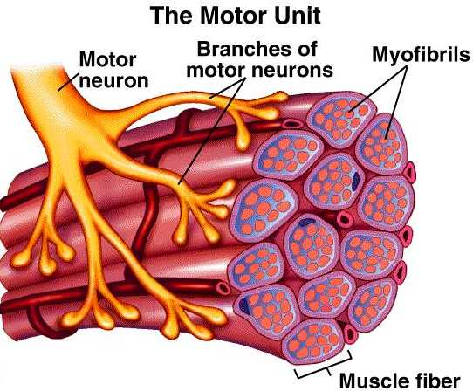

Slide 7
Muscle Fibers
Type I : SLOW
Slow switch and long contraction time
High O2 ➔ aerobic
More myoglobin and mitochondria
Less fatigable
Type II: FAST (a & b)
Fast
Anaerobic
Less myoglobin & mitochondria
Fatigable
Most skeletal muscles have mixture of the two

Slide 8
Common symptoms
positive
negative
Myalgia
Cramps
Contractures
Myoglobinuria
Myotonia
Weakness
Fatigue
Atrophy
Periodic paralysis
Cardiomyopathy
No correlating sensory symptoms

Slide 9
Patterns of weakness
Proximal arm and leg distribution
➔ by far most common
Distal distribution
Proximal arm and distal leg (scapulo-peroneal)
Distal arm and proximal leg
Prominent ptosis
Prominent head drop
Pattern + temporal profile = appropriate DDx list of myopathies

Slide 10
General approach
Hx
focus on 1) age of onset
2) temporal profile
3) triggers of onset (e.g. drugs)
4) family hx (tree)
P/E
➔ determine pattern, severity, and degree of disability
➔ full neurological and general exam (cardiac, thyroid, LNs,….)
Investigations
➔ CK, EMG, Biopsy (from moderately affected muscle)
➔ specific for the cause or complication like genetics, ESR…

Slide 11
Lower vs. Upper Motor Neuron Weakness
 | Upper Motor Neuron (Brain to corticospinal tract) | Lower Motor Neuron (Anterior horn cells to peripheral nerves)
Reflexes | Hyperactive +/- clonus | Diminished or absent
Atrophy | Absent* | Present
Fasciculations | Absent | Present
Tone | Increased (spasticity) | Decreased or absent
Extensor planter reflex | Up-going (Babinski’s sign) | Down-going
*Disuse atrophy can develop after initial presentation
Notes:
25

Slide 12
Distinguishing Lower Motor Weakness from Muscle Weakness
 | Due to Neuropathy | Due to Myopathy
Distribution | Distal > proximal | Proximal > distal
Fasciculations | May be present | Absent
Reflexes | Diminished | Can be preserved (initial phase)
Sensory signs/symptoms | May be present | Absent
Notes:
25

Slide 13
Types of myopathies
Congenital
Muscular dystrophies
Channelopathies
Metabolic (inherited)
Mitochondrial
Inflammatory
Infection induced
Drug(s) induced
Acquired metabolic
Others

Slide 14
Types of myopathies
Congenital
Muscular dystrophies
Channelopathies
Metabolic (inherited)
Mitochondrial
Inflammatory
Infection induced
Drug(s) induced
Acquired metabolic
Others

Slide 15
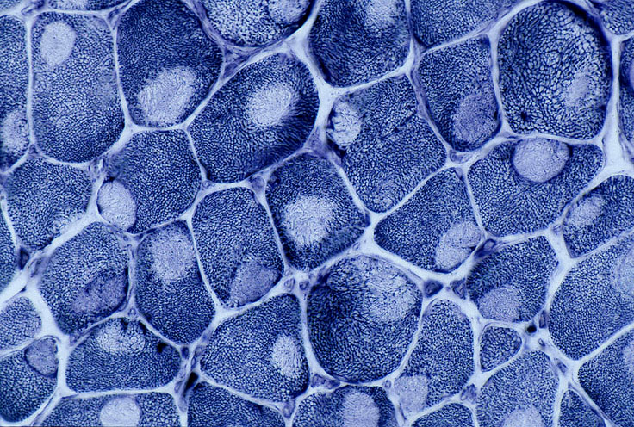
Congenital myopathies
Early childhood presentation
AD (majority), AR, or sporadic
Affect growth
+ deformities and contractures
May affect breathing
Central core myopathy may associate with malignant hyperthermia when go for anesthesia
Dx:
muscle biopsy +/- genetic testing
Rx
Genetic counseling
Medical and surgical Rx for complications
Teach re prenatal Dx

Slide 16
Duchenne Muscular Dystrophy
Dystrophinopathy
First described in 1881- dystrophin gene discovered in the early 1980's
Cause: deficiency of dystrophin, resulting in progressive loss of muscle fibers
Becker’s type: reduced amount of dystrophin with more benign course
Affects ~ 1 in 3500 live male births
X-linked disease - Xp21
50% of cases are sporadic

Slide 17
Duchenne Muscular Dystrophy
Boys with age of onset at 3-5 years
Initial symptoms: difficulty getting up from deep position and climbing steps, waddling gait
Weakness most pronounced in limb-girdle muscles, trunk erectors; craniobulbar muscles are spared
Skeletal deformities
Enlarged calves (pseudo-hypertrophy)
Cardiomyopathy
Inability to walk by 9-11 years
Death occurs usually in the 3rd decade, from respiratory insufficiency
Female carriers: usually asymptomatic

Slide 18
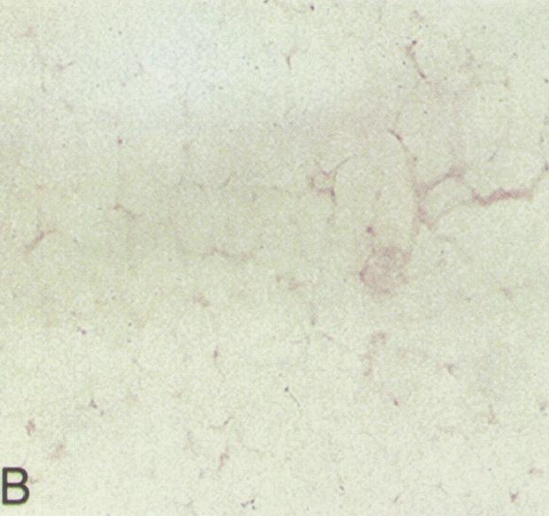
Duchenne Muscular Dystrophy
Normal dystrophin stain
Absent dystrophin stain
Dx
Lack of immunostaining of dystrophin in muscle biopsy
Demonstration of deletion in the dystrophin gene (limitation: small gene deletion in 30%)
Rx:
Supportive care, and Rx of complications
Steroids: delay deterioration
Genetic counseling

Slide 19
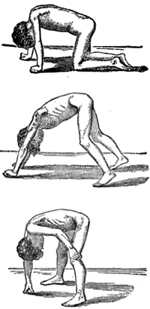
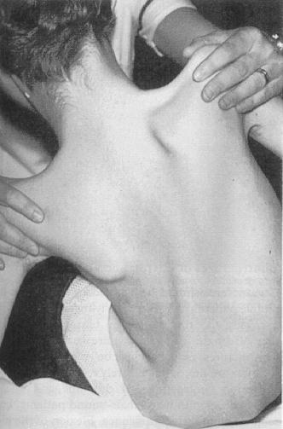
Gower’s sign

Slide 20
Myotonic Dystrophy
Prevalence: 1 in 8000
Cause: CTG repeat expansion in a gene on chr. 19
Autosomal dominant inheritance with anticipation
More CTG repeats ➔ younger age of onset
Usual onset: 3rd decade
Multisystemic disease:
Myotonia: hyperexcitability of muscle membrane → inability of quick muscle relaxation
Progressive muscular weakness and wasting, most prominent in cranial and distal muscles
Cataracts, frontal balding, testicular atrophy, diabetes
Cardiac abnormalities, mental retardation

Slide 21
Myotonic Dystrophy
Myotonia

Slide 22
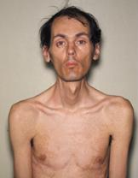
Myotonic Dystrophy
Dx:
Genetic testing
Screen for associated medical conditions like DM, cardiac,…
Rx: Counseling
Supportive
Prenatal Dx

Slide 23
Idiopathic Inflammatory Myopathies
Heterogeneous group of disorders characterized by:
Proximal muscle weakness
Non-suppurative inflammation of skeletal muscle with predominantly lymphocytic infiltrates
Types:
Polymyositis (PM)
Dermatomyositis (DM)
Inclusion Body Myositis (IBM)
Juvenile Dermatomyositis
Myositis associated with malignancy
Myositis associated with collagen vascular disease

Slide 24
Idiopathic Inflammatory Myopathies
2-8 cases per million per year
Female:male = 2:1
May associate with malignancy are common after the age of 50 years
35% with dermatomyositis (ovarian or lung)
15% with polymyositis (lymphoma or lung)
Mechanism:
Cell mediated in polymyositis and IBM
Humoral response with vasculitis in dermatomyositis

Slide 25
Polymyositis
Usually affect adults
Usually insidious onset over 3-6 months
No identifiable precipitant
Shoulder and pelvic girdle muscles affected most severely
Neck muscles (esp. flexors) involved in 50% of patients
Dysphagia & dysphonia may occur
Ocular and facial muscles almost never affected
Distal muscles are spared in majority of pts
Systemic features
Cardiac disturbances
Asymptomatic ECG changes
Conduction disturbances
Supraventricular arrhythmias
Cardiomyopathy
Congestive heart failure
Respiratory involvement
Interstitial fibrosis
Interstitial pneumonitis
Systemic symptoms
Arthralgias
Fever, malaise
Raynaud’s phenomenon

Slide 26
Dermatomyositis
Features of Polymyositis as well as cutaneous manifestations
The skin lesions may precede or follow the muscle syndrome
Gottron’s sign
Heliotrope rash
Shawl sign

Slide 27
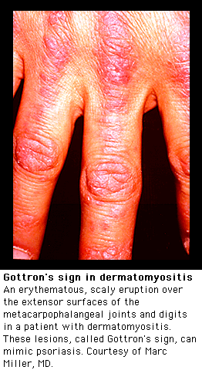
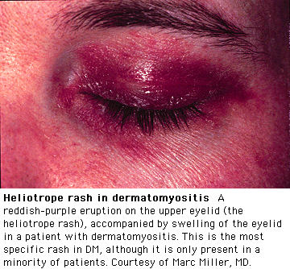
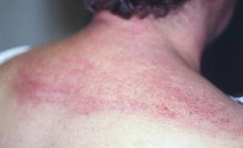

Slide 28
Inclusion Body Myositis
Usually affects adults >50 yrs
Gradual painless weakness of quadriceps and fingers flexors
Affects other muscles

Slide 29
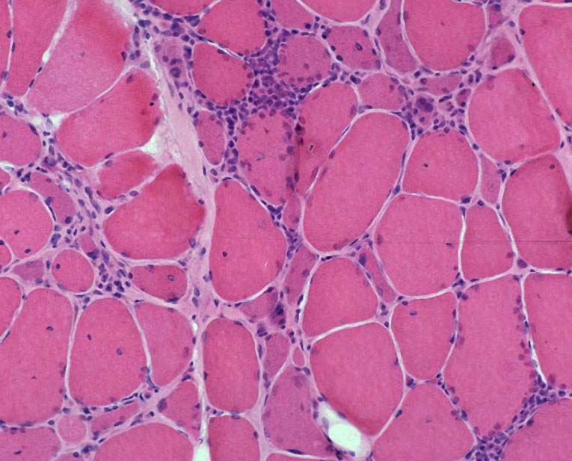
Idiopathic Inflammatory Myopathies
Diagnosis
Clinical presentation
Elevation of CK (may >10 times normal)… more at initial phase
AST, ALT, and LDH are elevated in most cases
Classic EMG findings for myositis
Muscle biopsy

Slide 30
Idiopathic Inflammatory Myopathies
Treatment:
Corticosteroids (prednisone)… less beneficial for IBM
Immuno-suppresive agents like azathioprine, methotrexate, mycophenylate mofetil
IVIG, and Plasma exchange
Early detection of malignancies!

Slide 31
Endocrine- myopathies
Thyrotoxic myopathy
Hypothyroidism
Hyperparathyroidism
Adrenal insufficiency
Hypokalemia
Others

Slide 32
Drug-induced Myopathies
Corticosteroids
Statins
ETOH
Heroin
Many others

Slide 33
Steroid-induced Myopathies
Exact incidence and prevalence ?
More in women
Reported with inhaled steroids too
Mechanism:
decreased protein synthesis
increased protein degradation
alterations in carbohydrate metabolism
mitochondrial alterations
electrolyte disturbances
decreased sarcolemmal excitability

Slide 34
Steroid-induced Myopathies
Tests:
CK, EMG, and muscle biopsy are typically normal
Treatment:
Re-assess indication of steroid and consider dose reduction
Avoid excessive exercises
Pain control and other supportive measures
=========================================================
END

