Slide 1
PROTEINURIA AND HEMATURIA
ASHIK HAYAT M.D. DM. FACP

Slide 2
Approach to Proteinuria and Hematuria
Ashik Hayat MD DM FACP
Consultant Nephrology

Slide 3
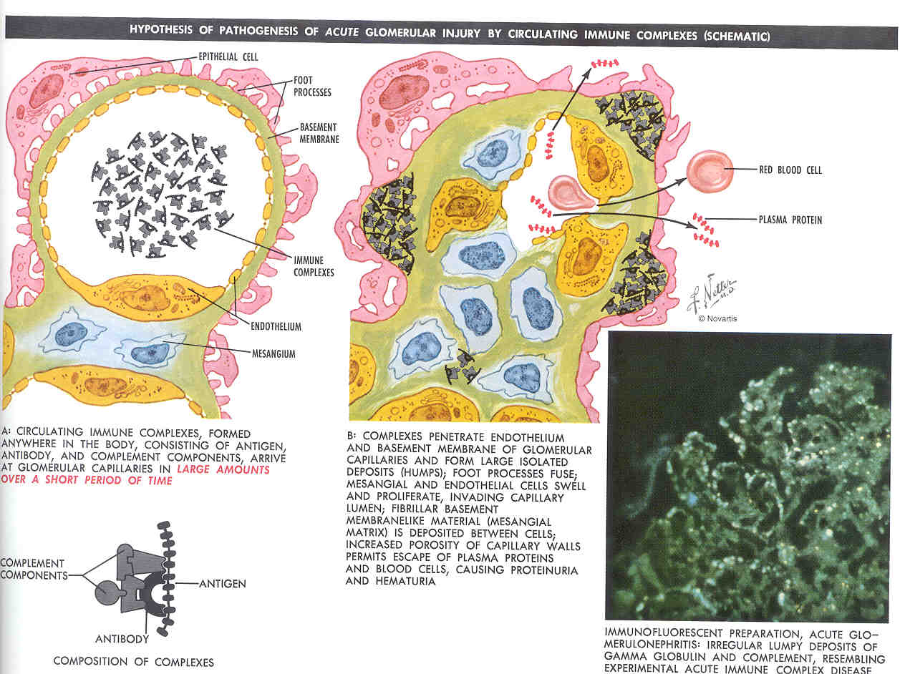

Slide 4
Proteinuria
Marker of renal disease.
Urinary protein excretion in adults < 150 mg/day albumin < 30mg/day
Isolated proteinuria defined as proteinuria without hematuria or an elevated serum creatinine.
Isolated proteinuria, asymptomatic detected incidentally by use of a dipstick

Slide 5
Other spectrum
Heavy proteinuria (>3 g/day)
Lipiduria
Edema
Active urine sediment containing red cells (which are often dysmorphic)
Red cell casts

Slide 6
Proteinuria
Occurrence in a single urine is relatively common
Routine urinalysis recommended for high risk patients, like diabetes or hypertension
Early detection and treatment with ACE I or ARB slows the progression
JAMA 2003; 290: 3101

Slide 7
Types of Proteinuria
Three main mechanism:
Glomerular
(increase filtration)
Tubular
(increase excretion- decrease Reabsorption)
Overflow
(marked overproduction of a particular protein)

Slide 8
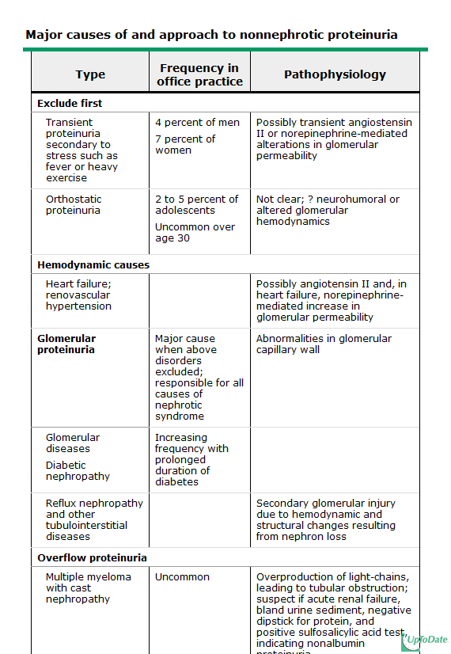

Slide 9
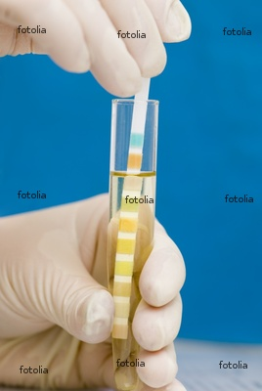
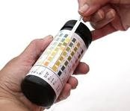
Measurement of urinary protein
Urine dipstick
Negative
Trace 15-30mg/dl
1+ 30-100 mg/dl
2+ 300mg/dl
3+ 300-1000mg/dl
4+ >1000mg/dl

Slide 10
Sulphosalicylic acid (SSA) test
Positive SSA test with a negative dipstick
indicates presence of nonalbumin proteins
Performed by mixing 1 part of urine with
3 parts 3% SSA , and grading the turbidity
False positive results occur with use of
iodinated radio contrast agents
Dipstick and SSA test detect urinary lysozyme,
increased in acute Monocytic leukemia.

Slide 11
Measurement of quantitative protein excretion
Important to quantify daily protein excretion
Benign forms of isolated proteinuria excrete <1 to 2 g/day.
Prognosis of the primary Glomerular disease
To monitor the response to therapy

Slide 12
Measurement of quantitative protein excretion
24-hour urine measurement Cumbersome
Total protein-to-creatinine ratio (mg/mg).
Correlates with daily protein excretion in terms of g per 1.73m2 of BSA
Easier and closely correlates with a wide range of proteinuria
Valuable for serial monitoring of proteinuria

Slide 13
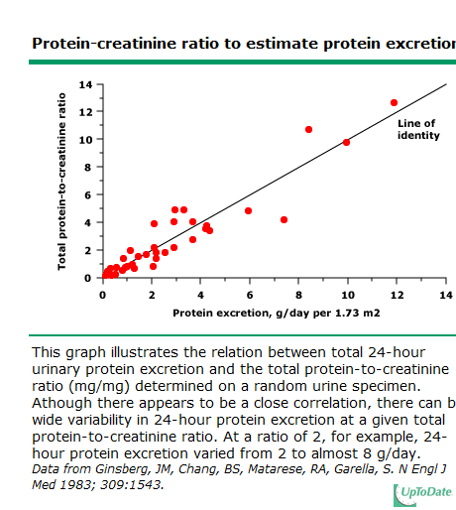

Slide 14
Microalbuminuria
Urine dipstick is highly specific, positive only when protein excretion > 300-500 mg/day
Insensitive to detect microalbuminuria, earliest manifestation of diabetic nephropathy
Microalbuminuria is defined as persistent albumin excretion between 30 and 300 mg/day (20 to 200 µg/min).

Slide 15
Approach to Proteinuria
A careful medical history for cause of proteinuria
Examination of the urine for Hematuria , Red cell casts, or Lipiduria
Unremarkable sediment, suggestive of transient proteinuria
Urine dipstick should be repeated on at least one other visit.
If subsequent tests are negative, the likely diagnosis is transient proteinuria.

Slide 16
Rule out Transient proteinuria
Transient proteinuria common, occurring in 4 % of men and 7 % of women on a single examination, with spontaneous resolution
Fever and exercise
Mediated by angiotensin II / norepinephrine-induced alterations in glomerular permeability, and urinary tract infection
Excretion of both albumin and low molecular weight proteins is increased,
No further evaluation should be reassured do not have kidney disease.

Slide 17
Orthostatic proteinuria
Split urine collection obtained if patient < 30 years age documented proteinuria on more than one occasion.
Common in adolescents 2 to 5 %, uncommon over the age of 30.
Increased protein excretion in the upright position, but normal in supine.
Related to neurohumoral activation and altered glomerular hemodynamics
Total protein excretion is generally less than 1 g/day
Benign condition requiring no further evaluation or specific therapy

Slide 18
Rule out orthostatic proteinuria
The first morning void is discarded.
A 16-hour upright collection is obtained between 7 AM and 11 PM, finishing the collection by voiding just before 11 PM.
Assume the recumbent position 2 hours before the daytime collection is finished to avoid contamination of the supine collection
A separate overnight 8 hour collection is obtained between 11 PM and 7 AM.

Slide 19
Persistent Proteinuria
Warrants a thorough evaluation
Measurement of serum creatinine and an ultrasound examination
Nephrologist referral regarding further management.
Renal biopsy indicated in nephrotic syndrome, increasing protein excretion, or an elevation in the plasma creatinine concentration.
The renal prognosis relates to the quantity of protein excreted.
Non-nephrotic proteinuria (less than 3 g/day) associated with a much lower risk of progressive chronic kidney disease

Slide 20
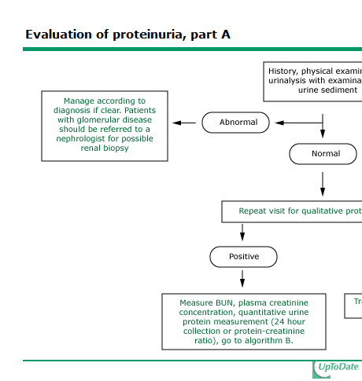

Slide 21
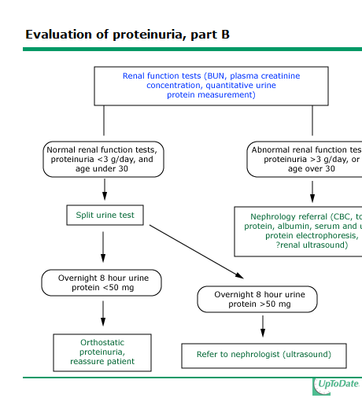

Slide 22
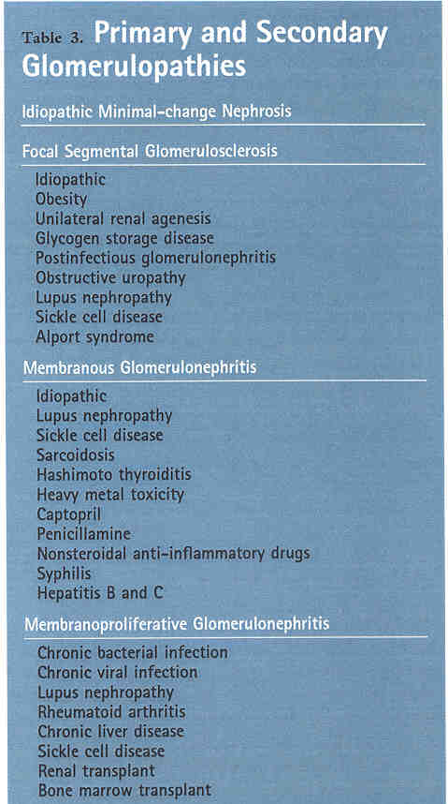

Slide 23
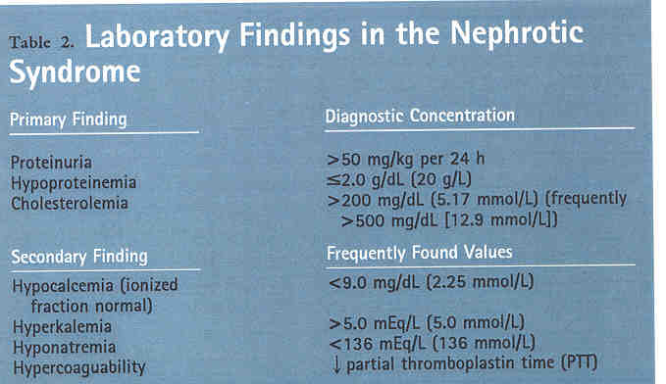

Slide 24
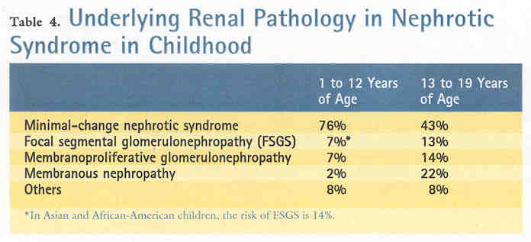

Slide 26
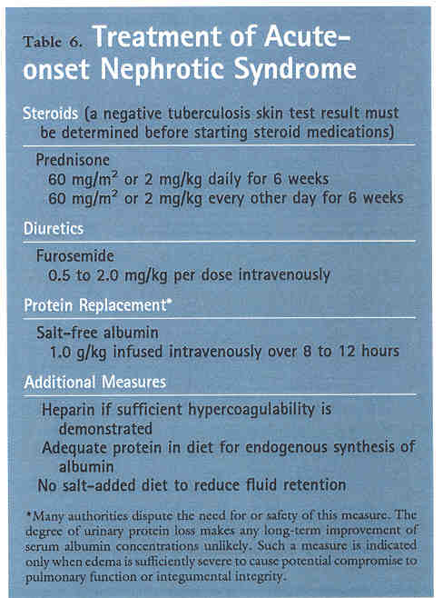

Slide 27
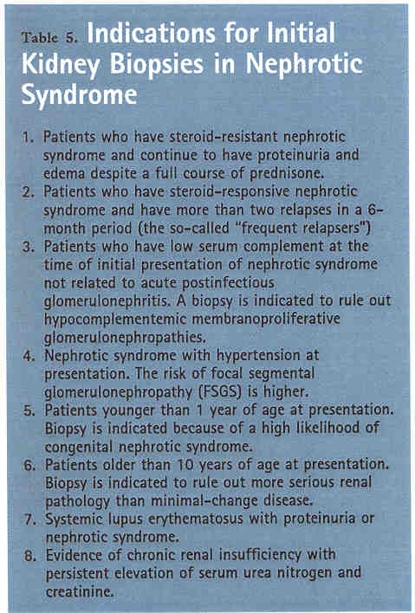

Slide 28
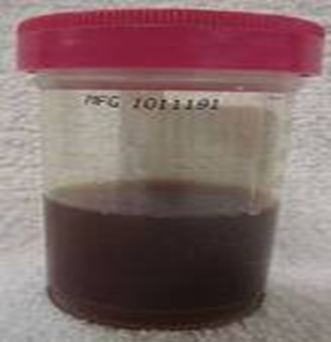
Hematuria

Slide 29
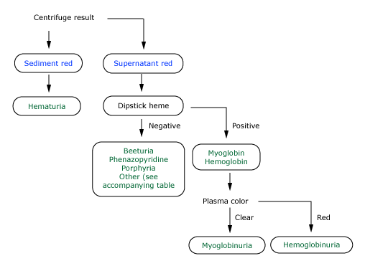
Approach to the patient with red or brown urine
Approach to patients with RED Urine

Slide 30
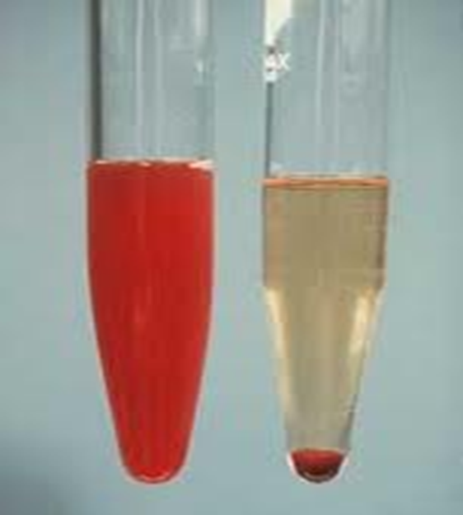
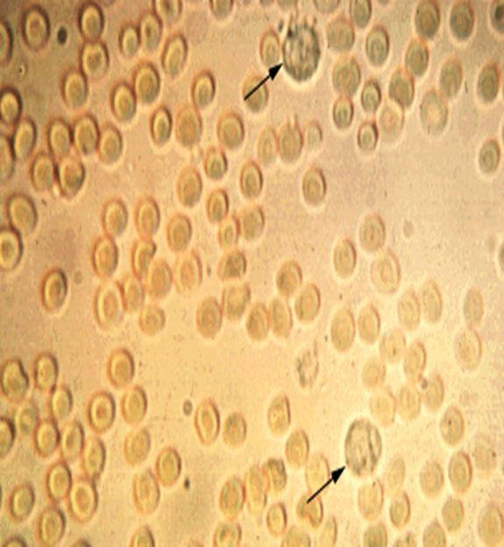
Hematuria

Slide 31
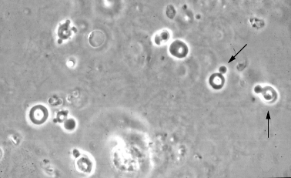
Phase contrast microscopy showing dysmorphic red cells in a patient with Glomerular bleeding. Acanthocytes can be recognized as ring forms with vesicle-shaped protrusions

Slide 32
Definition
Hematuria is defined by the presence of an abnormal quantity of red blood cells in the urine
Macroscopic: grossly visible
Microscopic: only upon urinalysis
>5-10 RBC’s per high power field

Slide 33
Gross hematuria
A large number of benign and serious conditions can cause hematuria in children.

Slide 34
Microscopic hematuria
Glomerulopathies
Hypercalciuria
Microlithiasis
UTI

Slide 35
Presentation
1-Onset of gross hematuria
2-Onset of urinary or other symptoms with incidental finding
3-Incidental finding during a health evaluation

Slide 36
Historical clues
The color of the urine
Glomerulonephritis may be brown and/or frothy urine,
Bleeding is suggested by the presence of blood clots, or pink or clearly red urine

Slide 37
The timing of the hematuria
Initial (urethral bleeding)
Terminal (bladder)
Throughout (no localizing value)

Slide 38
Circumstances associated
History of trauma, pain, micturating symptoms
Systemic signs including fever and skin and nasopharyngeal infection
Age of onset
Periodicity
Exposure to medications
Relation with exercise
Flank pain (loin pain hematuria syndrome)

Slide 39
Physical examination
Blood Pressure measurement
Assessment for edema or weight gain
Close skin examination
Direct visualization of the genitals
Abdominal mass or discomfort

Slide 40
Laboratory evaluation
Urinalysis, Urine culture, and urinary excretion studies
Glomerular bleeding evaluation
(24-hour urinary protein excretion/creatinine ratio, excretion of casts, protein excretion, blood clots, urinary Ph
Serum urea electrolytes, renal functions calcium,

Slide 41
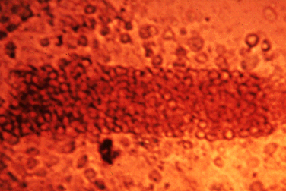
Urine sediment showing free red cells and a red cell cast that is tightly packed with red cells.

Slide 42
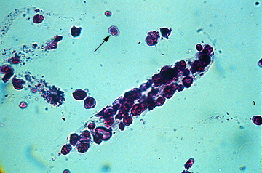
Epithelial cell cast with free epithelial cells (arrow) in the urine sediment. Renal tubular epithelial cells are larger than white cell and have a single, large central nucleus

Slide 43
Extrarrenal causes
Usually gross hematuria, no proteinuria, and RBC’s that are suggestive of nonglomerular origin.
Anatomical abnormalities-Polycystic kidney
Coagulation/hematology
Drugs / Exercise / Trauma
Hypercalciuria-hyperuricosuria-urolithiasis
-Nephrolithiasis
-Bladder and kidney infection
-Adenovirus
-Kidney / Bladder and ureteral tumors
-Urethral irritation

Slide 44
Hematuria
-Obstructive uropathy
-Post-traumatic kidney
-Onset of menarche
-Exposure to cyclophosphamide
-Thrombogenic condition
-Sickle cell trait
-Vascular bleeding
-”Nutcracker syndrome”
-Left renal vein entrapment
(Also orthostatic proteinuria)
-Loin pain hematuria syndrome
-Urethrovesical bleeding

Slide 45
Renal Causes (Glomerular causes)
Most patients also have proteinuria, red cell casts, and/or renal insufficiency. The clinical context is also suggestive.
-Postinfectious glomerulonephritis
-Henoch-Schonlein purpura
(tetrad: rash, arthralgias, abdominal pain and renal disease)
-IgA nephropathy persistent
-Alport Syndrome hematuria
-Thin base membrane disease (heterozygote carrier)
Systemic diseases
Lupus
Shunt nephritis
Hemolytic-uremic syndrome
Unexplained hematuria
-Factitious hematuria

Slide 46
Imaging studies
USG of the kidney and bladder, plain abdominal film
CT Urography
IVP
Cystoscopy

Slide 47
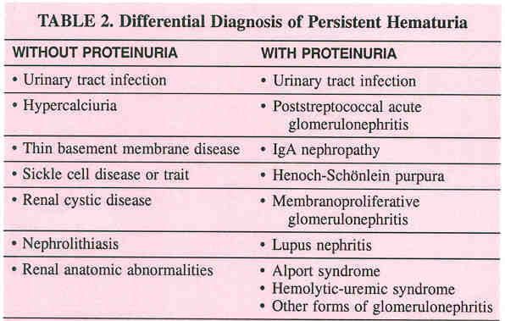

Slide 48
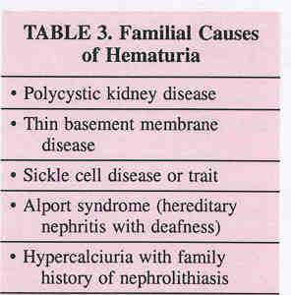

Slide 49
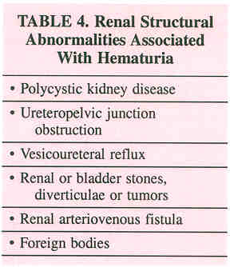

Slide 50
Clinical Syndromes of Hematuria
Post streptococcal glomerulonephritis
The most common type in children results through immunologic process, from A Beta-hemolytic streptococcus. Immunoglobulin A nephropathy
Most common variety of primary glomerulonephritis.
Usually negative family history.
Mesangial IgA deposition is the most prominent finding on renal biopsy.

Slide 51
Hereditary Nephritis
Alport Syndrome
Its classically X-linked form, suggested by hematuria in a male.
Positive family history of hematuria, deafness, and renal failure.
Abnormal collagen IV composition.
Thin base membrane disease
Also called benign familial hematuria,
Autosomal dominant /autosomal recessive Alport syndrome.

Slide 52
Treatment
General management
Salt and water restriction.
Specific treatment
Depends of the etiology or severity of the disorder.

