Slide 6
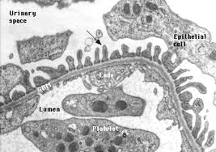
Normal glomerulus

Slide 7
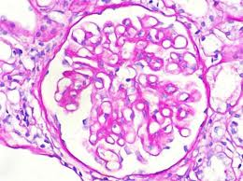
Minimal change disease

Slide 8
Focal segmental glomeruloscelerosis

Slide 9
Membranous glomerulopathy

Slide 10
Diabetic glomerulopathy

Slide 11
Nephritic syndrome
Inflammatory rupture of glomerular capillaries
Bleeding into urinary space
Oliguria
Azotemia
Hypertension
Hematuria with red cell casts
Proteinuria and edema may be present but are usually mild

Slide 12
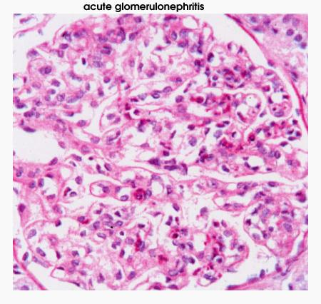

Slide 13
Crescentic acute glomerulonephritis

Slide 14
Lupus glomerulonephritis

Slide 16
Work up of glomerular disease

