Slide 1
Bronchiectasis
Dr Abdalla Elfateh Ibrahim
Consultant and assistant Professor
Of Pulmonary Medicine

Slide 2
Bronchiectasis
Bronchiectasis is an uncommon disease that results in the abnormal and permanent dilated, inflamed, and easily collapsible, resulting in airflow obstruction of one or more of the conducting bronchi or airways, most often secondary to an infectious process

Slide 3
Congenital
Acquired ( most often) occur in adults and older children
An infectious insult, impairment of drainage, airway obstruction,
And/or a defect in host defense

Slide 4
(1) Focal
Involving a lobe, segment, or subsegment of the lung
the most common
(2) Diffuse
Involving both lungs.
Most often associated with systemic illnesses, such as
-Cystic fibrosis (CF),
-Sinopulmonary disease,
(Cystic fibrosis or non-CF related bronchiectasis.)

Slide 5
Pathophysiology
Host response *Neutrophilic proteases
to infection *Inflammatory cytokines
*Nitric oxide
*O2 radicals
-Damage to the muscular and elastic components of the bronchial wall
-Diffuse peribronchial fibrosis
Impaired clearance of secretions

Slide 6
Causes
Cystic fibrosis
Lethal inherited disease in whites
Caused by defects in the gene for cystic fibrosis transmembrane conductance regulator (CFTR)
Viscid secretions in the respiratory tract, pancreas, GIT, liver, sweat glands, and other exocrine tissues.
Bronchiectasis associated with CF occur secondary to mucous plugging of proximal airways and chronic pulmonary infection

Slide 7
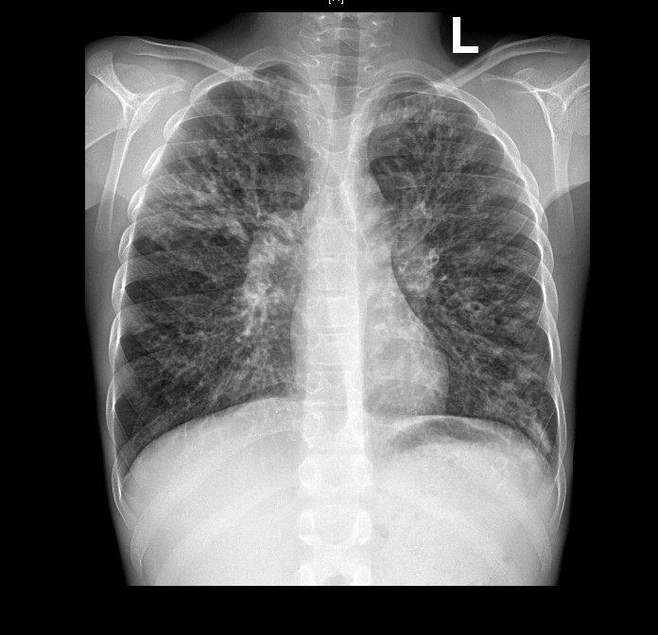

Slide 8
Causes (cont.)
Primary infections
Bronchiectasis may be the sequela of a variety of necrotizing infections that are either poorly treated or not treated at all
Typical organisms
Klebsiella species
Staphylococcus aureus
Mycobacterium TB
Mycoplasma pneumoniae
Measles virus, pertussis virus.

Slide 9
Organisms colonization may result in ongoing damage and episodic infectious exacerbations.
The organisms found most typically include Haemophilus species and Pseudomonas
Bronchial obstruction and Aspiration
Tumours ,bronchial stenosis or F.Body

Slide 10
Primary ciliary dyskinesia
(Kartagener) situs inversus, nasal polyps or sinusitis, and bronchiectasis in the setting of immotile cilia of the respiratory tract
Allergic bronchopulmonary aspergillosis
A hypersensitivity reaction to inhaled Aspergillus antigen that is characterized by bronchospasm, bronchiectasis,
Immunodeficiency states
Congenital and acquired I D usually present in childhood rarely in adults
Autoimmune diseases and idiopathic inflammatory disorders
RA ,SLE, SJorgen's syndrome ,ankylosing spondolitis
(Traction bronchiectasis)

Slide 11
Rare causes
Congenital anatomic defects and connective-tissue disorders
Alpha1-antitrypsin (AAT) deficiency
Autosomal dominant polycystic kidney disease
Toxic gas exposure

Slide 12
Clinical feature
Multiple episodes of infections
Cough and daily production of big amount of mucopurulent sputum,
Blood-streaked hemoptysis
Dyspnea
Pleuritic chest pain
Wheezing
Fever
Weakness, and weight loss

Slide 13
Coarse crackles
Scattered wheezing Wheezing may be due to airflow obstruction from secretions,
Digital clubbing
Cyanosis and plethora are rare findings secondary to polycythemia from chronic hypoxia.
Wasting and weight loss
Cor pulmonale. (Right-sided heart failure In severe cases.)
Respiratory failure

Slide 14
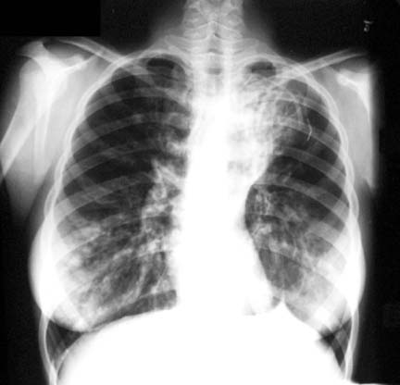
Immaging

Slide 15
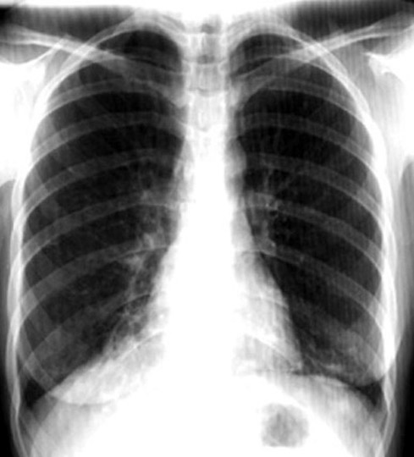

Slide 16
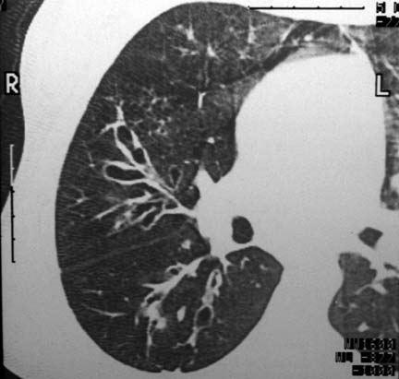

Slide 17
Laboratory Studies
A sputum analysis G stain ,AFB and c/s
CBC
Quantitative immunoglobulin levels
Quantitative AAT levels
Sweat test
Genetic analysis
Aspergillus precipitins and serum total IgE levels
Rheumatoid factor and/or other autoimmune screening tests
Pulmonary function test

Slide 18
Treatment
Antibiotic therapy
Oral, parenteral, and aerosolized antibiotics
Chest physiotherapy /Postural drainage
Bronchodilator therapy
Azithromycin

Slide 19
Surgical Care
Surgery should be reserved for patients who have focal disease that is poorly controlled by antibiotics.
Massive hemoptysis ( bronchial artery embolization.)
Foreign body or tumor removal

