Slide 1
Defuse parenchymal lung disease
Dr Abdalla Elfateh Ibrahim
Consultant and assistant Professor
Of Pulmonary Medicine

Slide 2
Definition
Defuse parenchymal lung disease (Interstitial lung disease)
Are a heterogeneous group of disorders associated with injury to the pulmonary parenchyma, leading to chronic interstitial inflammation, then to fibroblast activation and proliferation, and finally progressing to pulmonary fibrosis and tissue destruction.

Slide 3
Classification
1- Acute
2- Episodic (may present acutely )
3- Chronic due to occupational, environmental agents or drugs
4- Chronic with evidence of systemic disease
5- Chronic with no evidence of systemic disease

Slide 4
Classification (cont.)
OR
Idiopathic
Non idiopathic

Slide 5
Non idiopathic DPLD
Environmental or occupational exposures
Pneumoconiosis
( Inhalational exposures to inorganic dusts e.g. silicosis, asbestosis, berylliosis, coal worker's pneumoconiosis)
Hypersensitivity pneumonitis (HSP)
Caused by exposure to protein antigens (e.g., farmer's lung, pigeon-breeder's lung)
Fibrotic lung disease due to exposure to toxic gases, fumes, aerosols, and vapors (e.g., silo-filler's disease)
Radiation exposure

Slide 6
Connective-tissue diseases
Scleroderma (progressive systemic scleroderma) (CREST syndrome)
Rheumatoid arthritis
Mixed connective-tissue disease
Systemic lupus erythematosus
The pulmonary-renal syndromes
( Wegner or Goodpasture disease)
Predominant manifestation is vasculitis rather than fibrosis

Slide 7
Drug exposure
Cytotoxic agents
( Bleomycin, busulfan, methotrexate)
Antibiotics ( Nitrofurantoin, sulfasalazine)
Antiarrhythmics ( Amiodarone, tocainide)
Anti-inflammatory ( Gold, penicillamine)
Illicit drugs ( Crack cocaine, heroin)

Slide 8
Sarcoidosis & other granulomatous diseases
Related to other systemic illnesses
- Hepatitis C
- Inflammatory bowel disease
- Acquired immunodeficiency syndrome
Inherited
- Familial IPF or sarcoidosis
- Tuberous sclerosis
- Neurofibromatosis
- Gaucher disease

Slide 9
Idiopathic interstitial pneumonia
-Idiopathic pulmonary fibrosis (IPF)
Or
- Idiopathic interstitial pneumonia
(other than IPF)
- Desquamative interstitial pneumonia
- Acute interstitial pneumonia
- Respiratory bronchiolitis interstitial lung disease
- Non-specific interstitial pneumonia
- Cryptogenic organizing pneumonia (COP)
- Lymphocytic interstitial pneumonia

Slide 10
Idiopathic pulmonary fibrosis
(IPF) is an idiopathic interstitial pneumonia that is characterized histopathologically by the presence of usual interstitial pneumonia.
Is the most common idiopathic pulmonary fibrosis portends a poor prognosis,
Males > females aged 50 -70 years or older

Slide 11
Clinical features
Gradual onset dyspnea
Nonproductive cough
Systemic symptoms ( not common.)
Weight loss, low-grade fevers, fatigue, arthralgias, or myalgias
O/E Fine bibasilar inspiratory crackles
Digital clubbing in 25-50% of patients

Slide 12
Pathophysiology
Generalized inflammation progressed to widespread parenchymal fibrosis.
Is an epithelial-fibroblastic disease,
Unknown
Endogenous or environmental stimuli disrupt the homeostasis of alveolar epithelial cells
Diffuse epithelial cell activation and aberrant epithelial cell repair

Slide 13
Activated alveolar epithelial cells
release potent fibrogenic cytokines and growth factors
tumor necrosis factor-α (TNF-α), transforming growth factor-β(TGF-β) platelet-derived growth factor, insulin like growth factor-1
and endothelin-1 (ET-1)
migration and proliferation of fibroblasts and the transformation of fibroblasts into myofibroblasts
fibrogenesis, and myofibroblasts secrete extracellular matrix proteins.
(myofibroblasts must undergo apoptosis)
Failure of apoptosis leads to myofibroblast accumulation
Exaggerated extracellular matrix protein production
- persistent tissue contraction, and pathologic scar formation.

Slide 14
WORK UP
History (job, smoking ,hobbies , pets & drugs
Clinical exam.
Investigations
CXR
Full blood count ,CRP and ESR and U&Es
Liver function
ANA and rheumatoid factor
Autoantibodies , Serum precipitins
ANCA/anti- GBM
ACE
Lung function tests (VC/TLCO) ,6 MWD
ECG/echocardiography

Slide 15
Investigations (cont.)
HRCT
Bronchoscopy to do ;transbronchial biopsy
Broncho alveolar lavage (BAL)
Video-assisted thoracoscopy/open lung biopsy

Slide 17
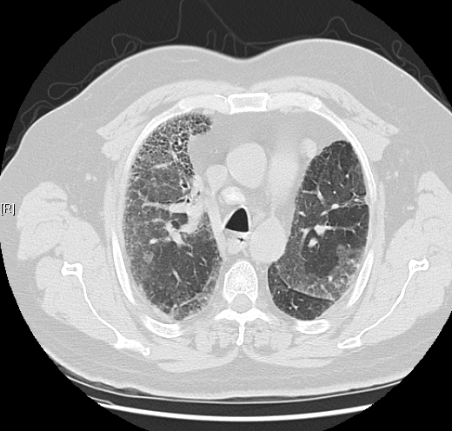

Slide 18
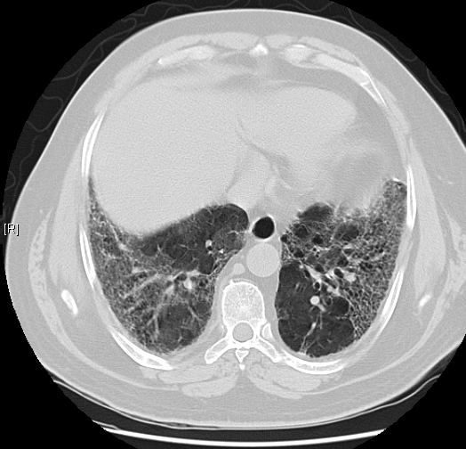

Slide 19
Treatment
Supportive measures
Supplemental oxygen therapy.
Palliation of breathlessness
‘‘untreatable’’ cough oral opiates can be used
Treat PAH
Smoking cessation.
Rehabilitation
Nutrition (BMI) of (17 and .27 kg m-2 )

Slide 20
Corticosteroids
Symptomatic improvement (50%)
Objective improvement, defined as an increase in FVC of 10% and TLCO (25%)
Steroid response is associated with better survival

Slide 21
Other immunosuppressant
Cyclophosphamide alone is not effective .
Side effects are common.
Response may take several months to become evident.
Azathioprine
Survival benefit when added prednisolone.
Side effects were not a problem

Slide 22
N-acetylcysteine (NAC)
N-acetylcysteine (NAC) is an antioxidant
Used together with corticosteroids in combination with other immunosuppressive drugs such as azathioprine
Slows the deterioration of vital capacity and single-breath diffusing capacity

Slide 23
Transplantation
When should patients be referred ?
Life threatening disease despite optimal medical treatment.
Failed trial of corticosteroid therapy
+ TLCO and/or VC below 50–60%
+ Resting hypoxia
+ Pulmonary hypertension.

Slide 24
Which patients should be referred?
60 years old
Discuses physically robust patients up to 65 years with the transplant centre

