Slide 1
the 12 lead ECG
Dr. Mustafa Kamal Memon

Slide 2
12 Lead ECG Interpretation
By the end of this lecture, you will be able to:
Understand the normal 12 lead ECG.
Perform an ECG recording.
Identify the ECG changes that occur in the presence of a heart disease.
Understand the value of ECG as a diagnostic and prognostic tool.

Slide 3
What is a 12 lead ECG?
Records the electrical activity of the heart (depolarization and repolarization of the myocardium).
Views the surfaces of the heart from 12 different angles.

Slide 4
Why do a 12 lead ECG?
Monitor patients heart rate and rhythm.
Evaluate the effects of disease or injury on heart function.
Detect presence of ischemia / infarction.
Evaluate response to medications, e.g. anti- arrhythmic.
Obtain baseline recordings before during and after surgical procedures.

Slide 5
Anatomy and Physiology Review
A good basic knowledge of the heart and cardiac function is essential in order to understand the 12 lead ECG.
Anatomical position of the heart.
Coronary Artery Circulation.
Conduction System.

Slide 6
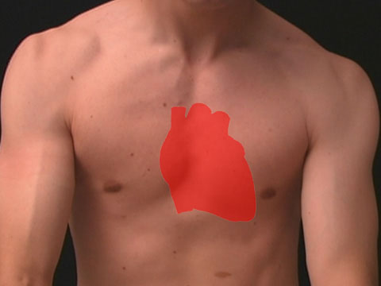
Anatomical Position of the Heart
Lies in the mediastinum behind the sternum.
between the lungs, just above the diaphragm.
the apex (tip of the left ventricle) lies at the fifth intercostal space, mid-clavicular line.

Slide 7
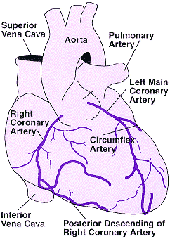
Coronary Artery Circulation

Slide 8
Coronary Artery Circulation
Right Coronary Artery
right atrium
right ventricle
inferior wall of left ventricle
posterior wall of left ventricle
1/3 interventricular septum

Slide 9
Coronary Artery Circulation Left Main Stem Artery divides in two:
Left Anterior Descending Artery
antero-lateral surface of left ventricle
2/3 interventricular septum
Circumflex Artery
left atrium
lateral surface of left ventricle

Slide 10
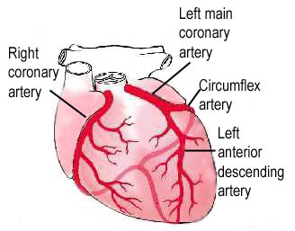
Coronary Artery Circulation

Slide 11
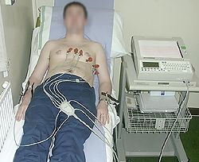
Recording an ECG
Explain procedure to patient, obtain consent and check for allergies.
Check cables are connected.
Ensure surface is clean and dry.
Ensure electrodes are in good contact with skin.
Enter patient data.
Wait until the tracing is free from artifact.
Request that patient lies still.
Push button to start tracing.

Slide 12
Basic electrocardiography
Heart beat originates in the SA node.
Impulse spreads to all parts of the atria via internodal pathways.
ATRIAL contraction occurs.
Impulse reaches the AV node where it is delayed by 0.1second.
Impulse is conducted rapidly down the Bundle of His and Purkinje Fibres.
VENTRICULAR contraction occurs.

Slide 13
ECG Waveforms
Normal cardiac axis is downward and to the left.
i.e. the wave of depolarization travels from the right atria towards the left ventricle.
when an electrical impulse travels towards a positive electrode, there will be a positive deflection on the ECG.
if the impulse travels away from the positive electrode, a negative deflection will be seen.

Slide 14
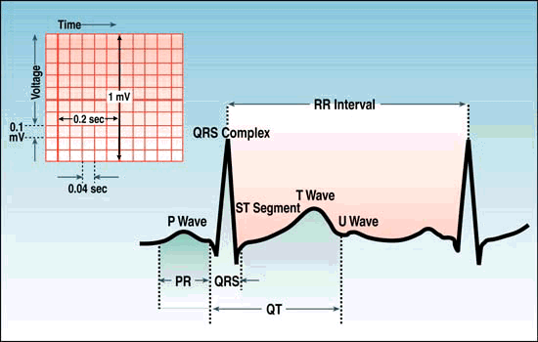
The P wave represents atrial depolarization.
The PR interval is the time from onset of atrial activation to onset of ventricular activation (Atrial depolarization + AV nodal delay).
The QRS complex represents ventricular depolarization.
The S-T segment should be iso-electric, representing the ventricles before repolarization.
The T-wave represents ventricular repolarization.

Slide 15
Think of the positive electrode as an ‘eye’… the position of the positive electrode on the body determines the area of the heart ‘seen’ by that lead.

Slide 16
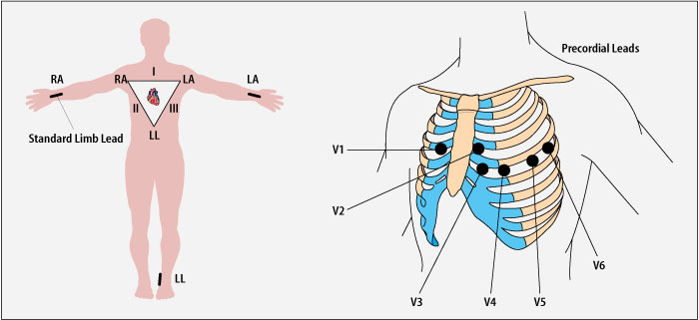
Limb leads Chest Leads

Slide 17
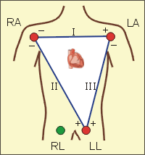
Limb Leads
3 Bipolar Leads
form (Einthovens Triangle)
Lead I - measures electrical potential
between right arm (-) and left arm (+)
Lead II - measures electrical potential
between right arm (-) and left leg (+)
Lead III - measures electrical potential
between left arm (-) and left leg (+)

Slide 18
Limb Leads
3 Unipolar leads
avR - right arm (+)
avL - left arm (+)
avF - left foot (+)
note that right foot is a ground lead

Slide 19
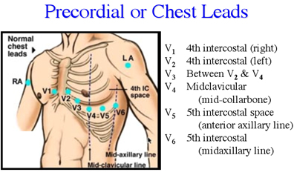
Chest Leads
6 Unipolar leads
Also known as precordial leads
V1, V2, V3, V4, V5 and V6 - all positive

Slide 20
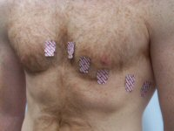

Slide 21
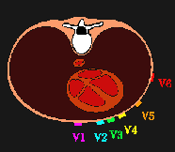
Chest Leads

Slide 22
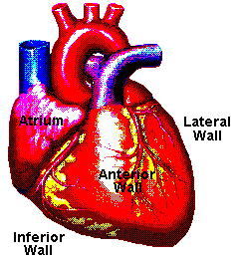
Surfaces of the Left Ventricle
Inferior - underneath
Anterior - front
Lateral - left side
Posterior - back

Slide 23
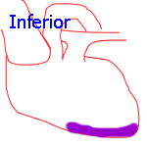
Inferior Surface
Leads II, III and avF look UP from below to the inferior surface of the left ventricle.
Mostly perfused by the Right Coronary Artery.

Slide 24
Inferior Leads
II
III
avF

Slide 25
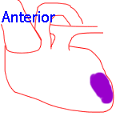
Anterior Surface
The front of the heart viewing the left ventricle and the septum.
Leads V2, V3 and V4 look towards this surface.
Mostly fed by the Left Anterior Descending branch of the Left artery.

Slide 26
Anterior Leads
V2
V3
V4

Slide 27
Lateral Surface
The left sided wall of the left ventricle.
Leads V5 and V6, lead-I and avL look at this surface.
Mostly fed by the Circumflex branch of the left artery.

Slide 28
Lateral Leads V5, V6, Lead-I, aVL

Slide 29
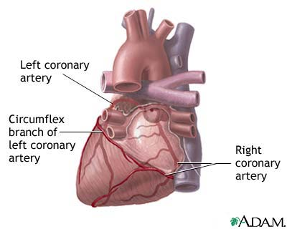
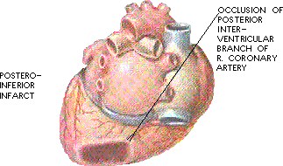
Posterior Surface
Posterior wall infarcts are rare.
Posterior diagnoses can be made by looking at the anterior leads as a mirror image. Normally there are inferior ischemic changes.
Blood supply predominantly from the Right Coronary Artery

Slide 30
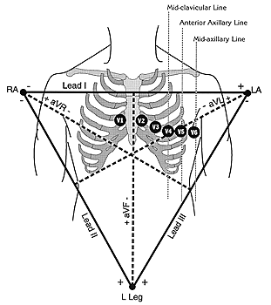
RIGHT
LEFT
Inferior II, III, AVF
Antero-Septal
V1,V2, V3,V4
Lateral I, AVL, V5, V6
Posterior V1, V2, V3

Slide 31
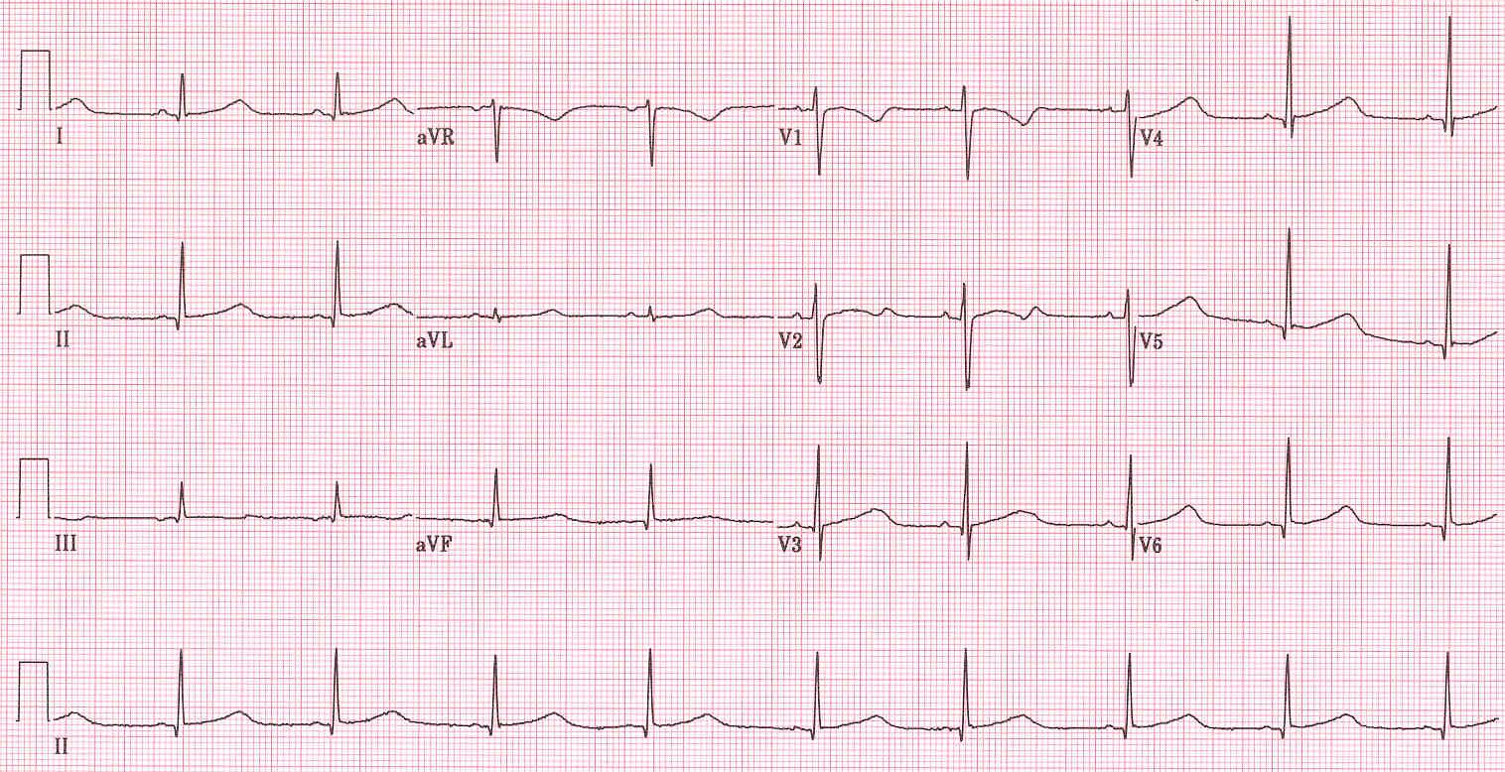
The standard 12 Lead ECG
6 Limb Leads 6 Chest Leads (Precordial leads)
avR, avL, avF, I, II, III V1, V2, V3, V4, V5 and V6
Rhythm Strip

Slide 32
INTERPRETATION OF ecg

Slide 33
What to look for in the ECG?
Heart Rate
Rhythm
Axis
P-wave abnormalities
P-R Interval
QRS complex
ST segment
T wave abnormalities
U wave
Q-T Interval

Slide 34
Heart Rate
60 – 100 --- Normal Heart rate
> 100 --- Tachycardia
< 60 --- Bradycardia
Calculated by:
1500
No. of small squares b/w R - R

Slide 35
Rhythm
Regular
Regularly Irregular
Irregularly irregular

Slide 36
Axis
Leads 1 and III or Leads I and AVF are used.
If R wave is upwards in both leads, it is normal axis.
If R wave is upwards in lead I and downwards in AVF, it is left axis deviation.
If R wave is downwards in lead I and upwards in AVF, it is right axis deviation.

Slide 37
P – wave abnormalities
Peaked tall P waves are seen in Right atrial hypertrophy.
Bifid or M-shaped P waves are seen in left atrial hypertrophy.
Absent in Junctional and ventricular Tachycardia.
Abnormal shaped in Atrial Tachycardia.
Irregular baseline (indiscernible P waves) in Atrial Fibrillation.
Very fast P waves (>250/min) without a visible baseline in Atrial Flutter.

Slide 38
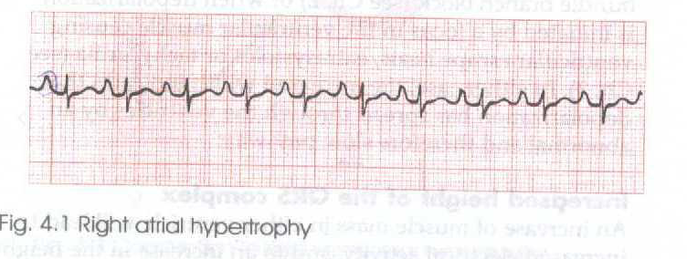
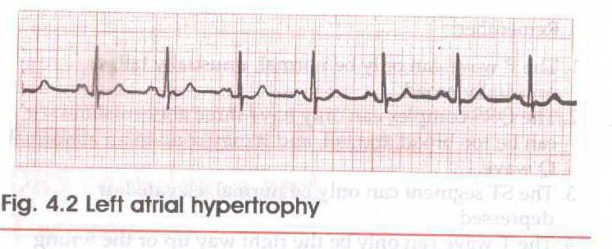

Slide 39
P-R Interval
Normal P-R Interval = 0.12 – 0.2 seconds (3 – 5 small squares).
If P-R interval prolongs, it is first degree heart block.
If P-R interval is short along with delta waves, it is Wolff-Parkinson-White syndrome.
If P-R interval gradually increases till a ventricular beat is dropped, it is second degree heart block (Mobitz type-I). Also referred to as Wenckebach’s phenomenon.

Slide 40
The QRS Complex
Normal duration up to 0.1 sec (less than 3 small squares).
Small Q waves are normal in lateral leads (I, AVL, V5 and V6 (Septal Q waves).
RSR pattern in the lead V1 with narrow QRS complexes is a normal variant.
R wave smaller than S wave in lead V1 and progresses gradually till lead V6.
R wave in lead V6 less than 25 mm (5 small sq.).
R wave in lead V6 plus S wave in lead V1 less than 35 mm (7 small squares).
If it is wide, it is either due to bundle branch block or ventricular arrhythmia.
If it is high, it shows left or right ventricular hypertrophy.

Slide 41
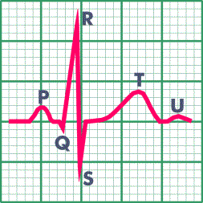
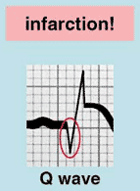
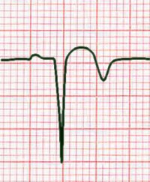
Q Waves
Non Pathological Q waves
Q waves of less than 2mm are normal.
Pathological Q waves
Q waves of more than 2mm
indicate full thickness myocardial
damage from an infarct.
Late sign of MI (evolved).

Slide 42
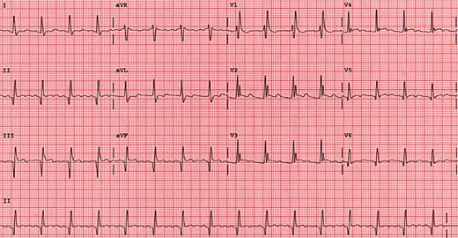
Pathological Q waves

Slide 43
ST Segment
Iso-electric in normal people.
Elevated in Acute Myocardial Infarction or Pericarditis.
Depressed in Coronary Ischemia (Angina) and Digoxin toxicity.

Slide 44
ST Segment Elevation
The ST segment lies above the isoelectric line:
Represents myocardial injury
It is the hallmark of Myocardial Infarction
The injured myocardium is slow to repolarise and remains more positively charged than the surrounding areas
Other causes to be ruled out include pericarditis and ventricular aneurysm

Slide 45
ST-Segment Elevation

Slide 46
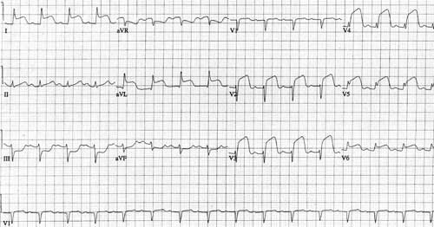

Slide 47
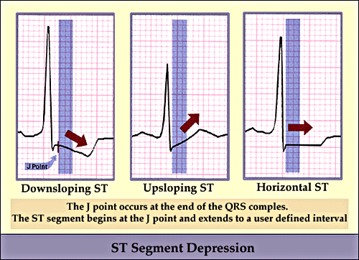
ST Segment Depression
Can be characterised as:-
Downsloping
Upsloping
Horizontal

Slide 48
Horizontal ST Segment Depression
Myocardial Ischaemia:
Stable angina - occurs on exertion, resolves with rest and/or GTN
Unstable angina - can develop during rest.
Non ST elevation MI - usually quite deep, can be associated with deep T wave inversion.
Reciprocal horizontal depression can occur during AMI.

Slide 49
Horizontal ST depression

Slide 50
ST Segment Depression
Downsloping ST segment depression:-
Can be caused by digoxin.
Upward sloping ST segment depression:-
Normal during exercise.

Slide 51
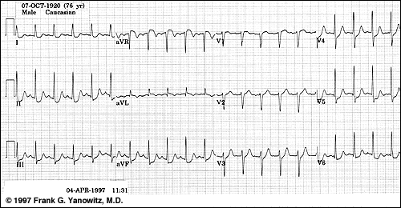

Slide 52
T waves abnormalities
The T wave represents ventricular repolarization.
Should be in the same direction as and smaller than the QRS complex.
Hyperacute T waves occur with S-T segment elevation in acute MI.
T wave inversion occurs during ischemia and shortly after an MI.

Slide 53
T waves abnormalities
Other causes of T wave inversion include:
Normal in some leads
Cardiomyopathy
Pericarditis
Bundle Branch Block (BBB)
Sub-arachnoid haemorrhage
Peaked T waves indicate hyperkalaemia

Slide 54
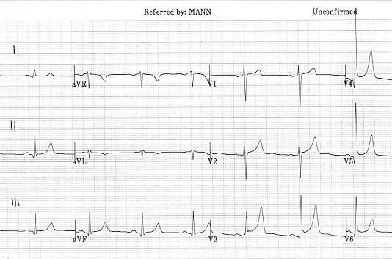
Hyperacute T waves

Slide 55
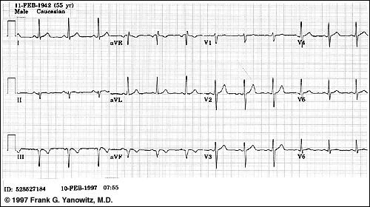
Inferior T-wave inversion

Slide 56
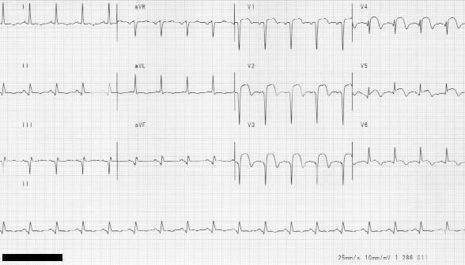
T wave inversion in an evolving MI

Slide 57
U Waves
May be normal.
Hypokalemia

Slide 58
FIRST DEGREE HEART BLOCK
P Waves are present and normal in shape and each P wave is followed by a normal QRS Complex.
P-R Interval is prolonged (more than 5 small squares or 0.2 seconds).
It is a sign of CAD, Acute rheumatic endocarditis, digoxin toxicity or electrolyte disturbances.

Slide 59
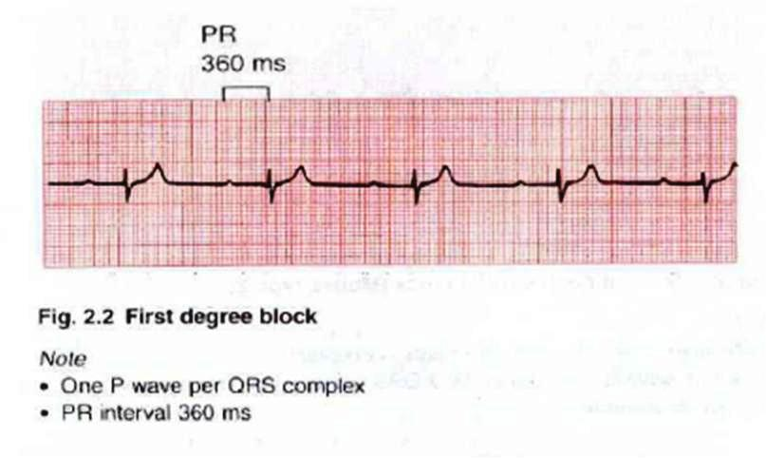

Slide 60
SECOND DEGREE HEART BLOCK
Some of the impulses generated from SA node are conducted to the ventricles while others are not. THREE VARIATIONS EXIST:
P-R interval gradually increases till a ventricular beat is dropped, it is Mobitz type I second degree block (Wenckebach’s phenomenon).
If QRS complex is dropped occasionally but time and again, it is Mobitz type II second degree block. PR interval is constant.
If 2 P-waves occur for 1 QRS complex with normal P-R interval, it is 2:1 block. If 3 P-waves occur for 1 QRS complex with normal P-R interval, it is 3:1 block. The rate of P waves is normal.
The causes are same as first degree heart block. The wenckebach phenomenon is usually benign, but other types of second degree heart block may lead to a complete heart block.

Slide 61
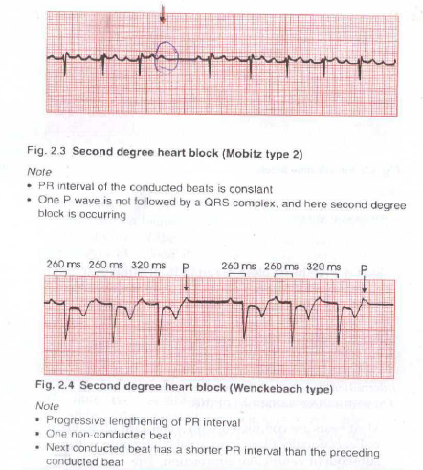

Slide 62
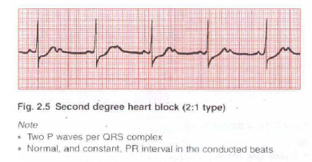

Slide 63
Complete heart block
It is also called Third degree heart block.
No impulses from SA node are conducted to the ventricles. So ventricles are excited by a depolarizing focus in the ventricular muscle. It is called Idioventricular escape rhythm.
Atrial depolarization is normal, so P waves are present and occur at the normal rate.
There is no association between P waves and QRS Complexes.
Wide QRS complexes
QRS complex rate is usually less than 50 / minute.

Slide 64
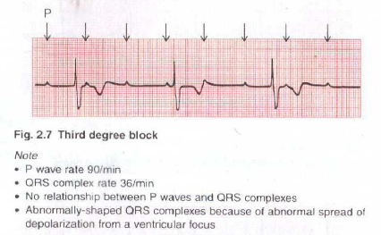

Slide 65
RIGHT BUNDLE BRANCH BLOCK
RBBB often indicates problems in the right heart.
RBBB pattern with normal QRS complexes is quite common in healthy people.
Wide QRS complexes (3 small squares or more).
RSR pattern in the lead V1.
A deep and wide S wave in the lead V6.
Inverted T waves in the lead V1 and sometimes in leads V2 and V3.

Slide 66
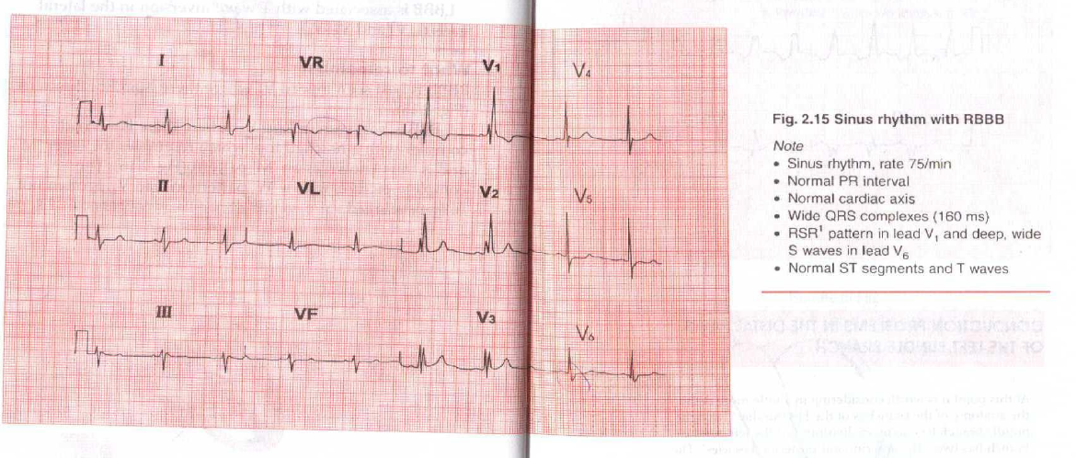

Slide 67
Left bundle branch block
LBBB is always an indication of heart disease, usually of left side.
Wide QRS complexes (3 small squares or more).
M pattern of R wave in lead V6 and sometimes in leads V4 and V5.
No septal Q waves in the lateral leads.
Inverted T waves in leads I, AVL, V5, V6 and sometimes in lead V4.

Slide 68
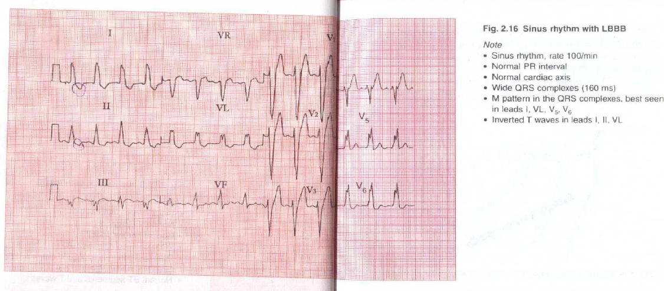

Slide 69
Bifascicular block
RBBB along with left anterior hemi-block (as good as complete heart block).
Left Axis Deviation.
Deep S waves in Leads II and III (inferior leads).
RBBB pattern.

Slide 71
Rhythm abnormalities
EXTRASYSTOLE :
Also called Premature beat.
Single early beat suppressing the next sinus beat.
May lead to Tachycardia, if they repeat.
ESCAPE BEAT :
Absence of sinus beat followed by late single beat
Their rate is slow, if they are continuous.

Slide 72
Supraventricular rhythms
IN GENERAL:
Narrow (normal) QRS Complexes
Same QRS Complexes as in Sinus Rhythm
Normal T waves
EXCEPTIONS:
SVT may have wide QRS complexes, if they occur with:
Bundle Branch Block
Wolff-Parkinson-White Syndrome

Slide 73
VENTRICULAR rHYTHMS
Wide QRS Complexes
Different QRS Complexes from sinus rhythm
Abnormal T waves

Slide 74
Common supraventricular rhythms
Sinus Rhythm
Atrial Extrasystole
Junctional (nodal) extrasystole
Atrial Tachycardia
Junctional (AV nodal) Tachycardia
Junctional escape
Atrial Flutter
Atrial Fibrillation

Slide 75
Common ventricular rhythms
Ventricular Extrasystoles
Ventricular Tachycardia
Ventricular escape (Single beats or complete heart block)
Ventricular Fibrillation

Slide 76
Sinus rhythm
One P wave per QRS complex.
Normal P-R interval.
R-R interval varies with respiration (less during inspiration and more during expiration).

Slide 77
Supraventricular extrasystoles
ATRIAL EXTRASYSTOLE:
Abnormal P wave.
Narrow but early QRS complex.
QRS complex same as in Sinus Rhythm.
Normal T wave.
Next P wave is late.
JUNCTIONAL EXTRASYSTOLE :
No P wave.
Narrow but early QRS complex.
QRS complex same as in Sinus Rhythm.
Normal T wave.
Next P wave is late.

Slide 78
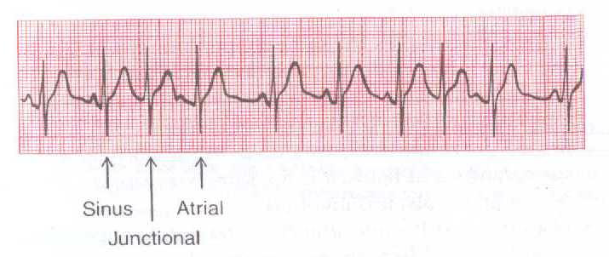
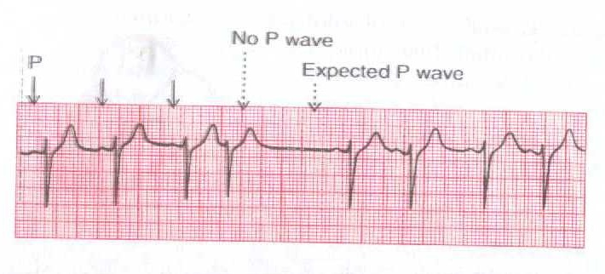

Slide 79
Ventricular extrasystoles
No P wave
Early QRS complex
Wide QRS complex
QRS complex not same as Sinus rhythm
Abnormal T wave
Next P wave is on time.

Slide 80
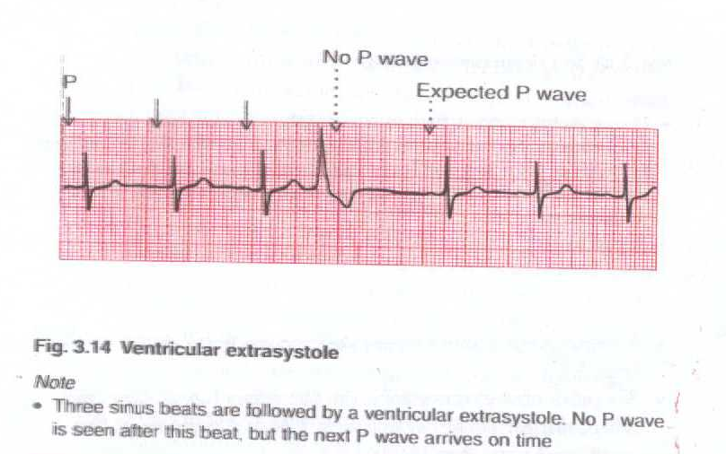

Slide 81
Atrial tachycardia
Abnormal P waves, usually with short P-R intervals.
QRS complex rate greater than 150 / minute.
Usually one P wave per QRS complex, but if P wave rate becomes greater than 200 / minute, then 2:1 block picture is seen.

Slide 82
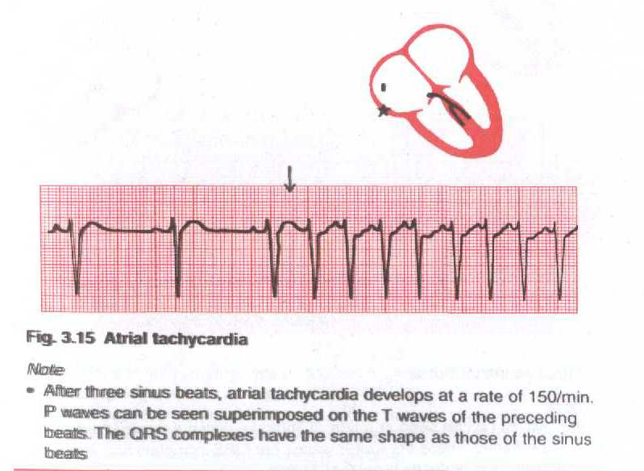

Slide 83
Junctional tachycardia
No P wave.
QRS complex rate usually 150-180 / minute.
Normal QRS complexes (same as in Sinus Rhythm).
Normal T waves.

Slide 84
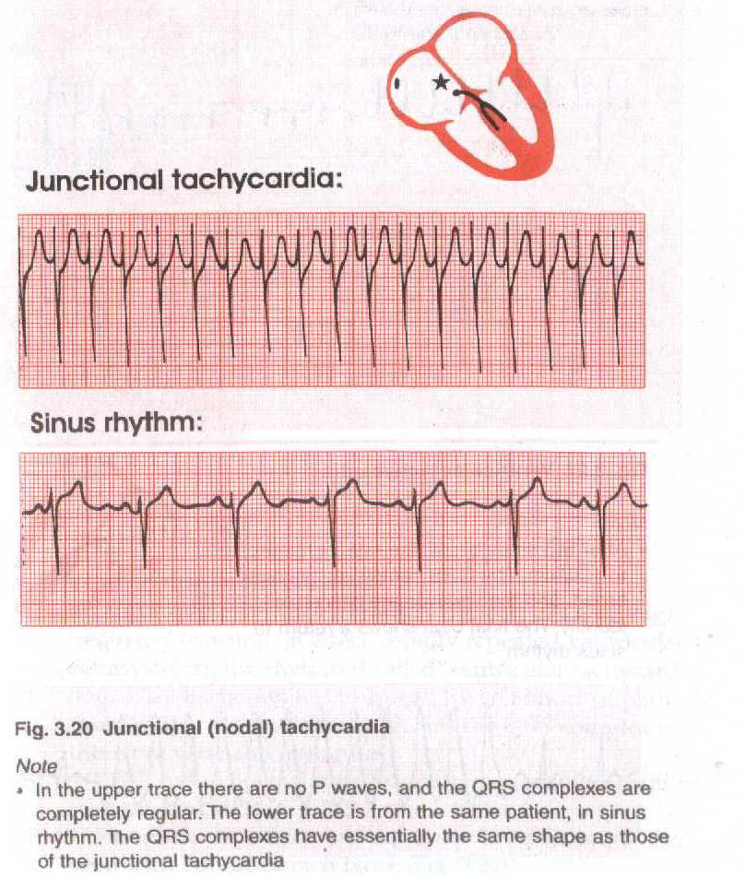

Slide 85
Ventricular tachycardia
No P wave
Broad QRS complexes
Unidentifiable T waves
QRS complex rate greater than 150 / minute.

Slide 86
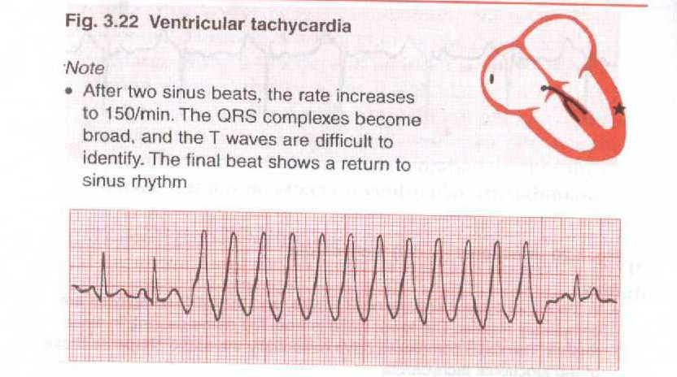

Slide 87
Atrial flutter
P wave rate is >250 / minute.
No flat line between P waves
Saw-toothed pattern
If QRS rate is normal , gives an appearance of 4:1 or 3:1 block.
If QRS rate is high, gives an appearance of 2:1 block.

Slide 88
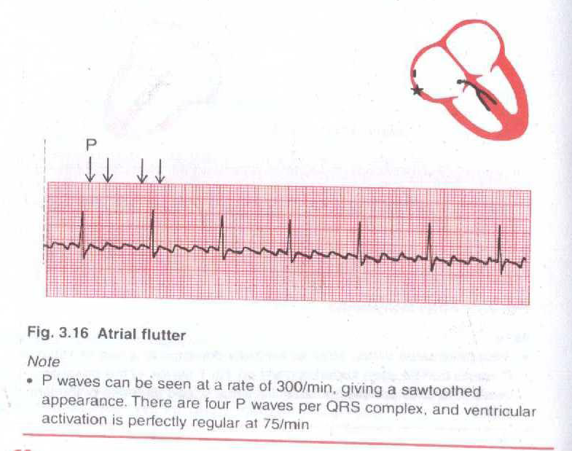

Slide 89
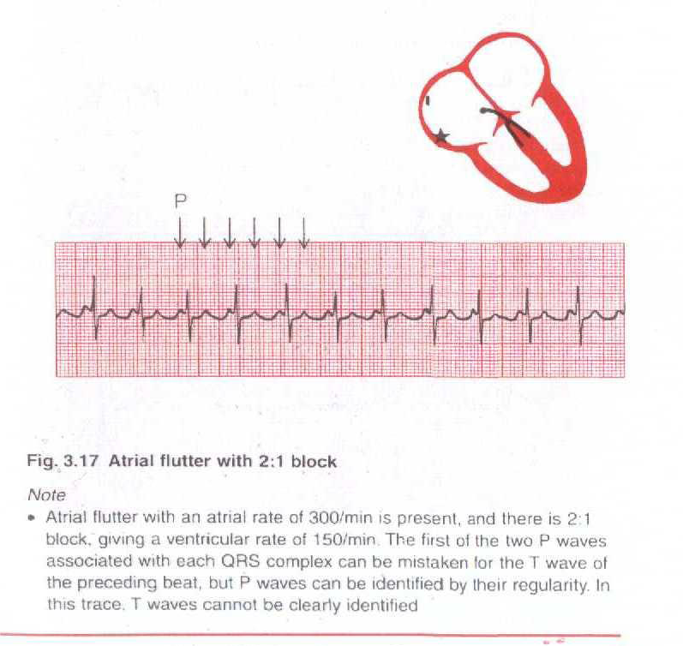

Slide 90
Atrial fibrillation
No identifiable P waves, only an irregular baseline.
Irregular, but normal shaped QRS complexes.
QRS rate varying between 80 and 180 / minute.
Normal T waves.
In lead V1, the pattern may be similar to atrial flutter; a common observation in AF.

Slide 91
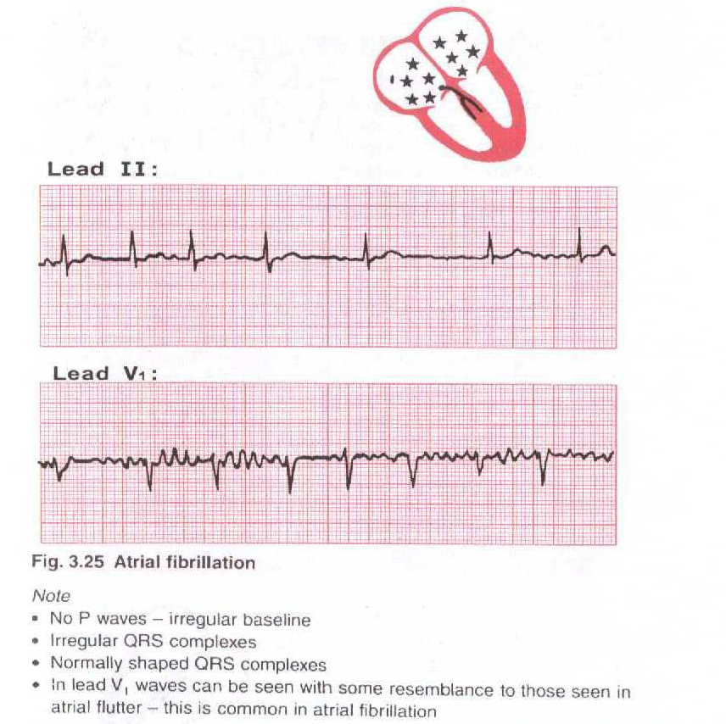

Slide 92
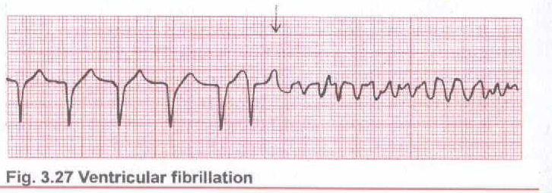
Ventricular fibrillation
No QRS complex can be identified and the ECG is totally disorganized.
Look at the patient, not the ECG, if you see this. The patient must be unconscious by then.

Slide 93
Wolff-parkinson-white syndrome
Sinus Rhythm
Short P-R interval
Wide QRS complex
Delta wave
Right Axis deviation

Slide 94
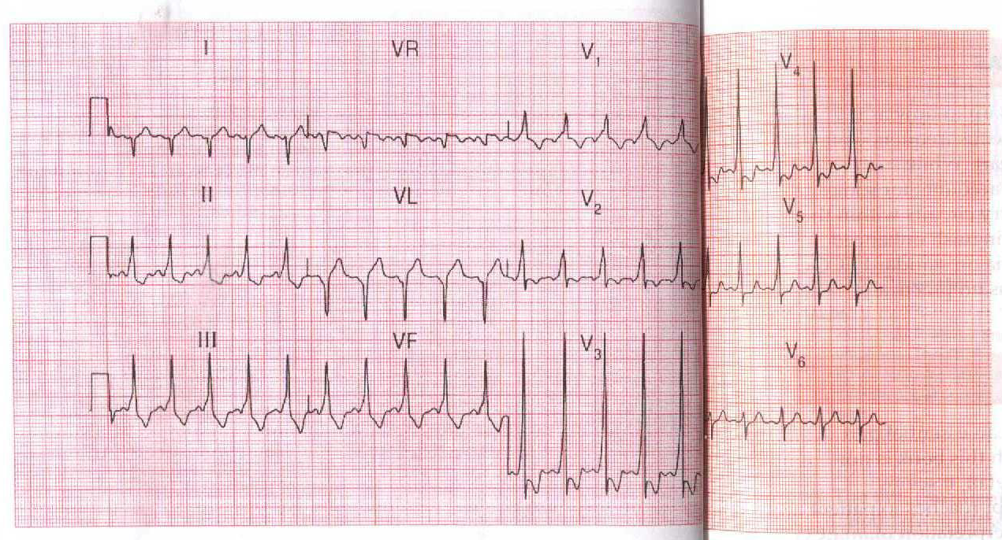

Slide 95
Left ventricular hypertrophy
May be Left axis deviation.
R waves in lead V5 or V6 greater than 25 mm.
R waves in leads V5 or V6 plus S waves in leads V1 or V2 greater than 35 mm.
Inverted T waves in leads looking at the left Ventricle (I, AVL, V5 and V6, and sometimes V4).

Slide 96
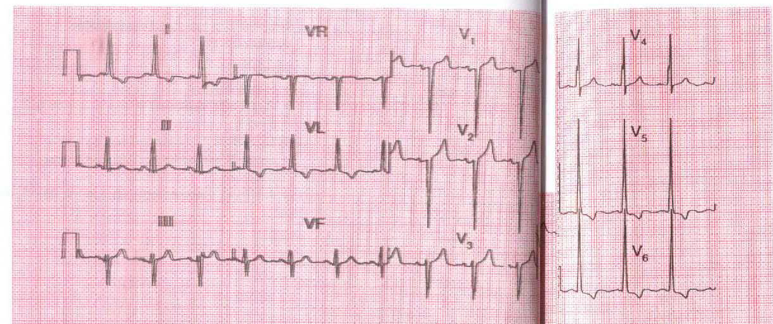

Slide 97
Right ventricular hypertrophy
Right Axis Deviation.
Tall R waves in lead V1.
Inverted T waves in leads looking at right ventricle (Leads V1, V2 and sometimes in V3 and even in V4).
Deep S waves in lead V6.

Slide 98
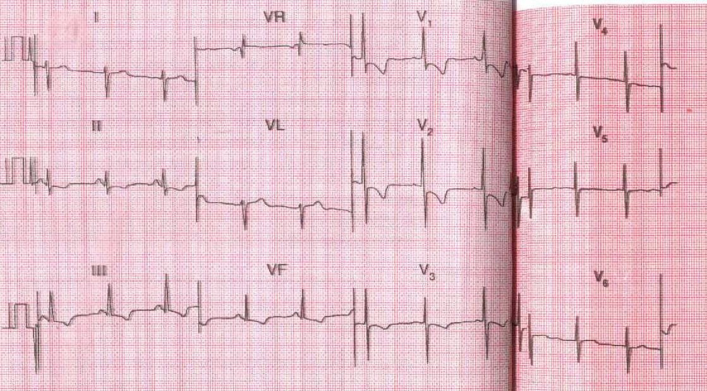

Slide 99
ECG Interpretation in Acute Coronary Syndromes

Slide 100
Ischaemic Changes
S-T segment elevation
S-T segment depression
Hyper-acute T-waves
T-wave inversion
Pathological Q-waves
Left bundle branch block

Slide 101
Myocardial Infarction
A medical emergency!!!
ST segment curves upwards in the leads looking at the threatened myocardium.
Presents within a few hours of the infarct.
Reciprocal ST depression may be present

Slide 102
The ECG in ST Elevation MI

Slide 103
The Hyper-acute Phase
Less than 12 hours
“ST segment elevation is the hallmark ECG abnormality of acute myocardial infarction” (Quinn, 1996)
The ECG changes are evidence that the ischaemic myocardium cannot completely depolarize or repolarize as normal
Usually occurs within a few hours of infarction
May vary in severity from 1mm to ‘tombstone’ elevation

Slide 105
The Fully Evolved Phase
24 - 48 hours from the onset of a myocardial infarction
ST segment elevation is less (coming back to baseline).
T waves are inverting.
Pathological Q waves are developing (>2mm)

Slide 106
The Chronic Stabilised Phase
Isoelectric ST segments
T waves upright.
Pathological Q waves.
May take months or weeks.

Slide 108
Reciprocal Changes

Slide 109
Reciprocal Changes
Changes occurring on the opposite side of the myocardium that is infarcting

Slide 110
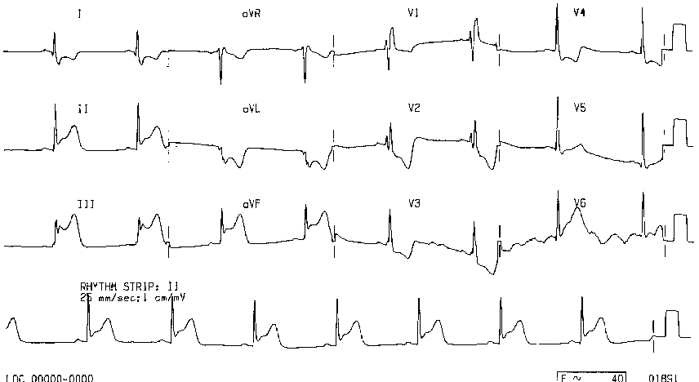
Reciprocal Changes

Slide 111
The ECG in Non ST Elevation MI

Slide 112
Non ST Elevation MI
Commonly ST depression and deep T wave inversion
History of chest pain typical of MI
Other autonomic nervous symptoms present
Biochemistry results required to diagnose MI
Q-waves may or may not form on the ECG

Slide 113
Changes in NSTEMI

Slide 114
The ECG in Unstable Angina
Ischaemic changes will be detected on the ECG during pain which can OCCUR AT REST
ST depression and/or T wave inversion
Patients should be managed on a coronary care unit
May go on to develop ST elevation

Slide 115
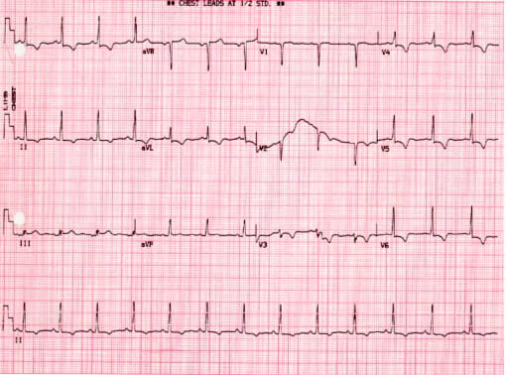
Unstable Angina ECG during pain

Slide 116
Quick Quiz How well have you listened?

Slide 117
Quick Quiz
Mr Jones is diagnosed as having had an anterior MI. On which leads would you expect to see the main changes?
(a) II, III and avL.
(b) I and avL.
(c) V2 - V4.

Slide 118
Quick Quiz
The Right Coronary Artery mainly supplies:
(a) The inferior surface of the heart?
(b) The anterior surface of the left ventricle?
(c) The lateral surface of the heart?

Slide 119
Quick Quiz
Mr Jackson has ECG changes suggestive of an MI on leads II, III and avF. Which surface of his heart is affected?
(a) The anterior surface.
(b) The lateral surface.
(c) The inferior surface.

Slide 120
Quick Quiz
The Circumflex artery mainly supplies:
(a) The right ventricle?
(b) The lateral surface of the heart?
(c) The ventricular septum?

Slide 121
Quick Quiz
The Left Anterior Descending Artery mainly
supplies:
(a) The right ventricle?
(b) The anterior and septal surfaces of the left ventricle?
(c) The right atrium?

Slide 122
Quick Quiz
Mrs Brown requires PTCA to her Circumflex artery after complaining of unstable angina symptoms. Her 12 lead ECG shows ST depression and T wave inversion in what leads?
(a) I, avL, V5 and V6
(b) II, III and avL
(c) V3 and V4

Slide 123
A 55 year old man with 4 hours of “crushing” chest pain.
Acute inferior myocardial infarction (with reciprocal changes)
ST elevation in the inferior leads II, III and aVF
reciprocal ST depression in the anterior leads

Slide 124
A 63 Year Old woman with 10 hours of chest pain and sweating Can you guess her diagnosis?
Acute anterior-lateral myocardial infarction
ST elevation in the anterior leads V1 - 6, I and aVL
reciprocal ST depression in the inferior leads

Slide 125
Which one is more tachycardic during this exercise test?

Slide 126
Thanks for paying attention. I hope you have found this session useful.

