Slide 1
Dyslipidemia
(Med-341)
Dr Anwar A Jammah, MD, FRCPC, FACP, CCD, ECNU.
Asst. Professor and Consultant in Medicine & Endocrinology
Department of Medicine, King Saud University

Slide 2
Objectives
Lipid physiology (story)
Common primary and secondary lipid disorders
Patient assessment (when we should request lipid profile.
Treatment and drugs used for patient with dyslipidemia
Targets we should achieved.
Clinical scenarios

Slide 3
The story of lipids
Chylomicrons transport fats from the intestinal mucosa to the liver
In the liver, the chylomicrons release triglycerides and some cholesterol and become low-density lipoproteins (LDL).
LDL then carries fat and cholesterol to the body’s cells.
High-density lipoproteins (HDL) carry fat and cholesterol back to the liver for excretion.

Slide 4
The story of lipids (cont.)
When oxidized LDL cholesterol gets high, atheroma formation in the walls of arteries occurs, which causes atherosclerosis.
Pre-HDL cholesterol is able to go and remove cholesterol from the tissue to liver.
Atherogenic cholesterol → LDL, VLDL, IDL

Slide 5
Atherogenic Particles
Apolipoprotein B
MEASUREMENTS:
Non-HDL-C
VLDL
VLDL_{R}
IDL
LDL
Small,
dense
LDL
TG-rich lipoproteins
Notes:
Atherogenic particles
Not only is LDL-C a risk factor for cardiovascular disease, but triglyceride-rich lipoproteins—very low density lipoprotein (VLDL), VLDL remnants, and intermediate-density lipoprotein (IDL)—may also increase the risk of heart disease. The NCEP ATP III uses non-HDL-C principally as a surrogate for these atherogenic particles.

Slide 6
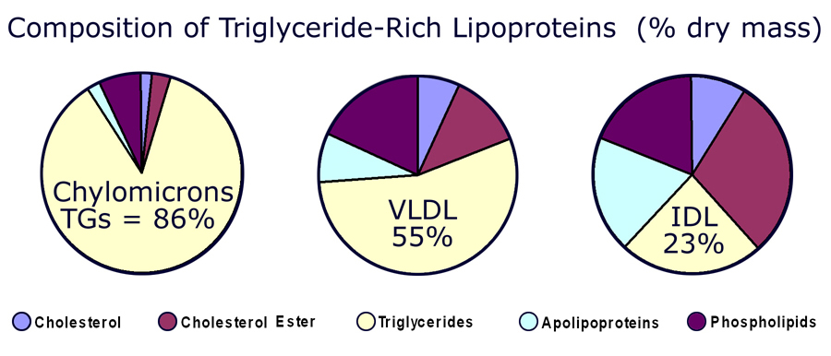

Slide 7
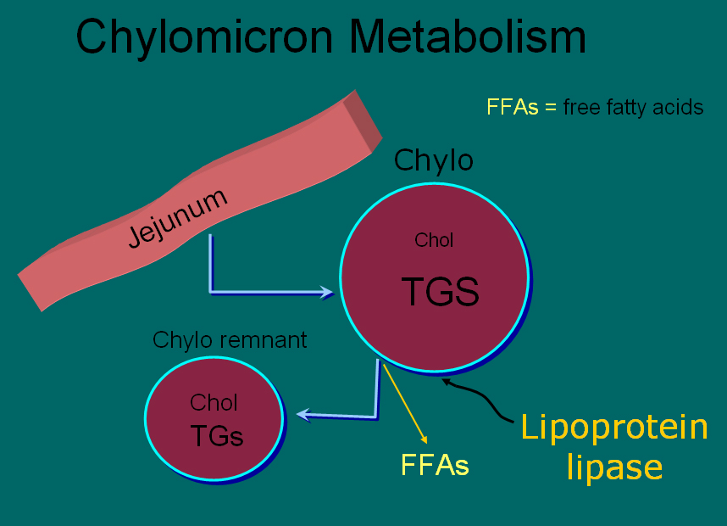

Slide 8
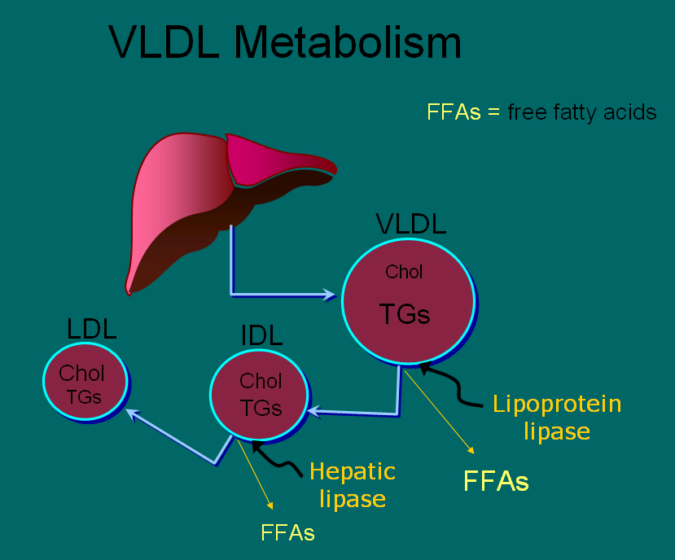

Slide 9
HDL and Reverse Cholesterol Transport
Bile
A-I
A-I
FC
CE
LCAT
CE
FC
FC
CE
FC
SR-BI
Nascent
HDL
ABCA1
Liver
Macrophage
Mature
HDL
Notes:
HDL and reverse cholesterol transport
HDL is believed to protect against atherosclerosis at least in part through the process of reverse cholesterol transport, whereby excess free cholesterol (FC) is removed from cells in peripheral tissues, such as macrophages within the arterial wall, and returned to the liver for excretion in the bile. FC is generated in part by the hydrolysis of intracellular cholesteryl ester (CE) stores. Several key molecules play a role in reverse cholesterol transport, including ATP-binding cassette protein A1 (ABCA1), lecithin:cholesterol acyltransferase (LCAT), and scavenger receptor class-B, type I (SR-BI). Promotion of this pathway could in theory help reduce atherosclerosis.

Slide 10
Plasma lipoproteins
Type | Source | Major lipid | Apoproteins | Athero-genicity
Chylomicrons | Gut | Dietary TGs | A-I, B-48, C-I, C-III, E | – (pancreatitis)
VLDL | Liver | Endogenous TGs | B-100, E, C-II, C-III, | +
IDL | VLDL remnant | Ch esters, TGs | B-100, C-III, E | +
LDL | VLDL, IDL | Ch esters | B-100 | +++
HDL | Gut, liver | Ch esters, PLs | A-I, A-II, C-II, C-III, D, E | anti- atherogenic
Notes:
Fredrickson Classification of the Hyperlipidemias
Fredrickson phenotypes may be used to classify dyslipidemias on the basis of which lipoproteins are elevated. The Fredrickson classification system is not etiologic, does not distinguish between primary and secondary hyperlipidemias, and does not include HDL.
Reference:
Fredrickson DS, Lees RS. A system for phenotyping hyperlipoproteinemia. Circulation 1965;31:321-327.

Slide 11
Fredrickson classification of hyperlipidemias
Phenotype | Lipoprotein(s) elevated | Plasma cholesterol | Plasma TGs | Athero-genicity | Rel. freq. | Treatment
I | Chylomicrons | Norm. to ↑ | ↑↑↑↑ | – pancreatitis | <1% | Diet control
IIa | LDL | ↑↑ | Norm. | +++ | 10% | Bile acid sequestrants, statins, niacin
IIb | LDL and VLDL | ↑↑ | ↑↑ | +++ | 40% | Statins, niacin, fibrates
III | IDL | ↑↑ | ↑↑↑ | +++ | <1% | Fibrates
IV | VLDL | Norm. to ↑ | ↑↑ | + | 45% | Niacin, fibrates
V | VLDL and chylomicrons | ↑ to ↑↑ | ↑↑↑↑ | + pancreatitis | 5% | Niacin, fibrates
Notes:
Fredrickson Classification of the Hyperlipidemias
Fredrickson phenotypes may be used to classify dyslipidemias on the basis of which lipoproteins are elevated. The Fredrickson classification system is not etiologic, does not distinguish between primary and secondary hyperlipidemias, and does not include HDL.
Reference:
Fredrickson DS, Lees RS. A system for phenotyping hyperlipoproteinemia. Circulation 1965;31:321-327.

Slide 12
Primary hypercholesterolemias
Disorder | Genetic defect | Inheritance | Prevalence | Clinical features
Familial hyper-cholesterolemia | LDL receptor | dominant | heteroz.:1/500 5% of MIs <60 yr homoz.: 1/1 million | premature CAD (ages 30–50) TC: 7-13 mM CAD before age 18 TC > 13 mM
Familial defective apo B-100 | apo B-100 | dominant | 1/700 | premature CAD TC: 7-13 mM
Polygenic hypercholesterolemia | multiple defects and mechanisms | variable | common 10% of MIs <60 yr | premature CAD TC: 6.5-9 mM
Familial hyper-alphalipoproteinemia | unknown | variable | rare | less CHD, longer life elevated HDL
Notes:
Fredrickson Classification of the Hyperlipidemias
Fredrickson phenotypes may be used to classify dyslipidemias on the basis of which lipoproteins are elevated. The Fredrickson classification system is not etiologic, does not distinguish between primary and secondary hyperlipidemias, and does not include HDL.
Reference:
Fredrickson DS, Lees RS. A system for phenotyping hyperlipoproteinemia. Circulation 1965;31:321-327.

Slide 13
Hereditary Causes of Hyperlipidemia
Familial Hypercholesterolemia
    Codominant genetic disorder, coccurs in heterozygous form
    Occurs in 1 in 500 individuals
    Mutation in LDL receptor, resulting in elevated levels of LDL at birth and throughout life
    High risk for atherosclerosis, tendon xanthomas (75% of patients), tuberous xanthomas and xanthelasmas of eyes.
Familial Combined Hyperlipidemia
    Autosomal dominant
    Increased secretions of VLDLs
Dysbetalipoproteinemia
    Affects 1 in 10,000
    Results in apo E2, a binding-defective form of apoE (which usually plays important role in catabolism of chylomicron and VLDL)
    Increased risk for atherosclerosis, peripheral vascular disease
    Tuberous xanthomas, striae palmaris

Slide 14
Primary hypertriglyceridemias
Disorder | Genetic defect | Inheritance | Prevalence | Clinical features
LPL deficiency | endothelial LPL | recessive | rare 1/1 million | hepatosplenomegaly abd. cramps, pancreatitis TG: > 8.5 mM
Apo C-II deficiency | Apo C-II | recessive | rare 1/1 million | abd. cramps, pancreatitis TG: > 8.5 mM
Familial hyper-triglyceridemia | unknown enhanced hepatic TG-production | dominant | 1/100 | abd. cramps, pancreatitis TG: 2.3-6 mM
Notes:
Fredrickson Classification of the Hyperlipidemias
Fredrickson phenotypes may be used to classify dyslipidemias on the basis of which lipoproteins are elevated. The Fredrickson classification system is not etiologic, does not distinguish between primary and secondary hyperlipidemias, and does not include HDL.
Reference:
Fredrickson DS, Lees RS. A system for phenotyping hyperlipoproteinemia. Circulation 1965;31:321-327.

Slide 15
Primary mixed hyperlipidemias
Disorder | Genetic defect | Inheritance | Prevalence | Clinical features
Familial dysbeta-lipoproteinemia | Apo E high VLDL, chylo. | recessive rarely dominant | 1/5000 | premature CAD TC: 6.5 -13 mM TG: 2.8 – 5.6 mM
Familial combined | unknown high Apo B-100 | dominant | 1/50 – 1/100 15% of MIs <60 yr | premature CAD TC: 6.5 -13 mM TG: 2.8 – 8.5 mM
Notes:
Fredrickson Classification of the Hyperlipidemias
Fredrickson phenotypes may be used to classify dyslipidemias on the basis of which lipoproteins are elevated. The Fredrickson classification system is not etiologic, does not distinguish between primary and secondary hyperlipidemias, and does not include HDL.
Reference:
Fredrickson DS, Lees RS. A system for phenotyping hyperlipoproteinemia. Circulation 1965;31:321-327.

Slide 16
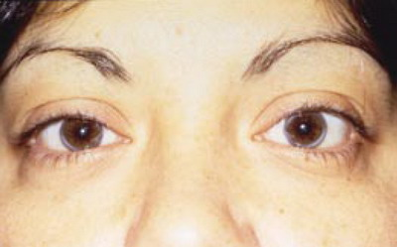
Corneal arcus (FH)

Slide 17
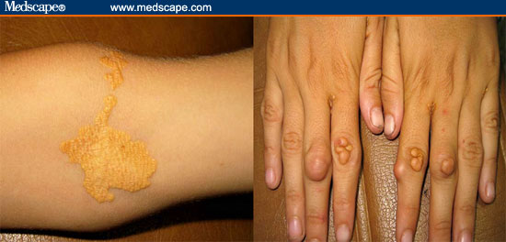
tendinous xanthomas (FH)

Slide 18
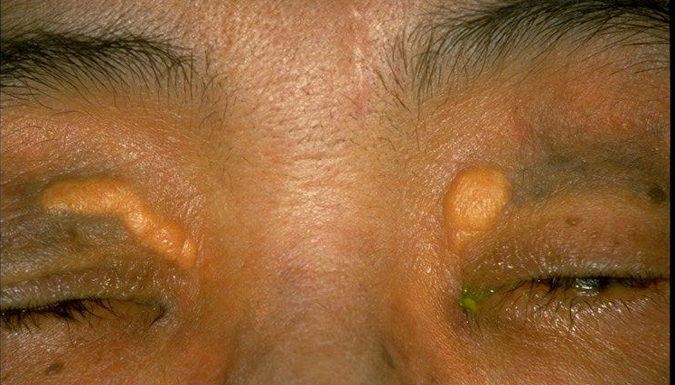
Xanthelasma (FH)

Slide 19
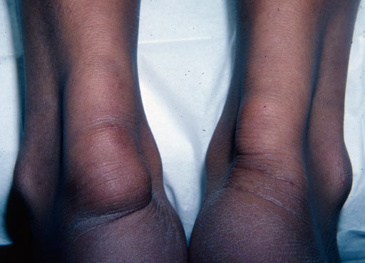
tendinous xanthomas (FH)
Achilles tendon

Slide 20
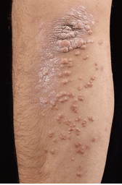
Eruptive xanthoma (hypertriglyceridemia)

Slide 21
Causes of Hyperlipidemia
Diet
Hypothyroidism
Nephrotic syndrome
Anorexia nervosa
Obstructive liver disease
Obesity
Diabetes mellitus
Pregnancy
Obstructive liver disease
Acute heaptitis
Systemic lupus erythematousus
AIDS (protease inhibitors)

Slide 22
Secondary hyperlipidemias
Disorder | VLDL | LDL | HDL | Mechanism
Diabetes mellitus | ↑ ↑ ↑ | ↑ | ↓ | VLDL production ↑, LPL ↓, altered LDL
Hypothyroidism | ↑ | ↑ ↑ ↑ | ↓ | LDL-rec.↓, LPL ↓
Obesity | ↑ ↑ | ↑ | ↓ | VLDL production ↑
Anorexia | - | ↑ ↑ | - | bile secretion ↓, LDL catab. ↓
Nephrotic sy | ↑ ↑ | ↑ ↑ ↑ | ↓ | Apo B-100 ↑ LPL ↓ LDL-rec. ↓
Uremia, dialysis | ↑ ↑ ↑ | - | ↓ | LPL ↓, HTGL ↓ (inhibitors ↑)
Pregnancy | ↑ ↑ | ↑ ↑ | ↑ | oestrogen ↑ VLDL production ↑, LPL ↓
Biliary obstruction PBC | - | - | ↓ | Lp-X ↑ ↑ no CAD; xanthomas
Alcohol | ↑ ↑ chylomicr. ↑ | - | ↑ | dep. on dose, diet, genetics
Many-many drugs | Please allways see for adverse effects before any drug presciption!!!

Slide 23
When to check lipid panel
Two different Recommendations
  Adult Treatment Panel (ATP III) of the National Cholesterol Education Program (NCEP)
      Beginning at age 20: obtain a fasting (9 to 12 hour) serum lipid profile consisting of total cholesterol, LDL, HDL and triglycerides
      Repeat testing every 5 years for acceptable values
  United States Preventative Services Task Force
      Women aged 45 years and older, and men ages 35 years and older undergo screening with a total and HDL cholesterol every 5 years.
      If total cholesterol > 200 or HDL <40, then a fasting panel should be obtained
      Cholesterol screening should begin at 20 years in patients with a history of multiple cardiovascular risk factors, diabetes, or family history of either elevated cholesteral levels or premature cardiovascular disease.

Slide 24
Checking lipids
Nonfasting lipid panel
    measures HDL and total cholesterol
Fasting lipid panel
    Measures HDL, total cholesterol and triglycerides
    LDL cholesterol is calculated:
      LDL cholesterol = total cholesterol – (HDL + triglycerides/5)

Slide 25
Treatment Targets
LDL: To prevent coronary heart disease outcomes (myocardial infarction and coronary death)
Non LDL( TC/HDL): To prevent coronary heart disease outcomes (myocardial infarction and coronary death)
Triglyceride: To prevent pancreatitis and may be coronary heart disease outcomes (myocardial infarction and coronary death)

Slide 26
LDL and Non-LDL(HDL/TC)
Risk Assessment Tool for Estimating 10-year Risk of Developing Hard CHD (Myocardial Infarction and Coronary Death)
Framingham Heart Study to estimate 10-year risk for coronary heart disease outcomes
http://hp2010.nhlbihin.net/atpiii/CALCULATOR.asp?usertype=prof
http://cvrisk.mvm.ed.ac.uk/calculator/calc.asp
http://www.mdcalc.com/framingham-cardiac-risk-score

Slide 27
Lower Cholesterol Levels Associated With Lower CHD Risk
150
The Framingham Heart Study
125
100
CHD Incidence per 1000
75
50
25
0
≤ 204
205-234
235-264
265-294
≥ 295
Serum Cholesterol (mg/100 mL)
Castelli WP. Am J Med. 1984;76:4-12.
Notes:
As of 1984, in most of northern Europe, North America, and other industrialized Caucasian societies, CHD is the number one cause of death. Cardiovascular disease is associated with increased levels of total cholesterol. Other risk factors include an increase in TC to HDL cholesterol ratio, hypertension, cigarette smoking, excess weight, elevated blood sugar levels, lack of exercise, stress, and electrocardiographic abnormalities. Intervention trials have shown that identifying and lowering these risk factors may help to reduce the subsequent rate of coronary heart disease, stroke, and other cardiovascular diseases.¹
Reference
Castelli WP. Epidemiology of coronary heart disease: The Framingham Study. Am J Med. 1984;76:4-12.

Slide 28
Adult Treatment Panel III Guidelines for Treatment of Hyperlipidemia
Risk Category | Begin Lifestyle Changes If: | Consider Drug Therapy If: | LDL Goal
High: CAD or CAD equivalents (10-yr risk > 20%) | LDL ≥ 2.58 mM | LDL ≥ 2.58 mM (drug optional if < 2.58 mM) | < 2.58 mM; < 1.8 mM optional
Moderate high: ≥ 2 risk factors with 10-yr risk 10 to 20%* | LDL ≥ 3.36 mM | LDL ≥ 3.36 mM | < 3.36 mM; < 2.58 mM optional
Moderate: ≥ 2 risk factors with 10-yr risk < 10%* | LDL ≥ 3.36 mM | LDL ≥ 4.13 mM | < 3.36 mM; < 2.58 mM optional
Lower: 0–1 risk factor | LDL ≥ 4.13 mM | LDL ≥ 4.91 mM (drug optional if 4.13–4.88 mM) | < 4.13 mM
*For 10-yr risk, see Framingham risk tables

Slide 29
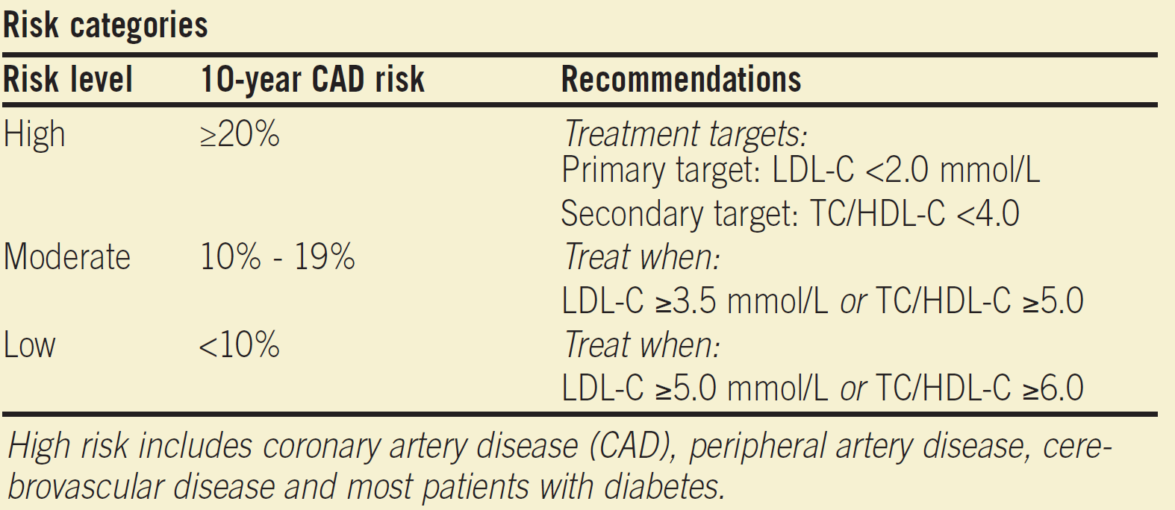
Canadian New Guideline

Slide 30
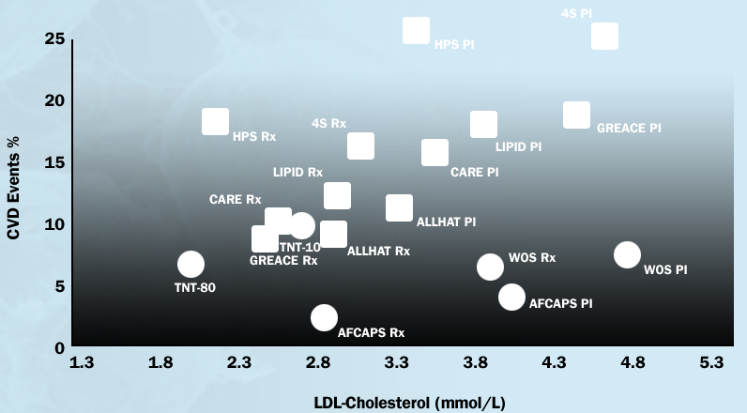
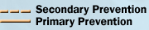
LDL-C Lowering and the associated reduction of CV outcomes
Fitchett DH, Leiter LA, et al. Can J Cardiol 2005;21:85-90
Notes:
NOTES:
Recent Canadian Cardiovascular Society position statement recommend that all high-risk patients receive medication to reduce LDL-C below 2.0 mmol/L
Reference:
Fitchett DH, Leiter LA, et al. Are Canadian guidelines for cholesterol lowering in high-risk patients optimal? Can J Cardiol 2005;21:85-90

Slide 31
Log-Linear Relationship Between LDL-C Levels and Relative Risk for CHD
This relationship is consistent with a large body of epidemiologic data available from clinical trials of LDL-C–lowering therapy.
These data suggest that for every 30-mg/dL change in LDL-C, the relative risk for CHD is changed in proportion by about 30%.
The relative risk is set at 1.0 for LDL-C = 40 mg/dL.
3.7
2.9
Relative Risk
for CHD
(Log Scale)
2.2
1.7
1.3
1.0
40
70
100
130
160
190
LDL-C, mg/dL
Reprinted with permission from Grundy SM, Cleeman JI, Merz CNB, et al. Implications of recent clinical trials for the National Cholesterol Education Program Adult Treatment Panel III Guidelines. Circulation. 2004;110:227–239.
Notes:
Key Point:
There is a log-linear relationship between LDL-C levels and relative risk for CHD.¹
Additional Background Information:
Although the association between LDL-C levels and CHD risk is continuous, risk rises more steeply with increasing LDL-C concentrations.¹
When the relationship between LDL-C levels and CHD risk is plotted on a log scale, the relationship becomes linear. Thus, at any level of LDL-C, for a given milligram-per-deciliter change in the LDL-C level, the change in relative risk is the same as at any other LDL-C level.¹
Reference:
1. Grundy SM, Cleeman JI, Merz CNB, et al. Implications of recent clinical trials for the National Cholesterol Education Program Adult Treatment Panel III Guidelines. Circulation. 2004;110:227–239.

Slide 32
Treatment of Hyperlipidemia
Lifestyle modification
  Low-cholesterol diet
  Exercise

Slide 33
Medications for Hyperlipidemia
Drug Class | Agents | Effects (% change) | Side Effects
HMG CoA reductase inhibitors | Statins | ↓LDL (18-55),↑ HDL (5-15) ↓ Triglycerides (7-30) | Myopathy, increased liver enzymes
Cholesterol absorption inhibitor | Ezetimibe | ↓ LDL( 14-18), ↑ HDL (1-3) ↓Triglyceride (2) | Headache, GI distress
Nicotinic Acid | Niacine | ↓LDL (15-30), ↑ HDL (15-35) ↓ Triglyceride (20-50) | Flushing, Hyperglycemia, Hyperuricemia, GI distress, hepatotoxicity
Fibric Acids | Gemfibrozil Fenofibrate | ↓LDL (5-20), ↑HDL (10-20) ↓Triglyceride (20-50) | Dyspepsia, gallstones, myopathy
Bile Acid sequestrants | Cholestyramine | ↓ LDL ↑ HDL No change in triglycerides | GI distress, constipation, decreased absorption of other drugs

Slide 34
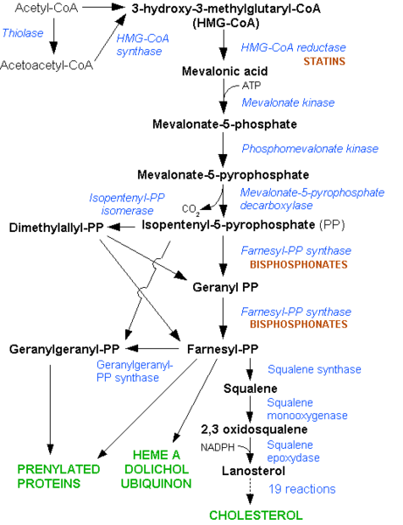

Slide 35
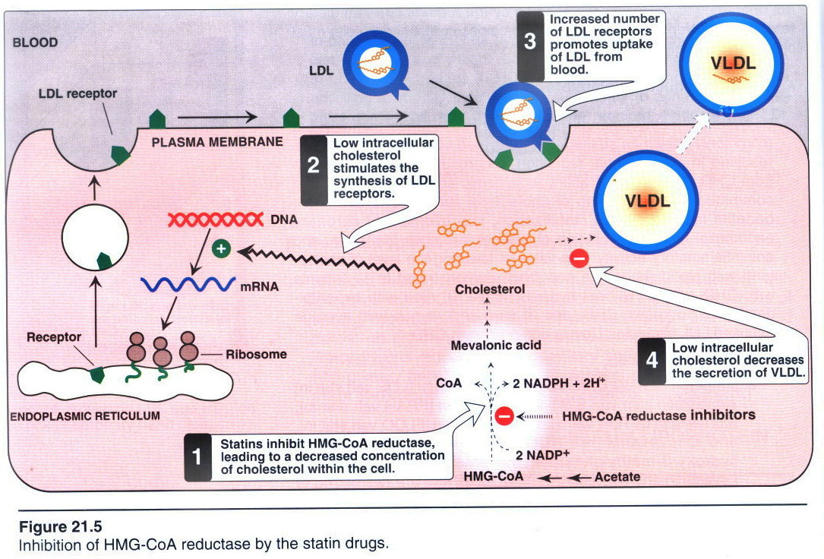

Slide 36
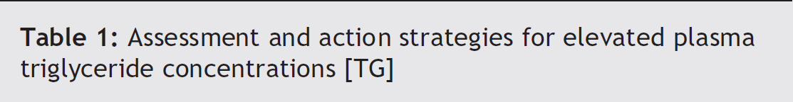
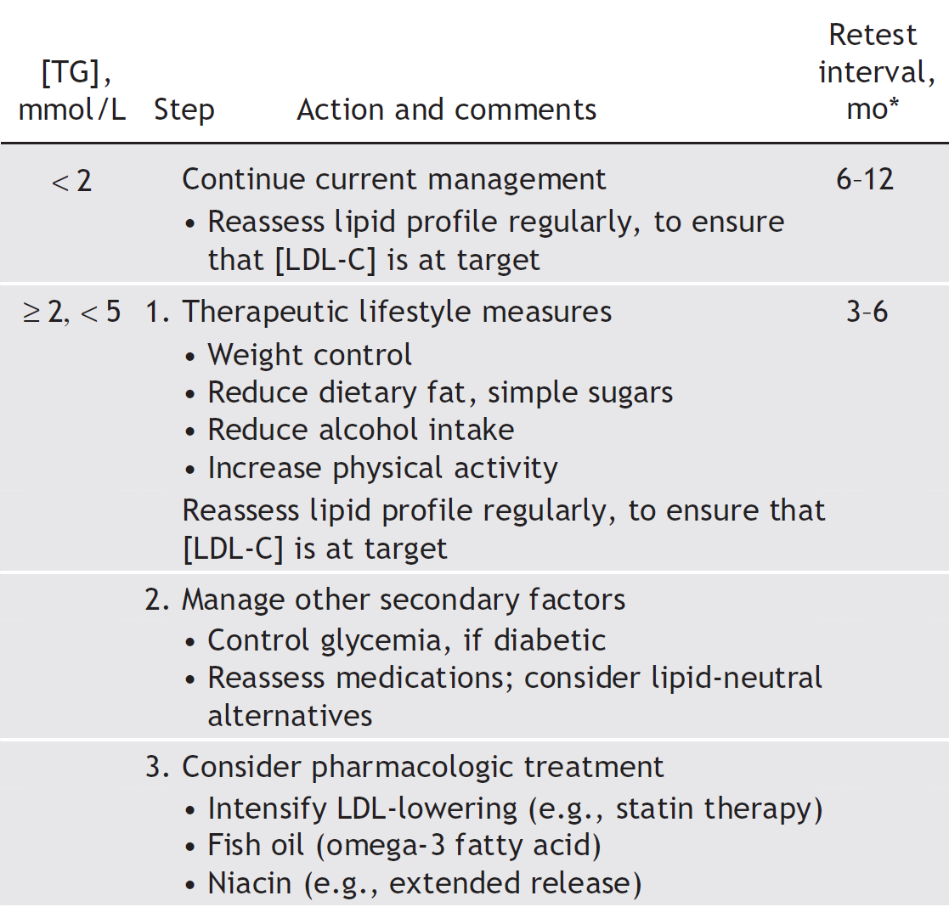

Slide 37
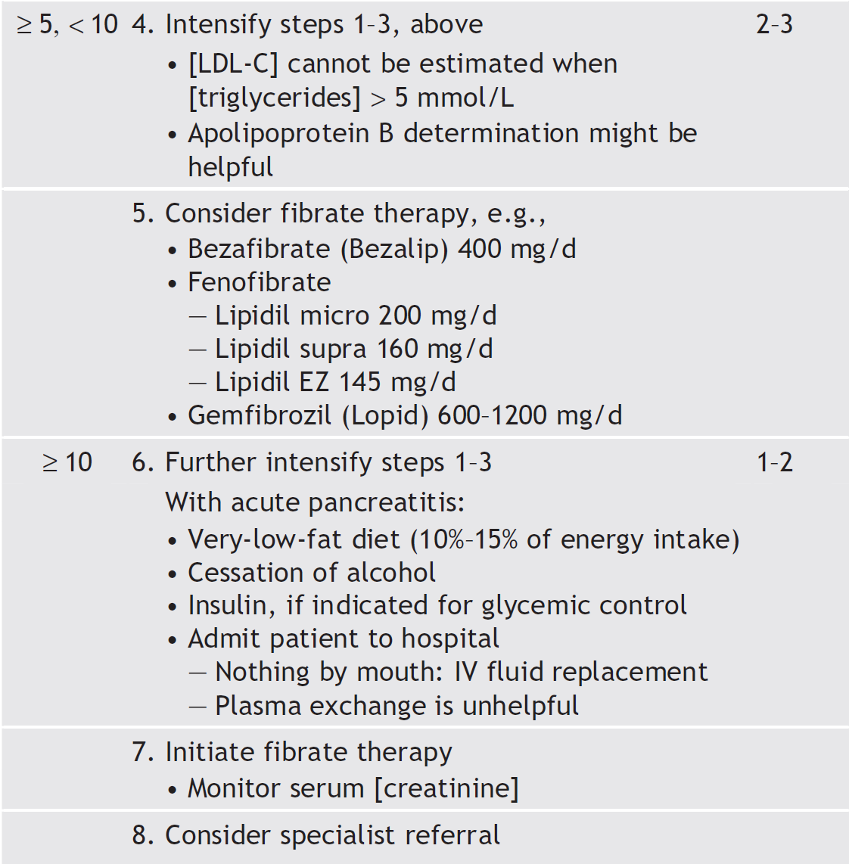
George Yuan, Khalid Z. Al-Shali, Robert A. Hegele
CMAJ • April 10, 2007 • 176(8)

Slide 38
You are asked to see a 14 years old boy with a reported total cholesterol concentration of 275mg/dl (7.8mmol/l. His father experienced a MI at age of 36 y, and his grandfather had MI at age of 49. He has a younger brother and sister, ages 7 years and 4 years.
On physical examination, he is well developed with secondary sexual characteristics consistent with puberty. His BMI is 22.4. BP 110/72. There are no xanthelasma or xanthomas.
Lipid test result
  HDL 46 mg/dl (1.2mmol/l)
  LDL 266 mg/dl(7)
  T. Cholesterol 303 mg/dl (8)
  TG 102mg/dl (1.1)
Which one of the following is the most appropriate next step in caring for this patient?
Collect skin fibroblast for LDL receptor activity
Perform genetic testing for LDL receptor mutation
Measure apolipoprotien B concentration
Lipid analysis on siblings
Gradient ultracentrifugation to determine LDL size and density

Slide 39
65 y old lady, dm, smoker, hypertensive, and have family history of premature CAD.
LAB
  Total cholesterol = 200 mg/dL (5.2)
  LDL = 176 mg /dL(4.6)
Her Framingham risk is estimated to be 20%.
Which one of the following option is likely to reduce her LDL to target?
Reinforcement of low fat diet
Atorvastatin to 40mg
Adding ezetimibe 10 mg od
Adding niacine 500 mg ER
Adding finofibrate 200mg od

Slide 40
Thank you

