Slide 1
بسم الله الرحمن الرحيم

Slide 2
Abdominal pain
One of the most common causes for OPD & ER visits
Multiple abd and non-abd pathologies can cause abd pain, therefore an organized approach is essential
Some pathologies require immediate attention

Slide 3
Types
Abdominal Pain
Visceral pain
Somatoparietal pain
Referred pain.

Slide 4
Categories
Abdominal Pain
Bright pain
Dull pain
Undifferentiated pain

Slide 5
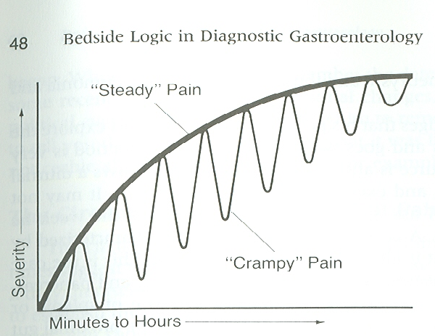
Abdominal Pain
Fig. 3- A graph to show contrast of “steady” pain
with “crampy” pain.

Slide 6
History
Abdominal Pain
PMH: Similar episodes in past
relevant medical problems
Systemic illnesses such as scleroderma, lupus, nephrotic
syndrome, porphyrias, and sickle cell disease often have
abdominal pain as a manifestation of their illness.
PSH: Adhesions, hernias, tumors, trauma
Drugs: ASA, NSAIDS, antisecretory, antibiotics, ect.
GYN: LMP, bleeding, discharge
Social: Nicotine, ethanol, drugs, stress
Family: IBD, cancer, ect.

Slide 7
A good thorough medical history is the most important step of the diagnostic approach
Abdominal Pain
OLD CARS
O onset
L location
D duration
C character
A aggravating/alleviating factors
associated symptoms
R radiation
S severity
OLD CARS
O onset
L location
D duration
C character
A aggravating/alleviating factors
associated symptoms
R radiation
S severity

Slide 8
Abdominal Pain
History Associated symptoms
Anorexia
Weight loss
Nausea/vomiting
Bloating
Constipation
Diarrhea
Hemorrhage
Jaundice
Dysurea
Menstruation

Slide 9
Abdominal Pain
History
Aggravating and alleviating factors
Eating
Drinking
Drugs
Body position
Defecation

Slide 10
Physical Exam
Abdominal Pain
General appearance
Ambulant
Healthy or sick
In pain or discomfort
Stigmata of CLD
Vital signs

Slide 11
Physical Exam- Abdomen
Abdominal Pain
Inspection
Distention, scars, bruises, hernia
Palpation
Often the most helpful part of exam
Tenderness
Guarding
Rebound
Masses
Auscultation
Abd sounds: present, hyper, or absent

Slide 12
Physical Exam- Abdomen
Abdominal Pain
Signs
Murphy’s
PR

Slide 13
Physical Exam- Extra-abdominal
Abdominal Pain
General appearance
Vital signs
Pelvic/scrotal exams
Lungs, heart
Remember it’s a patient, not a part

Slide 14
Laboratory Testing
Abdominal Pain
CBC
Liver profile
Amylase
Glucose
Urine dipsticks
Pregnancy test

Slide 15
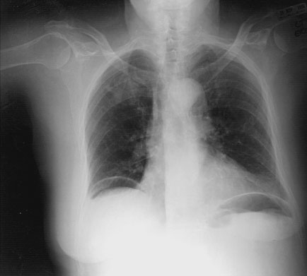
Imaging
Abdominal Pain
Plain films
Ultrasonography
Computed Tomography

Slide 17
Approach
Abdominal Pain
Abdominal pain
Acute Chronic
Surgical nonsurgical Continuous intermittent
? Alarm symptoms
Pain location

Slide 18
Approach
Abdominal Pain
Abdominal pain
Acute Chronic
Surgical nonsurgical

Slide 19
Definitions
Abdominal Pain
Acute abdominal pain with recent onset within hours-days
Chronic abdominal pain is intermittent or continuous abdominal pain or discomfort for longer than 3 to 6 months.

Slide 20
Acute abdominal pain
Abdominal Pain
Surgical
Appendicitis
Cholecystitis
Bowel obstruction
Acute mesenteric ischemia
Perforation
Trauma
Peritonitis
Nonsurgical
Cholangitis
Pancreatitis
Nonabdominal causes
Choledocholithiasis
Diverticulitis
PUD
gastroenteritis

Slide 21
Chronic abd pain approach
Abdominal Pain
History
continuous
Intermittent
metastasis
biliary
intest tumor
intest obstruction
pancreatic disorder
intst angina
pelvic inflammation
Treatment
endometriosis
Addison dis
porphoryea
functional disorder
IBS
Alarm symptoms
Fever
C&S
CT
Cholestasis
US/CT
ERCP
IDA
Hematochezia
Endoscopy
Weight loss
Endoscopy
CT

Slide 22
Abdominal Pain
PAIN LOCATION

Slide 23
Abdominal Pain
PAIN LOCATION

Slide 24
RUQ-PAIN
Abdominal Pain
Cholecystitis
Cholangitis
Hepatitis
RLL pneumonia
Subdiaphragmatic abscess

Slide 25
LUQ- PAIN
Abdominal Pain
Splenic infarct
Splenic abscess
Gastritis/PUD

Slide 26
RLQ-PAIN
Abdominal Pain
Appendicitis
Inguinal hernia
Nephrolithiasis
IBD
Salpingitis
Ectopic pregnancy
Ovarian pathology

Slide 27
LLQ-PAIN
Abdominal Pain
Diverticulitis
Inguinal hernia
Nephrolithiasis
IBD
Salpingitis
Ectopic pregnancy
Ovarian pathology

Slide 28
Epigastric-Pain
Abdominal Pain
PUD
Gastritis
GERD
Pancreatitis
Cardiac (MI,
pericarditis, etc)

Slide 29
Periumbelical-Pain
Abdominal Pain
Pancreatitis
Obstruction
Early appendicitis
Small bowel pathology
Gastroenteritis

Slide 30
Pelvic-Pain
Abdominal Pain
Cystitis
Prostatitis
Bladder outlet obstruction
Uterine pathology

Slide 31
Diffuse Pain
Abdominal Pain
Gastroenteritis
Ischemia
Obstruction
DKA
IBS
FMF

Slide 32
Irritable Bowel Syndrome (IBS)
Abdominal Pain
* IBS is characterized by abdominal discomfort
* associated with altered bowel habits
* in the absence of structural or biochemical
abnormalities

Slide 33
IBS- Assoc. Extraintestinal Disorders
Abdominal Pain
Fibromyalgia
Psychic disorders
Urinary symptoms
Sexual dysfunction

Slide 34
IBS- Epidemiology
Abdominal Pain
Worldwide point prevalence 10-20%
Prevalence higher below 50 years
More in women
May occur in pediatrics usually > 6 yrs
3x absence from work compared to non IBS patients
QoL is significantly lower than healty individuals and RA, DM, BA and GERD.
Economic impact 8-30 billion dollars (in USA)

Slide 35
IBS- Pathophysiology
Abdominal Pain
Three interrelated factors:
Altered gut reactivity (Motility, Secretion)
Meals
Bacteria
Environmental
Hypersensitive gut with enhanced pain
perception
Altered gut brain axis with greater reaction to
stress and modified pain perception

Slide 36
IBS-Diagnostic Criteria (1)
Abdominal Pain
Manning Criteria:
Pain relieve with defecation
More frequent stools at the onset of pain
Looser stools at the onset of pain
Sensation of incomplete evacuation
Passage of mucus
Visible abdominal distention

Slide 37
IBS-Diagnostic Criteria (2) Rom Criteria II:
Abdominal Pain
Contin. or recurrent abd. pain or discomfort for>12 wks, onset >6 months prior to diagnosis and includes at least 2 of:
Improvement with defecation
Onset assoc. with change in frequency of stool
Onset assoc. with change in form of stool
Symptoms cumulatively supporting the diagnosis:
Abnormal stool frequency(>3/d or <3/wk)
Abnormal stool form (lumpy/hard or loose/watery)
Abnormal stool passage (straining, urgency or sense of incomplete ev)
Passage of mucus
Bloating or feeling of abd. distension

Slide 38
IBS-Diagnostic Criteria (3) Rom III Criteria:
Abdominal Pain
3 months or more
Abd.discomfort or pain at least 3d/month
relieved by defecation
assoc. with change in stool form
assoc. with change in stool frequency
Drossman et al, Degnon Associates 2006

Slide 39
Endoscopy
Abdominal Pain
EGD
Colonoscopy
ERCP
EUS

Slide 41
Indications for referral To whom?
Abdominal Pain

Slide 42
Abdominal Pain
Gastroenterologist
Surgeon
Urologist
Gynecologist

Slide 43
Gastroenterologist
Abdominal Pain
Endoscopy
Indefinitive diagnosis
IBS not responding to therapy
Suspected:
IBD
Deverticulitis
Chronic bowel ischemia
Pancreatitis
Pancreatic cancer

Slide 44
Surgeon
Abdominal Pain
Acute abdomen
Hemodynamic instability
Free intraperitoneal gas
Suspected:
Appedicitis
Acute cholecystitis
Acute ischemic bowel
Intestinal obstruction

Slide 45
Surgical abdomen
Abdominal Pain
Is a clinical diagnosis
Early identification is essential
Early initiation of treatment
Early surgical consultation

Slide 46
Surgical abdomen
Abdominal Pain
Fevers, tachycardia, hypotension
tender, rigid abdomen
These findings may diminish with:
Advanced age
Immunosuppression

Slide 47
Surgical abdomen- peritonitis
Abdominal Pain
Perforation, large abscess, severe bleeding
Patient usually appears ill
Rebound, rigidity, tender to percussion or light palpation, pain with shaking bed

Slide 48
Surgical abdomen
Abdominal Pain
Peritonitis
Obstruction
Mesenteric ischemia

Slide 49
Surgical abdomen-Obstruction
Abdominal Pain
acute or acute on chronic
abdominal distention
Distal – distention, tympany
bowel sounds absent or high-pitched
Proximal – similar, but distention and
Tympany may be absent
pain
persistent vomiting

Slide 50
Surgical abdomen-Ischemia
Abdominal Pain
Usually seen in patients with CAD
Pain out of proportion to exam
Later present with peritonitis

Slide 51
Urologist
Abdominal Pain
Large stone
Failure to pass the stone within 6 weeks
Uretral obstruction
Fever

Slide 52
Gynecologist
Abdominal Pain
Lower abd pain and pos. pregnancy test
Suspected:
Pelvic inflammation
Adnexal torsion
Endometriosis

Slide 53
Take Home Points
Abdominal Pain
Good history and physical exam is important
(History is the most important step of the diagnostic approach )
Lab studies limitations.
Imaging studies selection (appropriate for presentation and location).
Alarm symptoms oriented investigations
Early referral of sick patients
Treatment initiation

Slide 54
Abdominal Pain

Slide 55
Fig. 3-1. Anterior view of the torso showing primary sites of pain from various organs in the abdomen. There is obvious overlap in some of these areas as shown.
Abdominal Pain

Slide 56
Fig. 3-2. Posterior view of the torso showing secondary sites of radiation or projection of pain from various organs in the abdomen.
Abdominal Pain

Slide 57
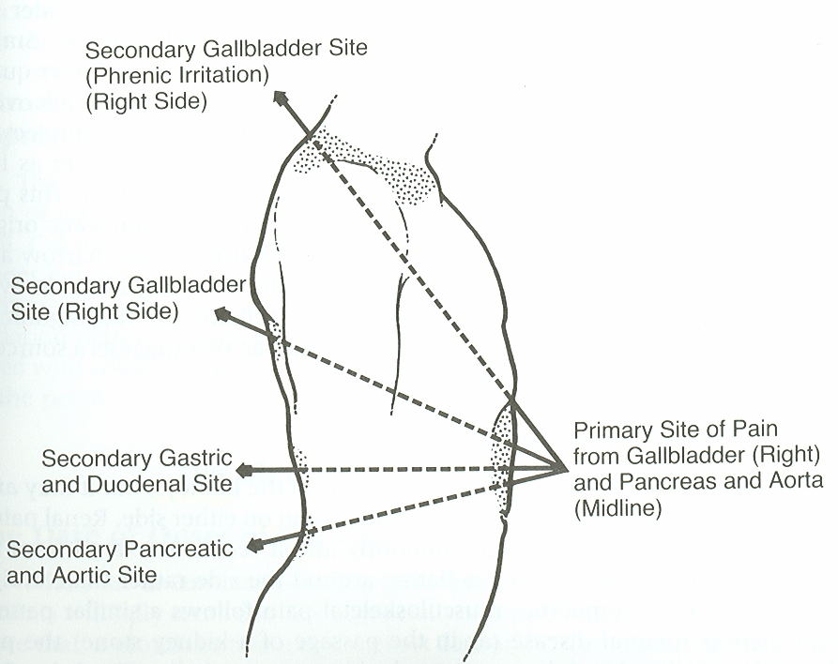
Fig. 3-3. Epigastric pains from the gallbladder, stomach, duodenum, pancreas, and aorta all project to the back by going straight through rather than radiating around the side. Pains from these organs do not always project to the back.
Abdominal Pain

Slide 58
Abdominal Pain

Slide 59
Diagnostic Approach
Abdominal Pain

