Slide 1
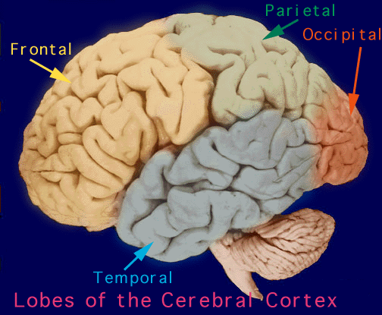
Antiepileptic drugs

Slide 2
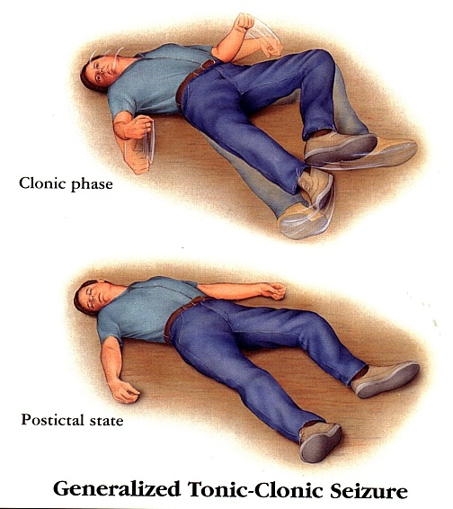
Definition
Epilepsy is a chronic medical condition characterized by 2 or more unprovoked seizures.
It is not a disease, it is a syndrome ( what is the difference ).

Slide 3
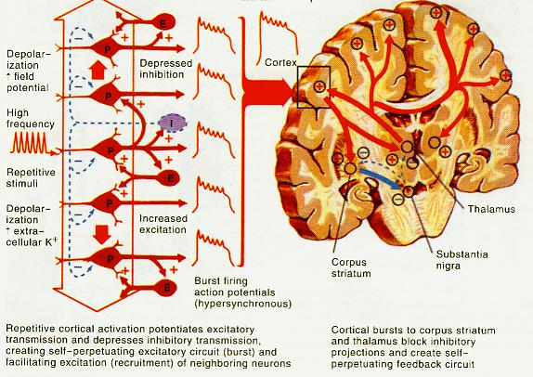
Seizure

Slide 5
Etiology
Idiopathic
Symptomatic
Inherited abnormality in the C.N.S.
Patients are treated chronically with antiseizure drugs or vagal nerve stimulation
Tumors
Head injury
Hypoglycemia
Meningeal infections
Drug withdrawal
Photo epilepsy ( by watching TV)
Fever

Slide 6
Triggers
Fatigue
Stress
Sleep deprivation
Poor nutrition

Slide 7
Generalized: Both hemispheres + loss of consciousness.
 | Tonic-clonic (Grand mal) | Stiffness (15-30 sec) followed by violent contractions & relaxation (1-2 minute)
 | Absence (Petit mal) | Brief loss of consciousness with minor muscle twitches eye blinking
 | Myoclonic | Rhythmic, jerking spasms
 | Clonic | Spasms of contraction & relaxation
 | Tonic | Muscle stiffness
 | Atonic | Sudden loss of all muscle tone

Slide 8
Partial Arise in one cerebral hemisphere
 | [1] Simple (consciousness is retained) |  | Features depend on part of brain affected
 |  | Motor (Jacksonian epilepsy) | Jerking, muscle rigidity, spasms, head-turning
 |  | Sensory | Unusual sensations
 |  | Autonomic
 |  | Psychologic | Memory or emotional disturbances
 | [2] Complex (Altered consciousness) |  | Automatisms & behavioral changes
 | [3] Secondarily generalized seizure |  | Begins as partial (simple or complex) and progress into grand mal seizure

Slide 9
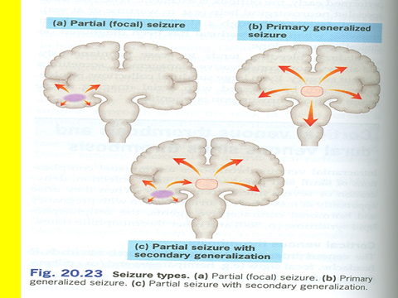

Slide 10
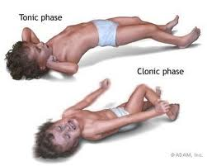
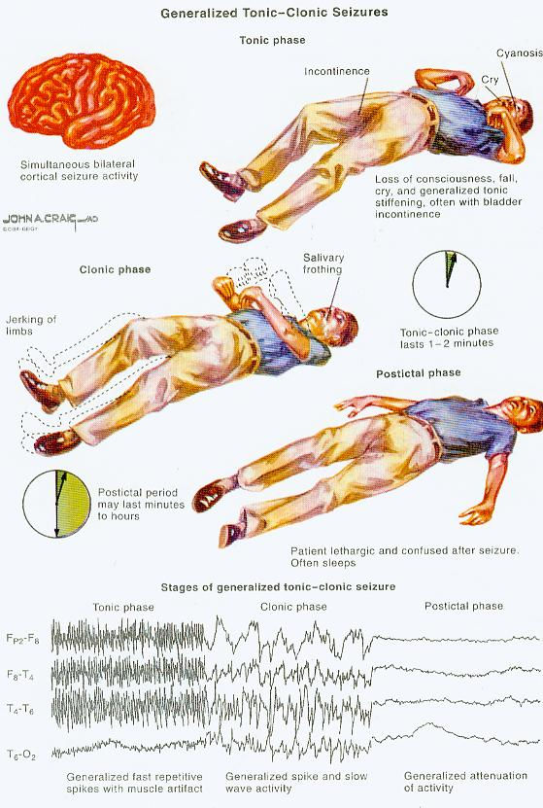
Tonic-clonic (grand mal) seizures

Slide 11
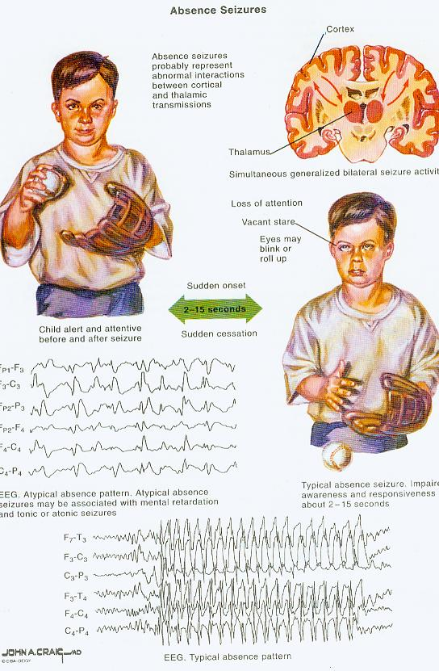
Absence seizures
brief; loss of consciousness accompanied by minimal motor manifestations
cessation of an ongoing behavior
full recovery is evident
after 5-15 sec.

Slide 12
Partial seizures
Simple
consciousness is often preserved. (e.g.deviation of the head
& eyes to one side)
Complex
loss of awareness or contact with the environment, often associated with behavioral or complex motor movements for which the patient is amnesic after the attacks

Slide 13
General rules for treatment of epilepsy
Antiepileptic drugs suppress but not cure seizures
Antiepileptic drugs are indicated when there is two or more seizures occurred in short interval ( 6 m-1y)
An initial therapeutic aim is to use only one drug (monotherapy).

Slide 14
Drugs are usually administered orally
Monitoring plasma drug level is useful
Triggering factors can affect seizure control by drugs.
Sudden withdrawal of drugs should be avoided
( cause status epilepticus)

Slide 15
Withdrawal started
After seizure –free period of 2-3 or more years from the last fit.
Normal neurological examination , Normal EEG
Relapse rate is 20-40%.

Slide 16
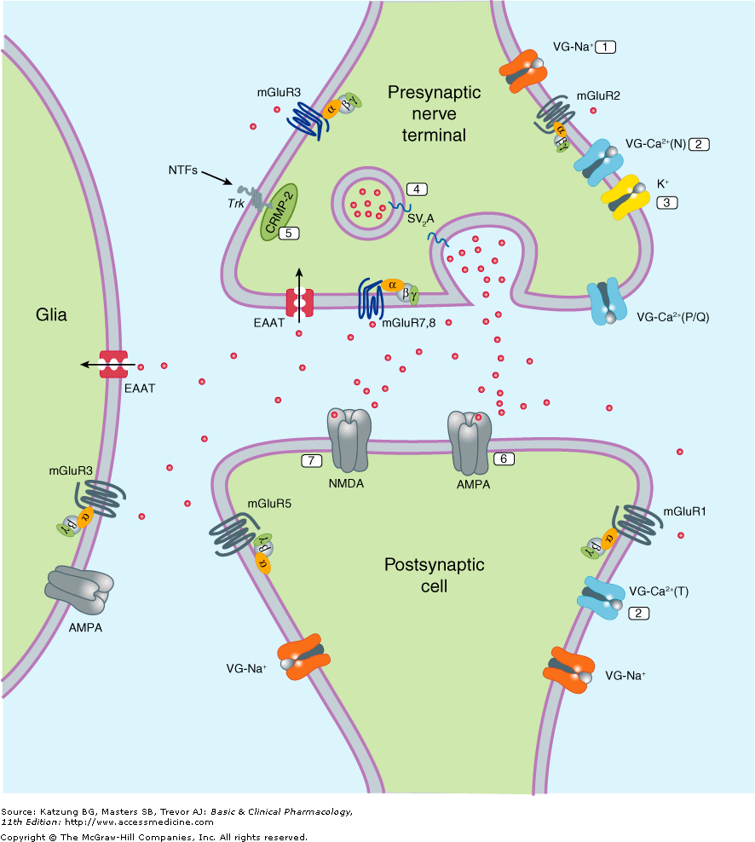
Pathophysiology of Epilepsy
How Drugs Act?
Blockade of voltage –gated channels (Na⁺ or Ca⁺)
Enhancement of GABA
Or interference with
Glutamate transmission (citatory)
(inhibitory)

Slide 17
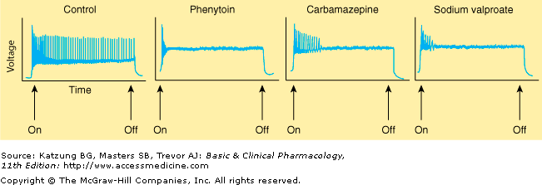

Slide 18
Classification of antiepileptic drugs
First-generation
Phenytoin
Carbamazepine
Valproate
Second- generation
Lamotrigine
Levitiracetam
Topiramate

Slide 19
Carbamazepine
Pharmacokinetics :
Available only orally
Well absorbed
Strong enzyme inducer including its own metabolism
Metabolized by the liver to active & inactive metabolites
Excreted in urine

Slide 20
Carbamazepine
Mechanism of action
Blockade of Na⁺ channels
reduce the propagation of abnormal impulses in the brain
inhibit the generation of repetitive action potential
Inhibit the release of glutamate
Therapeutic uses:
Drug of choice in partial seizures.
Tonic-clonic seizures (1ry & 2ry generalized) but Not in absence seizures.
Neuropathic pain
Mood stabilizer

Slide 21
Side effects
GIT upset.
Hypersensitivity reactions
Drowziness , ataxia, headache & diplopia
Blood dyscrasis
Hyponatremia & water intoxication
Teratogenicity ( neural tube defects ).
Induction of hepatic P₄₅₀

Slide 22
Phenytoin
Pharmacokinetics :
Well absorbed orally, it is also available as iv. (for emergency )
Enzyme inducer
Metabolized by the liver to inactive metabolites
Excreted in urine

Slide 23
Phenytoin
Mechanism of action
Blockade of Na⁺ channels.
Interfere with the release of excitatory transmitters
Potentiate the action of GABA
Therapeutic uses:
Partial and generalized tonic-clonic seizures Not in absence seizure.
In status epilepticus, IV .
Cardiac arrhythmias

Slide 24
Side effects
A ) dose-related :
Nausea or vomiting
Neurological like : headache, vertigo, ataxia, diplopia , nystagmus
Sedation

Slide 25
B) Non –dose related
Gum hyperplasia
Coarsening of facial features
Hirsutism
Acne
Megaloblastic anemia
Osteomalcia
Teratogenic effect
Enzyme inducer

Slide 26
Sodium Valproate Broad spectrum antiepileptic
Pharmacokinetics :
Available as capsules, Syrup Metabolized by the liver ( inactive )
Enzyme inhibitor
Excreted in urine

Slide 27
Sodium valproate
Mechanism of action
Blockade of Na⁺ channels.
Inhibits GABA -transaminase
Suppress glutamate action.
Blocks T-type Ca²⁺ channels
Therapeutic Uses
[I] Epilepsy:
It is effective for all forms of epilepsy e.g.
Generalized tonic-clonic seizures (1^{ry} or 2^{ry} ).
Absence seizures
Complex partial seizures
Myoclonic
Atonic
photosensitive epilepsy
[II] Other uses:
Bipolar disorder
Prophylaxis of migraine
Lennox-Gastaut syndrome

Slide 28
Sodium Valporate
Drug of choice in patients have concomitant generalized tonic-clonic seizures and absence seizures

Slide 29
Side effects:
Weight gain (↑appetite ).
Transient hair loss, with re-growth of curly hair
Thrombocytopenia
Hepatotoxicity
Teratogenicity ( spina bifida)
Enzyme inhibitor of P -450

Slide 30
Lamotrigine
Mechanism of action
Blockade of Na⁺ channels
Inhibits excitatory amino acid release ( glutamate & aspartate )
Inhibitory action on voltage activated Ca++ channels
Therapeutic Use
As add-on therapy in refractory complex partial seizure or as monotherapy in generalized seizures including absence seizure
Myoclonic seizures in children
Lennox-Gastaut syndrome

Slide 31
Side effects
Influenza-like symptoms.
Skin rashes (may progress to Steven –Johnson syndrome )
Somnolence
Blurred vision
Diplopia
Ataxia

Slide 32
Levetiracetam
Pharmacokinetics :
Taken orally ( tablets or solutions)
Not metabolized & excreted unchanged in urine
Does not affect liver enzymes
Drug interactions are minimal

Slide 33
Levetiracetam
Mechanism of action
Unknown
Therapeutic Uses
Adjunctive therapy in :
Partial seizures
Generalized tonic-clonic seizures
Monotherapy
Myoclonic seizures

Slide 34
Side effects
Ataxia
Dizziness
Somnolence
Pin & needles sensation in extremities
Blurred vision

Slide 35
Topiramate
Rapidly absorbed
Half-life 2 hours
Linear metabolism in liver
Excreted by kidney

Slide 36
Clinical Uses
Has a broad spectrum of activity
As adjunctive therapy in adult & pediatric patients with refractory partial seizures.
Monotherapy in generalized tonic-clonic seizures
In patients with LGS

Slide 37
Adverse effects
Somnolence
Dizziness
Confusion
Ataxia
Diplopia
Weight loss
Nephrolithiasis

Slide 38
Other antiepileptics
Old:
Phenobarbital and Primidone
Benzodiazepines (e.g.Diazepam and Lorazepam)
New antiepileptics for adjunctive treatment:
Gabapentin, vigabatrin, Felbamate, topiramate and others

Slide 39
Type of seizure | Choice among drugs
Partial seizures: Carbamazepine or phenytoin or valproate or lamotrigine.
Generalised seizures:
Tonic-clonic (grand mal) | Valproate or carbamazepine or phenytoin or lamotrigine
Myoclonic | Valproate, clonazepam
Absence | Ethosuximide or valproate
Atonic | Valproate

Slide 40
Drugs used for treatment of Status Epilepticus
Most seizures stop within 5 minutes. When seizures
follow one another without recovery of consciousness,
it is called “status epilepticus”. It has a high mortality
rate . Death is from cardiorespiratory failure.

Slide 41
Intravenous Injection of :
Lorazepam is the drug of choice
Diazepam
Phenytoin
fosphenytoin
phenobarbital .

Slide 42
Vagal nerve stimulation
It is an alternative for patients who have been refractory to multiple drugs .
Who are sensitive to the many adverse effects of antiseizure drugs
It is an expensive procedure

Slide 44
Pregnancy & antiepileptic medications
NO antiepileptic drug is safe in pregnancy.
Patient has to continue therapy using the least therapeutic doses & least teratogenic drug. If follow up of pregnancy reveals teratogenic effect, terminate pregnancy.

