Slide 1
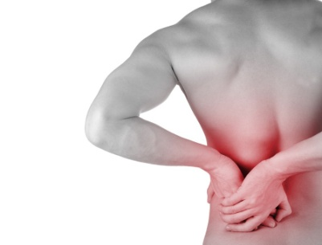
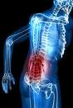
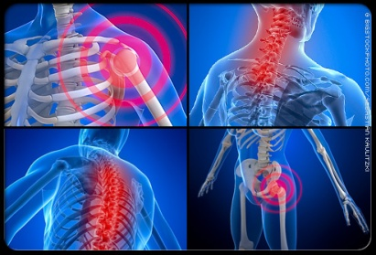
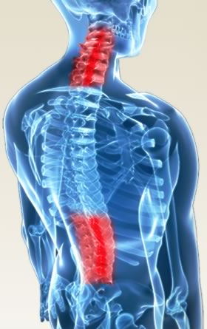
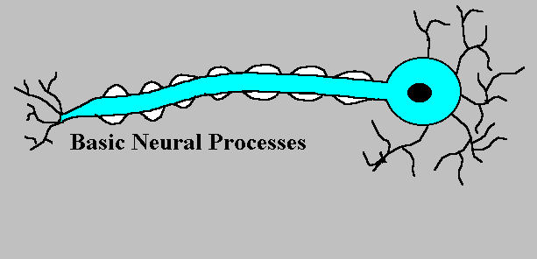
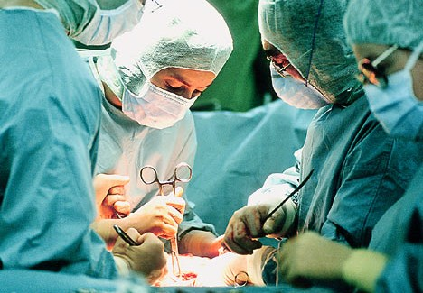

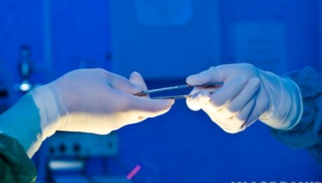
OPIOIDS

Slide 2
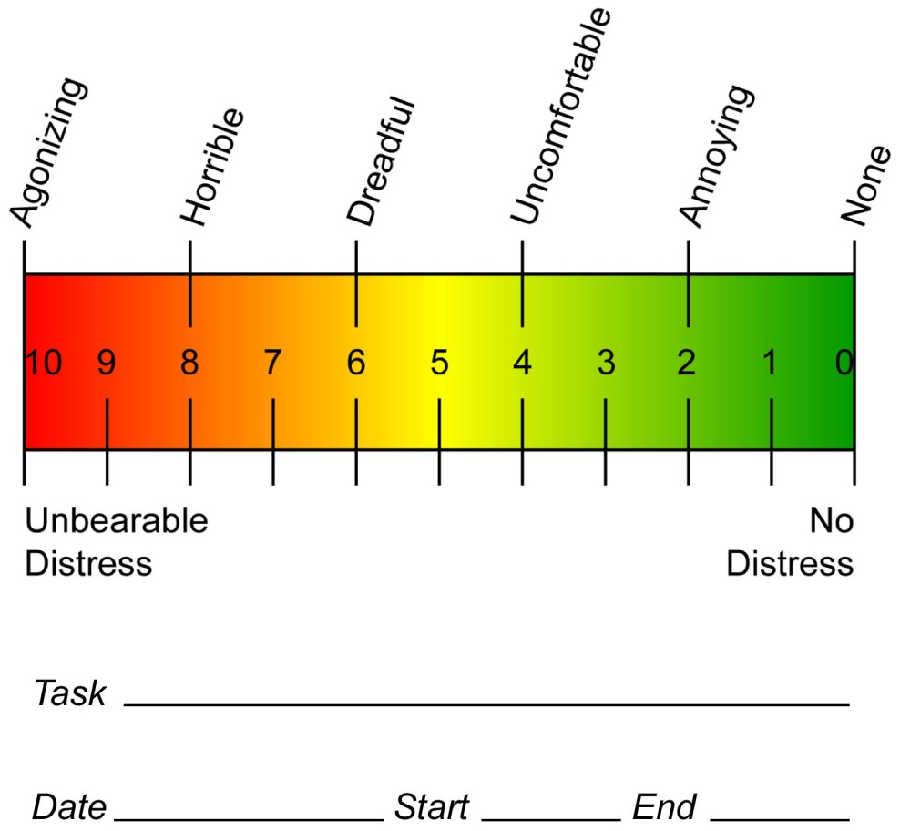
PAIN
Unpleasant sensory & emotional experience associated with actual or potential tissue damage. If uncontrolled  ruin the quality of life. It varies in intensity  annoying to unbearable.
Unbearable
Worst possible
Excruciating
very severe
Miserable severe
Troublesome
moderate
Annoying
mild
It varies in onset & longevity  acute vs chronic
It varies in nature acing, throbbing, burning, stabbing ….etc
It varies according to + damage [apparent injury, ischemia, inflammation, cancer,] or [not apparent as neuralgias].
It varies in origin; noniceptive & neuropathic

Slide 3
Generally pain is divided into two types:
ACUTE PAIN CHRONIC PAIN
It is a normal, predicted physiological response to a noxious chemical, thermal or mechanical stimulus
It is of sudden onset, lasting  hrs-ds (not > 6 ms )
Disappears once the underlying cause is treated.
Beneficial in a sense that it is a warning of actual or potential physical harm; signaling that damage has occurred & that something needs to be done.
It is the pain that starts acute & continues beyond normal time expected or persists or recurs for various other reasons
It outlived its usefulness & is no longer beneficial to patient.
Examples of acute pain :
Heart attack
Acute appendicitis
Bone fracture
Muscle sprain
Prolapsed disc
Examples of chronic pain:
Cancer
Neuropathy
Inflammation
Distensions
Eruptions
GOALS OF THERAPY
Focused to treat the cause > Reducing Pain
Focused on reducing the pain
Minimize pain, limit disability & maximize person’s function
Multidisciplinary; blends physical, emotional, intellectual & social variables

Slide 4
CHRONIC PAIN
Noniceptive
Neuropathic
Arising from damaged tissues other than nerve fibers & activates noniceptors
Arising from functional derangement or structural damage of nervous tissues
Superficial
Peripheral
Central
Somatic
Deep
Originating in PNS
Originating in CNS
Somatic
Visceral
Low back pain
Cancer pain
Diabetic neuropathy
Post herpetic neuralgia
Post amputation
Post Operative
Crush Injuries
Ischemic
Inflammation
Distention

Slide 5
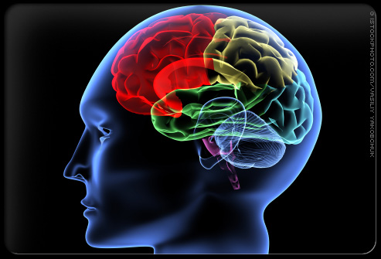
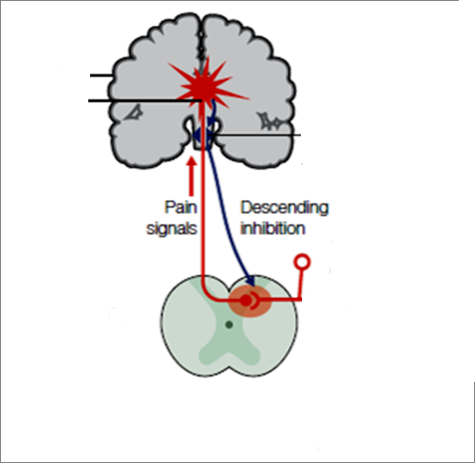
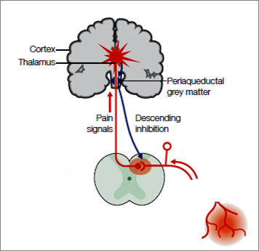
5HT, NE, Dopamine, GABA, Cannabinoids……etc.
Somatosensory Cortex
 Perception of Pain
Cingulate Cortex
 Affective component of Pain
5HT, NE, Dopamine, GABA, Cannabinoids……etc.
Thalamus
PAIN Transmission
& Processing
Periaqueductal Grey Matter
Dorsal Root Ganglion
Enkephalines, NE, GABA, Adenosine
Pain signals
Substantia Gelatinosa
Spinal
Cord
Noniceptors
ATP, Glutamate, Prostaglandins, Bradykinins, 5HT, Histamine, SP, CGRP, ions, metabolites
Stimulus

Slide 6
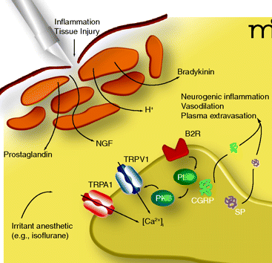
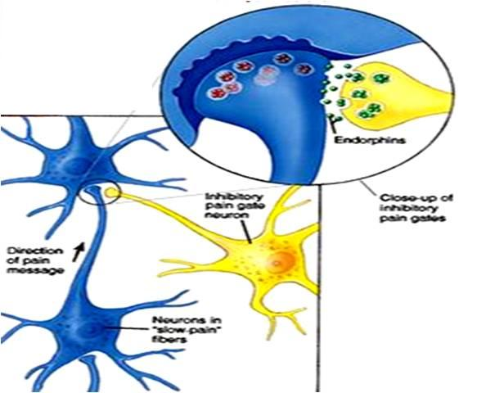
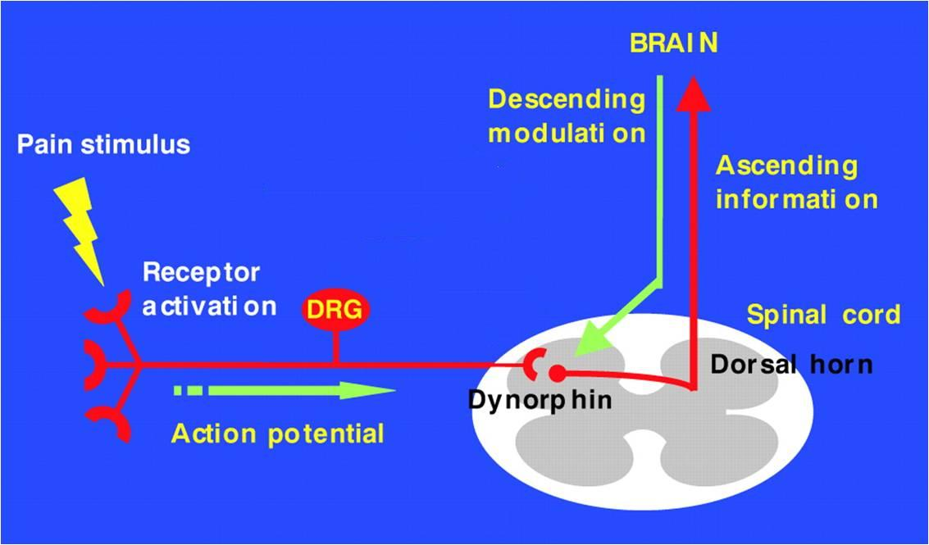
Inhibitory Pain Gate

Slide 7
Somatosensory Cortex
 Perception of Pain
Opioids, α₂ AD agonists, ADDs Anesthetics,
Cingulate Cortex
 Affective component of Pain
ADDs, Cannabinoid antagonists,
Thalamus
DRUGS USED TO CONTROL PAIN
Periaqueductal Grey Matter
Dorsal Root Ganglion
Local anesthetics, α₂ AD agonists, NMDA R antagonists
Opioids, ADDS,
Anticonvulsants
Pain signals
Local anesthetics
Opioids
Substantia Gelatinosa
Spinal
Cord
Noniceptors
ASA, Acetominophen, NSAIDs, Local Anesthetics, Capsaicin Anticonvulsants, CGRP antagonist, Cannabinoid antagonists
Stimulus

Slide 8
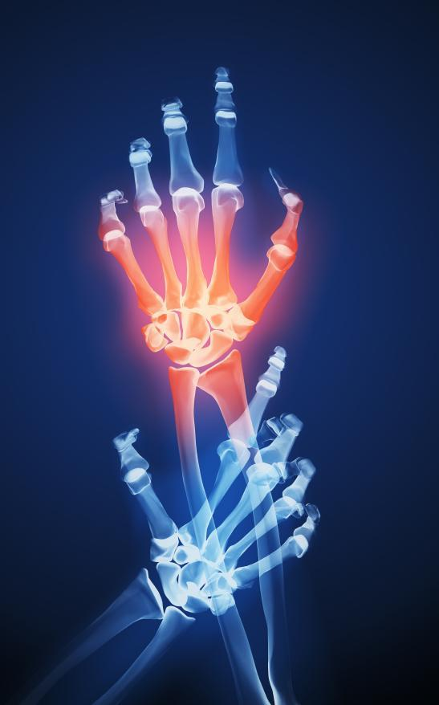
A state in which a painful stimuli is modulated; though perceived but felt no more painful.
TREATMENT OF PAIN
Noniceptive Pain
Neuropathic as Cancer Pain
NSAIDs
 ANALGESICS 
NSAIDs
OPIOIDS
OPIOIDS
Adjunctive
Adjunctive
ADDs
Capsaicin
ADDs
Steroids
Anti-Convulsants
Anti-Convulsants
NMDA R Antagonists

Slide 9

For Mild To Moderate Dull Aching
Analgesia
NSAIDs
For Moderate To Severe
> Visceral
Analgesia
OPIOIDS

Slide 10

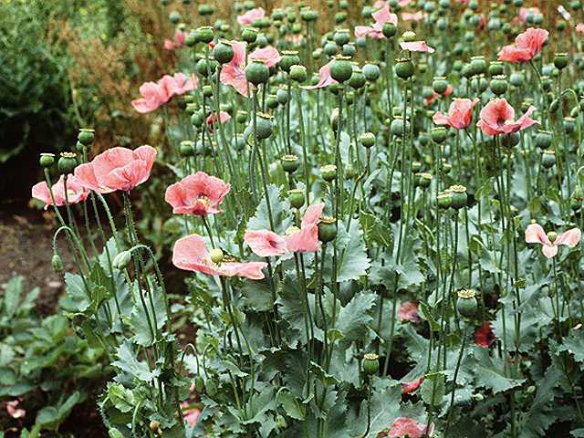
OPIOIDS
ANALGESICS  OPIOIDS
Derived from the dried milky juice  exuded by incised seed capsules of a species of poppy, Papaver somniferum,
It contains a mixture of alkaloids, the principal components being
morphine, codeine & papaverine.
Mimic action of endogenous opioids;
Endorphins, Dynorphins,Enkephalins
Act on endogenous opioid receptors
mu, delta, kappa, sigma

Slide 11
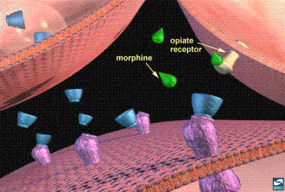
Functions mediated by endogenous OPIOIDS RECEPTORS
μ→ supraspinal analgesia, respiratory depression, euphoria,
physical dependence
δ→spinal analgesia, respiratory depression, GIT motility
Κ→ spinal analgesia, sedation, pupil constriction, dysphoria
All of them typical G-protein coupled receptors.
σ→ dysphoria, hallucination , pupil dilation, anxiety bad
dreams,…
It is not a true opioid receptor, as it binds psychotomimetic drugs.
Exceptionally of opioids only benzomorphans binds to it.

Slide 12
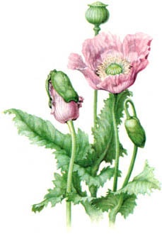
CLASSIFICATION OF OPOID ANALGESICS
According to their source
Natural ( Morphine)
Semisynthetic ( Codine )
Synthetic ( Mepiridine, Methadone, Fentanyl, Tramadol )
According to agonistic/antagonistic actions at receptors:
Agonists; Morphine, Codeine, Pethidine, Methadone
Fentanyl, Tramadol, Loperamide [no BBB  For diarrhea]
Mixed agonists /antagonists; Pentazosine, Buprenorphine
Pure antagonist; Nalaxone, Naltraxone, Nalmefene
According to their specificity of action on receptors:
Agonists on μ
Agonist on κ + partial antagonist on μ
Antagonist at μ, κ, σ.

Slide 13
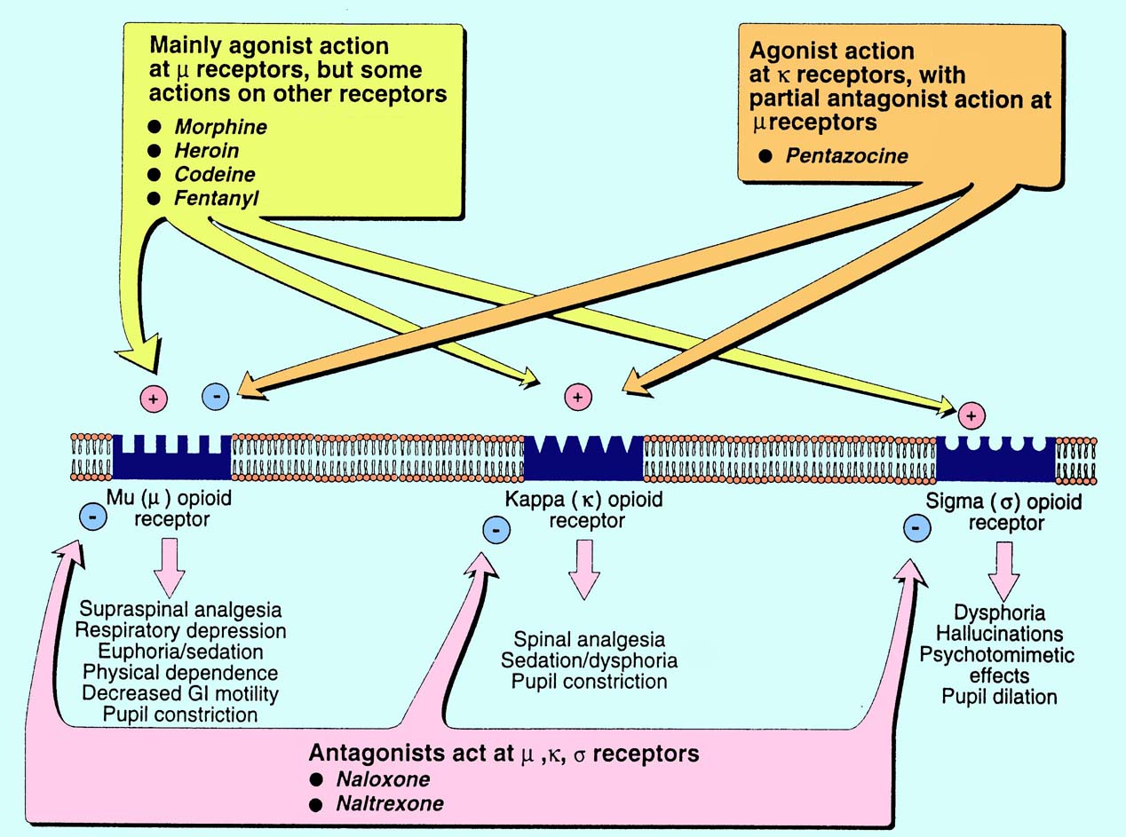

Slide 14
Binding to presynaptic opioid receptors coupled to Gi  AC & cAMP  voltage-gated Ca²⁺ channels  excitatory transmitter.
Binding to postsynaptic opening of K channels neuronal excitability
firing of nociceptive pathways converging at Periaqueductal GM
to allow for inhibitory firing along the descending pathway returning
to dorsal horn pain
Also inhibit pain transmission by acting directly on the dorsal horn, and by  excitation of peripheral nociceptive afferent neurones.
Morphine, Heroin, Pethadine,
Codeine, Fentanyl
CELLULAR MECHANISM OF ACTION OF AGONISTS & ANTAGONISTS

Slide 15
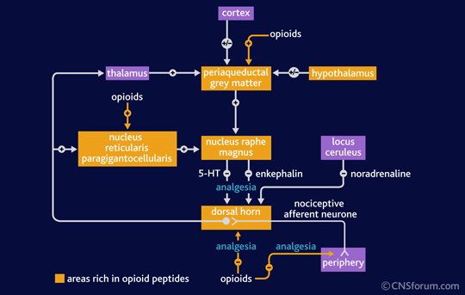
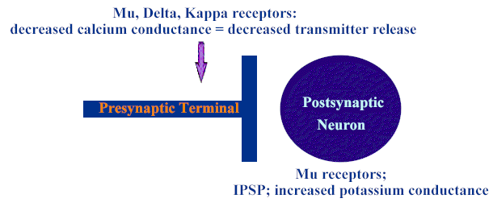

Slide 16
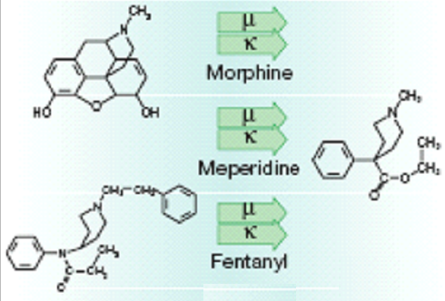
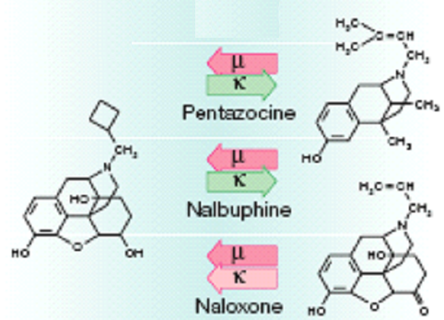
Agonist / Antagonist Actions of Some OPOID Analgesics
Dose-Response Curve
Comparing efficacy & potency of some opioid analgesics

Slide 17
1. OPIOID WITH AGONISTIC RECEPTOR ACTION
Pharmacodynamics
Morphine
1- Analgesia effective both in acute & chronic pain
2- Euphoria → powerful sense of contentment & well being
3- Respiratory depression→↑pCO₂
4- Depression of cough reflexes
5- Nausea & vomiting → ↑CRTZ
6- Pin point pupil:- due to stimulation of
occulomotor center by μ, κ effects. Diagnostic
7- Effects on GIT:-↑in tone ↓motility
→severe constipation
↑pressure in the biliary tract→
contraction of gall bladder &
constriction of biliary sphincter
8- Releases histamine from mast cells
9- LH, FSH, ACTH , testosterone
Prolactin, GH, ADH → urine retention

Slide 18
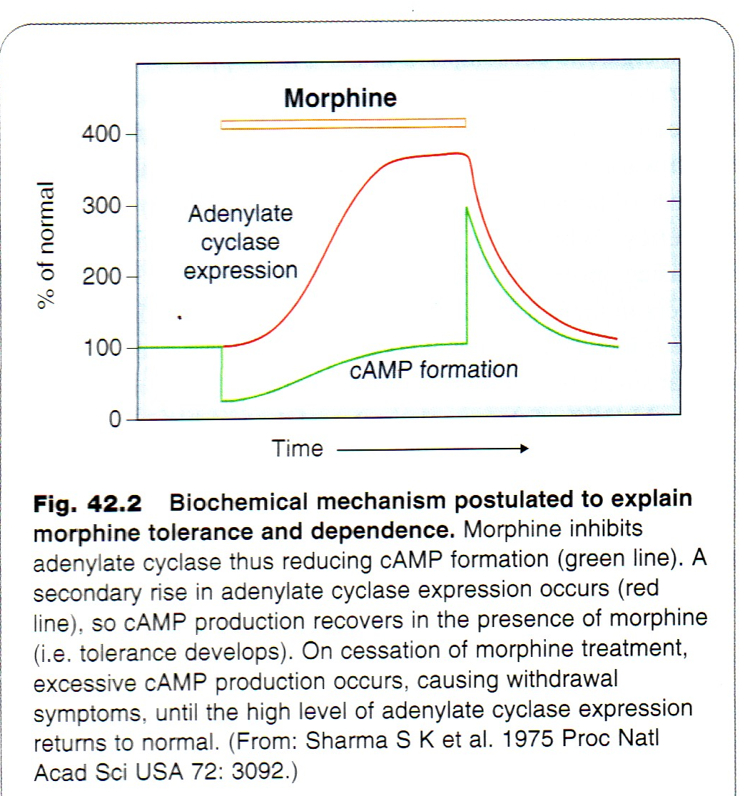
Morphine
TOLERANCE & DEPENDENCE develop rapidly .
Withdrawal manifestations develops upon stoppage.
Dependence comprises both:
Physical dependence lasting for a few days in form of ↑ body ache, insomnia, diarrhea, goose flesh, lacrimation
Psychological dependence lasting for months / years → craving
Withdrawal→

Slide 19
Pharmacokinetics
Morphine
t ½ is 2-3h converts to active morphine 6-glucuronide &
an inactive morphine 3-glucuronide metabolite
It is slowly & erratically absorbed orally.
Medically given by IM or IV injection.
It should be repeated if sustained effect
is needed.
Non-medically also be inhalation.
Undergoes enterohepatic recycling,
crosses BBB
crosses placenta.

Slide 20
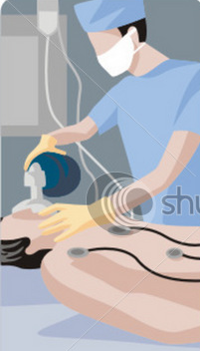
Clinical Indications
Morphine
CONTROL PAIN; cancer pain, severe burns, trauma
Severe visceral pain (not renal/biliary colics, acute pancreatitis )
DIARRHOEA
COUGH
ACUTE PULMONARY OEDEMA
MYOCARDIAL ISCHEMIA
NON PAINFUL CONDITIONS; HF to relieve distress
PREANAESTHETIC MEDICATION ??
ADRs
Sedation
Respiratory depression.
Constipation.
Nausea & vomiting.
Itching → histamine release
Tolerance; not to meiosis, convulsion or constipation
Dependence.
Euphoria.

Slide 21
HEAD INJURY
PREGNANCY
BRONCHIAL ASTHMA or impaired pulmonary function
Liver & Kidney diseases (including renal& biliary colics )
Endocrine diseases ( myxedema & adrenal insufficiency)
Elderly are more sensitive;metabolism, lean body
mass & renal function
Not given infants, neonates or during child birth
conjugating capacity  accumulate   respiratory
With MAOI
Contrindications of Morphine
Codeine
μ agonist
efficacy [_{1/10} morphine]
10% converted to morphine
Dependence < morphine
Large dose causes excitement
Used in mild& moderate pain, cough, diarrhea
HEROIN
μ agonist
Crosses BBB
Converted to morphine
No medical use
Strong addicting drug

Slide 22

Meperidine
Synthetic > effective κ agonism than morphine
Kinetics
Well absorbed orally [oral bioavailability]
Given also by IM
Half-life ( short ) 2-4 hours
active metabolite CNS stimulant effect
Excreted in urine
Actions
analgesic,  constipating ,  depressant on fetal respiration than morphine
Has atropine –like action
Smooth muscle relaxant effect
No cough suppressant effect

Slide 23
Meperidine
Indications
Pethidine
As in morphine but not in cough & diarrhea
Used in severe visceral pain; renal & biliary colics ( relaxes sm. muscles)
Used in obstetric analgesia (No  resp.)
Preanaesthetic medication ( better)
ADRs
Tremors, Convulsions, Hyperthermia, Hypotension
Burred vision, Dry mouth, Urine retention
Tolerance & Addiction

Slide 24
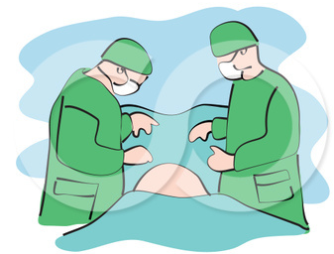
Fentanyl
Synthetic, μ agonism, strong & effective > meperdine & morphine
Kinetics
High lipid solubility
Rapid onset (2-3 min)
Very short duration of action (peak effect lasts15-30 min ) due to redistribution from brain to tissues
Rapidly & extensively metabolized
t_{1/2} being 2-4 hrs
Indications
Most commonly employed analgesic supplement during anesthesia, IV or intrathecal.
Can be used to induce & maintain anesthesia in poor-risk patients under going major surgery, with advantage of stabilizing the heart.
Used in combination with droperidol as NEUROLEPTANALGESIA; a state of inactivity &  response to external stimuli, used for complex diagnostic procedures.
In cancer pain & severe postoperative pain; transdermal patch changed every 72 hrs.
ADRs
Mimic opioid agonists but respiratory depression is the most serious & CV effects are less. Bradycardia may still occur

Slide 25
TRAMADOL
Synthetic, μ agonist ,  potent analgesia
Its analgesia is also due to  NE & 5HT
Kinetics
Given orally;  oral bioavailability,
Given by other different other routes
Undergoes extensive metabolism
Indications
Mild - moderate acute & chronic visceral pain During labor
ADR
Seizures , Nausea , Dry mouth, Dizziness , Sedation
Less adverse effects on respiratory & C.V.S.
Contrindications
In patients with history of epilepsy

Slide 26
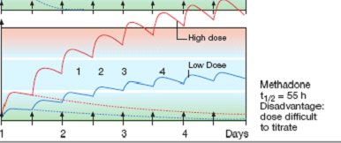
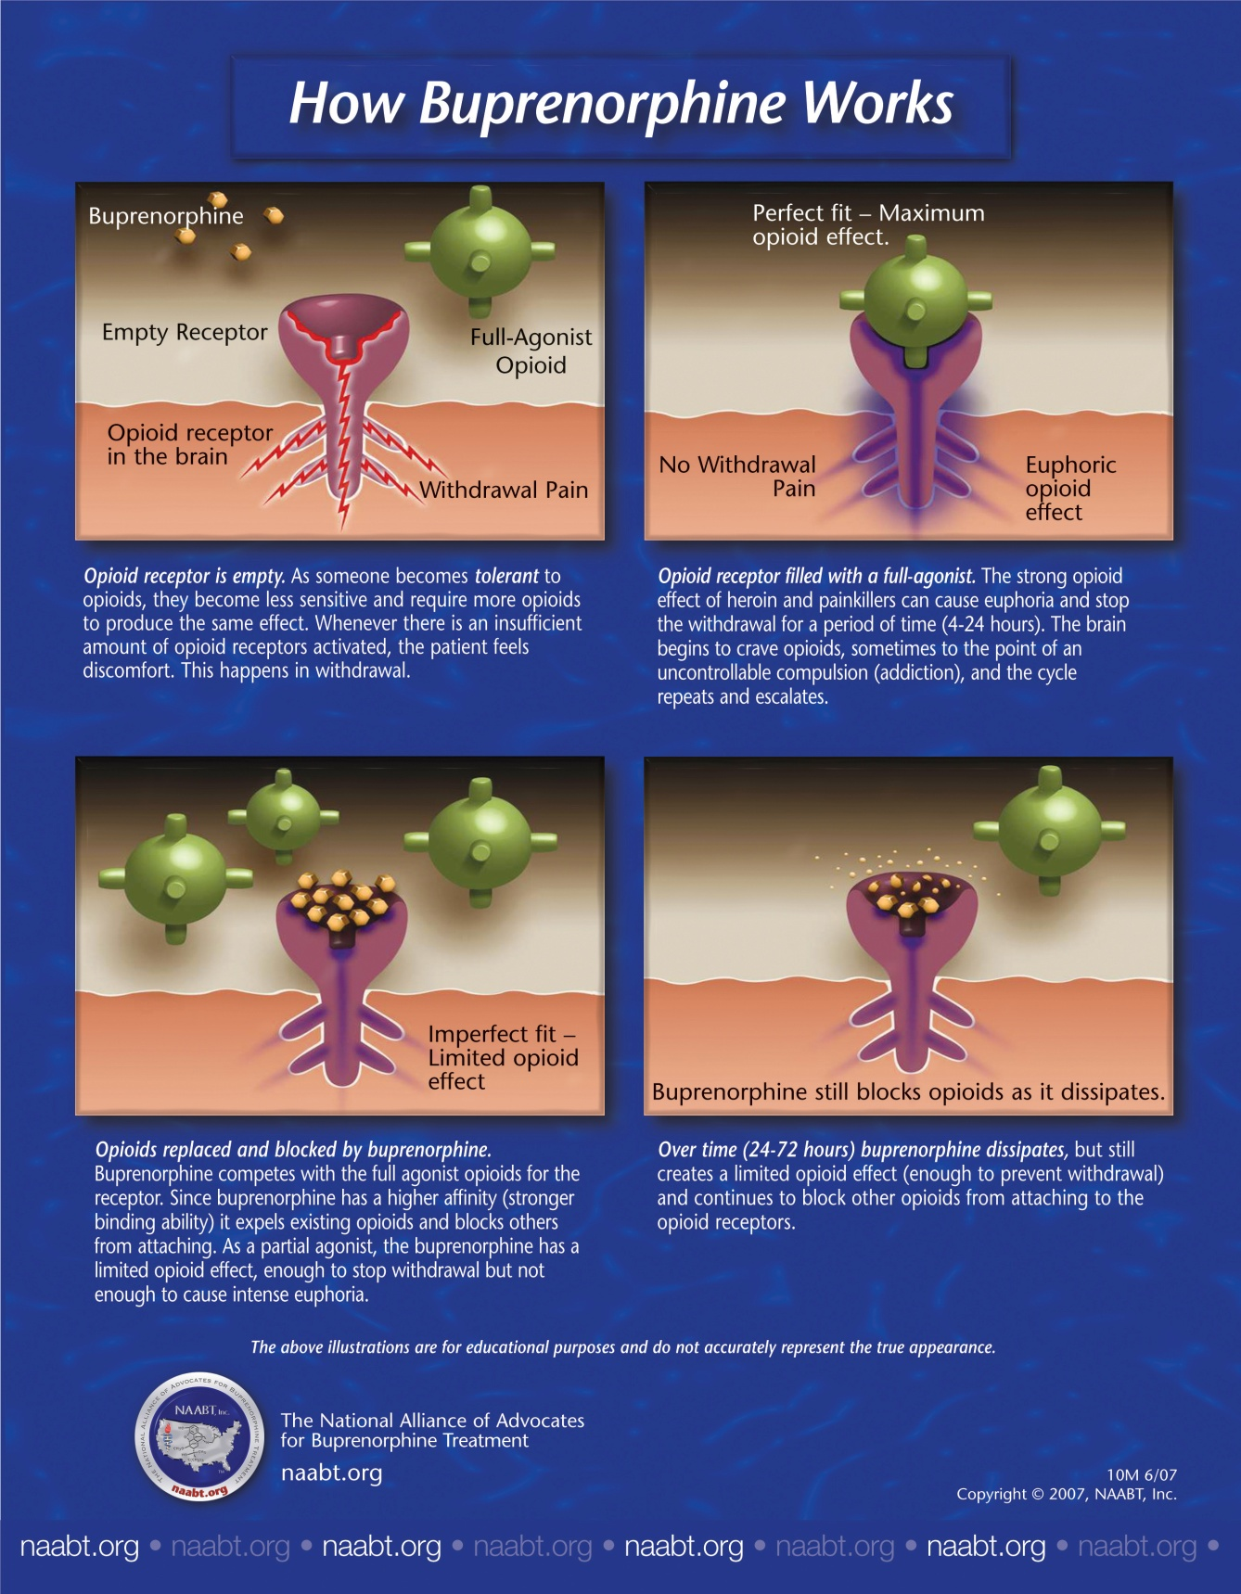
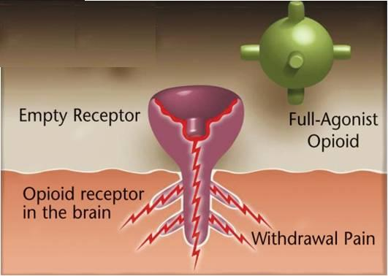
METHADONE
Synthetic, μ- Weaker Agonist, t½ 55 h.
Used to treat opioid withdrawal.
Firm occupancy of opioid receptors by methadone  desire for other opioid intake, because it is producing an  effect that stop withdrawal manifestations. With time addicts improve   craving
An ADDICT
After 72 hours
Methadone
Methadone
In non addicts, it causes tolerance & dependence but not as severe as that of morphine

Slide 27

2. OPIOID WITH MIXED RECEPTOR ACTION
Pentazocine
κ- Agonist / μ- Antagonist with additional actions on σ receptor (hallucination).
It pulmonary pressure.
It precipitate withdrawal manifestation if given in addicts
No more recommended.
BUPRENORPHINE
Partial agonist at μ.
Has long duration of action
Give sublingual or as nasal spray [to avoid systemic 1st pass metabolism]
Causes less : sedation , respiratory depression , hypotension than morphine.
So in morphine addicts it is now used instead of methadone. Used in detoxification & maintenance of heroin abusers

Slide 28
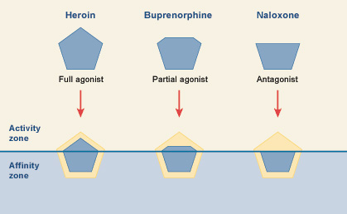
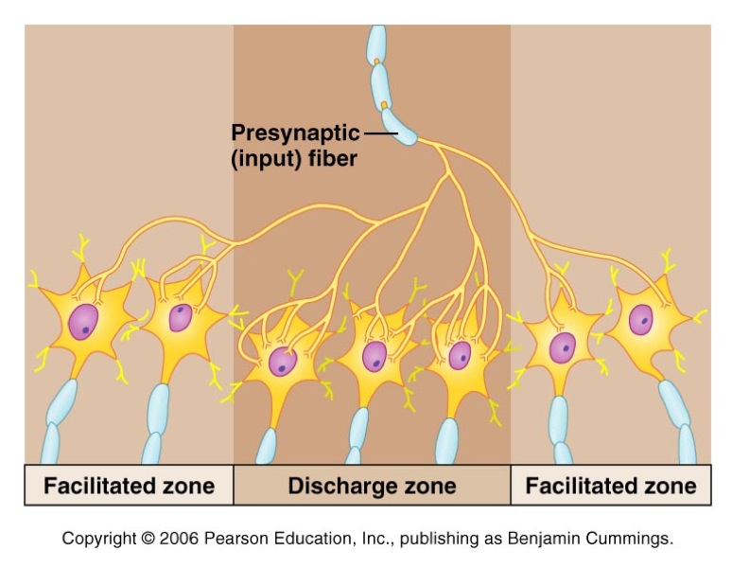
3. Antagonizing Acute Opioid Toxicity
Morphine
Nalorphine
Naloxone

Slide 29
3. Antagonizing Acute Opioid Toxicity
Naloxone
Pure opioid antagonist at μ receptor.
Has little effect on pain threshold but can cause hyperalgesia under conditions of stress or inflammation, when endo-genous opioids are produced.
Completely reverses respiratory depression caused by opioid overdose or in new born (if mother received morphine)
Partially reverses the analgesic effects of morphine.
Has rapid onset (sec.) & short duration of action (30-60min )
Is available for I.V. route. Effect lasts only for 2-4 hours.
Precipitates withdrawal syndrome in addicts
Naltrexone
Very similar to naloxone but with longer duration of action [t½=10h] . Given orally.
Can be given also to decrease psychological craving in chronic alcoholism

Slide 30

GOOD LUCK

