Slide 1
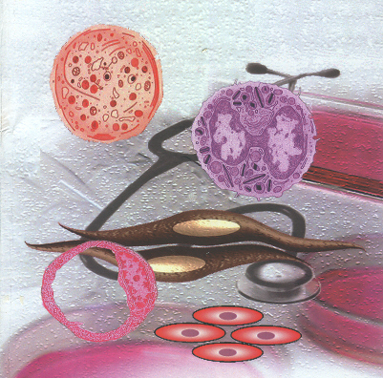
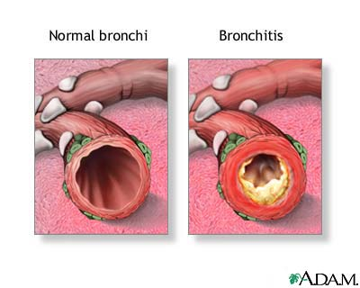
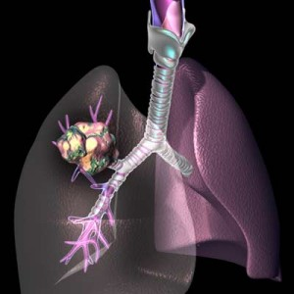
Drugs in
OBSTRUCTIVE AIRWAY DISEASE

Slide 2
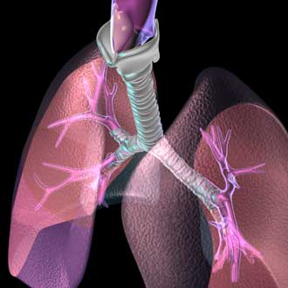
Asthma THERAPY
CONTROLLERS
PREVENT FUTURE ATTACKS
Reduce bronchial hyper-reactivity
LONG TERM CONTROL
Induce anti-inflammatory actions
REDUCE AIRWAY REMODELLING
Halt partial irreversibility
WHICH DRUGS ARE USED
DRUGS THAT DECREASE AIRWAY INFLAMMATION
To prevent airway remodeling
PREVENT RECUR OF ACUTE SYMPTOMS
Abort exacerbations
USED TOGETHER
Glucocorticoids.
Leukotrienes Modifiers
Leukotriene Synthesis Inhibitors
Leukotriene Receptor Antagonists
Anti IgE monoclonal antibodies
Antiallergics; Mast cell stabilizers
Bronchodilators;
Long-acting β₂-AR agonists (LABA)
Long acting Anticholinergics
PDE Inhibitors;
Non-Selective & PDE-4 Selective

Slide 3
CONTROLLERS
DRUGS THAT DECREASE AIRWAY INFLAMMATION

Slide 4
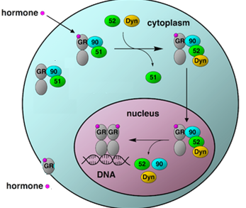
Asthma THERAPY
1. CORTICOSTEROIDS [GC]
Mechanism of action
Like all other steroids, GC acts on;
Cytosolic GC R  mediates GENOMIC Action 
Expression of proteins anti-inflammatory effects
Repression of proteins pro-inflammatory effects
slow process needs  hrs-days
Binding & Activation
Nuclear translocation
Dimerization on SRE
Gene Transcription
mRNA Translation
New Protein Formation
2. Membranous GC R  mediates NON-GENOMIC Action
 cross talks with GP coupled receptors  alter Ca, cAMP, their downstream kinases (PKA & PKC)  rapidly exert anti-inflammatory effects & shut down proinflammatory effects  rapid process needs minutes-hrs
PKA
cAMP
PKC
GRE
Ca
mRNA
Protein

Slide 5
Asthma THERAPY
Pharmacological Effects
CORTICOSTEROIDS
Suppress inflammation & immune reactions:
  ◉ release & synthesis of inflammatory mediators; so -ve PLA2  -ve
  AA & LTs pathways….
  ◉ antigen antibody reaction mast cell degranulation, infiltration & activity of inflammatory cells by  cytokines &
  chemokine production
  vascular permeability; so  edema of the airway mucosa
◉ airway mucus production
expression of bronchial β₂ AR & their responsiveness to β₂ AR agonists; via intermediary cross talk
◉ Formation of myofibroblasts, collagen deposition, subepithelial fibrosis & airway remodeling
Benefits of Use
Effective in exercise, allergic & irritant-induced asthma most types
Though it can never be given as monotherapy to induce relief of symptoms (i.e. No bronchodilatation), yet its use EARLY with relievers, help to stop the pool of mediators contributing to bronchoconstriction by its RAPID NON-GENOMIC ACTION

Slide 6
Asthma THERAPY
CORTICOSTEROIDS
It targets the etiopathogenic cascade  it is the MAINSTAY OF ASTHMA THERAPY  halting its progression to partial irreversibility. It takes 7-14 days to built its full anti-inflammatory effects & six weeks for achieving maximum benefits specially in halting remodeling by its GENOMIC ACTION
Indications
Used alone or + other drugs, depending on asthma frequency & severity
For mild persistent asthma  low dose inhalational monotherapy
For moderate persistent asthma  low-moderate doses inhalational +
long-acting ß-AD agonist
For severe persistent asthma  high doses inhalational + long-acting
ß-AR agonist + oral steroids (if needed)
For status asthmaticus  IV drip infusion has life-saving effects 
decreasing edema, local leukotriene generation, inflammatory cell
recruitment & reversal of ß2-AR downregulation.
Method of administration & preparations
INHALATIONAL or Systemic; oral / parenteral

Slide 7
Asthma THERAPY
INHALATIONAL STEROIDS
i.e. Beclomethasone, Budesonide & Fluticasone
CORTICOSTEROIDS
Inhalational therapy guarantees that therapeutic levels are rapidly reached with least systemic side effects (even if high doses are given).
Fluticasone is the best in use as it;
 first-pass clearance by the liver systemic availability
effective in control at 50% the dose of others
No pituitary adrenal axis suppression
Local (Topical) ADRs
Cough
Dysphonia (hoarseness)
    Candidiasis of the mouth or throat (Thrush)
    N.B. to limit local ADRs, instruct patient to rinse mouth, gargle & spit out, use spacer to  particle deposition in the oral-pharynx & larynx & tend to dose needed by adding LABA & giving it prior to steroids to open airways
SYSTEMIC STEROIDS
  Oral; Prednisone Chronicity, repeated acute exacerbations & hospitalization
Parenteral; Methylprednisolone, Dexamethasone  severe attacks, resistant to other controls & in status asthmaticus

Slide 8
Asthma THERAPY
CORTICOSTEROIDS
SYSTEMIC STEROIDS
If given > of one week, no abrupt withdraw should be done but tapper the doses gradually to prevent adreno-pituitary suppression fear of adrenal insufficiency
Systemic ADRs are dose & time dependent and include;
  Adrenal suppression
  Growth retardation premature fusion of epiphysis
  Osteoporosis
  Susceptibility to infections &  immunosuppresion
  Salt & water retention  Hypertension
  Increased appetite & weight gain
  Hyperglycemia & poor glycemic control(care in diabetics)
  Altered fat metabolism & distribution
  Protein catabolism
  Muscle wasting
  Mood disturbances / psychosis
  Cataract & Glaucoma

Slide 9
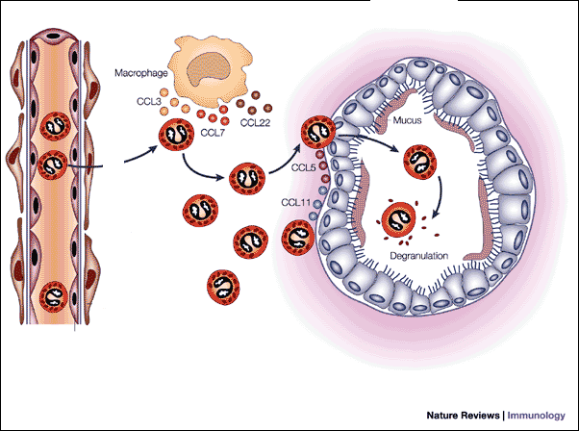
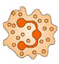
Asthma THERAPY
2. Leukotriene Modifiers
Membrane Phospholipids
Leukotrienes ?
Aspirin
NSAIDS
PLA2
Released by Inflammatory Cells
mast cells, basophils, macrophages, & eosinophils
Arachidonic Acid
5-LO Inhibitors
(Zileuton)
Cyclo-oxygenase
5-Lipoxygenase
Synthesis Inhibitors
Prostaglandins
Thromboxane
LTA4
LTC4 & LTD4
LTB4
Chemotaxsis
Ciliary Paralysis
CysLTs
Mucus secretion
LTC4
Slow reacting substance
of anaphylaxis (SRS-A)
Subepithelial fibrosis
LTD4
Cys-LT Receptors
Edema
LTD4
LT-Antagonists
Montelukast
Zafirlukast
LTE4
Eosinophil Recruitment
Bronchoconstriction
Hyperreactivity & BSMC Proliferation
Competitive antagonism of CysLT receptor
LTD4, ↑BF, permeability, extravasation & edema
LTC4 & LTD4
Leukotriene Modifiers

Slide 10
Asthma THERAPY
Synthesis Inhibitors; Zileuton Its use has declined considerably, with > efficacy of
Receptor Antagonists; Montelukast, Zafirlukast
Leukotriene Modifiers
Pharmacological Effects
Anti-inflammatory action < corticosteroids, but theyrequirement for
glucocorticosteroid Corticosteroid Sparing Action
Mild, slow-onset bronchodilatation
Kinetics
Montelukast
Rapidly absorbed from GIT.
t1/2 is 2.7–5.5 hours
Undergoes hepatic metabolism by CYP 3A and 2C9
Mainly excreted in the bile.
Individual responses vary “responders & nonresponders”
Benefits of Use
Used prophylactically to  frequency, nocturnal attacks & severity of attacks
Not indicated for monotherapy & not used as reliever in in acute attacks (bronchodilation = 1/3 of salbutamol)

Slide 11
Asthma THERAPY
Used in;
Prevention of
  Aspirin induced asthma > efficient
  Exercise induced asthma
  Decrease both early and late responses to allergen induced asthma
Maintenance (Long Term) Therapy of
Mild chronic persistent asthma as 2nd line or as add on therapy to LABA,
to  lung function /need of short-acting beta₂-agonists if exacerbations
Leukotriene Modifiers
Interactions & ADRs
  Restlessness & headache
  GI disturbances
  Hypersensitivity reactions, arthritis
  Respiratory tract infections
  Reversible hepatitis & hyperbilirubinemia ( >Zileutin)
  Acute vasculitis, eosinophilia &  of pulmonary symptoms (> Zafirlukast)
  All are avoided in pregnancy & breast-feeding
Zileuton metabolism of theophylline, warfarin, terfenadine, propranolol
Zafirlukast warfarin / theophylline & erythromycin concentration
Montelukast; is the safest, well tolerated, least reported ADRs & interactions.

Slide 12
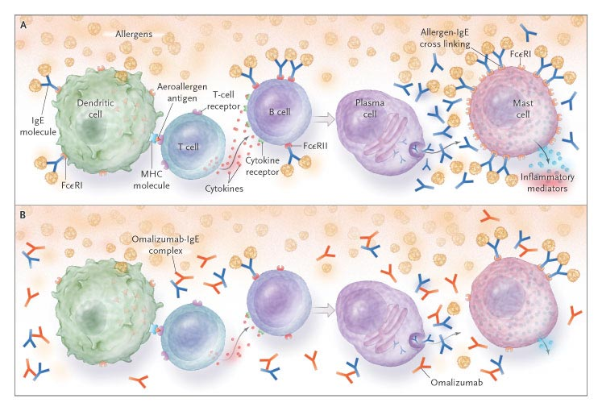
Asthma THERAPY
3. Anti- IgE Monoclonal Antibody
Omalizumab
Is a Recombinant MOA directed against human IgE  given subcutaneous
Mechanism
It binds to Fc region of free IgE molecules  prevent its binding to cell-surface receptors on inflammatory cells. It will not bind to IgE already bound.
Pharmacological effects
  early & late responses to antigen challenge
Indications
Given as SC every 2-4 weeks
frequency of allergen induced asthma
In moderate-sever persistent asthma (adults or children >12 ys.), not controlled by inhaled CS to frequency of attacks
◉ need for GC in maintenance & allows its safe withdrawal by exacerbation rate during this transition

Slide 13
Asthma THERAPY
4. Anti-Allergics
Cromolyn & Nedocromil
Weaker
Both are weak controllers
Mechanism
Block Ca influx, alter function of delayed Cl⁻ channel ???
 stabilize antigen-sensitized mast cells
Pharmacological Effects
Can control early & late phases of asthmatic reaction
Control early phase by
  Mast cell stabilization   histamine, LTs, PGs, chemokines, ….
  ◉ neuronal reflexes involving C-fibres & sensory neurons.
Control the late phase by
-ve accumulation & activation of inflammatory cells
Preserves mucocliliary function &  airway vascular leak
Kinetics
Poor oral absorption; being acidic & almost exclusively ionized
By inhalation; deposits & is retained at bronchial mucosa 
topical effect

Slide 14
Asthma THERAPY
Indication
 For Asthma
Anti-Allergics
    Only as an alternative for prophylactic prevention of mild to moderate
    attacks particularly allergen > exercise > irritant induced asthma. In allergen
    induced asthma  start 2-4 weeks before allergy season
    Useful > in children (safe) & in patients where ADRs to other drugs is a problem
    Their regular use > 3 months may reduce bronchial hyper reactivity.
 For allergic rhinitis &/or conjunctivitis
Methods of administration
Inhalational; as powder by dry powder inhaler, as aerosols by metered dose inhalers & also by nebulizers
As eye drops or nasal sprays
ADRs
  Generally well tolerated & if occur  are minor & localized (no systemic absorption).
    Bitter taste, throat irritation, cough & dry mouth
    Reversible dermatitis, myositis, gastroenteritis & joint swellings
    Nasal congestion, but pulmonary eosinophil infiltration, anaphylaxis  rare
    Respiratory side effect can be minimized by taking ß-AD agonist first

Slide 15
CONTROLLERS
PREVENT RECUR OF ACUTE SYMPTOMS
Abort exacerbations
LONG ACTING BRONCHODILATORS
Long-acting β₂-AR agonists (LABA)
Long acting Anticholinergics; Tiotropium
PDE Inhibitors;
Non-Selective & PDE-4 Selective ; Cilomilast
> COPD

Slide 16
Asthma THERAPY
1. Long Acting β₂-AR Agonists (LABA)
Salmeterol & Formoterol
Mechanism
1st given
◉
Bronchodilatation
> anti-inflammatory effects
But when given regular
◉
Tachyphylaxsis
+ Worsening of
Symptoms
In BSMC 
In B epithelium   NO release 
On presynaptic cholinergic f.  Ach release 
Activation of β₂ AR
Short Term via  cAMP
On inflammatory cells 
On mast cell > eosinophils   mediators & cytokine release 
In submucosa  Improve mucociliary function
◉ vascular leak
X
N.B. β₂ AR downregulation & desensitization
LABA; Never give alone as controller
Long Term via MAPK
& TF
Repression of pro-inflammtory molecules
Expression of anti-inflammatory molecules
Suppression of BSMC proliferation & remodeling
PRIMING of GC RECEPTORS (Cross-talk between GC & LABA)
GC  expression of bronchial β₂ AR & their responsiveness to β₂ AR
GIVEN CONCOMITTENT

Slide 17
Asthma THERAPY
Kinetics & Dynamic Character;
Duration: 12 hrs
(LABA)
β₂-AR
Salmeterol
Lipophilic
Long duration
Slow onset
Less potent
> selective
β₂-AR
Formoterol
Intermediate lipophilicity
Long duration
Rapid onset ?
More potent
< selective
Can be as rescue ?
Indications
Never as rescue in acute attacks
Never given as controller alone but must be with anti-inflammatory
Only as add on, to asthma treatment plan, if other medications do
not totally control symptoms, specially if not adequately controlled
with inhaled corticosteroids
Is particularly useful in treating nocturnal asthma
Administration
Inhalation unless inability to use inhalers?

Slide 18
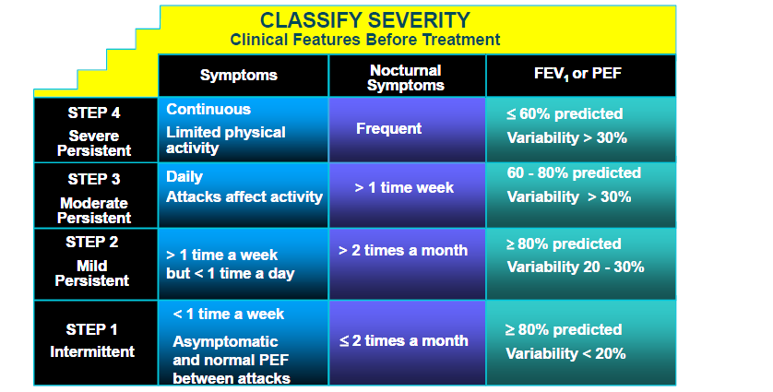
CLINICAL APPROACH TO ASTHMA THERAPY
A.
Presence of one feature of severity is sufficient to place patient in that category

Slide 19
B. Step-WISE APPROACH TO ASTHMA MANEGEMENT
Mild Intermittent
  Use: Albuterol (as needed)
Mild Persistent
  Use: Albuterol & Controllers (low dose inhaled steroids, aniallergics, montelukast)
Moderate Persistent
  Use: Albuterol & Combination Controllers (medium dose steroid + LABA &/or montelukast)
Severe Persistent
  Use: Albuterol & Combination Controllers (High dose inhaled steroids + LABA + &/or montelukast + need oral steroids
Depending on judgment, it can be applied either by beginning;
1. At high level to achieve quick control & then decrease “STEP DOWN” the medication; starting the “step down”, once persistent asthma
patient has been sustained well controlled for about 3 months
  N.B.  inhaled steroid by about 25% every 2 months until the lowest dose required to maintain control is obtained

Slide 20
2. At low level then increase “STEP UP” the medications ; starting the
“step up” if control is lost, when:
  Exacerbations are more than 3 times a week.
  Increased symptoms at night or early in the morning.
  Increased frequency of inhaled short-acting β2-AD agonist.
  Rescue course of prednisolone may be needed, at any time, at any step.
  Anti-muscarinic, are alternatives if patient is intolerant to β₂ AD agonists
  PDE Is, could be alternative to β₂ AD agonists only if persistent asthma is moderate
  (oral sustained release) or sever ( parenteral/ in hospital)
C. CAUSAL Treatment
  1. Avoidance (environmental control):
  Useful if allergic or irritant precipitating cause is known & can be avoidable. It produces a dramatic improvement.
  2. Immunotherapy: is exposure to  doses of antigenic substances, at varying intervals, in an attempt to  allergic response to it.
  Must be used for at least two yrs in order to maintain benefit.
  Immunotherapy is efficient for insect venom but not for food.

Slide 21
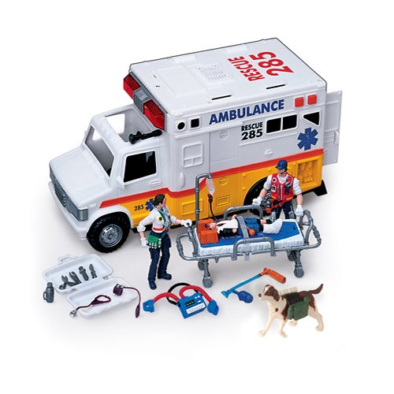
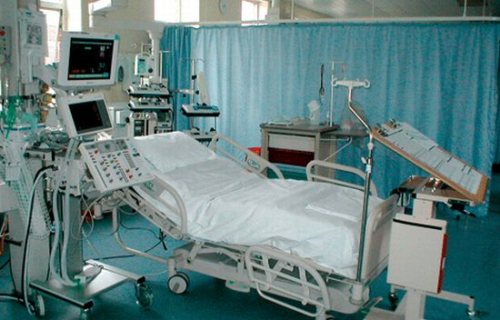
D.TREATMENT OF STATUS ASTHMATICUS
Dyspnea at rest
Cannot walk
Difficult or cannot speak
Cyanosis, confusion, drowsiness, incontinencence
Impending respiratory arrest
In ICU
Subcutaneous β₂-agonist (epinephrine)
IV aminophylline for maintainance
IV corticosteroid, to be repeated
Oxygen inhalation
Antibiotics may be used if there is bacterial infection
Repeated β₂-agonist inhalation by nebulizer
Consider artificial ventilation with intra-tracheal intubation in case of
worsening of dyspnea
Consider bronchial lavage

Slide 22
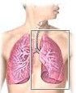
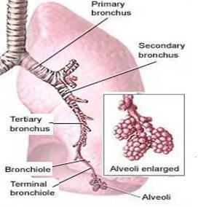
Remember that Asthma is a lung-inflammation disease
COPD
COPD
COPD
COPD is a lung- destruction disease.

Slide 23
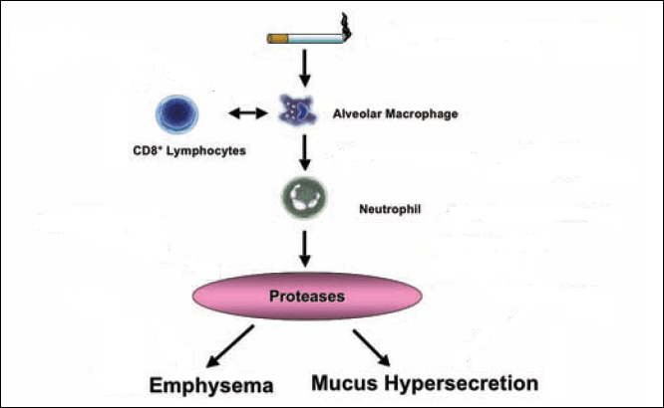
Lung- destruction Disease
 Goals is; slow the loss of lung function
COPD
COPD
SMOKING Cessation
COPD
Chemokine Antagonists
Immunosuppressants
Oxidants
Anti-inflammatory
PDE-4 Inhibitors
Protease Inhibitors
Surgery
Mucoregulators
But in view of lack of efficacy of pharmaceutical agents that can alter such progression of COPD (no disease-modifying)  treatment is driven by the need to REDUCE SYMPTOMS.
Bronchodilators
Immunomodulators & Anti-inflammatory

Slide 24
THERAPY of COPD
Bronchodilators for COPD
Short-acting
Long-acting
Fixed Combination
β₂-agonists:
Albuterol
Terbutaline
β-agonists:
Salmeterol
Formoterol
Albuterol + ipratropium
Budesonide + formoterol
Fluticasone + salmeterol
Anticholinergic:
Ipratropium
Anticholinergic:
Tiotropium
Why is it superior to ipratropium?
Methylxanthine:
Theophylline
Cilomalist
Cholinergic synapse
Ca²⁺
> Selective
Ca²⁺
TIOTROPIUM
ACh
_
Why is it benificial in COPD?
Anticholinergic
Acts for 24 hrs
Relax bronchospasm caused by irritant stimuli (irritants initiate a vagal reflex that liberates ACh)
M2
ACh
M3
M3
Decrease mucus secretion
Smooth muscle cell

Slide 25
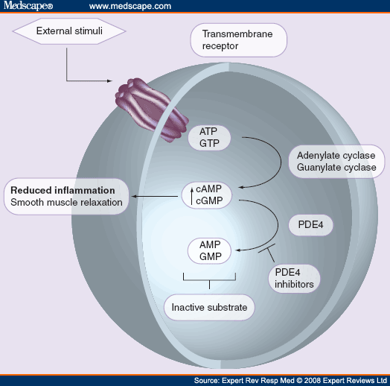
THERAPY of COPD
CILOMALIST
Is a SELECTIVE PDE-4 Inhibitor
Where is PDE-4 Localized???
It exists predominates in pro-inflammatory & immune cells
Effects
◉ (macrophages & CD8+ lymphocytes); cells considered central in etiopathogenesis of COPD
Kinetics
Orally active
Completely absorbed
Negligible first-pass metabolism
Protein bound
t_{1/2} 6.5 hours
BenefitsImproves FEV1
ADRs
GI toxicity nausea & emesis
No cardiac side effects
No CNS side effects like theophylline . Why???
Lymphocyte

Slide 26
Drugs in
OBSTRUCTIVE AIRWAY DISEASE
Good Luck

