Slide 1
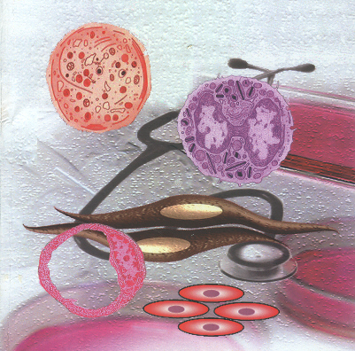
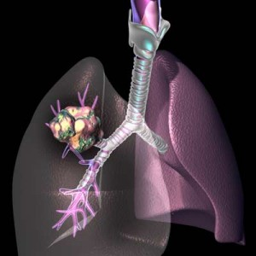
Drugs in
OBSTRUCTIVE AIRWAY DISEASE

Slide 2
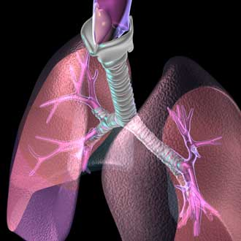
Drugs in obstructive airway disease
Asthma & COPD

Slide 3
Asthma is a lung-inflammation disease & COPD is a lung-distructive disease.
ASTHMA
Is a chronic inflammatory disorder of the airways where many cells & cellular elements play a role  causing an associated  in airway hyperresponsiveness  leading to recurrent episodes of wheezing, breathlessness, chest tightness and coughing, particularly at night or in the early morning. These episodes  are associated with widespread but variable airflow obstruction  mostly reversible, either spontaneously or with treatment.
Global Initiative for Asthma (GINA) Guidelines
Airway remodeling can occur in long-standing asthma results in PARTIALLY REVERSIBLE AIRFLOW OBSTRUCTION.
COPD
Is a disease state characterized by airflow limitation ( chronic bronchitis, emphysema, or both) that is not fully reversible. Such airflow limitation is usually progressive & associated with an abnormal response of the lungs to noxious particles or gases.
Global Initiative for Chronic Obstructive Lung Disease (GOLD) Guidelines

Slide 4
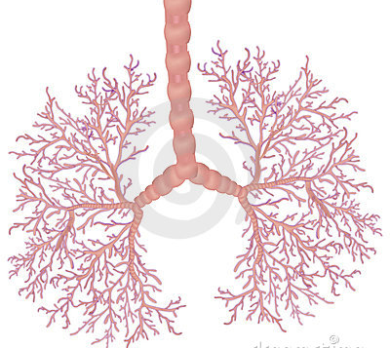
Asthma & COPD
Similarities
Both result from gene-environment interaction
Both are chronic inflammatory diseases that involve airways causing airflow limitation
Both are usually characterised by mucus, bronchoconstriction & bronchial hyperreactivity
Differences
Young > adult onset in nonsmokers
> Allergic
Asthma Sensitizing agent
COPD Noxious agent
Usually, Tobacco-related,
later in life < allergy history
Intermediate & small airways
No parenchymal involvement
Small airways +
parenchymal involvement
Inflammatory reaction involves
Eosinophils / Mast cells
CD4+ T lymphocytes
Inflammatory reaction involves
Neutrophils / Macrophages
CD8+ T lymphocytes
Normal lung volume & elastic recoil
If chronic  Remodeling  B. Membrane thickening / Sm.M. Hypertrophy
Hyperinflation / Loss of elastic recoil Alveoli emphysematous & destroyed
Gradually on going progression
Completely or partially reversible
Airflow limitation
Completely irreversible
Symptom come & go > night wake up
Symptoms; chronic (persistent) in morning

Slide 5
Asthma

Slide 6
Asthma
Types
Extrinsic (ATOPIC); Young, +ve family history, +ve allergic associations, + seasonal, + ve IgE (against the triggering antigen)
Triggered Always by allergens: food, pollens, spores, animal dander, and insects. … etc.  Once exposed & sensitized asthma can be provoked  whenever there is exposure to same trigger
More Common & Etiology becomes known  TYPE I Hypersensitivity Reaction
Intrinsic (NON-ATOPIC); Elder, -ve family history, + follows respiratory illness, perennial (lasting an indefinitely long time), + ve IgG (maybe against the injured tissues)
Triggered Initially by infections, drugs (aspirin & NSAIDs),dust, pollutants, chemicals, irritants (could be occupational)…etc.
Once exposed & sensitized asthma can be provoked by physical efforts, emotional & mental stress either in presence or despite avoidance of the triggers  i.e. can occur without an apparent provocation.
Less Common & Etiology remains unknown, may be Increased Immune Sensitivity

Slide 7
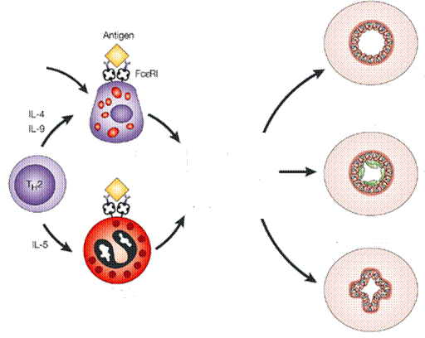
Asthma
Etio-Pathogenesis of Atopic Asthma
Through MUCOSA OF BRONCHIOLES
MEDIASTINAAL LYMPH NODES
SUBMUCOSA OF BRONCHIOLES
Bronchospasm
IgE
Antigen
Plasma C
IL-4
IL-2
IL-4
Mucous Overproduction
B Lymphocyte
+
+
Histamine
Leukotrienes
Cytokines
Proteases
MBP
ECP
IL-4
Mast C
APC
T
CD4
Th0
_
Mucosal Edema
Antigen presentation
Th1
Migrate to 
Clonal expansion &Maturation
Eosinophil
Extravasate back to 
AIRWAY OBSTRUCTION
Synthetization phase
Effector phase
TYPE I Hypersensitivity Reaction
Bronchial Response

Slide 8
Phases of Asthmatic Response
Remodeling
EarlyPhase (5-60 mins)
Mediated by; histamine & leukotrienes
Bronchial SMC contraction Bronchoconstriction
Edema & infiltration  Mucosal thickening
Thick, viscid plugs of mucous
Late Phase (4-24 hrs)
Mediated by; leukotrienes, cytokines, chemokines
Eosinophil infiltration, inflammation
Airflow obstruction & Airway Hyperresponsivness
Airway Remodeling
Occurs due to repeated attacks with residual inflammatory reaction
Mediated by proteases & ROS, Matrix Metaloproteinases, Growth Factors
Epithelial Damage, Subepithelial Fibrosis, Bronchial SMC hyperplasia
It is the cause of asthma becoming only partial reversible

Slide 9
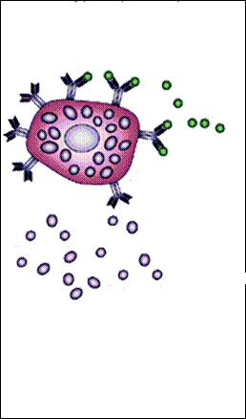
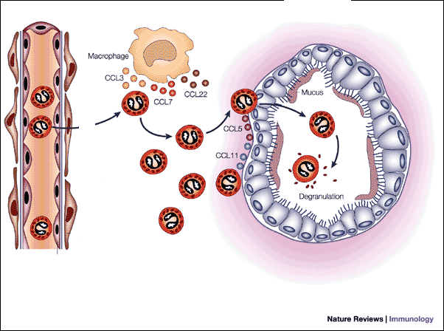
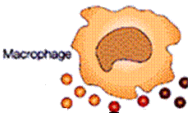
Early Phase (5-60 mins)
Phases of Asthmatic Response
Antigen
Mast C
IgE
Spasmogenics / Chemoattractants
Bronchiolar SMC
Blood Vessel
Bronchiole
Macrophage
MC/MP
Eosinophils
Inflammatory Infiltration
Interstitium
Late Phase (4-24 hrs)
REMODELING
Cells incriminated in injury
Cells responding to injury
Fibroblasts

Slide 10
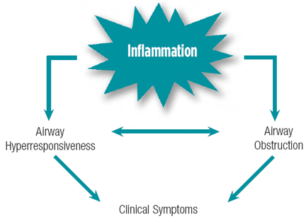
Asthma
CLINICAL SYMPTOMS
Asthmatic Attack
Chest tightness
Shortness of breath
Rapid respiration
Wheezing
Cough
Wheezing
FEV₁ = PEF  decreased reaching 60% in severe cases
↑ PaCO₂ and ↓ PaO₂
Recurrent , Episodic

Slide 11
Asthma
Goals of Therapy
Is to REDUCE INFLAMMATION as it cascades remodeling & partial irreversibility
So; first line treatment Inhaled Corticosteroids + relieve airflow obstruction symptoms by bronchodilators.
Outcome of Therapy

Slide 12
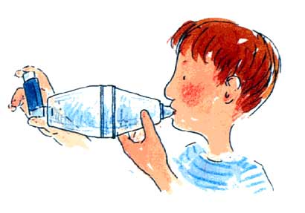
Asthma
CLASSIFICATION OF THERAPY
RELIEVERS
RESCUE
CONTROLLERS
MAINTENANCE
Induce bronchodilatation for quick
relief of acute attack symptoms
Decrease airway inflammation
to prevent airway remodeling
Selective β₂-AR agonists; Short Acting
Anti-cholinergics
PDE Inhibitors; Theophylline
Non-selective β₂-AR agonists Adrenaline, Isoprenaline
Corticosteroid
Antileukotrienes
Chromones
Anti-IgE monoclonal Ab
Prevent recur of acute symptoms
Selective Long acting β-AR agonists
Longer acting Anticholinergics
METHODS OF ADMINISTRATION
IN GENERAL INHALATIONAL THERAPY is the STANDARD METHOD UNLESS
The bronchial airways are almost obstructed in severe asthmatic state [Status Asthmaticus]  A life-threatening, prolonged & severe acute exacerbation of asthma, that does not respond to standard treatments
In children who cannot use inhalational devices
In those who develop worsening of cough & bronchospasm by the aerosoles

Slide 13
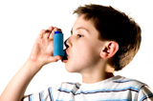
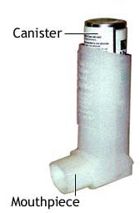
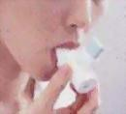
Asthma
ADVANTAGE OF INHALATIONAL THERAPY
Targeted delivery to site of action
Rapid onset; optimal in acute attacks
Minimal dosage needed
Less systemic side effects
Well tolerated
INHALATIONAL DEVICES
Metered-dose Inhalers
Dry-powdered Inhalers
Inhaler with Spacer
Nebulizers
Metered-dose Inhalers
MDIs; contain a pressurized inactive gas that propels the drug through a metering valve that dispenses a constant volume of drug in the propellant  to be inhaled directly in each 'puff‘ into the lung.
Inhalation technique is critical for optimal drug delivery
Dry Powder Inhalers
Drug is formulated in a filler & contained in a capsule in the device that is punctured to release the powder.
It is breath-activated & does not need patient coordination

Slide 14
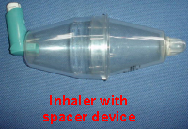
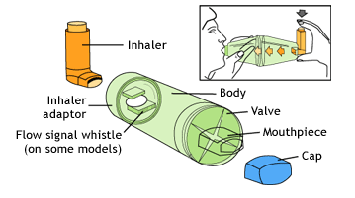
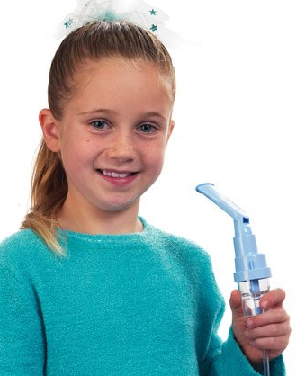
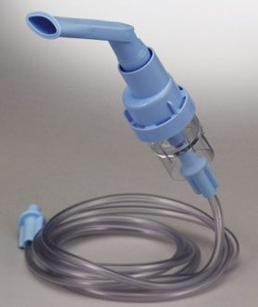
Asthma
N.B WITH INHALERSA slow, deep breath should be taken & held for 5 to 10 seconds. Proper rinsing of the mouth with water is a must.
Inhaler with Spacer
Usually are MDIs that are provided with spacers ???
A spacer (a holding chamber), insures to;
Catch all mist coming out, to be kept
within it, till all is breathed in.
Leaves less residual drug in mouth.
A facemask can be fitted sometimes,
instead of a mouthpiece
Nebulizers
Are electronic devices that transforms liquid into very fine mist, to be inhaled deeply into the lungs through a face mask or mouth piece. Useful in patients who are very breathless, mainly in hospital for severe attacks
Requires measuring the amount of medication carefully that is poured into the cup attached to the nebulizer tubing.

Slide 15
Asthma
RELIEVERS
WHAT ARE THEY?
Rescue medication
Quick relief of symptoms
Used during acute attacks
Action lasts 4-6 hrs
HOW TO INDUCE BRONCHODILATION?
WHICH DRUGS INDUCE BRONCHODILATION?
Selective β₂-AR agonists; Short Acting
Anti-cholinergics
PDE Inhibitors; Theophylline
Non-selective β₂-AR agonists Adrenaline, Isoprenaline

Slide 16
Asthma THERAPY
RELIEVERS
Bronchodilators
ADRENERGIC
HOW?
Adrenal Medulla
Vagus n.
AD
AD
AD
ß₂-AR
CHOLINERGIC
Cholinergic Ganglia
N
Postganglionic Cholinergic
AD
Ach
M₁
Bronchodilatation
M₃
M₂
Bronchoconstriction
ß₂-AR
M₃
ß₂-AR
NANC
Vasodilatation
Exudation
Sensory C Afferent Fibres
MEDIATORS CONTROLLING
BRONCHIAL REACTIVITY
Mucous secretion
Epithelial Irritation Shedding

Slide 17
Asthma THERAPY
RELIEVERS
Bronchodilators
RESCUE  for quick
relief of acute attacks
NO
β_{２} AR
M ₃ AchR
Bronchial SMC membrane
α_{ｓ}
β
γ
αq
β
γ
DAG
AC
ATP
G_{S}
Gq
PLC
PKC
Ca ²⁺
GTP
IP₃
c-GMP
c-AMP
-
Ca ²⁺
GMP
PDE
Ca/
CaM
AMP
PKA
Phosphatase
Phosphorylation
Dephosphorylation
PDE Inhibitors
P
MLCK
MLCK
MLC
P
MLC
Relax
Contraction
Anticholinergic agent
Selective (Short Acting) / Non-Selective β₂-AR agonists

Slide 18
Asthma THERAPY
1. Selective β₂- AR agonists
Act on β₂ AR G_{s}- protein coupled receptors
Bronchodilators
Mechanism
1. On BRONCHIAL SM
Stimulation of β₂ AR cAMP  activate PKA phosphorylate & -ve MLCK SM relaxation  BRONCHODILATATION
N.B. NO or Little β₂ AR desensitization to bronchodilation action of SHORT ACTING β₂ AR agonists
The main Reliever Action of
SHORT ACTING β₂- AR agonists
SO USED TO RELIEVE SYMPTOMS OF ACUTE ATTACKS
3. ON BRONCHIAL EPITHELIUM
Stimulation of β₂ AR NO release  cGMP  activate PKG phosphorylate & -ve MLCK SM relaxation  BRONCHODILATATION
2. ON PRESYNAPTIC PARASYMPATHETIC FIBRES
Stimulation of β₂ AR  Ach release inhibit M₃ AchR   Ca  -ve MLCK  SM relaxation  BRONCHODILATATION

Slide 19
Asthma THERAPY
1. Selective β₂- AR agonists
Bronchodilators
4. On MUCOCILIARY FUNCTION & MICROVASCULAR LEAK
Stimulation of β₂ AR in submucosa
◉ microvascular leak   bronchial edema
 mucous secretion (submucosal glands) +  ciliary beating   mucociliary clearance
Helps in Reliever Action of
SHORT ACTING β₂- AR agonists
In ACUTE ATTACKS
5. On MAST CELLS > EOSINOPHILS, T-LYMPHOCYTES…..etc
Stimulation of β₂ AR   mediators & cytokine release inflammation  bronchoconstriction
Part of its ANTI-INFLAMMATORY ACTION
The main Controller Action of
LONG ACTING β₂- AR agonists [LABA]
SO NOT USED TO RELIEVE SYMPTOMS OF ACUTE ATTACKS
The Short Acting β₂- AR agonists
Salbutamol(albuterol)
Terbutaline
Mechanism; 1,2,3,4 > >> 5

Slide 20
Asthma THERAPY
The Short Acting β₂- AR agonists
Bronchodilators
Benefits of Use
In rescue therapy Excellent bronchodilation without cardiac or systemic toxicity 
Rapid onset but short duration
Maximum effect occurs within 30 mins
Duration of action: 4-6 hours
In prophylaxis  Effective protection against various challenges: exercise, cold air & allergen  prior known exposure to triggers & not on regular schedule
Administration Frequency
4 hr dosing: 4 puffs (90 mcg/puff ) / can be  to 2 hrs dosing: 8 puffs accord-ing to severity & respective response
Limitations & ADRs
Exceeding the recommended dosage frequency or not following instructions (i.e wash mouth) will intensify development of systemic side-effects
heart rate
Cardiac arrhythmias
CNS effects; tremors
Muscle cramps
Metabolic disturbances

Slide 21
Asthma THERAPY
2. Anticholinergics
Bronchodilators
Block excitatory muscarinic receptors M₁ & M₃
Block inhibitory muscarinic M₂
Tiotropium
Ipratropium
Mechanism
Mainly by block of M₃ on bronchial SMC Gq signaling  -ve PLC/ PI₃ / Ca /CaCaM -ve activation of MLCK relaxation  Bronchiodilatation
Inhibit mucus secretion
Kinetics
Both are not absorbed orally
Given regularly only by inhalation (no tolerance develop)
Have slow onset of action (30-60 min)
Ipratropium  short acting (6-8hrs), weaker
Tiotropium  long acting (> 24hrs), potent  superior
AS RELIEVER
Benefits of Use
AS CONTROLLER & IN COPD
Best results in COPD. Given 2nd line adjuvant for relief of attacks if response to β₂-AR agonist is not satisfactory or if patient is intolerant
Limitations & ADRs
Limited systemic muscarinic side effects ( Dry mouth, Constipation
Headache, Urine retention )

Slide 22
Asthma THERAPY
3. PDE Inhibitors
Bronchodilators
Non-Selective
Selective
Methyl Xanthines
(Caffaine, Theobromine & Theophylline)
PDE-4 Inhibitors
Cilomilast ( orally)
Theophylline (orally)
Aminophylline (oral or parenteral)
CONTROLLER ACTION
In COPD > asthma
Are essentially CNS stimulants but possess
bronchodilator, inotropic, diuretic …etc actions
Mechanism
 In ASTHMA
1. Non-Selective Inhibition of PDE (3,4,5,7)  No inactivation of cAMP &/or cGMP;
Bronchiodilatation as PKA & PKG remain activated  pertain -ve MLCK
◉ microvascular leak   bronchial edema
 ciliary beating   mucociliary clearance
Anti-inflammatory effect;
-ve mast cell degranulation, leukotriene synthesis
-ve T-cell responses (particular CD8⁺)
responsiveness to corticosteroids [Cross Talk]
RELIEVE SYMPTOMS OF ACUTE ATTACKS
CONTROLLER ACTION
In COPD > asthma

Slide 23
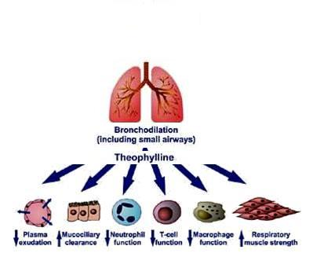
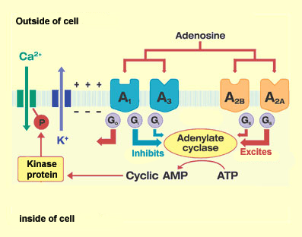
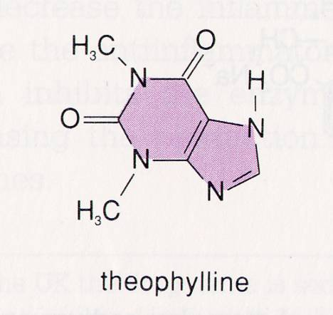
Asthma THERAPY
3. PDE Inhibitors
Mechanism
 In ASTHMA
Bronchodilators
2. Non-Selective Block of adenosine receptor (A₁, A₂ _{A}, A_{2B}, A₃) 
Bronchiodilatation  -ve NANC induced bronchoconstriction
+ ve sk. muscle contractiondiaphragmatic contractions
& + delays fatigueVentilation
Pulmonary vascular resistance
Anti-inflammatory effect;
-ve mast cell degranulation (A_{2B})
-ve partially airway remodeling (-ve fibroblasts)
responsiveness to corticosteroids [Cross Talk]
RELIEVE SYMPTOMS
CONTROLLER ACTION
Theophylline induced hyperpolarization
Theophylline induced immunosuppression

Slide 24
3. PDE Inhibitors
Asthma THERAPY
Other Pharmacological effects
Bronchodilators
On CNS;
+ve to higher cortex (wakefulness, delayed fatigue,…etc) & medullary centers; resp, cardiac,…etc
Cerebral vasoconstriction
On CVS:
Heart; + ve inotropic & chronotropic effects i.e (contractility & HR )
Blood Vessels; relax VSMCs  vasodilatation  BP & coronary dilatation
GIT: gastric acid secretions
Kidney :  renal blood flow  diuresis
Kinetics
Absorbed orally  better given after meals
Metabolized in liver by Cyt P450  subjected to change in therapeutic
levels t ½ = 8 h
Benefits of Use
As RESCUE THERAPY in HOSPITAL for severe asthma (if β₂ inhalation fails) or if there is status asthmaticus  by slow IV infusion
As CONTROLLER 2nd line therapy for bronchodilatory & anti-inflammatory potentials  given as a sustained-release oral preparation.

Slide 25
3. PDE Inhibitors
Asthma THERAPY
Limitations & ADRs
Bronchodilators
Has very narrow therapeutic index  must be therapeutically monitored  ranges kept from 5-20 μg/L
Nausea, vomiting, anorexia, diarrhea
Tachypnea
Headache, restlessness, insomnia, anxiety
Cardiac arrhythmias (ventricular may be fatal), hypotension  when levels > 30 μg/L
Seizures  when levels > 40 μg/L  Uncontrolled seizures may lead to hyperthermia and rhabdomyolysis
Interaction
Its therapeutic level & t_{1/2} decrease with concomitant administration of enzyme inducers (phenobarbitone, rifampicin)
Its therapeutic level & t_{1/2} increase with concomitant administration of enzyme inhibitors (cimetidine, erythromycin)

Slide 26
Asthma THERAPY
4. Non - Selective β₂- AR agonists
Bronchodilators
Adrenaline
Act on all α & β AR
Potent, rapidly acting (5 min), maximum effects (15 min), lasts (60-90 min)
Was formerly a mainstay of therapy to be given S.C. in home settings
Now reserved mainly to status asthmaticus, to be given by slow drip infusion in a hospital settings
Systemic ADRs & contraindications of non-selective
α & β AR activation has to be considered
Isoprenaline
Acts on β1 & β2 AR
Potent, rapidly acting (5 min), maximum effects (15 min), lasts (60-90 min)
Was formerly a mainstay of therapy to be given S.C. in home settings
Now reserved mainly to status asthmaticus, to be given by slow drip infusion in a hospital settings
Systemic ADRs & contraindications of non-selective α & β AR activation has to be considered

Slide 27
Asthma
To Be Continued

