Slide 1
Antiviral Drugs Prof. Alhaider, 1431 H
Definition:
What are the differences between bacterial and viral infections?
Classification of Antiviral Drugs:
Note: To understand the classification of antiviral drugs, students should remember the steps that are involved in viral replication (See Figure 491). However, most antiviral agents interfere with nucleic acid synthesis or late synthesis of viral proteins.
Furthermore, most of them act as antimetabolites.

Slide 2
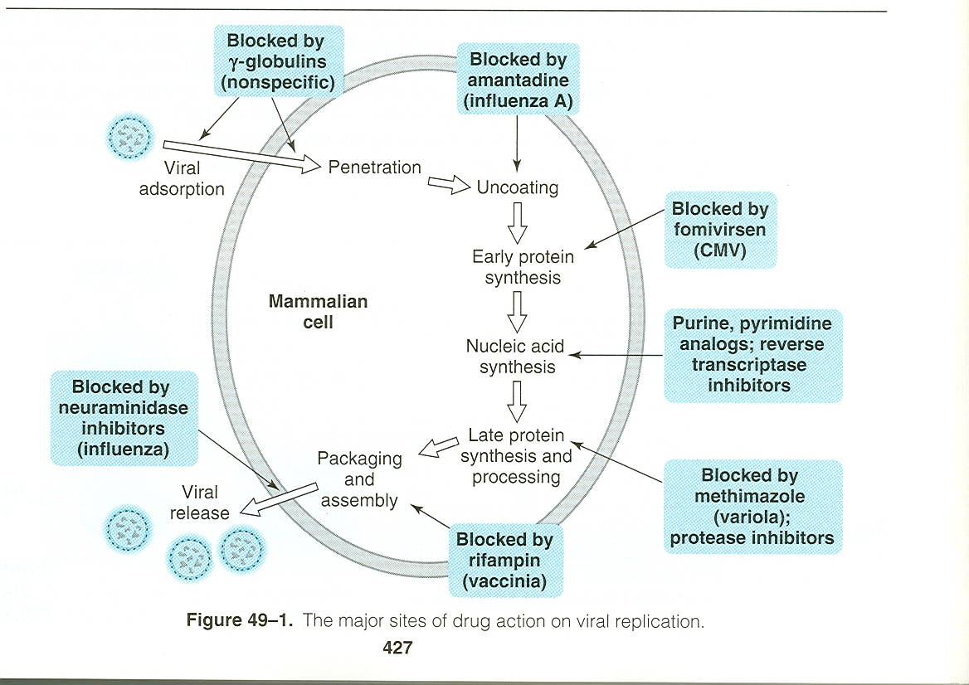

Slide 3
Classification of Antiviral Drugs
Best Classification Based on 1) Type of Viral Infections (Organisms) or 2) its site:
I. Agents to Treat Herpes Simplex virus (HSV) and Varicella Zoster Virus (VZV) infections.
II. Agents To Treat Cytomegalovirus infection (CMV)
III. Drugs Used for Rx of AIDS (Antiretroviral Agents)
IV. Antihepatitis Agents
V. Antiviral Used for Respiratory Tract Infections:

Slide 4
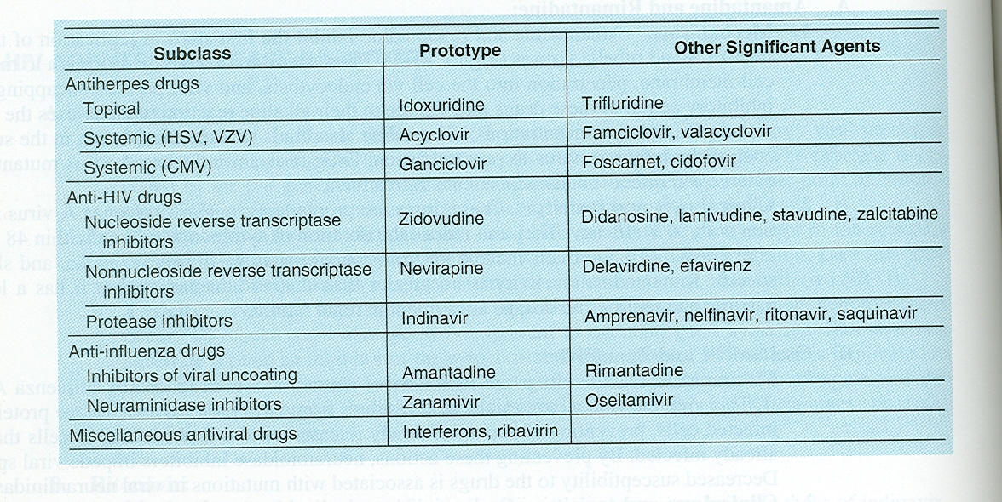
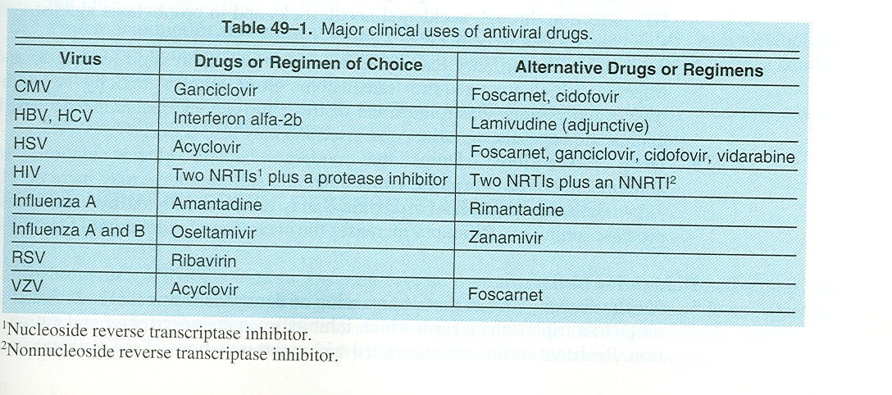
Table 2: Types of Antiviral drugs
1
2
3
4

Slide 5
Agents to Treat Herpes Simplex virus (HSV) and Varicella Zoster Virus (VZV) infections.
Examples: Acyclovir (prototype); Valcyclovir; Famiciclovir; Trifluridine (Topical)
MOA: (49-2) They are guanosine analogs without sugar moiety (so what?).
Three phosphorylation Steps are required for activation (one depends on viral thymidine kinase), forming triphosphate form (1 in the viral 2 on the host). This (acyclo-GTP), will incorporate into viral DNA-causing premature DNA-chain termination (irreversible binding to viral DNA polymerase) and inhibition of DNA snythesis.
What is the effect of drugs on the host cells (not infected)?

Slide 6
, Ganciclovir
)P

Slide 7
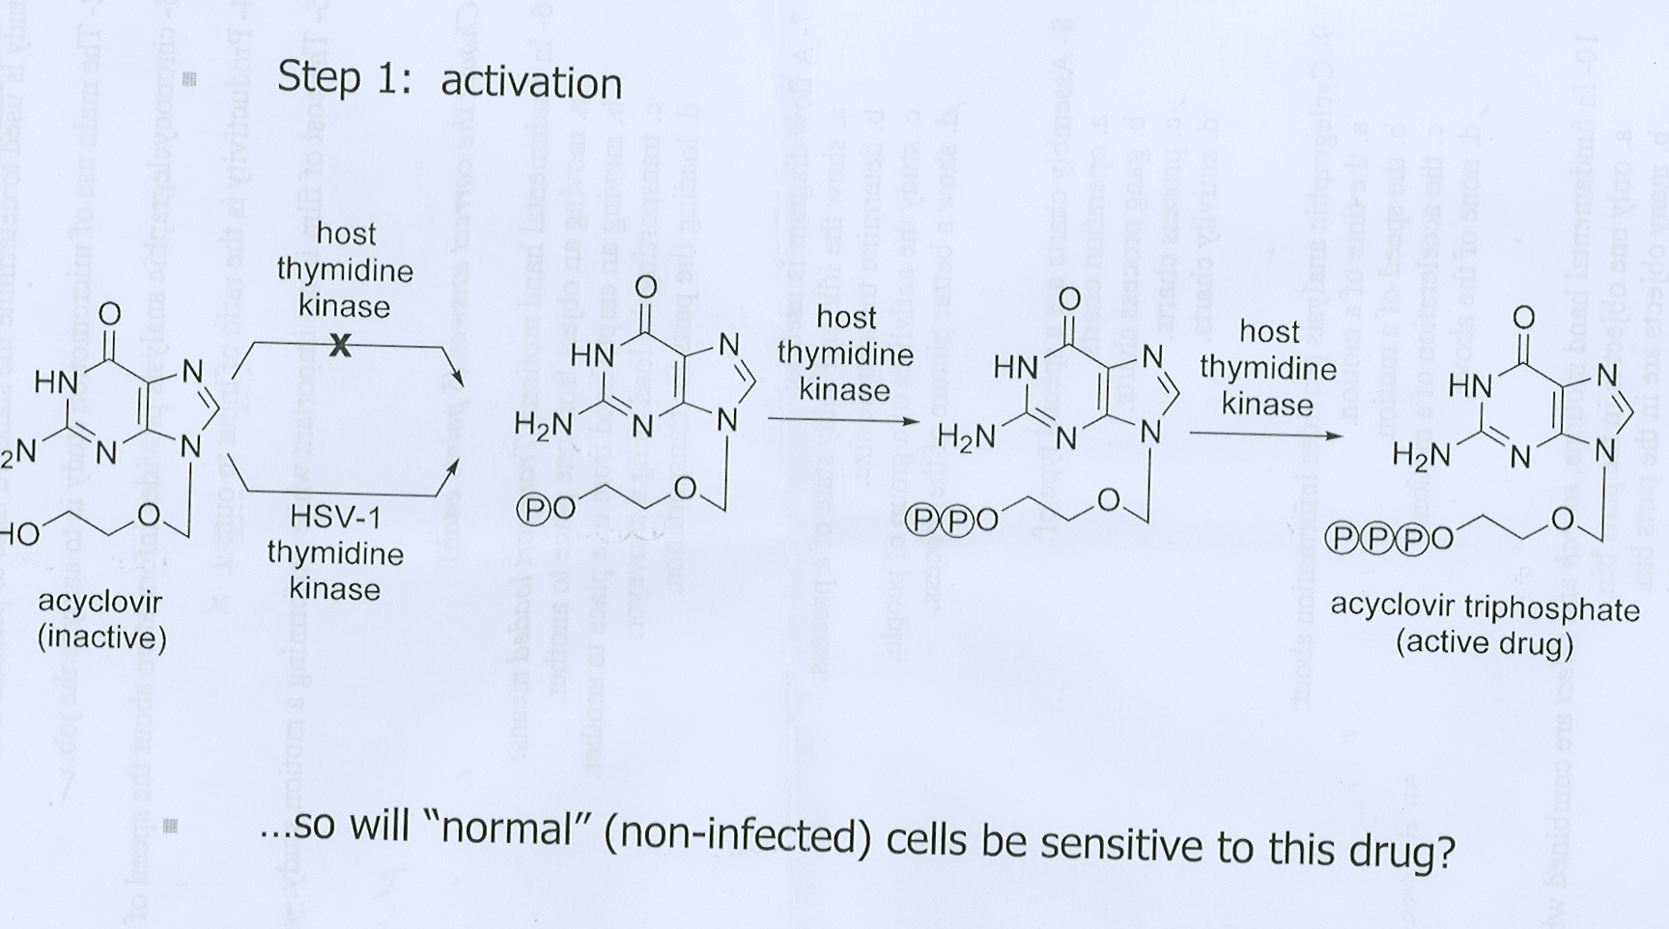

Slide 9
Resistance: Can be developed due to deficient or alteration of thymidine kinase and or alteration DNA polymerases.
Cross resistance: to valcyclovir, famiciclovir and gancyclovir
but no cross resistance for cidofovir (Cytomegalovirus drug)? Why (see Fig 49-2)

Slide 10
PK of Acyclovir :
is available as oral (15-20%) (not affected by food), topical and i.v.
Does it have high or low oral bioavailability?
Short t_{1l2} 3 hr (thus given 4-5 times daily) and eliminated mainly by kidney (t_{1l2} prolonged in renal impairment) t_{1l2} 20 hr.
Distribute in ALL parts of the body, including CNS (e.g: encephalitis) .
What is Valacyclovir?.
What is the meaning of a prodrug?
Clinical Uses (see Table 49-1)
HSV, Varicella-zoster VZV; Epstein-Barr virus mediated infection; HSV encephalitis; Genital herpes infection.

Slide 11
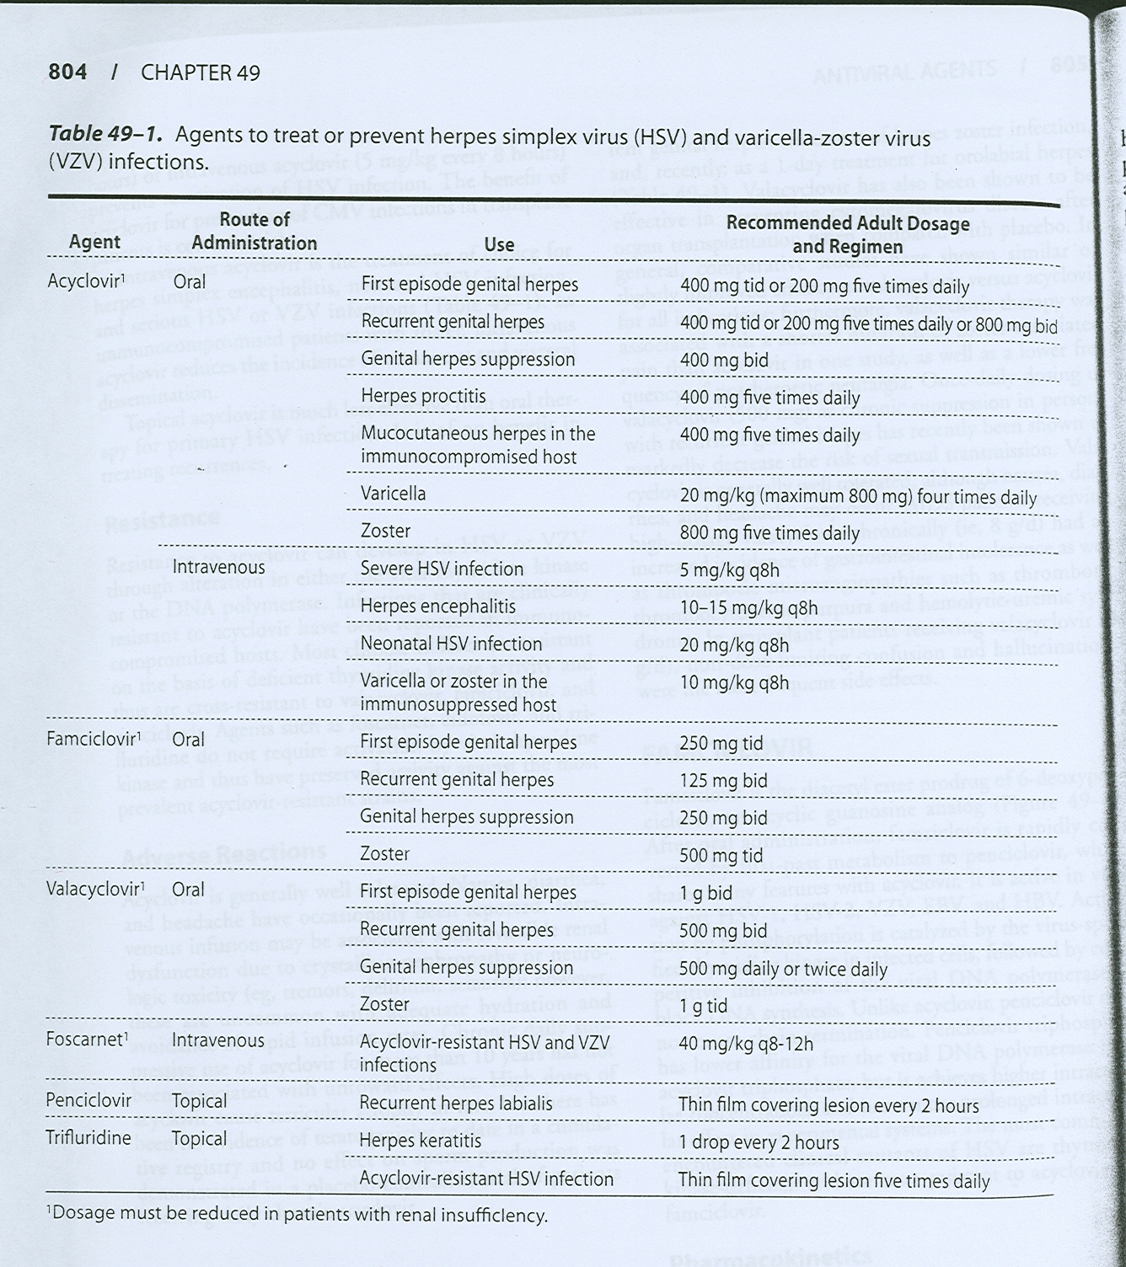

Slide 12
Side Effects of Acyclovir
(Generally speaking, acyclovir considers to be save drug Why?, however, it may produce:
1 . Transient Renal dysfunction at high dose or at i.v (Crystalline Nephropathy). RX
2. GIT disturbances
How valcyclovir differs from acyclovir?
High oral bioavailability; long duration (almost five times the plasma concentration)
Can replace i.v cyclivir
Effective even for CMV
Side Effects: Thrombotic thrombocytopenic purpura in pts with AIDS

Slide 15
II. Agents To Treat Cytomegalovirus infection (CMV)
Ganciclovir: Analog of acyclovir
Why Acyclovir is not active against CMV?
MOA: Similar to acyclovir
PK: How does it differ from acyclovir?
What is valganciclovir?
Clinical Uses of Ganciclovir:
i.v: (commonly used formulation)
- to delay the progression of CMV retinitis in patients with AIDS 2 weeks followed by oral form)
- for CMV colitis, esophagitis and pneumonitis.
- to prevent CMV before trasplantation.
Oral: (Used for prophylaxis)
- CMC prophylaxis in transplant patients
- prevention of end organ CMV disease in AIDS patients.
- as maintenance therapy for CMV retinitis.
Intraocularly (implant):
Rx CMV retinitis.

Slide 16
Adverse Effects of Ganciclovir:
- Myelosuppression (neurtroprnia 20-30%) and increases if given with? Zidovudine; azathioprime, mycophenolate mofetil)
- Vitreous hemorrhage and retinal detachment with intraocular implant.
- Mitogenicity in mammalian cells and - carcinogenic in animals at high dose
What is valganciclovir and when it should be used?
Simply it is an oral replacement for i.V Ganciclovir.

Slide 18
Cidofovir:
Differs from acyclovir in its long t1/2 26 hr with active metabolite.and MOA.
Activity: CMC; HSV; VZV and in:
MOA: phosophorylation does not depend on viral enzyme, and works as inhibitor and alternative substrate for viral DNA polymerase.
Used for CMV retinitis, colitis, and esophagitis.
and for Acyclovir-resistant
PK: produce active metabolite, thus it has long t1/2, eliminated in the kidney, Probenicid prolonged its action. but with poor CNS penetration.
Why acycliver is better than Cidofovir for encephalitis?
Side effects: Dose-dependent nephrotoxicity (53%) and uveitis and decrease IOP

Slide 19
Note: Normally, RNA from DNA, however,
Reverse transcriptase = RNA-directed DNA polymerase (DNA polymerase that transcribes single- stranded RNA into double-stranded DNA.

Slide 20
III. Drugs Used for Rx of AIDS (Antiretroviral Agents)
AIDS are caused by HIV, and zidovudine was the first drug used (1987).
To understand drugs used for AIDS, the life cycle of HIV should be utilized for drugs combination (See Figure 38-16)
Drug combination or the so-called Highly Active Antiretriviral Therapy (HAART) (Figure 38-17) as well as adherence to the regimen, both are very essential.
Classification of Anti AIDS (Based on life cycle) Table 2 and Figure 38-17):
1) Nucleotide Reverse Transcriptase Inhibitors (NRTIS) e.g.;
2) Non Nucleotide Reverse Transcriptase Inhibitors (NNRTIS) e.g.;
3) Protease Inhibitors e.g. Saquinavir; Ritonavir; Indinavir
4) Viral Fusion Inhibitor e.g. Enfuvirtide

Slide 22
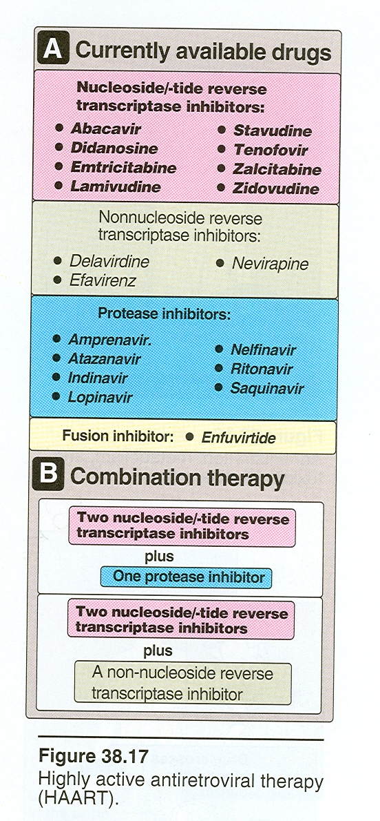

Slide 23
Objectives of HIV Treatment:
Suppression of viral replication (decrease the viral load).
Restoration of a degree of immunocompetency to the host.
Decrease incidence of opportunistic infections.
prolonged survival

Slide 25
Table 2: Types of Antiviral drugs

Slide 26
Nucleotide Reverse Transcriptase Inhibitors (NRTIS)
Chemistry (Figure 49-4): These are analogs of native ribosides (nucleotide with side chain containing ribose) but lack the 3’-hydroxy group.
MOA: Similar to most antiviral drugs, require triphosphorylation but mainly by cellular enzyme. Competitive inhibitor of HIV-1 reverse transcriptase. The triphosphorylated analog (with no hydroxyl group) incorporate into viral DNA by virus RT, preventing DNA chain elongation (See Figure 38-16)
NRTIS can be classified into group A (thymidine Analoges) (Zidovudine and Stavudine) and group B: (Didanosin; Zalcitabine and Lamovidin)

Slide 27
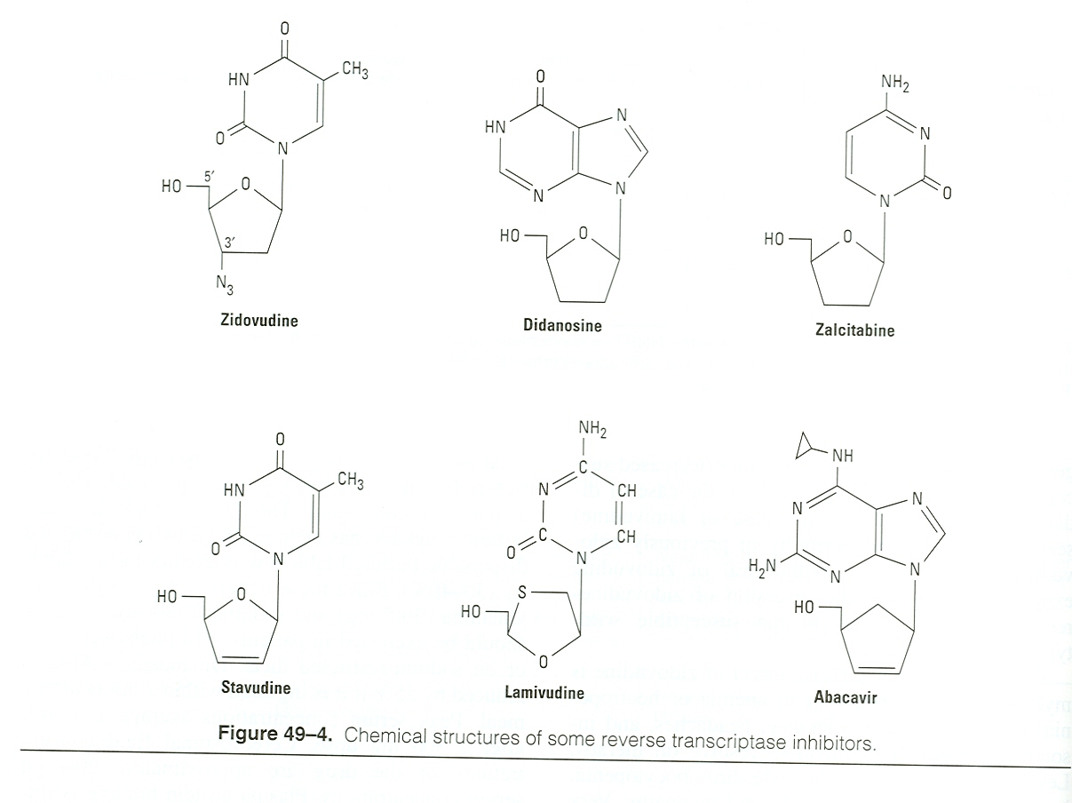
Group A
Group B

Slide 29
Zidovudine (AZT): 3-azido3deoxythymidine (AZT) (Pyrimidine Analog) Important Discovery 1987 G
MOA: Requires mammalian thymidine kinase for triphophorylation.
Resistance: Due to high rate of mutation at several code.
PK:
Excellent oral absorption
Penetrate well to CNS but has short t_{1/2}.(3 hrs 100 mg q 5 hr)
Metabolized by liver to glucuronated AZT but eliminated by kidney, therefore:
Its half life is affected in uremic and hepatic patients and by drugs that metabolized by glucoronidation. E.g.
Uses:
-The most important drug in HAART.
- for Rx and prevention of neanate (transmission) 14-35 of gestation and i.v during labor then AZT syrup from birth till 6 weeks.(decrease vertical transmission).
Does it decrease the severity of infection in mother?
Adverse effects:
- Pronounced bone marrow suppression as severe anemia & leucopenia (increases if given with?); thrombocytopenia .
- Headache, insomnia & seizure at higher doses.

Slide 30
Stavudine:
This is like AZT, a thymidine analogue (activated by the same enzymes) therefore, should not be combined with AZT
Like AZT has good oral bioavailability
Eliminated mainly by tubular secretion and glomerular filtration.
Major Side effect: sensory neuropathy and Hyperlipedemia but no leucopenia
Note: MCQ on side effect of Stavudine specially that related to neuropathy.

Slide 31
Tenofovir:
(it has one phospahate group in its structure) therefore requires only two phosphorylation
Has long t1/2 (once daily)
Similar to AZT requires dose adjustment in renal impairment.
Unlike AZT has no myelosuppressive effect.

Slide 32
Didanosine (dideoxyinosine) With out the two hydroxyl group.
Differ from Zidovudine:
Low oral bioavailability and destroy by acid (given before meals), but they change to chewable Tablets.
Used for AZT resistance.
Like AZT, Its elimination is dependent on kidney.
However, It is a chelating agent (interaction with tetracyclins and fluroquinoline (Two hour should be given before or after).
Side Effects:
Pancreatitis (check serum amylase) increases in alcoholics
Peripheral neuropathy (Dose related); hepatitis, but unlike AZT has no leucopenia.
Optic neuritis
Hyperuricemia
Note: should not be combined with AZT! Antagonize each other.
Zalcitabine:
Similar to Didanosine

Slide 33
Lamivudine:
This cytosine analog is the most interesting anti viral drug, because it can be used for HIV and HBV infections.
Advantages:
- Like AZT has good oral bioavailability with active metabolite.Safest drug among NRTI
- Can be combined with AZT
COMBIVIR (Lamovidine 150 mg + Zidovudine 300 mg)
- No significant side effects because it does not affect mitochondrial DNA synthesis or bone marrow precursor cells
Disadvantages:
has high rate of mutation if given alone, therefore should be combined in case of AIDS and hepatitis).
Is there any differences in the dose of Lamivudine for HIV and HBV patients?

Slide 34
Zalcitabine (dideoxycytidine ddc)
Does it remind you with Didanosine?
This drug used as replacement for Lamivudine in HIV, but differ in the following:
1) Oral bioavailability is dependent on food (Why?)
2) Similar to didanosine, it produces dose dependent neuropathy due to inhibition of mammalian mitochondrial DNA polymerases.
3) Pancreatitis but less than didanosine.

Slide 35
Emtricitabine:
This is fluoro-derivative of Lamuvidine; can replaced the former in HBV and HIV pateints.
Which of the following drugs does not cause peripheral neuropathy?
a) Lamivudine
b) Stavudine
c) Didanosine
d) Zalcitabine

Slide 36
2) Non Nucleotide Reverse Transcriptase Inhibitors (NNRTIS) e.g.;Nevirapine; Efaverenz
MOA: Bind selectively and non-competitive way to HIV reverse transcriptase at a side adjacent to that of NRTIs, and from their names they are neither nucleotide triphosphate nor require phosphorylation to be active.
Resistance:
Rapid resistance can be developed but it is not cross resistance to NRTIs or protease inhibitor.
Main features:
These drugs are lipophilic in nature with high degree of protein binding and oral bioavailability. Also, some of them either inhibit or enhance the liver metabolic enzymes.
Hypersensitivity has been observed with their use as serous rashes and Steves-Johnson syndrome. LFT

Slide 37
Nevirapine:
PK:
Lipophilic drug with high oral bioavailability.(not food dependent)
Metabolized by liver and it is enzyme inducer, may decrease the t_{1/2} of some drugs including anti AIDS, contraceptives and warfarin.
Uses:
In AIDS, it is only used together with other antiretrovirals.
Single dose (200 mg) for transmission of HIV from mother to newborn
A single dose of nevirapine to the mother, with or without a dose of nevirapine to the infant, added to oral zidovudine prophylaxis starting at 28 weeks' gestation, is highly effective in reducing mother-to-child transmission of HIV. N Engl J Med. 2004 Jul 15;351(3):217-28. Epub 2004 Jul 9
Disadvantages;
Life threatening skin rashes including Stevens-Johnson Syndrome and toxic epidermal necrolysis (can be reduced by Starting with low dose).
Fulminant hepatitis
Delaviridine:
It is unlike nevirapine, it inhibits CYP3A, with rash but not to the degree of Stavens Johnson Syndrome.

Slide 38
Efaverenz (commonly used NNRTI Safest):
Drug with long t_{1/2} (40-55 hrs) with high albumin binding; metabolized in the liver with some enzyme induction.
Side Effects: Occur only in the beginning of therapy, mainly in CNS (agitation, delusion; nightmares; euphoria)
Note: Unlike, nevirapine, efaverenz should not be used in pregnancy (fetal abnormalities)
Note: Enzyme inhibitors and inducers affects ALL NNRTI to the same level.

Slide 41
HIV Protease Inhibitors:
Very good Discovery 1995, make significant Decline
MOA:
Reversible inhibitors of the HIV aspartyl protease
What is aspartyl protease?
Are these drugs specific for HIV protease as compared to human? (Thousand)
PK:
In contrast to NNRTIs, most protease inhibitors have poor oral bioavailability and affected by by meal.
All are metabolized in the liver CYP3A4 isozyme of Cyto P450, and some of them like Ritonavir is CYP3A4 inhibitor.
High protein binding and pass blood BB.
What is the pharmacokinetic enhancer?

Slide 42
What is the pharmacokinetic enhancer?
Drug Interaction: Pharmacokinetic Type
Since they are inhibitors of CYP isozyme (Ritonavir (strong) while Saquinavir is the least) Drug interaction so common e.g: Statins; Benzodiazepines; Fentanyl; warfarin; phenytion
Side Effects:
Common: Parasthesias, N/V and Diarrhea. Hyperglycemia, Hypertriglyeridemia, LDL. Chronic use gives rise to Buflo hump and breast enlargement.(Similar to steriods but noosteoporosis)

Slide 43
Ritonavir
Is not uesd alone as a single protease inhibitorm but it is used as pharmacokinetic enhancer.
Side effects: GIT; paresthesia; hypertriglycemia; elevated AST
Indinavir:
Well absorbed orally with lowest protein binding among this group and high penetration to the CNS; but should be given in empty stomach.
Enzyme inhibitor
It is given together with Ritonavir as Trade name
Side Effects:
- Indirect hyperbilirubinemia,thrombocytopenia and nephrolithiasis due to crystallization of the drug (good hydration). Fat disribution.
Lopinavir/Ritonavir (Common and prefered combination)
Here, Ritonavir is used to suppress CYP3A4 .
What are the drugs that decrease the level of Lopinavir?

Slide 44
Lopinavir 100mg /ritonavir 400 mg (continue…) - Advantages - potent antiretroviral activity - co-formulated as Kaletra(^{R}) - once daily dosing is an option for treatment-naive patients - no food restriction with oral tablet formulation - Disadvantages - GI intolerance (once daily associated with a higher incidence compared with twice daily) - hyperlipidemia - possibly lower drug exposure in pregnant women
Saquinavir:
Available as hard gel capsule or soft. However, this drug has very short t_{1/2} and low bioavailability (12% and decreases of taken with fatty meal); therefore, it is combined with ritonavir. Why?
Side Effects: Headache and nausea.

Slide 45
MCQs
Which of the following are protease inhibitors:
Nelfinavir
Saquinavir
Abacavir
Ritonavir
Tenofovir
Nevirapine is a
1) Protease inhibitor
2) NRTI
3) NNRTI
4) Fusion inhibitor
Regarding Ritonavir in AIDS
1) should not be used alone
2) contraindicated in renal failure
3) GIT symptoms can be seen
4) may decrease the level of warfarin

Slide 46
Regimens for R_{X} of AIDS patients.
Highly Active Antiretriviral Therapy (HAART) (Figure 38-17) consists of:
Two NRTIs (why) plus:
One NNRTI or protease inhibitor
However, now aday most regimens use protease inhibitors
What should be done if some one working in the medical field is exposed accidentally to AIV virus?
How to decrease the development of mutation to HIV medications?
1) Drugs combination
2) Adherence to medication (missing 6 doses/year)

Slide 47
Regimens - Preferred: (One NNRTIs Plus Two NRTIs) - Efavirenz (NNRTI) plus (lamivudine or emtricitabine) Plus (zidovudine or tenofovir (NRTI)) (except in first trimester of pregnancy or women with high pregnancy potential) - Alternative: - Efavirenz plus (lamivudine or emtricitabine) plus (abacavir or didanosine or stavudine*) (except in first trimester of pregnancy or women with high pregnancy potential) - Alternative:
- Nevirapine**(NNRTI) plus (lamivudine or emtricitabine) plus (didanosine or zidovudine or stavudine* or abacavir or tenofovir) - * Stavudine has higher incidence of lipoatrophy, hyperlipidemia, and mitochondrial toxicities than other NRTIs

Slide 48
Protease Inhibitor-based Regimens (2 NRTI plus prorease inhibitor) - Prefered - Indinavir/ritonavir (Kaletral) * plus (lamivudine or emtricitabine) plus (zidovudine or stavudine** or abacavir or tenofovir or didanosine) - Alternative: - Lopinavir/ritonavir plus (lamivudine or emtricitabine) plus (stavudine** or abacavir or tenofovir or didanosine)
However, there are too many protocols for this type of treatment

Slide 49
3) Viral Fusion Inhibitor):
Enfuvirtide
MOA: Block entry into the cell.
Use: not orally but SC for resistance HIV-1 patients.
Regimens for R_{X} of AIDS patients (HAART) (see Fig. 38-17).

Slide 51
IV. Antihepatitis Agents:
Like in AIDS, they are suppressive rather than curative. Among many hepatitis viruses, HBV and HCV are the most common cause of chronic hepatitis, cirrhosis, and HCC.
Drugs for Hepatitis B (see Table )
Lamivudine:
MOA: inhibit HBV DNA polymerase and HIV reverse transcriptase, resulting in chain termination.
This safest NRTI antiretroviral drug, shows prolonged intracellular t_{1/2} in HBV cell lines (17-19 Hr), than in HIV-infected cell line. So What?.
Effectiveness:
Achieves almost universal HBV DNA suppression, with decrease in viral replication; and decrease progression to liver fibrosis.
Response is more rapid than using interferon alone.
What will happen of lamivudine is stopped?

Slide 52
Resisitance:
20 % can occur after 8-9 months of therapy.
What is the evidence of resistance?
2. Aldefovir:
This nucleotide (NRTIs) analog is also HBV infection especially in lamivudine resistance cases.
Is there any cross resistance between lamivudine and Aldefovir?
Side effects:
Eliminated by glomerular fil.and tubular secretion, thus it is nephrotoxic.
Lactic acidosis and hepatomegaly with steotosis may occur.

Slide 53
3. Interferon Alfa:
Endogenous glycoprotein or cytokine that produced in human leukocytes and exert anitviral, immunomodulatory and antiproliferative activities.
Commercially available as:
Interferon alfa-2b: Licensed for Rx of HBV and acute hepatitis C.
Interferon alfa-2a: can be used for HCV (Either alone or better with oral Ribaverin (quanosine analog).
Note: Both types can be used for HCV
MOA:
Unclear but may be via the induction of host cell enzymes that inhibit viral RNA translation and thus degradation of viral mRNA and tRNA.

Slide 54
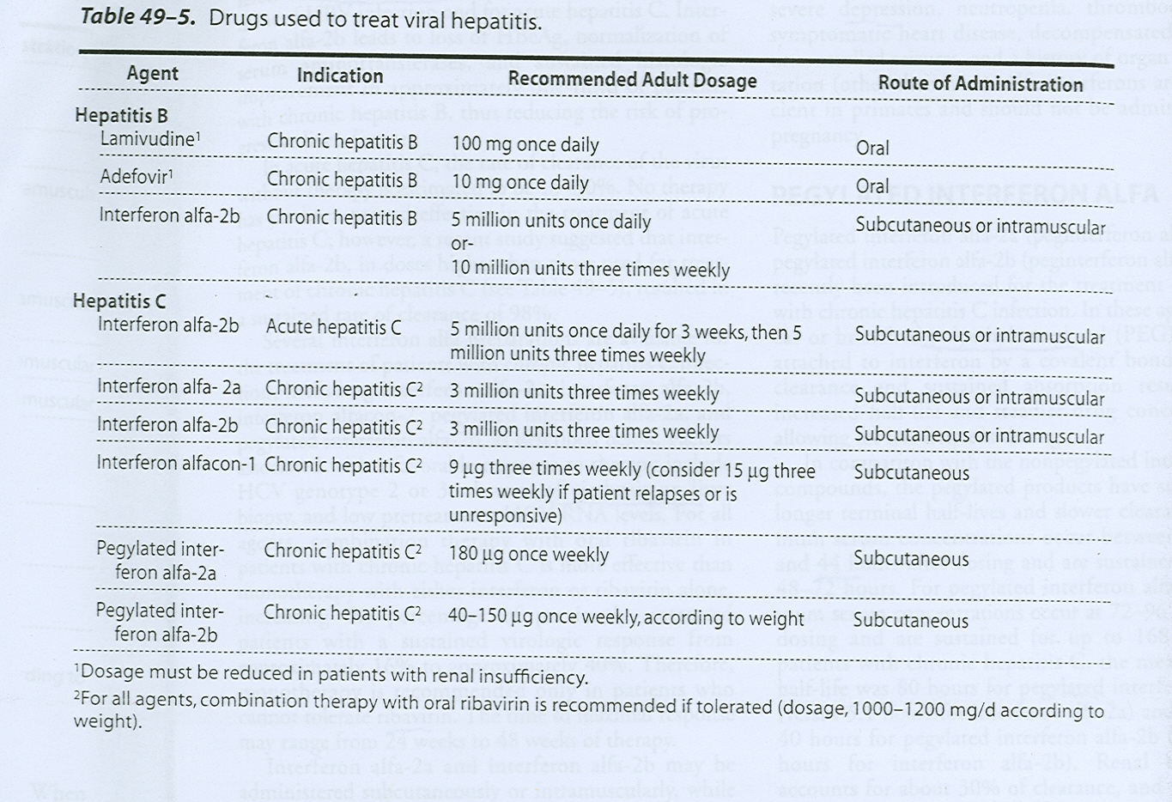

Slide 55
PK of interferons:
Both types could be administered either S.C or I.M. with short t_{1/2}.(4-7 hrs)
Filtered unchanged in the glomeruli with protolytic degradation in the tubule.
What are the differences between interferon and pegelated interferon Alfa?
1) Strucure: Peg Interferon alfa-2a and 2b represent the corresponding interferons with branched polyethylene moiety is attached by covalent bind. Thus,
2) Peg has longer t_{1/2} as compared to normal interferon. (80 Hr vs 5.1 for alfa-2b) and increase in renal impairment.
3) Efficacy is superior to non-pegelated interferon.

Slide 56
Other Uses of Interferon:
1) Cancers such as hairy-cell leukemia and Kaposi sarcoma related to AIDS.
2) Multiple Sclerosis
3) topically for genital warts.
4) prevent dissemination of herpes zoster in cancer patients or immunocompromised patients
5) Multiple myeloma
Side Effects of interferons:
-Since they are endogenous types of proteins, they may produce Flu-like symptoms within 6 hr in more than 30%, with N/V and anorexia; fatigue; rash; alopecia.
- Thrombocytopenia: granulocytopenia and elevation in aminotransferase level mainly in responders. Induction of autoantibodies.
- Mental depression and Neurotoxicity (somnolence)
Contraindications:
Psychosis; neutropenia; thrombocytopenia; dermatomyositis (why).; organ transplanted patients.

Slide 57
Ribavirin:
Guanosine analog requires phosporylation; and inhibits the replication of wide range of DNA and RNA viruses, including HCV; HIV; influenza A & B and respiratory syncytial virus (RSV).
Uses:
Orally: together with interferons for HCV.
Inhaled: For (RSV).

Slide 58
Ribaverin
Ribaver
Ribaverin

Slide 59
V. Antiviral Used for Respiratory Tract Infections:
1) Inhibitors of viral coating (e,g: Amantadine* and Rimantadine:
MOA: will Inhibit uncoating of viral RNA of influenza to the infected host cell, via blocking the viral membrane matrix M2 protein, thus it inhibits the replication of viral RNA.
Note: M2 protein only present in Influenza A? So What?
PK:
Amantadine eliminated unchanged in kidney, while rimantadine is metabolized in the liver. Both drugs can pass BBB and available in Tablet forms.
Which one is preferred in a patient with renal failure?
Uses:
For prophylactic and treatment of Influenza A
(Influenza B has different protein in the membrane).
Side Effects:
CNS: Nervousness, difficulty in concentration, lightheadness
GIT:
* Note: Amantadine is also used for management of Parkinson disease.

Slide 60
2. Neuraminidase Inhibitors:
What is neuraminidase?
Viruses that cause infuenza like orthomyxovirus contain the neuraminidase; which can be selectively inhibited by Zanamavir and Oseltamivir.
MOA:
- Via inhibition of neuraminidase these drugs inhibit the release of new virions (Influenza viruses employ specific neuroaminidase that is inserted into the host cell membrane for the purpose of releasing newly formed virions. Thus virions accumulate at the internal infected cell surface. .
- Active against both Influenza A and B.
What is the difference between Amantadine and Zanamavir?
What are the differences between Zanamavir (Inhaled) and Oseltamivir (Oral)?
Why Zanamavir should not be given for patients with B. Asthma?
3. Ribaverin: (see the above)
.

Slide 61
4. Palivizumab:
Huminized monoclonal antibody directed against the F glycoprotein on the surface of RSV
Uses: only for prevention of high- risk infants

