Slide 1
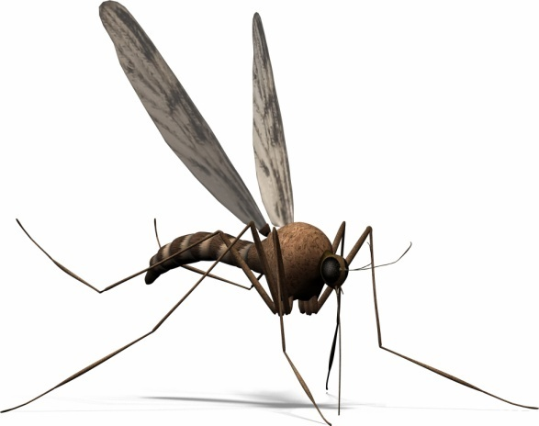
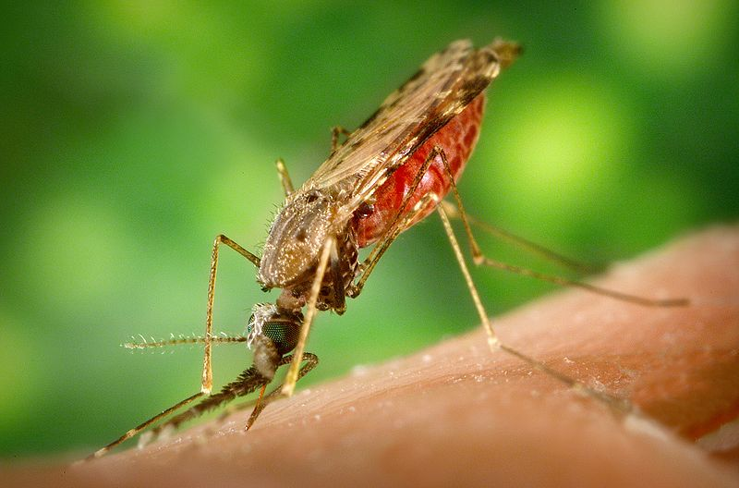
ANTIMALARIAL DRUGS

Slide 2
ANTIMALARIAL DRUGS
ILOs
By the end of this lecture you will be able to:
Recognize malaria life cycle & its varied clinical presentation
Classify antimalarial drugs
Identify the pharmacokinetic, dynamics, related to each drug
Focus on their relevance in clinical setting of treatment whether during acute attacks or in prevention of relapses
Highlight therapeutics meant for prophylaxis
Hint on possibilities of overcoming development of resistance

Slide 3
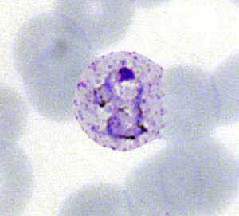
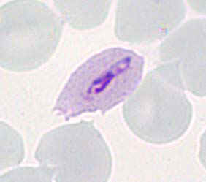
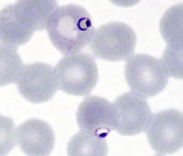
MALARIA
MALARIA

Slide 4
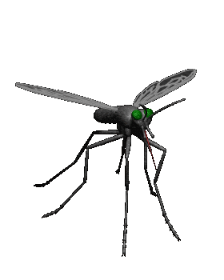
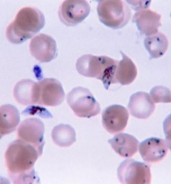
Malaria is a mosquito-borne infectious disease. It is naturally transmitted by the bite of a female Anopheles mosquito that is infected by plasmodium
Plasmodium species which infect humans
Plasmodium vivax (tertian)
Plasmodium ovale (tertian)
Plasmodium falciparum (tertian)
Plasmodium malariae (quartian)
The World Health Organization estimated that malaria causes about 250 million cases of fever and approximately one million deaths annually. The majority of cases occur in children under 5 years old, in pregnant women & vulnerable subjects

Slide 5
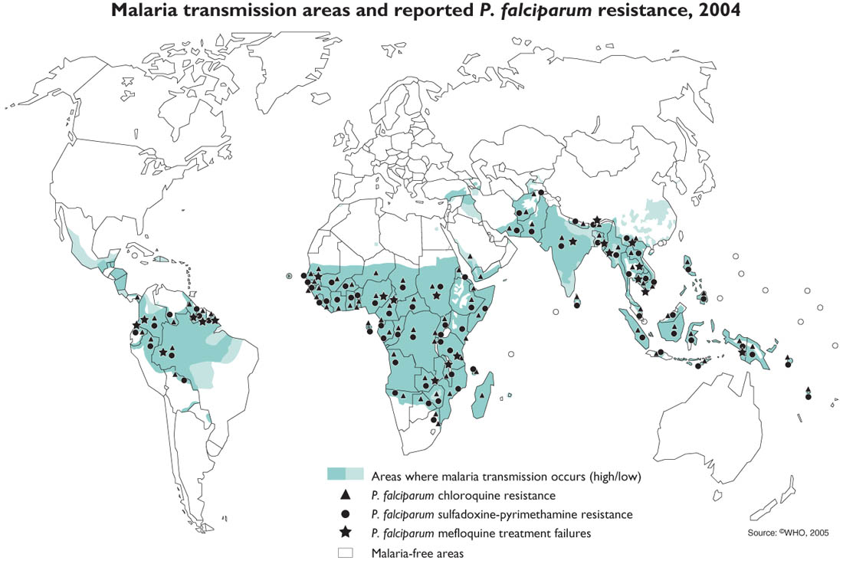
Endemic areas of Malaria

Slide 6
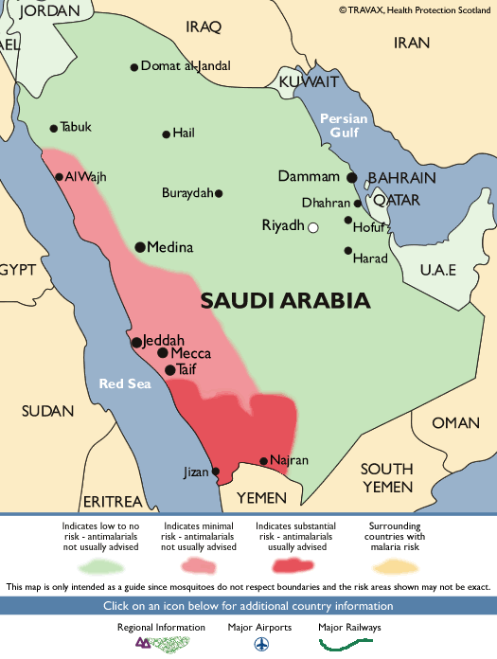
In KSA

Slide 7
Malaria Life Cycle Life Cycle
Sporogony
Oocyst
Sporozoites
Mosquito
Salivary Gland
Zygote
Sporozoites
Hypnozoites
(for P. vivax and P. ovale)
Gametocytes
Exo-
erythrocytic
(hepatic) cycle
Merozoites
Erythrocytic
Cycle
Merozoites
Schizogony

Slide 8
Malaria Transmission Cycle
Exo-erythrocytic (hepatic) Cycle:
Tissue Schizogony
Sporozoites infect liver cells & develop into schizonts, which release merozoites into the blood
SPOROZOIRES injected into human host during blood meal
Parasites mature in mosquito midgut and migrate to salivary glands
HUMAN
Dormant liver stage Hypnozoites
P. vivax and P. ovale
MOSQUITO
Erythrocytic Cycle:
Blood Schizogony
Merozoites infect red blood cells to form schizonts
Parasite undergoes SEXUAL REPRODUCTION in the mosquito
Some merozoites differentiate into male or female GAMETOCYCTES
Mosquito bites Gamet-ocytemic person
Mosquito bites
uninfected person
Symptom onset
Infective Period
Incubation Period
Sporogonic cycle
Recovery
Clinical Illness

Slide 9
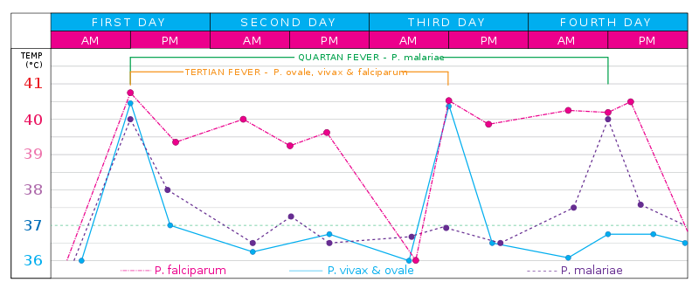
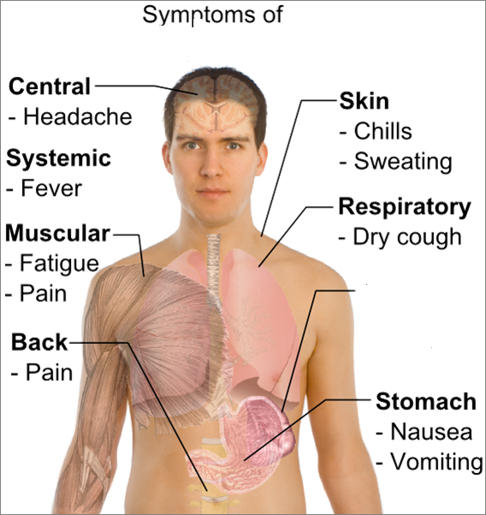
Clinical Presentation
A: Symptoms
Schizogenic periodicity presents length of asexual erythrocytic phase
48 hrs P.f., P.v., and P.o. (tertian)
72 hrs in P.m. (quartian)
periods of fever or febrile paroxsyms assume a more definite
3 (tertian)- or 4 (quartian)- day pattern
Intestine
- Diarrhea
N.B. Could be 1st mistaken for influenza or GIT infection

Slide 10
???
Clinical Presentation
C: Paroxysms
B: Signs
Recrudescence
Exacerbation of persistent undetectable parasitemia, due to survival of erythrocytic forms, no exo-erythrocytic cycle (P.f., P.m.)
Relapse
Reactivation of hypnozoites forms of parasite in liver, separate from previous infection with same species (P.v. and P.o.)
Recurrence or Reinfection
Exo-erythrocytic forms infect erythrocytes, separate from previous infection (all species)
Anemia
Thrombocytopenia
Jaundice
Hepatosplenomegaly
Respiratory distress syndrome
Renal dysfunction
Hypoglycemia
Mental status changes
Tropical splenomegaly syndrome
Cold stage - rigors
Hot stage – Max temp can reach 40-41º C splenomegaly easily palpable
Sweating stage
Lasts 8-12 hours, start between midnight and midday

Slide 11
Differences between plasmodia infections
 | P.v. | P.o. | P.m. | P.f.
Pre-erythroctic stage (dys) | 6-8 | 9 | 14-16 | 5.5-7
Incubation period (dys) | 15 (12-17) or up to 6-12 (m.) | 17 (16-18) or longer | 28 (18-40) or longer | 12 (9-14)
Erythrocytic cycle (hrs) | 48 (about) | 50 | 72 | 48
Primary attack | Mild-severe | Mild | Mild | Severe in non-immunes
Feb. Paroxysms (hrs) | 8-12 | 8-12 | 8-10 | 16-36 or longer
Relapses | ++ | ++ | - | -
Recrudescences | + | + | - | -
Period of recurrence | Variable | Variable | Very long | Short
Untreated infection (yrs) | 1.5-5 | #As P.v. | 3-50 | 1-2

Slide 12
ERADICATE ???
TREAT ???
ANTIMALARIAL DRUGS

Slide 13
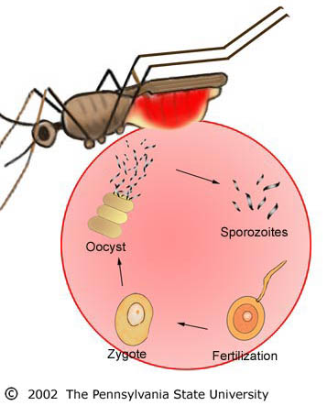
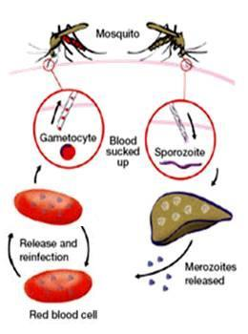
What are the Aims of Treatment?
Different antimalarials selectively kill the parasite’s different developmental forms.
Seek Prophylaxsis
Prevent Spread to Mosquito
MOSQUITO
Gametocytocides
Curtail Sexual Cycle
HUMAN
Seek Prophylaxsis
Sprontocides
To alleviate Symptoms
of Acute Attacks
Prevent Relapses
(P. vivax and P. ovale)
Blood Schizontocides
Hypnozoitocides
Radical
Tissue Schizontocides
CURE
Symptomatic

Slide 14
Principles of treatment depend on the following factors:
* Type of infection.
* Severity of infection.
* Status of the host.
* Associated conditions/ diseases.
Antimalarials used to fulfill treatment objectives
Aims | Causation | Therapy | Drugs
To alleviate symptoms | Symptoms are caused by blood forms of the parasite | Blood schizonticidal drugs | Chloroquine, quinine, pyrimethamine sulphadoxine, artemisinin
To prevent relapses | Relapses are due to hypnozoites of P. vivax/ P. ovale | Tissue schizonticidal drugs | Primaquine
To prevent spread | Spread is through the gametocytes | Gametocytocidal drugs | Primaquine for P. falciparum, Chloroquine for all other

Slide 15
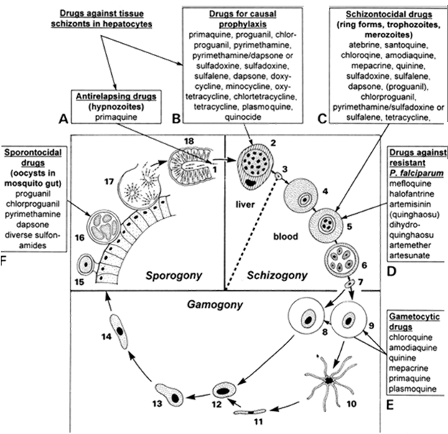
Classifications of Antimalarials According to Action Along the Life Cycle

Slide 16
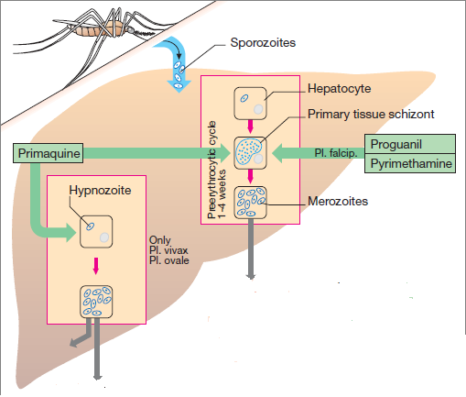
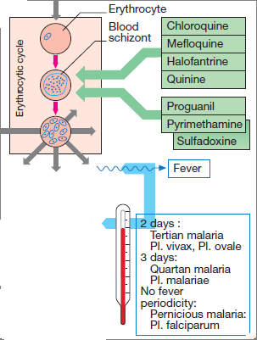
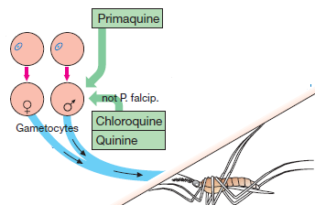
CAUSAL PROPHYLAXSIS
Tissue Schizontocides
TREAT ATTACK
Hypnozoitocides
Blood Schizontocides
ANTIMALARIALS
PREVENT RELAPSE
Gametocytocides
PREVENT SPREAD

Slide 17
TREAT ATTACK
4-AMINOQUINOLINES
CHLOROQUINE
Chloroquine and Amodiaquine
Potent blood Schizontocide & a Gametoside
Can be active against all forms of the schizonts
(exception is chloroquine-resistant P.f. & P.v.)
Against  P.v., P.o.
Pharmacokinetics
Rapidly & completely absorbed from the GIT
Has high volume of distribution
Concentrated into parasitized RBCs.
Released slowly from tissues
Metabolized in the liver
Excreted in the urine 70% unchanged
Initial t½ =2-3days & terminal t ½=1-2months
Chloroquine concentrates  1000-fold in food vacuole of parasite. Why ???
Its protonation & ion trapping due to  pH of vacuole
Its active uptake by a parasite transporter(s)
Its binding to a specific receptor in the food vacuole.

Slide 18
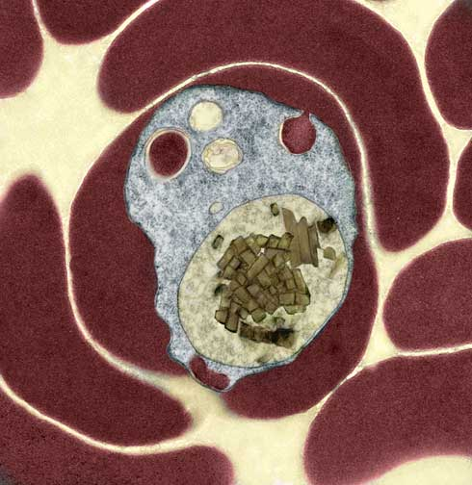
TREAT ATTACK
4-AMINOQUINOLINES
CHLOROQUINE
Mechanism
Malaria Parasite digest host cell’s Hb to obtain a.a.
Heme is released  Toxic
So parasite detoxifies it by heme polymerase  Hemozin (NonToxic) & traps it in food vacuole
RBC
Food vacuole
Malaria Parasite
(Hz)
(Heme)
(Hb)
(Hemozin)
(Heme)
(Hb)
X
Heme Polymerase
X
CHLOROQUINE
CHLOROQUINE
Peptides
concentrate inside acidic food vacuole
Uses
In Malaria;  Acute attack
 In prophylaxsis
In rheumatoid artheritis, SLE,….
N.B. safe in pregnancy
Lysis

Slide 19
TREAT ATTACK
4-AMINOQUINOLINES
CHLOROQUINE
ADRs
Short-term
1. Mild headache and visual disturbances;
2. Gastro-intestinal upsets; Nausea, vomiting
3. Pruritus, urticaria.
Prolonged therapy
Retinopathy, characterized by loss of central visual acuity, macular pigmentation and retinal artery constriction. Progressive visual loss is halted by stopping the drug, but is not reversible???
N.B. Chloroquine concentrates in melanin containing tissues, e.g. the retina.
2. Lichenoid skin eruption, bleaching of hair
4. Weight loss
5. Ototoxicity (cochleovestibular paresis in fetal life)
Bolus injection→ hypotension & dysrrhythmias

Slide 20
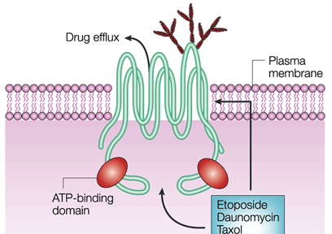
TREAT ATTACK
4-AMINOQUINOLINES
CHLOROQUINE
Resistance against the drug develops as a result of enhanced efflux of parasite vesicle →↑expression of the human multi drug resistance transporter P-glycoprotein
Chloroquine
entery
Effluxed Chloroquine
Chloroquine
AMODIAQUINE
Is thought to be more effective in clearing parasites in uncomplicated malarial than Chloroquine, thus leading to a faster rate of recovery.
Considered more effective in those with added HIV infection

Slide 21
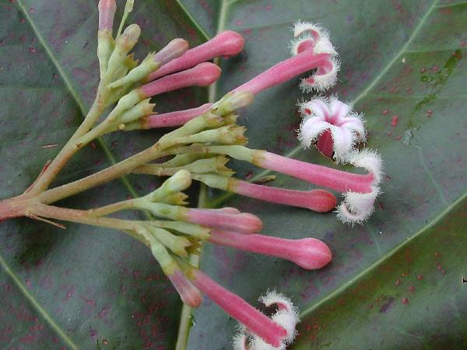
TREAT ATTACK
AMINOQUINOLINES DERIVATIVE
ARYLAMINOALCCOHOLS
Quinoline methanols; quinine, quinidine & mefloquine
Phenanthrene methanols; halofantrine
QUININE
Is a the main alkaloid in cinchona bark
Potent blood Schizontocide & weak Gametoside
Against all species  Ideal for P. falciparum
Against P.v. & P.m.
Pharmacokinetics
Rapidly & completely absorbed from the GIT
Peaks after 1-3 hrs
Metabolized in the liver
5% excreted in the urine unchanged
t½ = 10 hrs but longer in sever falciparum infection
N.B. Administered: orally in a 7 day course
or by slow IV for severe P. falciparum infection

Slide 22
TREAT ATTACK
AMINOQUINOLINES DERIVATIVE
QUININE
Mechanism
Same as chloroquine  heme polymerase  suppress heme deactivation  accumulate   parasite & RBC lysis
Other Pharmacological Actions
Quinidine – like action
Mild oxytoxic effect on pregnant uterus
Slight neuromuscular blocking action
Weak antipyretic action
Uses
In Malaria;  Drug of choice  acute attack of falciparum malaria
 In prophylaxis for individuals returning from an area
where malaria is endemic
Resistance  develops like chloroquine by efflux through p-glyco-protein MDR transporter

Slide 23
TREAT ATTACK
AMINOQUINOLINES DERIVATIVE
QUININE
ADRs
With therapeutic dose  poor compliance  bitter taste.
Higher doses 
Cinchonism  (tinnitus, deafness, headaches, nausea & visual disturbances)
Abdominal pain & diarrhea
Rashes, fever, hypersensitivity reactions
Hypotension & arrhythmias
Blood dyscarasis; anaemia, thrombocytopenic purpura &
hypoprothrombinaemia
Blackwater fever, a fatal condition in which acute haemolytic anaemia is associated with renal failure
IV  neurotoxicity  tremor of the lips and limbs, delirium, fits, stimulation followed by depression of respiration & coma

Slide 24
TREAT ATTACK
AMINOQUINOLINES DERIVATIVE
QUININE
Contraindications
Prolonged QT Interval
Glucose-6-Phosphate Dehydrogenase Deficiency
Myasthenia Gravis
Hypersensitivity
Optic Neuritis, auditory problems
Dose should be reduced in renal insufficiency
Interactions
Antacids: Antacids containing aluminum &/or magnesium may delay or decrease absorption of quinine.
Erythromycin (CYP3A4 inhibitor):
Cimetidine
Mefloquine.
Quinine can raise plasma levels of warfarin and digoxin.

Slide 25
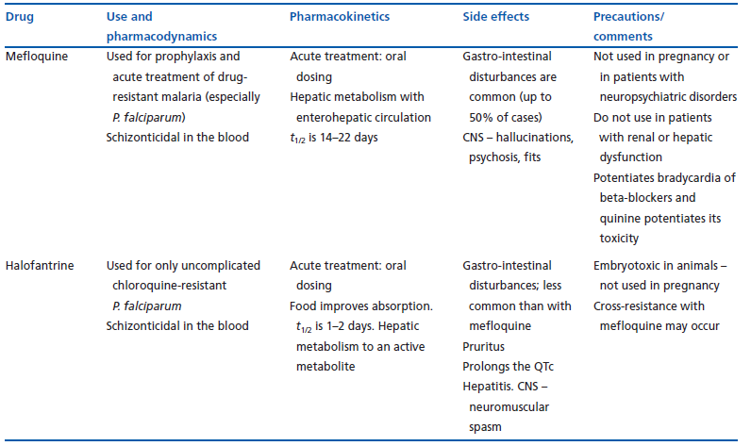
TREAT ATTACK
AMINOQUINOLINES DERIVATIVE
Mefloquine
but not on tissue form
Mechanism  heme polymerase
Halofantrine
Mechanism  heme polymerase

Slide 26
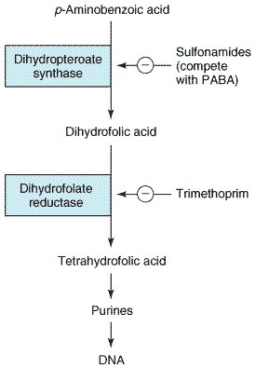
TREAT ATTACK
ANTIFOLATES
p-aminobenzoic a.
Type 1 Antifolates Sulphonamides & Sulphones (Dapsone)
competes with PABA.
Dihydropteroate Synthase
SULPHONAMIDES
Type 2 Antifolates Pyrimethamine & Proguanil
↓ dihydrofolate reductase
Dihydrofolate Reductase
PYRIMETHAMINE
Purines
DNA
 Halting DNA synthesis, cell division & reproduction.

Slide 27
TREAT ATTACK
ANTIFOLATES
Slow action as blood Schizontocide > than as tissue schizontocide
All act on P. falciparum (if resistance)
Proguanil act on P. f. , P. v. & P. o.
Sprontocides  affect sporogony in mosquito
Pharmacokinetics
Pyrimethamine & proguanil are absorbed orally slowly.
Metabolized in liver  Proguanil into an active metabolite cycloguanil
Excreted in urine.
t½;  pyrimethamine  4d /  proguanil  16h
Mechanism
They halt DNA synthesis, cell division & reproduction of parasite develop-mental stages variability whether in humans or mosquito
Uses
 In Malaria;
Weak to treat attacks alone so given in combinations. Pyrimethamine + either dapsone or sulfadoxine  in chloroquine resistant malaria

Slide 28
TREAT ATTACK
ANTIFOLATES
Uses
 In Malaria;
Used for prophylaxsis in combinations.
Proquanil + chloroquine or atovaquone
 In Mosquito;
Used in prevention as it curtails the plasmodium sexual cycle   spread from mosquito to man.
ADRs
Skin rash, hair loss, mouth ulcers, GIT disturbances…..etc
Large doses of pyrimethamine -dapsone combination  haemolytic anaemia, agranulocytosis.
Higher doses pyrimethamine ↓mammalian dihydrofolate reductase  megaloblastic anaemia.
Resistance
 Develops by a single mutation in the genes encoding parasite dihydrofolate reductase.

Slide 29
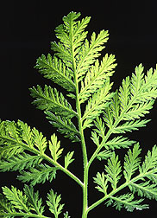
TREAT ATTACK
LACTONE ENDOPEROXIDES
ARTEMISININ
ARTEMISININ
ARTENUSATE
ARTEMETHER
Poor solubility
Soluble
Fast acting blood Schizontocide
Affect all forms of multi-drug resistant P. falciparum
Pharmacokinetics
Derivative are rapidly absorbed orally
Rapidly biotransform in liver into artenimol active metabolite
Widely distributed
t½ artemisinin  4hrs / artesunate  45min / artemether 4-11hrs
Artemesia annua
Mechanism
They have endoproxidase bridges that are cleaved by haem iorn to yeild
carbon-centred free radicals, that will
Alkylate membranes of parasite’s food vacuole and mitochondria no energy
Irreversibly bind & inhibit sarco-endoplasmic reticulum Ca²⁺-ATPase of the parasite, thereby inhibiting its growth
Inhibiting formation of transport vesicles no food vacuoles

Slide 30
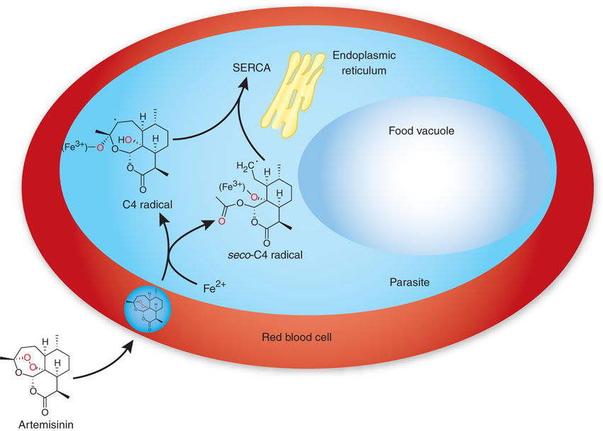
TREAT ATTACK
LACTONE ENDOPEROXIDES
ARTEMISININ
ARTEMISININ
ARTENUSATE
ARTEMETHER
Uses
In acute attack including chloroquine resistant & cerebral malaria.
ADRs
Transient heart block
↓neutrophil count
Brief episodes of fever
Neuro-, hepato- and bone marrow toxicity
Resistance
 not recorded

Slide 31
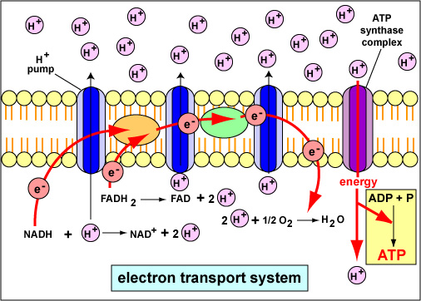
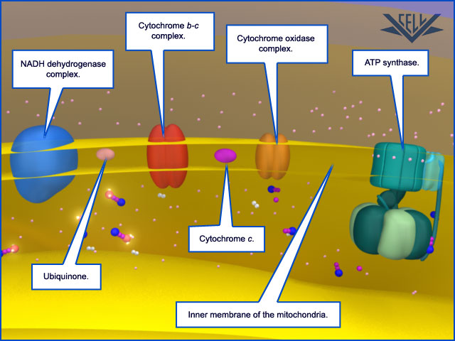
TREAT ATTACK
NAPHTHOQUINONE
ATOVAQUONE
Slow action as blood Schizontocide > than as tissue schizontocide
Pharmacokinetics
Slow, erratic absorption & low oral bioavailability  ↑by food,
Highly protein bound
Eliminated unchanged in faeces
t½;  2-3 dys
Mechanism  Is an ubiquinone analog   energy production

Slide 32
TREAT ATTACK
NAPHTHOQUINONE
ATOVAQUONE
Uses
 In Malaria;
Given to treat attacks & in prophylaxis but never alone (weak) so available in fixed prepreparations with proguanil.
 Other Uses;
Toxoplasmosis
Pneumocystis pneumonia
Resistance
 rapid  due to a single point mutation in gene of cytochrome b.
ADRs
Fever, rash
Headaches & insomnia
Difficulty sleeping (nightmares, incoherent dreams)
Stomach irritation
Contraindications  Pregnant & breast feeding women

Slide 33
PREVENT RELAPSES
8-AMINOQUINOLINES
PRIMAQUINE
Hypnozoitocides  against liver hypnozoites & gametocytocides
Radical cure of P. ovale & P. vivax
Prevent spread of all forms
Pharmacokinetics
Well absorbed orally
Rapidly metabolized to etaquine & tafenoquine  more active
t½  3-6h
Mechanism
Not well understood. It may be acting by;
Generating ROS  can damage lipids, proteins & nucleic acids
Interfering with the electron transport in the parasite  no energy
Inhibiting formation of transport vesicles no food vacuoles
Uses
In Malaria: It is the essential co-drug with chloroquine in treating all cases of malaria
The only known drug to cure both acute & relapsing malaria
May be used prophylactically
Resistance;  Rare when primaquine & chloroquine  combine

Slide 34
PREVENT RELAPSES
8-AMINOQUINOLINES
PRIMAQUINE
ADRs
At regular doses  patients with G-6-PD deficiency  hemolytic anemia.
In G-6-PD deficiency  NADPH, GSH synthesis.
So RBCs become sensitive to oxidative agents  HEMOLYSIS
Primaquine
◉
Oxidizes GSH to GSSG   GSH   detoxification of toxic products
At larger doses 
Epigastric distress & abdominal cramps.
Mild anemia, cyanosis & methemoglobinemia
Severe methemoglobinemia  rarely in patients with deficiency of NADH methemoglobin reductase.
Granulocytopenia & agranulocytosis  rare

Slide 35
Antibiotics
Slow action against blood schizonticides
CLINDAMYCIN
Mechanism Clindamycin  an antimicrobial 
◉ inhibits parasite apicoplast
Involved in lipid metabolism  specially fatty acids
 needed to form parasitophorous vacuole  mandatory for survival & successful invasion of host c.
Indications It is less effective than doxycycline or atovaquone/proguanil, but approved in treatment of acute uncomplicated falciparum malaria in combination with quinine for those
unable to tolerate
or who have contraindications
to the use of first-line agents (pregnant women & young children…)
It is not used in prophylaxsis

Slide 36
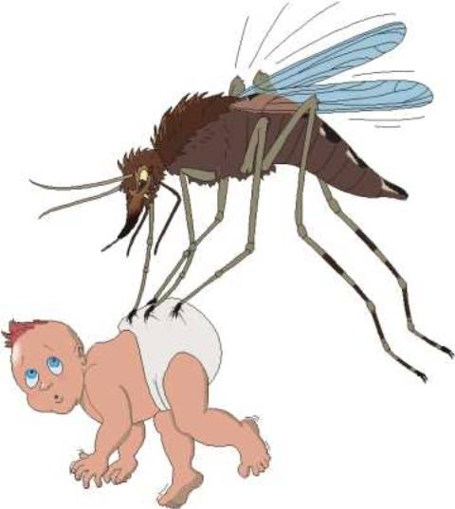
Antibiotics
Very slow action as a schizonticides
DOXYCYCLINE
Mechanism Inhibit protein synthesis by binding to 30s subunit of ribosome  preventing its bonding with the 50s unit
Indications Primarily; as an effective & cheap chemoprophylaxis in areas where mefloquine / chloroquine resistance exist
In combination with quinine in treatment of
acute uncomplicated falciparum malaria
Contraindications During pregnancy
In breast-feeding women
In children < 8 years of age.

Slide 37
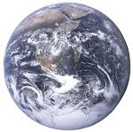
PROPHYLAXIS
ALL TRAVELLERS to an endemic area should be made aware of the risks.
Use appropriate measures to avoid mosquito bites (e.g.
repellents, appropriate cover at night, mosquito nets).
The choice of chemoprophylaxis regimen is dependent
on the dominant local parasite species and its drug
resistance profile.
Commonly used drugs are chloroquine, mefloquine, doxycycline, & combination of atovaquone & proguanil
Chemoprophylaxis must start before (2w), and continue
after (4w), travel to and from an endemic area.
Full compliance with the chemoprophylaxis regimen is
necessary.
Drug choice and doses may need to be altered in patients with renal or hepatic dysfunction.
Prophylaxis is not 100% effective.
Areas endemic for chloroquine sensitive strains
Areas endemic for chloroquine resistant strains

Slide 38
RESISTANCE
Resistance of P. falciparum to chloroquine, sulfodoxin-pyrimethamin & amodiaquine is the major problem of  malaria morbidity & mortality
Treating resistant strains  by Artemisinin Compounds  alone (7dys) or in combination with other drugs (3dys) is the current choice gametocyte carriage
Preventing spread of resistant strains achieved by;
Preventing malaria infections number by treating resistant cases
Prevent the transmission of resistant parasites 
Non-medical approach  insecticides, bed-nets, indoor spraying, environmental controls (as swamp draining),
personal protection (as mosquito repellents)
Medical approach
 Chemoprophylaxis ( specially travelers)
 Malaria vaccination ???

Slide 39
L
ANTIMALARIAL DRUGS
G
U
O
C
O
K
D

