Slide 1
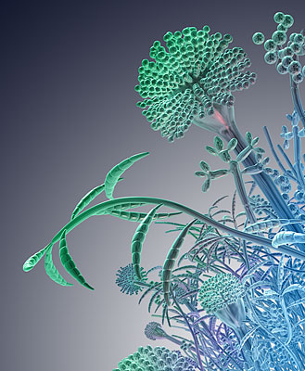
ANTIFUNGAL DRUGS
Prof. Dr. OMNIA NAYEL
ANTIFUNGALS

Slide 2
ILOs
Revisit; fungal structure & pathogenic types
Classify fungal infections
Specify cellular targets of antifungal therapy
Expand on the pharmacology of individual antifungal agents depending on their site of action, their chemical nature and their antifungal profile
Emphasis on their indications, contraindications, side effects & interactions
Contrast antifungal used for superficial mycosis vs deep mycosis
ANTIFUNGALS

Slide 3
A fungus is a member of a large group of eukaryotic organisms that includes microorganisms such as yeast, molds and mushroom
Their cell structure is formed of
Cell wall
Cell membrane
Cytosol containing;
Nucleus with well defined nuclear membrane & chromosomes
Organelles as, mitochondria with flat cristae, lomasomes responsible for synthesis of cell wall, scattered ribosomes ...etc.
Differ from mammalian cells
No cell wall in mamalian c.
Ergosterol not cholestrol in fungi
They are heterotrophic (not self sustaining) organisms they exhibit saprophytic or parasitic mode of nutrition.
In most types their body organize to form mycelium & sprout to form hyphae  partially function to digest & absorb nutrient from its' host

Slide 4
The Fungal Cell Wall
Fairly rigid layer that provides structural support and protection.
The rigidity is conferred > by its glucosamine polymer  CHITIN
It is made of three layers:
1) layer of mannoproteins
mannoproteins
β1,3
β1,6
glucans
2) layer of β-1,3, or 6 glucan
Cell
membrane
β1,3 glucan
synthase
ergosterol
3) layer of chitin
Fungi cell wall differ from that of plants (cellulose) and bacteria (peptidoglycan)

Slide 5
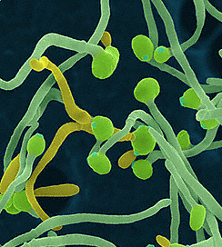
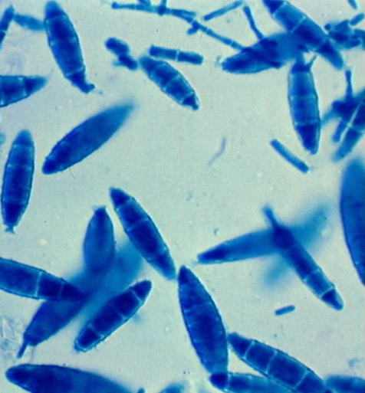
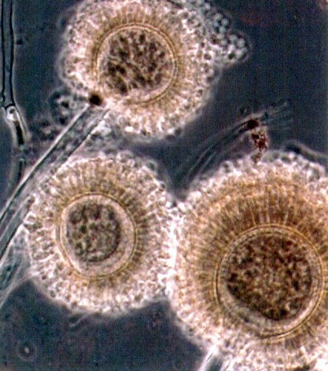
COMMON FUNGAL PATHOGENS
Source of infesting fungi
Either live commensally or exist in the surrounding environment
Immuno-suppression
Indiscriminate use of antibiotics
Opportunistic 
TYPES
Actinomycetes : actinomycosis, nocardiosis, streptomycosis
Yeasts: candidiasis, cryptococcosis
Dermatophytes (epidermo & tricho phytons, microsporum), superficial mycosis
Filamentous Fungi: chromoblastomycosis, zygomycosis, aspergillosis
Dimorphic Fungi: blastomycosis, histoplasmosis, coccidioidomycosis
streptomycetes
candidiasis
microsporum
aspergillosis
Notes:
The most overt distinction between fungal and mammalian cells is the cell wall of fungi. The uniqueness of this structure makes it a premier target of antifungal drugs.
Although the cell wall was initially considered an almost inert cellular structure that protected the cell against osmotic offense, more recent studies have demonstrated that it is a dynamic organelle. The major components of the cell wall are glucan and chitin, which are associated with structural rigidity, and mannoproteins.
Biosynthesis of β (1-3) glucans is under the control of a membrane protein complex, the glucan synthase. There are at least two subunits of this enzyme, one a catalytic subunit in the plasma membrane, the other a GTP-binding subunit that activates the catalytic subunit.
In the periplasmic space, neosynthesized β 1-3 glucans are modified and associated to the other cell wall polysaccharides (chitin, galactomannan and β 1-3, 1-4 glucan) to produce the rigid three-dimensional network characteristic of the cell wall.

Slide 6
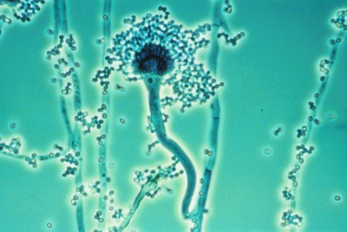
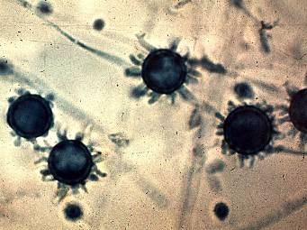
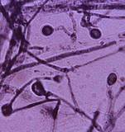
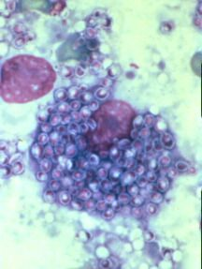
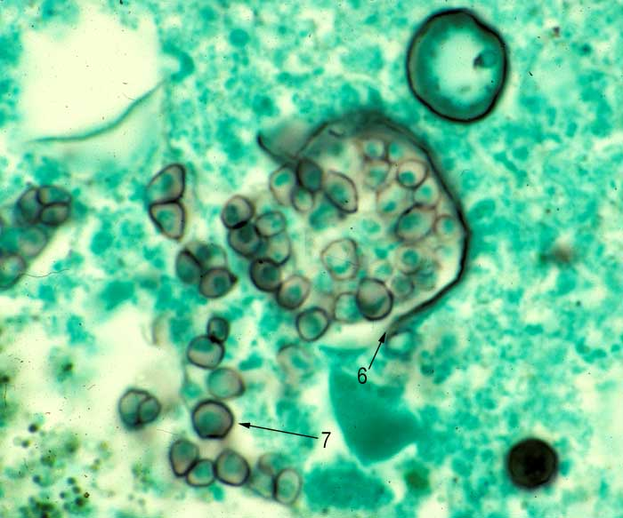
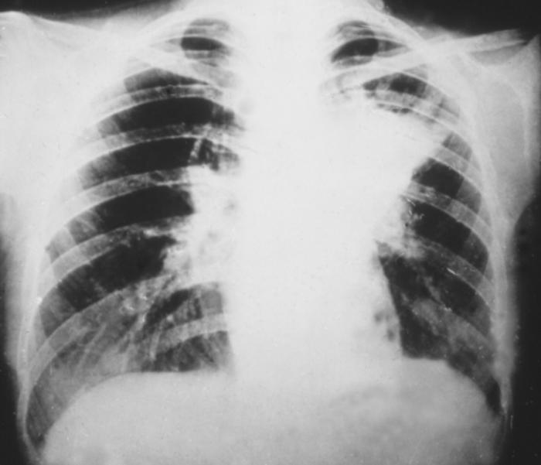
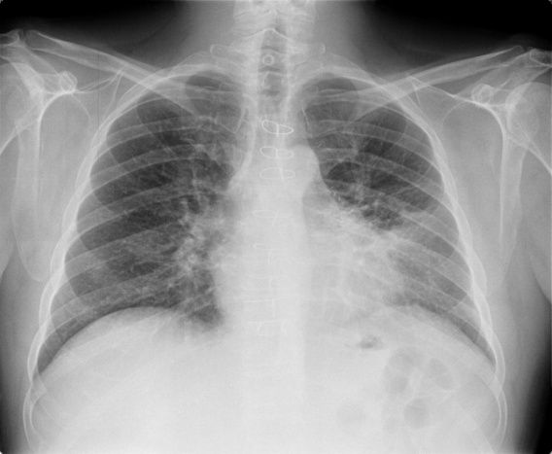
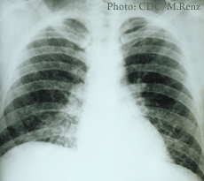
COMMON FUNGAL PATHOGENS
blastomycosis
histoplasmosis
coccidioidomycosis

Slide 7
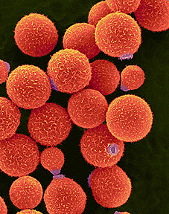
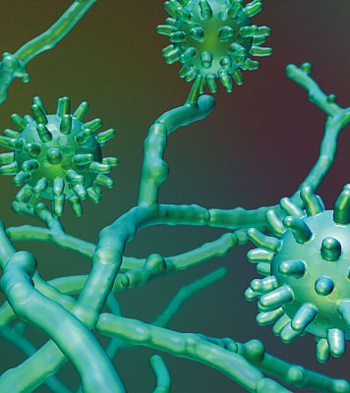
FUNGAL INFECTIONS
Mycosis
CLASSIFICATION OF MYCOSIS
Superficial Mycosis
Systemic Mycosis
Dermatomycoses as jn; athlete`s foot or tinea pedis, tinea cruris, tinea capitis …etc
Common fungi involved;
Epidermophyton (skin and nails)
Trichophyton (skin,hair & nail)
Microsporum (skin and hair)
Broncho-pulmonary infections, endocarditis, meningitis, otitis, ophthalmitis, ..etc
Common fungi involved;
Candida albicans, cryptococosis, chromoblastomycosis, zygomycosis, aspergillosis,
blastomycosis, histoplasmosis, coccidioimycosis
Candidias is in; oral thrush, vaginitis and diaper candidiasis
Common fungi involved
candida albicans affecting mucous membranes & muco-cutaneous junctions
Notes:
The most overt distinction between fungal and mammalian cells is the cell wall of fungi. The uniqueness of this structure makes it a premier target of antifungal drugs.
Although the cell wall was initially considered an almost inert cellular structure that protected the cell against osmotic offense, more recent studies have demonstrated that it is a dynamic organelle. The major components of the cell wall are glucan and chitin, which are associated with structural rigidity, and mannoproteins.
Biosynthesis of β (1-3) glucans is under the control of a membrane protein complex, the glucan synthase. There are at least two subunits of this enzyme, one a catalytic subunit in the plasma membrane, the other a GTP-binding subunit that activates the catalytic subunit.
In the periplasmic space, neosynthesized β 1-3 glucans are modified and associated to the other cell wall polysaccharides (chitin, galactomannan and β 1-3, 1-4 glucan) to produce the rigid three-dimensional network characteristic of the cell wall.

Slide 8
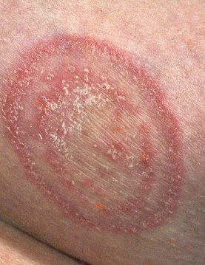
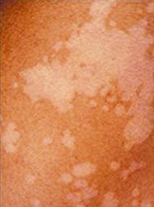
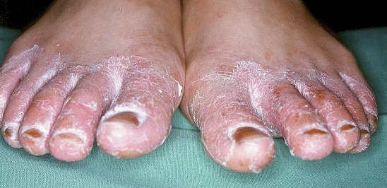
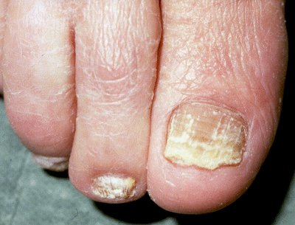
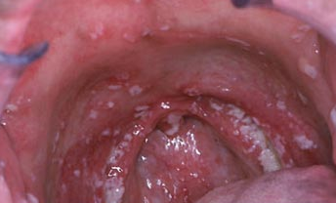

Slide 9
ANTIFUNGALS
ANTIFUNGALS

Slide 10
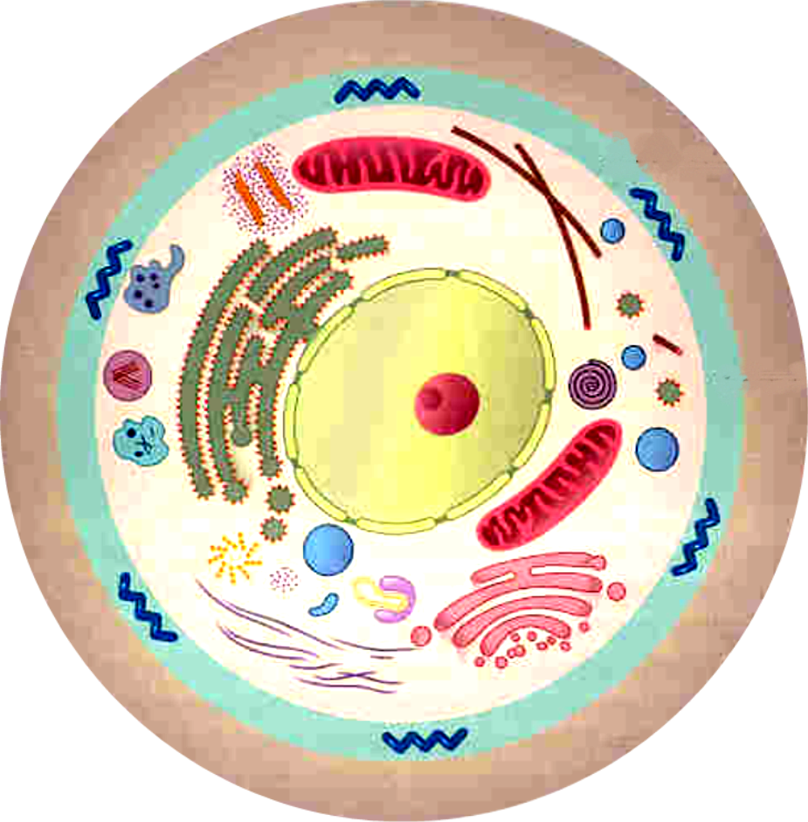
TARGETS FOR ANTIFUNGAL THERAPY
ACCORDING TO SITE OF ACTION  classified into those acting :
Cell Wall Glucan
Echinocandins, Caspofungin
Cell Membrane  Ergosterol
Polyene antibiotics
→ Amphotericin B, lipid formulations
→ Nystatin (topical)
Azole antifungals
→ Imidazoles:
Topical: Clotrimazole, Econazole, Miconazole
Systemic: Ketoconazole
→ Triazoles: Fluconazole, Itraconazole and Voriconazole
Allyamines: Tirbinafin, Naftifine , Butenafine
 Inhibit Mitosis:
Grisofulvin
Nuclear  DNA & RNA
Flucytosine

Slide 11
INDIVIDUAL ANTIFUNGAL
Therapy

Slide 12
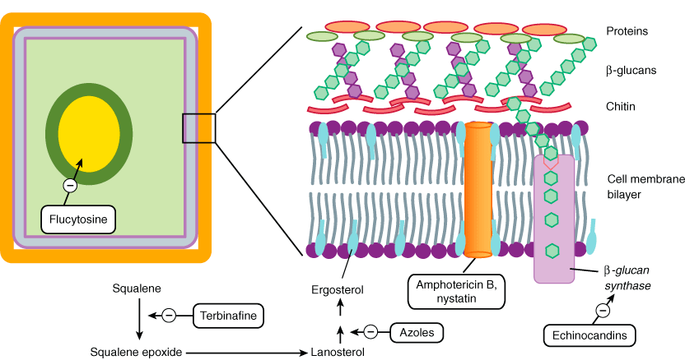
1) Cell Wall
-ve mitosis
Grisofulvin
4) Mitosis
2) Cell
Membrane
3) Nucleic a

Slide 13
1. On Cell Wall
ECHINOCANDINS
“Antifungal Penicillin”

Slide 14
ECHINOCANDINS
CASPOFUNGIN, MICAFUNGIN, ANIDULAFUNGIN
Newest class of antifungal agents developed
Synthetically modified lipopeptides
Fungicidal
Antifungal spectrum against Aspergillus , Candida species
Not C neoformans or the agents of zygomycosis and mucormycosis ,
Mechanism
Non - Competitive inhibitor of enzyme 1,3-β glucan synthase  responsible for synthesis of glycans in fungal cell wall  wall disruption & cell death
Echinocandins

Slide 15
ECHINOCANDINS
Pharmacokinetic:
Water soluble
Highly bound to serum proteins
t _{½}  9-11 hours
Slowly metabolized by hydrolysis & N-acetylation.
Eliminated equally by urinary and fecal route.
CASPOFUNGIN
Available only in intravenous formulations
Given as  single loading dose of 70 mg, followed by  50mg daily
Used in 
Severe candida infections; esophageal candidiasis, invasive candidiasis, including candidemia…
Invasive aspergillosis; when amphotricine B fails
Dosage adjustments is required in severe hepatic insufficiency
Adverse effects
Nausea ,vomiting, flushing
liver enzymes if combined with cyclosporine (contraindicated)
It is very expensive

Slide 16
2. On Cell Membrane
POLYENE ANTIBIOTICS
AZOLES
ALLYAMINES

Slide 17
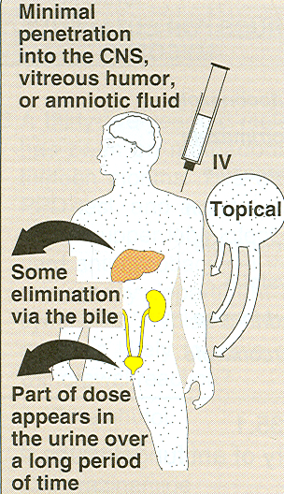
POLYENE ANTIBIOTICS
Fermentation product of Streptomyces nodusus
It is macrolide antibiotic.
AMPHOTERICIN B
Pharmacokinetics
Insoluble in water & unstable at 37 ºC
Topically preparations  skin, eye , ear, vagina, bladder, ….
For systemic use
Orally  Poorly absorbed  so useful only for GIT infestations
Parentral  given by slow I/V infusion.
Highly protein bound
Poorly cross BBB but increases in inflamed meningitis  better intrathecal
t _{½}  15 days
Excreted slowly via kidneys
Needs 2 months  complete clearance

Slide 18
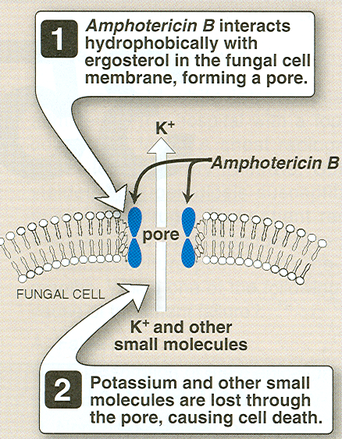
AMPHOTERICIN B
Pharmacodynamics
Fungicide at high and static at low conc
Broad spectrum
Antifungal spectrum against 
Aspergillus , Candida species, Blastomyces dermatitidis,
Histoplasma capsulatum , Cryptococcus neoformans,
Coccidioides immitis, Sporotrichum schenckii
Mechanism
Amphotricin has
 Hydroxylated hydrophilic surface on one side
 Unsaturated conjugated LIPOPHILIC surface on other.
High affinity binding for fungal ergosterols   its permeability  creats transmembrane pore (channel) with a hydrophilic centre   leakage of small molecules, e.g. glucose & K⁺

Slide 19
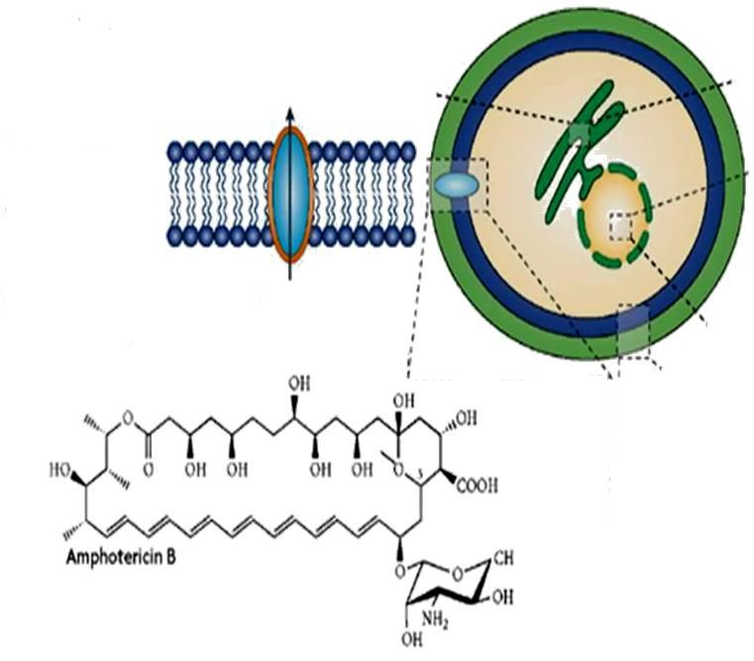
Leak of glucose, K⁺ ,Mg²⁺…etc
AMPHOTERICIN B

Slide 20
AMPHOTERICIN B
Uses
Fungal infestations;
Candidiasis; oral,vaginal,cutaneous Cryptococcosis, Histoplasmosis,
Aspergillosis,……etc
Leishmaniasis ;
(in resistant cases)
Course  treatment should last 6-12 weeks.
Dose  0.5-1 mg\kg\day
Forms;
Capsules, lozenges, drops, solutions, irrigations , vials
Interactions
Synergistic with  Flucytocin
Potentiating action if given with  Rifampicin & Minocyclin
nephrotoxicity with  Vancomycin & Aminoglycoside

Slide 21
AMPHOTERICIN B
ADRs
Reversible nephrotoxicity  high incidence
It results from vasoconstriction   glomerular filtration   tubular damage  leading to acute renal impairment (sometimes renal tubular acidosis)   creatinine clearance & tubular cation losses ( K⁺ ,Mg²⁺)  hypokalaemia & hypomagnesaemia
Nephrotoxcity may be potentiated by sodium depletion.
Infusion reactions; fever, chills, headache, hypotension, dyspnea, vomiting
Hydrocortisone can be given before each infusion
Anorexia, nausea, vomiting, abdominal, joint & muscle pain, loss of weight
Aspirin, antihistamines & antemetics help to alleviate symptoms
Impaired hepatic function
Temporary myelosuppression; normochromic normocytic anaemia, thrombocytopenia, …etc
Hypersensitivity reactions
Thrombophlebitis
To reduce the toxicity, several new formulations have been developed

Slide 22
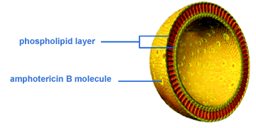
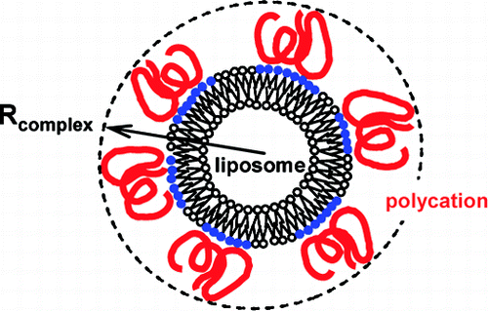
AMPHOTERICIN B
The new formulations are developed to overcome
1. Side effects
2. Improve tolerability
3. Improve delivery to site of action
4.  toxicity   nephrotoxic & anemia
Formulations are:
Lipid –associated preparations
Amphotericin B lipid complex
(Drug complexed to phosphatidylcholine / phosphatidylglycerol)
Amphotericin B colloidal dispersion
( Drug complexed to bile a. salts deoxycholate )
Liposomal Amphotericin B
(An encapsulated formula made of a closed, spherical vesicles created by mixing the drug with phospholipids & cholesterol  arrange into concentric bilayer membranes)
Can deliver larger doses, even five times
Have better clearance
But are expensive

Slide 23
POLYENE ANTIBIOTICS
NYSTATIN
It is polyene macrolide
Similar in structure & mechanism of action to amphotericin B
Even not absorbed & more toxic  reserved to topical use only
Uses
In superficial candidiasis of Skin, Mouth, Vagina, ….
Oral suspension for oral thrush
Tablets or suppositories   GIT colonization with Candida
Cream, ointment or powder for cutanueous candidiasis
Pessaries or ovules for vaginal moniliasis
Can be used in combination with
antibacterial agents
corticosteroids
NATAMYCIN
In; Keratitis, Monilial infections, Trichomonas vaginalis
HAMYCIN
+ Aspergillus

Slide 24
LACK SELECTIVITY;
human gonadal & steroid hormone synthesis   testosterone & cortisol production.
-ve hepatic the microsomal enzyme (P450) they are enz. inhibitors
IMIDAZOLES:
Topical: Clotrimazole, Econazole, Miconazole
Systemic: Ketoconazole
TRIAZOLES:
Fluconazole, Itraconazole & Voriconazole
AZOLES
SELECTIVE   endocrine disturbance
Penetrate to CNS & Resist degradation
Fungistatic
Broad spectrum  antibacterial, antiprotozoal, anthelminthic & antifungal
Mechanism
In the fungal endoplasmic reticulum  it inhibits cytochrome P450 3A enzyme, lanosine 14α-desmethylase  responsible for converting lanosterol to ergosterol (sterol in fungal cell membrane)   toxic sterols  alters fluidity & permeability of the membrane  inhibiting the growth of fungi.

Slide 25
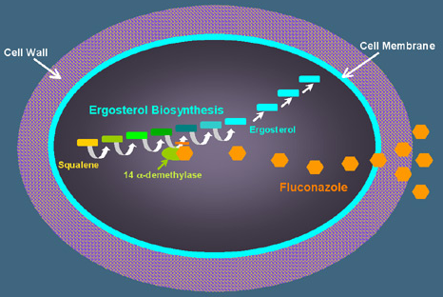
Acetyl-Co-A
Acetyl-Co-A
Lanosine 14α-desmethylase
Squanlene
Squanlene
Azoles

Slide 26
SYSTEMIC AZOLES
IMIDAZOLES
KETOCONAZOLE
Antifungal spectrum against 
Mainly candida species, C neoformans, some filamentous & Dimorphic Fungi
Pharmacokinetics
Oral absorption favored in acidic pH of stomach > empty stomach
Bioavailability  by:
H₂ blockers, proton pump inhibitors & antacids.
Food if neutralizes stomach acidity.
N.B. In achlorhydria   by cola drinks & citrus fruit juice
t_{1/2}   by dose. With 800 mg dose  7-10 hrs.
Protein binding high  80-90% does not cross BBB
Hepatic metabolism
Biliary, faecal (unchanged) & renal elimination
N.B. Its efficacy is poor in immuno-compromized patients & in meningitis
Not suitable for fungal infections of UT  levels of drug in urine is very low
Doses
In serious infections  800 mg/day
Less serious  200-400 mg/day

Slide 27
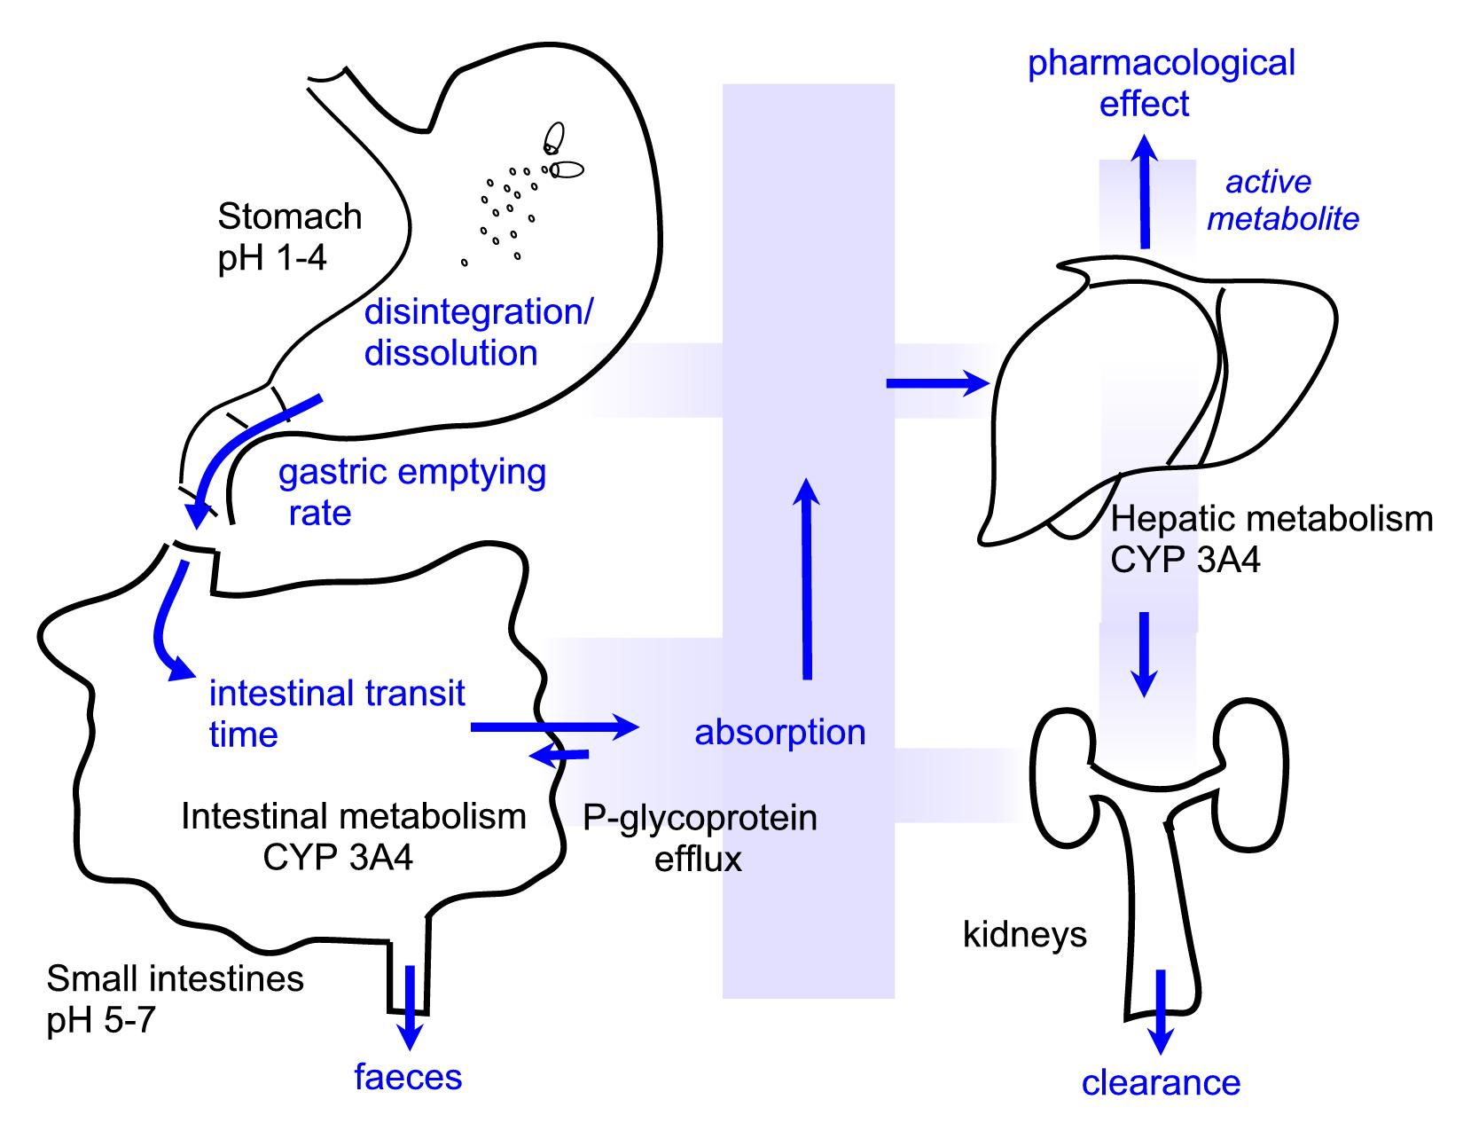
SYSTEMIC AZOLES
IMIDAZOLES
KETOCONAZOLE

Slide 28
SYSTEMIC AZOLES
IMIDAZOLES
ADRs
KETOCONAZOLE
Nausea & vomiting, worse with higher doses (800 mg/day)
Fluid retention & hypertension
Hair loss
Hepatoxicity (2-8%), increase in transaminases, hepatitis
Dose related inhibition of CYP P450   testosterone synthesis 
In males; Gynecomastia, oligosperma, decreased libido
In females; Menestrual disturbances
Dose-related inhibition of CYP P450   adrenal cortisol synthesis
Interactions
Pharmacokinetic
Cyclosporin, phenytoin , H₁ blockers   its metabolism   its toxicity.
It   metabolism of cyclosporin, warfarin, astemizole, corticosteroid, theophylline,…   their toxicity.
Warfarin ,Rifampin increase   its metabolism   its concentration.
H₂ blockers, proton pump inhibitors, antacids   its absorption.
Pharmacodynamic
It  fungicidal action of polyene antibiotics by  availability of ergosterol
Contraindication  Pregnancy

Slide 29
SYSTEMIC AZOLES
TRIAZOLES
ITRACONAZOLE
Antifungal spectrum 
Much more broader than ketokonazole > deep mycosis; as aspergillous
Pharmacokinetics
Oral absorption favored by food
High lipid solubility  Distributes well to bone, adipose t., sputum
t_{1/2}  long  30-40 hrs.
Steady state is reached after 4 days needs loading dose
Protein binding high  does not cross BBB
Extensive hepatic metabolism / Less cytochrome or steroid synthesis inhibition
N.B. It is efficient in immuno-compromized patients
Doses
Orally: 100 mg b.i.d with food. Loading dose given as 300 mg t.i.d  in deep mycosis
Intravenously; reserved only to serious infections 200 mg b.i.d as infusion over an hour for two consequent days followed by 200 mg daily for 12 days
ADRs
Nausea, vomiting, hypertriglyceridemia, hypokalaemia
 aminotransferase  hepatotoxicty
Rash  drug discontinuation

Slide 30
SYSTEMIC AZOLES
TRIAZOLES
VORICONAZOLE
Antifungal spectrum 
As itraconazole but more potent drug of choice in invasive aspergillosis
Pharmacokinetics
Oral absorption favorably absorbed with high bioavailability
t_{1/2}  short  6 hrs.
Protein binding less than itraconazole  can cross BBB
Extensive hepatic metabolism
◉ Cytochrome or steroid synthesis < ketokonazole but > itraconazole
Doses
Orally: 400 mg / day
Intravenous formulations  available for deep mycosis
ADRs
Reversible visual disturbance with IV. Resolves after 30 min.
Rash, photosensitivity dermatitis
 aminotransferase

Slide 31
SYSTEMIC AZOLES
TRIAZOLES
FLUCONAZOLE
Antifungal spectrum 
Much more broader than ketokonazole. Most effective in cryptococcosis & in coccidio-mycosis of the dimorphic fungal infection.
Least effective on filamentous / no effect on asperagillous
Pharmacokinetics
Complete oral absorption water soluble . Not affected by food or acidity
Excellent bioavailability concentration after oral & IV nearly similar
Widely distribute in body  to bone, adipose t., sputum & crosses BBB classical in meningitis …( cryptococcal & coccidial meningitis)
t_{1/2}  rather long  22–31 hrs.
Least effect on microsomal enz.  Few interactions / no  steroid synthesis
Renal excretion up to 90%
N.B. It is efficient in immuno-compromized patients; specially in BM transplant recipients & in AIDs patients
Uses & Doses
Candidiasis (mucocutaneous): 200 mg on 1st dy then 100 mg daily for 2 ws
Cryptococcosis: 400 mg daily for 8 weeks in meningitis.

Slide 32
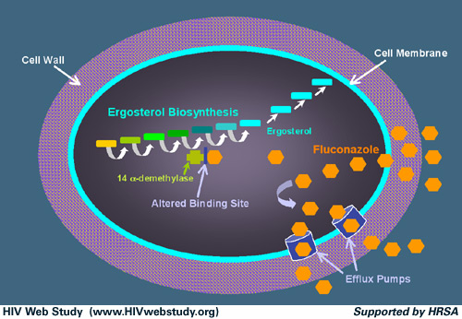
SYSTEMIC AZOLES
TRIAZOLES
FLUCONAZOLE
In coccidial meningitis it is drug of choice
In AIDS 200 mg for life.
ADRs
GIT disturbances
Reversible alopecia & skin rash
Headache
Hepatic failure may lead to death
Highly teratogenic
Fluconazole Resistance devlop
to non-albicans candidiasis
more in immunocompromized
Mechanism:
Target enzyme modification:
* change in its binding site
* over expression
Enhanced efflux pumps
Drug import suppression
Modification of ergosterol biosynthetic pathway

Slide 33
SYSTEMIC AZOLES
ITRACONAZOLE | FLUCONAZOLE | KETOCONAZOLE
Expanded | Expanded | Narrow | Spectrum
oral | Oral, i.v | Oral | Route of administration
30-40 | 30 | 6-9 | t _{1/2}
no | yes | no | CSF penetration
no | yes | no | Renal excretion
Less frequent | Not common | Frequent | Interaction with other drugs
NO inhibition | no inhibition | Dose dependent inhibitory effect | Inhibition of mammalian sterol synthesis

Slide 34
TOPICAL AZOLES
Popular azoles used topically  Clotrimazole, Econazole, Miconazole
Given in;
Tinea; corporis, pedis, cruris
Ring worm
Athlete’s foot
Otomycosis & Fungal Keratitis
Oral, cutaneous or vaginal candidiasis
Formulations;
Topical; Should be applied for 2-3 weeks
* For cutaneous application ; lotion, cream, powder
* For vaginal application; Vaginal creams, ovules & suppositories
Oral: tablets  reserved to affection in nail or hair
CLOTRIMAZOLE
Topical Absorption
less than 0.5 % from intact skin
3-10 % from vagina and activity in vagina remains for 3 days.

Slide 35
TOPICAL AZOLES
CLOTRIMAZOLE
Used
In dermatophytes. It is effective in 60-100%.cutaneous candidiasis  cure rate is 80-100%
It can be used for oral thrush  pleasant-tasting alternative to nystatin
Favoured in vulvovaginal candidiasis  because of long lasting residual effect  used once daily at bed time cure rate 80%
Systemic administration  200mg/dys in onychomycosis & scalp affections
ADRs Stigma, erythma, edema, vesication, pruritus, urticaria, mild vaginal burning sensation
N.B. Miconazole causes more frequently vaginal irritation & pelvic cramp.
SYSTEMIC AZOLES
TOPICAL
N.B. Ketokonazole shampoo & lotion are available for ring worm of the scalp. Lotion is also used for seborrheic dermatitis and pityriasis versicolor
N.B. Itraconazol though it has no common topical preparations yet it is given orally for topical affections.

Slide 36
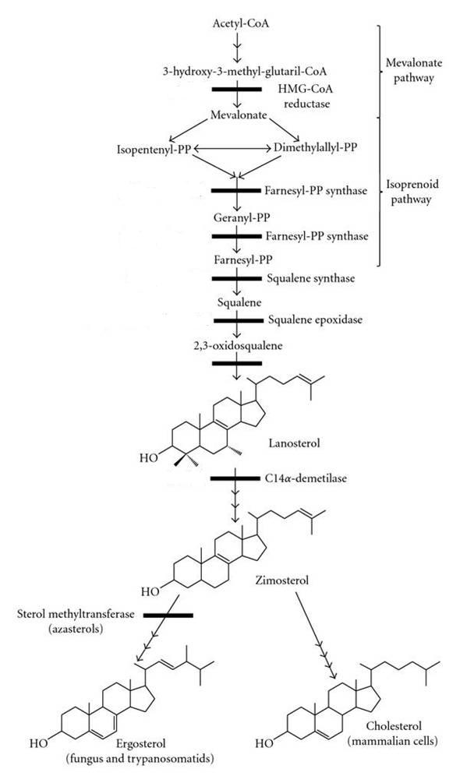
ALLYAMINES
Terbinafine, Naftifine , Butenafine
TERBINAFINE
The newest synthetic allylamine
Fungicidal #
Antifungal spectrum  c. albicans & dermatophytes
FUNGICIDAL
Inhibit squalene epoxidase
 Mechanism
The accumulation of toxic
amounts of squalene 
Fungal Cell Death
Azoles
FUNGISTATIC
Given both orally & topically
Orally 250mg /dys.  2-6 wks / 3 m
Locally  1% ointment twice daily
Used In & candida & drug of choice for many dermatophytes
In onychomycosis of fingers  6w
In onychomycosis of toes  3m

Slide 37
ALLYAMINES
Pharmacokinetics
TERBINAFINE
Well absorbed orally
Bioavailability   due to first pass metabolism in liver
Protein binding  > 99% in plasma
Accumulates in skin, nails and fat
t _{1/2} 12 hrs / extends to 200-400 hrs  slow release from tissues  found in plasma for 4-8 weeks after prolong therapy
Metabolized in liver & excreted in urine
Clearance is reduced in moderate and hepatic impairment.
ADRs
GIT disturbance, altered taste and transient  aminotransferase
Rare hepatotoxicity  not given in azotemia or hepatic failure
Interactions
Not much significant interactions with hepatic microsomal enzymes.
* Rifampicin   its serum levels
* Cimetidine   its serum levels

Slide 38
3. On Nucleic a.
FLUCYTOSINE

Slide 39
PYRIMIDINE ANALOGES
FLUCYTOSINE
Fluorinated pyrimidine antimetabolite related to  chemotherapeutic 5-fluorouracil (5-FU).
Fungistatic
Antifungal spectrum  Rather limited  c. albicans & cryptococci
Synergistic to 
Itraconazole for treating chromoblastomycosis
Amphotericin for treating cryptococcosis.
Pharmacokinetics
Oral absorption (> 90%) & rapid peak within 1-2hrs
Little protein bound.
Peak plasma con. reaches 70-80 ug /ml in 1-2 hrs.
Widely distributed in body  penetrates well into CSF.
80% dose is excreted unchanged in urine.
t _{1/2} 3-6 hours / in renal failures it may be 200 hrs
Excreted in urine

Slide 40
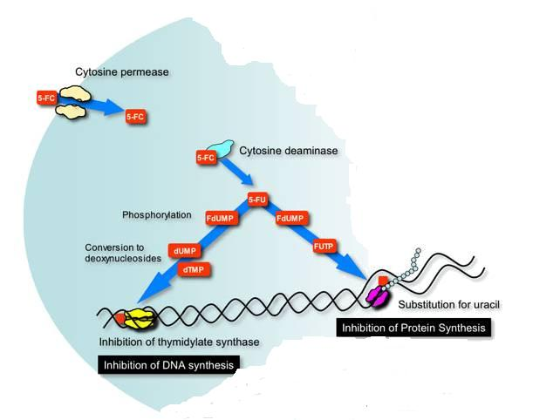
PYRIMIDINE ANALOGES
FLUCYTOSINE
Taken up by fungal cells via
cytosine permease
Pharmacodynamics
Converted intracellularly first to 5-FU by cytosine deaminase
RESISTANCE
5-fluorodeoxyuridine monophosphate
fluorouridine triphosphate
Inhibit thymidylate synthase
Inhibit Protein Synthesis
Inhibit DNA Synthesis
Human cells are unable to convert the parent drug to its active metabolites, resulting in selective toxicity to the fungal cell

Slide 41
PYRIMIDINE ANALOGES
FLUCYTOSINE
Not used as a single agent so as not to develop resistance
Doses
Given  100-150 mg /kg per day divided into 4 oral doses
Dose must be adjusted in renal disease
Uses
In chromoblastomycosis  with itraconazole
In cryptococcal meningitis, in AIDS patients with amphotericin
In candidiasis  Vaginal candidiasis  3 days
In dermatophytosis  7-15 days & Onychomycosis  3 months
ADRs
Reversible neutropenia, thrombocytopenia and occasional bone marrow depression.
Nausea ,vomiting ,diarrhea, severe enterocolitis
Reversible hepatic enzyme elevation in 5% patients

Slide 42
4. On Mitosis
GRISEOFULVIN

Slide 43
GRISOEOFULVIN
Isolated from pencillium griseofulvum, but has no antibacterial activity
Fungistatic
Antifungal spectrum 
Narrow spectrum. Used mainly against dermatophytes (can actively concentrate it ) but not against candida that causes deep mycosis.
Pharmacokinetics
Sparsely soluble in water  poor oral absorption it needs 4 hrs t reach peak effect
Absorption   by fatty meal & by intake of barbiturates
It is ineffective topically
Distributes in newly formed keratin of hair & nails
t_{1/2}  1 day.
Extensively metabolized in liver
It is a metabolizing enzyme inducer

Slide 44
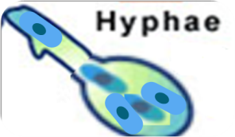
Pharmacodynamics
Mechanism
Interferes with tubulin polemerization  altered spindle formation  abnormal metaphase ( failure of daughter nuclei to separate during mitosis  multinucleated stunted hyphae
Doses & Uses
Orally: 5-15 mg /kg for children
500-1 gram for adults.
1 m.  scalp & hair ringworm
6-9 m.  finger nails / 1 y.  toe nails
ADRs
GIT upsets & hepatotoxicity
CNS symptoms; neuritis , lethargy , mental confusion, impairment in performance of routine task, fatigue, vertigo ,syncope
Photosensitivity
Leucopenia
Allergy
Microsomal enzyme inducer;  activity of anticoagulants & cause intolerance to alcohol

Slide 45
ANTIFUNGAL THERAPY FOR SUPERFICIAL MYCOSIS
Dermatomycoses;
Cutaneous infections 
Topical imidazole; as meconazole, clotirmazole…etc. for skin infection Nail infection 
Topical imidazole; as Tioconazole
Extensive scalp & nail infection  Grisofulvin orally
Candidias;
Cutaneous infection 
Topical amphotericin, clotrimazole ,
econazole, miconazole or nystatin
Oral (GITmucosa) candidiasis 
Topical amphotericin, fluconazole,
ketoconazole, miconazole or nystatin.
Vaginal candidiasis 
Topical cotrimazole,econazole,
ketoconazole, miconazole or nystatin
Use of Topical Antifungal Therapy
Efficacy of topical agents in superficial mycoses depends not only on type of lesion & mechanism of the drug action but also on;
Viscosity, hydrophobicity & acidity of the formulation  Cream or solution are preferred.
Their ability to concentrate in to stratum corneum, squamous mucosa, or cornea.
Topical antifungal agents are usually not successful in mycoses of the nails & hair and has no place in therapy of subcutaneous mycoses.

Slide 46
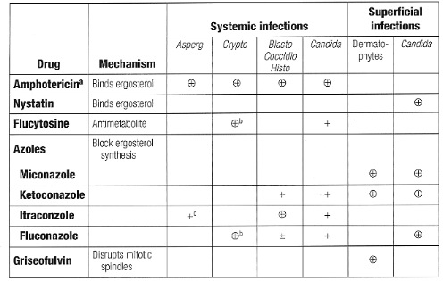
ANTIFUNGAL THERAPY FOR SUPERFICIAL vs SYSTEMIC MYCOSIS
Caspofungin Disrupts + +
cell wall

Slide 47
ANTIFUNGAL THERAPY FOR SYSTEMIC MYCOSIS
Oral or parentral polyene antibiotics
Systemic azoles
Flucytosine
Echinocandins
Drugs used | Disease
Amphotericin, Flucytocin, Fluconazole, Caspofungin Amphotericin, Flucytocin , Fluconazole, Itraconazole Itraconazole, Amphotericin, Itraconazole, Amphotericin, Amphotericin, Itraconazole, Fluconazole, Caspofungin Fluconazole. Itraconazole, Amphotericin, Fluconazole. Itraconazole, Amphotericin, Amphotericin, Flucytocin ,Amphotericin, Amphotericin, Flucytocin | Systemic candidiasis Cryptococcosis( meningitis) Systemic Aspergillosis Blastomycosis Histoplasmosis Coccidiomycosis Paracoccidiomycosis Mucormycosis Disseminated Sportrichosis

Slide 48
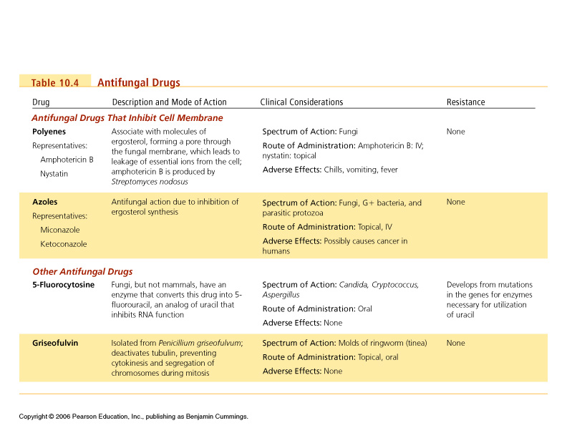
COMPARATIVE PHARMACOLGY OF ANTIFUNGAL THERAPY

Slide 49
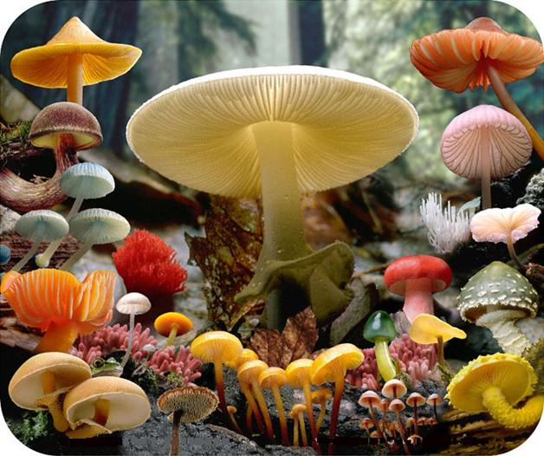
G
O
O
D
L
U
C
K

