Slide 1
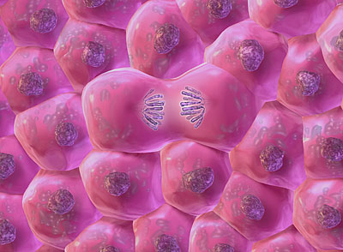
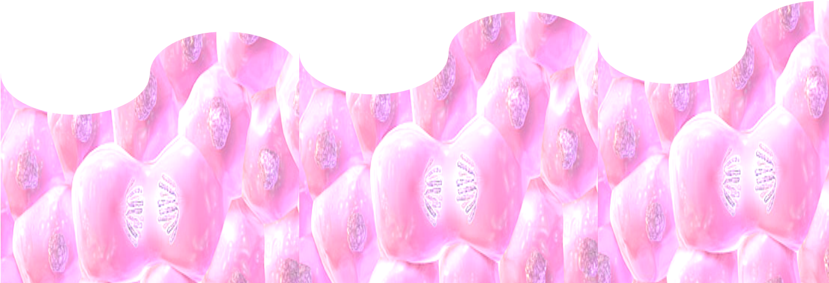
CANCER CHEMOTHERAPY

Slide 2
CANCER CHEMOTHERAPY
PART I
ILOs
Differentiate a normal from a malignantly transformed cell
Hint on major tumor growth kinetics
Contrast the varied modalities of treatment
Elaborate on chemotherapy regarding their classification
according to their chemical nature, target site of action &
relevance to cell cycle
Raise the principles of their antineoplastic mechanisms
Discuss their varied side effects & toxicities
Explain how resistance against them develops
Raise the different strategies of administration

Slide 3
NORMAL CELLS
1. Non dividing (terminally differentiated ) 2. Continually proliferating
3. Resting but may be recruited into cell cycle
?
Mitosis Begin
Cytokinesis
Differentiate
DNA content = 4n
Mitosis
M 2%
G₂ 20%
Synthesis needed for mitosis
Enter Cycle
Restjng
G₀
G₁ 40%
Proliferating
Interphase
DNA content = 2n
Synthesis needed for DNA synthesis
S 38%
DNA synthesis
Committed
ORGANIZED CELL DIVISION
Notes:
Interphase

Slide 4
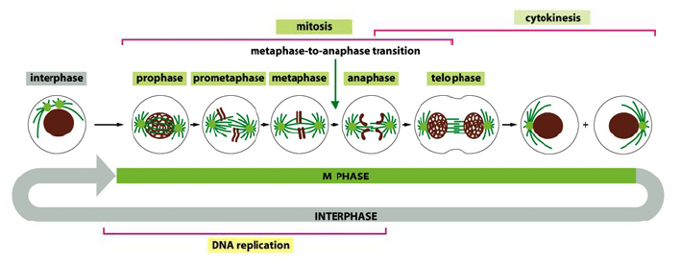
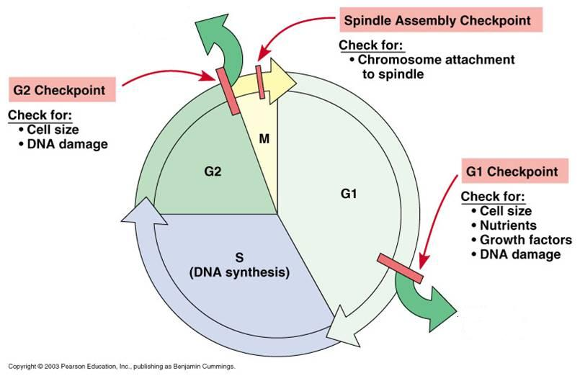
Other Mitotic checkpoints
NORMAL CELLS
ORGANIZD CELL DIVISION
Metaphase;
Chromosome attachment to spindle is appropriate
Cell size
DNA replication complete
Cell size
Nutrients
Growth factors
DNA damage
Replication Checkpoint
DNA replicating appropriate

Slide 5
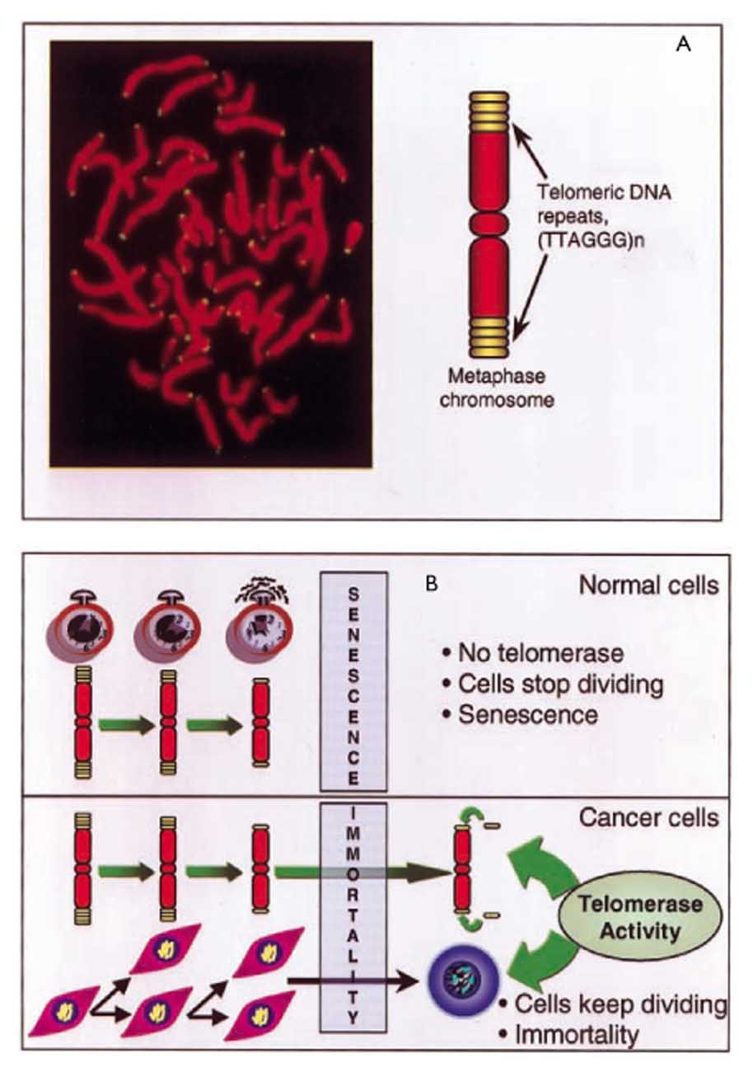
NORMAL CELLS
ORGANIZD CELL DIVISION
Telomerase enzyme is not activated
Body cells can only divide a limited number of times because the TELOMERES (protective caps) shorten with cell division till cell goes into SENESCENCE
N.B.If telomerase enzyme is activated to pertain telomeres so cell can become immortal

Slide 6

NORMAL CELLS
-ve Cell cycle control prts
& DNA repair ptrs
p16, 27, 21,
pRB /E2F
p53
□
Anti-apoptotic prts.
Bcl2 # Bax, Fas
□
-ve Tolemerase
GF  GF R
◉
Signaling Molecules;
Ras
MAP Kinase
◉
TF;
Fos, Jun, Myc
◉
+ve Cell cycle control prts;
Cyclins/ Cdk
Cytokinesis
Mitosis
M
G₂
G₀
G₁
Interphase
S
ORGANIZED CELL DIVISION
Coordinated GF production & signaling…etc
Tightly regulated tumor suppressor genes & apoptotic prts
Goes into senescence
Notes:
Interphase

Slide 7
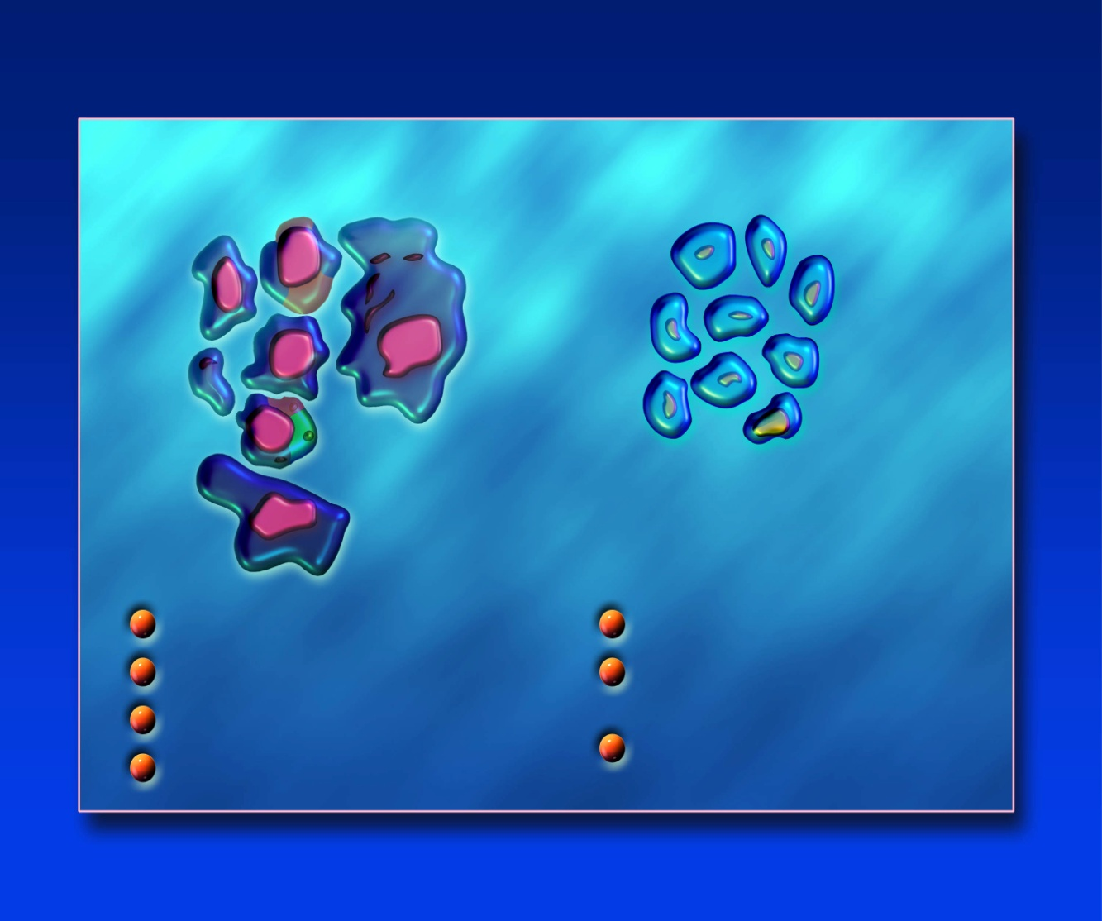
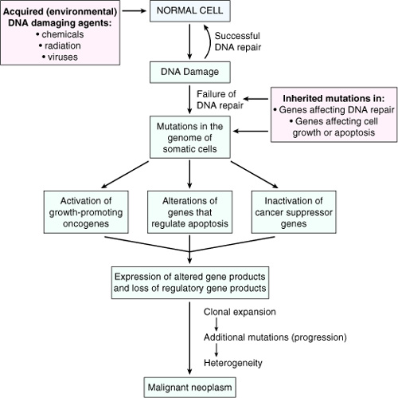
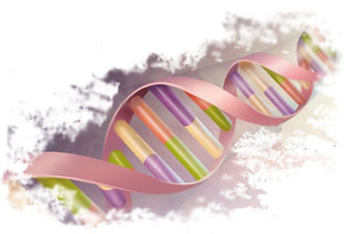

NORMAL CELLS
Transformation  Clonal expansion  mutation  heterogenicity
Differ from normal cells in :
Uncontrolled proliferation
Dedifferentiation and loss of function
Invasiveness
Metastasis.
MALIGNANT CELLS

Slide 8
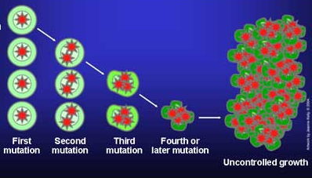
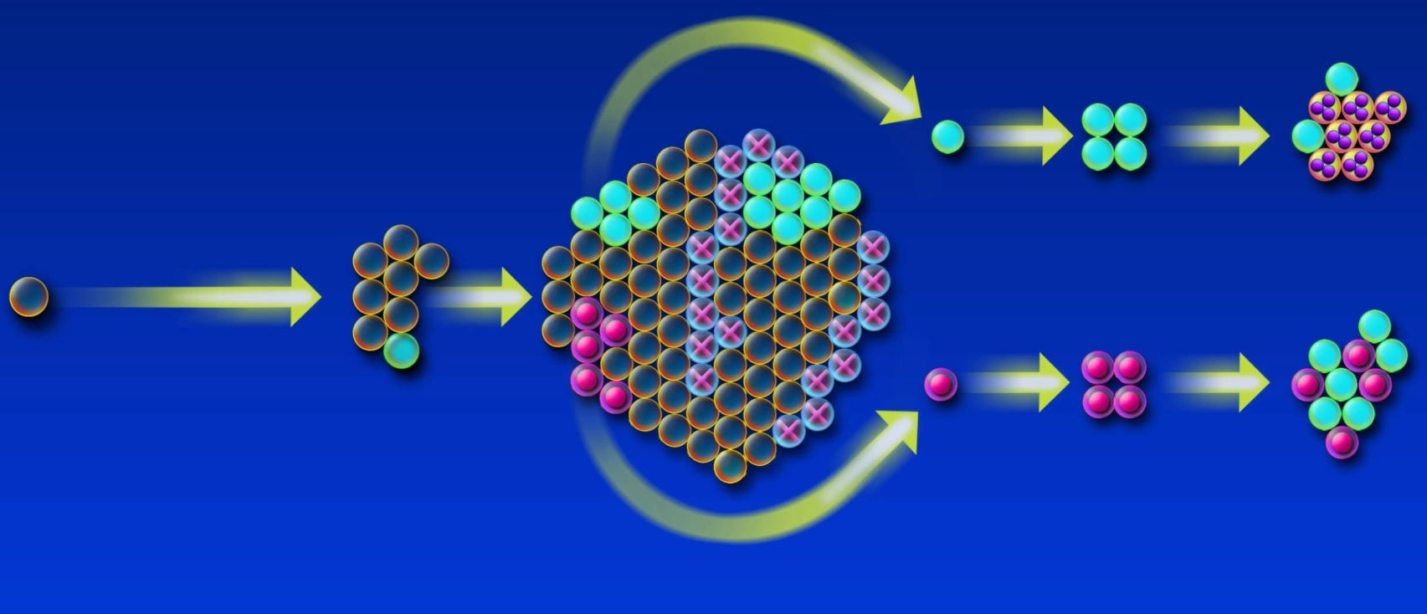
THE JOURNY OF TUMORIGENESIS
Normal
cell
Initial
genetic change
(pRb functional loss or c-myc overexpression)
Secondary
genetic change
(p53 dysfunction or bcl-2 overexpression)
Subsequent
genetic change
Increase in cell proliferation & halt apoptotic signals
Decrease
in apoptotic
cell death
More alterations
in phenotype
(eg, invasiveness
and metastasis)
PRY NEOPLASM
METASTASES
TRANSFORMATION EXPANSION/ MUTATIONS METASTASIS          
& HETEROGENECITY

Slide 9
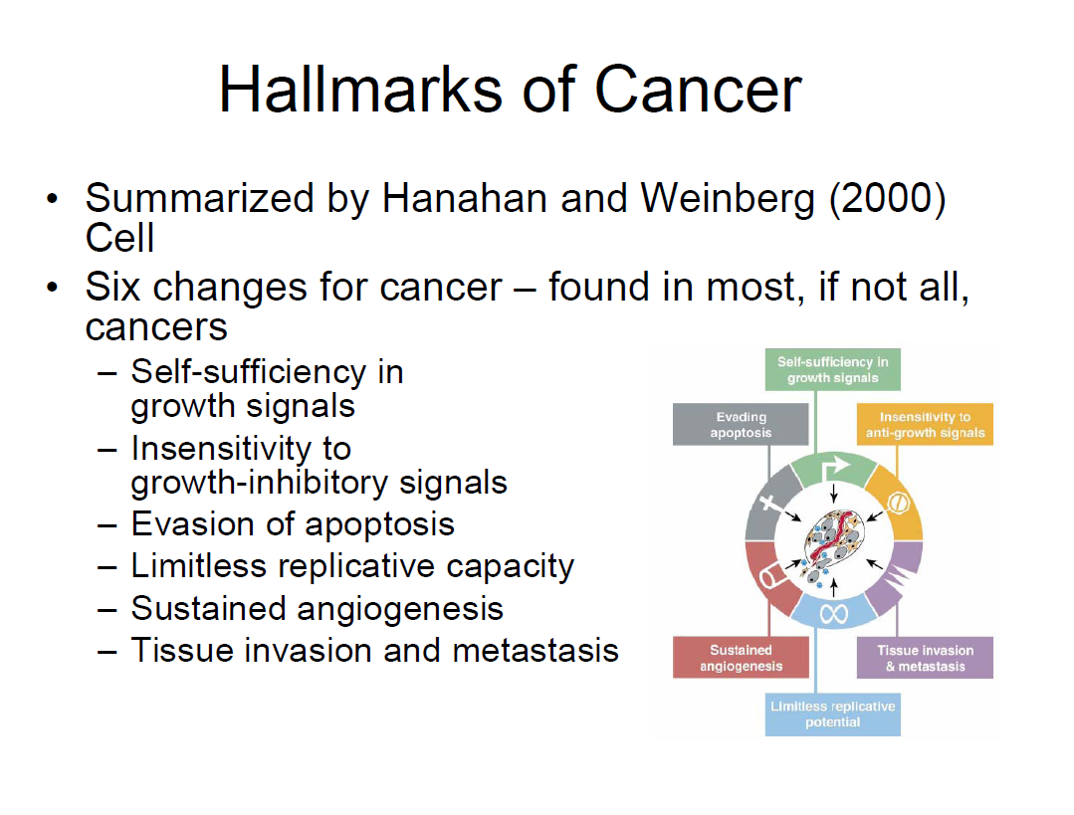
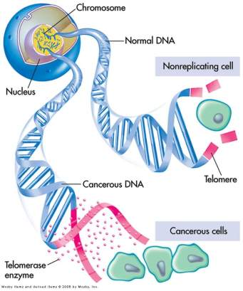
Features of MALIGNANT CELLS
NORMAL CELLS
CANCEROUS CELLS
IMMORTALITY

Slide 10
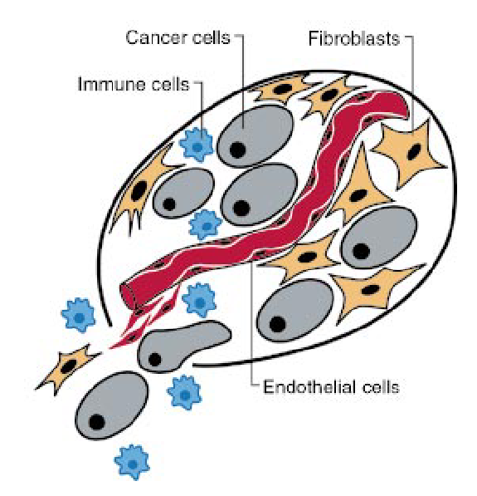
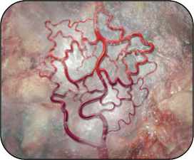
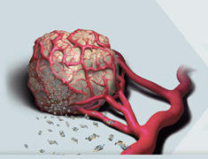
Features of MALIGNANT CELLS

Slide 11
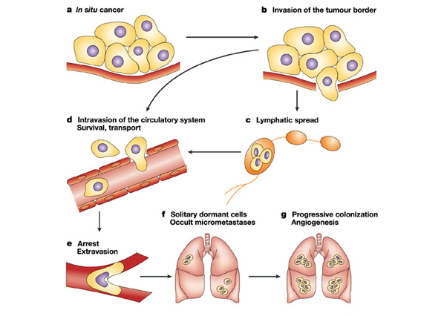
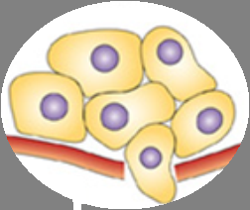
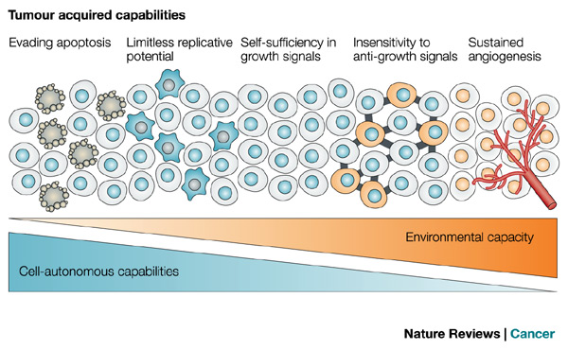
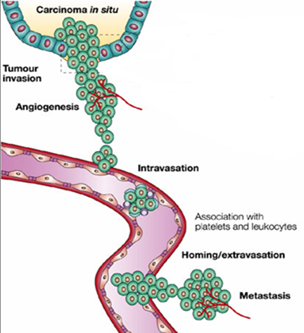
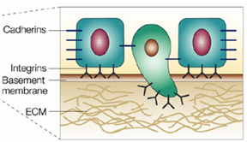
Features of MALIGNANT CELLS
Blood Spread
Lymphatic Spread
Invasion of tumor border
Invasion of blood vessle
METASTASIS

Slide 12
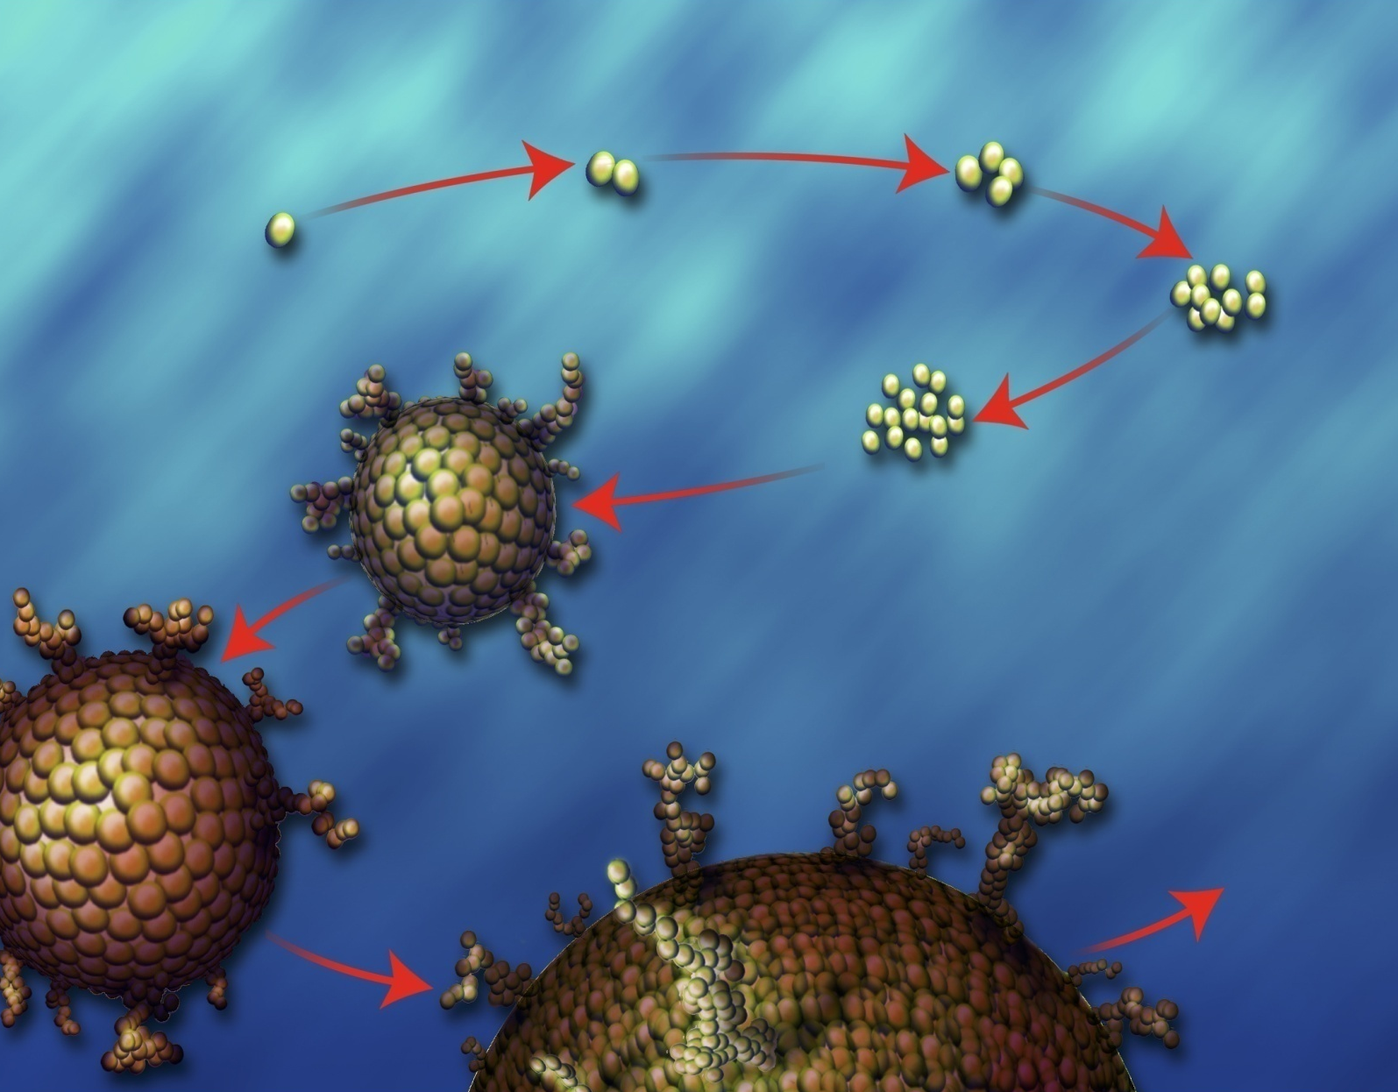
Exponential Growth of MALIGNANT CELLS
EARLY GROWTH
Zero Order Kinetics
Doubling
Normal
cell
Doubling
2 cancer cells
4 cells
Malignant
transformation
8 cells
1 million cells
(20 doublings)
undetectable
Doubling
Dividing
16 cells
CELL CYCLE TIME: Time required for tumor to double in size  variable
Hodgikin’s Disease  3 - 4 days
Colonic carcinoma  80 days
1 billion cells
(30 doublings)
LUMP APPEARS
41 – 43
doublings
Death
Limit of clinical
detection

Slide 13
The more the tumor enlarges  its growth slows 
becomes non-exponential
LATE GROWTH
Gompertzian Kinetics
GROWTH RATE will depend on;
Growth fraction
Cell cycle time
Rate of cell loss
10 ¹²
10 ⁹
diagnostic
threshold
(1cm)
number of
cancer cells
Thus at any particular time
Some cells are in CC &
others are Resting at G_{0.}
Ratio of Proliferating / Resting 
GROWTH FRACTION [GF]
A tissue  ⬆% of Proliferating Cells / Resting Cells High Growth Fraction.
A tissue composed mostly of cells in G₀  Low Growth Fraction
time
undetectable
cancer
detectable
cancer
Smaller tumors = grow slowly but have large GF
Medium size tumors = grow more quicker but with smaller GF
Large tumors = have small growth rate and GF

Slide 14
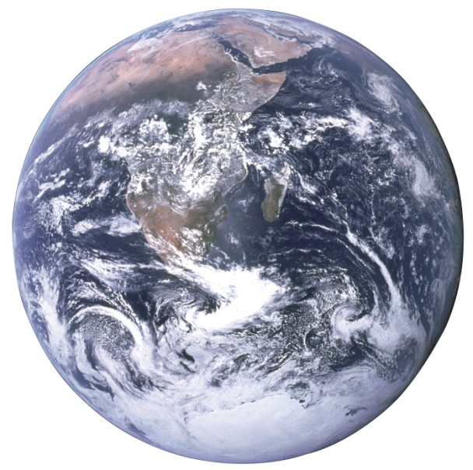
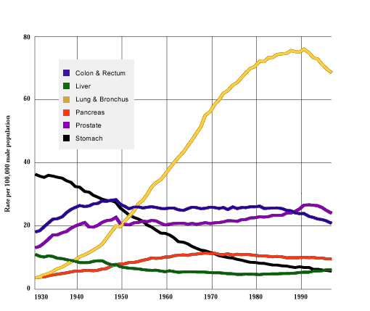
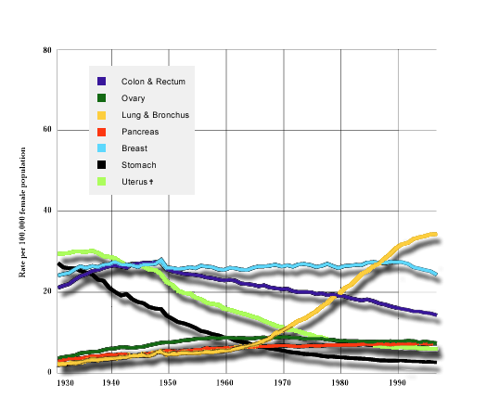
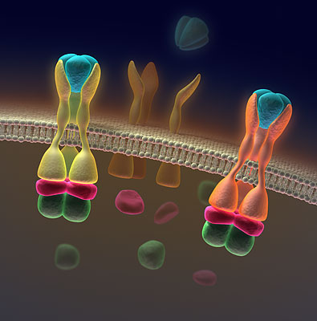
How far is the problem?
1 in 3 develop cancer
50% die/survive
17% cured by chemotherapy.
> 16 million new cancer cases diagnosed yearly
Nearly 10 million die of cancer
Males
Females

Slide 15
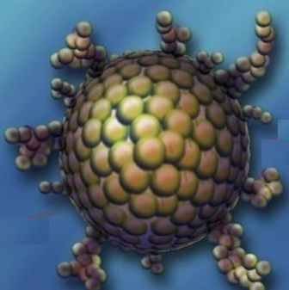
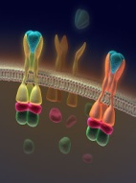
TREATMENT MODALITIES
Surgery
Radiotherapy
Chemotherapy
Endocrine therapy
Immunotherapy
Biological therapy
THERAPEUTICs
GOALS?
ANTINEOPLASTIC AGENTS
Curative; Total eradication of cancer cells  if could not be surgically excised or some disseminated tumors; Testicular, Wilms’, Hodgikin’s Disease
Palliative; ⬆ survival, alleviate symptoms, avoid life-threatening toxicity  In most other inoperable disseminated tumors to delay growth &  size
Adjuvant therapy to surgery or irradiation; In attempt to eradicate micrometastasis to recurrence  solid tumors as breast cancer & colorectal cancer

Slide 16
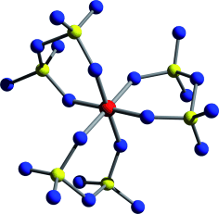
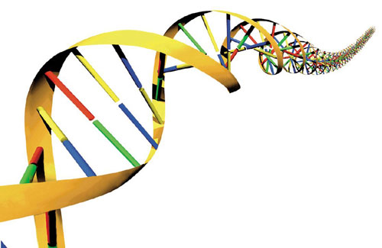
1- CHEMOTHERAPY
CLASSIFICATION
ACCORDING TO THEIR CHEMICAL CLASS
ACCORDING TO SITE OF ACTION
Alkylating Agents & Related Compounds
Antimetabolites (Structural Analogues)
Cytotoxic Antibiotics (Antitumor Antibiotics)
Plant Alkaloids
Miscellaneous Agents
IN RELATION TO CELLULAR TARGETS
Purines & Pyrimidines Nucleic a
◉
DNA
◉
RNA
◉
Proteins
◉
Microtubules
IN RELATION TO CELL CYCLE
I. Cell Cycle Specific (CCS)
Phase Dependent
Drugs act only at a specific phase in CC.
II. Cell Cycle Non-Specific (CCNS)
Non Phase Dependent
Drugs act at all proliferation stages but not in the G₀-resting phase

Slide 17
IN RELATION TO CELLULAR TARGETS
PURINE SYNTHESIS
PYRIMIDINE SYNTHESIS
6-MERCAPTOPURINE
6-THIOGUANINE
METHOTREXATE
5-FLUOROURACIL
HYDROXYUREA
CYTARABINE
RIBONUCLEOTIDES
ALKYLATING AGENTS
AKYLATING LIKE (INTERCALATING)
ANTIBIOTICS
DEOXYRIBONUCLEOTIDES
DNA
ETOPOSIDE
RNA
TOPOISOMERASE
PROTEINS
L-ASPARAGINASE
VINCA ALKALOIDS
TAXOIDS
ENZYMES
MICROTUBULES

Slide 18
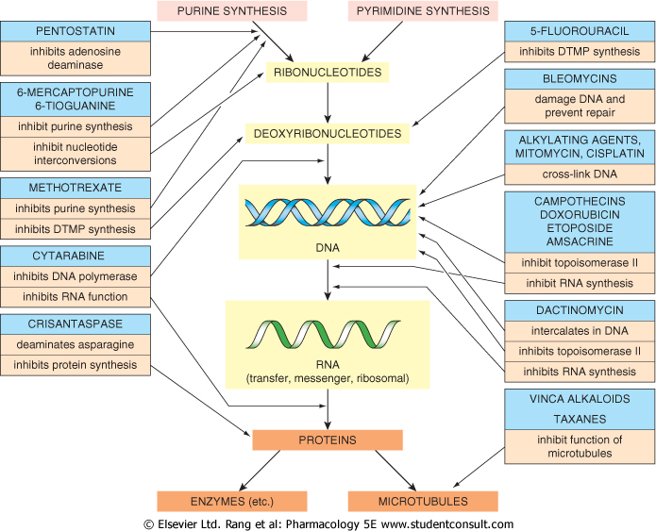
IN RELATION TO CELLULAR TARGETS

Slide 19
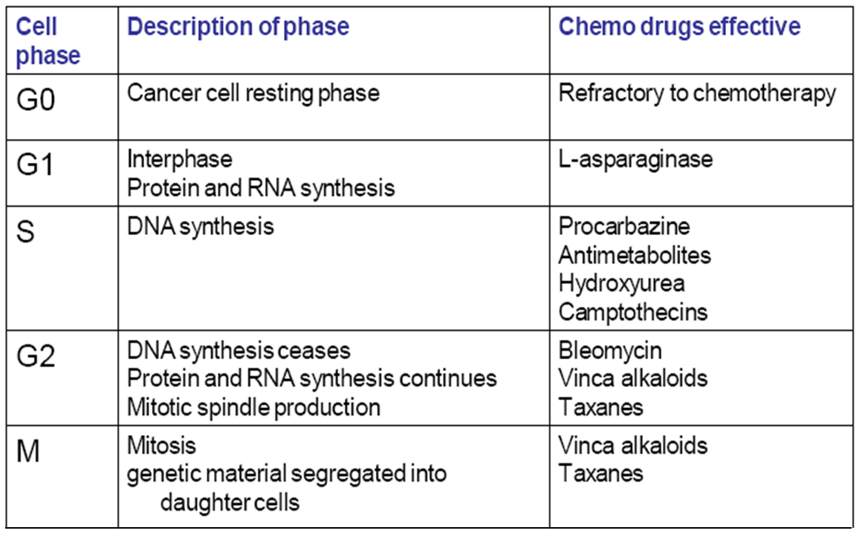
Cell Cycle Specific (CCS)
Phase Dependent
IN RELATION TO The CELL CYCLE
MTX, 6-MP, 5-FU, Cyt-Arb, Fludarabine, Pentostane, Bleomycin, Vinca alkaloids, Taxanes, Etoposide Camptothecins, L-asparaginase
Antibiotics
Antimetabolites
Unreplicated DNA S Arrest
Topoisomerase Inhibitors
DNA damage G2 Arrest
S
G2
Vinca alkaloids
M
Mitotic inhibitors
Taxoids
Alkylating agents
Improper spindle formation M Arrest
DNA damage G1 Arrest
G1
G0
Cell Cycle Non-Specific (CCNS)
Non Phase Dependent
Cyclophosphamide, Busulfan, Carmustine, Lomustine , Cisplastin, Doxorubicin, Actinomycin D

Slide 20
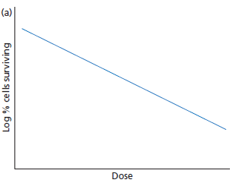
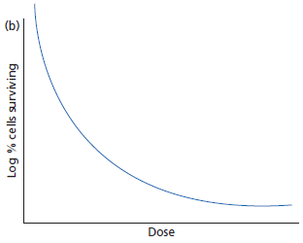
IN RELATION TO The CELL CYCLE
What is the difference between phase dependence & phase non dependence?…..
Phase non-Dependence (non-specific):
Their dose-cytotoxicity relationships follow first-order kinetics (cells are killed exponentially with increasing dose).
  The drugs generally have a linear dose-response curve(↑ the drug administration, the ↑ the fraction of cell killed).
  Cytotoxic drugs are given at very high doses over a short period
  Effective in tumors both GF &  GF
Phase Dependence (specific):
Their dose - cytotoxicity curve is initially exponential, but at higher doses the response approaches a maximum
  Above a certain dosage level, further increase in drug doesn’t result in more cell killing.
  Cytotoxic drugs are given by infusion and the duration can be varied to killing demands
  Effective in tumors with  GF

Slide 21
Principles of Anti-neoplastic Actions
Log-Kill Hypothesis
Objective of giving chemotherapy is to KILL (eradicate) cancer cells. How much?
It was found that  a given intervention will kill the same FRACTION [PROPORTION] of cancer cells each time rather than kill a constant NUMBER of cells  so, if the drug was to kill 99.99% of cells (1 in every 10⁴ survives), representing a “log kill” of 4. If the initial tumor burden was 10¹¹ cells this leaves 10⁷ still viable. So we always need multiple sessions.
A high “log kill” by monotherapy is seldom achieved, as toxic side effects restrict the doses used & resistance can develop with repeating sessions.
Schedules of combinations therapy is mandatory to produce as near total cell kill as possible while minimizing resistance development
Dividing cell  more susceptible to chemotherapy  outer part
G₀ cells  not sensitive but activate when therapy ends  at core;
usually youngest cells, hypoxic region
Solid cancer tumors  GF  respond poorly to chemotherapy remove 1st by surgery
Disseminated cancers  GF  respond well to chemotherapy

Slide 22
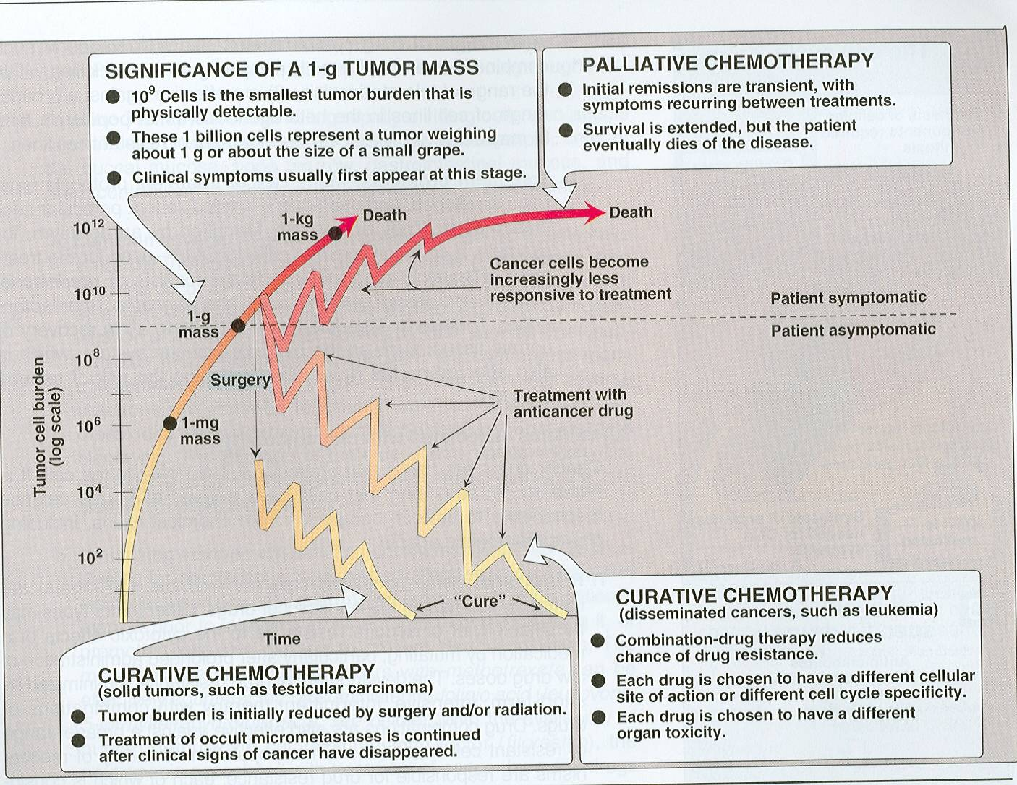
Principles of Anti-neoplastic Actions
Log-Kill Hypothesis
Tumor regrowth after premature cessation of therapy
3 log kill / 1 log survive

Slide 23
COMMON TOXICITIES OF CHEMOTHERAPY
An ideal chemotherapeutic would eradicate cancer cells without harming normal tissue.
But there is no so far ideal
ADRs
 Common to develop ???
 Time Course of development
Kill fast growing cells
  blood cells progenitors
  cells in the digestive tract
  reproductive system
  hair follicles
Affect other vulnerable tissues
  heart and lungs
  kidney and bladder
  nerve system
Immediate Early Delayed Late
(hours - days) (days - weeks) (weeks- months) (months - yrs)
Extravasation Myelosuppression Cardiotoxicity Second Cancer
Nausea & Emesis Mucositis Lung fibrosis Encephalopathy
Hypersensitivity Alopecia P. Neuropathy Sterility
Tumour lysis Cystitis Hepatotoxicity Teratogenicity
Nephrotoxicity

Slide 24
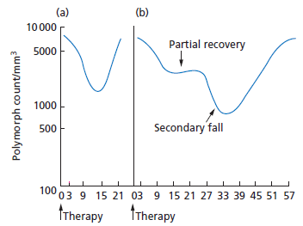
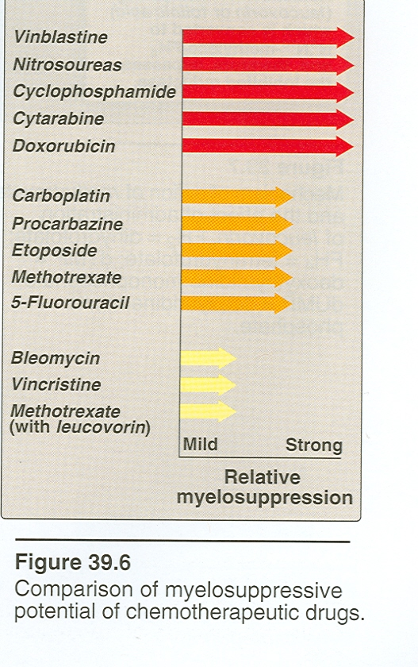
COMMON TOXICITIES OF CHEMOTHERAPY
1. BM DEPRESSION  Myelosuppression  lead to infection , bleeding, anemia
Recovery may be
a. rapid (17–21 days)
b. delayed (initial fall 8–10 days, 2nd fall at 27–32 days, recovery 42–50 days)
Support with blood products (red cells & platelet concentrates) + early antibiotic
Treatment  erythropoietin, granulocyte colony-stimulating factor (G-CSF), granulocyte macrophage colony-stimulating
factor (GM-CSF )
Vincristine, Bleomycin, Cisplastin, Glucocorticosteroids seldom cause BM depression

Slide 25
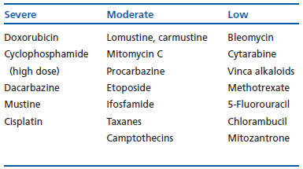
COMMON TOXICITIES OF CHEMOTHERAPY
2. Nausea & vomiting deterrent to patient compliance in completing the course of treatment
Mechanisms  Stimulation of CRTZ
Release of serotonin in GIT activate 5-HT₃
Stimulation of vagal afferents  peristalsis & gastric atony
Treatment  anti-emetic therapy; 5-HT₃ antagonist; ondansterone + Steroids
Emetogenic Potential of Chemotherapy

Slide 26
COMMON TOXICITIES OF CHEMOTHERAPY
3. Extravasation  severe tissue necrosis
4. Damage to gastrointestinal epithelium  diarrhea & dehydration
5. Impair wound healing
6. Alopecia; Doxorubicin, ifosfamide, parenteral etoposide, camptothecins,
anti-metabolites, vinca alkaloids & taxanes
7. Kidney damage; The rapid cell destruction  extensive purine
catabolism  urates precipitate in renal tubules  renal failure  so
can give allopurinol + excessive fluid intake
8. Depression of growth
 in children
9. Sterility
10. Teratogenicity
11. Carcinogenicity
Toxicity | Drug(s)
Renal | Cisplatin, methotrexate
Urinary | Cyclophosphamide
Hepatic | 6-MP, busulfan, cyclophosphamide
Pulmonary | Bleomycin, busulfan, procarbazine
Cardiac | Doxorubicin, daunorubicin
Neurologic | Vincristine, cisplatin, paclitaxel
Immuno- suppression | Cyclophosphamide, cytarabine, dactinomycin, methotrexate
Distinctive Toxicities of Some Anticancer Drugs

Slide 27
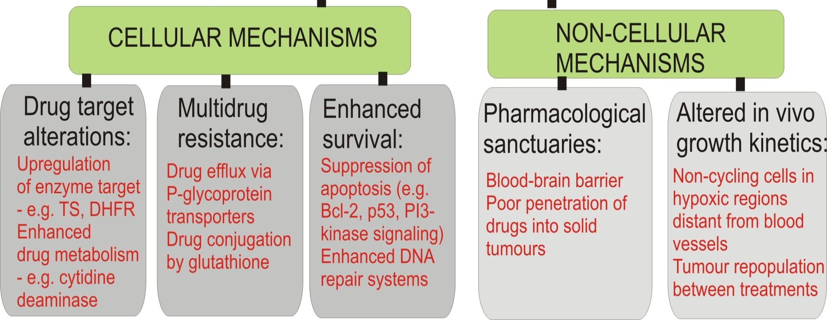
?
RESISTANCE TO CHEMOTHERAPY

Decrease inward transport
The use of monotherapy can lead to the appearance of survivor cells resistant to several other unrelated cytotoxic agent i.e. MDR
doxorubicin vincristine paclitaxel
atoposide
5-FU
methotrexate
6MP
Cyclophosphamide
Minimize incidence by using combinations & if develops add
VERAPAMIL (a CCB) in adjuvance to chemotherapeutics to inhibit P-glycoprotein !!!
intracellular drug concentration
Cytosine arabinoside
5-FU
Cyclophosphamide
Cisplatin

Slide 28

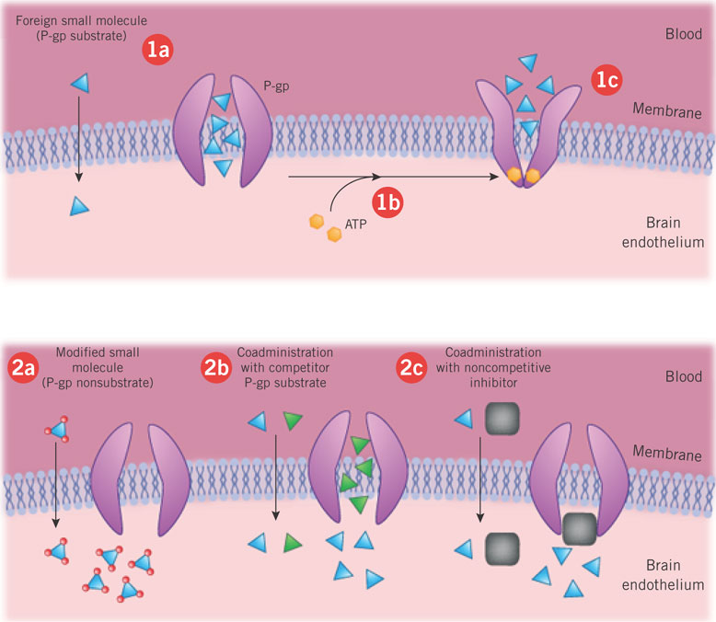
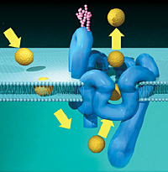
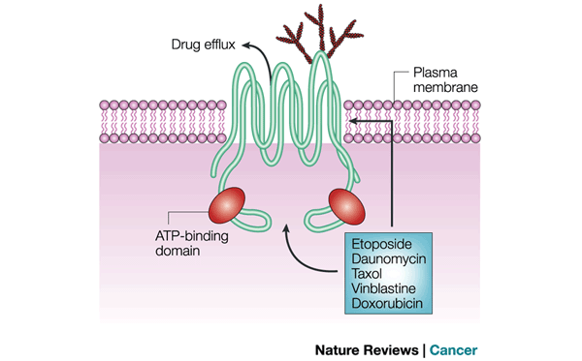
MDR
Reduced Folate Carrier (RFC)
Folic a., THF,
Methotrexate
5-FU
Folate Receptor (FR-α)
Folic a., THFs
◉ inward transport
 Outward efflux
Effluxed Vincristine
Vincristine enters
Vincristine

Slide 29
STRATEGIES OF CHEMOTHERAPEUTIC DRUG ADMINISTRATION
The RATIONAL is to  combine several chemotherapeutics rather than apply one only as monotherapy and to give that on intermittent sessions
Combination of drugs with different antiproliferative profiles that affect different biochemical pathways and with varying toxicity profile is likely to merit:
Maximization of cell kill within the range of tolerated toxicity
Having no additive toxicity
Effectiveness against the broader range of tumor cellular heterogenicity
Slowing or preventing development of resistance
Intermittently to
Allow recovery of normal tissues that have been toxically affected.
Minimize the opportunity of developing resistance
N.B. If tumor is operable we combine across modalities of treatment as chemotherapy (before or after surgery) with or without radiotherapy with or without addition of immuno or biological therapy
If tumor is inoperable; the same could be applied without surgery

Slide 30
CANCER CHEMOTHERAPY
TO BE CONTINUED

Slide 31
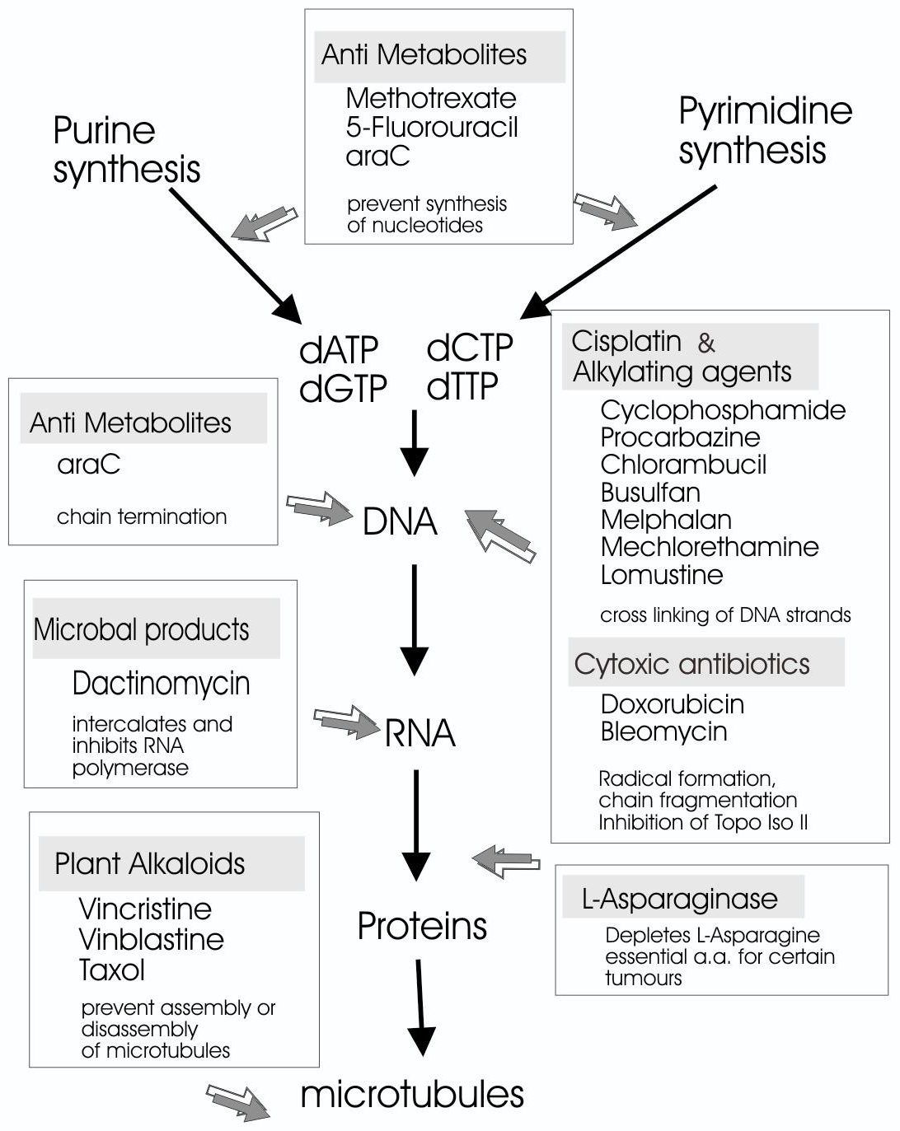
ACCORDING TO SITE OF ACTION
IN RELATION TO CELLULAR TARGETS
Nucleotide Synthesis
DNA Synthesis
DNA Replication
DNA Transcription
DNA Function

