Slide 1
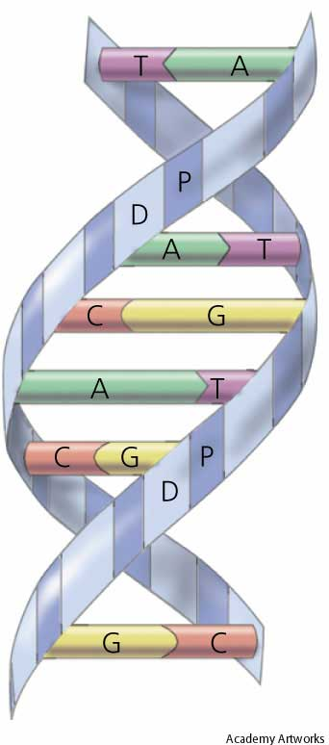
CANCER CHEMOTHERAPY
PART II
ILOs
Study different types of cancer chemotherapy, their mechanism of action, their relevance to the cell cycle
Relate their anti-neoplastic mechanism to their indications
Justify their varied toxicities
State if there exists specific antidote that would ameliorate or eliminate toxicity

Slide 2
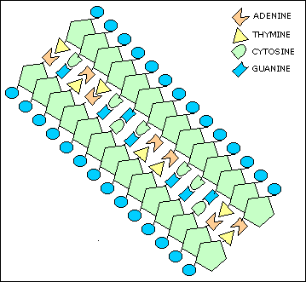
INDIVIDUAL CHEMOTHERAPEUTIC GROUP
ALKYLATING AGENTS AND RELATED COMPOUNDS
Nitrogen mustards | Alkyl sulphonates | Nitrosoureas | Alkylating-like agents
Mechlorethamine. Cyclophosphamide. Chlorambucil. Melphalan. Ifofamide | Busulphan. | Carmustine. Lomustine. Semustine. Streptozocin. | Thiazines Procarbazine. Dacarbazine. Platinum compounds Cisplatin / Carboplatin.
By definition, they are a diverse group of chemicals that have in common the capacity to contribute, under physiological conditions, mostly, alkyl groups to biologically vital macromolecules such as DNA.
ANTINEOPLASTIC MECHANISM OF ACTION
Are CCNS  Non-Phase Dependent
They contain reactive gps that covalently bind to the guanosine base of DNA, specially at the number 7 nitrogen atom of the imidazole ring. It can less bind to adenine & cytosine.

Slide 3
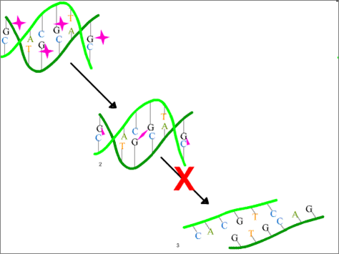
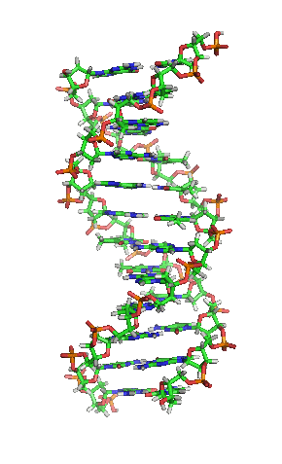
ALKYLATING AGENTS AND RELATED COMPOUNDS
Cannot uncoil & separate
In most of them the reactive gps are 2 alkyl groups (C_{n}H_{2n+1})  so are bifunctional allowing inter & intra nucleotide crosslinking of the guanine neucleobases in the DNA double-helix strands  so strand become unable to uncoil and separate.
The cells are most susceptible to alkylation in late G1 & S phases of CC with expression of block in G2  apoptosis So they stop tumor growth.

Slide 4
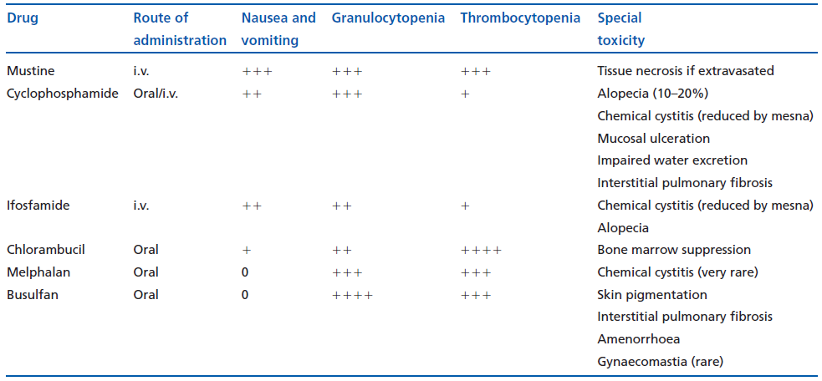
ALKYLATING AGENTS AND RELATED COMPOUNDS
Class ADRs
Carcinogenesis: Chlorambucil, cyclophosphamide, streptozocin and semustine have been implicated as causes of second malignancies
Sterility: may occur with long-term use of any alkylating agent.
Bone marrow suppression:  white counts, platelets & megacaryocytes lowest level after 10-12 days of mechlorethamine or cyclophosphamide. Recovery within 21 (cyclophosphamide) to 42 (mechorethamine) days.
Drug-Specific ADRs

Slide 5
Nitrogen Mustard; ALKYLATING AGENTS
Uses
Cyclophosphamide
In Lymphomas, Burkitt’s lymphoma, Myeloma & Chronic leukemias.
Can induce complete cure in acute lympho-blastic leukemia of childhood.
In conjunction with others in carcinoma of the ovary, cervix and colon.
As adjuvant therapy with others after breast cancer surgery if lymph nodes present.
A Pro-Drug
HEPATIC
CYTOCHROMES
P 450
ACTIVATION
Other Uses
4-OH CYCLOPHOSPHAMIDE
ALDOPHOSPHAMIDE
As potent immuno-suppressant in organ rejection after transplantation, intractable rheumatoid arthritis & nephrotic syndrome in children.
INACTIVATION
ALDEHYDE
DEHYDROGENASE
4-KETO-CYCLOPHOSPHAMIDE
CARBOXYPHOSPHAMIDE
PHOSPHORAMIDE
MUSTARD
ACROLEIN
CYTOTOXICITY
TOXICITY
Mesna

Slide 6
Nitrogen Mustard; ALKYLATING AGENTS
ADRs
Cyclophosphamide
Alopecia.
Mucosal ulcerations, ridging of nails, pigmentation of skin.
Interstitial pulmonary fibrosis
Hepatic toxicity (liver injury)
Sterile haemorrhagic cystitis in 5-10% of patients due to chemical irritation produced by reactive metabolites of (acrolein). Reduced by  fluid intake & giving MESNA ( a sulphydryl donar  interact with acrolein  NON-TOXIC.
Amenorrhoea, testicular atrophy and sterility.
Its metabolites  antidiuretic effect  water intoxication. Treatable.
Bone marrow depression  Thrombocytopenia  less common.
Nitrosourea ; ALKYLATING AGENTS
Has alkylating and carbamoylating activities
Lipid soluble and can, therefore, cross BBB
Used  tumors of brain & meninges
Initial BM depression
Lomustine & Carmustine

Slide 7
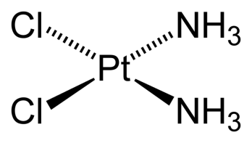
Alkyl Sulfonates ; ALKYLATING AGENTS
Well absorbed. t½ 2-3 hrs. Excreted in urine.
Suppress formation of granulocytes & platelets in low dosage & red cells in higher dosage.
No effect on lymphoid tissue or GIT
Used  Chronic granulocytic leukaemia
Busulphan
ADRs
Myelosuppression  thrombocytopenia.
Impotence, sterility and amenorrhoea.
Interstial pulmonary fibrosis
Carcinogenic & leukemogenic effects.
Hyperuricemia  due to  purine catabolism 
renal damage by ureates  give ALLOPURINOL.
Skin pigmentation.
Platinum Compounds; ALKYLATING-LIKE AGENTS
Inorganic water soluble metal complex  given > infusion
Analogues to alkylating agents
Intracellularly  Cl⁻ dissociate  forms DNA
intrastrand cross-links
Cisplatin
Used  Solid ovarian & testicular tumors
ADRs
Oto-toxicity
Severe nausea & vomiting  give ondansetron.
Nephrotoxicity  Pre-hydration & fluid diuresis

Slide 8
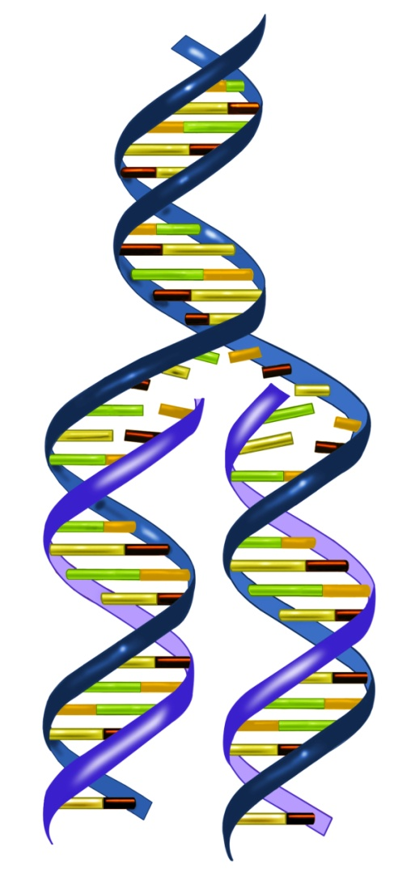
INDIVIDUAL CHEMOTHERAPEUTIC GROUP
II. ANTIMETABOLITES [Structural Analogues]
Folic a. Analogues | Purine Analogues | Pyrimidine Analogues
Methotrexate. | Mercaptopurine (6-MP). Thioguanine. Azathiopurine Fludarabine Pentostain | Fluorouracil (5-FU) Cytarabine. Capecitabine. Gemcitabine. Azacitidine.
By definition, antimetabolites are structural analogues of, and compete with, endogenous nucleic acid precursors, namely purines & pyrimidines.
ANTINEOPLASTIC MECHANISM OF ACTION
Are CCS. Act predominantly on S phase  Phase Dependent
They interfere at different levels on nucleic a. synthesis   its availability for DNA replication i.e. during the S phase of CC.

Slide 9
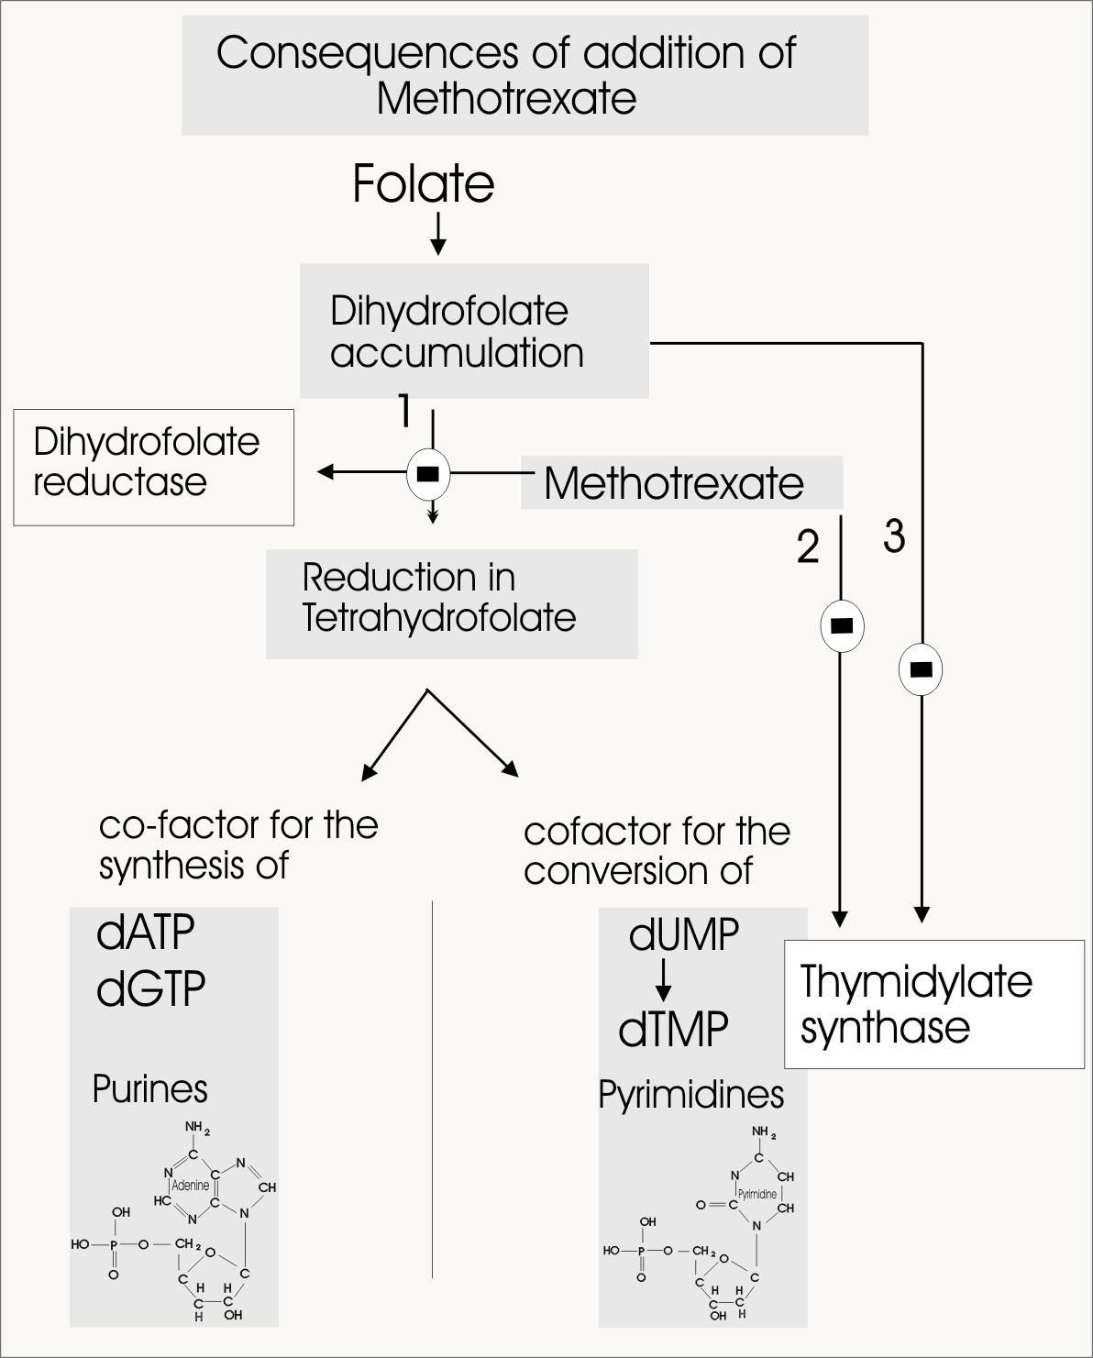
FOLIC ACID ANTIMETABOLITES
Folic a.
Methotrexate
Mechanism
1.
Methotrexate binds to catalytic part of enzyme DIHYDROFOLATE REDUCTASE preventing it from converting folic a to tetrahydrofolic a. (FH4 ).
2.
3.
Purine
Pyrimidine
Lack of cofactor FH4  -ve :
Thymine formation via  -ve THYMIDYLATE SYNTHASE
Purine nucleotides
Serine & methionine a.a. via  -ve methyle gp donation
Guanine
Adenine
Cytosine
Thymine
Uracil
Interfere with DNA, RNA formation & protein synthesis

Slide 10
FOLIC ACID ANTIMETABOLITES
Methotrexate
It is well distributed through out the body but does not cross BBB; so can be given intrathecal if needed for intracranial tumors
It is actively taken up into cells by the transport system used by folate . Inside cells , it is metabolised to polyglutamate derivatives, which is retained in cells for weeks allowing the drug to exert a sustained effect.
Urinary excretion of metabolite & unchanged drug occurs in high doses  toxicity  adequate hydration is essential
Uses
Curative for choriocarcinoma & osteogenic sarcoma
Induces remission  acute lymphocytic leukaemia & Burkitt’s lymphoma
Adjuvant therapy  breast carcinoma
Palliative therapy  metastatic breast, head, neck, cervical & lung carcinomas
Other Uses
Immunosuppressant in psoriasis, rheumatoid artherits, .....

Slide 11
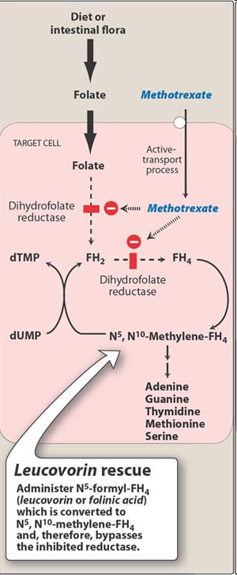
FOLIC ACID ANTIMETABOLITES
Folic a.
Methotrexate
ADRs
Bone marrow depression
Damage to GIT epithelium
Pneumonitis & interstitial fibrosis
Hepatitis  when used in low dose for immuno-suppression
Neurological toxicities when given intrathecal  meningeal irritation, stiff neck, headache and fever.
Nephrotoxicity when used in high dose  must be followed after 24 hrs by “Rescue Therapy” with LEUCOVORIN (Folinic acid )  that by passes the dihydrofolate reductase blockade & methotrexate toxicity,
+ give ample fluids + better alkalinize urine pre treatmnent to  tubular injury

Slide 12
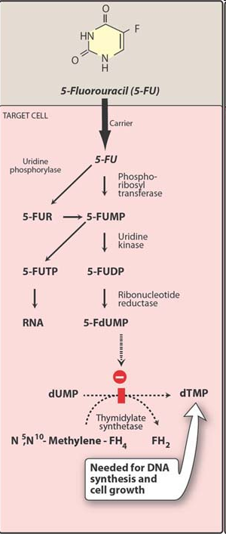
PYRIMIDINE ANTIMETABOLITES
Fluorouracil
5-FU
Fluorouracil (5-FU), a pyrimidine analogue is devoid of cytotoxic activity
Mechanism
Intracellularly, convert to;
5-flurorouridine monophosphate  incorporate in RNA impairing its function & its polyadenylation
5-fluorodeoxyuridine phosphate (5-FdUMP ) which competes with deoxyuridine monophos-phate (dUMP) for the enzyme THYMIDYLATE SYNTHETASE  -ve production of dTMP  so no thymine nucleotide form  -ve of DNA synthesis through “THYMINELESS DEATH”.
5-FU is given by IV line.
Dose adjusted in hepatic disorders

Slide 13
PYRIMIDINE ANTIMETABOLITES
Uses
Fluorouracil
In the treatment of slowly growing solid tumors such as carcinoma of the breast, ovary, pancreas and gastric carcinoma.
ADRs
GIT epithelial damage; nausea, vomiting, diarrhea and sever ulceration of the oral and gastrointestinal mucosa,
Alopecia.
Severe bone marrow depression.
Cerebellar ataxia, accumulation of neurotoxic product
PYRIMIDINE ANTIMETABOLITES
It is cytosine arabinoside
Cytarabine
It is rapidly deaminated in the body into inactive uracil derivative  there fore is given mostly by continuous intravenous infusion  to produce relatively constant plasma levels over 8 to 24 hours.
Mechanism
It enters target cell by active transport  phosphorylates by deoxycystidine kinases  cytosine arabinoside trisphosphate

Slide 14
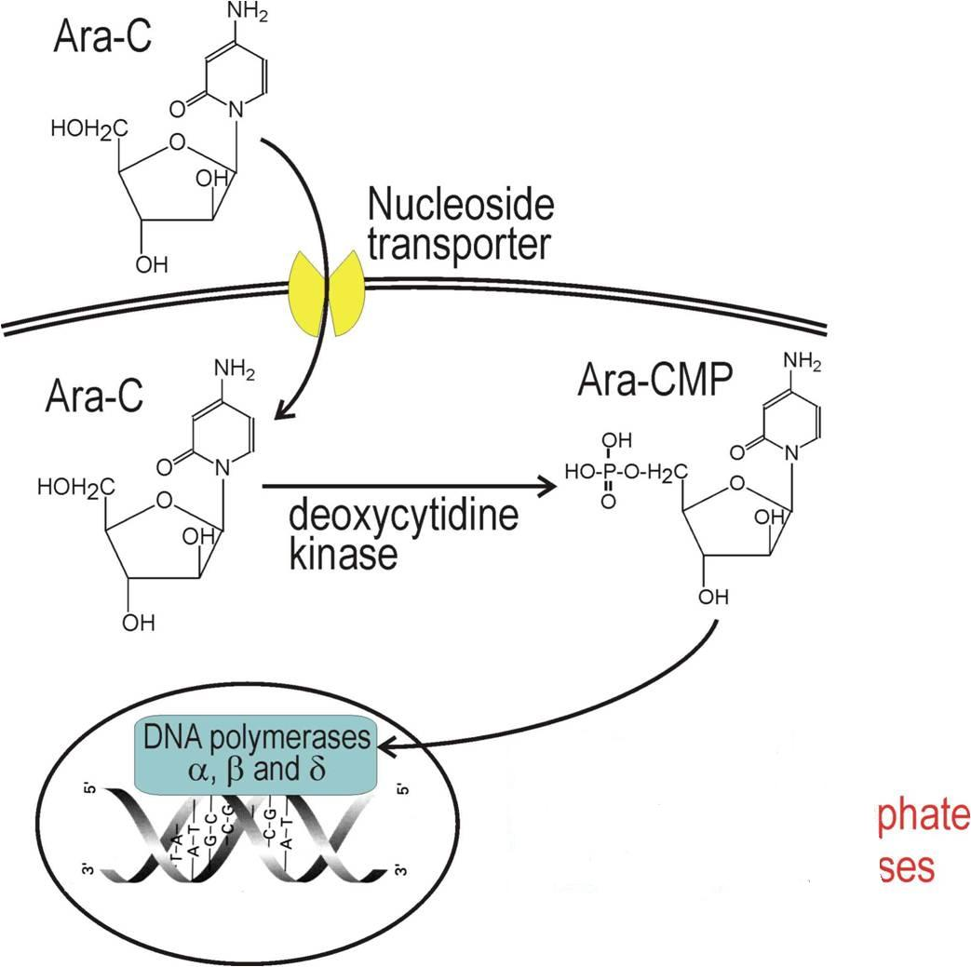
Arabinoside-CTP 
inhibits DNA polymerases
incorporaties into DNA  strand breaks  triggers apoptosis
Uses
Acute myelogenous leukemia
Intrathecally in meningeal leuk- emias & lymphomas in alternative to methotrexate
Other Uses
Antivirus against generalized herpes infection
ADRs
GIT epithelial damage
Myelotoxicity
Cellebellar toxicity  if dose

Slide 15
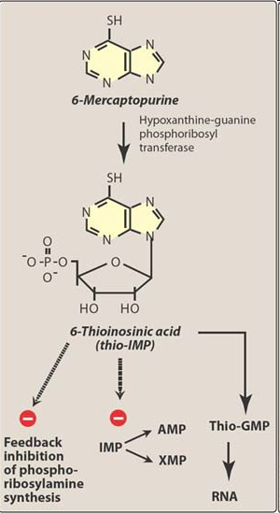
PURINE ANTIMETABOLITES
They impair synthesis of purine nucleotide.
6 - MERCAPTOPURINE
Mechanism
HGPRT
It is activated by HGPRT to a cytotoxic nucleotides  6-thioguanine  -ve several enzymes involved in nucleotide interconversion  -ve purine metabolism
Cancer cells can develop resistance by:
◉ activity of HGPRT that activates it
 activity of ALP that inactivates it
Allopurinol –ve xanthine oxidase, that breaks down mercaptopurine in the body   its effect & toxicity
Uses
Maintenance therapy to pertain remission of acute lymphoblastic leukemia.

Slide 16
PURINE ANTIMETABOLITES
FLUDARABINE
Mechanism
Metabolize to triphosphate  -ve DNA synthesis like cystarabine
Uses
Highly active in treatment of chronic lymphocytic leukemia.
It is myelosuppressive
PENTOSTAIN
Mechanism
-ve adenosine deaminase needed for nucleic a. turnover.
Uses
Very effective in the therapy of hairy cell leukemia.

Slide 17
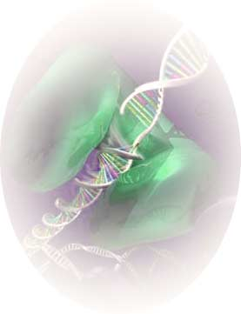
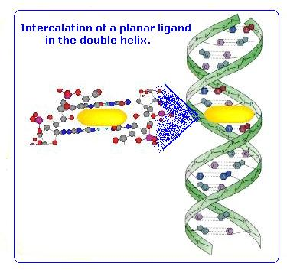
INDIVIDUAL CHEMOTHERAPEUTIC GROUP
III. CYTOTOXIC ANTIBIOTICS
A. Anthracyclines; Doxorubicin
B. Dactinomycin.
C. Bleomycins
Products of various strains of the soil fungus streptomyces..
ANTINEOPLASTIC MECHANISM OF ACTION
Mostly are CCNS. Non - Phase Dependent
Mostly intercalate usually in minor groove of DNA, interfering with all forms of DNA- dependent RNA synthesis
DOXORUBICIN
 Antibiotic produced by Streptomyces peucetius.
Given IV. Does not cross BBB. Metabolized by liver to active metabolite’ Partially excreted in bile & < partially in urine

Slide 18
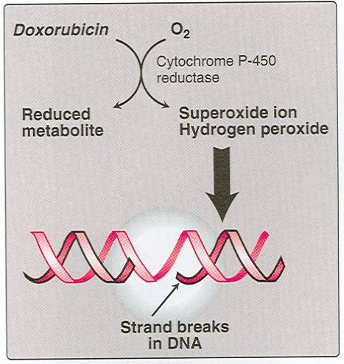
CYTOTOXIC ANTIBIOTICS
DOXORUBICIN
Mechanism
 CCNS, non-Phase Dependence
 cytotoxic actions through 3 mechanisms:
1. It intercalates in DNA  block DNA & RNA synthesis due to DNA strand break  2ndry to supercoiling occuring during replication as a result of inhibition of TOPOISOMERASE II by doxorubicin.
Enzyme contains a DNA lyase & DNA ligase  functions to relieve DNA super-coiling by cleaving, reorient, and religate genomic DNA to relax negative supercoils.
2. Binds cell membranes  alter fluidity & ion transport
3. Generation of semiquinone FR & oxygen FR through enzyme-mediated reductive process.

Slide 19
CYTOTOXIC ANTIBIOTICS
Uses
DOXORUBICIN
Carcinomas  breast, ovary, endometrium, testicles, bladder, thyroid
Sarcomas neuroblastoma, Ewing’s sarcoma, osteosarcoma, rhabdo- myosarcoma.
In several combination regimens  lymphomas & Hodgkin’s disease
ADRs
Cardiotoxicity; arrhythmias, myopathy, acute & chronic HF
These occur because  drug avidly binds to cardiac inner mitochon-drial membranes & produce the semiquinone FR  induce lipid peroxidation  impair cardiac mitochondrial function & structure
This risk is reduced by concomitant administration of DEXRAZOXANE
Bone marrow suppression with neutropenia & thrombocytopenia;
Alopecia, nausea, vomiting;
Exacerbate or reactivate radiation dermatitis or pneumonitis
If extravasation  severe tissue necrosis.

Slide 20
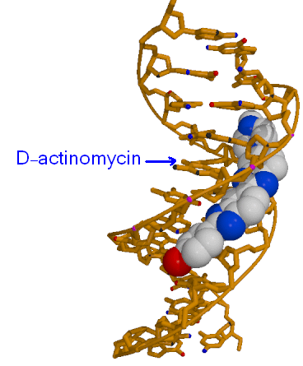
CYTOTOXIC ANTIBIOTICS
Mechanism
D-ACTINOMYCIN
CCNS, non-Phase dependence
Intercalate in minor groove of DNA between adjacent guanine-cytosine pairs, interfering with the movement of RNA POLYMERASE along the gene and thus preventing transcription
Has actions like antracyclines on tropoisomerase
D-ACTINOMYCIN
Uses
Gestational choriocarcinoma, testicular tumors, lymphomas, melanomas & sarcomas.
ADRs
Bone marrow suppression with neutropenia & thrombocytopenia;
Immunosuppression
Elevated liver enzymes & hepatitis
If extravasation  severe tissue necrosis.

Slide 21
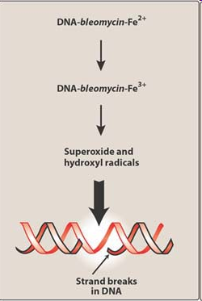
CYTOTOXIC ANTIBIOTICS
BLEOMYCIN
Metal-chelating glycopeptide antibiotics
Mechanism
CCS  G₂ Phase dependence  causes accumulation of cells in G₂
Binds to DNA  DNA-bleomycin-Fe(II)-complex  chain fragmentation & release of free bases
Uses
Advanced testicular carcinomas, Hodgkin’s & non-Hodgkin’s lymphomas.
ADRs
Pulmonary fibrosis.
Allergic reactions & may be hyperpyrexia
Mucocutaneous reactions

Slide 22
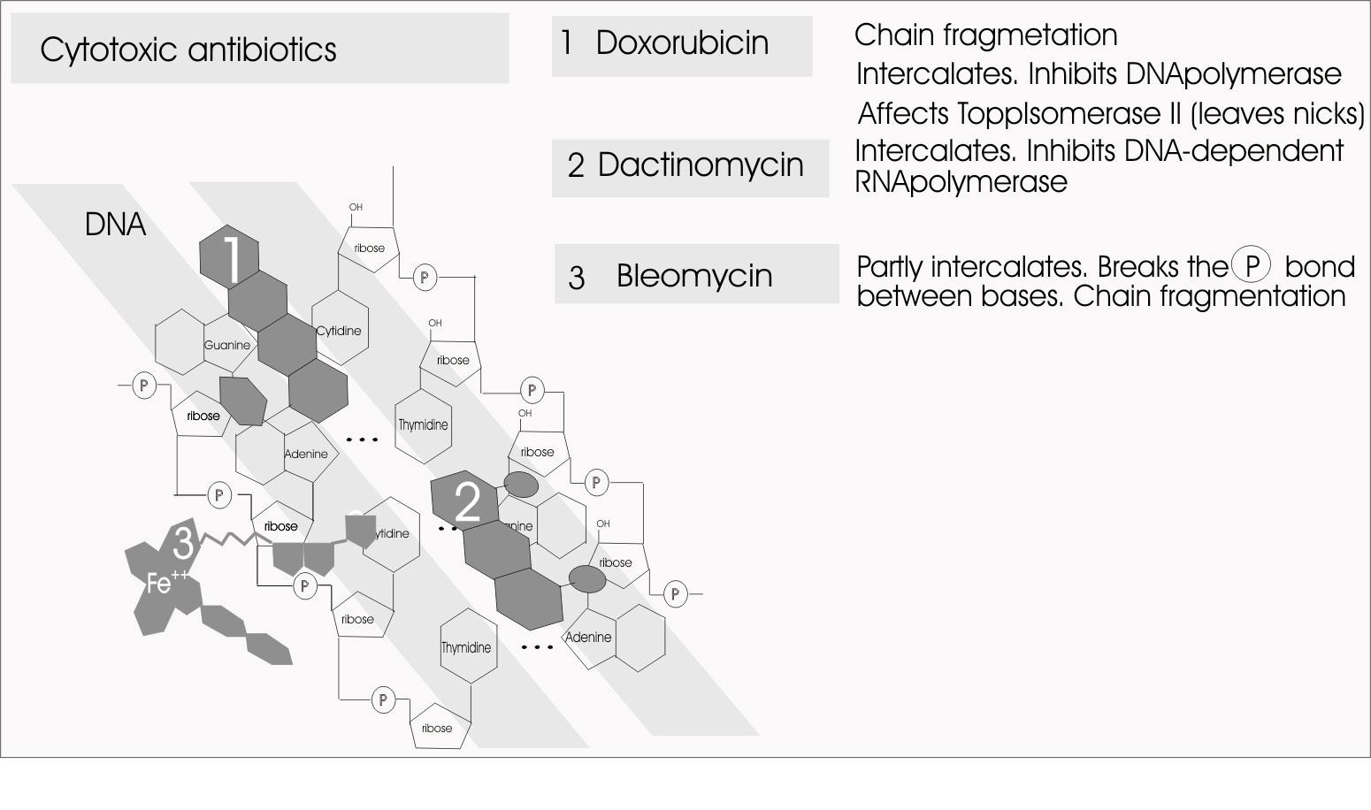
III. CYTOTOXIC ANTIBIOTICS

Slide 23
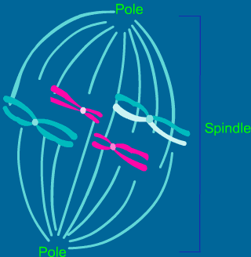
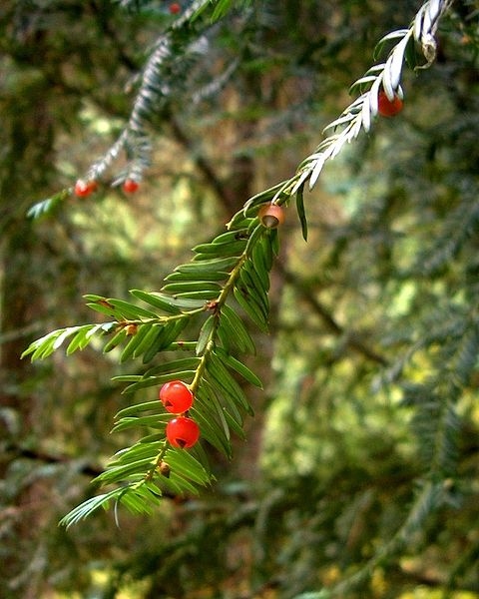
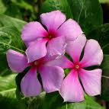
INDIVIDUAL CHEMOTHERAPEUTIC GROUPS
IV. PLANT ALKALOIDS
VINCA ALKALOIDS | TAXANES | PODOPHYLOTOXINE (Topoisomerase II Inhibitors) | CAMTOTHECINS (Topoisomerase I Inhibitors)
Vinca rosea | Taxus brevifolia | Podophyllum peltatum | Camptotheca acuminata
Vinblastine. Vincristine. | Paclitaxel. | Etoposide Teniposide | -Iranotecan. -Topotecan
ANTINEOPLASTIC MECHANISM OF ACTION
All are CCS. Phase Dependent. Vinca & Taxines are microtubule poisons  so act on M phase  Metaphase arrest
Podophylotoxins are topoisomerase II Camtothecins are topoisomerase I Inhibitors  so act on  S-G2 phase

Slide 24
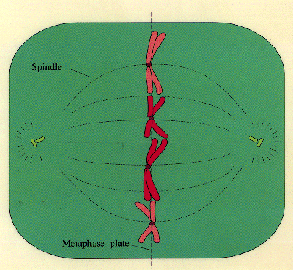
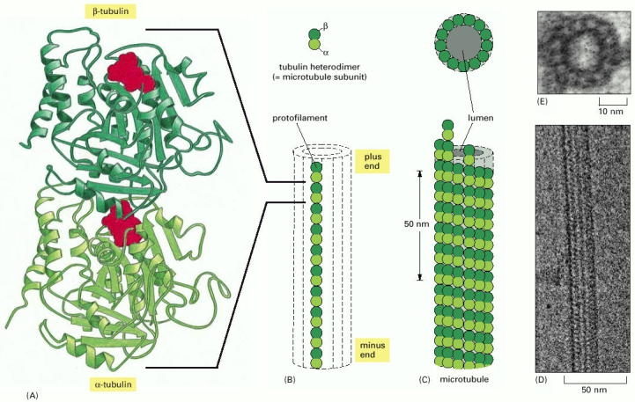
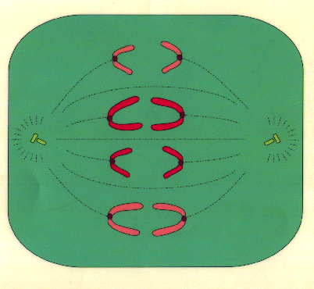
PLANT ALKALOIDS
Extensively bound to tissues.
Biliary excretion.
Both drugs
Vinca Alkaloids
Mechanism
Vincristine & Vinblastine
Bind β-tubulin, a protein that forms the microtubules  -ve its polymerization with α-tubulin  No Assembly an essential step for mitotic spindle formation  needed for chromosomal segregation & cell proliferation.
Thus they –ve metaphase of mitosis  CCS, M Phase Dependent. Both drugs are also known as ‘MICROTUBULE INHIBITORS’ or POISONS
Vinca Alkaloids
X
Metaphase
M Phase
Anaphase

Slide 25
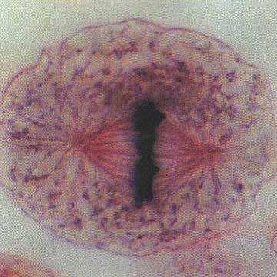
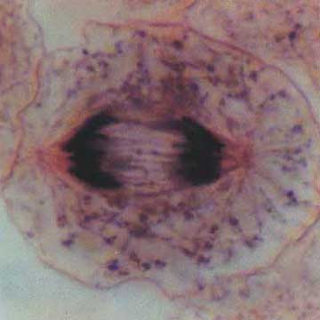
PLANT ALKALOIDS
Uses & ADRs
Vincristine  in combination therapy for acute lympho- blastic leukemia, Hodgkin’s disease
Cause  Neurological toxicity
Vinca Alkaloids
Metaphase
Anaphase
Vinblastine  testicular carcinomas , Hodgkin’s disease, breast cancer & renal cell carcinoma.
Cause  Bone marrow toxicity
X
Both drugs cause  Alopecia &
Cellulites, phlebitis, t. necrosis if extravasated.
Vinblastine | Vincristine
Uses ; Hodgkin’s disease Lymphomas Carcinoma Breast Testicular tumors Toxicity: Bone marrow suppression, Anorexia, nausea, vomiting Diarrhea, Alopecia | Uses: Childhood leukemias Childhood tumors-Wilm’s tumor, Neuroblastoma, Hodgkin’s disease Toxicity: Peripheral neuritis with Paresthesia, Muscle weakness Has marrow sparing effect

Slide 26
PLANT ALKALOIDS
Mechanism
Taxines
Bind β-tubulin,  prevent its Depolymerization 
No Disassembly 
No chromosomal segregation & cell proliferation
Paclitaxel
Thus they –ve metaphase of mitosis  CCS, M-G₂ Phase Dependent. So it is a ‘MICROTUBULE INHIBITORS’ or POISONS
The drug
Poorly absorbed  given intravenously
Has large volume of distribution
Inactivated by hepatic CYP450
Uses
In carcinomas  breast, ovary, cervix, lung, head & neck.
+ cisplatin  ovarian & lung carcinomas
+ doxorubicin  breast cancer
Other Uses
As antiproliferative  on stents for cardiac intervention & in
Restenotic complications of cardiac intervention
ADRs
BM toxicity, Alopecia,
Peripheral neuritis with numbness & tingling sensation

Slide 27
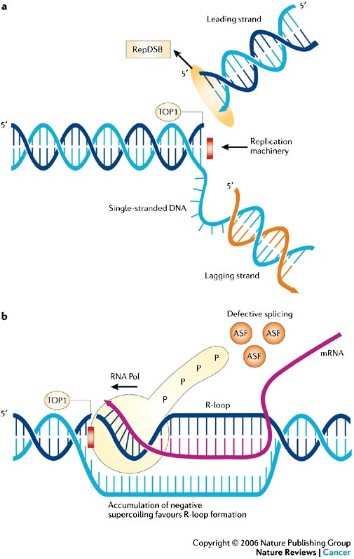
TOPOISOMERASE INHIBITORS
PLANT ALKALOIDS
During Replication
& Transcription
DNA TOPOISOMERASEs
Prevent 
Supercoiling
?
Enzyme contains a DNA lyase & DNA ligase  functions to relax torsionally strained supercoiled DNA helix by cleaving, reorientation & religation of the genomic DNA
As DNA strands separate
Supercoiling
CAMTOTHECINS
PODOPHYLOTOXINE
Iratecan, Topotecan
Etoposide
TOP I
TOP II
Topoisomerase I  transient single-strand breaks in DNA  removes supercoils one at a time
Topoisomerase II  transient double-strand breaks in DNA  removes supercoils two at a time.

Slide 28
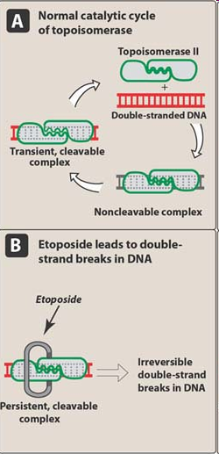
PLANT ALKALOIDS
PODOPHYLOTOXINE
Semi-synthetic derivative
TOPOISOMERASE II INHIBITORS
Etoposide
Stabilizes topoisomerase II–DNA complex prevent ligation  breaks are pertained  apoptosis
CCS. Late S-G2 Phase dependent
The drug  Given IV or orally 50% bioavailability
Metabolized in liver by CYP3A
Uses
Small-cell lung cancer
Testicular and ovarian germ cell cancers
Lymphomas, acute myelogenic & lymphoblastic leukemia
ADRs
Mild nausea, alopecia, allergic reaction
Phlebitis at the injection site
Bone marrow toxicity

Slide 29
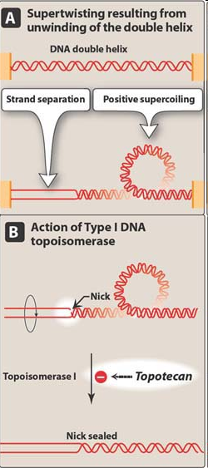
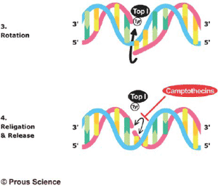
PLANT ALKALOIDS
CAMTOTHECINS
TOPOISOMERASE I INHIBITORS
Topotecan
Block cells in S-G2 phase of cell cycle  DNA degradation
Nucleoside transport inhibition
Mitochondrial electron transport inhibition
Uses
Small-cell lung cancer
Ovarian cancers
Cervical cancers

Slide 30
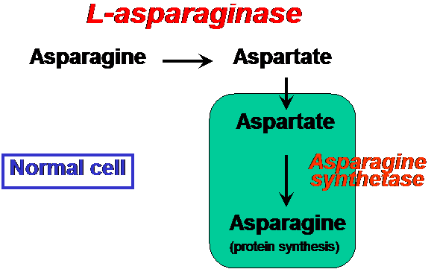
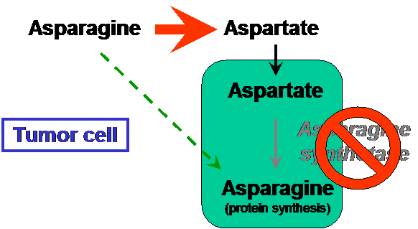
INDIVIDUAL CHEMOTHERAPEUTIC GROUPS
V. OTHERS: Enzyme Chemotherapy
L-Asparginase
Derived from bacteria
ANTINEOPLASTIC MECHANISM OF ACTION
Relies on the fact that; Normal cells have high levels of asparaginase to form asparagine.
Yet some cancer cells as ALL leukemic cells are unable to do so due to deficiency in asparagine synthatase. So these cells depend on blood as source to obtain the a.a.
L-Asparaginase hydrolyzes bld. asparagine to aspartate & ammonia  depriving tumor cells of this only source to form its proteins
The drug is not distribute, remains in blood, little pass to CSF
Uses
Acute lymphoblastic leukemia (in combination) & certain types of lymphoma
ADRs
Hypersensitivity reactions, anaphylactic shock, acute pancreatitis
No effect on rapidly dividing cells; ie BM, GIT, hair follicles,…..

Slide 31
CANCER CHEMOTHERAPY
TO BE CONTINUED

