Slide 1
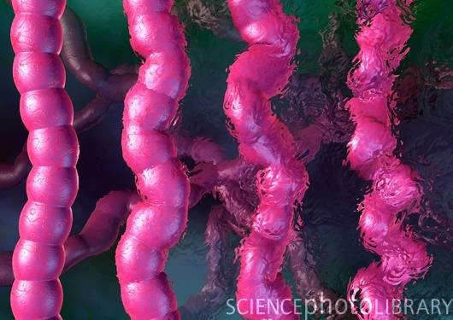
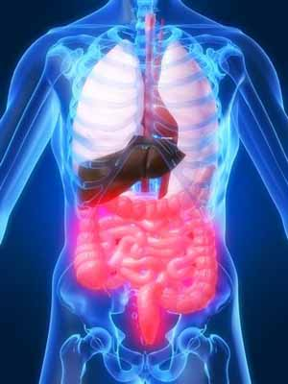
DRUGS & BOWEL MOVEMENTS

Slide 2
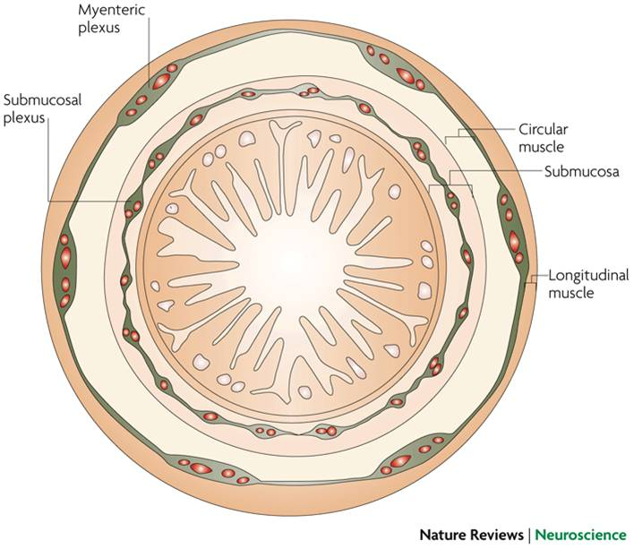
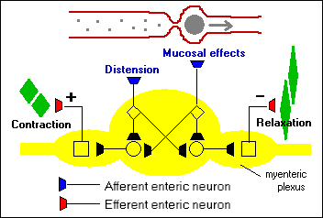
ENTERIC NERVOUS SYSTEM
Regulate GI motility & secretion independent of the EXTRINSIC sympathetic & parasympathetic input
PeristalsisPropagation
Ach, SP 
contraction above
NO, VIP, ATP 
relaxation below
Segmental
Mixing
Contraction above
Relaxation below

Slide 3
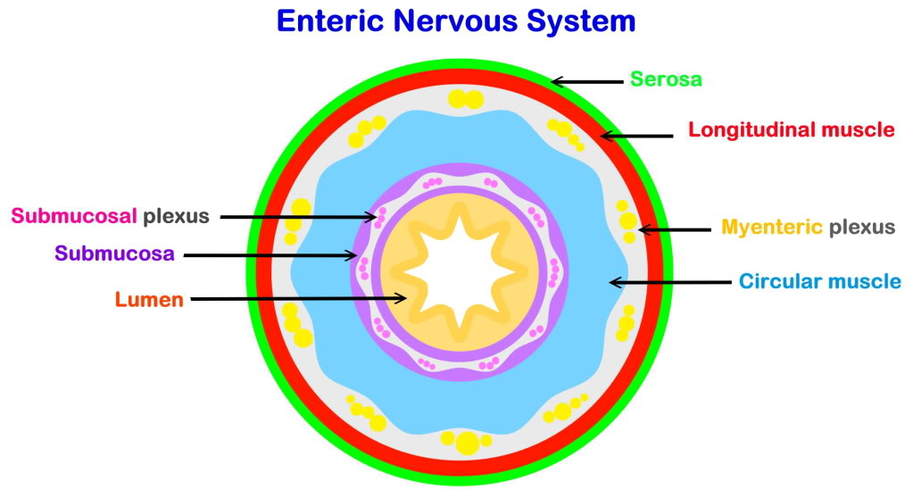
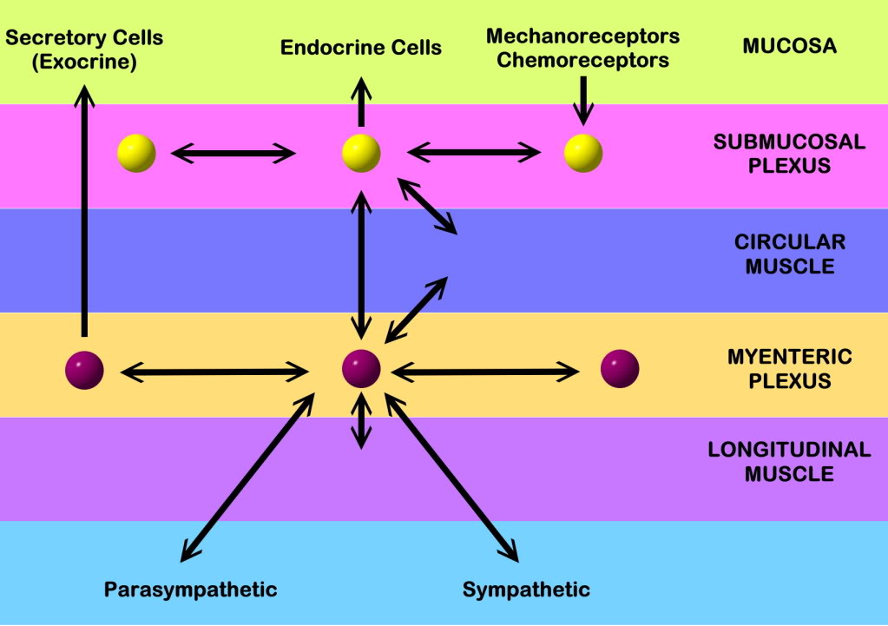
ENS interacts with
ENTERIC ENDOCRINE SYSTEM
& LOCAL NEUROTRANSMITTERS
& LOCAL NEUROPEPTIDES
& AUTONOMIC NS

Slide 4
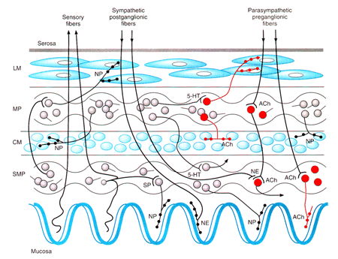
Neurotransmitters; acetylcholine (ACh), serotonin (5HT), dopamine … & Neuropeptides; enkephalins, neurokinins,… & Hormones; somatostatins, corticotropin releasing factor(CRF)… are important regulators of motility, water absorption & mediation of pain perception & sensitization

Slide 5
Serotonin importance in gut function
95 % of it is in GIT
Act on varied selective 5HT receptors within ENS as:
5HT3 receptors
Ligand-gated cation channel
Control sensation, contraction of intestinal muscle
It increase release of fluid into the intestine
5HT₄ receptors
G-protein-coupled receptor
Mediate both relaxation & contraction of circular SMCs
Induces small bowel & to a lesser extent colonic fluid secretion
Serotonin relation to GIT disorders
GI disorders can be caused by;
an imbalance of serotonin in the gut
an improper reaction of the digestive system to serotonin
a faulty communication network between serotonin in the gut, the brain & spinal cord.

Slide 6
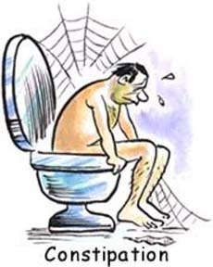
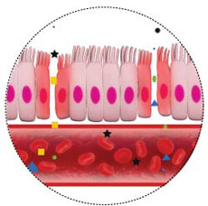
DRUGS USED TO TREAT CONSTIPATION
Laxatives
OTHERS

Slide 7
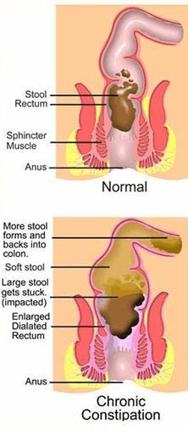
CONSTIPATION
Is a condition that characterized by infrequent bowel movements that are painful or difficult, or stools that are hard in consistency
May be accompanied by abdominal pain, back pain and abdominal bloating
Troublesome to elderly & pregnant female
Other symptoms of / with constipation
Nausea +/- vomiting
Abdominal and Rectal pain
Flatulence
Loss of appetite
Depression

Slide 8
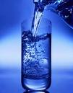
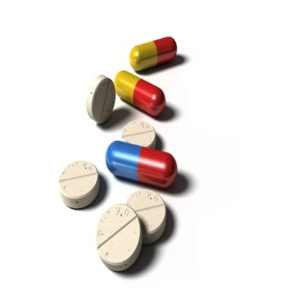
CAUSES
Lack of dietary fibers
No enough water
High meat diet
Ignoring the urge
Endocrine disturbances such as DM
Drugs
Narrowing or blockade of the colon due to cancer
Drugs which cause constipation
Opioid analgesics
Aluminium , calcium -containing antacids
Antidepressants
Calcium channel blockers (Verapamil)
Iron supplements
Antimuscarinic & 1st Gener. Antihistaminics
Diuretics
Disopyramide

Slide 9
Patients with constipation present in two ways
Long-standing constipation in otherwise healthy people may be due to decreased colon motility or to difficulty in defecating, or to a combination of both
Loaded colon / rectum or fecal impaction
General Approach to Treat Constipation
Exclude probable causative local or systemic diseases, drugs….
If long standing start with life style modification [fluid & bulk of diet (fibers have regulatory action on gut transit time & motility),...] if natural modalities fail help with LAXATIVES
If colon/ rectum is loaded, use suppositories / enemas / senna laxative, if fail  apply manual disimpaction
Help with; PROKINETICS GIT motility  Metoclopramide, Alvimopan
ENTEROKINETIC  5HT₄ Receptor agonist  Prucalopride  stimulate colonic mass movements CL CHANNEL ACTIVATORS  Lubiprostone  produce Cl- rich fluid secretion

Slide 10
I. Laxatives
Definitions
A Laxative effect
Production of a soft formed stool over a period of 1 or more days
A Catharetic effect
Rapid, fluid evacuation of the bowel, with more intense purging
TYPES of Laxitives
Bulk-forming Laxatives
Stool softeners
Lumbricant Laxatives
Stimulant or irritant Laxatives
Saline Laxatives

Slide 11
General Indications
GENERAL RULE IS THAT LAXITIVES ARE BETTER AVOIDED / EMPLOYED ONLY IN RESTRICTED CONDITIONS
If straining at stools cause damage[ postoperative, haemorrhoids, after myocardial infarction, ….
In hepatocellular failure to formation or absorption of endotoxins in bowel
To evacuate bowel before diagnostic or surgical procedures
In constipation induced by drugs, in pregnancy & elderly (occasional)
Method of Administration
Given;
Orally
Suppositories
Enemas
SUPPOSITORIES
Have rapid onset of action
Establish reflex defecation
Mechanism vary according to type of laxative used, e.g.
Stimulant suppositories (bisacodyl)

Slide 12
Method of Administration
ENEMAS
Mechanism of action:
Distending the rectum to contract, propulse & eliminate stools
Defecation occurs between few mins. – 1 hr. after enema is inserted
Additional mechanisms also works depending on laxative used
Saline enemas (Na phosphate, dodecyl sulfate...) withdraw H₂O in colon
Mineral oil enemas (Paraffin, Arachis Oil) lubricate & soften stools
Stimulant enemas (Bisacodyl, Glycerol …)  activate peristalsis
Indication:
Preparation of colon before surgical or endoscopic, procedures
Relieves constipation (not on regular use ) & fecal impaction.
Side effects:
Frequent enemas → fluid & electrolyte disturbances
Injury by the nozzle

Slide 13
Increased prevalence of Secondary Causes…..
General Contraindications
Inflammatory bowel diseases
Acute surgical abdomen
Chronic use and abuse
Why does constipation become a problem in the elderly?
Immobility
Improper Diet
Endocrine & Metabolic Disorders
Neurological Disorders
Psychological Conditions
Medications

Slide 14
Bulk-Forming Laxatives
Examples: Include high-fiber products; dietary fibers, , bran, methylcellulose
Mechanism of action: Absorb liquids in the intestines & swells to slowly distend the wall of intestine  propulsive movements + make stools > soft. Fibres also binds organic molecules as bile salts
Site of action: Small & large intestine
Onset of action: 12 - 72 hours
They should be taken with plenty of water
Bulk-producing agents have the gentlest of effects among laxatives and can be taken just for maintaining regular bowel movements
Side effects: Abdominal distension & flatulence. Phytates in bran bind Ca & Zn
Contraindications: Intestinal obstruction & Gluten entropathy

Slide 15
Stool Softeners
Examples: Docusate (Ca / Na salt), Dodecyl Na sulphosuccinate,
Mechanism of action: soften stools by causing water & fats to penetrate the stool, making it easier to move along the GIT [Emollient action] +  intestinal electrolyte transport.
Uses More to prevent constipation than to treat it
They are commonly recommended for patients who should avoid straining while defecating, including:
Patients recovering from abdominal, pelvic, or rectal surgery, childbirth
Patients with painful piles or anal fissures Softening the stool in these patients can help reduce pain during defecation
Lubricant Laxatives
Examples: Mineral oils; Paraffin or Arachis Oil.
Mechanism of action: coats the surface of the stool make it slippery so move out of the body more easily
Side effects: absorption of fat-soluble vitamins (A, D, E & K)

Slide 16
Stimulant Laxatives
Examples: Senna, Co-danthramer & bisacodyl are used
Castor oil, Phenolphthalein are now obsolute
Mechanism of action: Stimulant laxatives are the harshest laxatives. They stimulates small & large intestinal motility causing the bowel to squeeze or contract to move the stools out. It promotes evacuation of the bowels usually within 2 to 6 hours
Side effects:
Acutely  abdominal discomfort, cramping & tenesmus
Chronically  If repeated or on long use can lead to loss of;
Absorption of nutrients & minerals
Colon function (cathartic colon)  Consequently, constipation becomes > worse & unresponsive to laxatives
N.B. Glycerol suppositories act as rectal irritant action  used when rapid evacuation is wanted.

Slide 17
Saline [Osmotic] Laxatives
Examples: Non-absorbable Mg citrate, hydroxide, sulfate
Mechanism of action: They retain fluid in bowel by the osmotic activity of their unabsorbed ions. Mg also stimulate gall-bladder contraction & relax sphincter of Oddi. They increase gastric, intestinal & pancreatic enzyme secretion + may act indirectly via cholecystokinin  All this cause rapid bowel evacuation.
Uses  Bowel evacuation prior to surgical procedures
N.B. Phillips Milk Of Magnesia (Mg OH)  is used in occasional constipation given with a glass of water at bed time or morning
Side Effects
If Mg salts used for prolonged periods (in renal insufficiency)  hypermagnesemia may occur (cardiac depression, neuromuscular disorders and CNS depression)

Slide 18
Saline [Osmotic] Laxatives
2. Can cause dehydration & electrolyte imbalance; to avoid this now
Macrogols (inert polymers of ethylene glycol ) sequester fluid in the bowel; so if give fluid with them  dehydrating effect of osmotic laxatives.
Other examples:
PHOSPHATE ENEMAS  useful in bowel clearance before radiology, endoscopy & surgery.
LACTULOSE  a disaccharide  broken down in colon by CHO- fermenting bacteria to unabsorbed organic anions ( acetic & lactic acids)  retain fluid + make the colonic contents more acid 
laxative effect after 2-3 days.
Uses  Of particular value in treatment of hepatic encephalopathy, as it discourages the proliferation of ammonia-producing organisms
& the absorption of ammonia.

Slide 19
II. New Modalitis
prucalopride
○ Is a selective 5ht₄ receptor agonist  it stimulates colonic mass movements, which provide the main propulsive force for defecation  enterokinetic activity  given in chronic constipation
lubiprostone
○ Is a FA derived from Pg E₁  activator of cl channel (on apex of enetrocytes) produce chloride-rich fluid secretion  soften stool &  motility  given in chronic idiopathic constipation, enteric neuropathy
It does not induce tolerance, or altered serum electrolyte concentration
alvimopan
Is a μ-opioid antagonist (limited ability to cross BBB) stimulates intestinal movements  i.e. prokinetic activity  accelerates GIT recovery period after intestinal resections to avoid ileus.
In chronic constipation it shortens transit time fluid reabsorption  loss stools

Slide 20
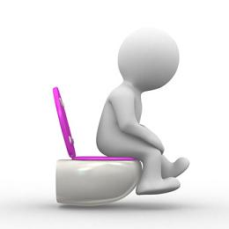
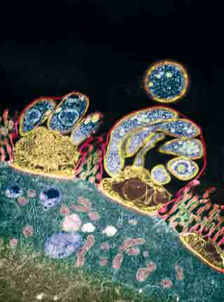
DRUGS THAT TREAT DIARRHOEA

Slide 21
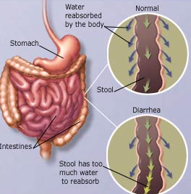
DIARRHOEA
Is the condition of having 3 or > loose or liquid bowel movements per day, or as having more stools than is normal for that person.
The accompanying loss of fluid cause dehydration & electrolyte imbalance  can be sever to be a reason for death (2nd cause in infancy).

Slide 22
CLASSIFICATION OF DIARRHEA
Type | Mechanism | Some Typical Causes
Osmotic | Unabsorbed solute | Lactase deficit, Mg antacid excess
Secretory | Increased secretion of electrolytes | E. coli infection, ileal resection, thyroid cancer
Exudative | Defective colonic absorption, outpouring of mucus and/or blood | Ulcerative colitis, Crohn’s disease, shigellosis, leukemia
Motility disorder | Decreased contact time | Irritable bowel syndrome, diabetic neuropathy

Slide 23
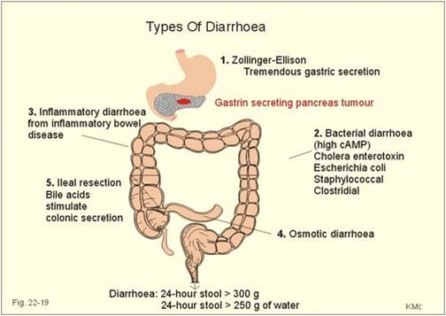

Slide 24
General Lines of Therapy
Maintenance of fluid & electrolyte balance, particularly in children & in elderly  Oral (or parenteral) rehydrating therapy & zinc tablets (above 6 months) are 1st line treatment in most case.
In non-pathogenic diarrhea or viral gastroenteritis, antibiotics and antidiarrhoeal drugs are best avoided.
Initial therapy should be with oral rehydration preparations which contain electrolytes and glucose.
Antibiotic treatment is indicated for patients with systemic illness & evidence of bacterial infection.
Adjunctive symptomatic treatment is sometimes indicated either by
Prolonging intestinal transit time (Allow fluid reabsorption)
Increasing bulk & viscosity of the gut contents.

Slide 25
Drugs that prolong intestinal transit time
I. OPIOIDS
Lomotil ( Diphenoxylate + Atropine)
related to pethidine & has structural similarities to anticholinergic drugs  may cause drug dependence & euphoria
Overdose in children causes features of opioid & atropine intoxication
 Do not cross BBB
loperamide antagonizes peristalsis, by activating presynaptic opioid receptors in the enteric nervous system  to inhibit Ach release in the intramural nerve plexus of the gut, although non-cholinergic effects may also be involved.
It is poorly absorbed & acts directly on the bowel.
Given as 4 mg initially, followed by 2 mg after each loose stool up to a total dose of 16mg/day.
Adverse effects ; dry mouth, dizziness, skin rashes and gastric disturbances, abdominal cramps
Excessive use (especially in children) is to be strongly discouraged / contraindicated less than 4 years

Slide 26
2- octeotide (somatostatin)
Peptide secreted from D cells of pancreas, enteric nerves and hypothalamus.
Mechanism of action:
secretion of gastrin, CCK, glucagon, secretin, GH, 5HT, VIP
◉ intestinal fluid secretion
Slows down GIT motility
Enhance vascular smooth muscle contraction
-ve Ant. Pituitary hormones
Uses:
Treatment of diarrhea (at high doses) particularly related to carcinoid & VIP tumors
Side Effects:
-ve pancreatic secretion… steatorrhea
Nausea, vomiting, abdominal pain
Alter fat absorption, sludge and gall stones
Hyper or hypoglycemia (insulin-glucagon disturbance)
Hypothyroidism

Slide 27
Drugs increasing bulk & viscosity of the gut contents
Adsorbents, such as kaolin, are not recommended for diarrhoea.
Bulk-forming drugs:as ispaghula, methylcellulose,…
They are useful in controlling fecal consistency by absorbing excess water. They also can absorbs intestinal toxins
Uses: Control mild form of diarrhea associated with diverticular disease.
Can be used in during ileostomy and colostomy
Bismuth subsalicylate
It retards expulsion of fluids into the digestive system by irritated tissues, by "coating" them.
Reducing inflammation/irritation of stomach and intestinal lining
Killing some bacteria that cause diarrhea (salicylate action)
Uses:
Travelers diarrhea
ADRs:
Black tongue & stools
Rare salicylism
Contrindications:
Viral infection for fear of Reye’s syndrome

Slide 28
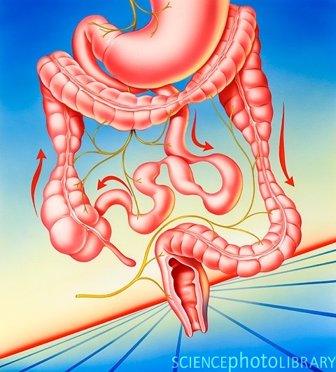
TREATEMENT OF IRRITABLE BOWEL SYNDROME [IBS]

Slide 29
IRRITABLE BOWEL SYNDROME [IBS]
Is chronic or recurrent GI symptoms
Lower abdominal pain / discomfort
Altered bowel habits
Bloating / Urgency
No structural or biochemical abnormalities
N.B. Stressful life events are associated
Fibromyalgia( 49%pts have IBS), chronic fatigue syndrome (51%), chronic pelvic pain (50%)
IBS Clinical Subgroups
Women: Men = 3:1
Constipation predominant [IBS-C]
Diarrhea predominant [IBS-D]
Mixed (Alternate) [IBS-M]
Abdominal
pain
Reduced sense of
well being
Altered bowel
habits
Faulty communication between brain & intestinal tract
Constipation
Diarrhea
Urgency
Cramps
Bloating

Slide 30
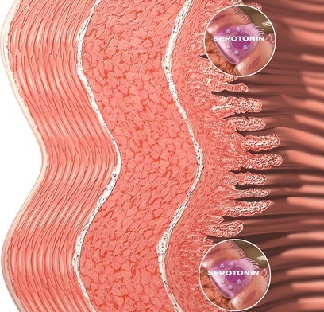
Pathogenesis of IBS
Genetic factors
Stress
Infections
Inflammation
Diet
Small intestine bacterial overgrowth [SIBO]
PATHOPHYSIOLOGY CHANGES
A Biopsychosocial Disorder
Biological
Altered GI motor activity
Altered visceral sensation
Neurochemicals involved in bowel symptoms; 5HT
Psychosocial
Somatization; The psychological conflicts are unconsciously expressed as physical signs
Even overt
depression (in 25%)
or
anxiety (in 25%)
can develop
Vagal
Nuclei
5-HT
Sympathetic
Altered motility
Altered Visceral Hypersensitivity
[SIBO]

Slide 31
Genetic Predisposition
Stress
Environmental
Influences
History
Of Abuse
 Mucosal permeability
 Lymphocytes (Lamina propria)
Parental
Modeling
Infection /
Inflammation /
SIBO
levels of Lactobacilli & Bifidobacterium
levels of Clostridium
Other
Factors
Development of IBS
Alters myenteric nerve function / Sensitizes to stress
Stress
Anxiety
Loosen intercellular tight junctions
 frequency & intensity of symptoms
Somatization
Poor
Coping
Skills
Depression
Manifestation of symptoms of IBS

Slide 32
General Approach to treatment of IBS
Via Lifestyle Modification + Behavioral, Psychiatric & Drug Therapy…
Many drugs have a placebo effect, of up to 60 - 70%
No single type of drug or modality works best for everyone.
When anxiety, panic attacks, and depression are key symptoms, psychological therapies should be first-line treatment
Treatment should depend on symptom sub-type.

Slide 33
Drug Gps used in treatment of IBS
For Pain  Antispasmodics  Mebeverine, Otilonium bromide, Roceverine, Dicycloverine, Oxyphenonium,
 Anticholinergics  Hyocine
 antidepressants  TCAs > SSRIs
For Diarrhea Antidiarrheals Loperamide, Diphenoxylate
 Bulking agents  Ispaghula
 5HT3- Antagonist  Alosetron, Cilansetron
For Constipation  Laxatives  Bisacodyl
 5HT4- Agonist  Tegaserod, Prucalopride, Renzapride
 Cl Channel Activators  Lubiprostone
For Bloating  SIBO is the most probable cause
 Probiotics Non-pathogenic live microbial food supplements or capsules  improves intestinal microbial balance
 Antiobiotics  Rifaximin –luminal nonabsorbable antibiotic

Slide 34
Alosetron
A 5-HT₃ receptor blockers
Slows intestinal transit ↓ Urgency
Decreases intestinal secretions
Decreases the water content of stool
Diminish colonic pain
ADRs:
Constipation, fecal impaction, rarely perforation, obstruction, ischemic colitis….
Reintroduced on 2002 for IBS-D  but restricted use only in women with unsatisfactory response to other treatment
Tegaserod
A 5-HT₄ receptor agonist
Accelerate gastric emptying
Accelerate small and large bowel transit
Increase stool water content
ADRs:
Increased risks of heart attack or stroke
Reintroduced 2007  for restricted use in IBS-C or CIC if no response to other treatment. Better use Prucalopride, Renzapride

Slide 35
Other modalities of treatment of IBS
Diet modification
Eliminate gas producing food, food causing lactose intolerance, fatty foods, ….etc
 Regulate amount of fibers according to presenting symptoms
 Consume food rich in nucleotides
Behavioral Therapy; Assurance, modification, assertion training, hypnotherapy. ….etc
Psychiatric Therapy; If psychiatric disease predominates
For Depression  TCAs  Nortryptiline, Desipramine, Amitriptyline
 SSRIs Fluoxetine, Citalopram
 SNRIs  Venlafaxine
For Anxiety Anti-anxiety Paroxetine, Alprazolam, Clonazepam

Slide 36
DRUGS & BOWEL MOVEMENTS
GOOD LUCK

