Slide 1
(Drugs Used for Nausea and vomiting)
Antiemetic drugs
Prof. Alhaider
Nausea and vomiting may be manifestations of many conditions . However, a useful abbreviation for remembering causes of nausea and vomiting is VOMIT.
Vestibular
Obstruction or drugs like opiates)
Mind (dysmotility)
Infection (irritation of gut)
Toxins (taste and other senses)

Slide 2
Causes of Vomiting
1.CTZ stimulation (Dopamine and 5-HT):
Drugs morphine, apomorphine, digitalis, L-dopa (How?), bromocryptine, estrogen, emetine.
Chemicals
Radiation.
Uremia (very important).

Slide 3
2. The periphery via sensory nerves (DA;5-HT)
GIT irritation, myocardial infarction, renal or biliay stones.
3. Disturbance of vestibular system (Ach and Histamin)
4. Higher cortical centers stimulation : emotional factors, nauseating smells or sights.

Slide 4
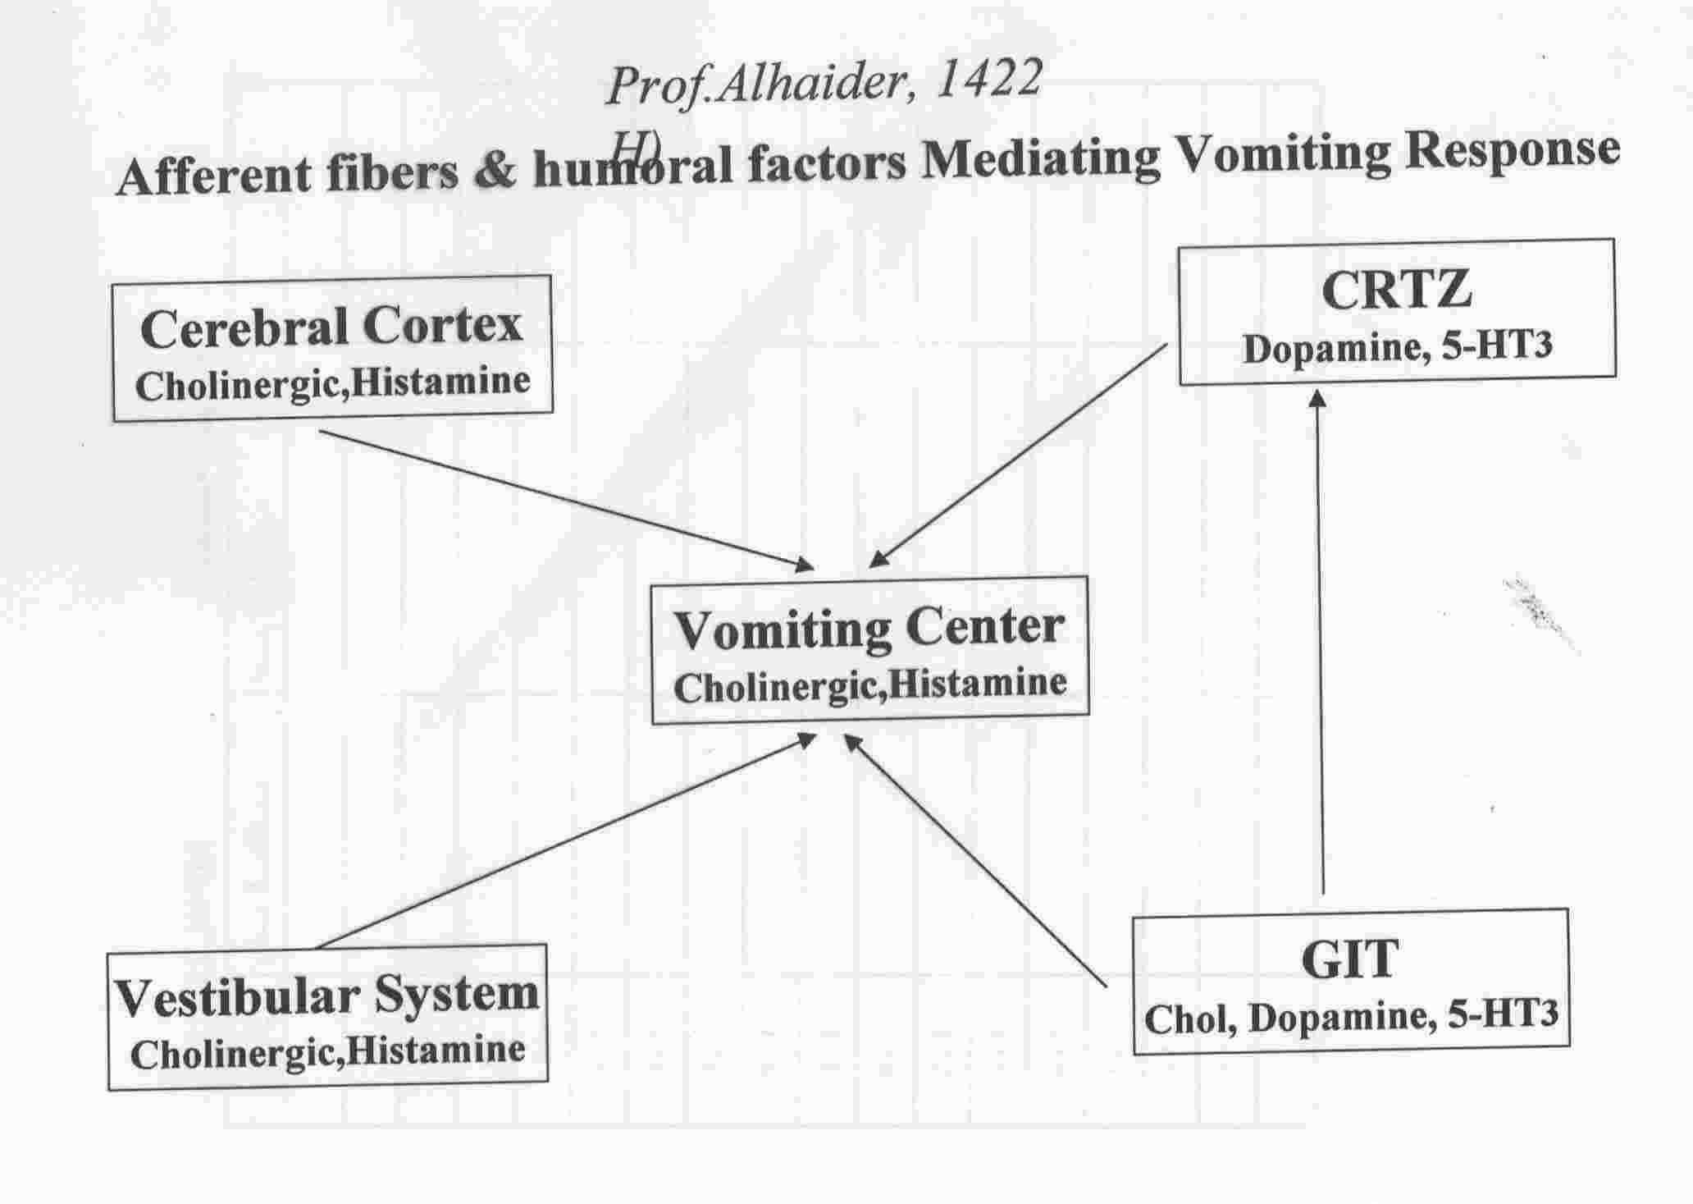

Slide 5
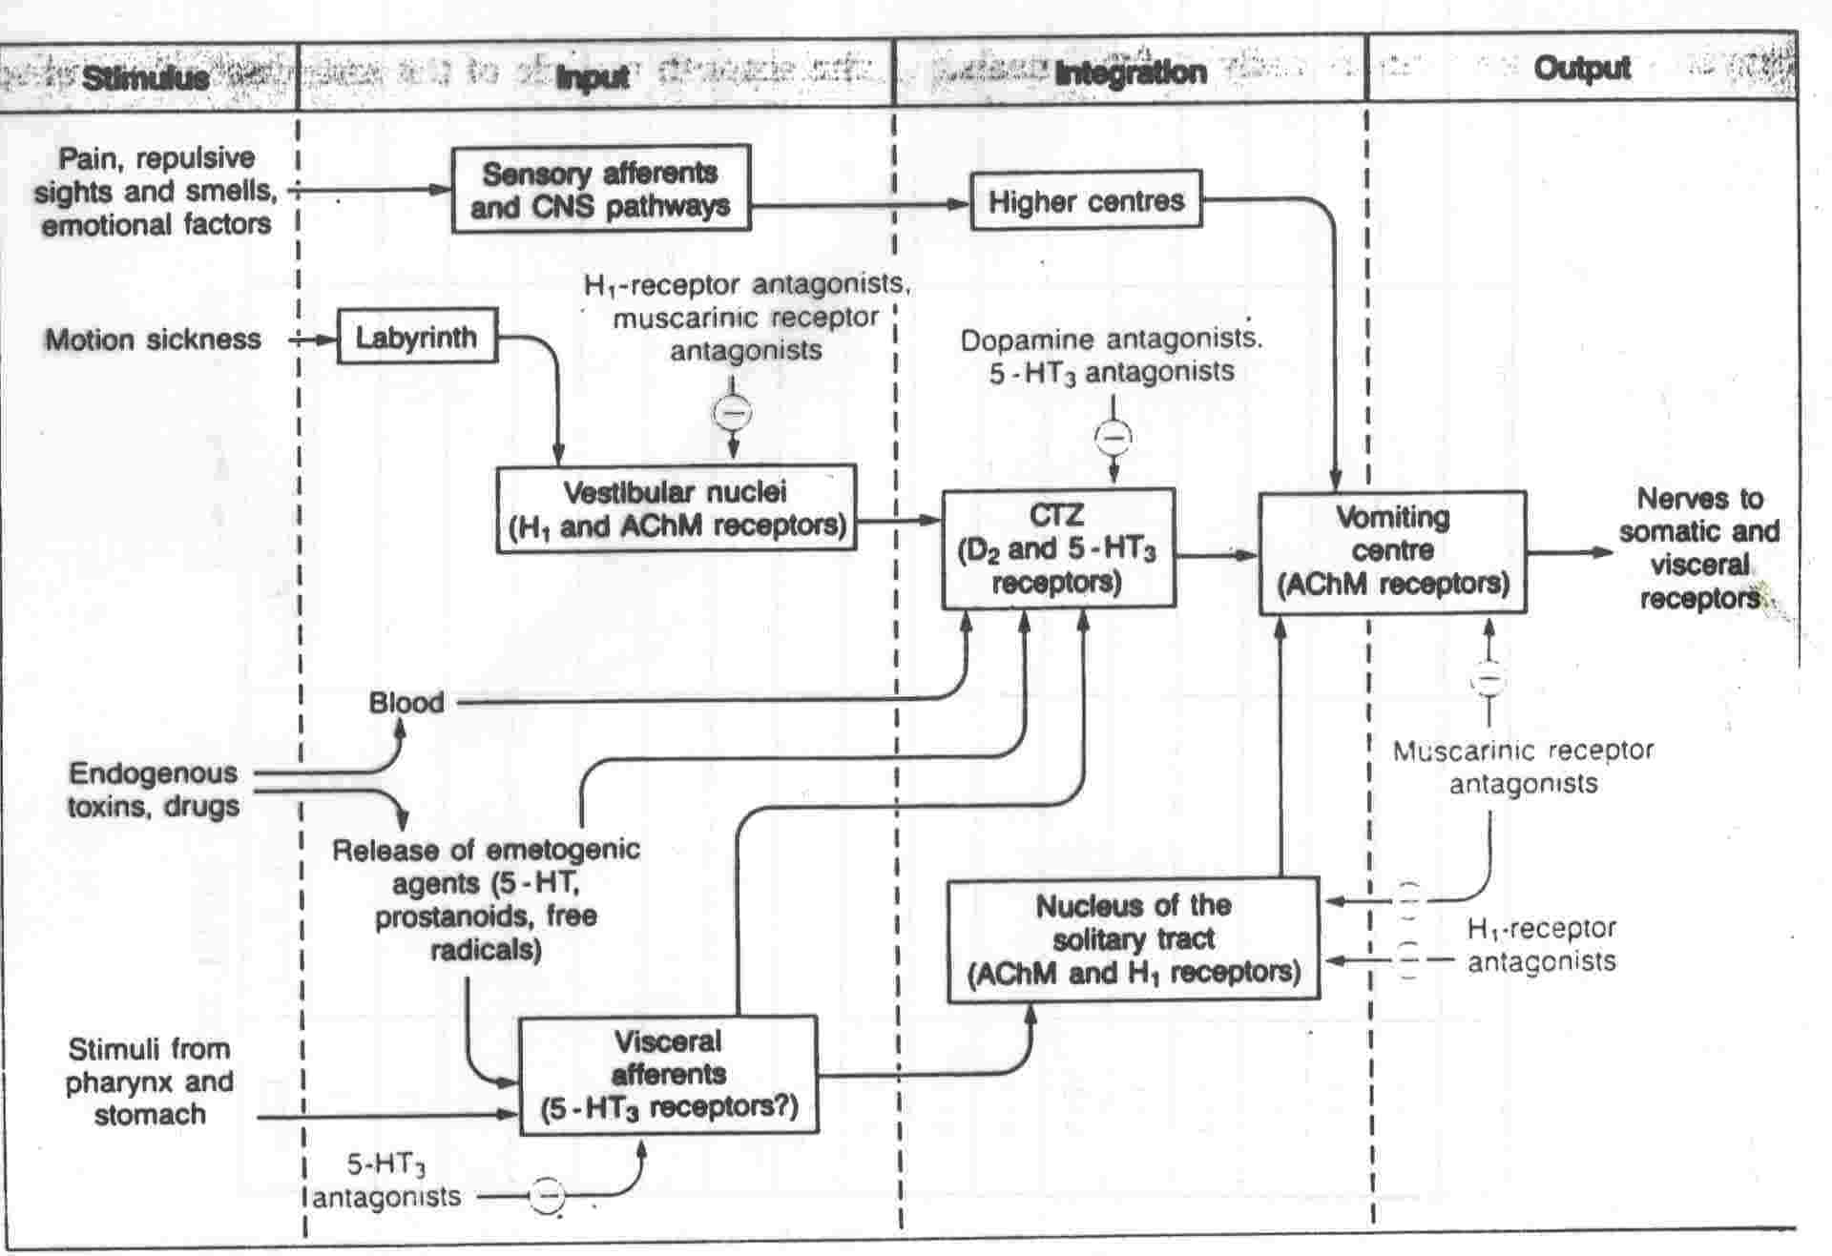

Slide 6
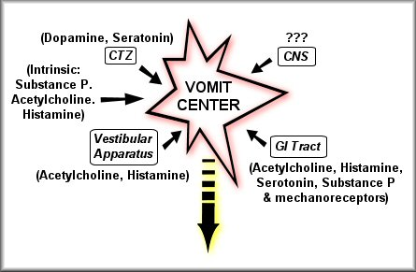
Receptors Associated with Nausea and Vomiting

Slide 7
Note: It is very important to know the causes of N&V to select the proper drug and to have the right diagnosis.
ii. Mechanism of N & V (see Figure)
How many neurotransmitters that are involved in the etiology of N &V?.
Can you predict which group of drugs that can be used for Rx N&V?.

Slide 9
iii. Example of Drugs that commonly used For Rx N/V.
a. Antihistamines (promethazine; cyclizine; meclozine (Navidoxine^{R}) Dimenhydrinate (Dramamine^{R})
b. Anticholinergics (Hyosine)
c. Antidopaminergics
Metoclopramide; Domperidone; Phenothiazines
d. 5-HT3 receptor antagonists (new
approach): Metoclopramide
Ondansetron, Granisetron; Tropisetron

Slide 10
CLINICAL USES OF ANTI-EMETIC DRUGS
A) H1-receptor antagonists:
_ Dimenhydrinate; Cyclizine and promethazine (also acts as D2 antagonist):
Uses:
-Prophylaxis of motion sickness (Doc for motion sickness (Long journey) ;
-Vestibular disorders (e.g. Meniere's disease) Betahistine
-Severe morning sickness of pregnancy (but only if absolutely essential).
B) Muscarinic-receptor antagonists:
-Hyoscine: motion sickness (DOC for short journey due to side effects)

Slide 11
ANTIEMETICS
2- ANTI-HISTAMINICS
Dimenhydrinate, Meclizine, Cyclizine / Promethazine
Motion Sickness
Vertigo
ADRs
Drowsiness, sedation, confusion, blurred vision, dry mouth & urinary
retention < anticholinergics

Slide 12
.
C) D2-receptor antagonists:
1) Phenothiazines (e.g.thiethylperazine; Promethazine):
vomiting caused by uraemia, radiation,
viral gastroenteritis ; severe morning sickness of pregnancy (but only if absolutely essential)
2) Metoclopramide (Plasil^{R}): It is prokinetic agent and commonly used for vomiting caused by uraemia, radiation, gastrointestinal disorders, cytotoxic drugs.
What are the limitations of the uses of the Dopaminergic antagonist?
Answer: Extrapyremidal symptoms How?
3) Domperidone (MOtilium^{R})
What are the differences between metoclopromide and Domperidone?

Slide 13
D) 5-HT3-receptor antagonists (e.g. Ondansetron; Granisetron; Tropisetron; Dolasetron):
1) They mainly used for nausea and vomiting caused by cytotoxic anticancer drugs (drugs of choice);
2) postoperative vomiting; radiation- induced vomiting.
Side Effects: Constipation
Does metoclopromide antagonize 5- HT3 receptors?
E) Cannabinoids (e.g. nabilone) for vomiting caused by cytotoxic anticancer drugs.

Slide 14
F. Glucocorticoids
- Dexamethasone and methylprednisolone
- Highly effective in acute emesis
- Mechanism not known.
-Side Effects:
G. Vitamin B6 (Pyridoxine)
Aprepitant belongs to a class of drugs called substance P antagonists (SPA). It acts by blocking the neurokinin 1 (NK₁) receptor.Used for N/V due to cancer chemotherapy and radiation.

Slide 15
Therapeutic Choice of Antiemetics
Motion sickness
Hyoscine: For short Journey.
Diphenhydramine: For Long Journey.
Vomiting with pregnancy
Avoid all drugs in the first trimester
Pyridoxine (B6)
Promethazine

Slide 16
CENTRAL ACTIONS OF ANTIEMETICS
Antagonist
5-HT₃ RAs
Promethazine
Atropine
Domperidol
NK-₁ RA
Agonist
5-HT₃
H₁
M
D₂
Substance P
Receptor Site
Chemoreceptor
Trigger Zone (CTZ)
Area
Postrema
BLOOD BORN EMETICS
Solitary Tract
Nucleus
Parvicellular
Reticular
Formation
Vestibular Nuclei
Emetic
Center

Slide 17
ANTIEMETICS
General rules on use of antiemetics
Should only be used when the cause of nausea or vomiting is known i.e cause of vomiting should be diagnosed.
Otherwise, the symptomatic relief produced could delay diagnosis of a remediable and serious cause.
Treat the cause (e.g. diabetic ketoacidosis, intestinal obstruction, intracerebral space-occupying lesion) usually cures the vomiting.
The choice of drug depends on the aetiology
Indications of antiemetics
1- Chemotherapy-induced
vomiting
2- Post-irradiation vomiting
3- Postoperative vomiting
4- Vomiting of pregnancy
5- Motion (travel) sickness

